Slide 1

Enabling Multithreading on CGRAs
Aviral Shrivastava¹, Jared Pager¹, Reiley Jeyapaul,¹
Mahdi Hamzeh¹², Sarma Vrudhula²
Compiler Microarchitecture Lab,
VLSI Electronic Design Automation Laboratory,
Arizona State University, Tempe, Arizona, USA

Slide 2

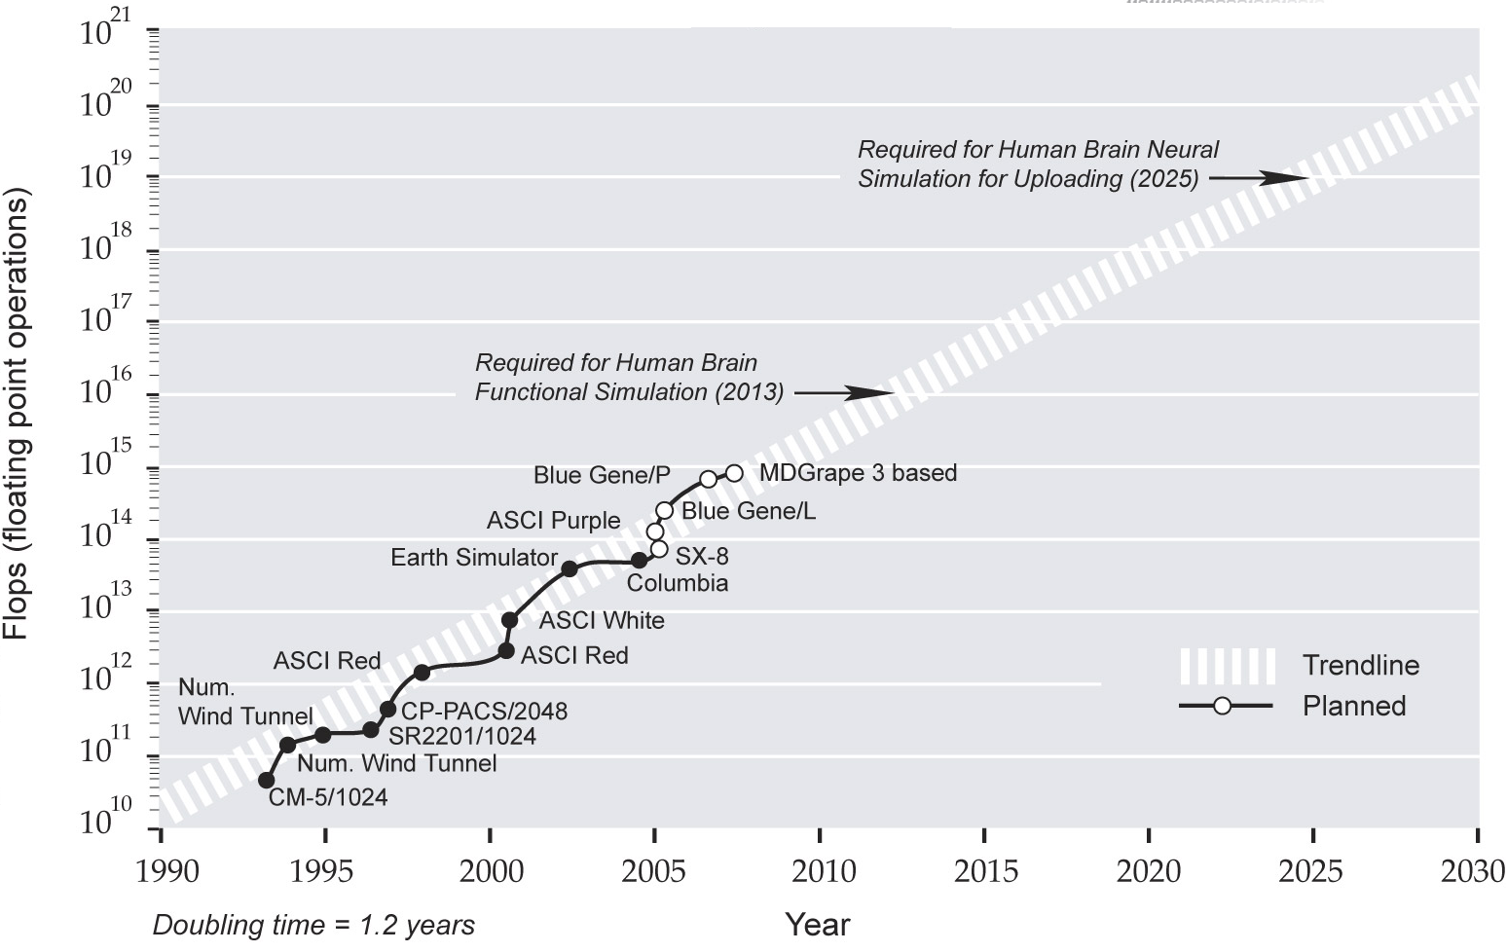

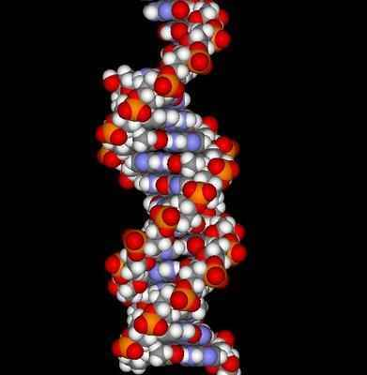

Need for High Performance Computing
Applications that need high performance computing
Weather and geophysical simulation
Genetic engineering
Multimedia streaming
zettaflop
petaflop

Slide 3
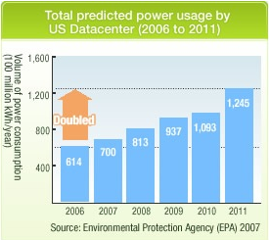
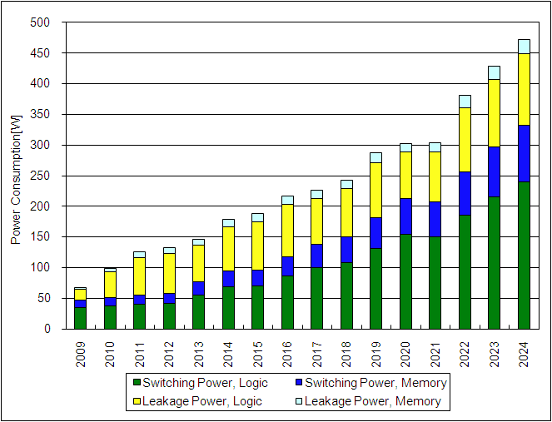
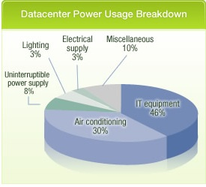
Need for Power-efficient Performance
Power requirements limit the aggressive scaling trends in processor technology
In high-end servers,
power consumption doubles every 5 years
Cost for cooling also increases in similar trend
2.3% of US Electrical Consumption
$4 Billion Electricity charges
ITRS 2010

Slide 4


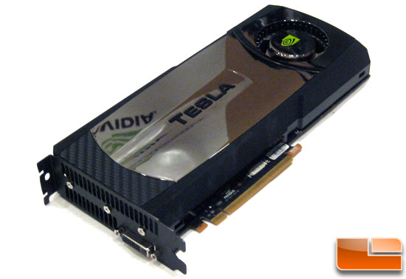
Accelerators can help achieve Power-efficient Performance
Power critical computations can be off-loaded to accelerators
Perform application specific operations
Achieve high throughput without loss of CPU programmability
Existing examples
Hardware Accelerator
Intel SSE
Reconfigurable Accelerator
FPGA
Graphics Accelerator
nVIDIA Tesla (Fermi GPU)
Notes:
Technical Question:
How is IBM cell an accelerator?
Flow question:
Having presented the existing set of processor accelerators that help achieve power-efficient performance, what is the motivation for yet another solution in this direction ?
How do I highlight that CGRAs when used as accelerators help in this cause ?

Slide 5
CGRA: Power-efficient Accelerator
Distinguishing Characteristics
Flexible programming
High performance
Power-efficient computing
Cons
Compiling a program for CGRA difficult
Not all applications can be compiled
No standard CGRA architecture
Require extensive compiler support for general purpose computing
PEs communicate through an inter-connect network
PE
PE
PE
PE
PE
PE
PE
PE
From Neighbors and Memory
Local Instruction Memory
PE
PE
PE
PE
FU
RF
PE
PE
PE
PE
Local Data Memory
To Neighbors and Memory
Main System Memory

Slide 6
Mapping a Kernel onto a CGRA
Given the kernel’s DDG
Mark source and destination nodes
Assume CGRA Architecture
Place all nodes on the PE array
Dependent nodes closer to their sources
Ensure dependent nodes have interconnects connecting sources
Map time-slots for each PE execution
Dependent nodes cannot execute before source nodes
Loop:
t1 = (a[i]+b[i])*c[i]
d[i] = ~t1 & 0xFFFF
Data-Dependency Graph:
Data-Dependency Graph:
1
2
1
2
Spatial Mapping
&
3
3
Temporal Scheduling
1
PE
1_{i}
PE
PE
PE
4
5
9
4
5
9_{i-6}
8
2
8_{i-5}
2_{i}
3
PE
3_{i-1}
PE
PE
4
PE
6
4_{i-2}
6
5
PE
5_{i-2}
PE
PE
6
PE
6_{i-3}
7
7
7_{i-4}
7
PE
PE
PE
PE
8
8
9
9

Slide 7
Mapped Kernel Executed on the CGRA
Loop:
t1 = (a[i]+b[i])*c[i]
d[i] = ~t1 & 0xFFFF
Execution time slot:
(or cycle)
0
1
5
6
7
2
3
4
Data-Dependency Graph:
After cycle 6, one iteration of loop completes execution every cycle
1
2
3
Entire kernel can be mapped onto CGRA by unrolling 6 times
1₀
1₁
1₂
1₃
1₄
1₅
1₆
PE
1₇
PE
PE
PE
9₀
9₁
4
5
8₀
8₁
2₀
8₂
2₁
2₂
2₃
2₄
2₅
2₆
2₇
3₀
3₁
3₂
3₃
3₄
3₅
PE
3₆
PE
PE
PE
4₀
4₁
4₂
4₃
4₄
4₅
6
5₀
5₁
5₂
5₃
5₄
PE
5₅
PE
PE
PE
6₀
6₁
6₂
6₃
6₄
7₀
7₁
7₂
7₃
Iteration Interval (II) is a measure of mapping quality
7
PE
PE
PE
PE
8
Iteration Interval = 1
9

Slide 8
Traditional Use of CGRAs
E₀
E₁
E₂
E₃
E₄
E₅
E₆
E₇
Application Input
Application Output
E₈
E₉
E₁₀
E₁₁
E₁₂
E₁₃
E₁₄
E₁₅
An application is mapped onto the CGRA
System inputs given to the application
Power-efficient application execution achieved
Generally used for streaming applications
ADRES, MorphoSys, ADRES, KressArray, RSPA, DART

Slide 9
Envisioned Use of CGRAs
Processor
co-processor
Program thread
Kernel to accelerate
E₀
E₁
E₂
E₃
E₄
E₅
E₆
E₇
E₈
E₉
E₁₀
E₁₁
E₁₂
E₁₃
E₁₄
E₁₅
Specific kernels in a thread can be power/performance critical
The kernel can be mapped and scheduled for execution on the CGRA
Using the CGRA as a co-processor (accelerator)
Power consuming processor execution is saved
Better performance of thread is realized
Overall throughput is increased

Slide 10
CGRA as an Accelerator
Application: Single thread
Entire CGRA used to schedule each kernel of the thread
Only a single thread is accelerated at a time
Application: Multiple threads
Entire CGRA is used to accelerate each individual kernel
if multiple threads require simultaneous acceleration
threads must be stalled
kernels are queued to be run on the CGRA
Not all PEs are used in each schedule.
Thread-stalls create a performance bottleneck
S₃
S₂
S₁
E₀
E₁
E₂
E₃
E₄
E₅
E₆
E₇
E₈
E₉
E₁₀
E₁₁
E₁₂
E₁₃
E₁₄
E₁₅

Slide 11
Proposed Solution: Multi-threading on the CGRA
Through program compilation and scheduling
Schedule application onto subset of PEs, not entire CGRA
Enable dynamic multi-threading w/o re-compilation
Facilitate multiple schedules to execute simultaneously
Can increase total CGRA utilization
Reduce overall power consumption
Increases multi-threaded system throughput
Threads: 1, 2, 3
Shrink-to-fit mapping maximizing performance
Threads: 2, 3
Expand to maximize CGRA utilization and performance
Threads: 1, 2
Maximum CGRA utilization
S₂
S₃
S₃
E₀
E₁
E₂
E₃
S_{3’}
E₄
S_{2’}
S₁
E₅
E₆
E₇
S₂
S₃
S₂
S₃
E₈
E₉
E₁₀
E₁₁
E₁₂
S_{2’}
E₁₃
E₁₄
E₁₅

Slide 12
Our Multithreading Technique
Static compile-time constraints to enable fast run-time transformations
Has minimal effect on performance (II)
Increases compile-time
Perform fast dynamic transformations
Takes linear time to complete with respect to kernel II
All schedules are treated independently
Features:
Dynamic Multithreading enabled in linear runtime
No additional hardware modifications
Require supporting PE inter-connects in CGRA topology
Works with current mapping algorithms
Algorithm must allow for custom PE interconnects
Notes:
Confirm and clarify the features

Slide 13
Hardware Abstraction: CGRA Paging
Page: conceptual group of PEs
A page has symmetrical connections to each of the neighboring pages
No additional hardware ‘feature’ is required.
Page-level interconnects follow a ring topology
P₀
P₁
P₀
P₀
PE
e₀
PE
e₁
PE
e₂
PE
e₃
P₁
P₁
PE
e₄
PE
e₅
PE
e₆
PE
e₇
Local Instruction Memory
P₂
P₃
P₂
PE
P₂
e₈
PE
e₉
PE
e₁₀
PE
e₁₁
P₃
P₃
PE
e₁₂
PE
e₁₃
PE
e₁₄
PE
e₁₅
Local Data Memory
Main System Memory
Notes:
Page definition clarify and confirm

Slide 14
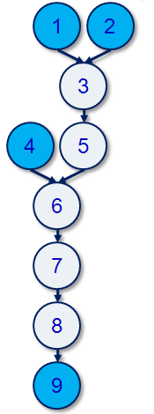
Step 1: Compiler Constraints assumed during Initial Mapping
Compile-time Assumptions
CGRA is collection of pages
Each page can interact with only one topologically neighboring page.
Inter-PE connections within a page are unmodified
These assumptions,
in most cases will not effect mapping quality
may help improve CGRA resource usage
Naïve mapping could result in under-used CGRA resources
Our paging methodology,
helps reduce CGRA resource usage
P₀
P₃
1
e₀
1
9
e₁
e₂
e₃
3
2
3
8
2
4
e₄
e₅
e₆
e₇
P₁
P₂
5
5
6
9
e₈
e₉
8
7
e₁₀
e₁₁
4
6
7
e₁₂
e₁₃
e₁₄
e₁₅

Slide 15
Step 2: Dynamic Transformation enabling multiple schedules
Example:
application mapped to 3 pages
Shrink to execute on 2 pages
Transformation Procedure:
Split pages
Arrange pages in time order
Mirror pages to facilitate shrinking
Ensures inter-node dependency
Shrunk pages executed on altered time-schedules
Constraints
inter-page dependencies should be maintained
P₀
P₃
e₀
1
e₁
e₂
e₃
2
3
e₄
e₅
e₆
e₇
P₁
P₂
e₈
5
8
9
e₉
e₁₀
e₁₁
4
6
7
e₁₂
e₁₃
e₁₄
e₁₅

Slide 16
Step 2: Dynamic Transformation enabling multiple schedules
Transformation Procedure:
Split pages
Arrange pages in time order
Mirror pages to facilitate shrinking
Ensures inter-node dependency
Shrunk pages executed on altered time-schedules
P₀
P₃
e₀
1
e₁
e₂
e₃
e₄
e₅
e₆
e₇
2
3
P₁
P₂
e₈
e₉
e₁₀
e₁₁
5
8
9
e₁₂
e₁₃
e₁₄
e₁₅
4
6
7

Slide 17
Step 2: Dynamic Transformation enabling multiple schedules
Example:
application mapped to 3 pages
Shrink to execute on 2 pages
Transformation Procedure:
Split pages
Arrange pages in time order
Mirror pages to facilitate shrinking
Ensures inter-node dependency
Shrunk pages executed on altered time-schedules
Constraints
inter-page dependencies should be maintained
P₀
P_{0,1}
1
e₀
1
e₁
T₀
T₃
3
2
3
2
e₄
e₅
P_{1,1}
P₁
5
e₈
5
e₉
T₂
T₄
T₁
4
6
e₁₂
e₁₃
4
6
P₂
P₂
9
9
8
8
e₁₀
e₁₀
e₁₁
e₁₁
T₂
7
7
e₁₄
e₁₄
e₁₅
e₁₅

Slide 18
Experiment 1: Compiler Constraints are Liberal
Mapping quality measured in Iteration Intervals
smaller II is better
Constraints can degrade individual benchmark performance by limiting compiler search space
Constraints can also improve individual benchmark performance by, ironically, limiting compiler search space
On average, performance is minimally impacted

Slide 19
Experimental Setup
CGRA Configurations used:
4x4, 6x6, 8x8
Page configurations:
2, 4, 8 PEs per page
Number of threads in system:
1, 2, 4, 8, 16
Each has a kernel to be accelerated
Experiments
Single-threaded CGRA
Each thread arrives at “kernel”
thread is stalled until kernel executes
Multi-threaded CGRA
CGRA used to accelerate kernels as and when they arrive
No thread is stalled
Thread 1
Thread 3
Thread 2
Thread 4
kernel to be accelerated
Only ONE thread serviced
MULTIPLE threads serviced
CPU
Core
CPU
Core
CPU
Core
CPU
Core
CGRA

Slide 20
Multithreading Improves System Performance
Number of Threads Accessing CGRA:
As the number of threads increases, multithreading provides increasing performance
CGRA Size:
As we increase CGRA size, multithreading provides better utilization and therefore better performance
Number of PEs per Page:
For the set of benchmarks tested, the number of optimal PEs per page is either 2 or 4
Notes:
Performance improvement numbers ??

Slide 21
Summary
Power-efficient performance is the need of the future
CGRAs can be used as accelerators
Power-efficient performance can be achieved
Has limitations on usability due to compiling difficulties
With multi-threaded applications, need multi-threading capabilities in CGRA
Propose a two-step dynamic methodology
Non-restrictive compile-time constraints to schedule application into pages
Dynamic transformation procedure to shrink/expand the resources used by a schedule
Features:
No additional hardware required
Improved CGRA resource usage
Improved system performance
Notes:
Numbers ?

Slide 22
Future Work
Using CGRAs as accelerator in systems with inter-thread communication.
Study the impact of compiler constraints on compute-intensive and memory-bound benchmark applications?
Possible use of thread-level scheduling to improve overall performance?

Slide 23
Thank you !

Slide 24
Measuring CGRA Performance
A completed mapping is called a schedule
A schedule consists of a prolog, kernel, and epilog
Mapping Quality is measured by Initiation Interval (II)
II is a measure how many cycles it takes the kernel portion to execute a single iteration of a loop
ie, if II=2, every two cycles, an iteration of the original loop is completed
II is limited by CGRA resources (number of PEs, etc) and by recurrence cycles
If there are only 4 PEs but a DDG contains 9 nodes, II can at best be 3
If a loop cannot be unrolled, II can be hurt
Recurrence Cycle:
t1 = A[i] + C[i - 1]
C[i] = B[i] + t1
1_{i}
3_{i}
2
1_{i}
4
3_{i}
2
1_{i+1}
5_{i}
4
Unrolling:
t1a = A[i] + C[i-1]
C[i] = B[i] + t1a
t1b = A[i+1] + C[i]
C[i+1] = B[i+1] + t1b
3_{i+1}
2
5_{i}
4
5_{i+1}
t1b can never execute any earlier,
no matter how many times we unroll

Slide 25
DDG with Recurrance
1_{i-2}
1_{i}
3_{i-2}
2_{i-2}
1_{i-1}
3_{i}
2
4
4_{i-2}
3_{i-1}
2_{i-1}
1_{i}
1_{i+1}
5_{i}
5_{i-2}
4_{i-1}
3_{i}
2_{i}
3_{i+1}
2
4
6_{i-2}
5_{i-1}
4_{i}
5_{i+1}
6_{i-1}
5_{i}
6_{i}

Slide 26
State-of-the-art Multi-threading on CGRAs
Polymorphic Pipeline Arrays [Park 2009]
Enables dynamic scheduling
Collection of schedules make a kernel
Some schedules can be given more resources than other schedules
Limitations
Collection of schedules must be known at compile-time
Schedules are assumed to be ‘pipelining’ stages in a single kernel
Data Set 2
Data Set 1
Filter 1
Filter 1
Filter 1
Data Set 3
Filter 2
Filter 2
Filter 3
Filter 2
Filter 3
Filter 3
Output
Output
Output
Filter 1
Filter 1
Filter 1
Filter 2
Filter 2
Filter 3
Filter 2
Filter 3
Core 1
Core 3
Core 5
Filter 3
Core 7
Core 2
Core 4
Core 6
Core 8
Mem
Bank 1
Mem
Bank 2
Mem
Bank 3
Mem
Bank 4
Notes:
More clarity in the PPA technique explanation

