Slide 1
Quantitative Analysis of Control Flow Checking Mechanisms for Soft Errors
Aviral Shrivastava, Abhishek Rhisheekesan,
Reiley Jeyapaul, and Carole-Jean Wu
Compiler Microarchitecture Lab
Arizona State University
http://aviral.lab.asu.edu

Slide 2
Existing Techniques for Control Flow Checking are not useful for protection from Soft Errors
OR
Aviral Shrivastava, Abhishek Rhisheekesan, Reiley Jeyapaul, and Carole-Jean Wu
Compiler Microarchitecture Lab
Arizona State University
http://aviral.lab.asu.edu

Slide 3
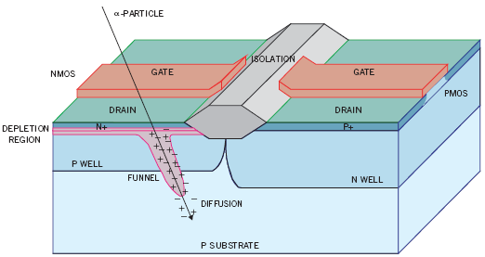
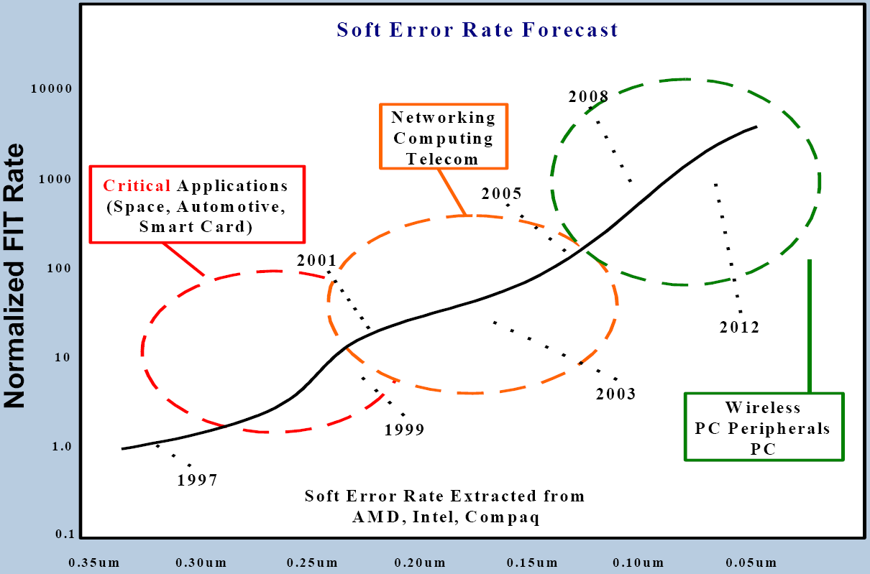
Increasing threat of soft errors
Random and spontaneous bit-changes
Can be caused by several factors, but more than 50% are due to radiation strikes [Bauman 05, TI]
Soft error rates projected to increase from 1-per-year to 1-per-day in two decades.
Purported Instances of Soft Errors
SUN server crashes of Nov, 2000.
CISCO 12000 series routers experience unexpected resets.
Toyota Prius un-intended acceleration??

Slide 4
Soft Error Protection Mechanisms
Redundancy
Control Flow Checking
EDDI - Error Detection by Duplicated Instructions
SEDSR – Soft Error Detection using Software Redundancy
REESE – REdundant Execution using Space Elements
DMR - Dual Modular Redundancy, TMR – Triple Modular Redundancy
Reunion, UnSync
EDDI - Error Detection by Duplicated Instructions
Instr1
Duplicate Instr1
Instr2
Duplicate Instr2
Cmp Result1, Result2
JNE Error
Add R3, R1, R2
Add R33, R11, R22
Sub R5, R4, R3
Sub R55, R44, R33
Cmp R5, R55
JNE Error
Notes:
DMR - Dual Modular Redundancy
TMR - Triple Modular Redundancy
CFCSS - Control Flow Checking by Software Signatures
SWIFT - Software Implemented Fault Tolerance
CEDA – Control-Flow Error Detection Using Assertions
ACCE – Automatic Correction of Control-flow Errors
EDDI – Error Detection by Duplicated Instructions
ECCA – Enhanced Control-Flow Checking Using Assertions
YACCA – Yet Another Control-Flow Checking using Assertions
DSM – Dynamic Signature Monitoring
Redundancy based – data flow checking
Duplication of instructions and comparison of results
Control Flow Checking
Unique Signature for each BB.
Comparison of Runtime Signature and pre-assigned signature
Goal: Quantitatively Evaluate Protection Achieved by CFC

Slide 5
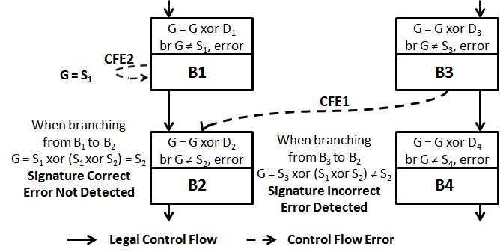
What is Control Flow Checking?
CFCSS - Control Flow Checking by Software Signatures
Oh et. al., Transactions on Reliability 2002
Notes:
DMR - Dual Modular Redundancy
TMR - Triple Modular Redundancy
CFCSS - Control Flow Checking by Software Signatures
SWIFT - Software Implemented Fault Tolerance
CEDA – Control-Flow Error Detection Using Assertions
ACCE – Automatic Correction of Control-flow Errors
EDDI – Error Detection by Duplicated Instructions
ECCA – Enhanced Control-Flow Checking Using Assertions
YACCA – Yet Another Control-Flow Checking using Assertions
DSM – Dynamic Signature Monitoring
Redundancy based – data flow checking
Duplication of instructions and comparison of results
Control Flow Checking
Unique Signature for each BB.
Comparison of Runtime Signature and pre-assigned signature
Goal: Quantitatively Evaluate Protection Achieved by CFC

Slide 6
Why Control Flow Checking?
Basic Idea: If the sequence of executed instructions is correct, then most probably the execution is correct.
Claim of high error coverage at low overhead
90+% error coverage
< 10% HW overhead
Technique | Type | Error Detection Coverage (%) | Performance Overhead (%) | Overall Error Coverage (%)
EDDI | Redundancy | 22.08 | 105.9 | 98.5
CFCSS | Control Flow | 35.26 | 43.14 | 96.9

Slide 7
Many Control Flow Checking Techniques
Control Flow Checking
Hardware
Hybrid
Software
time
1980
1995
2006
ASIS – Asynchronous Signatured Instruction Streams
W-D-P – Watchdog Direct Processing
OSLC – Online Signature Learning and Checking
CFCET - Control Flow Checking using Execution Tracing
Notes:
DMR - Dual Modular Redundancy
TMR - Triple Modular Redundancy
CFCSS - Control Flow Checking by Software Signatures
SWIFT - Software Implemented Fault Tolerance
CEDA – Control-Flow Error Detection Using Assertions
ACCE – Automatic Correction of Control-flow Errors
EDDI – Error Detection by Duplicated Instructions
ECCA – Enhanced Control-Flow Checking Using Assertions
YACCA – Yet Another Control-Flow Checking using Assertions
DSM – Dynamic Signature Monitoring
Redundancy based – data flow checking
Duplication of instructions and comparison of results
Control Flow Checking
Unique Signature for each BB.
Comparison of Runtime Signature and pre-assigned signature
Goal: Quantitatively Evaluate Protection Achieved by CFC

Slide 8
Many Control Flow Checking Techniques
Control Flow Checking
Hardware
Hybrid
Software
time
1980
1982
1995
1999
2004
2006
2008
SIS – Signatured Instruction Streams
CSM – Continuous Signature Monitoring
WA & EPC – Watchdog Assists and Extended Precision Checksums
CFEDC – Control Flow Error Detection and Correction
Notes:
DMR - Dual Modular Redundancy
TMR - Triple Modular Redundancy
CFCSS - Control Flow Checking by Software Signatures
SWIFT - Software Implemented Fault Tolerance
CEDA – Control-Flow Error Detection Using Assertions
ACCE – Automatic Correction of Control-flow Errors
EDDI – Error Detection by Duplicated Instructions
ECCA – Enhanced Control-Flow Checking Using Assertions
YACCA – Yet Another Control-Flow Checking using Assertions
DSM – Dynamic Signature Monitoring
Redundancy based – data flow checking
Duplication of instructions and comparison of results
Control Flow Checking
Unique Signature for each BB.
Comparison of Runtime Signature and pre-assigned signature
Goal: Quantitatively Evaluate Protection Achieved by CFC

Slide 9
Many Control Flow Checking Techniques
Control Flow Checking
Hardware
Hybrid
Software
time
1980
1982
1995
1999
2004
2006
2008
2012
CEDA - Control-Flow Error Detection Using Assertions
ACCE - Automatic Correction of Control-flow Errors
CFCSS - Control Flow Checking by Software Signatures
ECCA - Enhanced Control-Flow Checking Using Assertions
YACCA - Yet Another Control-Flow Checking using Assertions
Notes:
DMR - Dual Modular Redundancy
TMR - Triple Modular Redundancy
CFCSS - Control Flow Checking by Software Signatures
SWIFT - Software Implemented Fault Tolerance
CEDA – Control-Flow Error Detection Using Assertions
ACCE – Automatic Correction of Control-flow Errors
EDDI – Error Detection by Duplicated Instructions
ECCA – Enhanced Control-Flow Checking Using Assertions
YACCA – Yet Another Control-Flow Checking using Assertions
DSM – Dynamic Signature Monitoring
Redundancy based – data flow checking
Duplication of instructions and comparison of results
Control Flow Checking
Unique Signature for each BB.
Comparison of Runtime Signature and pre-assigned signature
Goal: Quantitatively Evaluate Protection Achieved by CFC

Slide 10
Our Claim
Control Flow Checking techniques are not useful to protect computation from soft errors
What went wrong?
Evaluation of the effectiveness of the CFC techniques was inconclusive!
How to evaluate the effectiveness of a protection technique?
Beam testing
– not easily available
Fault injection
– exhaustive fault injection not practical
Targeted fault injection
– hard to ensure right distribution of faults
Exhaustive Fault Injection is Extremely Time Consuming
32-bit register
Avg MiBench execution time
39 billion cycles
Avg MiBench host simulation time
1121s
Total fault injection runs required
32*39 billion = 1.25 trillion
Total host simulation time required
1121 * 1.25 trillion = 1399 trillion seconds
= 252 years on our 22 node cluster, each node with Dual Quad-Core Xeon processors

Slide 11
What went wrong?
Techniques used for targeted fault injection
Assembly code instrumentation
GDB-based runtime fault injection
Fault injection in memory bus
Assembly code instrumentation
Randomly flip a bit in the binary of a program
Then see how many of the errors are caught by the CFC.
Problems
Actually soft faults happen in the latches of the hardware
This correctly simulates faults in instruction memory, but not in other structures that store instructions, e.g., instruction cache, or PC
where probability of a fault in an instruction depends on the residency of the instruction in the structure
Does not model faults in RF, data caches, pipeline, reorder buffer, load store buffer, etc.

Slide 12
Need a metric of protection
Vulnerability*
A <bit, cycle> in execution is vulnerable, if a fault in it will result in erroneous execution. Otherwise, it is not-vulnerable.
Approximation: A <bit, cycle> is vulnerable, if it will be read/committed next. If it is overwritten, then it is not-vulnerable.
W
R
W
R
R
R
Register
time
V
NV
V
* Mukherjee et al., MICRO 2003

Slide 13
Calculate vulnerability by simulation
Application Binary
Processor Pipeline
Register File
Cache
(Instruction/
Data)
Buffers
W
R
W
R
R
R
Register
V
V
time
NV
Vulnerability*:
- For a bit, vulnerability is the sum of the time intervals which end in a use.
- For a component (like a register file), vulnerability is the sum of vulnerability of all its bits.
- For a processor, it is the sum of all such bit-intervals for all its components.
* Mukherjee et al., MICRO 2003
Notes:
Fault to Error to Failure
Fault - a physical defect that occurs within hw or sw components
Error - a deviation from accuracy or correctness – manifestation of fault
Failure - nonperformance of some action that is due or expected - malfunction

Slide 14
How to model protection achieved by a CFC?
Compute vulnerability before CFC
Compute vulnerability after CFC
Reduction in vulnerability is the protection offered by the CFC
In other words
Find <bit, cycle>s which were vulnerable before CFC, but are no longer vulnerable after CFC.
Two step process
For each vulnerable <bit, cycle>, find out which control flow errors it causes
This step is relatively CFC independent, and captures the impact of soft errors in architectural bits on the control flow of the program
Find out if the control flow error can be caught by the CFC
This step is relatively architecture independent and captures the capabilities of the CFC technique

Slide 15
What control flow errors are caused by a fault in a <bit, cycle>?
Component-wise analysis
PC
Register file
Pipeline registers
Buffers
Caches
In general, very hard to find out all the control flow errors that a fault in <bit, cycle> can cause
Saved by an important observation
Pipeline Registers
Register File
PC
Buffers
Instruction Cache
Data
Cache

Slide 16
Important Observation
Two kinds of control flow errors
Not successor control flow error
Wrong successor control flow error
Not-successor control flow error
BB1
Wrong-successor control flow error
Correct control flow
BB2
BB3
Existing CFC techniques
can detect not-successor control flow errors
cannot detect wrong-successor control flow errors
We just need to find the number of <bit,cycles>, such that faults in them cause a not-successor control flow error
Only they are protected by CFC

Slide 17
Which <bit, cycle>s are protected by CFC?
PC → Mostly cause not-successor control flow errors
Some fields in the processor pipeline, e.g., Branch target address → Not-successor control flow errors
All other bits in the pipeline → Wrong-successor control flow error
Bits in RF → Wrong-successor control flow error
exception: jump on register value (indirect jump)
Bits in Cache → Wrong-successor control flow error
Exception: jump on memory value(return address)
More detailed analysis in the paper
IF/ID
ID/EX
EX/MEM
MEM/WB
PC
PC
PC
Adder
Branch Target Addr
Opcode BO
BO
Shift Left 2
Instruction Cache
Decode logic
MUX
Br
Br
4
Adder

Slide 18
Which components are protected by CFC?
PC
Pipeline Registers
Register File
Instruction Cache
Data
Cache
Buffers
Protected
Partly Protected
Vulnerable
In a processor with unprotected caches: <1% of bits are protected by CFC
In a processor with protected caches: < 4% of bits are protected by CFC
CFCs reduce vulnerability by ~ 4%
But cause an increase in vulnerability due to extra instructions
Notes:
Fault to Error to Failure
Fault - a physical defect that occurs within hw or sw components
Error - a deviation from accuracy or correctness – manifestation of fault
Failure - nonperformance of some action that is due or expected - malfunction

Slide 19
Experimental setup
Setup
Compiler
LLVM [Lattner et al., CGO 2004]
ARM
Cross-compiler
gcc, ARM
Benchmarks
MiBench suite [Guthaus et al., IEEE WWC 2001]
Cycle Accurate Simulator
GemV-CFC (based on gem5 [Binkert et al., Comput. Archit. News 2001])
ARM - Single core, Out of Order, 2GHz, 5-stage pipeline
CFC techniques
CFCSS [Oh et al., Transactions on Reliability 2002]
CFCSS+NA [Chao et al., IEEE CIT 2010]
CEDA [Vemu et al., IEEE Trans. Comput. 2011]
CFEDC [Farazmand et al., ARES 2008]
CFCET [Rajabzadeh et al., Microelectronic Reliability, 2006]

Slide 20
Increase in Effective Vulnerability
The effective vulnerability increase on applying CFCSS :18%, CFCSS+NA : 18%, CEDA : 21%, CFEDC : 5%, CFCET : 0%
CEDA, supposed to fix loopholes in CFCSS like aliasing, and jump checking, increases vulnerability further by 3%, due to additional code

Slide 21
Summary
Two kinds of Control Flow Errors
1st kind : Not-successor CFE
e.g., error in PC, or branch offset in pipeline registers
2nd kind : Wrong-successor CFE
e.g., fault causes wrong register value in RF, that changes the branch outcome
Faults in most processor components cause wrong-successor control flow errors
But existing CFCs cannot detect these errors
CFCs are not effective against soft errors

Slide 22
Outlook
Redundancy still works
Component-based approaches
Pipeline registers can be protected
C-elements, Razor, [Gardiner et al., IOLTS 2007]
Area overhead reported is 6.4 to 15%
ECC can protect RF
Selectively protect only the most vulnerable registers
Can reduce AVF of integer RF by up to 84%
Area overhead is 10% and power overhead is 45% for the protected registers
Power-efficient protection
Assertion-based fault testing, e.g., ABFT [Abraham IEEE ToC 1984]
CFC may be useful in other domains
Security, software integrity checks

