Slide 1
A Software-Level Redundant MultiThreading for Soft/Hard Error Detection and Recovery
Hwisoo So*, Moslem Didehban#, Aviral Shrivastava#, Kyoungwoo Lee* *Department of Computer Science, Yonsei University, Seoul, Korea #Compiler Microarchitecture Lab, Arizona State University, Tempe, AZ Presented by Hwisoo So

Slide 2






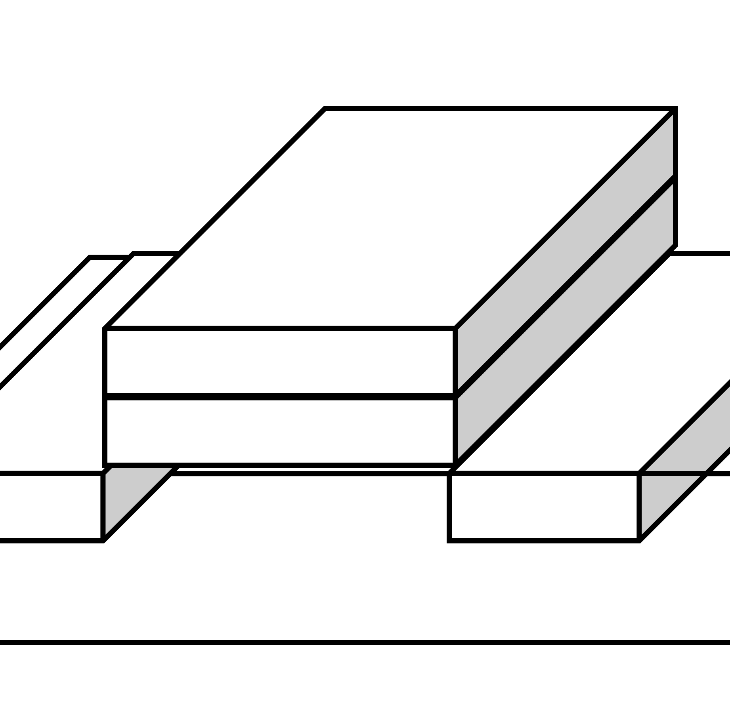
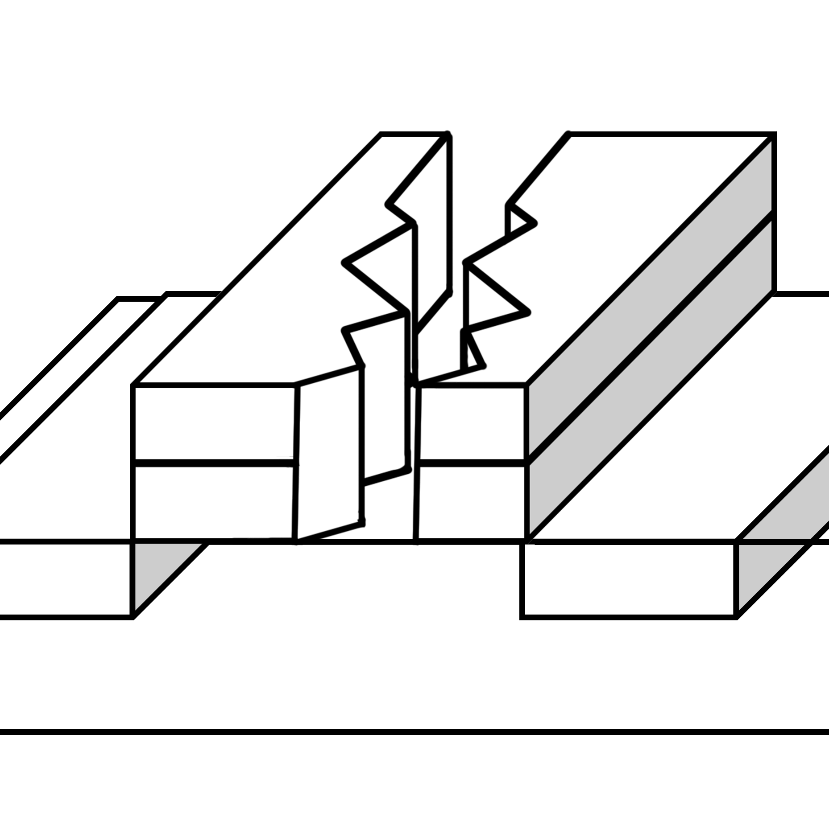
FISHER: FlexIble Soft and Hard Error Resiliency
Redundant Thread
Original Thread
Redundant Thread
Instructions
Instructions
Soft
Error
Instructions
Hard
Error

