Slide 1




‏Adaptive Reduced Bit-width Instruction Set Architecture (adapt-rISA)
Sandro Neves Soares – UCS
Ashok Halambi – UCI
Aviral Shrivastava – ASU
Flávio Rech Wagner – UFRGS
Nikil Dutt - UCI
Compiler Microarchitecture Lab
Arizona State University
17th International Conference on Very Large Scale Integration

Slide 2
Introduction
Code size continues to be an extremely important concern for low-end embedded systems
  controllers in cars, TVs, refrigerators and music players
A higher code size can imply:
  the impossibility to execute the functionality
  a significant impact on the system power and cost
The problem is becoming complex with the current trend of increasing software content on embedded systems
rISA (reduced bit-width ISA) is a popular solution for this code size problem
  two instruction sets, the “normal” and the “reduced bit-width”
17th International Conference on Very Large Scale Integration

Slide 3
Introduction
The advantages of rISA:
  significant code size reduction
  less fetches to the instruction memory
The benefits of rISA are heavily dependent on the application
  and on the narrow instruction set design
Just one rISA is unable to exploit the dynamically changing "working IS" of today's embedded applications
  a "reduced bit-width" ISA can have only a very limited number of opcodes
17th International Conference on Very Large Scale Integration

Slide 4
Introduction
Previous works suggested techniques to design the best rISA for an embedded application
  but they only solve the problem for single "reduced bit-width" ISA architectures
The focus is now changed to develop dual "reduced bit-width" ISA for architectures such as ARM 11
  the different computational requirements inside a single application should be considered
Our approach adapt-rISA is the first effort to design "reduced bit-width" ISAs for multiple rISA architectures
17th International Conference on Very Large Scale Integration

Slide 5
Outline
Introduction
rISA Architectural Feature
Related Work
Adaptive rISA
  Code Conversion
  Design Space Exploration
  Implementation Details
  Experiments and Results
Conclusion
Future Work
17th International Conference on Very Large Scale Integration

Slide 6
rISA Architectural Feature
(a)
lw $4,12($fp)
addi $2,$4,-1
move $4,$2
sw $4,12($fp)
lw $4,8($fp)
addi $2,$4,1
move $4,$2
sw $4,8($fp)
(b)
Change Mode Instruction
lw_r $4,12($fp) | addi_r $2,$4,-1
move_r $4,$2 | sw_r $4,12($fp)
lw_r $4,8($fp) | addi_r $2,$4,1
move_r $4,$2 | sw_r $4,8($fp)
rISA_nop | Ch.Mode Instr.
Reduction
Normal code (a) and Reduced code (b) of a small section of the CRC32 program
A program, compiled using rISA, is composed by reduced and normal blocks
The role of a rISA compiler is to find the best rISA design and also the best rISA design configuration
17th International Conference on Very Large Scale Integration

Slide 7
rISA Architectural Feature
(a)
addi $2,$4,-1 (normal)
Opcode(6 bits) - rs(5) - rt(5) - imm(16)
001000 – 00010 – 00100 - 1111111111111111
addi instruction: Normal (a) and Reduced (b)
using rISA design rISA_4444
(b)
addi_r $2,$4,-1 (reduced)
Opcode(4 bits) – rs(4) – rt(4) - imm(4)
0000 – 0010 - 0100 - 1111
A rISA design specifies the number of bits in each bitfield
    rISA_4444: opcode(4 bits) – rs(4) – rt(4) - imm(4)
A rISA design configuration specifies the different opcodes employed
  to increase code density, rdc must include the most frequently encountered instructions
  for power reduction, the most executed instructions must be selected
17th International Conference on Very Large Scale Integration

Slide 8
subu $sp,$sp,40
sw $31,32($sp)
sw $fp,28($sp)
sw $16,24($sp)
move $fp,$sp
sw $4,40($fp)
sw $5,44($fp)
jal __main
move $16,$0
lw $3,44($fp)
addu $2,$3,4
move $3,$2
sw $3,44($fp)
addu $2,$fp,20
lw $4,0($3)
addu $5,$fp,16
move $6,$2
jal crc32file
or $16,$16,$2
la $4,$LC0
lw $5,16($fp)
jal printf
sltu $3,$0,$16
move $2,$3
Instructions selected by rdc A
subu $sp,$sp,40
sw $31,32($sp)
sw $fp,28($sp)
sw $16,24($sp)
move $fp,$sp
sw $4,40($fp)
sw $5,44($fp)
jal __main
move $16,$0
lw $3,44($fp)
addu $2,$3,4
move $3,$2
sw $3,44($fp)
addu $2,$fp,20
lw $4,0($3)
addu $5,$fp,16
move $6,$2
jal crc32file
or $16,$16,$2
la $4,$LC0
lw $5,16($fp)
jal printf
sltu $3,$0,$16
move $2,$3
rdc B:
sw
addu
lw
move
rdc A:
  sw
  addu
  la
  sltu
Instructions selected by rdc B
17th International Conference on Very Large Scale Integration

Slide 9
Related Work
Shrivastava et al present a DSE framework for rISA design aimed at improving code density
  the experiments employed various rISA designs: from 16 to 128 reduced opcodes
  the work shows that the rISA design rISA_4444 presents a good trade-off
  If a normal instruction cannot fit on a reduced instruction, it is discarded from reduction
  some other rISA designs solve this problem adding special reduced instructions
It is shown that a conversion aimed at improving code density does not achieve the best results in energy reduction
17th International Conference on Very Large Scale Integration

Slide 10
Related Work
Shrivastava et al details various aspects of rISA designs:
  there can be only an even number of contiguous rISA instructions
  there should be a mechanism in software to specify the execution mode: mx and rISA_mx instructions
When the processor is in rISA mode, the fetched code is assumed to contain two rISA instructions
  they are translated into normal instructions before execution
  only the decode logic needs to be modified
17th International Conference on Very Large Scale Integration

Slide 11
Adaptive rISA
A simple application probably includes distinct sections with different requirements
The idea supporting adaptive rISA is that a divide and conquer rISA approach can be used
  previous works did not consider such granularity
Most of the software and hardware aspects behind the adapt-rISA solution are the same of those in rISA
17th International Conference on Very Large Scale Integration

Slide 12


Adapt-rISA
Routine R1
Begin
...
End
Routine R2
Begin
...
End
Routine R3
Begin
...
End
Routine R4
Begin
...
End
Main Routine
Begin
...
End
An unique rdc for the entire application
Routine R1
Begin
...
End
Routine R2
Begin
...
End
Routine R3
Begin
...
End
Routine R4
Begin
...
End
Main Routine
Begin
...
End
Routine reduced using the rdc A
rdc B
rdc C
rdc A
rdc C
17th International Conference on Very Large Scale Integration

Slide 13
Adaptive rISA
A reduced set with less opcodes can encompass more instructions (to be reduced) in a given section
  lesser number of bits may be employed to specify the opcode
  rISA_4444 seems to be a good solution for these cases
Not all the initially marked instructions, as specified by the rdc, are actually reduced
  the main cause of discard is overflow
  number of contiguous instructions is too small
  branches and jumps between normal and reduced blocks are not allowed
17th International Conference on Very Large Scale Integration

Slide 14
Adaptive rISA
Discard of instrs., qsort program – r_4444 (right) x r_8ops (left)
rISA_8ops seems to be a good solution for adapt-rISA
17th International Conference on Very Large Scale Integration

Slide 15
Code Conversion
INPUT: application's Assembly code produced by gcc
PARAMETERS: rISA design and rISA design configuration
if (mips.usingRISA ( )) {
mips.rISA.mapRegisters ( );
mips.rISA.markCandidates ( );
mips.rISA.isPossibleToReduceCandidates();
mips.rISA.discardSmallBlocks ();
while(mips.rISA.treatBranchesAndJumps())
mips.rISA.discardSmallBlocks ();
mips.rISA.countFinalBlocks ();
mips.rISA.translateToRISAstep1 ( );
mips.rISA.translateToRISAstep2 ( );
mips.rISA.generateFinalCode ( output);
}
17th International Conference on Very Large Scale Integration

Slide 16
Design Space Exploration
Our DSE process focus on the dynamic aspects of the execution
The application is executed with a small dataset to get its execution profile
The different opcodes of these marked instructions are identified and stored
A DSE process is triggered using combinations of these opcodes (8 or 16 each time) to try improved results for:
  total number of reduced instructions
  average block size
  total number of blocks
17th International Conference on Very Large Scale Integration

Slide 17
Design Space Exploration
The most promising combinations are used to form a rISA design and configuration database
  each record of this database is applied on the application using the conversion-to-rISA algorithm
  the application is then executed
The granularity of this DSE is changed to application’s individual routines to support adapt-rISA
  the result is a set of different rISA design configurations
17th International Conference on Very Large Scale Integration

Slide 18
Implementation Details
Some additional software and hardware aspects are needed for adapt-rISA:
  the mx instruction carries the rISA design configuration identifier as an immediate value
  the translation unit must receive, as an input, this rISA design configuration identifier
  it may also store the translation information partitioned into smaller and independent sub-units
Adapt-rISA improve power not only by reducing the number of fetches, but also during the translation process
A framework for design space exploration of embedded processors has been used in this work: T&D-Bench
17th International Conference on Very Large Scale Integration

Slide 19
Experiments and Results
The methods and tools described were used to experiment with the bitcount, CRC32, qsort and stringsearch programs
  first, the experiments were executed using these programs individually and, afterwards, grouped
In the experiments, we present the following metrics:
  number of fetches (main metric)
  percentage of actual reduced instructions
  average size of the reduced blocks
  total number of reduced blocks
  application's code size reduction (only informative)
Each application was reduced using adapt-rISA and also the (one) optimal rdc for each individual program
17th International Conference on Very Large Scale Integration

Slide 20
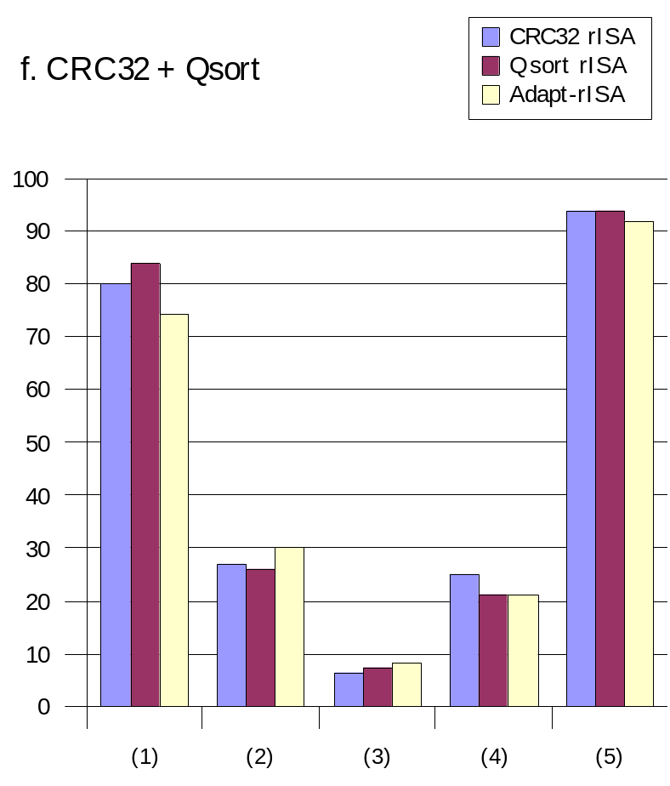
Experiments and Results
  (1) number of fetches
  (2) percentage of actual reduced instructions
  (3) average size of the reduced blocks
  (4) total number of reduced blocks
  (5) application's code size reduction
17th International Conference on Very Large Scale Integration

Slide 21
Experiments and Results
In general, adapt-rISA achieves better results: less fetches and better values in the code compression metrics
  there were, in four of the six applications, less fetches, from a minimum of 2% to a maximum of 7% of reduction
  the total number of reduced instructions was always larger in the presence of adapt-rISA: the average improvement was 19%
  in 5 applications, the average size of the reduced blocks was improved by adapt-rISA
These results were obtained using the new design rISA_8ops
Experiments were validated by comparing the result(s) obtained at the host platform with the corresponding result(s) produced by the simulator
17th International Conference on Very Large Scale Integration

Slide 22
Conclusion
adapt-rISA presents better results in almost all the applications, and for most of the metrics
  for the code compression main metric, the average improvement was 19%
  concerning the fetch requests, there were up to 7% less fetches
This work also described a new rISA design
17th International Conference on Very Large Scale Integration

Slide 23
Future Work
The work focused mainly on DSE for rISA design configuration
  the path is opened for a DSE focused on different rISA designs
The definition of a more robust heuristic to find the best rISA design and configuration
The hardware implementation of the adapt-rISA translation unit
Evaluation using other embedded applications
17th International Conference on Very Large Scale Integration

Slide 24
Thank you !
Questions ?

