Slide 1



gemV: A Validated Toolset for the Early Exploration of System Reliability
Karthik Tanikella♦, Yohan Ko★, Reiley Jeyapaul■, Kyoungwoo Lee★, and Aviral Shrivastava♦
★
♦
■
Notes:
Good morning. It’s a great honor to present today and it’s my first oral presentation in ASAP conference. I’m Yohan from Yonsei University in South Korea. Today, I’d like to talk about our paper, ‘gemV: A Validated Toolset for the Early Exploration of System Reliability’. This is our solution to quantify the system-level reliability of processors.

Slide 2
Summary
gemV : Toolset for Early Design Space Exploration of System Reliability
Problems
Embedded systems need to execute correctly in the presence of soft errors
Need to quantify the reliability of processors against soft errors
Fault injection & beam testing are expensive to set up and experiment
Contributions of This Paper
Comprehensive, accurate, and configurable vulnerability modeling and estimation of each microarchitecture block in an out-of-order processor
Interesting Application of Design Space Exploration
82% vulnerability reduction with 1% runtime overhead by changing hardware options
91% vulnerability reduction with 53% runtime reduction by changing software options
38% vulnerability reduction by varying instruction set architectures
Notes:
I’m going to present our work under the following headings. First is the motivation why we dig into the reliability estimation. Because soft errors are important design concern in embedded systems, we need to estimate the reliability of processors against soft errors. Fault injection and neutron beam testing are methods to quantify the reliability accurately, but they are too expensive to set up and perform experiments. In this paper, we’ve implemented vulnerability estimation toolset for out-of-order processors based on gem5 simulator. Our first finding is that we can reduce the vulnerability by up to 82% with only 1% performance overhead by just changing hardware configurations. Our second finding is that software configurations are more sensitive to vulnerability rather than runtime. And, we also find that the choice of ISAs can vary vulnerability a lot even with the same hardware and software configurations.

Slide 3
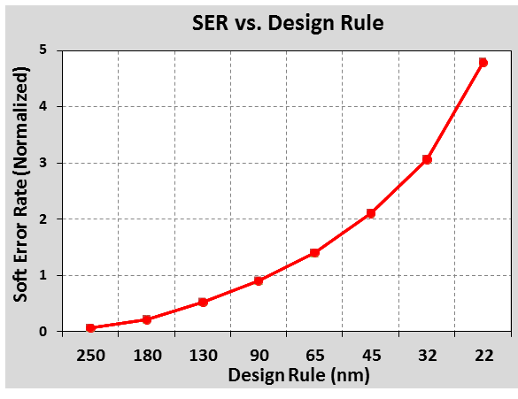
Soft Error? Vulnerability?
gemV : Toolset for Early Design Space Exploration of System Reliability
Soft error
Temporary bit flip in a semiconductor device
Data used in processor execution
Data
Overwritten
Data
Incoming
Data
Write
Data
Write
[Hubert15]
Data
Read
Data
Read
Data Access Pattern
Data is Vulnerable
Vulnerability: Number of bits * Number of cycles in which the bits are vulnerable
How to calculate Vulnerability: Perform vulnerability analysis for each component for the entire program simulation
Notes:
In the previous slide, I said an unfamiliar term, soft error. Soft error is temporary bit flip in a semiconductor device when high energy particle strikes the transistor.
Soft error rate is exponentially increasing with technology scaling. For now, there are just one or two bit soft errors in the systems. However, system are becoming smaller and smaller for IoT era, and soft errors are exponentially increasing in the near future.
We use the vulnerability as the metric of reliability. Let's see the data access pattern in processors. Data can be read and written.
If data is read by CPU, it might be used for processor execution.
In case of write operations, new value overwrites the data.
Read and eviction at the dirty state can be vulnerable since soft errors at that time can be propagated to CPU. Thus, vulnerability estimation depends on data access patterns. Vulnerability is the sum of these vulnerable periods in microarchitectural components.

Slide 4
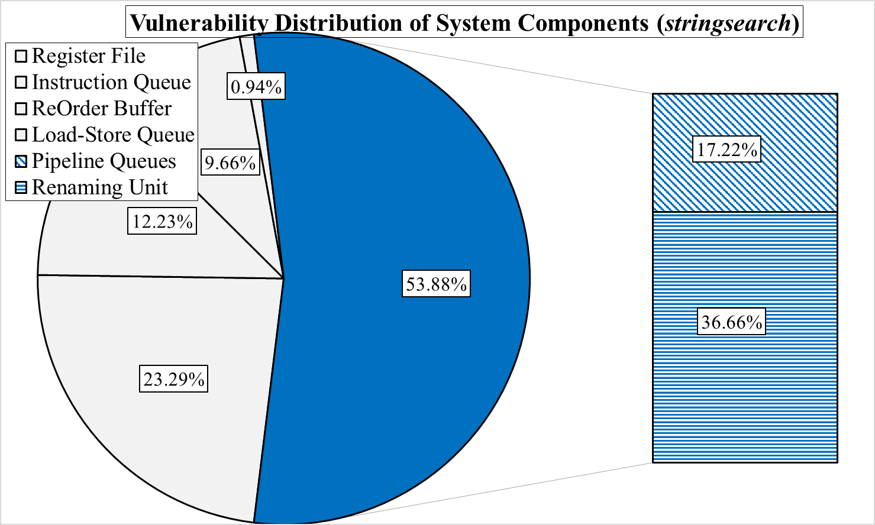
Comprehensive!
gemV : Toolset for Early Design Space Exploration of System Reliability
 | Mukherjee-AVF [1] | SoftArch [2] | Sim-SODA [3]
Register file | YES | YES | YES
Instruction queue | YES | YES | YES
Reorder buffer | NO | NO | YES
Load-store queue | NO | NO | YES
Pipeline queues | NO | NO | NO
Renaming unit | NO | NO | NO
gemV (This work)
YES
YES
YES
YES
YES
YES
With previous tools, more than half of vulnerability is ignored
[1] S. S. Mukherjee, C. Weaver, J. Emer, S. K. Reinhardt, and T. Austin, “A systematic methodology to compute the architectural vulnerability factors for a high-performance microprocessor,” in MICRO, 2003.
[2] X. Li, S. V. Adve, P. Bose, and J. A. Rivers, “Softarch: an architecture-level tool for modeling and analyzing soft errors,” in DSN, 2005
[3] X. Fu, T. Li, and J. Fortes, “Sim-SODA: A unified framework for architectural level software reliability analysis,” in WMBS, 2006.
Notes:
Our gemV tool is comprehensive because we estimate the all the microarchitectural components in out-of-order processors. There are many components in O3 processors, such as register file, instruction queue, reorder buffer, load-store queue, pipeline queues, and renaming units. There were several vulnerability estimation tools, but nor of them modeled the pipeline queues and renaming units. Of course, it doesn’t matter if their contribution for entire vulnerability is not significant.
However, vulnerabilities of pipeline queues and renaming units take up 54% in case of a benchmark, stringsearch.
So, previous tools can ignore more than of vulnerabilities because they only estimated the subset of components in O3 processors.

Slide 5
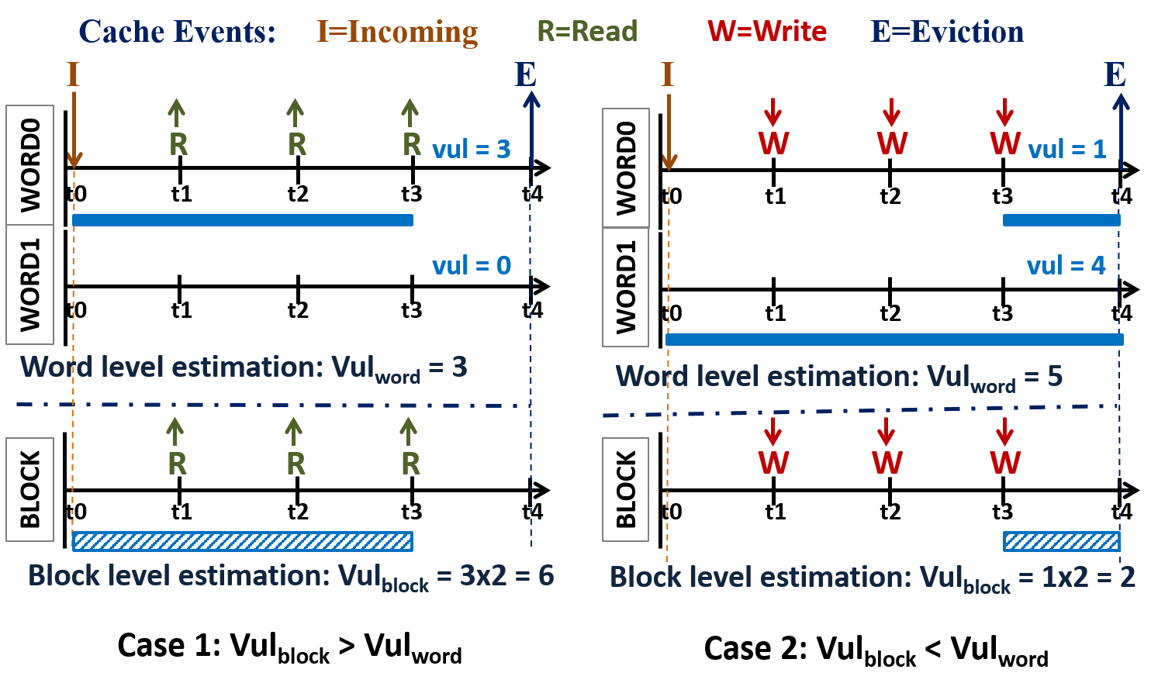
Accurate! Fine-Grained Vulnerability Modeling
gemV : Toolset for Early Design Space Exploration of System Reliability

Slide 6
Accurate! Validated Vulnerability Modeling
gemV : Toolset for Early Design Space Exploration of System Reliability
Target Component | Faults Injected | Matched Results | Mismatched Results | Accuracy (in %)
Register file | 3,000 | 2,899 | 101 | 96.63
Rename map | 3,000 | 2,748 | 252 | 91.60
History buffer | 3,000 | 2,781 | 219 | 92.70
Instruction queue | 3,000 | 2,978 | 22 | 99.27
Reorder buffer | 3,000 | 2,760 | 240 | 92.00
Load-store queue | 3,000 | 2,979 | 21 | 99.30
Fetch queue | 3,000 | 2,890 | 110 | 96.33
Decode queue | 3,000 | 2,902 | 98 | 96.73
Rename queue | 3,000 | 2,827 | 173 | 94.23
I2E queue | 3,000 | 2,959 | 41 | 98.63
IEW queue | 3,000 | 2,873 | 127 | 95.77
Overall Accuracy |  |  |  | 96.78
gemV (This work)
Validated by fault injection campaigns
 | Mukherjee-AVF | SoftArch | Sim-SODA
Validation | No published results | No published results | No published results
Data
Incoming
Data
Write
Data
Write
Data
Read
Data
Read
Data Access Pattern
Data is Vulnerable
Data is Non-Vulnerable
If there are soft errors, it may induce system failures. Really?
Although there are soft errors, it may not induce system failures. Really?
Need to Validate Modeling!
$$\# of injections=\left(\# of benchmarks\right) ×\left(\# of componenets\right) ×300=10 ×11 ×300=33,000$$
Notes:
Secondly, Our gemV provides accurate vulnerability modeling. Assume that we get the vulnerability information from data access patterns. What is the meaning of vulnerable of non-vulnerable.
Vulnerable. If there are soft errors, it may induce system failures such as system halts or incorrect output. Non-vulnerable. Even with soft errors, it may not induce system failures. Really? How can we validate our modeling?
We need to inject faults. After that, we can determine whether injected faults incur system failures or not.
In this work, we have injected more than 30 thousands faults for all the components for 10 benchmarks. Through intensive fault injection campaigns, the accuracy of our vulnerability modeling is about 97%.

Slide 7
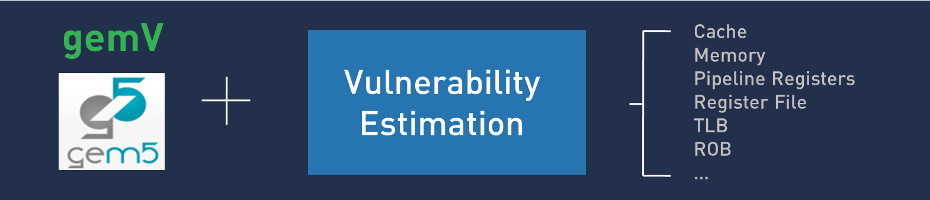
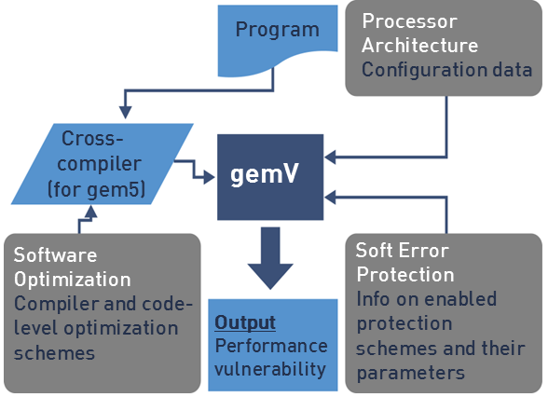
Configurable!
gemV : Toolset for Early Design Space Exploration of System Reliability
Hardware configuration
Issue width, ROB size, IQ size, LSQ size
Software configuration
Compiler (gcc, LLVM)
Optimization options
Algorithm
System configuration
ISAs (ARM, X86, POWER, SPARC)
Number of cores
Good for Design Space Exploration (DSE) in terms of Performance and Reliability at the Early Design Phase
Notes:
Lastly, our gemV supports flexible vulnerability modeling because we have implemented it based on flexible gem5 simulator. With various inputs, our gemV returns vulnerability as well as runtime.
First off, we can change hardware configuration such as issue width and the size of ROB, IQ, and LSQs.
We can also configure software options such as compilers, optimization levels, and algorithms.
Lastly, gemV supports system configurations such as ISAs and number of cores.
So, we can explore the design space between performance and reliability with our gemV at the early design phase.

Slide 8
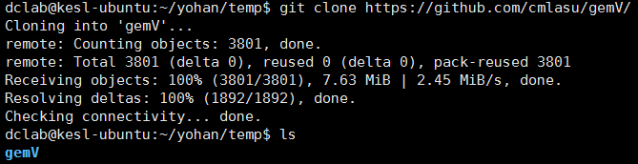
How to Download gemV
gemV : Toolset for Early Design Space Exploration of System Reliability
Download it from github
https://github.com/cmlasu/gemV/archive/master.zip

Slide 9
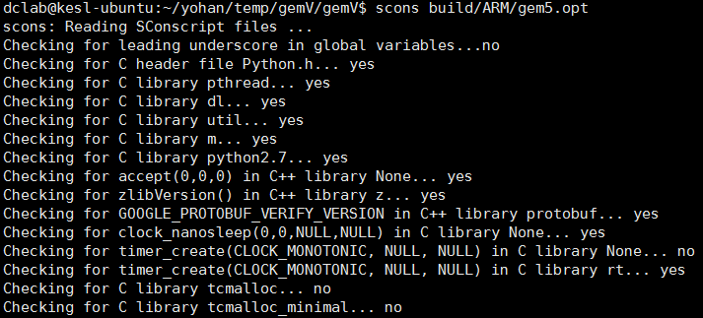
How to Build gemV
gemV : Toolset for Early Design Space Exploration of System Reliability
Build it like gem5
scons build/ARM/gem5.opt
ISA
Build system: debug, opt, fast, prof, perf

Slide 10
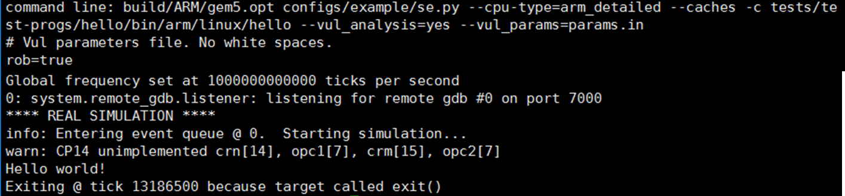
How to Run gemV
gemV : Toolset for Early Design Space Exploration of System Reliability
Run it with parameters
build/ARM/gem5.opt configs/example/se.py --cpu-type=arm_detailed –-caches –c $benchmark --vul_analysis=yes --vul_params=params.in
Out-of-order processor
Vulnerability analysis
Architecture which you want to trace (e.g., rob=true)

Slide 11
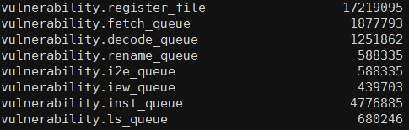
How to See Results from gemV
gemV : Toolset for Early Design Space Exploration of System Reliability
See it from “stats.txt”
[component].vulnerability: Number
Vulnerability of a [component] in bit-cycles

Slide 12
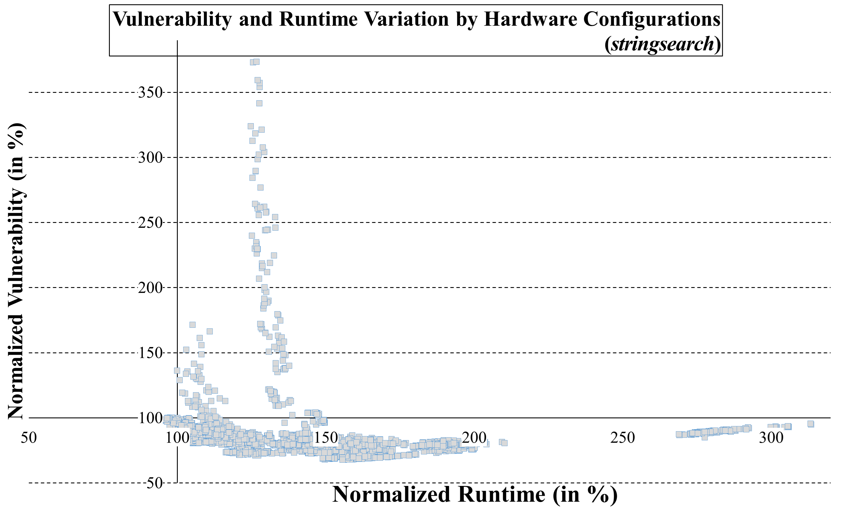
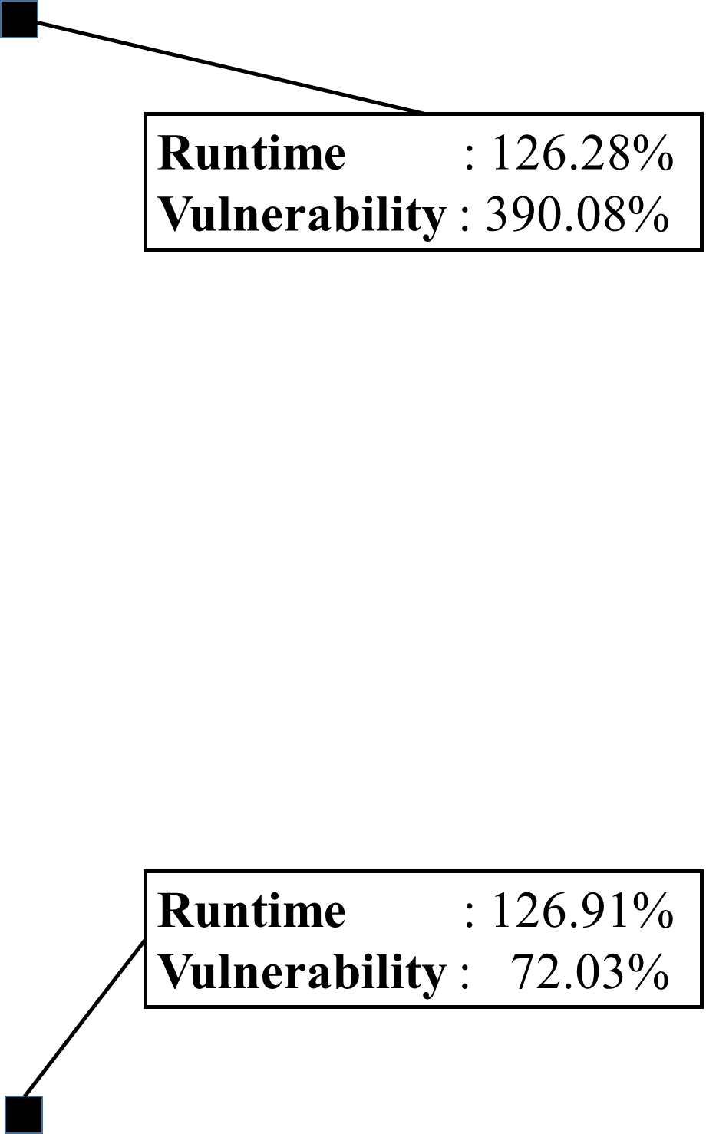
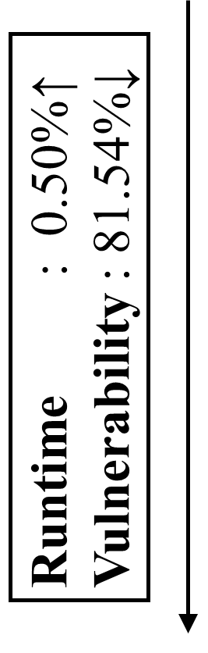
DSE: Hardware Architect
gemV : Toolset for Early Design Space Exploration of System Reliability
Hardware options | Setup
ROB | 64 ~ 384
LSQ | 4 ~ 256
IQ | 4 ~ 256
Fetch queue | 1 ~ 8
Decode queue | 1 ~ 8
Rename queue | 1 ~ 8
I2E queue | 1 ~ 8
Software options | Setup
Algorithm | X
Compiler | gcc
Optimization | O3
System options | Setup
ISA | ARM
# of cores | 1
Notes:
So, I’d like to share with you about design space exploration at the perspective of hardware architect. In this experiment, I fix the software and system options and change hardware options as shown in this table.
This graphs shows the vulnerability and runtime with changing hardware options. And, vulnerability and runtime are normalized to gem5 default configuration.
In this graph, we can find the interesting region. In this box, runtime is quite similar, but vulnerability varies a lot.
For this two point, we can reduce the vulnerability by up to 82% with less than 0.5% performance overhead by just changing hardware configurations.

Slide 13
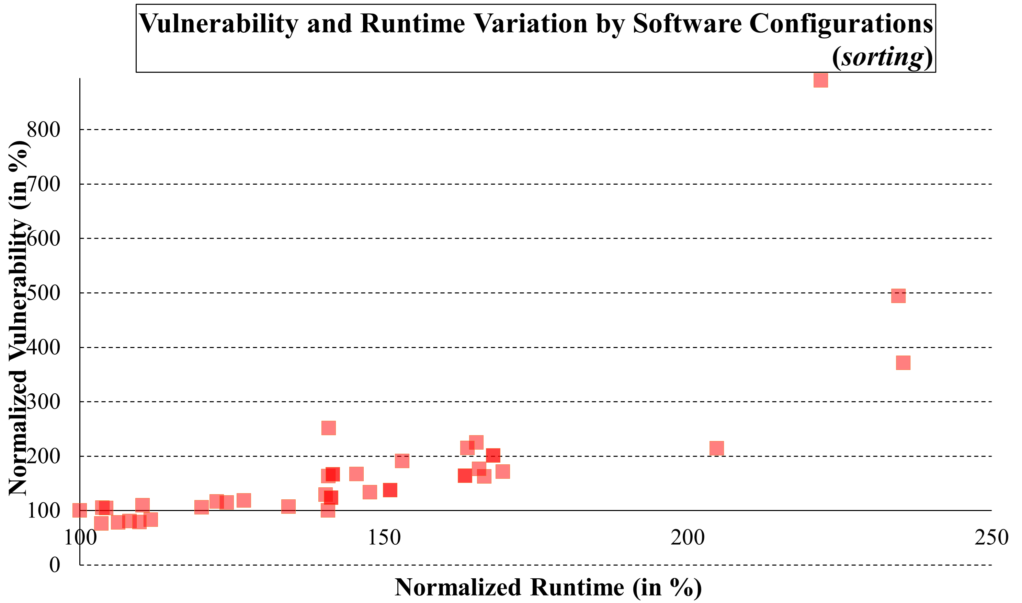
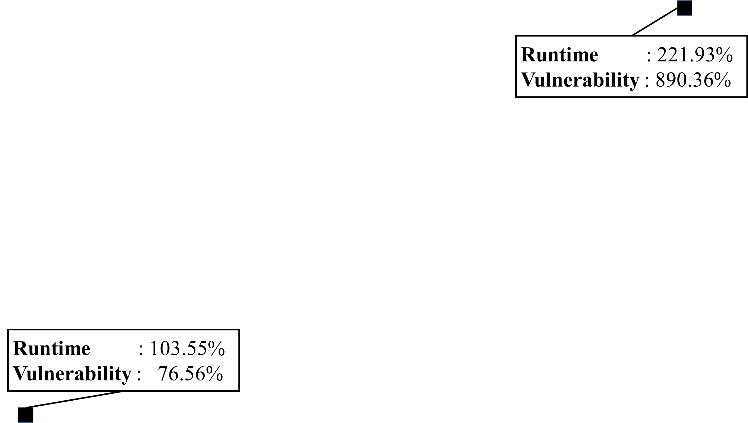
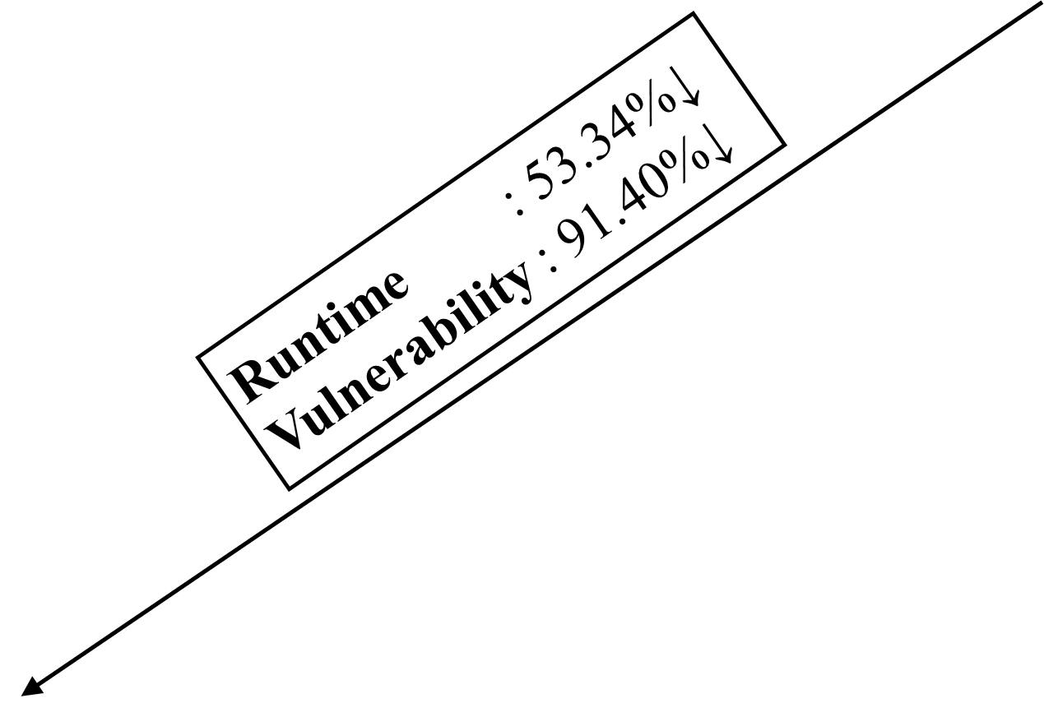
DSE: Software Engineer
gemV : Toolset for Early Design Space Exploration of System Reliability
Hardware options | Setup
ROB | 64
LSQ | 8
IQ | 8
Pipeline queues | 8
Software options | Setup
Algorithm | bubble, quick, insertion, selection, heap,
Compiler | gcc, LLVM
Optimization | X, O1 ~ O3
System options | Setup
ISA | ARM
# of cores | 1
Notes:
The next slide shows the example of DSE in case of software engineering. For this experiment, we have fixed hardware and system options. Assume that we want to sort an array. For sorting program, we can change algorithms such as bubble sort, quick sort, insertion sort, selection sort, and heap sort. And, software engineers can also change compilers such as gcc and LLVM with various optimization levels.
This graph shows the normalized the vulnerability and runtime with changing software configurations.
From this graph, we don’t have to sacrifice performance to improve the reliability. But, interestingly, software options are more sensitive to the vulnerability rather than runtime. We can reduce the both vulnerability and runtime by 53% and 91%, respectively. It is interesting that software engineers can improve hardware reliability against soft errors without changing hardware things.

Slide 14
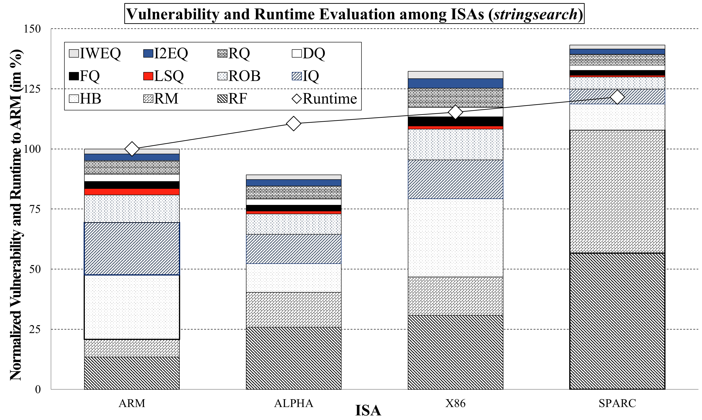


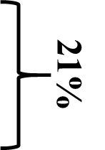
DSE: System Designer
gemV : Toolset for Early Design Space Exploration of System Reliability
Hardware options | Setup
ROB | 64
LSQ | 8
IQ | 8
Pipeline queues | 8
Software options | Setup
Algorithm | X
Compiler | gcc
Optimization | O3
System options | Setup
ISA | ARM, ALPHA, X86, SPARC
# of cores | 1
Notes:
The last DES example is for system designers who want to make new processors. Assume that a system designer plans to change instruction set architectures among ARM, ALPHA, X86, and SPARC. For fair comparison, I’ve fixed the hardware and software configurations.
This graph shows the vulnerability and runtime with varying ISAs. Both vulnerability and runtime are normalized to ARM architectures. ARM architecture can be good option for performance-oriented application. But, ALPHA architecture is better for safety-crucial systems because its vulnerability is the least. And, why don’t you dig into the distribution of vulnerability of each ISAs. In this graph, RF, RM, and HB stand for register file, rename map, and history buffer. Assume that we want to protect SPARC architecture because it’s the most vulnerable architectures among them. But, we can protect just 2 components because of protection costs.
For SPARC architecture, it’s better to protect register file and rename map because they occupies three-fourth of the entire vulnerability. Can we say that this protection can be applicable for other architecures?
No. In case of ARM, register file and rename map are just one-fifth of total vulnerability.
If we can protect 2 components for ARM architecture, we need to protect history buffer and instruction queu because they takes almost half of vulnerabilities.

Slide 15
Conclusion
gemV : Toolset for Early Design Space Exploration of System Reliability
Our Contribution
Comprehensive, accurate, and configurable vulnerability analysis for out-of-order processors in a quantitative manner
Future Work
Consider several masking effects for accurate vulnerability estimation
 | Mukherjee-AVF | SoftArch | Sim-SODA
Comprehensiveness | NO (Subset of components) | NO (Subset of components) | NO (Subset of components)
Accuracy | NO (No published results) | NO (No published results) | NO (No published result)
Configurability | NO (Only for Intel) | NO (Only for POWER) | NO (Only for ALPHA)
gemV (This work)
YES (All the components)
YES (validated by FI)
YES (Applicable for ISAs)
Notes:
The best way to explore the design space b/w performance and reliability is making real physical processors. However, it’s almost impossible or too expensive. So, we need to estimate vulnerability with an extensive and quantitative manner. And, I also show you some interesting design space exploration with perspective of hardware architect, software engineer, and system designers. Our future work will include analyzing masking effects in order to improve the accuracy of vulnerability modeling. Thanks for listening.

