Slide 1
Efficient Mapping onto Coarse-Grained Reconfigurable Architectures using Graph Drawing based Algorithm
Jonghee Yoon, Aviral Shrivastava*, Minwook Ahn, Sanghyun Park, Doosan Cho and Yunheung Paek
SO&R Research Group
Seoul National University, Korea
* Compiler and Microarchitecture Lab
Arizona State University, USA

Slide 2
Reconfigurable Architectures
Reconfigurable = Hardware reconfigurable
Reuse of silicon estate
  Dynamically change the hardware functionality
  Use only the optimal hardware to execute the application
High computation throughput
  Reduced overhead of instruction execution
Highly power efficient execution
Several kinds of reconfigurable architectures
  Field Programmable Gate Arrays
  Instruction Set Extension
  Coarse Grain Reconfigurable Architectures

Slide 3
Coarse Grain Reconfiguration
FPGAs (Field-Programmable Gate Arrays)
  fine grain reconfigurability
  limited application fields
    slow clock speed & slow reconfiguration speed
  S/W development is very difficult
CGRAs (Coarse-Grained Reconfigurable Architectures)
  higher performance in more application fields
  Operation level granularity
  Word level datapath
  S/W development is easy

Slide 4
Outline
Why Reconfigurable Architectures?
Coarse-Grained Reconfigurable Architectures
Problem Formulation
Graph Drawing Algorithm
  Split & Push
  Matching-Cut
Experimental Results
Conclusion
2

Slide 5
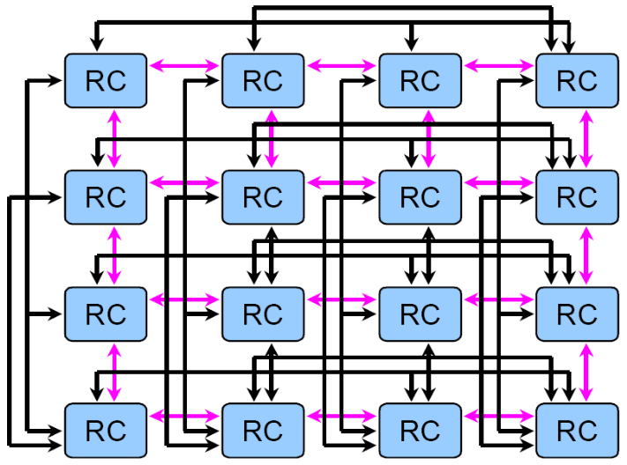
CGRAs
A set of processing elements (PEs)
  PE (or reconfigurable cell, RC, in MorphoSys)
    Light-weight processor
    No control unit
    Simple ALU operations
  ex) Morphosys, RSPA, ADRES, .etc
MUX A
MUX B
A L U
Register
File
Shift Logic
Register
MorphoSys RC Array
PE structure of RSPA
4

Slide 6
Application Mapping onto CGRAs
Compiler’s has a critical role for CGRAs
  analyze the applications
  Map the applications to the CGRA
Two main compiler issues in CGRAs are…
  Parallelism
    finding more parallelism in the application
    ➔ better use of CGRA features
    e.g., s/w pipelining
  Resource Minimization
    to reduce power consumption
    to increase throughput
    to have more opportunities for further optimizations
    e.g., power gating of PEs
5

Slide 7
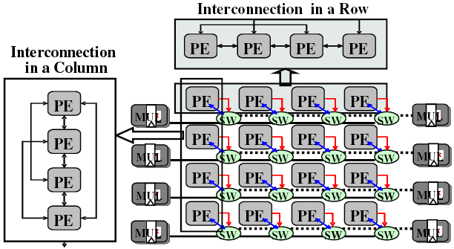
CGRAs are becoming customized
Processing Element (PE) Interconnection
  2-D mesh structure is not enough for high performance
Shared Resources
  cost, power, complexity,
  multipliers and load/store
  units can be shared
Routing PE
  In some CGRAs, a PE can be
  used for routing only
  to map a node with degree
  greater than the # of connections of a PE
1
4
5
2
3
R
4
5
6
7
8
7
8
9
10
RSPA structure
6

Slide 8
Existing compilers assume simple CGRAs
Various Compiler Techniques for CGRAs
  MorphoSys and XPP : can only evaluate simple loops
  DRESC for ADRES : Too long mapping time, low utilization of PE
  ➔ Those do not model complex CGRA designs (shared resources, irregular interconnections, row constraints, memory interface .etc)
  AHN et al. for RSPA : Spatial mapping, shared multiplier & memory
  ➔ can only consider 2-D mesh PE interconnection
  do not consider PEs as routing resources
Our Contribution
  We propose a compiler technique that considers
    irregular PE interconnection
    resource sharing
    routing resource
7

Slide 9
Problem Formulation
Inputs
  Given a kernel DAG K = (V, E), and a CGRA C = (P, L)
Outputs
  Mapping M1: V → P (of vertices to PEs)
  Mapping M2: E → 2^{L} (of edges to paths)
Objective is to minimize
  Routing PEs
  Number of rows
    More useful in practice
Constraints
  Path existence: links share a PE (routing PE)
  Simple path (no loops in a path)
  Uniqueness of routing PE (Routing PE can be used to route only one value)
  No computation on routing PE (No computation on routing PE)
  Shared resource constraints
8
Notes:
Utilizing less # of rows → more opportunities for novel power and performance optimization techniques.
(e.g.,
for power reduction : power gating of a whole row
for performance improvement : executing another application
)

Slide 10
Outline
Why Reconfigurable Architectures?
Coarse-Grained Reconfigurable Architectures
Problem Formulation
Graph Drawing Algorithm
  Split & Push
  Matching-Cut
Experimental Results
Conclusion
2

Slide 11
Graph Drawing Problem ( I )
Split & Push Algorithm¹
Split
Split
Push
Split
Push
Push
Split
Fork occurs!!
Push
Dummy node insertion
3
1
3
1
3
1
3
1
3
1
3
3
4
1
1
4
2
4
2
4
2
2
4
2
Dummy node insertion
8
4
4
2
2
Kernel DAG
CGRA
Kernel DAG
CGRA
Good Mapping
Bad Mapping
Bad split decision incurs more uses of resources
  2 vs. 3 columns
Forks happen
  When adjacent edges are cut by a split
  Forks incurs dummy nodes, which are ‘unnecessary routing PEs’
How to reduce forks?
¹G. D. Battista et. al. A split & push approach to 3D orthogonal drawing. In Graph Drawing, 1998.
9

Slide 12
Graph Drawing Problem ( II )
Matching-Cut²
  Matching: A set of edges which do not share nodes
  Cut: A set of edges whose removal makes the graph disconnected
: shared
A cut, but not a matching
A matching, but not a cut
A matching-cut
Forks can be avoided by finding matching-cut in DAG
3
1
A matching-cut, need 4 PEs, no routing PEs
3
1
A cut, need 6 PEs, 2 routing PEs
4
2
4
2
²M. Patrignani and M. Pizzonia. The complexity of the matching-cut problem. In WG ’01: Proceedings of the
27th International Workshop on Graph-Theoretic Concepts in Computer Science, 2001.
10

Slide 13


Split & Push Kernel Mapping
PE is connected to at most 6 other PEs.
At most 2 load operations and one store Operation can be scheduled.
  Load : Store : ALU : RPE : Fork :
# of node : |V| = 10
# of load : L = 3
# of store : S = 1
Initial ROWmin = = = 3
1
8
8
8
1
1
1
1
4
1
10
4
10
4
10
10
8
8
8
4
4
4
10
8
4
4
10
8
10
2
3
1
10
1
1
1
10
1
1
1
1
1
1
9
3
1
3
9
9
4
5
6
9
3
1
3
1
3
9
9
3
7
1
2
1
9
1
1
9
3
6
5
7
5
7
7
5
2
5
7
7
5
2
6
2
7
6
5
2
7
8
9
2
2
6
5
10
6
6
6
No Matching Cut ➔ Forks occur
Row-wise Scattering
Repeat with increased ROWmin
➔ RPEs Insertion
Violation
Matching Cut
Split & Push
Initial Position
11

Slide 14
Outline
Why Reconfigurable Architectures?
Coarse-Grained Reconfigurable Architectures
Problem Formulation
Graph Drawing Algorithm
  Split & Push
  Matching-Cut
Experimental Results
Conclusion
2

Slide 15
Experimental Setup
We test SPKM on a CGRA called RSPA
  RSPA has orthogonal interconnection (irregular interconnection)
  Each row has 2 shared multipliers
  Each row can perform 2 loads and 1 store (shared resource)
  PE can be used for routing only (routing resource)
2 Sets of Experiments
  Synthetic Benchmarks
  Real Benchmarks
12

Slide 16
SPKM for Synthetic Benchmarks
4x4 CGRA
Random Kernel DAG generator
  First choose n (1-16) – number of nodes in DAG – cardinality
  Then randomly create non-cyclical edges between nodes of DAG
100 DAGs of each cardinality
Run [AHN] and SPKM on them
Compare
  Map-ability
  Number of RRs
  Mapping Time

Slide 17
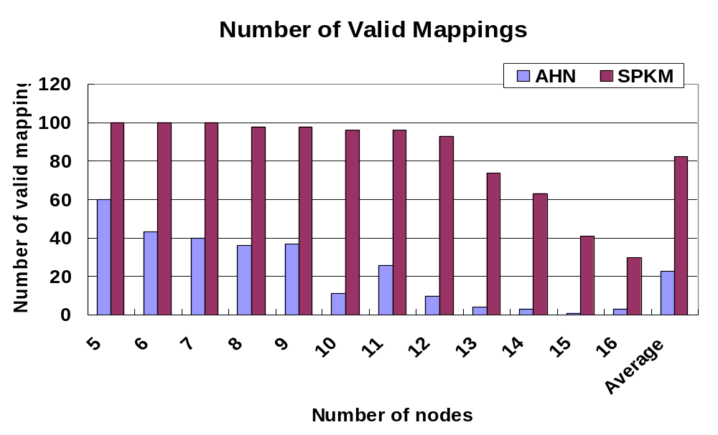
SPKM maps more applications
Y axis : # of applications that each technique can map
X axis : # of nodes that each application has
SPKM can map 4.5X more applications than [AHN]
SPKM can on average map 4.5X more applications than AHN
For large application, SPKM shows high map-ability since it considers routing PEs well
13

Slide 18
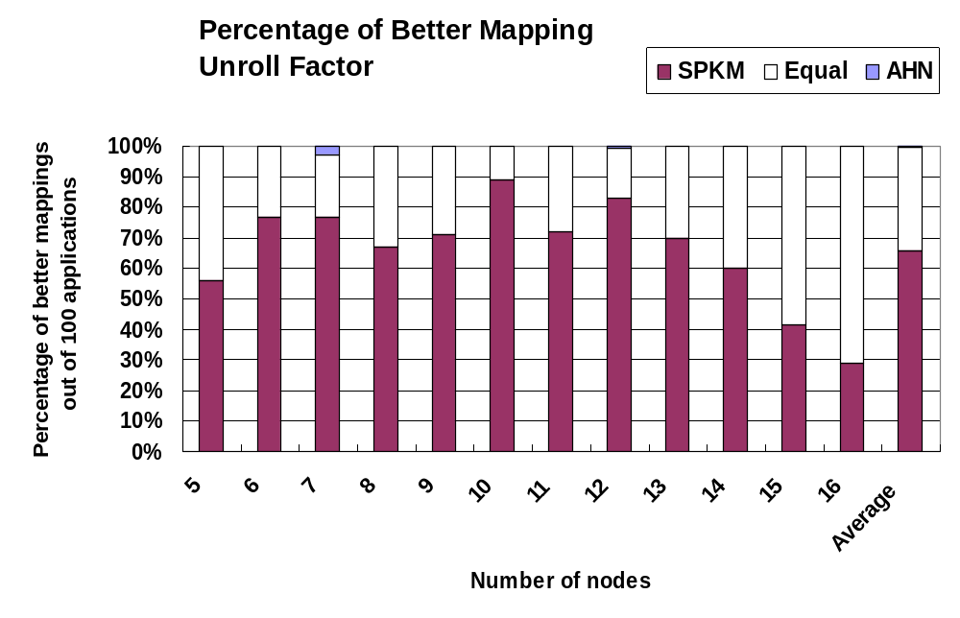
SPKM generates better mapping
[AHN] uses less Rows
[AHN] and SPKM use equal number of Rows
SPKM uses less Rows
For 62% of the applications, SPKM generates better mapping as [AHN]
For 99% of applications, SPKM generates at least as good mapping as [AHN]
15

Slide 19
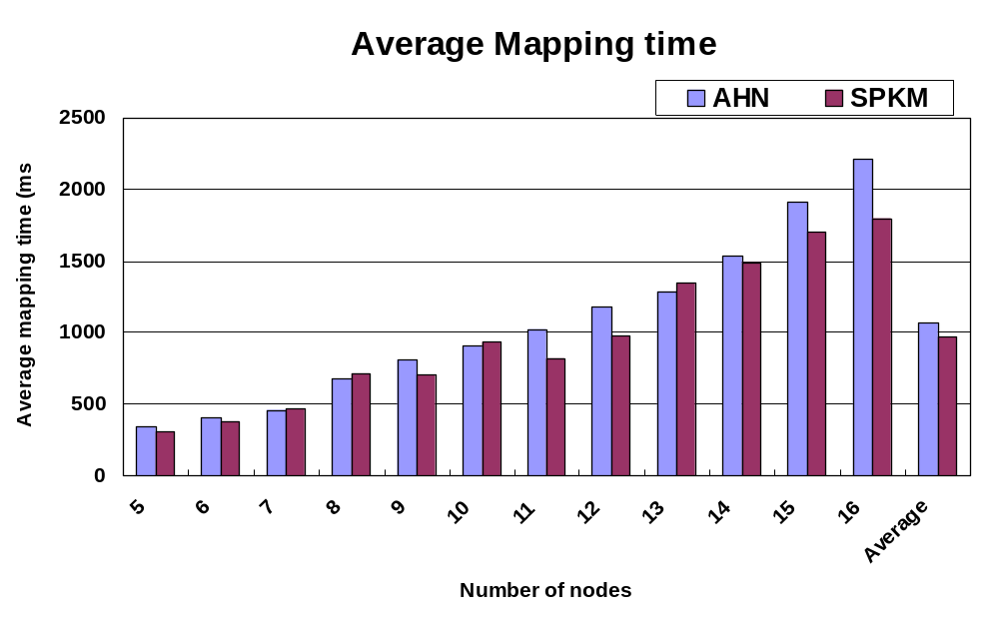
No significant difference in mapping time
SPKM has 8% less mapping time as compared to AHN.
16

Slide 20
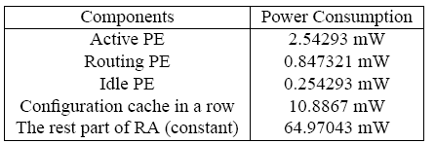
SPKM for real benchmarks
Interconnection in a Row
PE
PE
PE
PE
PE
PE
PE
Interconnection
PE
Interconnection
in a Column
in a Column
PE
PE
PE
PE
PE
PE
PE
PE
PE
PE
PE
MUL
MUL
MUL
MUL
MUL
MUL
MUL
MUL
SW
SW
SW
SW
SW
SW
SW
SW
PE
PE
PE
PE
PE
PE
PE
PE
PE
PE
PE
MUL
MUL
MUL
MUL
MUL
SW
MUL
SW
SW
SW
SW
SW
SW
MUL
SW
MUL
PE
PE
PE
PE
PE
PE
PE
PE
PE
PE
PE
MUL
MUL
MUL
MUL
MUL
SW
MUL
SW
SW
SW
SW
SW
SW
MUL
SW
MUL
PE
PE
PE
PE
PE
PE
PE
PE
PE
PE
PE
MUL
MUL
MUL
MUL
MUL
MUL
MUL
MUL
SW
SW
SW
SW
SW
SW
SW
SW
Benchmarks from Livermore loops, MultiMedia, and DSPStone
17

Slide 21
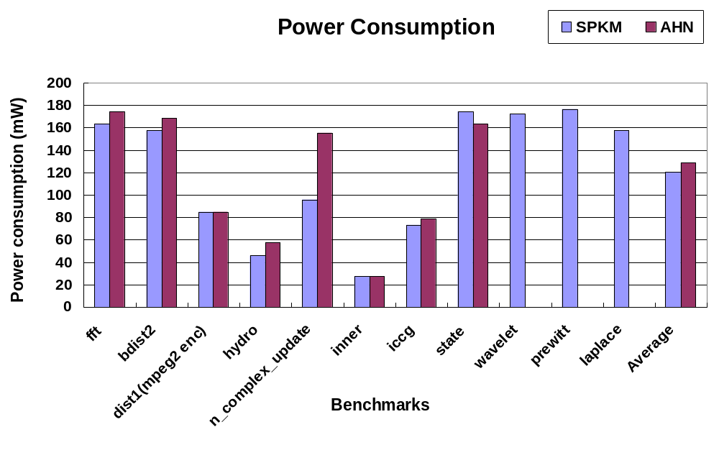
SPKM for real benchmarks
10% reduction in power consumption
AHN fails to map
SPKM can map more real benchmarks
SPKM reduces power consumption by 10% on applications that both [AHN] and SPKM can map.
18

Slide 22
Conclusion
CGRAs are a promising platform
  High throughput, power efficient computation
Applicability of CGRAs critically hinges on the compiler
CGRAs are becoming complex
  Irregular interconnect
  Shared resources
  Routing resources
Existing compilers do not consider these complexities
  Cannot map applications
We propose Graph-Drawing based heuristic, SPKM, that considers architectural details of CGRAs, and uses a split-push algorithm
  Can map 4.5X more DAGs
  Less number of rows in 62% of DAGs
  Same mapping time
19

Slide 23
Thank you

