Slide 1
Functional and Timing Validation of Partially Bypassed Processor Pipelines
*Qiang Zhu
Fujitsu Laboratories LTD. Japan
Aviral Shrivastava
Computer Science and Engineering,
ASU, Tempe, USA
Nikil Dutt
Information and Computer Science,
UC Irvine, USA

Slide 2
Processor Bypasses
Improve performance of pipelined processors
  Eliminating certain data hazards
  Most existing processors are heavily bypassed architecture
    Alpha 21064 has 45 separate bypass paths
Significantly increase
  Cycle time
  Power consumption
  Wiring complexity
RF
RF
Hazard
Hazard
F
D
OR
X1
X2
WB
F
D
OR
X1
X2
WB
R4 ← R4 + R1
R1 ← R2 + R3
R1
R4 ← R4 + R1
R1
R1 ← R2 + R3
Non Bypassing
Full Bypassing
Notes:
In processor designs, Register bypasses or forwarding paths improve the performance of a processor by eliminating certain data hazards,
With bypasses, additional data paths and control logic are added to the processor so that the result of an operation is available for dependent operations even before it is written to the RF.
Most of existing processors have heavily bypassed for deriving the best performance of pipelined execution. For example Alpha 21064 has 45 separate bypass paths.
Here is an example to compare the non-bypassing and full bypassing pipelined architecture.
Assume there are a pair of dependent operations that are executed in the non-bypassed and fully-bypassed pipelined architecture.
In non-bypass architecture the dependent operations, the latter operation has to be stalled in the OR stage, until the former operation finish to write the value of R1 back to the Register File.
The data hazards occur two times in the X1 and X2 pipeline stages. In contrast, in the fully bypassed architecture, the pipeline hazards can be eliminated by forwarding the data via bypass paths.
Actually, this improvement can shorten the execution time of dependent operations.
However, taken as a whole, is bypassing always nice? The answer is 'no'.
Because of additional data paths and control logic, it incurs significant overheads on the cycle time, wiring area, and the power consumption of the processor.

Slide 3
Partial Bypassing in Embedded Systems
Customize the bypasses in Embedded Systems
  Keep only the important ones
  Remove the less needed ones
The problem: How to verify the correctness of designs?
  Manually specifying test sequences for partial bypasses is
    Complex and cumbersome
    Error-prone
Partial Bypassing
Is it possible to automatically generate test sequences for partial bypassing?
RF
F
D
OR
X1
X2
WB
Partial Bypassing
Notes:
In embedded systems, where power, area, and complexity are as critical as performance.
We have to find a good bypassed architecture which can realize high performance but with lower cost. Partial bypassing is a popular approach to achieve increased performance at the cost of modest overheads. The idea is to keep only the important ones and remove the less needed ones. We need a Partial Bypassing exploration scheme to search the optimal bypassed architecture. Actually this is other research scope for partial bypassing, and it’s already done by a PBExplore tool.
In this research we focus on how to verify the correctness of the designs with respect to its specification. Once you change the design, such as removing existed bypass or adding a new bypass from/to the design, than you need to check the correctness of such modification. How manually specifying test sequences for partially bypasses is a complex and cumbersome job, because you have to consider both of instructions architecture as well as micro-architecture at same time to find dependent operations which can excise the bypasses. Because the complexity of bypasses, you must be very careful to write the test sequence, which can exactly activate the bypass to check if it is implemented correctly or not.
Consequently, we need more efficient way to make such test sequences, the question is it is possible to automatically generation test sequences for partial bypassing?
The answer is Yes but it is not easy.

Slide 4
Challenges in Test Generation
The test cases must verify that the bypass configuration in the implementation is exactly same as in the specification
  Bypasses absent in the specification are actually absent in the implementation
  Bypasses present in the specification are indeed present in the implementation
Need to check not only functional errors but also timing errors
  Absence/Presence of bypasses may not cause functional errors.
  Existing techniques only consider the absence of bypasses.
Require detailed architectural information:
    e.g., operation latency, bypass configuration, dependent operations, the position and registers of the dependent operands ...
Notes:
The test cases must verify the bypass configuration in the implementation is exactly same as in the specification, these means that:
Bypasses absent in the specification are actually absent in the implementation
Bypasses present in the specification are indeed present in the implementation
To check presence and absence of bypasses we need to check ….
Note that, Absence/Presence of bypasses may not cause functional errors.
For example, by a chance, designers misunderstand spec. and forget to implement the bypasses which are described on the spec.
However, if you don’t check the occurrences of pipeline hazards, you even can not be aware of such mistakes, because you can get same results for any test sequences or benchmarks. But the performance may not satisfy the requirements.
For such test generation, it also requires detailed architectural information, includes …, which can help you get dependent operations to precisely excise the bypasses.

Slide 5
Related Work
Partial bypassing
  PBExplore: A framework to explore the power-performance tradeoffs of bypass configurations.
  AutoOT: A tool to automatically generate Operation Tables from ADL description.
Processor pipeline test generation
  Test generation for instruction set architecture
    Aharon et al. and Fine et al. proposed test generation for ISA.
    ISA can not capture the bypasses in processor
  Test generation for micro-architecture
    Iwashita et al. and Ur et al. describe the micro-architecture in a high-level description and transform them into the FSM. They generate tests based on FSM model.
    They ONLY consider absence but not presence of the bypasses.
    The FSM model may not scale with the micro-architectural complexity.
  Directed test generation
    Mishra et al. generate direct tests from a high-level processor description in EXPERSSION ADL.
    But they DO NOT model bypasses in their ADL description.
No existing technique can generate tests for partial bypassing

Slide 6
Contributions
Proposed a partially bypassed test generation techniques from a high level processor Architecture Description Language (ADL)
Proposed a directed test generation scheme based on fault models for partial bypasses
Apply our proposal to the Intel XScale – a super-pipelined processor with up to 35 bypasses
  The results show that our proposal can very efficiently generate test sequences to cover 100% fault models with less number of tests and shorter time than random test generation.
  The results also present our approach can generate test cases for any bypass configurations and cover either presence or absence of bypasses.

Slide 7
Outline
ADL driven test generation flow
Test sequence for partial bypassing
ADL and Operation Tables
Fault models
Direct test generation
Experiments
Summary

Slide 8
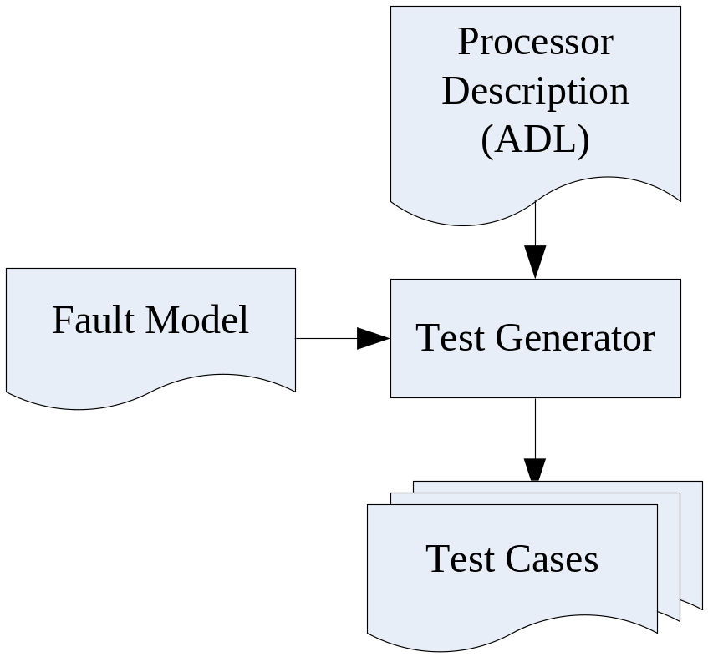
ADL driven Test Generation
Describe processor micro-architecture using a high level Architecture Description Language (ADL).
Define fault model for partially-bypassed architecture.
Directly generate tests to cover the fault models.
Automatically, efficiently, directly generate tests for any given bypass configuration

Slide 9
Test sequence for partial bypassing
//Part1. Initialize the registers
ADDI R2 R0 2 // R2 <- 2
ADDI R3 R0 5 // R3 <- 5
ADDI R6 R0 5 // R6 <- 5
//Part2. Excite the bypass (X1 to OR)
MUL R1 R2 R3 // R1 <- R2*R3
NOP
ADD R5 R1 R3 // R5 <- R1+R3
//Part3. Check timing and function
IF (stall) JUMP ERROR
IF (R5 != 15) JUMP ERROR
SUCCESS
RF
F
D
OR
X1
X2
WB
R5 ← R3 + R1
R1
R1 ← R2 * R3
2 cycles
BPO (Bypass Producer Operation)
  An operation generates value to a bypass
BCO (Bypass Consumer Operation)
  An operation receives value from a bypass
Main goal: generate sequences
of BCO, BPO from ADL description.

Slide 10
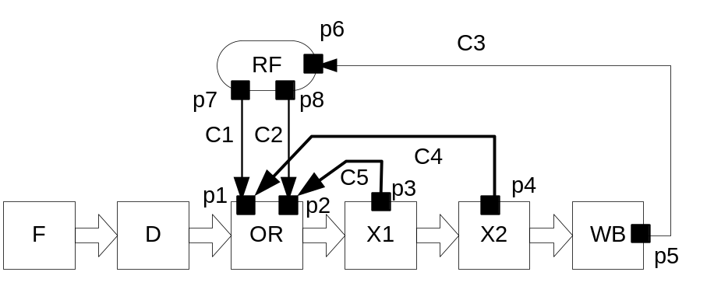
Processor Description - ADL
Model the flow of operations in the pipeline.
  A pipeline unit contains a list of operations that it supports.
    Ex. F, D, OR, X1, X2, WB
  Pipeline units can read/write operands using read/write ports.
    Ex. p1-p8
  A port can connect to other ports via explicit directed connections.
    Ex. C1-C5
  Bypasses are modeled simply as a connection between a write port on a pipeline unit and a read port on the OR pipeline unit.
    Ex. C4, C5
Automatically generate Operation Tables (OTs) from the ADL description
  [DATE2006] Automatic Generation of Operation Tables for Fast Exploration of Bypasses in Embedded Systems
    S. Park, A. Shirivastava, N. Dutt, A. Nicolau
OTs

Slide 11
Operation Table
Operation Table for ADD R1 R2 R3
RF
C3
1. F
2. D
3. OR
ReadOperands
R2
C1 RF
R3
C2 RF
C5 EX
DestOperands
R1 RF
4. EX
BypassOperands
R1
C5 OR
5. WB
WriteOperands
R1
C3 RF
C1
C2
C5
F
D
OR
EX
XWB
ADD R1 R2 R3
Operation Table
  Describes the mapping of an Operation to the processor resources
  Detect Resource Hazards
  Describes the mapping of an Operation to the processor registers
  Detect Data Hazards
OTs can effectively use for test generation
  Includes all necessary information to generate tests
  Easily find dependent operations to cover any specific bypasses

Slide 12
Fault models for partial bypassing
Fault model for the presence of bypasses
  Let Activate Set ACT_{b} be a set of all possible operation sequences that can activate the bypass b.
  If the implementation of the bypass b is erroneous, then at lease one of ACT_{b} will have
    Incorrect results, or
    Unexpected stall occurrence
Fault mode for the absence of bypasses
  Let Stall Set SS_{or} be a set of all possible operation sequences that can stall the OR unit.
  If the implementation of bypasses are erroneous, then at lease one of SS_{or} will have
    Incorrect results, or
    No stalls occurrence
To directly generate operation sequences for ACT_{b} and SS_{or}

Slide 13
Direct test generation from OTs
Details in the paper
TestGenerate()
01: for each bypass b in B
02: for each operation bco in BCO(b)
03: for each operation bpo in BPO(b)
04: // generate tests for (b, bpo, bco)
05: Get destination operands from OTs
06: Get source operands from OTs
07: for each destination operands
08: for each source operands
09: Let t1 be writing cycles to bypass b
10: Let t2 be reading cycles to bypass b
11: operation latency = |t1-t2|;
12: Generate test sequences for bypass b
13: end for
14: end for
15: end for
16: end for
17: end for
NOT Difficult to generate test sequences from OTs

Slide 14
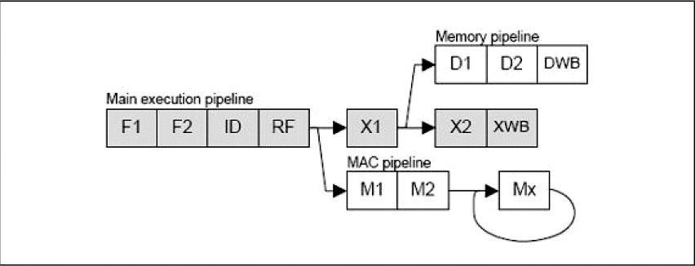
Experiments
Applied the idea to the partially bypassed Intel XScale processor
  Assumed that 7 pipeline stages can bypass to all the 4 operands in the RF stage, thus 7x4 = 28 different possible bypasses.
  Described the ARM ISA and the XScale micro-architecture in EXPRESSION processor-ADL, and automatically generate OTs.
  Developed a tool to generate test sequences from OTs.
XScale 7-stage super pipeline

Slide 15
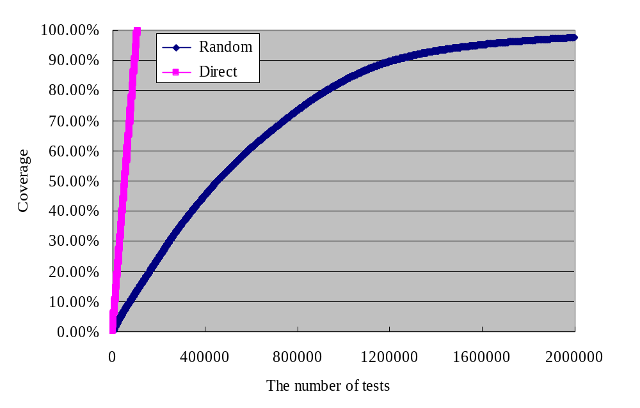
Comparison with random test generation
The direct test generation achieved 100% coverage for our fault models using about 107,074 tests within 40 minutes.
The random test generation spent about half day to achieve 100% coverage after 2 million tests.
  Randomly generate dependent operations, and their latency.

Slide 16
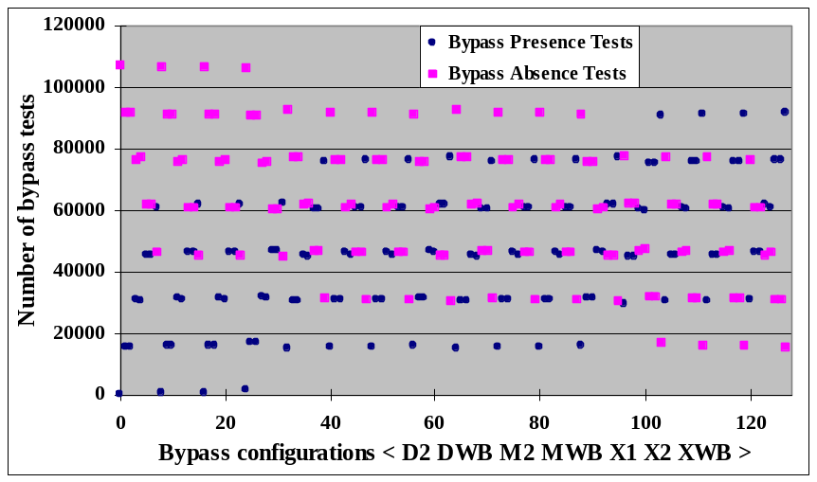
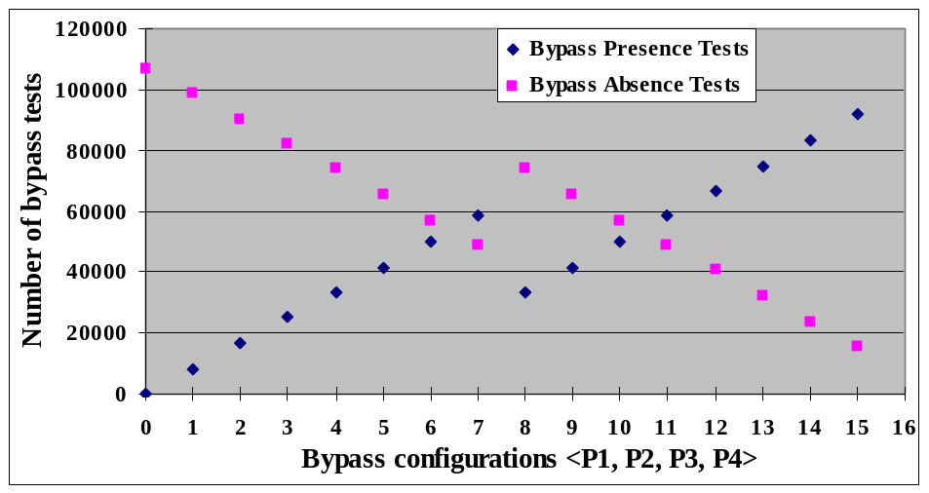
Other bypass configurations
Automatically generate test sequences by
  varying the bypass sources
    7 units can generate a bypass value, therefore 2⁷ = 128 bypass configurations.
  varying the bypass destinations.
    4 ports at RF unit, there are 2⁴ = 16 bypass configurations
Our approach can efficiently apply to any partially-bypassed configurations.
Number of tests while exploring bypass sources
Number of tests while exploring bypass destinations

Slide 17
Summary
Present a test generation technique for partially-bypassed architecture.
  Describe partially-bypassed architecture using high-level process Architecture Description Language (ADL)
  Define fault model for partially-bypassed architecture.
  Automatically generate test sequences from OTs and fault models.
Apply our approach to a Intel XScale super pipeline architecture.
  Generate 107,074 tests to achieve 100% coverage for our fault models within 40 minutes.
  In contrast, random test generation scheme achieve 100% coverage after 2 million tests with half day.
  Easily apply to any partially bypass configurations.
The results demonstrate that we can successfully, automatically, and efficiently generate bypass tests for a partially bypassed processor pipeline.

