Slide 1
GCCFG: A New Graphical Representation for
Inter-procedural Optimizations in
Software-Managed Manycore (SMM) Architectures
Bryce Holton, Thesis Presentation

Slide 2
Simplified Overview
We are working on a cache-less processor
  Has scratchpad memories only
Data has to be managed in software
  Through DMA instructions
Want to fetch data at coarse-granularity, and in advance
  Sometimes in the previous function
Need inter-procedural analysis
  Need a program-level data structure
Existing program-level data structures, e.g., Call graph are not so useful, or are too big
Propose GCCFG: Global Call Control Flow Graph
  Captures both function calls and control flow in a hierarchical manner
Thesis is about the construction of GCCFG

Slide 3
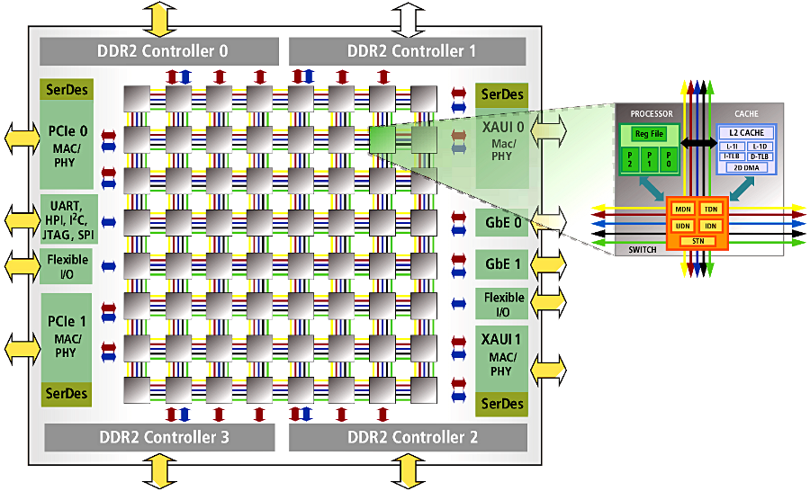

The Manycore Challenge
Scaling cores is easy… but how to scale the memory
Cache coherency protocols do not scale well
Non-Coherent Cache Architectures
  Intel 48-core Single-chip Cloud Computer
  8-core DSP from Texas Instruments, TI 6678
Caches still consume too much power
  44% power, and greater than 34 % area [1]
64-core Tilera
Intel 48 core chip
[1] Segars et al., International Solid-State Circuits Conference Tutorial 2001

Slide 4
    Software Managed Manycore (SMM)
Scalable manycore architecture
  Simpler to design and verify
Microarchitectural policies are Software-Managed
  Most importantly, and in particular: data movement
Cache-less architecture
  Each core has a scratchpad instead of cache
Execution Core
Execution Core
Execution Core
Execution Core
Execution Core
Execution Core
Main Core
SPM
SPM
SPM
SPM
SPM
SPM
DMA
DMA
DMA
DMA
DMA
DMA
Interconnect Bus
Main Memory
[2] Banakar CODES’02.
DMA

Slide 5
Scratchpad Memory (SPM)
Tag Array
Data Array
Tag Comparators, Muxes
Address Decoder
Cache
SPM
40% less energy as compared to cache [Banakar02]
  Absence of tag arrays, comparators and muxes
34 % less area as compared to cache of same size [Banakar02]
  Simple hardware design (only memory array & address decoding)
Simpler and cheaper to build and verify

Slide 6
The Promise of SMM Architecture
In hardware:
An SMM architecture is more power-efficient than coherent cache based architecture
Processor | Style | Fab | Frequency | Potential GFlops | Power | Power Efficiency
Cell/B.E. | SMM | 90nm | 3.2 GHz | 230 | 50 W | 4.6
Intel i7 4-core Bloomfield 965 XE | CCM | 45nm | 3.2 GHz | 70 | 130 W | 0.5
In Software:
[DAC 2013] Code can be managed more efficiently than in a cache-based architecture
[CODES+ISSS 2013] Stack data can be managed more efficiently than in a cache-based architecture
Supports arbitrary pointers and recursion

Slide 7
Manage code and data in Software
int global;
f1() {
int a,b;
global = a + b;
f2();
}
int global;
f1() {
int a,b;
DMA.fetch(global)
global = a + b;
DMA.writeback(global)
DMA.fetch(f2)
f2();
}
Original Code
SPM-aware Code
Notes:
All the state-of-the-art data management techniques that have been developed for SMM architectures are inter-procedural code transformations, and require extensive inter-procedural analysis.

Slide 8
How to efficiently manage code and data
What granularity of management?
  As coarse-grain as possible
How do I optimize?
  Insert management calls only when needed
  Perform data management in advance
  Perform data management in parallel with computation
Manage data at function-level granularity
Need to understand the execution flow of the application
Need inter-procedural analysis

Slide 9
The problem of Code Management
Static Compilation
  Functions need to be linked before execution
Divide code part of SPM in regions
Map functions to these SPM regions
Functions in the same region replace each other
F1
F5
REGION
F2
REGION
F3
F7
REGION
F6
•
•
•
F4
Local Memory Code Section

Slide 10
Code Management: Setting
stack
F1
heap
F1
F1
F2
global
F2
F2
Code
region
F1
F3
F3
F3
F3
F2
(a) Application call graph
SECTIONS {
OVERLAY {
F1.o
F3.o
}
OVERLAY {
F2.o
}
}
(c) Local Memory
(d) Global Memory
# of Regions and Function-To-Region Mapping
  If each function in a region
  If all functions in a region, and only 1 region
(b) Linker script
Notes:
I haven’t mentioned that the architecture is the Cell processor

Slide 11
Code Management Optimization
Problem formulation:
  Input: A ‘C’ program
  Ouput: Divide SPM in regions, and map functions to regions
  Minimize: The amount of code transfer
Given a mapping, how do we find out the amount of code transfer
  Find the sequence of function calls
  Then for each region, note down the number of function swaps
F1()
….
….
F2()
F3()
….
….
END F1()
F1, F2
F1, F3
F1
F3
F2
F2, F3
f1, f2, f1, f3, f1
f1, f2, f1, f3, f1
f1, f2, f1, f3, f1
f1, f2, f1, f3, f1

Slide 12
How do we capture the whole program?
Call Graph
Can call graph be used to estimate the function execution pattern
  Children are not ordered
  How many times are the children called
    Can be annotated
      But what is the pattern of the call?
Must capture control flow information also
F1
F1
F1
F1
L1
10
10
L1
L2
10
F2
F3
F2
F3
F2
F3
F2
F3
f1, f2, f1, f3, f1
f1, (f2, f1, f3, f1)¹⁰
f1, (f2, f1)¹⁰, (f3, f1)¹⁰
f1, [f2, f3], f1

Slide 13
How do we capture the whole program
Control Flow Graph (CFG) – only for a function
Global CFG
  Combine all the CFGs in a program
  Wherever there is a function call, attach the CFG of the function
Can Global CFG be used to estimate the function execution pattern?
  Yes – it has all the information
  But
    Grows too large
    Recursion

Slide 14
GCCFG: Global Call Control Flow Graph
Functions (circle)
Loops (square)
Conditions (diamond)
Abstracts away straight line code
Captures control flow
Captures function call information
Captures the order of execution
  Left child is executed before right child
F1()
….
….
F2()
F3()
….
….
END F1()
F2()
….
IF(condition)
F4()
ELSE
F5()
….
END F2()
F3()
….
FOR (1…n)
F6()
END FOR
….
END F1()
F1
F2
F3
condition
L2
F4
F5
F6
Notes:
GCCFG contains three types of nodes
Function Node
Function call in a program
Circle Shape
Loop Node
Loop in a program
Square Shape
Condition Node
If-then-else in a program
Diamond Shape
Two sets of children
Left Set – Children executed in the if path
Right Set – Children executed in the false path
GCCFG contains edges between nodes
Set of outgoing edges
ordered set
edges on left are executed before edges on right.

Slide 15
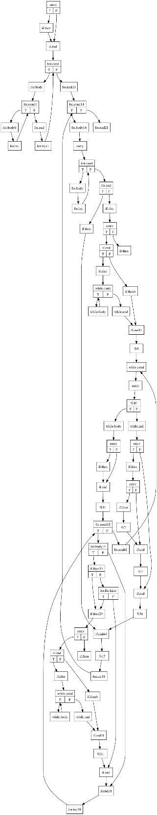
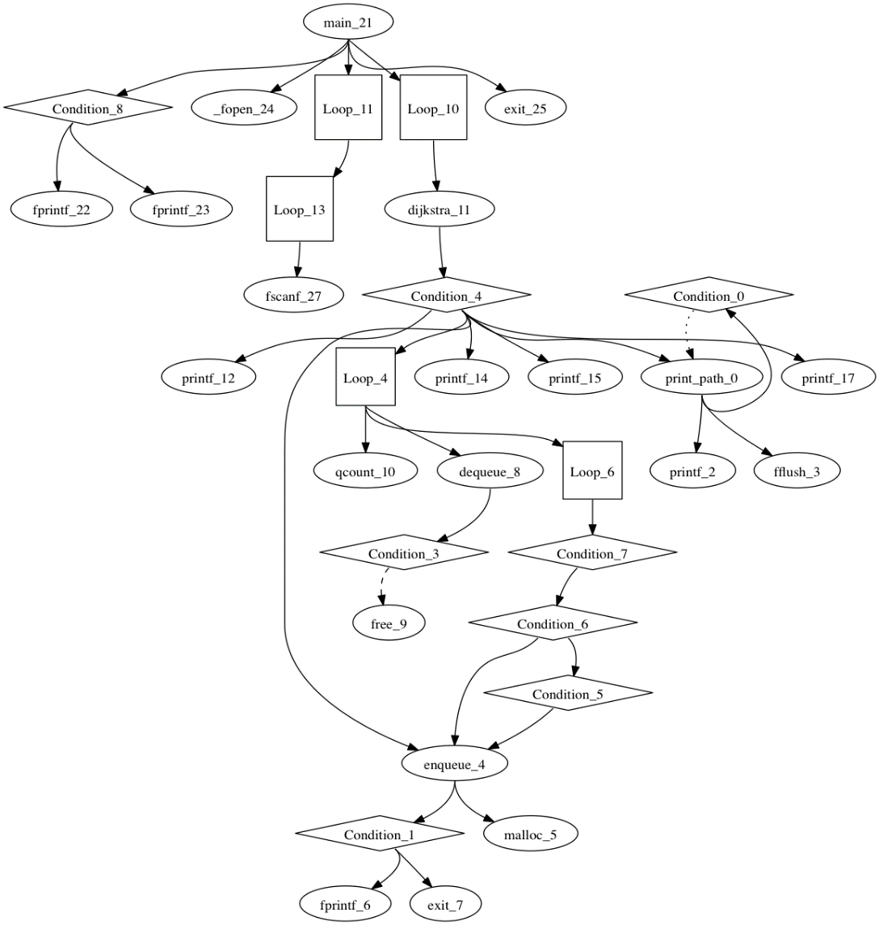
Example Graph: Dijkstra
GCCFG
Whole program data structure
Hierarchical representation
Contains control flow information as well
Much smaller than Global CFG
Global CFG
(without library functions)
GCCFG (with library functions)

Slide 16
How to construct GCCFG?
Step 1: Extract all loops
  Set of nodes in a loop
Step 2: Build a Hierarchical Flow Graph
  One level of hierarchy
Step 3: Build Call Control Flow Graph (CCFG)
  Hierarchical graph for one function
Step 4: Join the CCFGs to create GCCFG
  Hierarchical graph for all the functions

Slide 17



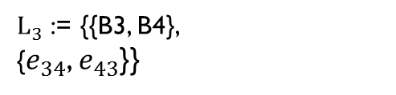

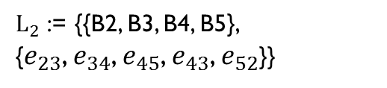

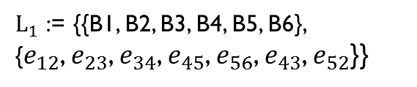


Step 1: Extract Loop Information
Input: Set of Basic Blocks and Edges
Find: Strongly connected components
Unique entry and exit block
May contain sub-loops
Has a Depth
Highest Level Loop
  Contains all blocks and edges in CFG
B1
$$e_{12}$$
B2
$L_{1}$ := {{B1, B2, B3, B4, B5, B6},
{$e_{12}$, $e_{23}$, $e_{34}$, $e_{45}$, $e_{56}$, $e_{43}$, $e_{52}$}}
$$e_{23}$$
$$e_{52}$$
B3
$$e_{43}$$
$$e_{34}$$
$L_{2}$ := {{B2, B3, B4, B5},
{$e_{23}$, $e_{34}$, $e_{45}$, $e_{43}$, $e_{52}$}}
B4
$$e_{45}$$
$L_{3}$ := {{B3, B4},
{$e_{34}$, $e_{43}$}}
B5
$$e_{56}$$
B6
Notes:
Extract loop information from all of the CFG’s
Contains Basic Blocks and edges
Contains Sub-loops
Strongly connected components
Block is reachable from all other blocks
Unique entry and exit block
If not - we will convert the loop
Loop has depth
Highest level loop
Contains all of the blocks and edges from CFG

Slide 18








Step 2: Build an HFG
B1
$$e_{12}$$
Loop1
Loop2
Loop3
B2
Loop2
Loop3
F1
$$e_{23}$$
Loop1
Loop2
Loop3
B3
B1
B2
B3
B1
$$e_{52}$$
B2
B3
$$e_{43}$$
$$e_{34}$$
$$e_{43}$$
B4
Loop2
Loop3
Loop2
Loop3
B4
B4
$$e_{45}$$
B5
B6
B5
B6
B5
$$e_{56}$$
B6
Notes:
Copy all blocks and edges from a loop into HFG
Iterate over all blocks in HFG
If a block belongs to a sub-loop and is a loop entrance or exit
If sub-loop is one nesting level below HFG
Remove edge between HFG and sub-loop block
Add edge between HFG and Loop Place Holder block

Slide 19
Step 3a: Create nodes of CCFG
F1
F1
Call to F2
B1
condition
B2
B3
F2
Loop2
B4
L2
B5
Notes:
Iterate over all blocks in HFG
Look for Function Calls in instructions
Add a function call node to CCFG
Look for LPH’s
Add a loop node to CCFG
Look for blocks with more than one child
Add a condition node to CCFG

Slide 20
Step 3b: Add edges in CCFG
F1
F1
Call to F2
B1
condition
B2
B3
F2
L2
Loop2
B4
B5
Notes:
Iterate over all blocks in HFG
Look for Function Calls in instructions
Add a function call node to CCFG
Look for LPH’s
Add a loop node to CCFG
Look for blocks with more than one child
Add a condition node to CCFG

Slide 21
Step 3b: Add edges in CCFG
F1
F1
Call to F2
B1
Call to F3
condition
B2
B3
F3
F2
L2
Loop2
B4
B5
Notes:
Iterate over all blocks in HFG
Look for Function Calls in instructions
Add a function call node to CCFG
Look for LPH’s
Add a loop node to CCFG
Look for blocks with more than one child
Add a condition node to CCFG

Slide 22
Step 3b: Add edges in CCFG
F1
F1
Call to F2
B1
F3
condition
B2
B3
F2
L2
Loop2
Call to F3
B4
B5
Notes:
Iterate over all blocks in HFG
Look for Function Calls in instructions
Add a function call node to CCFG
Look for LPH’s
Add a loop node to CCFG
Look for blocks with more than one child
Add a condition node to CCFG

Slide 23



Step 4: Building GCCFG
Find matching nodes in two CCFG’s
  Glue them together
F1
F1
$${G1}_{}^{′}$$
$$G$$
condition
condition
F2
L2
F2
L2
$${G2}_{}^{′}$$
L2
F3
F3
Glue Point

Slide 24
Code mapping using GCCFG
  Function F3 calls F6 in a loop
  A lot of data transfer
Functions F4 and F5 in the same region
  since only one of them will be called
F1()
….
….
F2()
F3()
….
….
END F1()
F2()
….
IF(condition)
F4()
ELSE
F5()
….
END F2()
F3()
….
FOR (1…n)
F6()
END FOR
….
END F3()
F1
Region 1
F1
Region 1
F1
F2
F3
Region 2
F5
Region 2
F5
Region 3
F3
Region 3
F3
condition
L2
Region 4
F4
Region 4
F4
F2
F2
Region 5
Region 5
F4
F5
F6
Region 6
F6
Region 6
F6

Slide 25
Poorly Formed Loops
Contain multiple exits
  Caused by continue, break, and goto statements
Transform the loops
  Create a single exit block; lead all outgoing and back edges to exit block.
B0
B0
B1
B1
B2
B3
B2
B3
B4
B5
B4
B5
B6
B6
Exit

Slide 26
Poorly Formed Loops
Intertwined loops
  Caused by goto statements
Transform the loops
  Create a single exit block; lead all outgoing and back edges to exit block.
B0
B0
B1
B2
B1
B2
Exit

Slide 27
Switch Statements
A basic block has more than two children
Transform graph so that each block has at most two children
B1
B1
B2
Intermediate
Block
B2
B3
B4
B3
B4

Slide 28
Experimental Setup
Construct GCCFG using LLVM
  llvm-link unites all source code files into one file
  llvm Function Pass operates on one function at a time
  After all passes are finished
    Combine all CCFG’s into GCCFG
  Annotate graph
    Information relevant to Code, Stack management
Code management and Stack management
  Use Global CFG vs GCCFG as input
  Measure time to compile both, using each data structure

Slide 29
Code Management: GCCFG 5x faster compile time than Global CFG
Notes:
5X faster with GCCFG vs. Global CFG
Measure the amount of time it takes to do a single step of code management
Initially all functions are mapped to their own region
Each step merges two functions into one region
This continues until reaching the code space requirement
Each step needs to calculate the interference of all the functions existing in the same region
Calculated using GCCFG vs. Global CFG
An average step takes 8X longer with Global CFG

Slide 30
Stack management: GCCFG 4x faster compile time than Global CFG
Notes:
4X faster with GCCFG vs. Global CFG
Global CFG must be reduced at every iteration to just the functions in an application
We again measure the time for one iteration of stack management
In each step stack frames are combined together into sets on a single path of execution.
On average a single pass takes 8X longer with Global CFG vs. GCCFG

Slide 31
GCCFG 9x smaller than Global CFG
 | Graph Size
Benchmark | GCCFG(Nodes) | GCFG(Nodes)
Basicmath | 8 | 34
Dijkstra | 29 | 71
Patricia | 28 | 124
Sha | 14 | 111
String_Search | 4 | 24
Susan_Corners | 21 | 389
Susan_Edge | 23 | 399
Susan_Smoothing | 28 | 168

Slide 32
Summary
Coherent Caches will not scale for long
SMM architectures is a promising solution
  Each core has a SPM
  Code and data must be explicitly managed
Compiler techniques for SMM already use GCCFG
  Construction hasn’t been shown yet
  Construction is not straight forward in many common cases
Using GCCFG instead of Global CFG is more efficient
  5X average compilation time speedup in state-of-the-art code management
  4X average compilation time speedup in state-of-the-art stack management.

Slide 33
Outcomes
Paper accepted and presented at CASES 2014
Patent application filed. Currently in review.

