Slide 1

Code Transformation for TLB Power Reduction
Reiley Jeyapaul, Sandeep Marathe, and Aviral Shrivastava
Compiler Microarchitecture Laboratory
Arizona State University
http://www.public.asu.edu/~ashriva6

Slide 2
Translation Lookaside Buffer
Translation table for addresses translation and page access permissions
TLB required for Memory Virtualization
  Application programmers see a single, almost unlimited memory
  Page access control, for privacy and security
TLB access for every memory access
  Translation can be done only at miss
  But page access permissions needed on every access
TLB part of multi-processing environments
  Part of Memory Management Unit (MMU)
http://www.public.asu.edu/~ashriva6
Notes:
Add a diagram showing TLB in parallel to cache

Slide 3
TLB Power Consumption
TLB typically implemented as a fully associative cache
  8-4096 entries
High speed dynamic domino logic circuitry used
Very frequently accessed
  Every memory instruction
TLB can consume 20-25% of cache power[9]
TLB can have power density ~ 2.7 nW/mm² [16]
  More than 4 times that of L1 cache.
Important to reduce TLB Power
[9] M. Ekman, P. Stenstrm, and F. Dahlgren. TLB and snoop energy-reduction using
virtual caches in low-power chip-multiprocessors.
In ISLPED ’02, pages 243–246, New York, NY, USA, 2002. ACM Press
[16] I. Kadayif, A. Sivasubramaniam, M. Kandemir, G. Kandiraju, and G. Chen.
Optimizing instruction TLB energy using software and hardware techniques.
ACM Trans. Des. Autom. Electron. Syst., 10(2):229–257, 2005.

Slide 4
Related Work
Hardware Approaches
  Banked Associative TLB
  2-level TLB
  Use-last TLB
Software Approaches
  Semantic aware multi-lateral partitioning
  Translation Registers (TR) to store most frequently used TLB translations
  Compiler-directed code restructuring
    Optimize the use of TRs
No Hardware-software cooperative approach
http://www.public.asu.edu/~ashriva6

Slide 5
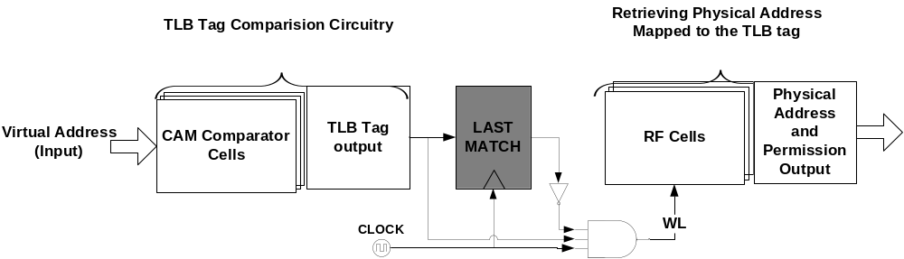
Use-Last TLB Architecture
Use-last TLB architecture
  “WL” is not enabled if the immediate previous tag and the current tag addresses (page addresses) are the same
  Achieves 75% power savings in I-TLB
  Deemed ineffective for D-TLB, due to low page locality
Need to improve program page-locality
http://www.public.asu.edu/~ashriva6

Slide 6

Code Generation and TLB Page Switches
for (i=1; i < N; i++)
for (j=1; j < N; j++)
prediction = 2 * A[i-1][j-1] + A[i-1][j] + A[i][j-1];
A[i][j] = A[i][j] – prediction;
endFor
endFor
ArraySize( A ) > Page_Size
A[i-1][j] and A[i][j-1] access different pages
# Page-Switch =
T1 = A[i][ j] – 2*A[i-1][ j-1];
T2 = A[i][ j-1] + A[i-1][ j];
A[i][j] = T1 – T2;
4
A[i][ j],
A[i][ j-1]
A[i-1][ j],
A[i-1][ j-1]
High Page Switch Solution
Page 1
Page 2
# Page-Switch =
1
T1 = 2*A[i-1][ j-1] + A[i-1][ j];
T2 = A[i][ j] - A[i][ j-1];
A[i][j] = T2 – T1;
A[i][ j],
A[i][ j-1]
A[i-1][ j],
A[i-1][ j-1]
Page 1
Page 2
Low Page Switch Solution
http://www.public.asu.edu/~ashriva6

Slide 7
Outline
Motivation for TLB power reduction
Use-last TLB architecture
Intuition of Compiler techniques for TLB power reduction
Compiler Techniques
  Instruction Scheduling
    Problem Formulation
    Heuristic Solution
  Array Interleaving
  Loop Unrolling
Comprehensive Solution
Summary
http://www.public.asu.edu/~ashriva6

Slide 8

Page Switching Model
Represent instruction by a 4-tuple
  d: destination operand, s1 : first source operand, s2: second source operand
When instruction executes, assume that operands are accessed in the order,
  i.s1, i.s2, i.d
Need to estimate the number of page switches for a sequence of instructions
  PS(p, i₁, i₂, …, i_{n}) = PS(p, i₁.s1, i₁.s2, i₁.d, i₁.d, i₂.s1, i₂.s2, i₂.d, …, i_{n-1}.d, i_{n}.s1, i_{n}.s2, i_{n}.d)
Page Mapping
  Scalars : undef
  Globals: p1
  Local Arrays
    Different arrays map to different pages
    Find dimension, such that size of array in lower dimensions > page size
    Any difference in higher dimension index is a different page
http://www.public.asu.edu/~ashriva6

Slide 9
Problem Formulation
Source Node
Data Dependence Edge
0
0
Instruction node
0
Page-Switch Edge
1
0
2
1
3
Weight = # of page switches when node “i” is scheduled immediately next to node “j”
2
2
3
0
1
4
2
5
3
Instruction schedule for minimum page-switch = Finding shortest hamiltonian from source to sink.
1
0
2
7
6
0
0
Sink Node
http://www.public.asu.edu/~ashriva6

Slide 10
Heuristic Solution
Greedy Solution:
Pick source of PNSE at priority
After scheduling (1)
  Can pick up (2) or (3)
Picking up (3) is a bad idea
  Loose the opportunity to reduce page
1
2
3
4
5
6
7
Data Dependence Edge
1
2
3
Page-Non-Switching Edge (PNSE)
4
5
Our Solution
Pick up PNSE edges greedily
6
7
http://www.public.asu.edu/~ashriva6

Slide 11
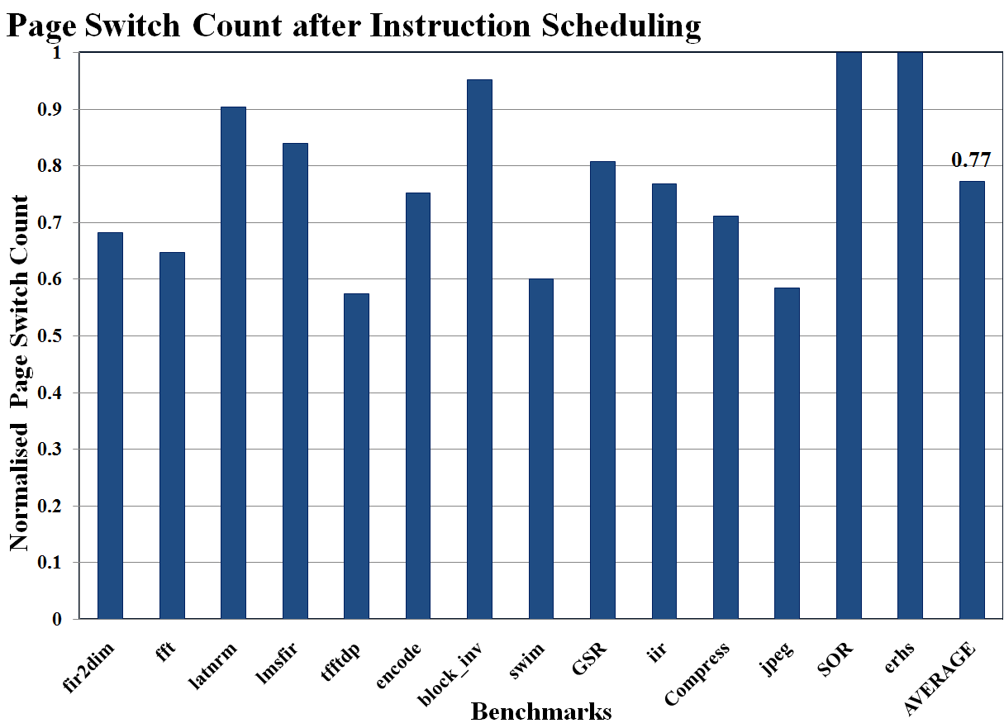
Experimental Results
23% reduction in TLB switching by instruction scheduling
http://www.public.asu.edu/~ashriva6

Slide 12
Outline
Motivation for TLB power reduction
Use-last TLB architecture
Intuition of Compiler techniques for TLB power reduction
Compiler Techniques
  Instruction Scheduling
  Array Interleaving
  Loop Unrolling
Comprehensive Solution
Summary
http://www.public.asu.edu/~ashriva6

Slide 13
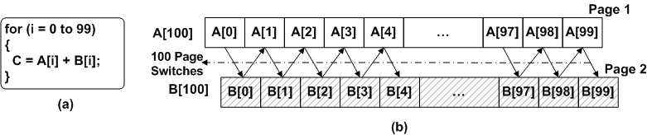
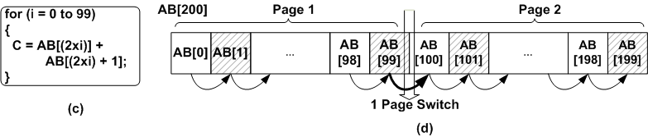
Array Interleaving
Array size > Page size.
Arrays accessed successively before interleaving.
Arrays accessed successively after interleaving.
Arrays are interleaving candidates if
arrays have the same access function
arrays are the same size
  padding leads to memory usage and addressing overheads.
Multi-Array Interleaving
  If arrays A and B are interleaving candidates for loop 1, and B and C for loop 2, then arrays A,B and C are interleaved together.
http://www.public.asu.edu/~ashriva6

Slide 14
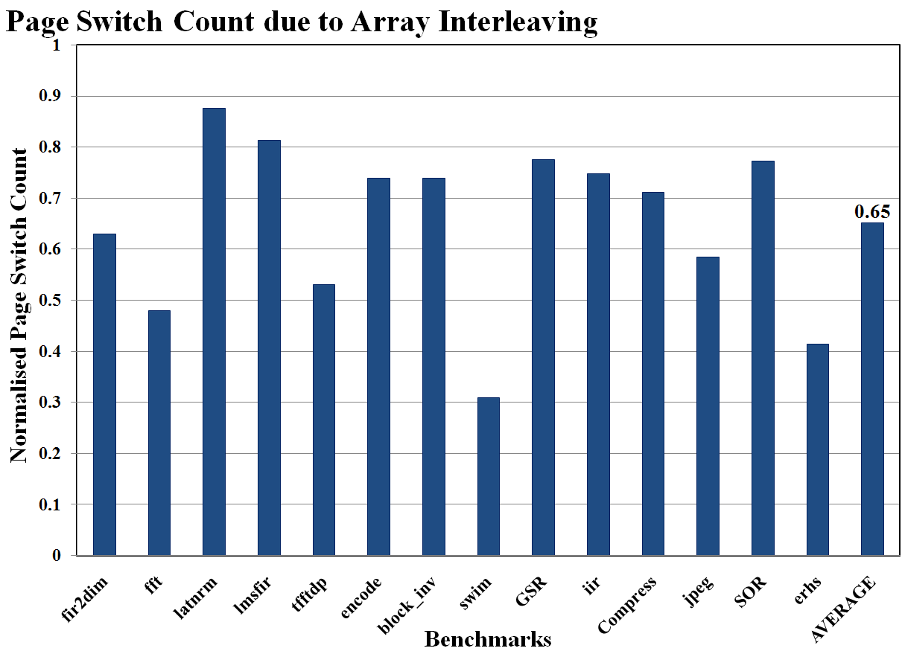
Experimental Results
35% reduction in TLB switching by AI
http://www.public.asu.edu/~ashriva6

Slide 15
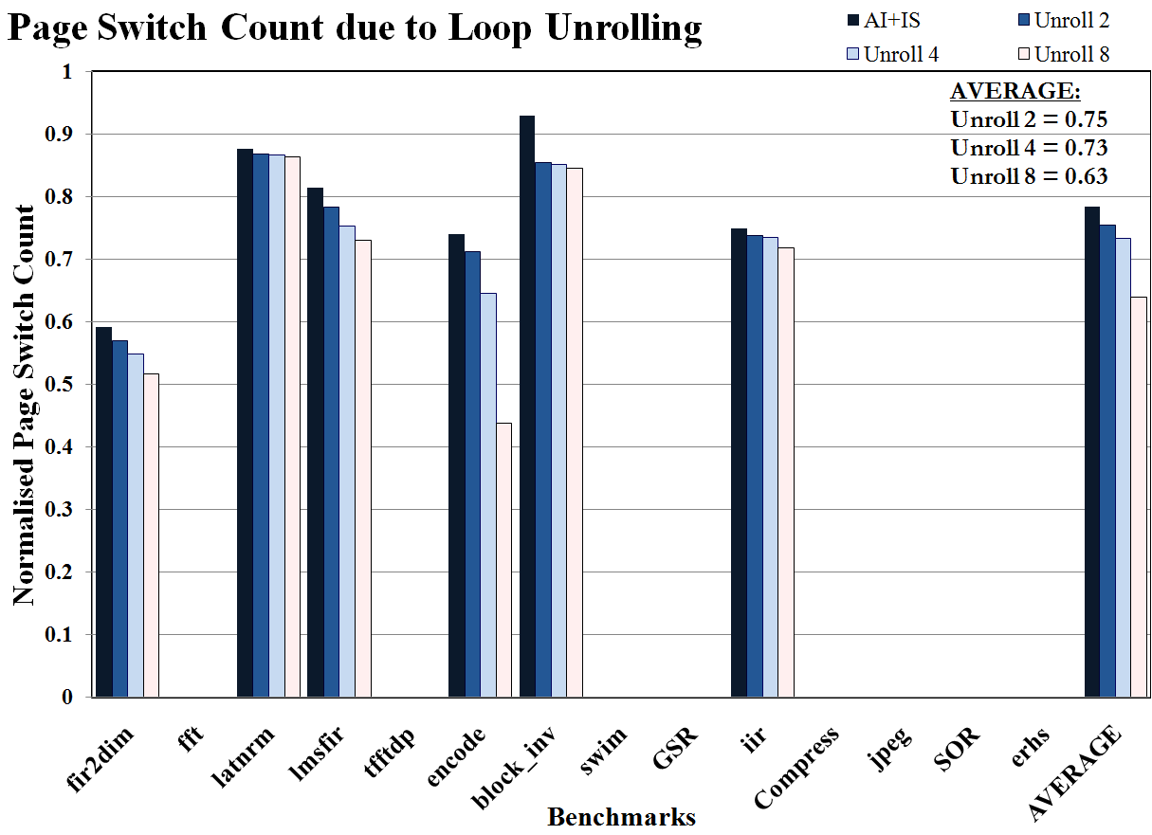
Effect of Loop Unrolling
Loop unrolling can only improve effectiveness of page switch reduction
Loop unrolling is done if there exists one instruction in the loop such that:
  two copies of the same instruction over successive iterations, scheduled together, will reduce page-switches.
Unrolling further reduces TLB switching
http://www.public.asu.edu/~ashriva6

Slide 16
Outline
Motivation for TLB power reduction
Use-last TLB architecture
Intuition of Compiler techniques for TLB power reduction
Compiler Techniques
  Instruction Scheduling
  Array Interleaving
  Loop Unrolling
Comprehensive Solution
Summary
http://www.public.asu.edu/~ashriva6

Slide 17
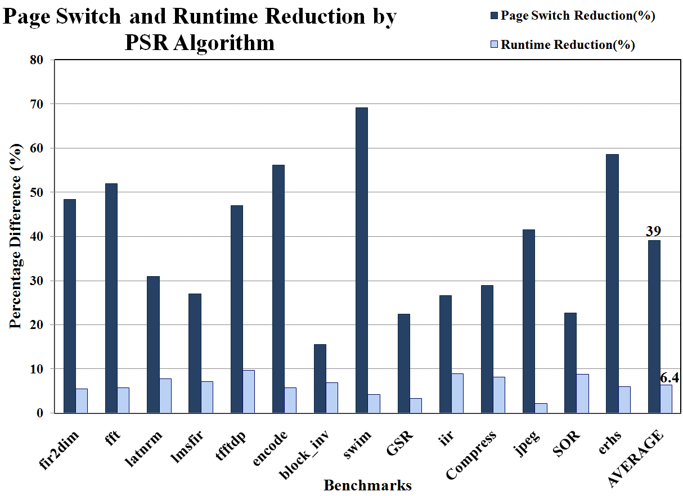
Comprehensive Technique
Fundamental transformations for PS reduction:
  Instruction Scheduling
  Array Interleaving
Enhancement transformations:
  Loop unrolling after all re-scheduling options are exploited
Order of transformations:
  Array Interleaving
  Loop unrolling
  Instruction Scheduling
61% reduction in page switches for 6.4% performance loss
http://www.public.asu.edu/~ashriva6

Slide 18
Summary
TLB may consumes significant power, and also has high power density
  Important to reduce TLB power
Use-last TLB architecture
  Access to the same page does not cause TLB switching
  Effective for I-TLB, but need compiler techniques to improve data locality for D-TLB
Presented Compiler techniques for TLB power reduction
  Instruction Scheduling
  Array Interleaving
  Loop Unrolling
Reduce TLB power by 61% at 6% performance loss
  Very effective hardware-software cooperative technique
http://www.public.asu.edu/~ashriva6

