Slide 1
Dynamic Code Mapping Techniques for Limited Local Memory Systems
Seungchul Jung
Compiler Microarchitecture Lab
Department of Computer Science and Engineering
Arizona State University

Slide 2
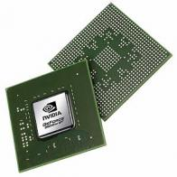
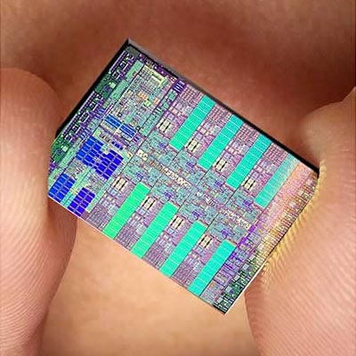

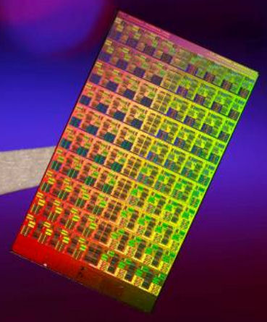
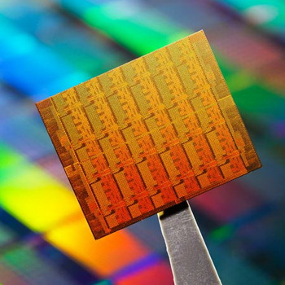
Multicore Landscape
Singlecore Architecture
Power
Temperature
NVidia
IBM
Heat
Reliability
Multicore Architecture
Intel
Notes:
Multicore architecture has less power density

Slide 3
Multi-core Memory
Critical issues with cache in DMS
  Scalability
  Coherency Protocols
SPU
SPU
SPU
SPU
SPU
SPU
SPU
SPU
LS
LS
LS
LS
LS
LS
LS
LS
DMA
DMA
DMA
DMA
DMA
DMA
DMA
DMA
Element Interconnect Bus
PPU
Memory
Controller
Bus Interface
Controller
Notes:
As the number of core increases, the number of local memory increases too.
Managing those memories in hardware may cause serious performance overhead
(it consumes a lot of power, and it does not scale well with the number of cores due to data coherency protocol)
Consequently, in distributed memory system, is the only option for memory scaling.
One example of LLM is cell

Slide 4
Core Memory Management
Local Memory size is limiting factor
Need for Automatic Management
  Application developers are already busy
Code, Variable, Heap and stack
int global;
F1(){
int var1, var2;
global = var1 + var2;
F2();
}
int global;
F1(){
int var1, var2;
DLM.fetch(global);
global = var1 + var2;
DLM.writeback(global);
ILM.fetch(F2);
F2();
}
Notes:
Scales for any number of cores.
Cuz it’s direct/physical mapping on SPM
Mention Cell processor

Slide 5



Code Management Mechanism
SECTIONS {
OVERLAY {
F1.o
F3.o
}
OVERLAY {
F2.o
}
}
F1
F2
stack
F3
heap
F1
F1
(a) Application Call Graph
variable
F2
F2
F2
F3
(b) Linker.Script
F3
code
F1
F3
(c) Local Memory
(d) Main Memory
Notes:
I haven’t mentioned that the architecture is the Cell processor

Slide 6






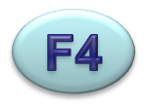
Code Management Problem
REGION
REGION
REGION
•
•
•
Local Memory Code Section
# of Regions and Function-To-Region Mapping
  Two extreme cases
Wise code management due to NP-Complete
  Minimum data transfer with given space
Notes:
How do you map all the functions into limited space (define problem)
then, figure ou number of regions and function-to-region mapping
What’s issue?

Slide 7
Related Work
Cluster functions into regions
  minimize the intra-cluster interference
ILP formulation [2,3,4,5]
  Intractable for large application
Heuristics are proposed
  Best-fit[6], First-Fit[4], SDRM[5]
Egger et al. Scratchpad memory management.. EMSOFT '06
Steinke et al. Reducing energy consumption.. ISSS '02
Egger et al. A dynamic code placement.. CASES '06
Verma et al. Overlay techniques.. VLSI’06
Pabalkar et al. SDRM: Simultaneous.. HIPC’08
Udayakumaran et al. Dynamic allocation for.. ACM Trans.’06
Notes:
Brief Two last explanation

Slide 8

















Limitations of Previous Works 1
F1(){
F2();
F3();
}
1KB
1
F1
1
F3
1KB
F2
1KB
F2(){
for(i=0;i<10;i++){
F4();
}
for(i=0;i<100;i++){
F5();
}
}
10
10
10
100
1KB
1KB
1KB
1KB
F6
F7
F4
F5
Clear Execution Order
(b) Call Graph
1KB
1
F1
1
F3(){
for(i=0;i<10;i++){
F6();
F7();
}
}
F2
1KB
F3
1KB
1
1
1
L1
10
L2
100
L3
10
1
1
1
1
1KB
1KB
1KB
1KB
F4
F5
F6
F7
(a) Example Application
(c) GCCFG
Notes:
Interference estimate – what information to start with
Call graph + profile
Lost information
GCCFG
Has information
We need to know which function is executed first, so we need function order
Importance of Loop existence in GCCFG
Effect in call count

Slide 9













Limitations of Previous Works 2
F1(){
F2();
}
F1, 2KB
Regoin 0
2Kb
F1
F1,F4
F1
Regoin 0
2Kb
Regoin 0
2Kb
1
Region 1
1.5Kb
F2,F3
Region 1
1.5Kb
Region 1
1.5Kb
F2
F2,F3
F2,F3,F4
F2(){
F3();
}
F2, 1.5KB
1
(b) Intermediate Mapping
(c) NOT considering other functions
(d) Considering
other functions
F3, 0.4KB
2Kb + 0.4Kb
2Kb + 0.2Kb
2Kb + 0.2Kb
Regoin 0
F3(){
F4();
}
Regoin 0
1
Regoin 0
1.5Kb + 0.4Kb
F4, 0.2KB
Region 1
Region 1
1.5Kb + 0.2Kb
+
0.4Kb + 0.2Kb
Region 1
0
+
0.4Kb + 0.2Kb
(a) Example
(a) Call Graph
21%
Notes:
Give overall picture of purpose in this slide
Interference cost depends on where other functions are mapped
Show that this is true
Show it is important to consider it

Slide 10








Our Approach
F1() {
F2();
for(int I = 0; I < 200; i++){
F5();
}
}
F1
1
1
F2
L2
1
1
200
F2() {
F3();
for(int I = 0; I < 100; i++){
F4();
}
}
F3
L1
F5
100
F4

Slide 11



FMUM Heuristic
Maximum (7.5KB)
Given (5.5KB)
F1
F1
1KB
1.5KB
F1,F5
1.5KB
F2
1.5KB
F2
F3
0.5KB
F2
1.5KB
1.5KB
F3
0.5KB
F3
0.5KB
F4
2KB
F4
2KB
F4
2KB
F5
F5
1.5KB
F6
F6
1KB
F6
1KB
(a) Start
(b) Next step
(c) Final
Notes:
Mention the metric of evaluation (data transfer amount)
(and effect in performance)

Slide 12








FMUP Heuristic
Minimum (2KB) Given Size (5KB)
(a) START
(c) STEP2
(e) FINAL
F1
F2
F3
1.5KB
2KB
F4
F5
F6
2KB
New Region
New Region
1.5KB
1.5KB
(b) STEP1
(d) STEP3

Slide 13





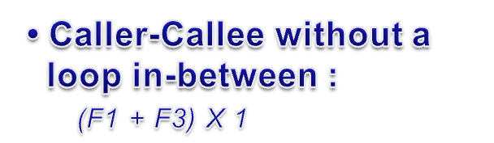



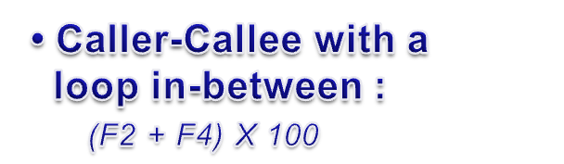



Interference Cost Calculation
F1
1
1
F2
L2
3
1
200
F3
L1
F5
100
F4
Notes:
Between slide 9 and 10

Slide 14








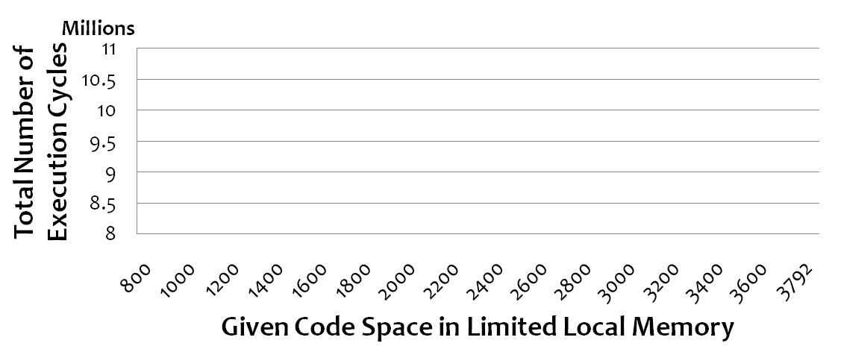
Experiments Setup
FMUM
FMUP
SDRM
Notes:
legend

Slide 15
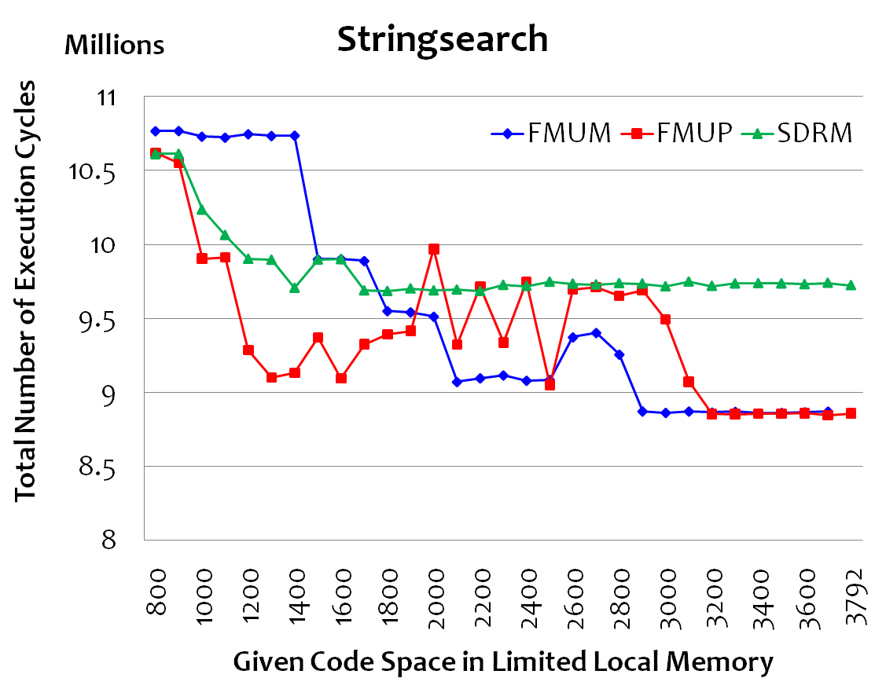
Typical Performance Result
FMUM performs better
FMUP performs better
Notes:
Why FMUP(FMUM) is beeter

Slide 16
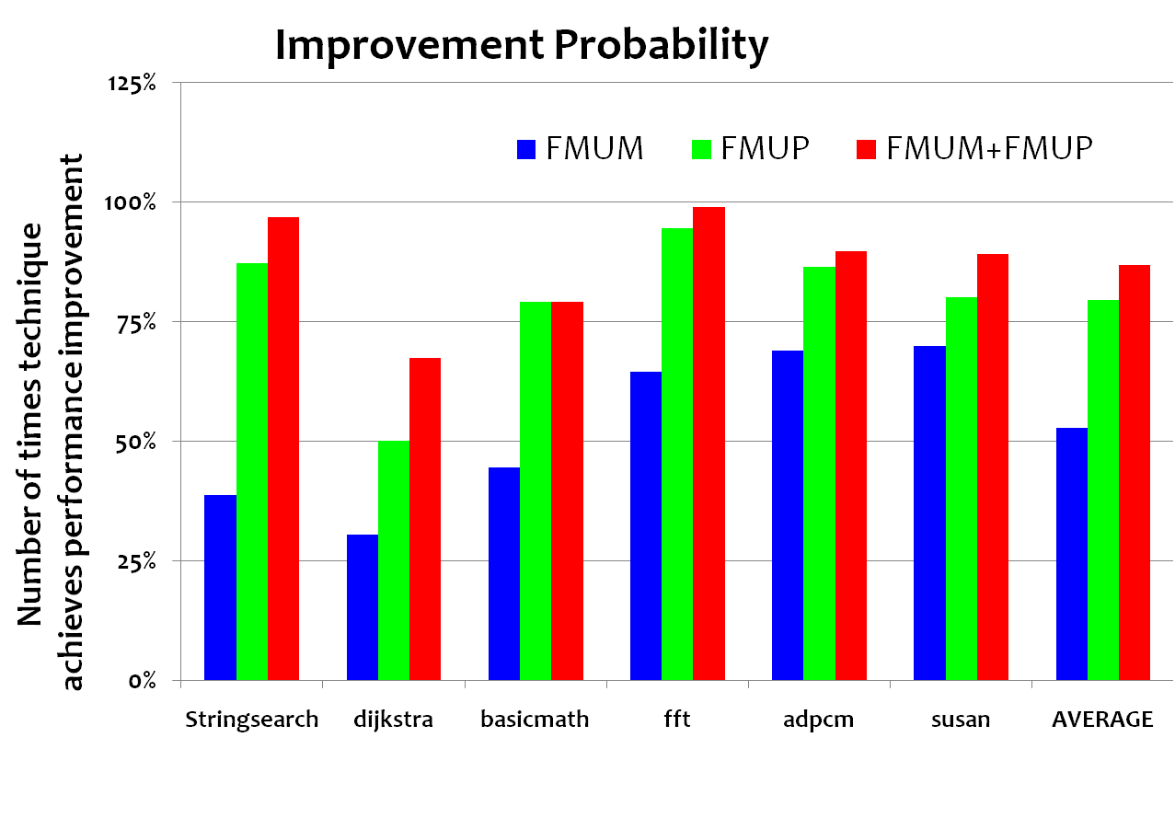
Number of Times of Improvement
Pick the better of FMUM and FMUP
82% of time, FMUM + FMUP gives better result
Notes:
Percentage of number of points which gives better result than SDRM (explain with previous slide)
Explain bars/setup more clearly

Slide 17
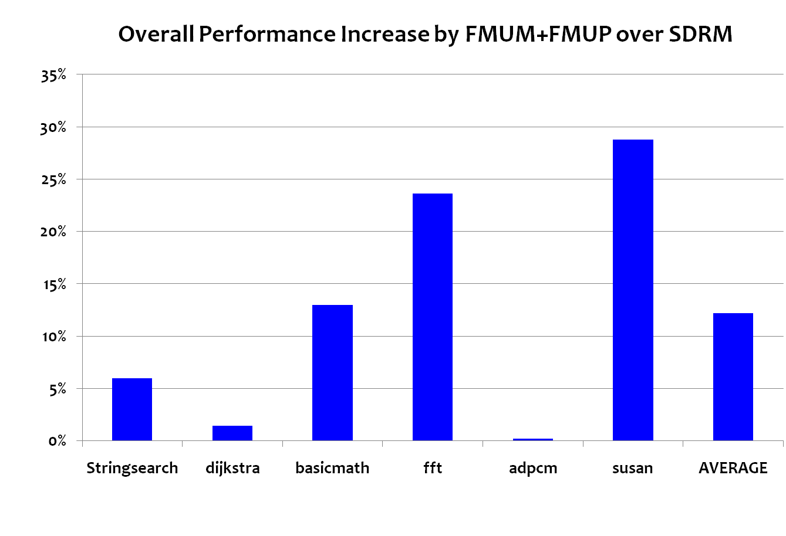
Average 12% reduction in runtime
FMUM + FMUP gives better Perf. by 12%

Slide 18
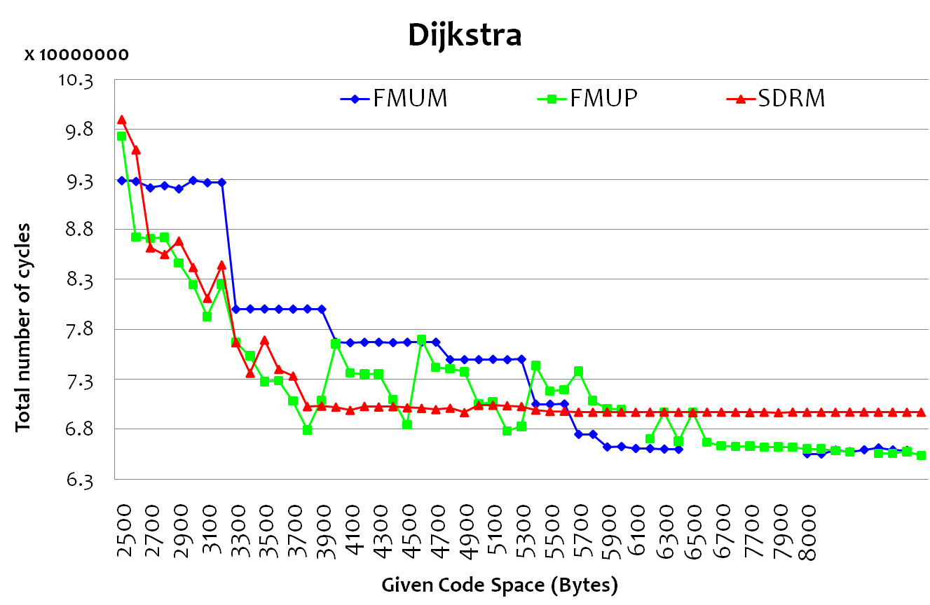
Utilizing Given Code Space
Given code space is fully utilized
Notes:
Give introduction of 3 limitations

Slide 19
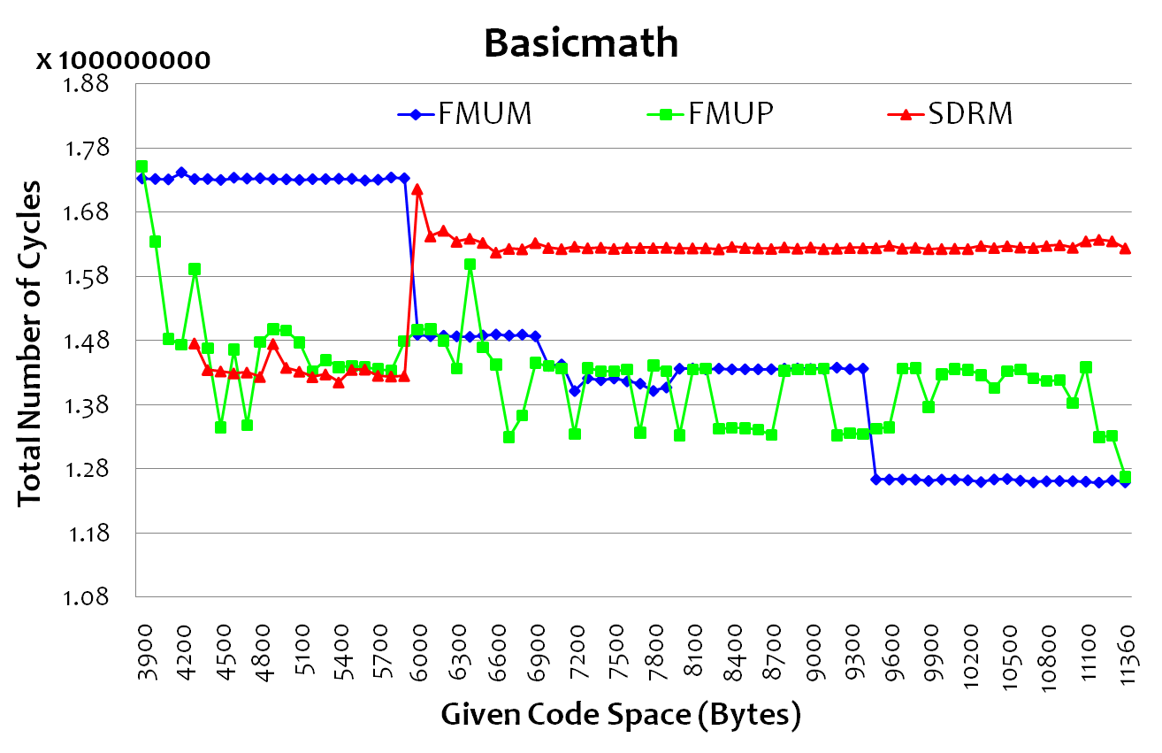
Efficient in-Loop-Functions Mapping
In-loop-functions are mapped separatly

Slide 20
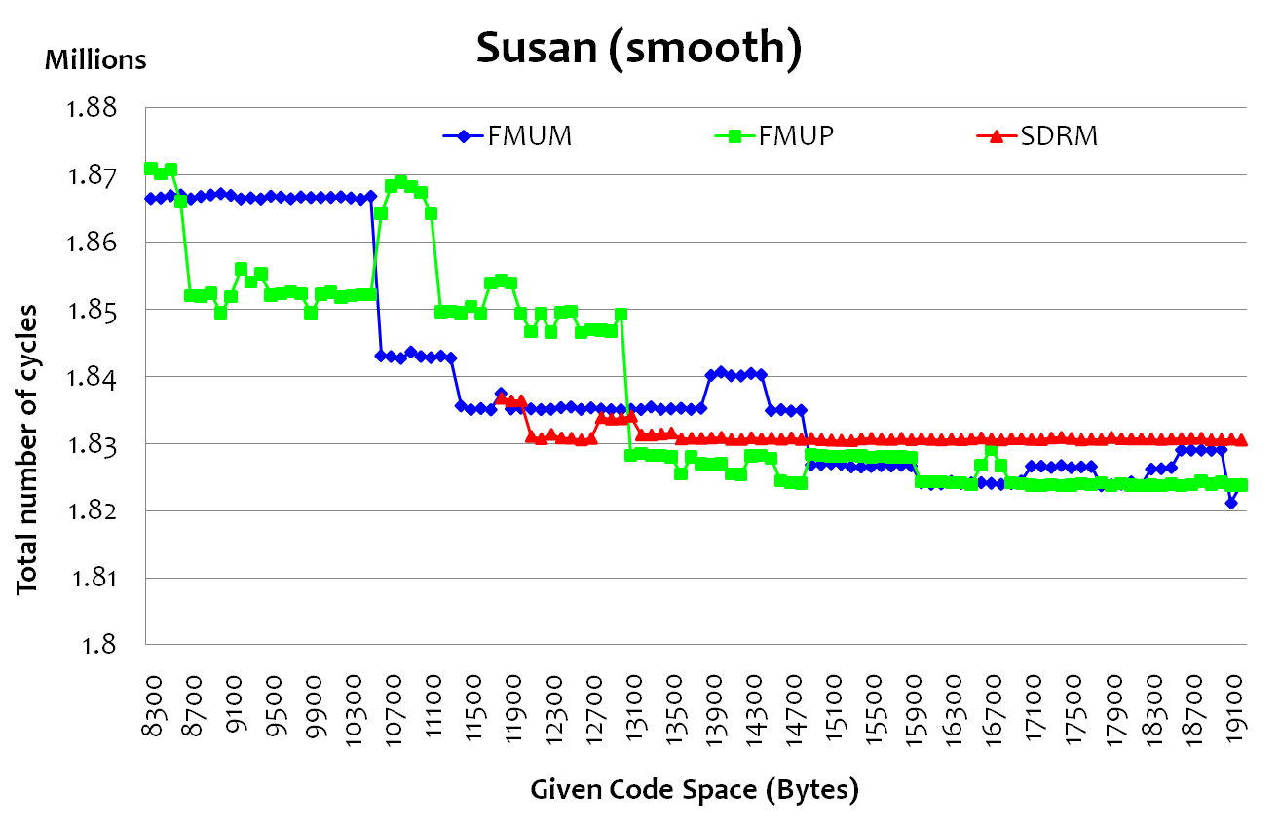
Increase Map-ability
100% mappability Guaranteed

Slide 21
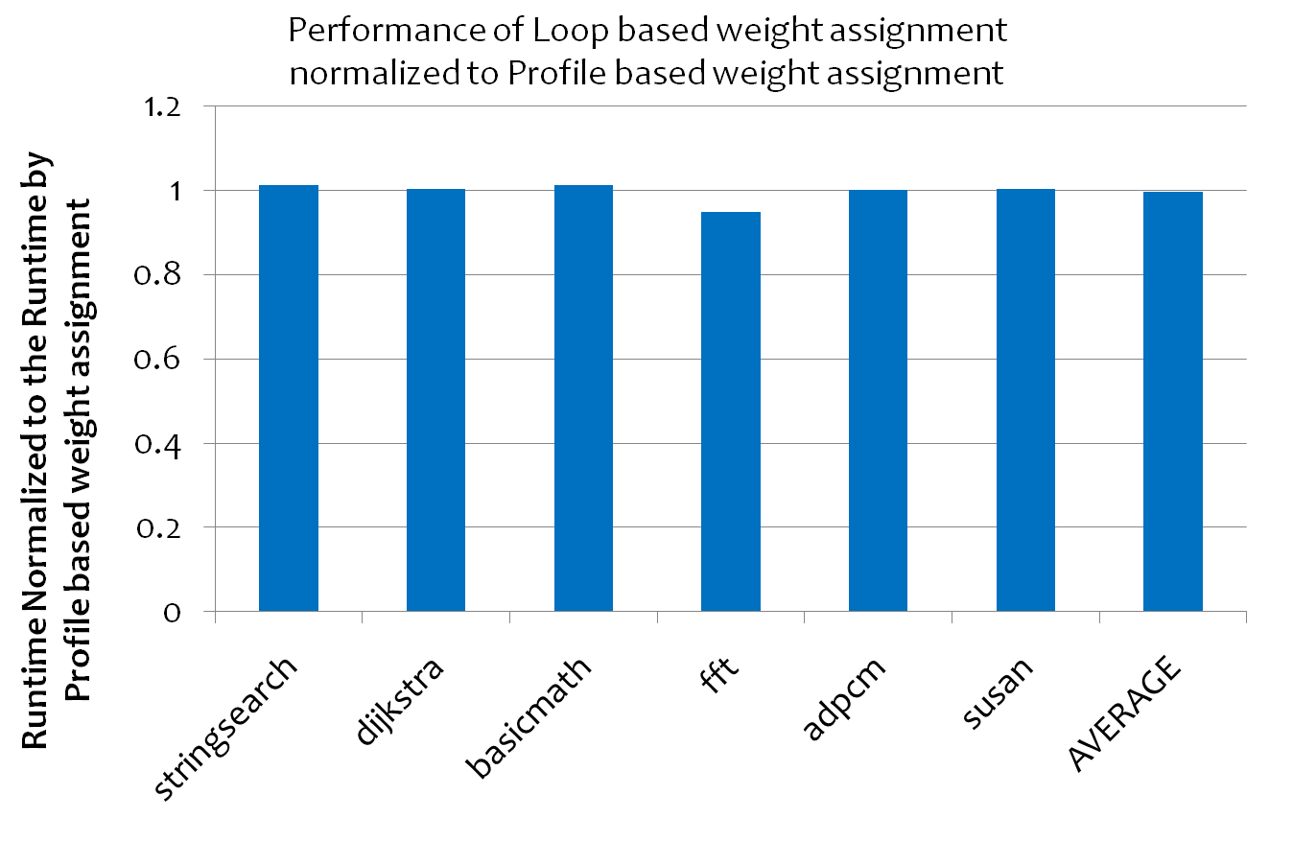
Impact of Different GCCFG Weight Assignment
Can Reduce compile time overhead
1.04
0.96

Slide 22
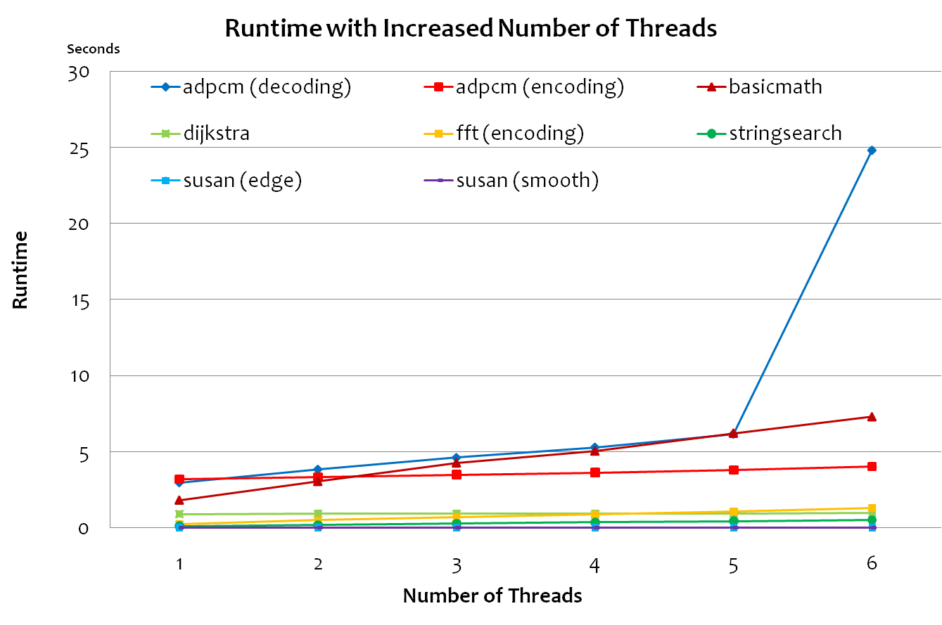
Performance w/ Increased SPU Threads
Scalability with increased number of cores
Notes:
Adpcm uses bigger input data
EIB is overloaded
Explain about abnormality
2 SPU are reserved for PS3 itself

Slide 23
Conclusion
Trend of Computer Architecture
  Multicore with Limited Local Memory System
Memory Management is required
  Code, Variable, Heap and Stack
  Better performance with limited resource
Limitations of previous works
  Call Graph and fixed Interference Cost
Two new heuristics (FMUM, FMUP)
  Overall Performance Increase by 12%
  Tolerable Compile Time Overhead

Slide 24
Contributions and Outcomes
Contributions
  Problem formulation using GCCFG
  Updating interference cost between functions
Outcomes
  Software release (www.public.asu.edu/~sjung)
  Paper submission to ASAP2010
Plans
  Journal submission prepared

