Slide 1
Temperature and Process Variations aware
Power Gating of Functional Units
Deepa Kannan, Aviral Shrivastava,
Sarvesh Bhardwaj, and Sarma Vrudhula
Compiler and Microarchitecture Labs
Department of Computer Science and Engineering
Arizona State University, Tempe, AZ, USA - 85281
http://www.public.asu.edu/~ashriva6/cml

Slide 2
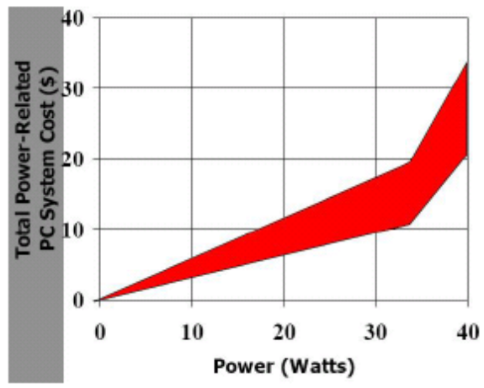
Need to Reduce Power
High Performance Processors
  Limits Performance
  Packaging Cost
Embedded Processors
  Impacts charging frequency, charging time, volume, shape, weight and cost
Device | Battery life | Charge time | Battery weight/ Device weight
Apple iPOD | 2-3 hrs | 4 hrs | 3.2/4.8 oz
Panasonic DVD-LX9 | 1.5-2.5 hrs | 2 hrs | 0.72/2.6 pounds
Nokia N80 | 20 mins | 1-2 hrs | 1.6/4.73 oz
http://www.public.asu.edu/~ashriva6/cml

Slide 3
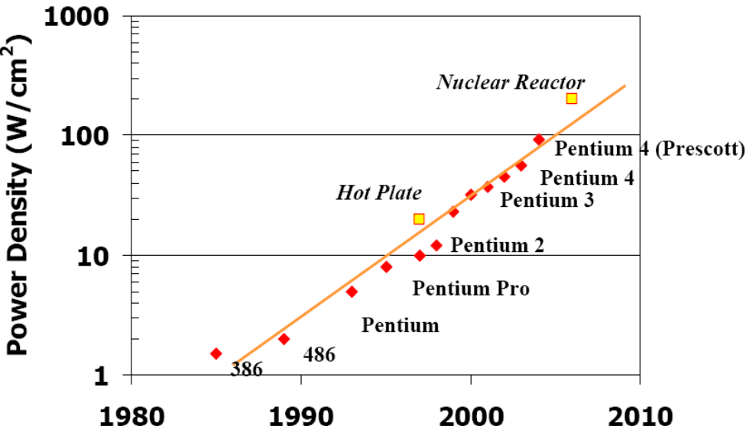
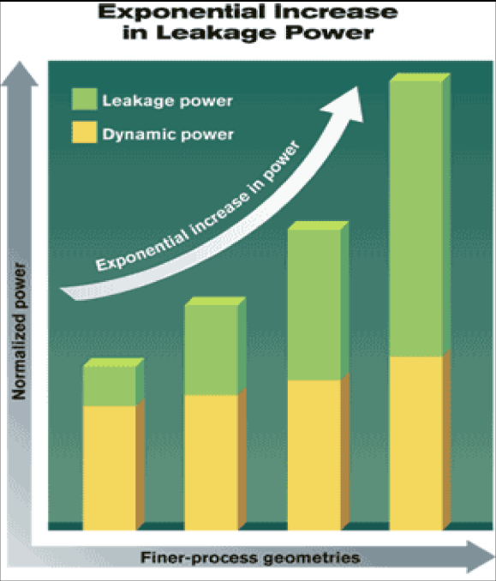
Increasing Power Density
Linear Technology scaling
  Per Transistor
    Dynamic Power decreases linearly
    Leakage Power increases exponentially
  Number of Transistors increase squarely
Exponential increase in power density
Increase in Leakage power
http://www.public.asu.edu/~ashriva6/cml
Notes:
Driven by the ever increasing performance demands, there has been continuous technology scaling over the past few years.
The most significant impact of technology scaling has been an exponential increase in power densities.
Higher power densities result in increasing leakage power and operating temperatures thereby limiting the amount to which the transistor dimensions can be scaled down for performance improvement.

Slide 4
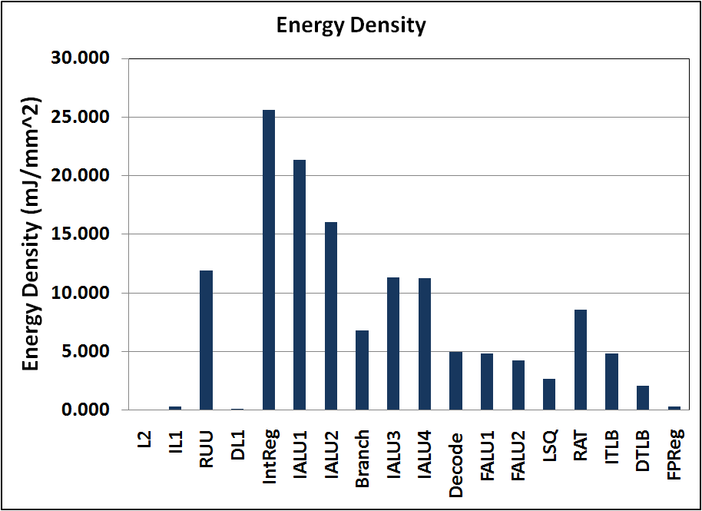


Power Distribution In High-Perf Processors
Functional Units (e.g., ALUs)
  Regions of high energy density
  Regions of high variation in energy consumption
4 out of top 5 hottest
micro-architetcural blocks are FUs
Total Power (Dynamic + Leakage) of microarchitectural blocks in the ALPHA DEC 21364 processor scaled to 45nm
http://www.public.asu.edu/~ashriva6/cml
Notes:
Why bother about reducing power in Functional units of a processor?
There are 2 main reasons for considering FU power reduction.
The primary reason being their high energy density. FUs being regions of very high activity, dissipate significant mount of power, thereby resulting in very high energy densities.
Secondly, FUs are found to be regions of high variation in energy consumption.
The two figures here plot the energy density and std. dev. in energy consumption respectively of all the functional blocks in the ALPHA DEC 21364 processor. It can be observed that ALUs have the second highest energy densities only next to the Integer Register File. ALUs also have the highest values for std. deviation in energy consumption.
Hence, reducing both the total power and the variation in the power consumption of FUs is an important problem

Slide 5
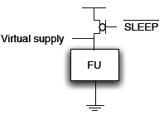
Power Gating
Switch the power OFF to the FU when not needed
Achieved by using a suitably sized header or footer transistor
Popular technique to reduce FU power
Issues in Power Gating
  How to Power Gate?
  When to Power Gate?
  What to Power Gate?
http://www.public.asu.edu/~ashriva6/cml
Notes:
Among the various techniques that exist to reduce the leakage of FUs, power gating is one of the most promising approaches.
Power gating is a technique to reduce leakage by shutting off the power supply to a unit during long periods of inactivity. It is achieved by using a suitable sized header or a footer transistor to which a sleep signal is issued thereby turning off the power supply.
Power gating being the most effective FU leakage reduction technique, there has been significant research on developing several efficient methods to implement power gating.

Slide 6
Related Work on “How to Power Gate?”
Several Issues: Main - Sleep Transistor Sizing
    Large sleep transistor results in increased Dynamic Power
    Small sleep transistor results in slow switching
    Plus power supply noise effects etc.
    Chandrakasan et al., DAC 1997
    Ramalingam et al., DAC 2005
    Gu et al., ISLPED 2007
    Chiou et al., DAC 2007
http://www.public.asu.edu/~ashriva6/cml

Slide 7
Related Work on “When to Power Gate?”
For Spec2K, in a 4-issue superscalar processor, FUs are idle for 60% of the time [Hu et al., ISLPED 2004]
How to find the idle time
  Compiler based solutions
    Entire code examined offline to identify suitable idle regions [Rele et. al, CC, 2002]
  Microarchitecture based solutions
    Idle-Time based Power Gating - FU activity is monitored and power supply to the FU is gated off after detecting no activity for t_{idle} cycles [Hu et. al, ISLPED, 2004]
Microarchitectural solutions are preferred
  Work for pre-compiled binaries
  May have power performance overheads due to the additional control circuitry
http://www.public.asu.edu/~ashriva6/cml

Slide 8

Limitations of Previous Approaches
Do not consider the Impact of Process Variations
  ALUs have different power characteristics
  Systematic correlated variations
Do not consider the Impact of Temperature Variations
  ALUs do not dissipate the same power at all times
  Leakage increases exponentially with temperature
Therefore no related work on “Which FU to Power Gate?”
This Work
Microarchitectural Techniques for Power Gating considering Process and Temperature Variations
http://www.public.asu.edu/~ashriva6/cml

Slide 9
Our Approach: IPC-based LA-OFBM
Instructions Per Cycle based Leakage Aware OFBM
  How many FUs to power gate?
    Determined based on the current IPC (Instructions Per Cycle)
    Example: 4 issue processor
      If current IPC = 2.8 instructions per cycle
      Then power-on 3 ALUS, or power gate 1 ALU
    Note: Slightly different IPC definition
      Traditional IPC : Average number of instructions issued per cycle
      Our IPC: Average number of instructions that were ready to be issued per cycle
  Which FUs to power gate?
    Determined using the leakage sensor readings
    Power gate the FU that will leak the most
2 parameters for IPC-based LA-OFBM
  1st Parameter: History
    Current IPC = average IPC of the last “history” cycles
  2nd Parameter: IPC thresholds
    For a 4 issue processor, IPC thresholds are IPC2, IPC3, and IPC4
    If (IPC2 < currentIPC < IPC3), then keep 3 ALUs on.
http://www.public.asu.edu/~ashriva6/cml
Notes:
In order to account for the variations in leakage during runtime, our idea is to introduce leakage sensors inside FUs and use the leakage sensor readings to power gate the FUs.
Our power gating mechanism called IPC threshold-based leakage aware power gating or LA-PG operates in 2 steps.
The first step is to find out how many FUs to power gate. This is determined using the current IPC information. It is to be noted that IPC here stands for the number of instructions ready to be issued per cycle, as opposed to the conventional IPC which stands for the number of instructions that are issued per cycle.
The second step is to decide on which FUs to power gate. This is determined using the leakage values of the FUs obtained from the sensor readings.

Slide 10
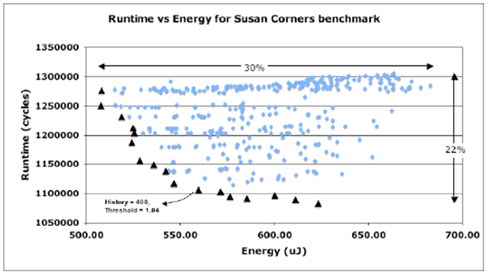
Parameterization
Find out optimal values of parameters by Design Space Exploration
  IPC1, IPC2, IPC3 and history
Energy and runtime for all combinations of parameters for susan corners
History = 400 cycles
IPC Thresholds = 1.04, 2.04, 3.04
http://www.public.asu.edu/~ashriva6/cml

Slide 11
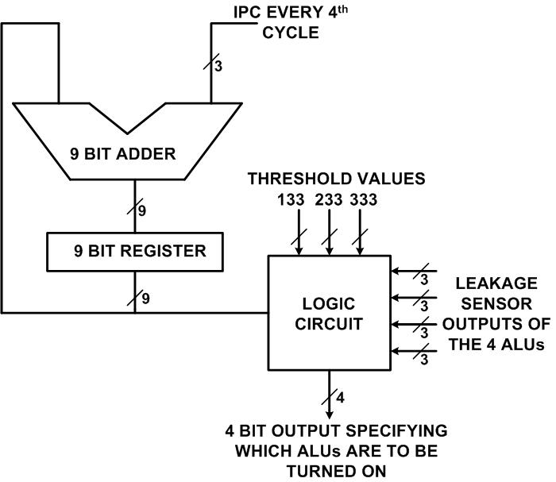
Optimizing the Supporting Hardware
Comparison with threshold values to determine the no. of FUs to power gate
To compute the history
Comparison with leakage sensor readings to determine which FUs to power gate
Sample IPC every 4th cycle, take 128 samples
  128 samples span 4*128 = 512 cycles
  Reduces the datapath width by 2 bits
  Need to perform the addition in 4 cycles
    Can use ripple carry adder for low-power
Perform this computation and comparison every 10,000 cycles
  Temperature changes are slow
  Further reduces power overhead
http://www.public.asu.edu/~ashriva6/cml

Slide 12
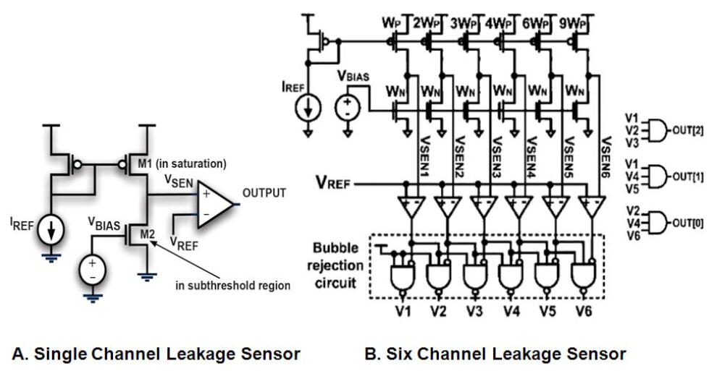
Enabler – Leakage Sensors
Extremely small, but accurate on-die leakage sensors
  [Kim et al., IEEE VLSI 2006]
    Smaller and simpler than temperature sensors
    Are themselves immune to process variations
    Can be sprinkled everywhere on the die
http://www.public.asu.edu/~ashriva6/cml

Slide 13
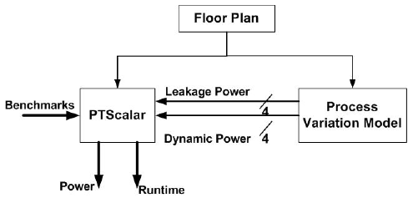
Experimental Setup
Processor Power and Performance Simulation Framework
Process Variation Model : Generates dynamic and base leakage power at 30ºC of the ALUs for 1000 sample dies. Models random and systematic geographically correlated variations
PTScalar: Simplescalar based power-performance-temperature simulator
Benchmarks : From MiBench and Spec2000 suite
http://www.public.asu.edu/~ashriva6/cml
Notes:
The figure here shows the power performance simulation framework that we develop to demonstrate the efficiency of our power gating scheme.
We perform experiments on the floorplan of ALPHA DEC 21364 processor. The power, performance and temperature modeling of alpha processor is done using a modified version of sim-outorder of the PTScalar toolset. The process variation model generates the dynamic power and leakage power values of the 4 ALUs in the processor for 1000 die samples based on the Karhunen Loeve Expansion model for process variations. The floorplan of the processor, leakage and dynamic powers of the ALUs are given as input to PTscalar, which then simulates the benchmark from Mibench and Spec 2000 suite to estimate the power, performance and temperature of all the units.

Slide 14
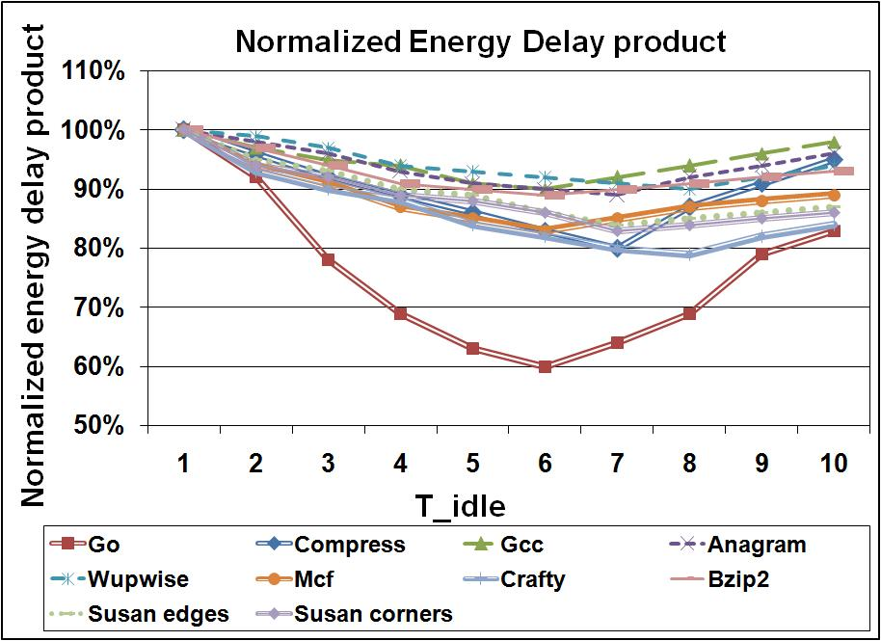
Previous Approach
Idle Time-based Power Gating (IT-PG)
Normalized energy delay product of all our benchmarks for varying values of t_{idle}
Optimal value of t_{idle} = 7 cycles
  Consistent with previous results – Hu et. al
Use this for comparison
http://www.public.asu.edu/~ashriva6/cml
Notes:
As a first step, we implemented and explored one of the popular power gating techniques, the Idle Time-based power gating proposed by Hu et. al.
In this technique, the idle detect time tidle is the key parameter. Activity of FUs is monitored and if an FU is idle for more than tidle number of cycles, power supply to it is gated off.
The control circuit for power gating each of the FUs is local and is independent of the other FUs. Once in power gated state, the FU will be woken up when an operation is issued to it. Tidle can be changed to tradeoff performance for leakage savings.
The second figure plots the normalized energy delay product of all our benchmarks for varying values of tidle. The average of the energy delay product is the least for tidle = 7 cycles, which is consistent with the previous work.
We use this IT-PG to compare the performance of our proposed power gating scheme.

Slide 15
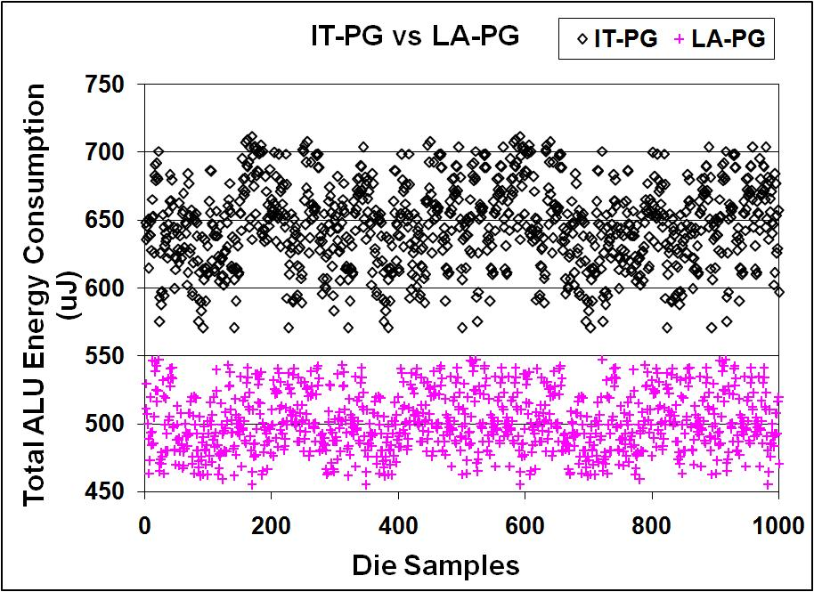
IT-PG vs. LA-PG
ALU energy consumption for IT-PG and LA-PG in 1000 die samples for susan-corners
LA-PG power numbers includes
  power overhead of the extra hardware
  Inaccuracy of leakage sensors
http://www.public.asu.edu/~ashriva6/cml
Notes:
The figure here plots the ALU energy consumption for IT-PG and LA-PG in 1000 die samples for the representative susan corners benchmark from the Mibench suite. There are two main observations that can be made from this plot.
The first is that all the La-PG points lie lower than the IT-PG points signifying that the mean of the ALU energy consumption in the case of LA-PG is reduced as compared to IT-PG.
The second observation is that the width of the vertical band in which the La-PG points is lesser than the width of the IT-PG. This signifies that the LA-PG reduces the std. deviation in ALU energy consumption as compared to IT-PG.
Thus, it can be observed that LA-Pg reduces the mean as well as the variation in the power consumption of FUs.

Slide 16
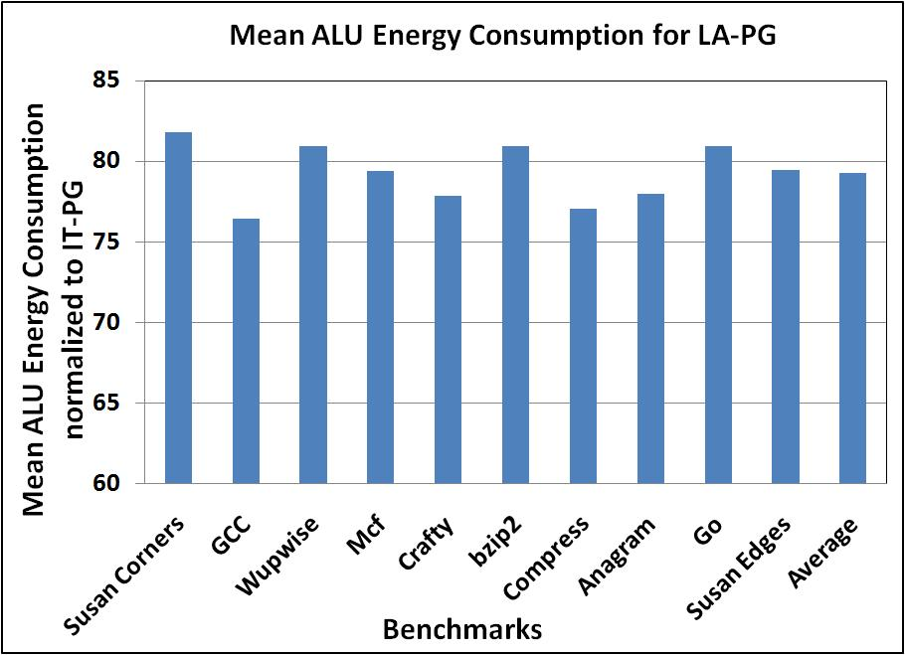

LA-PG reduces ALU energy consumption
Mean of the ALU energy consumption for LA-PG computed over 1000 sample dies and normalized to IT-PG for each benchmark
LA-PG reduces the average energy consumption by 22% as compared to IT-PG
http://www.public.asu.edu/~ashriva6/cml
Notes:
The figure here plots the mean ALU energy consumption for LA-PG computed over 1000 die samples and normalized to IT-PG for all our benchmarks. It can be observed that the reduction in the average energy consumption by LA-PG is consistent over all our benchmarks. LA-PG reduces the mean of the ALU energy consumption by 22% as compared to IT-PG.

Slide 17
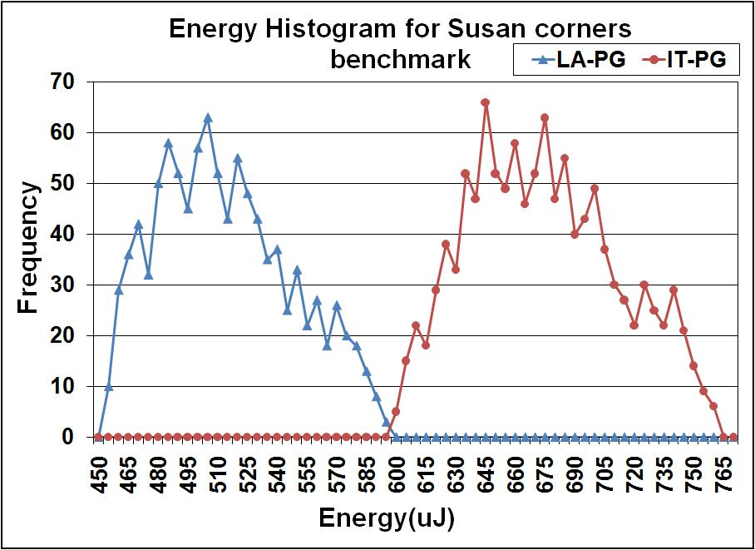

LA-PG mitigates Temperature and Process Variations
Energy histogram for LA-PG and IT-PG for 1000 die samples for susan-corners benchmark
LA-PG reduces the std. deviation in ALU energy consumption by 25% as compared to IT-PG
Reducing variation in power improves parametric yield
http://www.public.asu.edu/~ashriva6/cml
Notes:
This figure here is another view of comparison between LA-PG and IT-PG. The figure plots the energy histogram for LA-PG and IT-PG for 1000 die samples for susan corners benchmark. The rightmost curve corresponds to the energy distribution for IT-PG. For processors that will incorporate leakage energy sensors, LA-PG technique is very
effective. As compared to ITPG, LA-PG reduces the energy consumption by 22% and reduces the standard deviation by 25%.

Slide 18
Summary
Technology scaling resulting in
  Higher Power Consumption
  Higher Variation in Power Consumption
FUs, e.g. ALU are regions of high power density
Power Gating is effective approach for FU power reduction
But, existing Power Gating Techniques do not consider the impact of process and temperature variations while Power Gating
Our Approach LA-PG
  How many FUs to power gate? - IPC threshold
  Which FUs to power gate? – Leakage sensor based
LA-PG is both temperature and process variations aware
LA-PG reduces the mean and std. dev. of ALU energy consumption by 22% and 25% respectively
http://www.public.asu.edu/~ashriva6/cml

Slide 19
THANK YOU!
Questions, Comments: Aviral.Shrivastava@asu.edu
http://www.public.asu.edu/~ashriva6/cml

Slide 20
BACKUP SLIDES
http://www.public.asu.edu/~ashriva6/cml

Slide 21
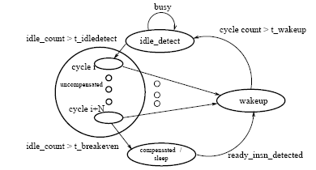
Idle Time-based Power Gating (IT-PG)
Optimal value of t_{idle} = 7 cycles (consistent with previous work – Hu et. al)
Idle Time-based PG mechanism
Normalized energy delay product of all our benchmarks for varying values of t_{idle}
http://www.public.asu.edu/~ashriva6/cml
Notes:
As a first step, we implemented and explored one of the popular power gating techniques, the Idle Time-based power gating proposed by Hu et. al.
In this technique, the idle detect time tidle is the key parameter. Activity of FUs is monitored and if an FU is idle for more than tidle number of cycles, power supply to it is gated off.
The control circuit for power gating each of the FUs is local and is independent of the other FUs. Once in power gated state, the FU will be woken up when an operation is issued to it. Tidle can be changed to tradeoff performance for leakage savings.
The second figure plots the normalized energy delay product of all our benchmarks for varying values of tidle. The average of the energy delay product is the least for tidle = 7 cycles, which is consistent with the previous work.
We use this IT-PG to compare the performance of our proposed power gating scheme.

Slide 22
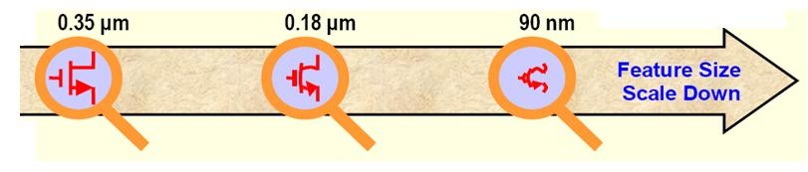
Process Variations
Process parameter variations are random in nature
Expected to be more pronounced in smaller geometry transistors
Two main sources of variation:
  Variation in effective channel length
  Variation in threshold voltage
http://www.public.asu.edu/~ashriva6/cml
Notes:
One of the most important consequences of technology scaling is the loss of control in lithography and fabrication processes resulting in increased variations in the characteristics of manufactured devices. These variations called process variations are random in nature and are expected to be more pronounced in the transistors of smaller dimensions.
There are two main sources of variation in device parameters. Variation in the effective channel length of transistors and variation in the device threshold voltage. Variation in these two parameters have a significant impact on the leakage of the transistors.

Slide 23
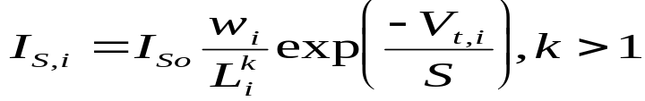
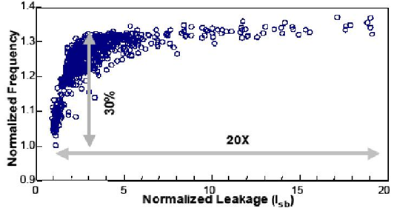
Impact of Process Variations on Leakage of FUs
Subthreshold leakage is given by,
where L_{i} is the gate length of gate i
Leakage is inversely proportional to gate length
Leakage is exponentially proportional to threshold voltage
0.18 um CMOS process
20X variation in leakage due to variation in process parameters
Source: S. Borkar et. al, DAC 2003
http://www.public.asu.edu/~ashriva6/cml
Notes:
Subthreshold leakage is given by the following equation.
It can be observed that leakage is inversely proportional to gatelength and exponentially proportional to threshold voltage.
The impact of these process variations was illustrated by Borkar et al, wherein the authors demonstrated a 20X variation in leakage for a 1.3X performance variations for Intel processors fabricated in a 0.18 micron process.
Hence, the effect of process variations cannot be neglected while considering maximum savings in leakage using power gating techniques.

Slide 24
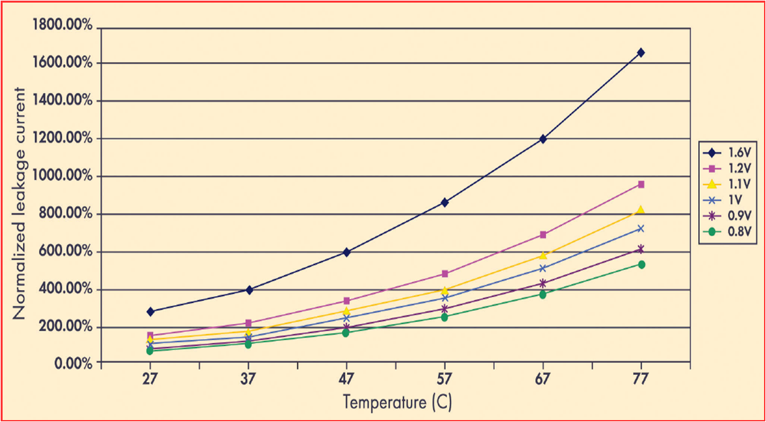
Impact of Temperature Variations on Leakage of FUs
Leakage varies super-linearly with temperature mostly due to subthreshold leakage
65 nm
Low Vt
http://www.public.asu.edu/~ashriva6/cml
Notes:
Another important consequence of technology scaling is the increasing power densities and operating temperatures.
Leakage in CMOS gates, mostly subthreshold leakage varies super-linearly with temperature.
Santarini et. al, showed that a 10ºC rise in temperature from 35ºC will result in leakage currents going up by 126%. Combined with the fact that the operating temperatures of Intel Pentium 4 Processor soar to more than 75ºC, signifies the strong dependence of leakage on temperature in processors fabricated in nano-scale technologies.
FUs being regions of very high activity, dissipate high dynamic power thereby increasing their temperature. In turn, due to the super linear dependence of leakage on temperature, leakage of FUs increases significantly.
Hence, variations in leakage due to variations in temperature need to be taken into account.

Slide 25
Drawbacks of existing FU PG techniques
Compiler based solutions – require that the entire code be examined off-line to identify suitable idle regions
Hardware based solutions – consume additional power for identifying idle regions
Static compile time techniques – Variations in leakage due to temperature and process variations are ignored
Need: A dynamic, temperature and process variations aware PG scheme to obtain maximum leakage savings
http://www.public.asu.edu/~ashriva6/cml
Notes:
Existing techniques for power gating include compiler based solutions and hardware based solutions.
Compiler based solutions require that the entire code to be examined off-line in order to identify the idle regions suitable for applying power gating.
While hardware based solutions require the use of additional circuitry to identify the idle regions and result in additional power consumption.
Overall, the existing static compile time techniques for power gating do not consider the variations in leakage due to temperature and process variations.
The need of the hour is a runtime, temperature and process variation aware power gating scheme in order to achieve maximum possible savings in leakage and maximum possible reduction in the variation in leakage.

Slide 26
IPC Threshold – based LA-PG
Computation of average IPC
How many FUs to power gate?
Comparison of average IPC with thresholds to determine the no. of FUs to power gate
Determination of the FUs to power gate using leakage value of FUs from the sensor readings
Which FUs to power gate?
http://www.public.asu.edu/~ashriva6/cml
Notes:
The following is a brief description of our IPC threshold-based LA-PG.
At each decision moment, we compute the average IPC or the average of the number of instructions ready to be issued every cycle. The number of FUs to power gate is then determined by comparing the computed average IPC with a threshold. For an n-FU config, there are n-1 thresholds. For instance, for a 4-aLU configuration, there will be three thresholds to power gate the ALUs. Suppose the thresholds are 1.1, 2.1 and 3.1, then we will power gate 2 ALUs if the average IPC is more than 1.1, and power gate 1 ALU if the average IPC is more than 2.1, and so on.
In order to reduce the leakage, we want to power gate the FUs which have the highest leakage. We introduce a leakage sensor inside each FU and continuously measure the FU leakage during the chip operation. An FU may have high leakage either because of process variations, or because it’s temperature is high. And then FUs are power gated in the order of their leakage values. An FU with the highest leakage is power gated first, followed by the one with the next highest leakage and so on. Thus LA-PG is both temperature and process
variation aware. Power gating the FU with the highest leakage, minimizes the FU power consumption; in addition it also reduces the variation in the leakages of FUs.

Slide 27
Our Architecture Model
Comparison with threshold values to determine the no. of FUs to power gate
To compute the history
Comparison with leakage sensor readings to determine which FUs to power gate
Logic circuit does not appear in the critical path of execution – hence no performance penalty
http://www.public.asu.edu/~ashriva6/cml
Notes:
The microarchitectural enhancements to implement our power gating scheme includes a 9-bit low power ripple carry adder and a 9-bit register to compute the average IPC and a small combinational logic circuit to compare the average IPC with the thresholds to determine the no. of FUs to power gate and to compare the leakage sensor readings to determine which FUs to power gate.
We synthesized this logic using Synopsys Design Compiler and compared the area and energy overhead with that of the logic synthesized for IT-PG. Since this logic does not become a
part of timing critical path in the processor, it does not cause an increase in the cycle time.

