Slide 1
OPERATION AND DATA MAPPING FOR CGRA’S WITH MULTI-BANK MEMORY
Yongjoo Kim, Jongeun Lee*,
Aviral Shrivastava** and Yunheung Paek
Software Optimization And Restructuring
Department of Electrical Engineering
Seoul National University, Seoul, Korea
* High Performance Computing Lab
UNIST (Ulsan National Institute of Sci & Tech)
Ulsan, Korea
**Compiler and Microarchitecture Lab
Center for Embedded Systems
Arizona State University, Tempe, AZ, USA.
LCTES 2010, Stockholm Sweden

Slide 2
Coarse-Grained Reconfigurable
Array (CGRA)
High computation throughput
High power efficiency
High flexibility with fast reconfiguration
Category | Processor | MIPS | mW | MIPS/mW
VLIW | Itanium2 | 8000 | 130 | 0.061
GPP | Athlon 64 Fx | 12000 | 125 | 0.096
GPMP | Intel core 2 duo | 45090 | 130 | 0.347
Embedded | Xscale | 1.250 | 1.6 | 0.78
DSP | TI TM320C6455 | 9.57 | 3.3 | 2.9
MP | Cell PPEs | 204000 | 40 | 5.1
DSP(VLIW) | TI TM320C614T | 4.711 | 0.67 | 7
* CGRA shows 10~100MIPS/mW
SO&R and CML Research Group

Slide 3
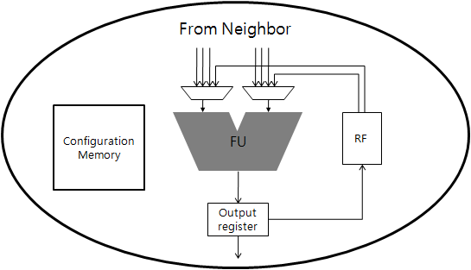
Coarse-Grained Reconfigurable
Array (CGRA)
Configuration Memory
PE Array
Local Memory
Array of PE
Mesh-like interconnection network
Operate on the result of their neighbor PE
Execute computation intensive kernel
SO&R and CML Research Group

Slide 4
Execution Model
CGRA as a coprocessor
  Offload the burden of the main processor
  Accelerate compute-intensive kernels
Main
Processor
CGRA
Main memory
DMA controller
SO&R and CML Research Group

Slide 5
Memory Issues
Feeding a large number of PEs is very difficult
  Irregular memory accesses
  Miss penalty is very high
  Without cache, compiler has full responsibility
Multi-bank memory
  Large local memory helps
  High throughput
PE Array
Local Memory
load
S[i]
R
Bank1
Memory access freedom is limited
  Dependence handling
  Reuse opportunity
load
D[i]
+
-
Bank2
store
R[i]
*
Bank3
Bank4
SO&R and CML Research Group
Notes:
Large local memory helps
May contain entire arrays
Enable inter-loop data reuse
Multi-bank is the only way to implement large memory efficiently

Slide 6
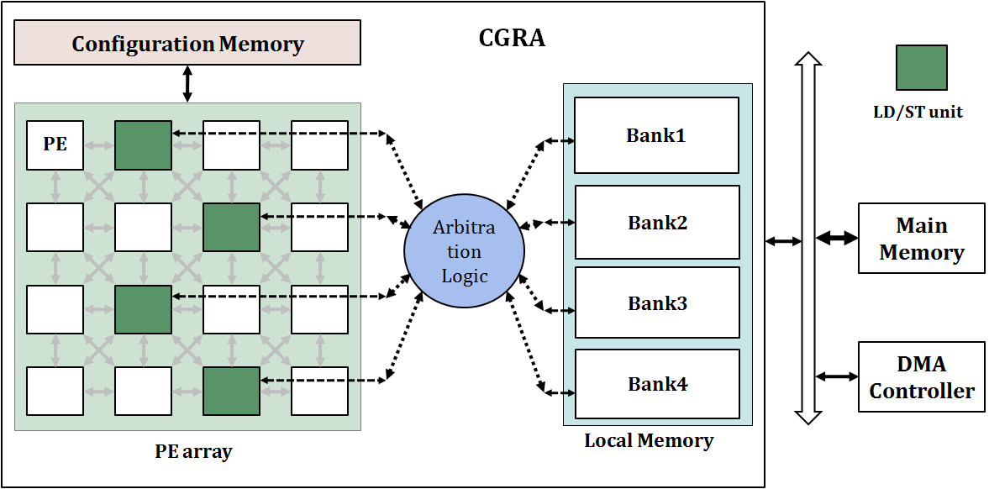

MBA (Multi-Bank with Arbitration)
SO&R and CML Research Group
Notes:
This is scalable, flexible. The only problem is sometimes Bank Conflict can happen, which causes one cycle stall.

Slide 7
Contributions
Previous work
  Hardware solution: Use load-store queue
  More hardware, same compiler
Our solution
  Compiler technique: Use conflict-free scheduling
 | MBA | MBAQ
Memory Unaware Scheduling | Baseline | Previous work [Bougard08]
Memory Aware Scheduling | Proposed | Evaluated
SO&R and CML Research Group

Slide 8
How to Place Arrays
4-element array on
3-bank memory
Bank1
Bank2
<Sequential>
< Interleaving>
Bank3
Sequential
  Easy-to-analyze behavior
  Unbalanced use of banks
Interleaving
  Balanced use of all banks
  Spread out bank conflicts
  More difficult to analyze access behavior
SO&R and CML Research Group

Slide 9

Hardware Approach (MBAQ + Interleaving)
DMQ of depth K can tolerate up to K instantaneous conflicts
DMQ cannot help if average conflict rate > 1
Interleaving makes bank conflicts spread out
NOTE: Load latency is increased
by K-1 cycles
How to improve this using compiler approach?
SO&R and CML Research Group

Slide 10
Operation & Data Mapping: Phase-Coupling
CGRA mapping = operation mapping + data mapping
A[i]
B[i]
0
1
Bank1
A, B
Bank2
C
2
3
C[i]
4
< Data mapping result >
 | PE0 | PE1 | PE2 | PE3
0
1
2
0
1
Conflict !
PE1
PE0
Bank1
Arb. Logic
3
2
PE2
PE3
Bank2
4
< Operation mapping result >
SO&R and CML Research Group

Slide 11
Our Approach
Main challenge
  Solving inter-dependent problems between operation and data mapping
  Solving simultaneously is extremely hard → solve them sequentially
Application mapping flow
  Pre-mapping
  Array clustering
  Conflict free scheduling
DFG
Array clustering
Pre-mapping
Array analysis
If array clustering fails
Array clustering
Conflict free scheduling
If scheduling fails
SO&R and CML Research Group

Slide 12
Conflict Free Scheduling
Our array clustering heuristic guarantees the total per-iteration access count to the arrays included in a cluster
Conflict free scheduling
  Treat memory banks, or memory ports to the banks, as resources
  Save the time information that memory operation is mapped on
  Prevent that two memory operations belonging same cluster is mapped on the same cycle
SO&R and CML Research Group

Slide 13
Conflict Free Scheduling Example
Cluster1 | Cluster2
A[i], C[i] | B[i]
PE1
PE0
Bank1
Arb. Logic
PE2
PE3
Bank2
 | PE0 | PE1 | PE2 | PE3 | C1 | C2
0
1
2
3
4
5
6
0
0
x
x
1
2
II=3
1
2
A
A[i]
3
3
4
5
B
x
7
6
4
5
6
B[i]
x
x
8
r
x
7
8
C[i]
x
x
x
r
x
8
x
x
x
SO&R and CML Research Group

Slide 14
Array Clustering
Array mapping affect performance in at least two ways
  Concentrated arrays in a few bank decrease bank utilization
    ➔ Array size
  Each array is accessed a certain number of times per iteration.
    If ∑_{A∈∁}Acc^{L}_{A}>II’_{L}
    there can be no conflict free scheduling
    ( ∁ : array cluster, II’_{L} : the current target II of loop L )
    ➔ Array access count
It is important to spread out both
  Array sizes & array accesses
SO&R and CML Research Group

Slide 15

Array Clustering
Pre-mapping
  Find MII for array clustering
Array analysis
  Priority heuristic for which array to place first
  Priority_{A} = Size_{A}/SzBank + Acc^{L}_{A}/II’_{L}
Cluster assignment
  Cost heuristic for which cluster an array gets assigned to
  Cost(∁, A) = Size_{A}/SzSlack∁+ Acc^{L}_{A}/AccSlack^{L}∁
  Start from the highest priority array
SO&R and CML Research Group

Slide 16
Experimental Setup
Sets of loop kernels from MiBench, multimedia benchmarks
Target architecture
  4x4 heterogeneous CGRA (4 load-store PE)
  4 local memory banks with arbitration logic (MBA)
  DMQ depth is 4
Experiment 1
  Baseline
  Hardware approach
  Compiler approach
Experiment 2
  MAS + MBA
  MAS + MBAQ
 | MBA | MBAQ
Memory Unaware Scheduling | Baseline | Hardware approach
Memory Aware Scheduling | Compiler approach
SO&R and CML Research Group

Slide 17
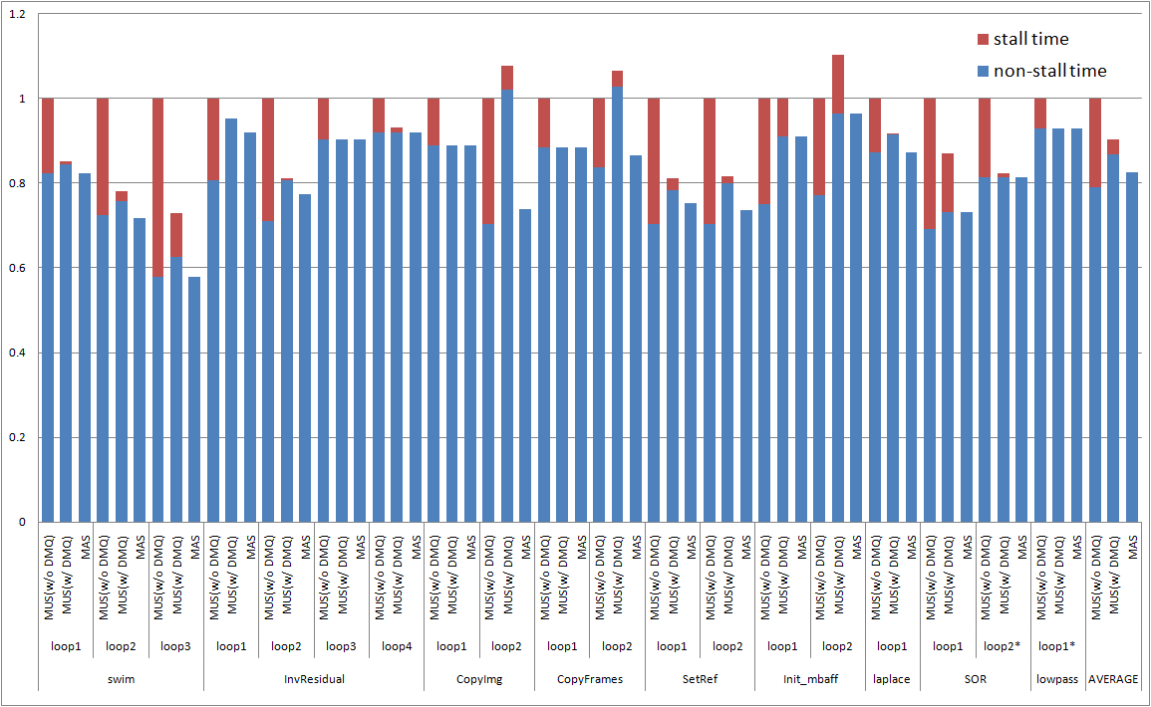
Experiment 1
MAS shows 17.3% runtime reduction
SO&R and CML Research Group
Notes:
Comparing with MUS(w/o DMQ), MUS(w/ DMQ) shows 9.7% runtime reduction.
Comparing with MUS(w/o DMQ), MAS shows 17.3% runtime reduction.
MAS shows 8.5% runtime reduction, even comparing with MUS(w/ DMQ)
MUS uses interleaving memory architecture to reduce stall, MAS uses sequential memory architecture for static analysis.

Slide 18
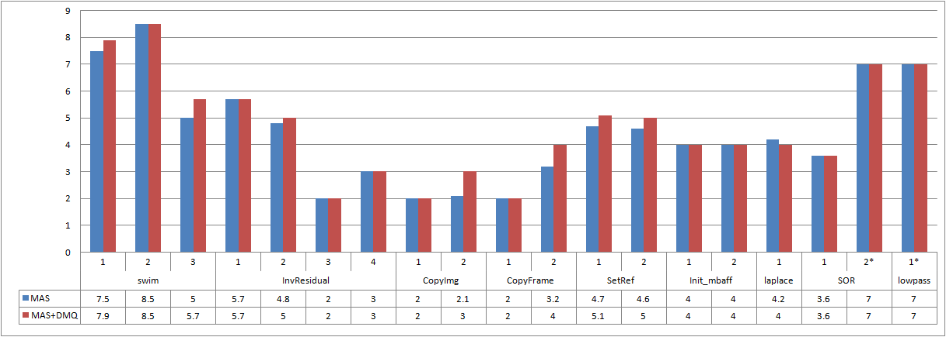
Experiment 2
Stall-free condition
  MBA: At most one access to each bank at every cycle
  MBAQ: At most N accesses to each bank in every N consecutive cycles
DMQ is unnecessary with memory aware mapping
SO&R and CML Research Group

Slide 19
Conclusion
Bank conflict problem in realistic memory architecture
Considering data mapping as well as operation mapping is crucial
Propose compiler approach
  Conflict free scheduling
  Array clustering heuristic
Compared to hardware approach
  Simpler/faster architecture with no DMQ
  Performance improvement: up to 40%, on average 17%
  Compiler heuristic can make DMQ unnecessary
SO&R and CML Research Group

Slide 20
Thank you for your attention!
SO&R and CML Research Group

Slide 21
Appendix
SO&R and CML Research Group

Slide 22
Array Clustering Example
Name | #Acc / iter
A | 1
B | 3
C | 2
D | 3
Name | #Acc / iter
C | 2
D | 2
E | 3
Name | Priority
A | 1/4 + 1/3 = 0.58
B | 1/4 + 3/3 = 1.25
C | 1/4 + 2/3 + 2/5 = 1.32
D | 1/4 + 3/3 + 2/5 = 1.65
E | 1/4 + 3/5 = 0.85
Name | Priority
D | 1.65
C | 1.32
B | 1.25
E | 0.85
A | 0.58
<loop1 arrays>
II’ = 3
<loop2 arrays>
II’ = 5
Cost(B1,D) = 1/4 + 3/3 + 2/5 = 1.65
Cost(B2,D) = 1/4 + 3/3 + 2/5 = 1.65
Cost(B3,D) = 1/4 + 3/3 + 2/5 = 1.65
Resource table
Loop 1 (II’ = 3) | Loop 2 (II’ = 5)
0 | 0
0 | 0
0 | 0
Bank1
D
3
2
Cost(B1,C) = X
Cost(B2,C) = 1/4 + 2/3 + 2/5 = 1.32
Cost(B3,C) = 1/4 + 2/3 + 2/5 = 1.32
2
2
Bank2
C
A
3
Bank3
B
E
3
3
Cost(B1,B) = X
Cost(B2,B) = X
Cost(B3,B) = 1/4 + 3/3 = 1.32
<Bank capacity>
<#Access>
If array clustering failed, increased II and try again.
We call the II that is the result of Array clustering MemMII
MemMII is related with the number of access to each bank for one iteration and a memory access throughput per a cycle.
MII = max(resMII, recMII, MemMII)
Cost(B1,E) = 1/3 + 3/3 = 1.33
Cost(B2,E) = 1/3 + 3/3 = 1.33
Cost(B3,E) = 1/3 + 3/5 = 0.93

Slide 23
Memory Aware Mapping
The goal is to minimize the effective II
  One expected stall per iteration effectively increases II by 1
  The optimal solution should be without any expected stall
    If there is an expected stall in an optimal schedule, one can always find another schedule of the same length with no expected stall
  Stall-free condition
    At most one access to each bank at every cycle (for DMA)
    At most n accesses to each bank in every n consecutive cycles (for DMAQ)
SO&R and CML Research Group

Slide 24
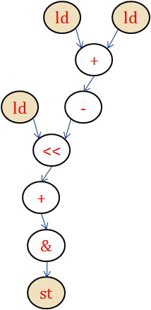
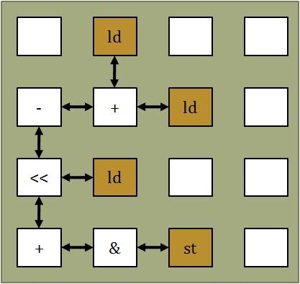
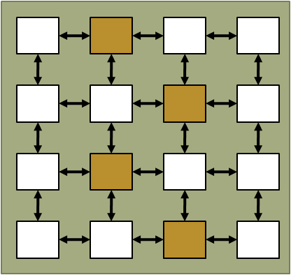
Application mapping in CGRA
Mapping DFG on PE array mapping space
Should satisfy several conditions
  Should map nodes on the PE which have a right functionality
  Data transfer between nodes should be guaranteed
  Resource consumption should be minimized for performance
SO&R and CML Research Group

Slide 25
How to place arrays
Interleaving
  Guarantee a balanced use of all the banks
  Randomize memory accesses to each bank
  ⇒ spread bank conflicts around
Sequential
  Bank conflict is predictable at compiler time
Assign size 4 array on
local memory 0x00
Bank1
Bank2
< Interleaving>
<Sequential>
Bank2
SO&R and CML Research Group

Slide 26
Proposed scheduling flow
DFG
DFG
Pre-mapping
Pre-mapping
Array clustering
Array analysis
Array clustering
Cluster assignment
If cluster assignment
fails
Array analysis
If cluster assignment fails
Conflict aware scheduling
Cluster assignment
If scheduling
fails
Conflict aware scheduling
If scheduling fails

Slide 27
Array clustering example
Name | #Acc / iter
A | 1
B | 3
C | 2
D | 3
Name | #Acc / iter
C | 2
D | 2
E | 3
Name | Priority
A | 1/4 + 1/3 = 0.58
B | 1/4 + 3/3 = 1.25
C | 1/4 + 2/3 + 2/5 = 1.32
D | 1/4 + 3/3 + 2/5 = 1.65
E | 1/4 + 3/5 = 0.85
Name | Priority
D | 1.65
C | 1.32
B | 1.25
E | 0.85
A | 0.58
<loop1>
II’ = 3
<loop2>
II’ = 5
Resource table
Cost(B1,D) = 1/4 + 3/3 + 2/5 = 1.65
Cost(B2,D) = 1/4 + 3/3 + 2/5 = 1.65
Cost(B3,D) = 1/4 + 3/3 + 2/5 = 1.65
Loop 1 (II’ = 3) | Loop 2 (II’ = 5)
D
3
2
Bank1
Bank2
Cost(B1,C) = X
Cost(B2,C) = 1/4 + 2/3 + 2/5 = 1.32
Cost(B3,C) = 1/4 + 2/3 + 2/5 = 1.32
C
2
2
Bank3
<Bank capacity>
<#Access>
Cost(B1,B) = X
Cost(B2,B) = X
Cost(B3,B) = 1/4 + 3/3 = 1.32
B
3
E
3
A
3
SO&R and CML Research Group

Slide 28
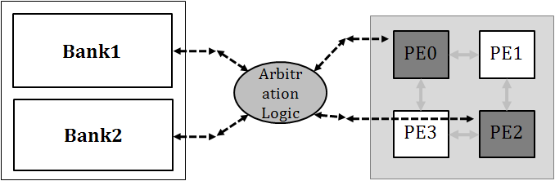
Conflict free scheduling example
Cluster1 | Cluster2
A[i], C[i] | B[i]
 | PE0 | PE1 | PE2 | PE3 | CL1 | CL2
0 |  |  | x | x
1 |  |  |  |  | A
2 |  |  |  |  |  | B
3 |  | x
4 | x | x |  |  | x
5 | x | x | x |  |  | x
6 |  | x | x | x
0
0
1
2
II=3
1
2
A[i]
3
3
4
5
7
6
4
5
6
B[i]
c1
r
7
8
C[i]
r
c2
SO&R and CML Research Group

Slide 29
Conflict free scheduling with DMQ
In conflict free scheduling, MBAQ architecture is used for relaxing the mapping constraint.
  Can permit several conflict within a range of added memory operation latency.
SO&R and CML Research Group

