Slide 1
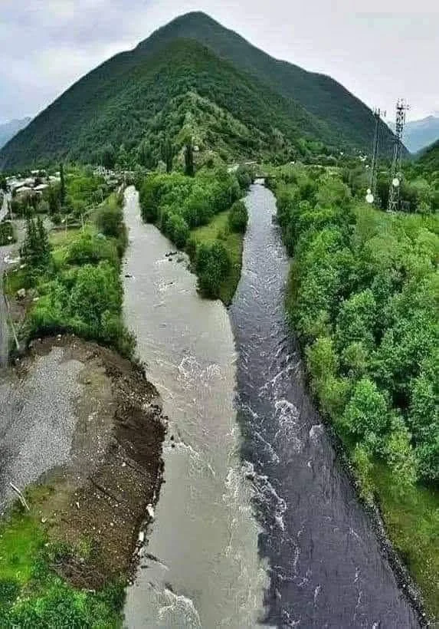
DSP-MLIR (A Compiler for Digital Signal Processing in MLIR)
DSP
MLIR
DSP-MLIR
Abhinav

Slide 2
Agenda
Limitation of Traditional DSP Compiler
MLIR
DSP MLIR Framework
  DSP Dialect and DSP Language
  Optimizations
  Implementation Details – Lowering
  Applications & Results
Conclusion & Future Work

Slide 3
Agenda
Limitation of Traditional DSP Compiler
MLIR
DSP MLIR Framework
  DSP Dialect and DSP Language
  Optimizations
  Implementation Details – Lowering
  Applications & Results
Conclusion & Future Work

Slide 4
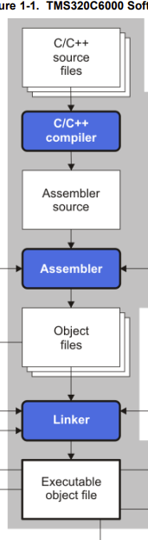
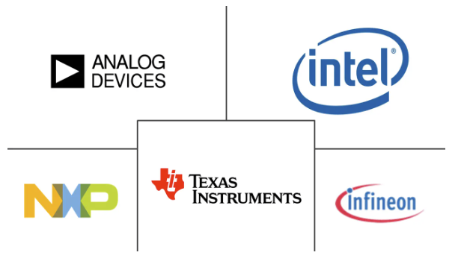
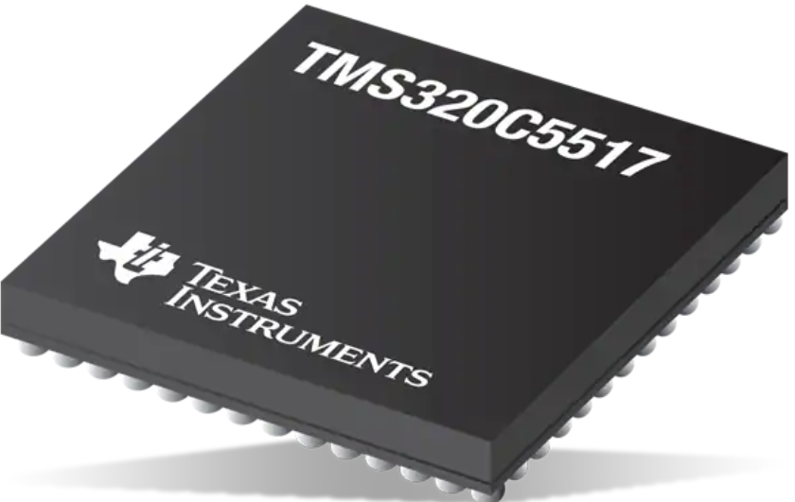
DSP Software Development Flow
Popular DSP Chip Manufacturers

Slide 5
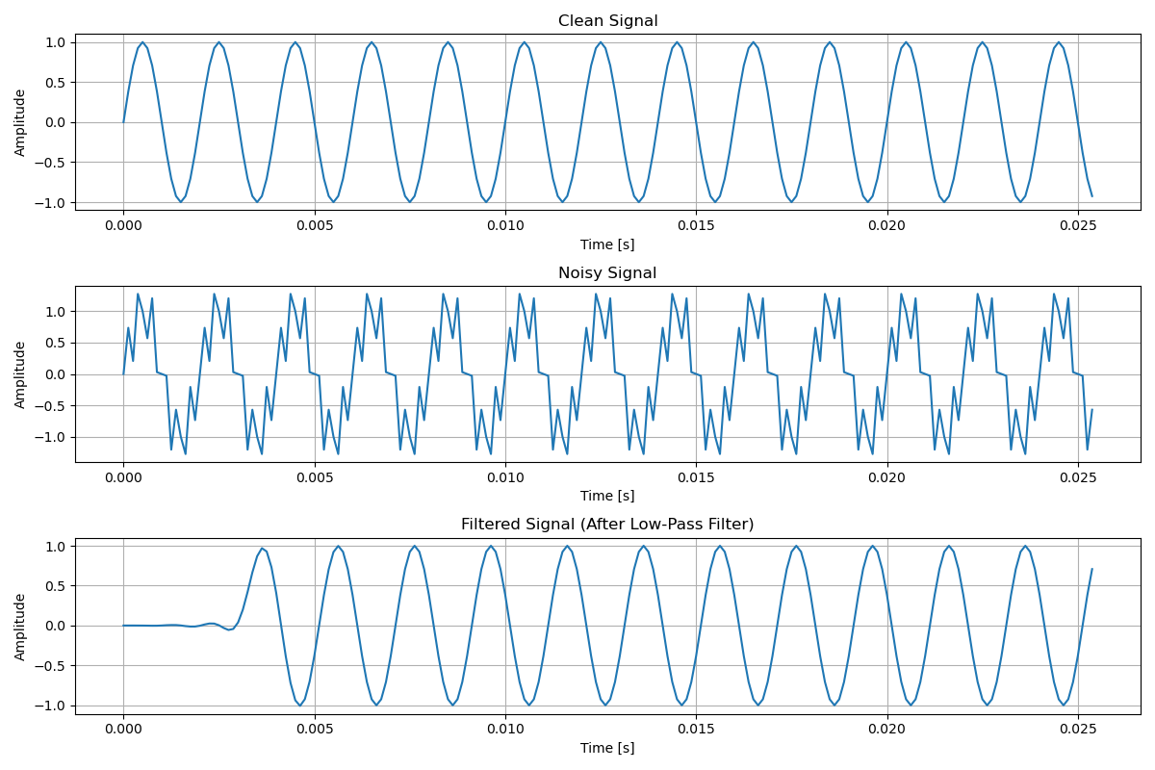
A DSP Application Ex- Low Pass Filtering
Input Signal + Noisy Signal
Window Function
FIR Filter Design
FIR Filter Response
Output Signal
Low Pass Filtering Application

Slide 6
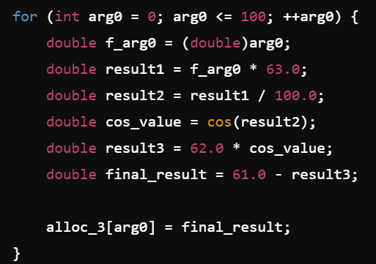
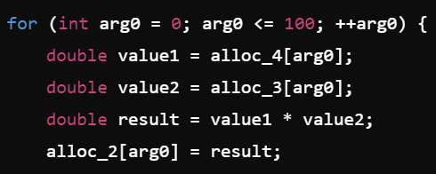
Limitation with Traditional DSP Compiler
Traditional C Compiler
Input Signal + Noisy Signal
Window Function
FIR Filter Design
FIR Filter Response
Output Signal
High-level
Hamming Function
IdealLowPassFilter = 1
Hamming Window = 2
Multiplication ( 1, 2 )
Vector Multiplication
Low Pass
Filtering

Slide 7

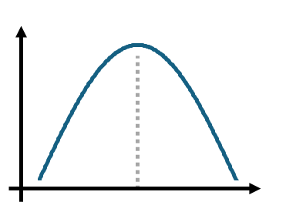
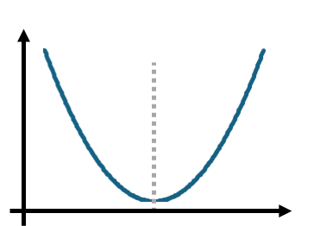
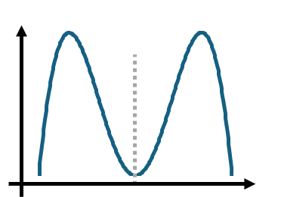

Example of High-level Information
High-level
Input Signal + Noisy Signal
Window Function
FIR Filter Design
FIR Filter Response
Output Signal
IdealLowPassFilter = 1
Hamming Window = 2
Multiplication ( 1, 2 )
Traditional
compilers
Domain-specific knowledge:
These two are symmetric
X
=
Low Pass
Filtering
Expand (symmetric)

Slide 8
Agenda
Limitation of Traditional DSP Compiler
MLIR
DSP MLIR Framework
  DSP Dialect and DSP Language
  Optimizations
  Implementation Details – Lowering
  Applications
  Results
Conclusion & Future Work

Slide 9


MLIR – Multi-level Intermediate Representation
Framework for Compiler Development
Libraries for compiler IR
Tensorflow IR
XLA IR
MHLO IR
LLVM IR
Linalg
….

Slide 10
Agenda
Limitation of Traditional DSP Compiler
MLIR
DSP MLIR Framework
  Dialect and DSP Language
  Optimizations
  Implementation Details – Lowering
  Applications
  Results
Conclusion & Future Work

Slide 11
DSP Compiler Framework
DSP Language
DSP
Dialect
DSP
Ops
Auxil.
Ops
Optimization
Mem
Arith
Affine
Math
Func
Legend
scf
New Component
Existing Dialect
mlir-llvm
New Dialect
External to MLIR
LLVM-IR
New Lowering
Clang
Existing Lowering

Slide 12
Agenda
Limitation of Traditional DSP Compiler
MLIR
DSP MLIR Framework
  DSP Dialect and DSP Language
  Optimizations
  Implementation Details – Lowering
  Applications
  Results
Conclusion & Future Work

Slide 13
DSP Compiler Framework – Dialect
DSP Langg
DSP
Dialect
DSP
Ops
Auxil.
Ops
DSP
Ops
Aux.
Ops
Opt
Signal
Ops
Filter
Ops
Transform
Ops
MLIR
Helper
App Dev
Helper
Mem
Arith
Affine
Math
Func
scf
Delay,
Quantiz.
FIR ,
Response
DFT,
DCT
Func,
CastOp
Print,
GenVector
mlir-llvm
20 + 15 Ops
LLVM-IR
Clang

Slide 14
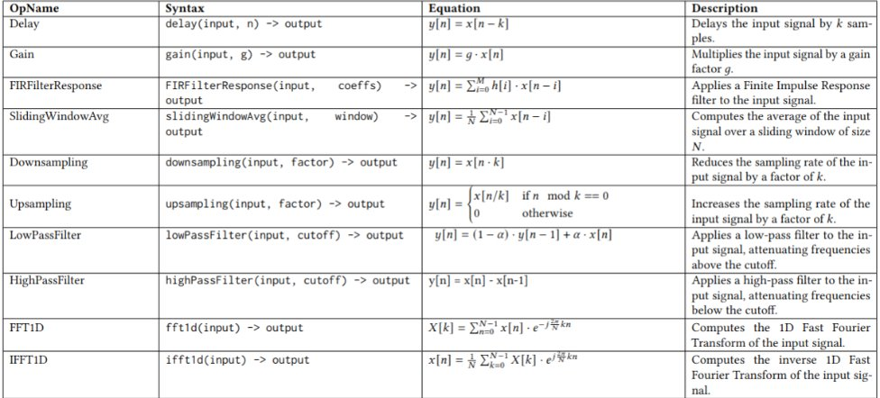
Dialect Ops – Part 1

Slide 15
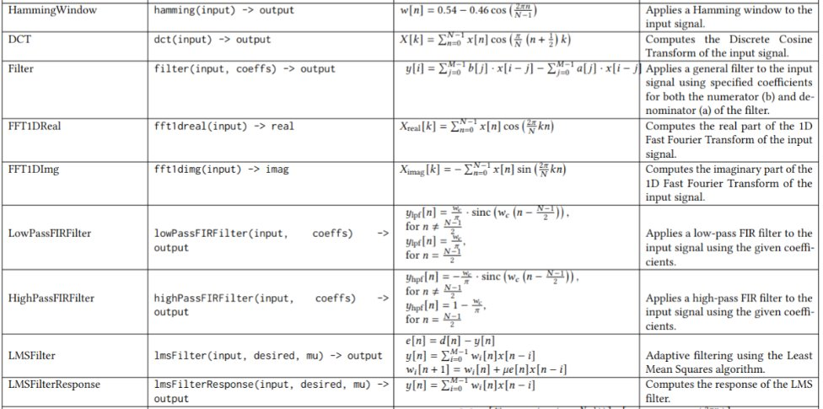
Dialect Ops – Part 2

Slide 16
Agenda
Limitation of Traditional DSP Compiler
MLIR
DSP MLIR Framework
  Dialect and DSP Language
  Optimizations
  Implementation Details – Lowering
  Applications & Results
Conclusion & Future Work

Slide 17
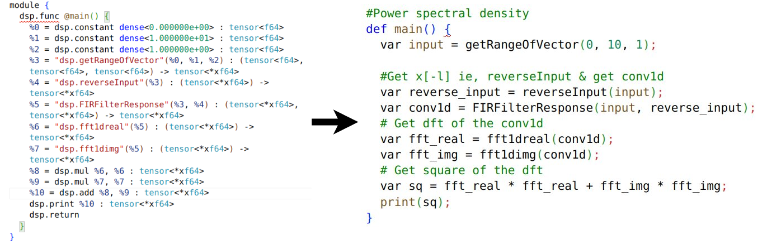
DSP Langg – Frontend for DSP Dialect
Easy Way
App in DSP Langg
App in DSP Dialect
Hard Way

Slide 18
DSP Compiler Framework – DSP Langg
DSP Langg
DSP Langg
DSP
Dialect
Lexer
DSP
Ops
Auxil.
Ops
Opt.
Token/Symbols
Parser
Mem
Arith
Affine
Math
Func
Parse Tree
Modified
scf
mlir-llvm
MLIR-Gen
LLVM-IR
DSP
Dialect
Clang

Slide 19
Agenda
Limitation of Traditional DSP Compiler
MLIR
DSP MLIR Framework
  Dialect and DSP Language
  Optimizations
  Implementation Details – Lowering
  Applications & Results
Conclusion & Future Work

Slide 20
DSP Compiler Framework - Optimizations
DSP Langg
DSP
Dialect
Optimization
Mem
Arith
Affine
Math
Func
Legend
scf
New Component
Existing Dialect
mlir-llvm
New Dialect
External to MLIR
LLVM-IR
New Lowering
Clang
Existing Lowering

Slide 21
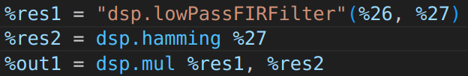
DSP Dialect Specific Optimization – An Example
Pattern name | Base OP | Old pattern | New pattern | Source
Symmetric Filter | MulOp | [IdealFilter, Hamming, Mul] | [FilterHammingOpt] | DSP book
Before optimization
After optimization
FilterHammingOpt
Mul
IdealFilter
Hamming
Optimization

Slide 22

DSP Compiler Framework – Optimization
DSP Langg
Pattern name | Base OP | Source
Symmetric Filter | MulOp | DSP book
Filter Response at symmetric input | FilterRespOp | Our contribution
Filter Response at Input and Reverse | FilterRespOp | DSP book
DFT Response at Symmetric Input | DFT1DRealOp | DSP book
Parseval’s Theorem | DivOp | DSP Theorem
DFTReal and DFTImg Fusion | DFTImgOp | MLIR Limitation
LMSFilter and Gain Fusion | GainOp | MLIR Limitation
DSP
Dialect
DSP
Ops
Aux.
Ops
Opt
Mem
Arith
Affine
Math
Func
scf
mlir-llvm
LLVM-IR
Clang

Slide 23

DSP Opt. 1: Symmetric filter at Filter Design
Pattern name | Base OP | Old pattern | New pattern | Source
Symmetric Filter | MulOp | [IdealFilter, Hamming, Mul] | [FilterHammingOpt] | DSP book
Before optimization
After optimization
X
X
=
Expand (symmetric)
Domain-specific knowledge:
Both IdealFilter and Hammming are always symmetric
Benefit:
requires ~ 50% computation

Slide 24
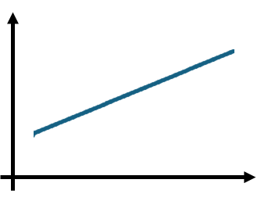
DSP Opt. 2: Filter Response at Symmetric Input
Pattern name | Base OP | Old pattern | New pattern | Source
Filter Response at symmetric input | FilterRespOp | [FilterHammOpt, FilterResponse] | [FilterResSymmOpt] | Our contribution
Before optimization
After optimization
Conv1D
Conv1D
Left-side
filter
(loaded)
Right-side
filter
(Reuse)
Input
Filter Input
Input
Domain-specific knowledge:
Filters are often symmetric
Benefit: requires ~ 50% less memory load for FilterHammOpt

Slide 25
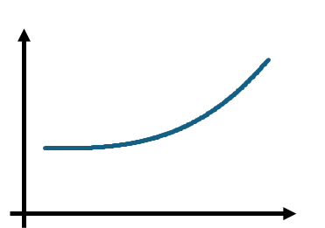
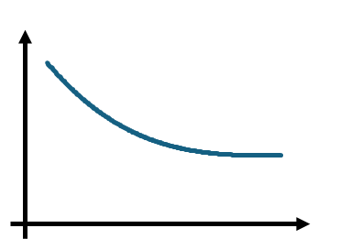
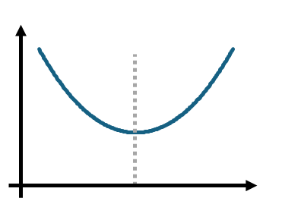
DSP Opt. 3: Filter Response at Input and Reverse
Pattern name | Base OP | Old pattern | New pattern | Source
Filter Response at Input and Reverse | FilterRespOp | [ReverseInput, FilterResponse] | [FilterYSymmOpt] | DSP Book
Before optimization
After optimization
Reverse
Reverse
Conv1D
Conv1D
=
=
Domain-specific knowledge:
At x[n] & x[-n] , the filter response is symmetric
Benefit:
We just calculate half of the output

Slide 26
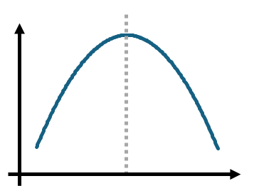
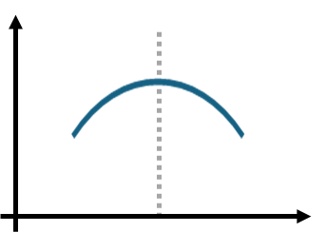
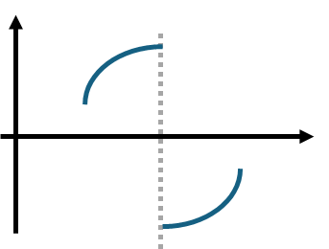
DSP Opt. 4: DFT Response at Symmetric Input
Pattern name | Base OP | Old pattern | New pattern | Source
DFT Response at Symmetric Input | DFT1DRealOp | [FilterResponse, DFT1DReal] | [DFT1DRealSymmOp] | DSP Book
Before optimization
After optimization
DFT
DFT
=
=
Real part
Imaginary part
Real part
Imaginary part
Domain-specific knowledge:
Real and imag. parts are symmetric / conjugate symmetric
Benefit:
We just calculate half of the output

Slide 27
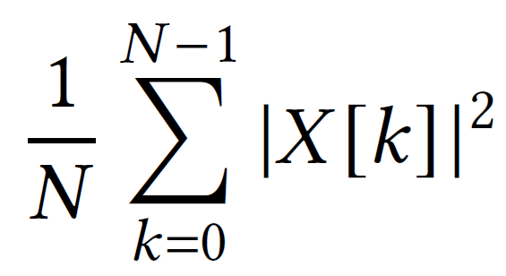
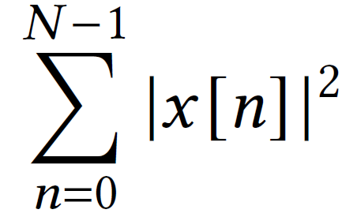
DSP Opt. 5: Parseval's Theorem
Pattern name | Base OP | Old pattern | New pattern | Source
Parseval’s Theorm | DivOp | [DFT1D, Square, Sum, Div] | [Square, Sum] | DSP Theorem
Before optimization
After optimization
=
=
=
Energy
Energy
Frequency-domain
(requires FFT calculation)
Frequency-domain
(requires FFT calculation)
Time-domain
(FFT-free)
Domain-specific knowledge:
Energy is same in frequency- and time-domains
Benefit:
FFT computation is not required

Slide 28
DSP Opt. 6: Fusion for FFTReal & FFTImg Part
Pattern name | Base OP | Old pattern | New pattern | Source
DFTReal and DFTImg Fusion | DFTImgOp | [DFTReal , DFTImg] | [DFT1D] | MLIR Limitation
Before optimization
After optimization
for i = 0 to 10 {
for j = 0 to 10 {
}
}
for i = 0 to 10 {
for j = 0 to 10 {
}
}
Computation for
real part
Computation for
real and
imaginary parts
for i = 0 to 10 {
for j = 0 to 10 {
}
}
Computation for
imaginary part
Domain-specific knowledge:
None
Benefit:
We can merge two loops as one

Slide 29
DSP Opt. 7: LMSFilter and Gain Fusion
Pattern name | Base OP | Old pattern | New pattern | Source
LMSFilter and Gain Fusion | GainOp | [LMSFilter , Gain ] | [LMSFilterGainOpt] | MLIR Limitation
Before optimization
Before optimization
After optimization
After optimization
for i = 0 to 10 {
for j = 0 to 20
for k = 0 to 20
}
for i = 0 to 10 {
}
for i = 0 to 10 {
for j = 0 to 20
for k = 0 to 20
}
Computation 1 for LMS Filter (Filter output)
Computation 1 for LMS Filter (Filter output)
Computation 2 for LMS Filter (Filter weight)
Computation 2 for LMS Filter (Filter weight)
Computation for Gain
Computation for Gain
Domain-specific knowledge: None
Benefit:
We can merge the nested loops as one

Slide 30
Agenda
Limitation of Traditional DSP Compiler
MLIR
DSP MLIR Framework
  Dialect and DSP Language
  Optimizations
  Implementation Details – Lowering
  Applications & Results
Conclusion & Future Work

Slide 31
DSP Compiler Framework - Lowering
DSP Langg
DSP
Dialect
DSP
Ops
Aux.
Ops
Lowering
Opt
Mem
Arith
Affine
Math
Func
scf
mlir-llvm
LLVM-IR
Clang

Slide 32
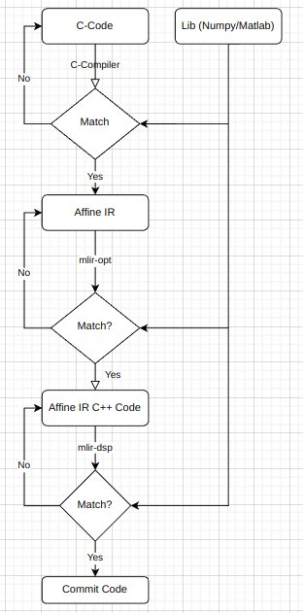
DSP Compiler Framework– Lowering Approach
DSP Langg
DSP
Dialect
Mem
Arith
Affine
Math
Func
scf
mlir-llvm
LLVM-IR
Clang

Slide 33
Agenda
Limitation of Traditional DSP Compiler
MLIR
DSP MLIR Framework
  Dialect and DSP Language
  Optimizations
  Implementation Details – Lowering
  Applications & Results
Conclusion & Future Work

Slide 34
Results – Lowpass Filter
Input Signal + Noisy Signal
Window Function
FIR Filter Design
FIR Filter Response
Output Signal
Application | LowPass FIltering
Optimization used | Symmetric Filter & FilterResponse Optimization
Performance Improvement | 1.4x

Slide 35
Results - Periodogram
Input Signal
Reverse Input
FFT Real , FFT Img
Output Signal
Conv1d
Square
Sum
Application | Periodogram
Optimization used | FilterResponse at x[l] & x[-l] and FFT Prop when input is real & symmetric
Performance Improvement | 1.5x

Slide 36
Combined Results
Y-axis is normalized by the execution time of no optimization

Slide 37
Agenda
Limitation of Traditional DSP Compiler
MLIR
DSP MLIR Framework
  Dialect and DSP Language
  Optimizations
  Implementation Details – Lowering
  Applications
  Results
Conclusion & Future Work

Slide 38
Conclusion & Limitations
Domain specific optimizations are best represented at higher level (unlike C-level (traditional compilers))
DSP-MLIR Framework provides framework
  For DSP Application Development​
  For DSP Domain pattern recognition, High level Optimizations
Limitations:
  Development of Optimized Algorithm for Complex Operations
  Not Production Ready

Slide 39



Future Paths
Future Paths:
  Integration with different frontend like Simulink
  Frontend for DSP Chips
  Integration with deep learning flow

Slide 40

Questions

Slide 41
Implementation Details

Slide 42



Opt 1: Symmetric filter at Filter Design
$$y_{lpf}\left[n\right]=\left\{\begin{aligned}\frac{w_{c}}{π}∙sinc\left(w_{c}\left(n−\frac{N−1}{2}\right)\right), for n≠\frac{N−1}{2} \\ \frac{w_{c}}{π}, for n=\frac{N−1}{2}\end{aligned}\right.$$
$$w\left[n\right]=0.54 −0.46 cos\left(\frac{2πn}{N−1}\right)$$
$y_{filter}=y_{lpf}\left[n\right]$ * $w\left[n\right]$
$y_{filter}$ is symmetric about $\frac{N−1}{2}$ ie, $y_{lpf}\left[N−1−n\right]=y_{lpf}\left[n\right]$
Notes:
These optimizations are not possible using standard libraries with different implementations of these blocks or with affine level IR/ Low level IR. DSP DIALECT provides opportunities to optimize whenever we encounter any of such patterns.

Slide 43

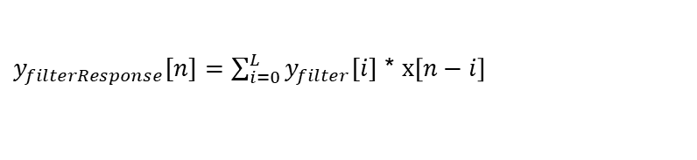
Opt 2: Conv1D at Symm IP for Low-Pass Filtering
$y_{filter}=y_{lpf}\left[n\right]$ * $w\left[n\right]$
$y_{filterResponse}[n]=\sum_{i=0}^{L}{y_{filter}[i]}$ * $x\left[n−i\right]$
$y_{filter}$ is symmetric about $\frac{N−1}{2}$ so
$$y_{filterResponse}[n]=$$
Proof – Expand the equation and use y_{filter}[n] = y_{filter}[N-1-n]
Notes:
These optimizations are not possible using standard libraries with different implementations of these blocks or with affine level IR/ Low level IR. DSP DIALECT provides opportunities to optimize whenever we encounter any of such patterns.

Slide 44
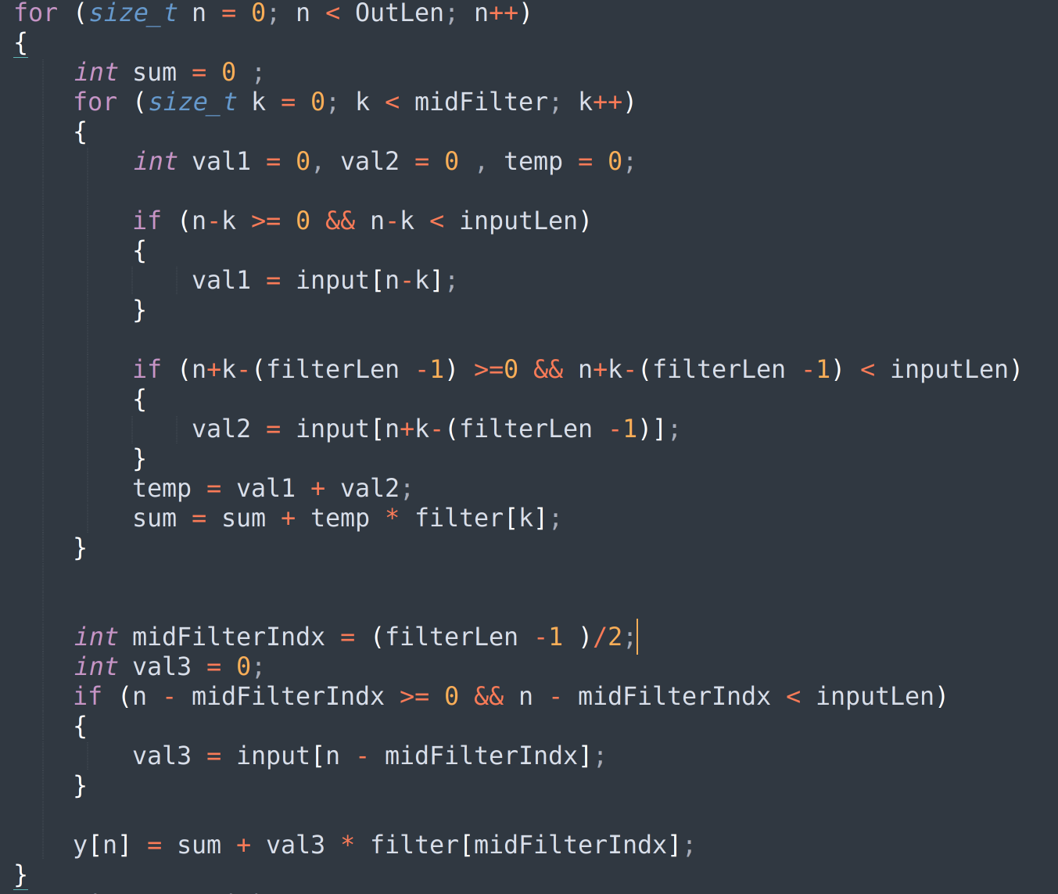
Opt 2: Conv1D at Symm IP for Low-Pass Filtering
=> Reduce Number of load/store
=> increase the number of control branches
=> Still better !!
Notes:
These optimizations are not possible using standard libraries with different implementations of these blocks or with affine level IR/ Low level IR. DSP DIALECT provides opportunities to optimize whenever we encounter any of such patterns.

Slide 45
Opt 3a: Conv1d Prop at input & reverseInput
Result1 = Convolution of x[l] & x[-l] ... (1)
Property: If x[l] is real , then Convolution x[l] & x[-l] = Symmetric
=> For eq1 : Original = 0<=n < N
Optimized Operation = 0<=n < (N+1)/2
Notes:
These optimizations are not possible using standard libraries with different implementations of these blocks or with affine level IR/ Low level IR. DSP DIALECT provides opportunities to optimize whenever we encounter any of such patterns.

Slide 46
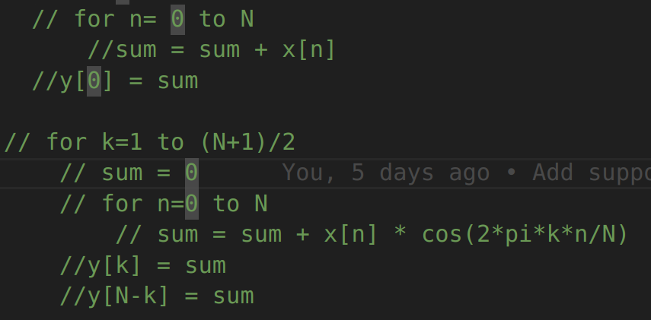

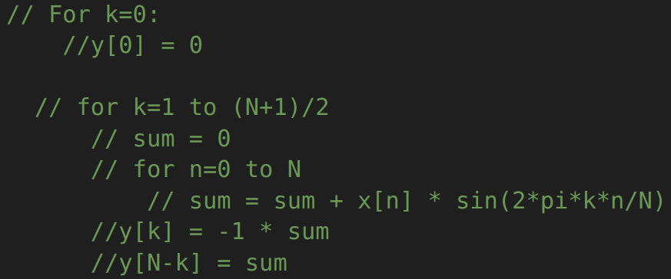

Opt 3b: FFT Property at real symmetric input
Output = FFT( result1 ) .. (2)
Property: If result1 is real & symmetric,
FFT(x[l]) = FFTreal + j FFTImg would give
FFTreal[n] = FFTreal[N-n]
FFTimg[n] = -FFTimg[N-n]
=> For eq2 : Original Real,
Optimized Real : Xreal[N-k] = X[k] (N+1)/2 <= k < N
Original Img =
Ximg[N-k] = -X[k] , (N+1)/2 <= k < N
Notes:
These optimizations are not possible using standard libraries with different implementations of these blocks or with affine level IR/ Low level IR. DSP DIALECT provides opportunities to optimize whenever we encounter any of such patterns.

Slide 47

Opt 5: Parsevaal's Theorem
Total energy computed in time domain = that in freq domain
=> If there is any time RHS pattern, we can simply replace with LHS
Our claim : Hard to be done with Traditional Compilers (C/lower levels IR) !!

Slide 48
Result7 - Audio Equalizer
Input Signal
FFT
Square (Real , Img)
Sum
DivideByN
Output
Application | Audio Compression
Optimization used | Symmetric
Performance Improvement | 1.1x

Slide 49



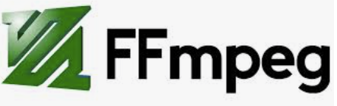
DSP Based Libraries/Framework
Libraries

Slide 50
Example of High-level Information
IdealLowPassFilter
High-level
Hamming Window
Input Signal + Noisy Signal
Window Function
FIR Filter Design
FIR Filter Response
Output Signal
Vector Multiplication
Traditional
compilers
Domain-specific knowledge:
These two are symmetric
X
=
Low Pass
Filtering
Expand (symmetric)

Slide 51
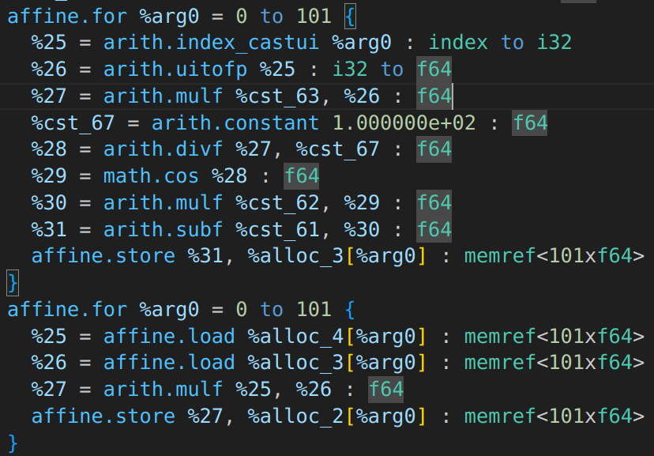
Limitation with Traditional DSP Compiler
Intermediate Representation (IR)
Input Signal + Noisy Signal
Window Function
FIR Filter Design
FIR Filter Response
Output Signal
High-level
dsp.hamming
Traditional compilers optimize
the code in C-level
→ Limitation: they cannot utilize
high-level Information for optimization
dsp.mul
Low Pass
Filtering

Slide 52
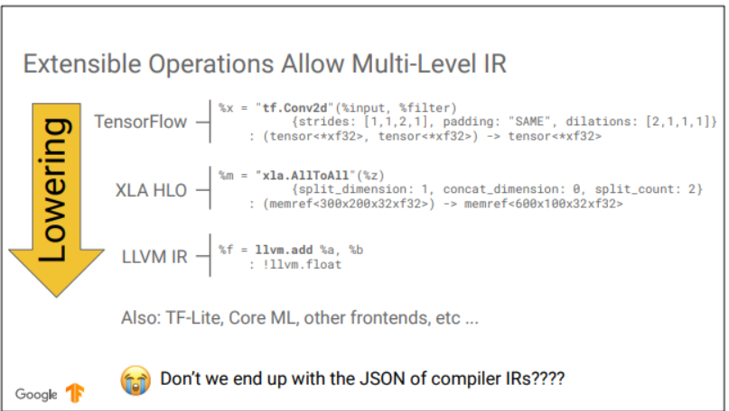
MLIR – An example Tensorflow

Slide 53
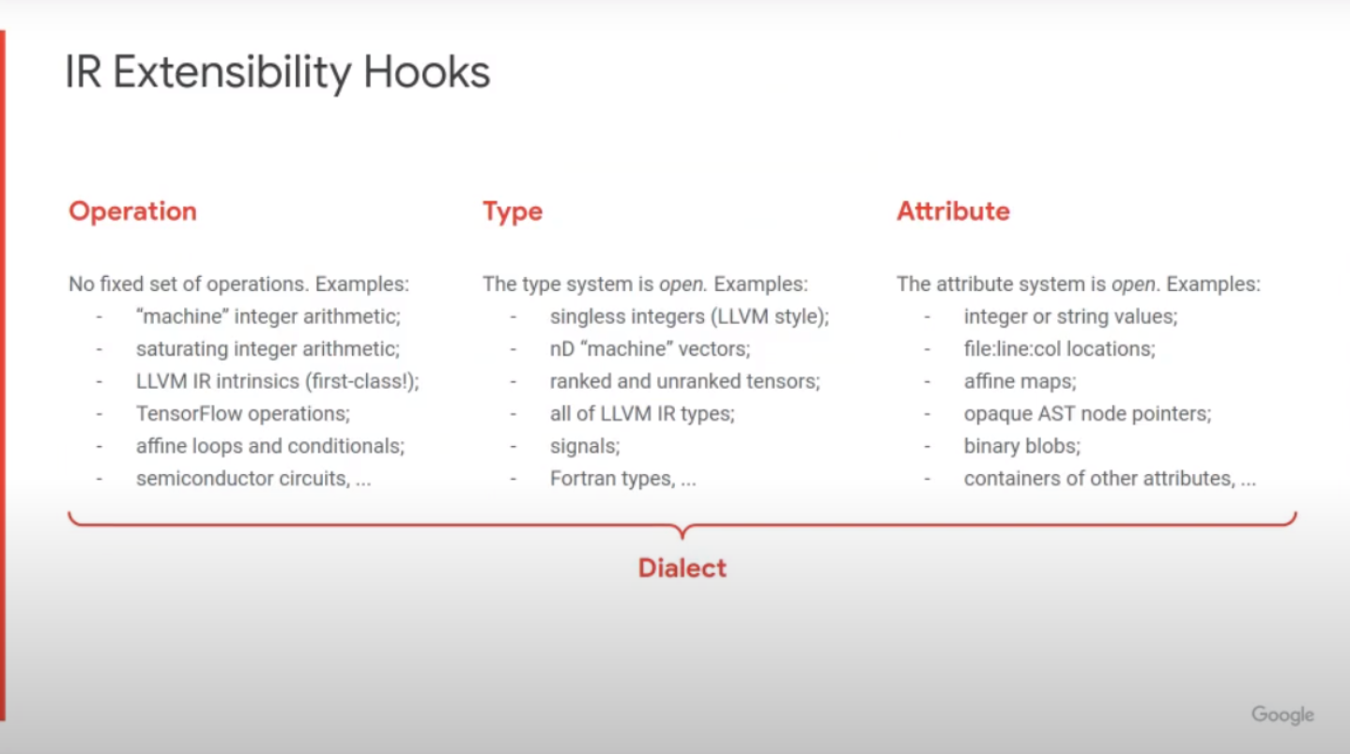
MLIR – Dialects

Slide 54
DSP Compiler Framework
DSP Langg
DSP
Dialect
DSP
Ops
Aux.
Ops
Opt
Mem
Arith
Affine
Math
Func
Legend
scf
New Component
Existing Dialect
mlir-llvm
New Dialect
External to MLIR
LLVM-IR
New Lowering
Clang
Existing Lowering

Slide 55
Conclusion & Future Work
Domain specific optimizations are best represented at higher level (unlike C-level (traditional compilers))
DSP-MLIR Framework provides framework for DSP App Development​ and utilizes this
Future Work:
  More Apps / Optimizations ( Ongoing )
  Show for different backend like GPU , etc
  Integration with different frontend
  Language Feature Development like recursion support

Slide 56
Conclusion & Future Work
Domain specific optimizations are best represented at higher level (unlike C-level (traditional compilers))
DSP-MLIR Framework provides framework
  For DSP Application Development​
  For DSP Domain pattern recognition
Future Work:
  Limitations
  Integration with different frontend like Simulink
  Integration with deep learning flow
  Development of Optimized Algorithm for Complex Operations
  More Applications and Patterns

Slide 57
Conclusion & Future Work
Domain specific optimizations are best represented at higher level (unlike C-level (traditional compilers))
DSP-MLIR Framework provides framework
  For DSP Application Development​
  For DSP Domain pattern recognition
Future Work:
  Integration with different frontend like Simulink
  Integration with deep learning flow
  Development of Optimized Algorithm for Complex Operations
  More Applications and Patterns

Slide 58
Agenda
Limitation of Traditional DSP Compiler
  Compare Examples from TI DSP Processor
  Numpy, Scipy libraries
MLIR
DSP MLIR Framework
  Dialect and DSP Language
  Optimizations
    Which type of optimization is faster due to which reason
      Symmetry – Less No Of Operations
      Load/Store Operation
      FFT Calculation ByPass
  Implementation Details – Lowering
    Lowering problem ex- Actual Lowering from TOSA to Affine
  Applications
  Results
Conclusion
Backup slides --> Function Block for Applications

Slide 59
Why we can do this now ? The MLIR Framework
Tensorflow IR
Affine IR
Scf IR
LLVM IR
Multi-level IR Framework
Different Abstractions, same IR structure
  TensorFlow graphs, all the way down to machine level

Slide 60
Result1 - Filter Design
FilterSetup
Window Function
Output Signal
Multiply
Application | Filter Design
Optimization used | Symmetric
Performance Improvement | 1.5x

Slide 61
Result2 - Low Pass Filtering
Input Signal + Noisy Signal
Window Function
FIR Filter Design
FIR Filter Response
Output Signal
Application | LowPass FIltering
Optimization used | Symmetric Filter & FilterResponse Optimization
Performance Improvement | 1.4x

Slide 62
Result3 - Periodogram
Input Signal
Reverse Input
FFT Real , FFT Img
Output Signal
Conv1d
Square
Sum
Application | Periodogram
Optimization used | Conv1d at x[l] & x[-l] and FFT Prop when input is real & symmetric
Performance Improvement | 1.5x

Slide 63
Result4 - Audio Compression
Input Signal
FFT
Threshold
Quantization
RLE Encoding
Output
Application | Audio Compression
Optimization used | Symmetric
Performance Improvement | 1.1x

Slide 64
Result5 - Spectral Analysis (Energy )
Input Signal
FFT
Square (Real , Img)
Sum
DivideByN
Output
Application | Spectral ANalysis
Optimization used | Parsevaal's Theorem
Performance Improvement | 20x

Slide 65
Result6 - Hearing Aid Application
Noisy Signal
LMS Filter
Gain
Output
Application | Hearing Aid
Optimization used | LMS Filter and Gain
Performance Improvement | 1.5x

Slide 66
Result7 - Audio Equalizer
Input Signal
FFT
Square (Real , Img)
Sum
DivideByN
Output
Application | Audio Compression
Optimization used | Symmetric
Performance Improvement | 1.1x

Slide 68

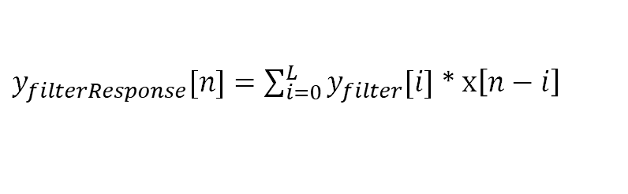
Opt 2: Conv1D at Symm IP for Low-Pass Filtering
$y_{filter}=y_{lpf}\left[n\right]$ * $w\left[n\right]$
$y_{filterResponse}[n]=\sum_{i=0}^{L}{y_{filter}[i]}$ * $x\left[n−i\right]$
$y_{filter}$ is symmetric about $\frac{N−1}{2}$ so
$$y_{filterResponse}[n]=$$
Proof – Expand the equation and use y_{filter}[n] = y_{filter}[N-1-n]
Notes:
These optimizations are not possible using standard libraries with different implementations of these blocks or with affine level IR/ Low level IR. DSP DIALECT provides opportunities to optimize whenever we encounter any of such patterns.

Slide 69
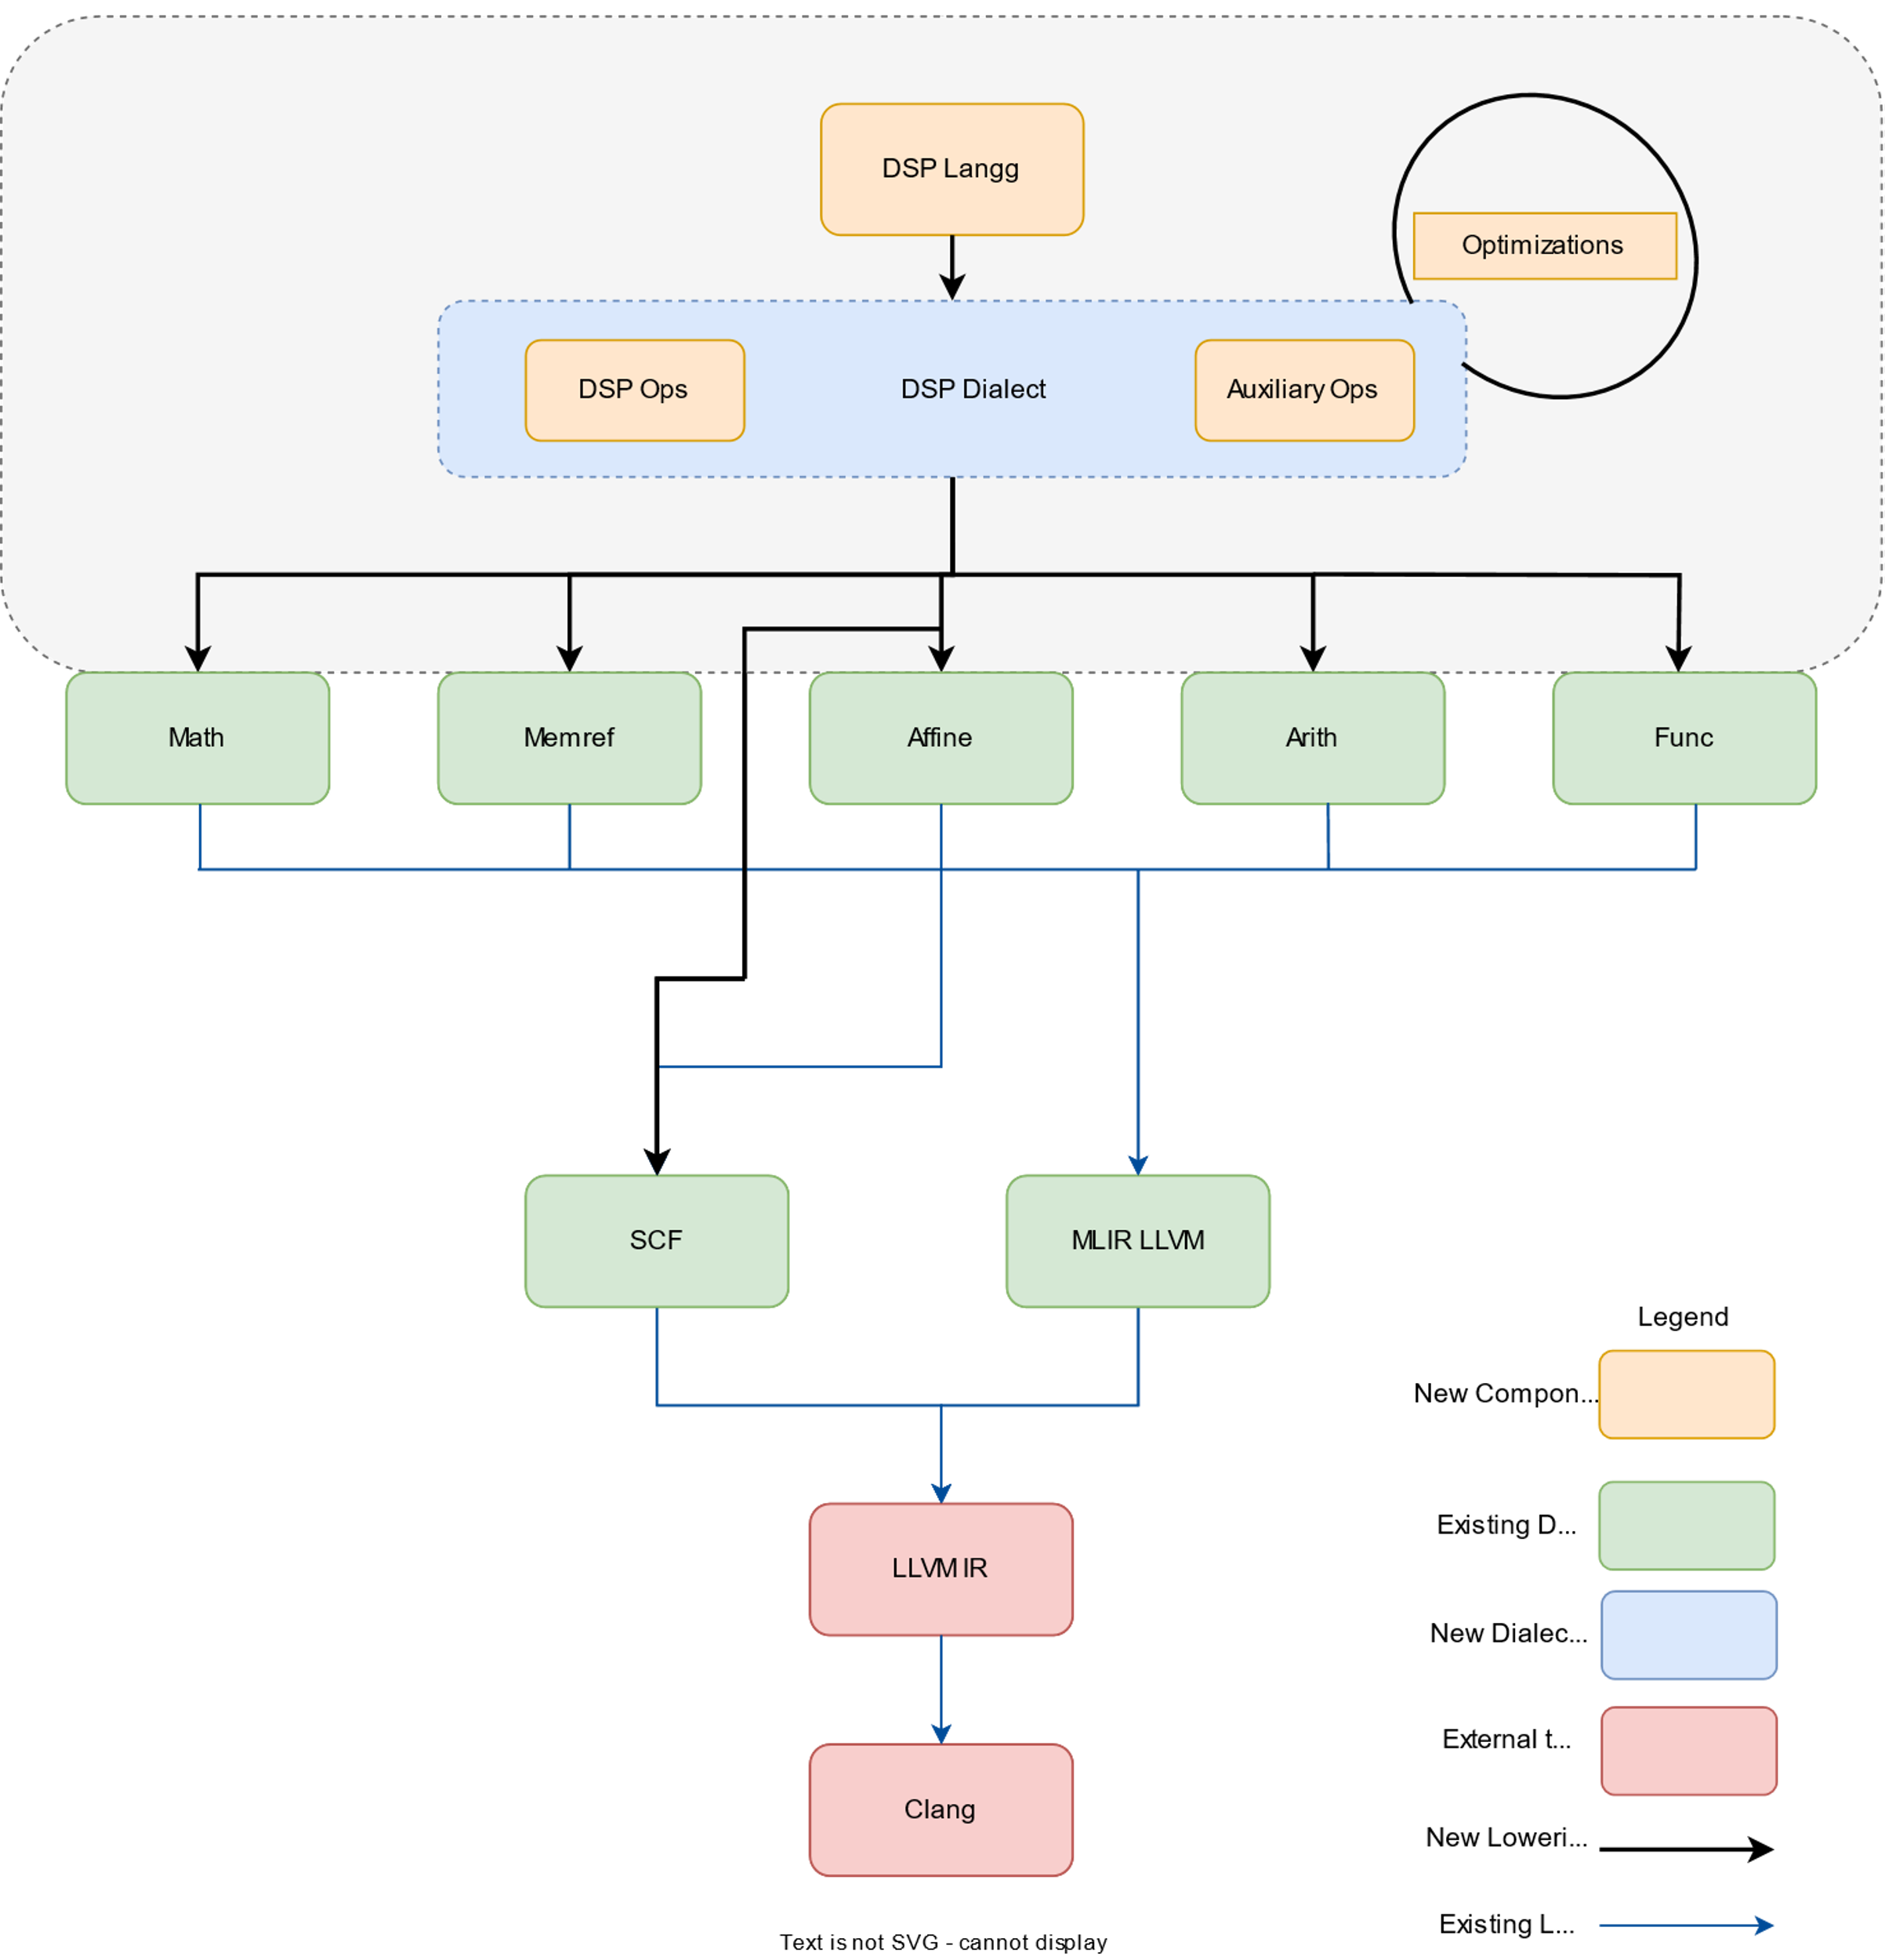
DSP Compiler Framework

Slide 70
DSP Compiler Framework
DSP Langg
DSP Dialect
DSP Ops
Auxil. Ops
Memref
Arith
Affine
Math
Func
scf
mlir-llvm
LLVM-IR
Clang

Slide 71
Results – Hearing Aid Application
Noisy Signal
LMS Filter
Gain
Output
Application | Hearing Aid
Optimization used | LMS Filter and Gain
Performance Improvement | 1.5x

Slide 72
Combined Results
Y-axis is normalized by the execution time of no optimization

Slide 73
Conclusion & Future Work
DSP Language
Domain specific optimizations are best represented at higher level
DSP Dialect
DSP
Ops
Auxil.
Ops
Optimization
DSP-MLIR Framework provides framework for DSP App Development​ and utilizes this
Memref
Arith
Affine
Math
Func
scf
mlir-llvm
Future Work
More Apps / Optimizations ( Ongoing )
Show for different backend like GPU, etc.
Language Feature Development
LLVM-IR
Clang

