Slide 1
LUCI
Multi-Application Orchestration Agent
By
Guna Sekhar Sai Harsha Lagudu
A Thesis Presented in Partial Fulfillment
of the Requirements for the Degree
Master of Science
Graduate Supervisory Committee:
Aviral Shrivastava, Chair
Amarsagar Reddy Ramapuram Matavalam
Vidya Chhabria

Slide 2
Introduction

Slide 3


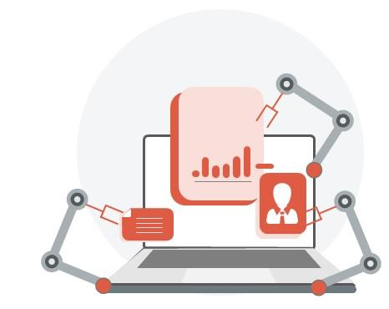
Problem Statement
Computer Automation uses technology to perform tasks traditionally done by humans, freeing us up to focus on more strategic or creative work.

Slide 4
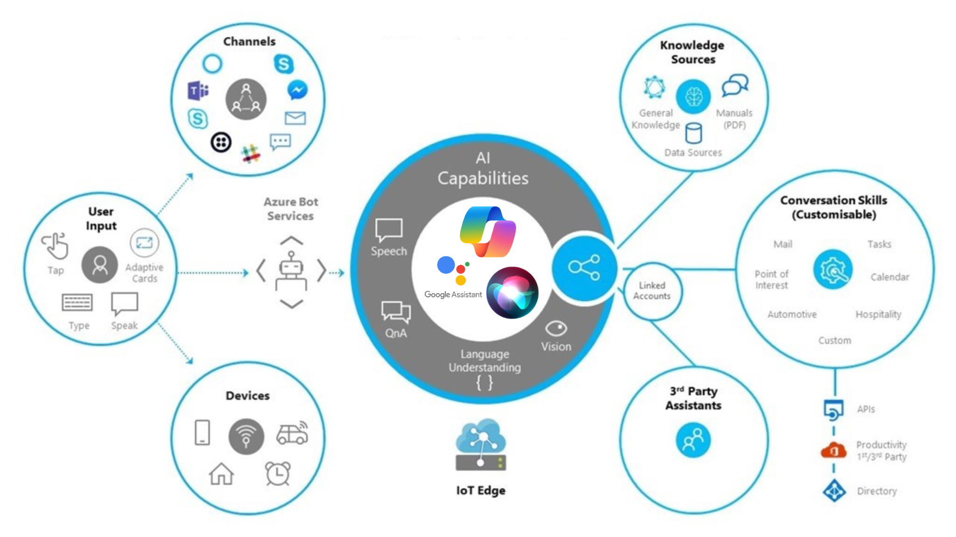
Motivation

Slide 5
Previous Approaches and Limitations
Computer Agents with LLM
w/ API
w/ GUI
Limitations
Poor Generalizability.
Context Length.
API Space.
Limitations
Low information density.
High noise.
Context Length.
Can handle one App at a time.
Absence of agent tailored for both desktop and web applications.

Slide 6
LUCI : LLM-assisted User Control Interface
Instruction
A tool that extends the capabilities of LLMs to automate GUIs.
Bridge the gap between human intent and machine execution.
Designed to enable LLMs to orchestrate multiple applications and execute complex tasks by interacting with the GUI.
LLM
Decompose Complex task and plan
sub-tasks
Environment Feedback
Environment
Mapping
Perform actions on UI elements
Map sub-tasks to UI elements

Slide 7
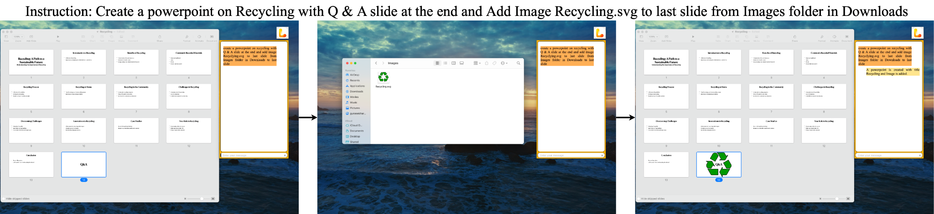
LUCI Capabilities
Figure : An illustrative execution trace of LUCI creating a presentation to satisfy the given instruction. First LUCI opens the Keynote Application and creates a presentation on Recycling. Then, open the Images folder from the Downloads directory and select "Recycling.svg" file. Finally, LUCI adds the image to the last slide of the presentation. This showcases LUCI's ability to execute tasks involving multiple applications.

Slide 8
Demo Video

Slide 9


Slide 10
LUCI Architecture

Slide 11
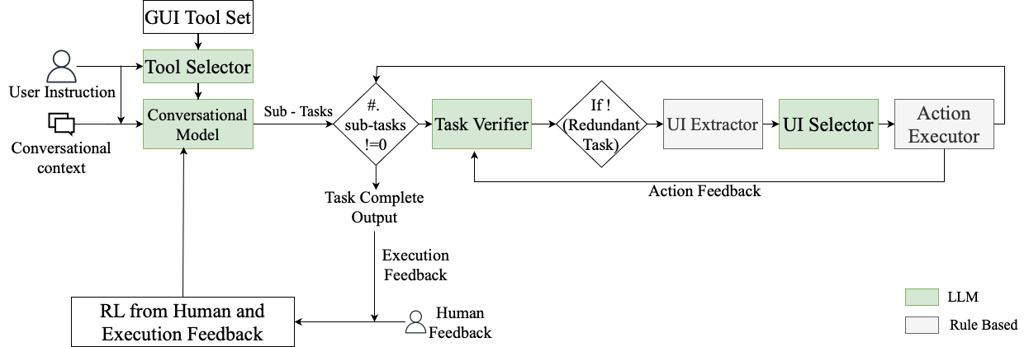
Figure : Architecture of LUCI.

Slide 12
GUI Tool Set
Contains a collection of different GUI application names that the agent is allowed to work on.
We have used 22 GUI applications.
Web applications are accessed through a browser like Safari, chrome.

Slide 13
Tool Selector
The tool selector is a language model that uses in-context learning to select a GUI application from the GUI Tool set based on given user instruction I.
Input: <User Instruction, GUI Tool set>, Output: Desktop Application Name

Slide 14
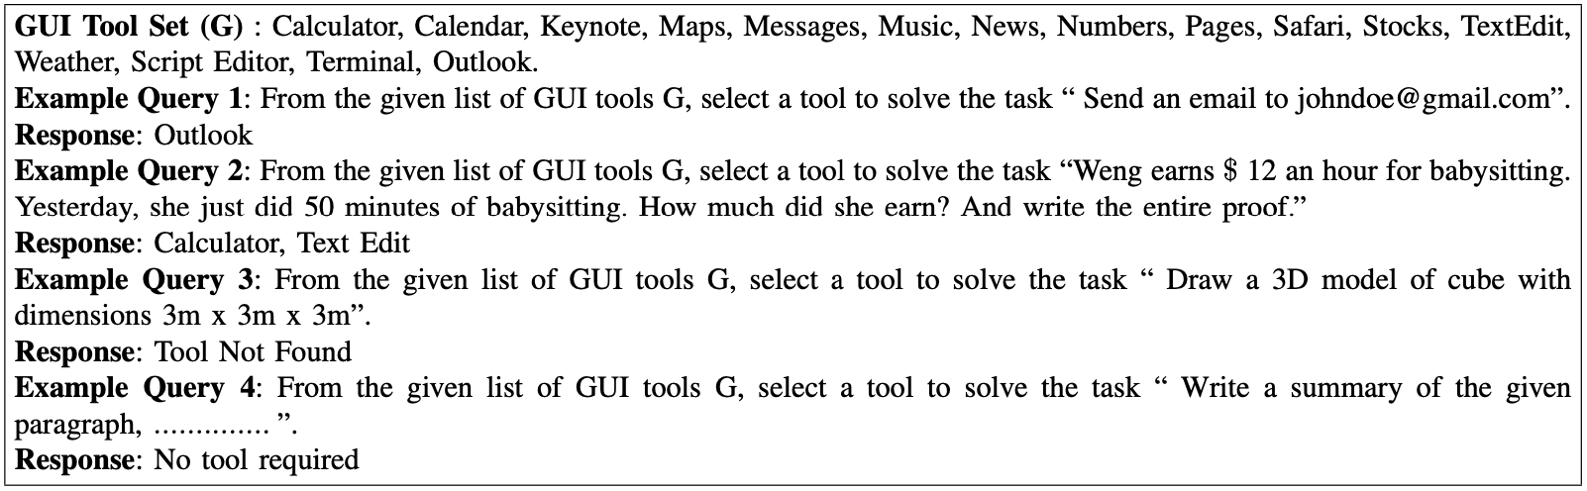
Figure : Illustrative of examples of Tool Selector in selecting a GUI application from a given GUI Tool set.

Slide 15
Conversational Model
Acts as a “brain” for this framework.
Understand user's intention from the current instruction and past conversations, then develop a set of sub-tasks (known as solution outline) required to use the GUI application.
To generate a Solution outline, we employed the Chain-of-thought
Input: <Desktop Application name, User Instruction, Conversation Context>, Output: Solution Outline

Slide 16
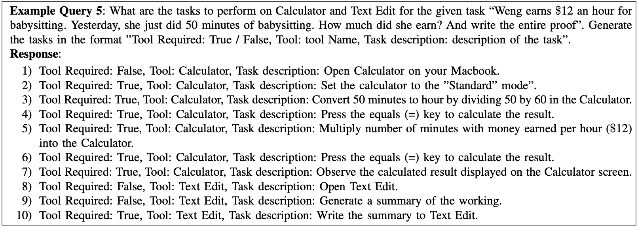
Figure : Illustrative example of solution outline from Conversation model to solve a task

Slide 17
Task Verifier
Before executing a sub-task, it should be evaluated for 2 things to remove redundant tasks and improve efficiency:
Whether the sub-task is necessary or not based on future tasks.
Sub-task is already executed or not based on previous tasks.
Input: <Current Sub-task, Future Sub-tasks, Action feedback>, Output: <Reason to execute, Execute yes / no>

Slide 18
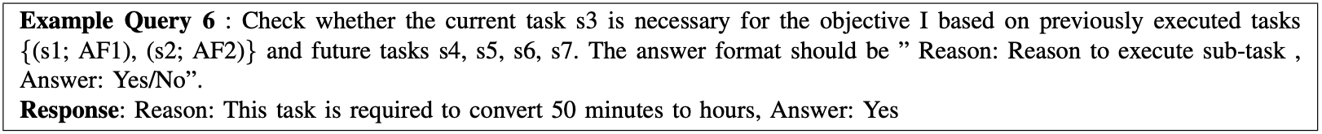
Figure : Illustrative example of Task verifier in deciding whether a task is redundant or not by reasoning.

Slide 19
UI Extractor
In any desktop application, the graphical interface is based on tree structure.
We used accessibility tools provided by Windows and MAC OS to extract this tree structure.
We parse through tree structure using a bottom-top approach.
Input: <Tool Name>, Output: <List of all UI elements>

Slide 20

We divide the UI elements into 3 categories:
Information Elements (I) : UI elements that contain only Information. Example: < p >, < h1> − < h6>, <span >, < div > e.t.c (in context of HTML).
Action Elements (A) : UI elements which perform can post and get methods. Example: buttons, hyperlinks, submit buttons e.t.c.
Field Elements (F) : UI elements that collect user input. Example: textbox, checkbox, radio buttons e.t.c.

Slide 21
Based on these 3 categorizations, we assume the following:
User input is sent to server when a post method is called. It means every F is associated with a A. For instance the submit button comes after the search box.
If there are multiple F’s while parsing through the tree it is associated with the same A within the branch. Every F has a corresponding A but A need not have a F.
If there is I , it is linked with A either in its child nodes or child nodes to parent nodes of I to get the context.
I can contain multiple A . For example, heading and list of links.
I can have multiple I’s, each associated with A’. For example, a webpage contains a heading, subheading and list of links for each subheading.
Based on the above assumptions, we parse through the tree structure using a bottom-top approach and the tree structure can be broken into:
I [I1: < A1, F1>, I2:< A2, F2>, I3: < A3, F3>, ........]
I1, I2, I3,...... contains all text information in a given node. < An, F n > is a set of A and its corresponding F pairs

Slide 22
UI Selector
We convert the task of UI element selection into a multi-choice question answering (QA) problem and select from a list of options.
UI element pertinent to the sub-task is not located by UI selector, a feedback signal is relayed to the conversational model, prompting a revision of the current sub-task.
Input: <Sub-task description, list of UI elements>, Output: UI elements

Slide 23
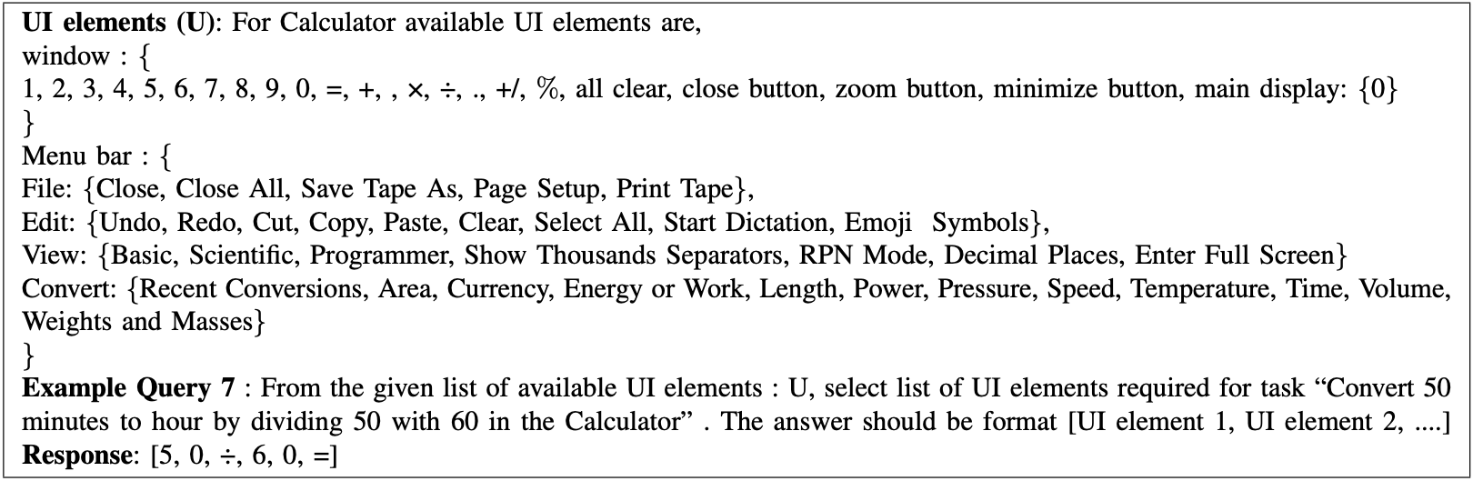
Figure : Illustrative example of UI selector selecting a list of UI elements.

Slide 24
Action Executor
It utilizes information about UI elements, such as their location and size, to execute an appropriate action based on the type of UI element.
Incorporated with a feedback mechanism to ascertain whether an action is performed or not and used to generate action feedback for the next sub-task.
Following the execution of all the sub-tasks, it will send a message to the conversation model to generate an execution feedback and furnish results to users.
Input: UI elements, Output: Action Feedback

Slide 25
Learning from Feedback
RLHF learning mechanism is used to improve the task planning and task prioritization by the controller.
Human feedback is combined with execution feedback, this combined feedback is denoted by F.

Slide 26
Novel Contributions of LUCI
Modular OS agnostic Agent
LUCI
Hierarchical Control Structure
Novel Tool Selection Mechanism
Novel UI Parser

Slide 27
Experiments and Results

Slide 28
Performance of LUCI on GUI Applications
Evaluated our work on day-to-day tasks we performed our experiments on 22 GUI applications (including both desktop and web applications).
Most of the applications lack an appropriate dataset for comprehensive evaluation. We used a set of hand-written tasks serving as seed examples and then, utilize ChatGPT to generate more tasks.
Evaluation metric : Success rate, reflecting the agent's effectiveness in completing the assigned task.
Categorized three types of failure:
  tool selection
  selection of unwanted UI elements and task failure
  If the agent successfully carries out the created plan but is unable to complete the assignment and thus not rewarded.

Slide 29
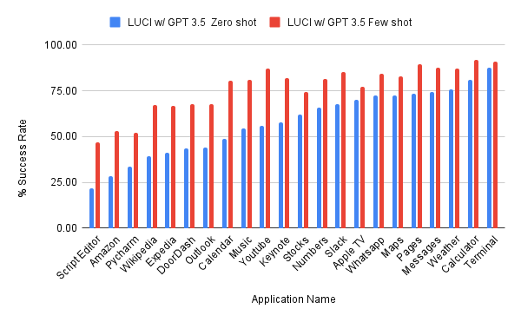
Figure : Average success rate of LUCI in using GUI Applications with GPT-3.5 under zero-shot setting and Few Shot Setting. LUCI can generalise to multiple applications.

Slide 30
Performance on Mind2Web
Evaluated LUCI’s generalizability over web tasks and compared with baselines.
The dataset is divided into three test sets: Cross-Task, Cross-Website, and Cross-Domain, evaluating generalizability over tasks from the same, similar and completely unseen domains, respectively.
Evaluation Metrics :
  Operation F1 (Op. F1) for token-level F1 score for predicted operation comprised of action and input value
  Step Success Rate for success rate per task step.
  Success Rate for successfully executing the entire task.

Slide 31
Baseline | Cross - Task |  |  | Cross - Website |  |  | Cross - Domain
 | Op. F1 | Step SR | SR | Op. F1 | Step SR | SR | Op. F1 | Step SR | SR
MindAct | 56.6 | 17.4 | 0.8 | 48.8 | 16.2 | 0.6 | 52.8 | 18.6 | 1.0
Synapse | - | 30.6 | 2.4 | - | 29.1 | 0.6 | - | 26.4 | 1.5
WebGUM | 75.9 | 64.9 | - | 75.3 | 62.5 | - | 77.7 | 66.7 | -
GPT-4V | 80.9 | 65.7 | 50 | 83.7 | 70 | - | 73.6 | 62.1 | -
LUCI w/GPT-3.5 | 93.8 | 86.7 | 76.4 | 96.3 | 89.1 | 81.9 | 91.7 | 84.2 | 74.2
LUCI w/PHI-2 | 82.3 | 82.8 | 66.8 | 84.9 | 83.3 | 70.5 | 79.4 | 79.1 | 61.3
Table : Average performance of different methods on Mind2WEB Benchmark. LUCI w/ GPT-3.5 achieves state-of-the-art performance.

Slide 32
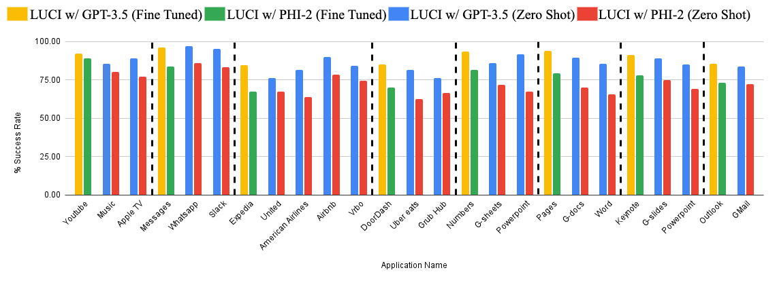
LUCI Enables Cross-Application Adaptability
Figure : Cross application performance of LUCI with GPT-3.5 and PHI-2. LUCI fine-tuned on an application that exhibits comparable performance on similar unseen applications.

Slide 33
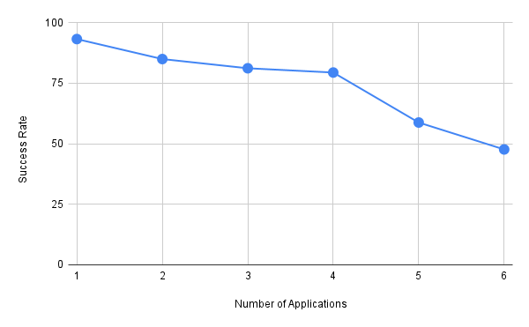
LUCI can Utilize Multiple Apps for Executing Complex Tasks
Figure : Average success rate of LUCI across tasks involving the use of multiple applications. The trend shows LUCI's ability to use at least four applications without losing efficacy.

Slide 34
Conclusion
LUCI, a computer agent that uses planning and reasoning capabilities of LLMs to interact and control wide range of desktop and web applications to solve complex tasks.
LUCI represents the UI interface in structured Information - Action - Field (IAF) representations.
  Can handle both native and web interfaces seamlessly.
  Helps smaller LLMs to map sub-task to UI elements without losing performance.
LUCI achieves over 70% success rate on unseen applications, which is a less than 5% drop as compared to the fine-tuned applications i.e, can generalize well.
LUCI enables multi-application control and able to use at least 4 applications without losing efficacy.
Submitted paper to ESWEEK Conference

Slide 35
Q & A

Slide 36
Thank you

Slide 37
Motivation
Computer automation involves using software programs and algorithms to perform tasks with minimal human intervention to improve efficiency, reduce errors, improve scalability, and cost savings.
Implementing automation often requires upfront investment in software development and infrastructure.
Thus, there is a need for developing agents AI capable of controlling computer interfaces through natural language.
Popular examples of AI Agents : Google assistants, Microsoft co-pilot, SIRI, ALEXA e.t.c.

Slide 38
Novel Contributions of LUCI

Slide 39
Modular OS-Agnostic Agent

Slide 40
Modular OS-Agnostic Agent

Slide 41
Novel tool selection mechanism

Slide 42
Novel UI Parser

Slide 43
Hierarchical Control Structure

Slide 44
LUCI outperforms previous approaches on executing complex tasks
LUCI is tested across following benchmarks:
  Miniwob ++
  Mind2Web
LLM’s used to perform all the experiments are :
  GPT-3.5-turbo
  Phi-2
All experiments are run for 50 episodes to generate results.

Slide 45
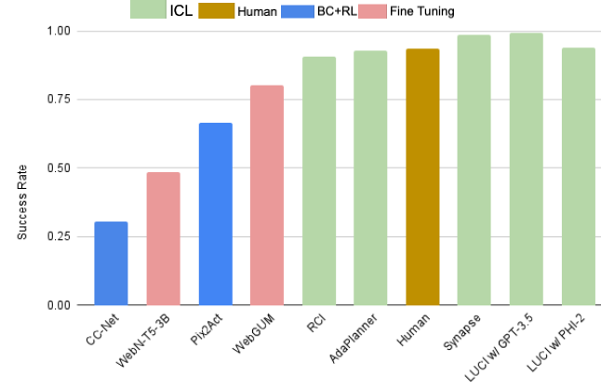
Performance on MiniWob++
Evaluation Metric: Success rate determined by the proportion of successful episodes, wherein the agent receives a positive reward.
Figure : Average performance comparison with baselines in MiniWoB++ environment. LUCI w/ GPT-3.5 achieves state-of-the-art performance and LUCI w/ PHI-2 is the first model to achieve human-level performance with LLM less than 3B parameters using ICL.

Slide 46
Future Work and Conclusion

Slide 47
Representation in Data
Use of Multimodal Information
Tolerance to Noise
Safety Concerns

