Slide 1





TMA: An Efficient Timestamp-Based Monitoring Approach to Test Timing Constraints of Cyber-Physical Systems
Mohammadreza Mehrabian, Arizona State University
Mohammad Khayatian, Arizona State University
Ahmed Mousa, Arizona State University
Aviral Shrivastava, Arizona State University
Ya-Shian Li-Baboud, National Institute of Standard and Technology (NIST)
Patricia Derler, National Instruments corporation
Edward Griffor, National Institute of Standard and Technology (NIST)
Hugo A. Andrade, University of Texas at Austin
Marc Weiss, Marc Weiss Consulting
John Eidson, University of California Berkeley
Dhananjay Anand, National Institute of Standard and Technology (NIST)

Slide 2
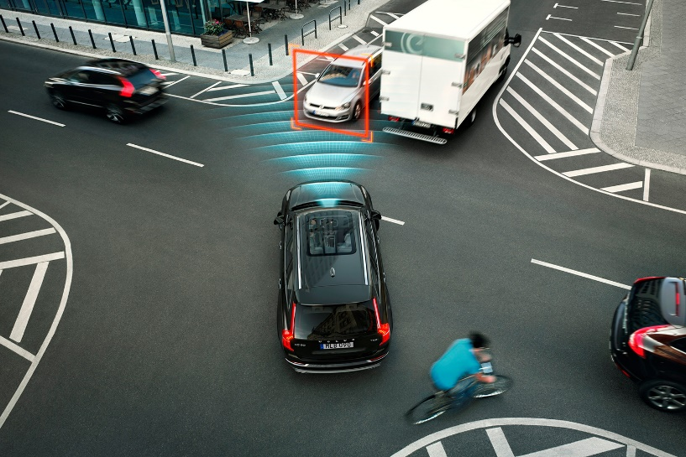
Timing is fundamental to CPS
Hard-real-time CPS
  Correctness depends on functionality as well as correct timing [1].
  Failure of timing can lead to a catastrophe!
  E.g. In an autonomous car, the time between obstacle detection and braking in an autonomous car should be less than a certain value
Timing constraints come from
  System stability requirements
  System performance requirements
  Safety and Liveness
[1] Shrivastava, Aviral, et al. "Time in cyber-physical systems." Hardware/Software Codesign and System Synthesis (CODES+ ISSS), 2016 International Conference on. IEEE, 2016.

Slide 3
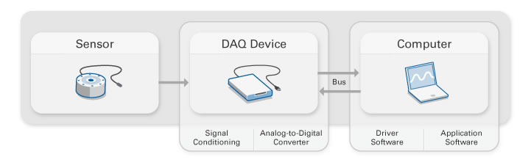
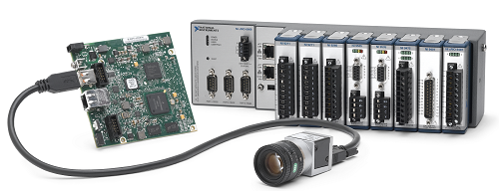
Implementing the Timing Monitoring
Software approaches
  Timing constraints are evaluated in a software.
  Limited memory bandwidth and computation power
Hardware approaches
  Timing constraints are evaluated on a hardware
  Online Monitoring
  Can be used in safety-critical systems

Slide 4

Implementing the Timing Monitoring on FPGA
Field Programmable Gate Array (FPGA)
  minimizes computational latencies
  allows for simultaneous monitoring of multiple signals
  while supporting the flexibility for modifications and upgrades
FPGA space is limited and it should be utilized efficiently.
 | Previous works | TMA
The required space on FPGA | depends on the timing constraint interval | uses a constant space for any interval
Monitoring an application | occupy about all space on FPGA | just needs 11% of Flip-flops and LUTs.

Slide 5
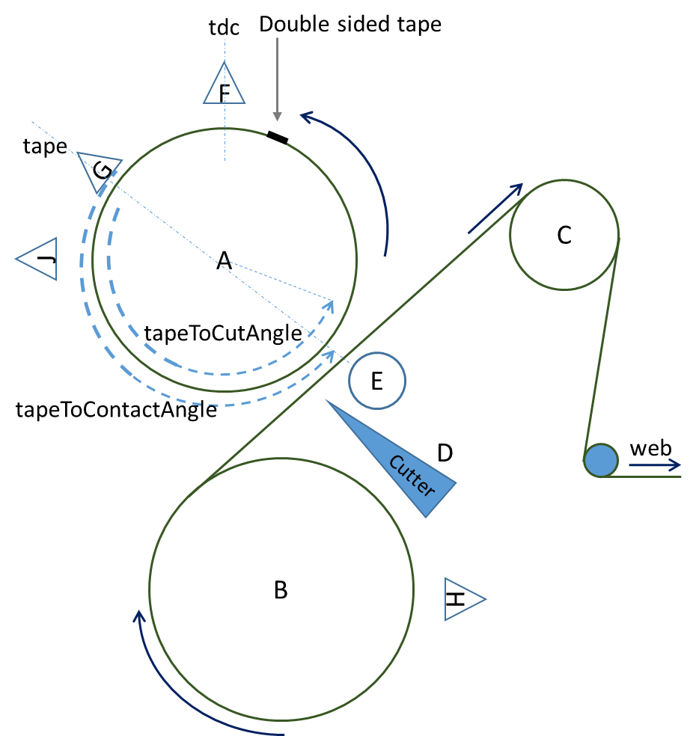
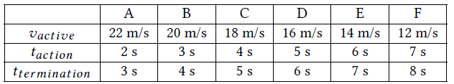
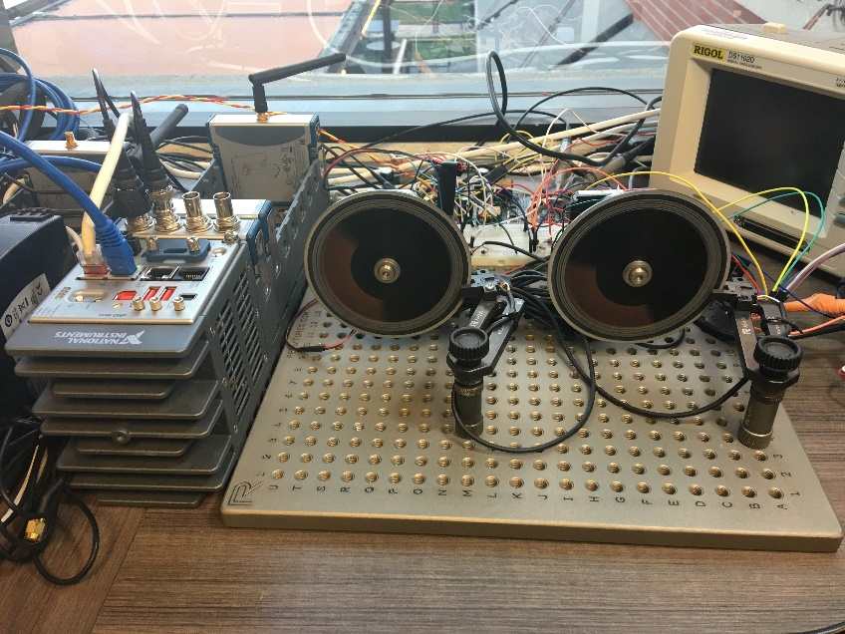
Monitoring Flying Paster Application
A Flying Paster is a splicer for a web press that is used for continuous production. It works by "pasting" a spare roll onto the active roll so that the press does not have to stop.
  Seven timing constraints are evaluated
  Six different scenarios are implemented
Spare Roller
Active Roller

Slide 6
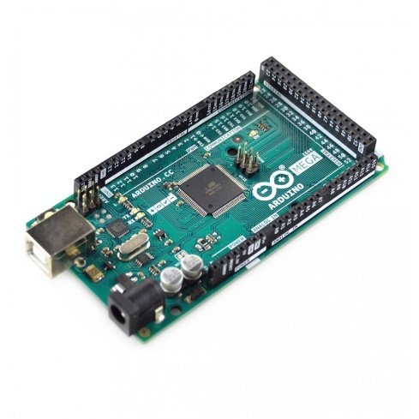
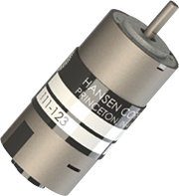
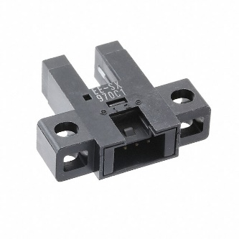
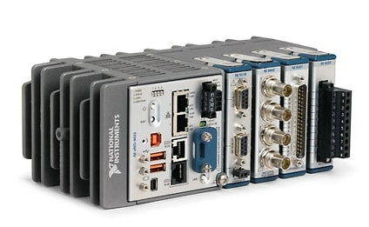
Testing Device Specifications
Controlling two motors as Active and Spare
  Hansen DC motors
  Omron EESX970C1 sensors
  Arduino Mega 2560
Testing Equipment
  cRIO 9035
    Xilinx Kintex-7 7K70T
    82,000 FFs
    41,000 LUTs
    20KHz of sampling frequency

Slide 7
TMA
Previous works
TMA

Slide 8
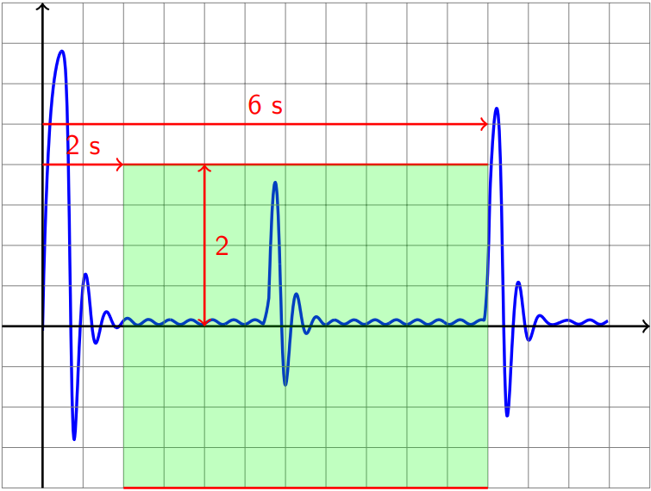
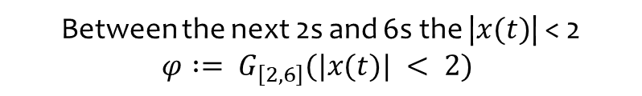
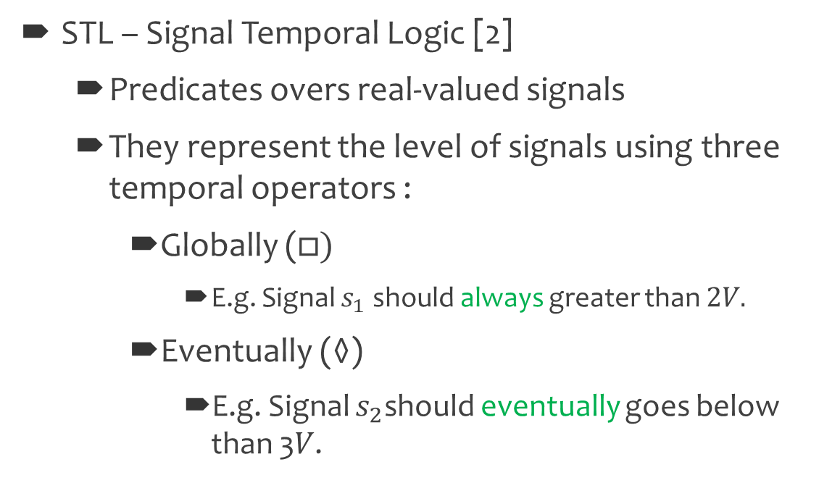
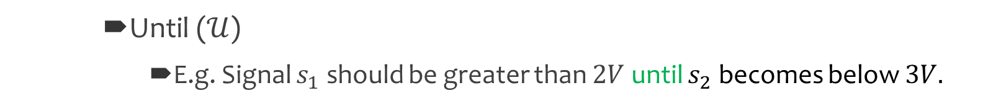
Expressing Timing Requirement in CPS (Previous Works)
STL – Signal Temporal Logic [2]
  Predicates overs real-valued signals
  They represent the level of signals using three temporal operators :
    Globally ($□)$
      E.g. Signal $s_{1}$ should always greater than $2V.$
    Eventually ($◊$)
      E.g. Signal $s_{2}$should eventually goes below than 3𝑉.
Between the next 2s and 6s the |$x(t)$| < 2
$$φ := G_{\left[2,6\right]}(|x(t)| < 2)$$
    Until ($𝒰$)
      E.g. Signal $s_{1}$ should be greater than $2V$ until $s_{2}$ becomes below $3V.$
[2] Donzé, Alexandre. "On signal temporal logic." International Conference on Runtime Verification. Springer, Berlin, Heidelberg, 2013.

Slide 9

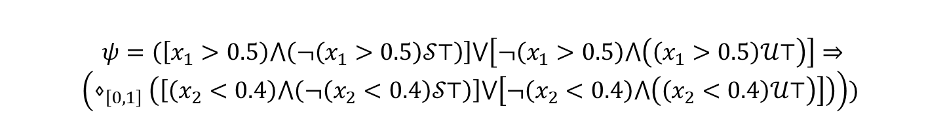

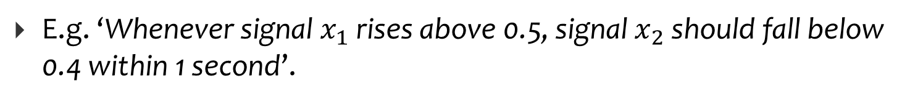



Even-based Timing Constraints in Previous Works
Some timing constraints express timing between instantaneous events.
Expressing events in STL are often convoluted and esoteric.
E.g. ‘Whenever signal $x_{1}$ rises above 0.5, signal $x_{2}$ should fall below 0.4 within 1 second’.
$$x_{1}(t)$$
$$0.6$$
$$0.4$$
$$x_{2}(t)$$
$$t≤1$$
$$ψ=\left(\left[x_{1}>0.5\right)⋀\left(¬\left(x_{1}>0.5\right)𝒮⊤\right)\right]⋁\left[¬\left(x_{1}>0.5\right)⋀\left(\left(x_{1}>0.5\right)𝒰⊤\right)\right]⇒$$
$$\left(⋄_{\left[0,1\right]}\left(\left[\left(x_{2}<0.4\right)⋀\left(¬\left(x_{2}<0.4\right)𝒮⊤\right)\right]⋁\left[¬\left(x_{2}<0.4\right)⋀\left(\left(x_{2}<0.4\right)𝒰⊤\right)\right]\right)\right))$$

Slide 10






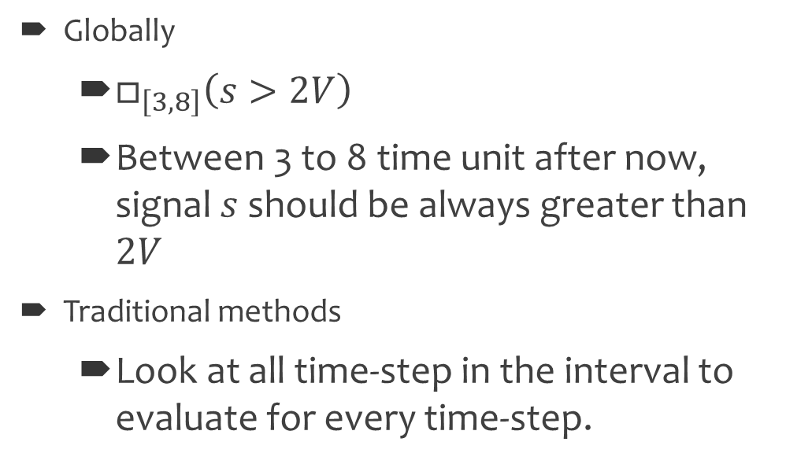


Existing Monitoring Approaches Vs TMA
Globally
  $□_{\left[3,8\right]}\left(s>2V\right)$
  Between 3 to 8 time unit after now, signal $s$ should be always greater than $2V$
Traditional methods
  Look at all time-step in the interval to evaluate for every time-step.
$$⊤$$
$$ψ$$
$$⊥$$
$$⊤$$
$$□_{\left[3,8\right]}ψ$$
$$⊥$$
$$t_{1}$$
$$t_{1}+3$$
$$t_{1}+8$$
time
  Optimized methods look into a portion of the interval. However, required memory and computation iterations still depend on the interval.
TMA
  Just examine the timestamps of the most recently events.

Slide 11










Existing Monitoring Approaches Vs TMA
Globally
  $□_{\left[3,8\right]}\left(s>2V\right)$
  Between 3 to 8 time unit after now, signal $s$ should be always greater than $2V$
Traditional methods
  Look at all time-step in the interval to evaluate for every time-step.
$$⊤$$
$$ψ$$
$$⊥$$
$$⊤$$
$$□_{\left[3,8\right]}ψ$$
$$⊥$$
$$t_{1}$$
$$t_{2}+3$$
$$t_{2}+8$$
time
$$t_{2}$$
  Optimized methods look into a portion of the interval. However, required memory and computation iterations still depend on the interval.
TMA
  Just examine the timestamps of the most recently events.

Slide 12




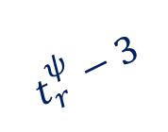
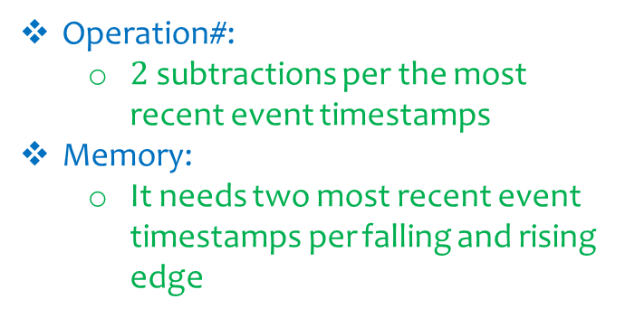


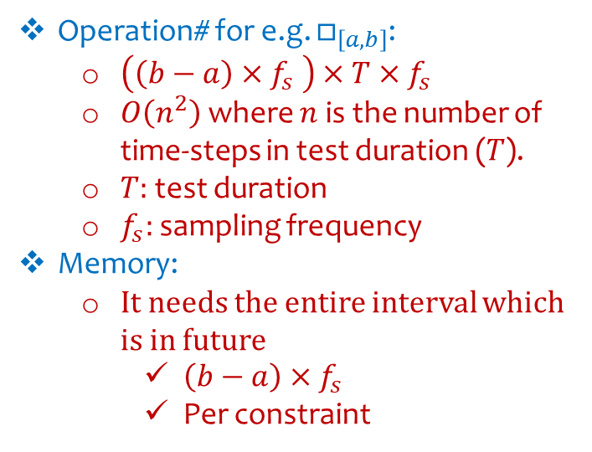








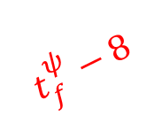
Existing Monitoring Approaches Vs TMA
Operation# for e.g. $□_{\left[a,b\right]}$:
  $\left(\left(b−a\right)×f_{s} \right)×T×f_{s}$
  $O\left(n^{2}\right)$ where $n$is the number of time-steps in test duration ($T$).
  $T:$ test duration
  $f_{s}:$ sampling frequency
Memory:
  It needs the entire interval which is in future
    $\left(b−a\right)×f_{s}$
    Per constraint
$$⊤$$
$$ψ$$
$$⊥$$
$$⊤$$
$$□_{\left[3,8\right]}ψ$$
$$⊥$$
$$t_{1}$$
$$t_{2}+3$$
$$t_{2}+8$$
time
$$t_{2}$$
$$⊤$$
$$t_{r}^{ψ}−3$$
$$⊥$$
$$t_{f}^{ψ}−8$$
$$ψ$$
Operation#:
  $2$ subtractions per the most recent event timestamps
Memory:
  It needs two most recent event timestamps per falling and rising edge
$$⊤$$
$$⊥$$
$$□_{\left[3,8\right]}ψ$$
$$t_{r}^{□_{\left[3,8\right]}ψ}$$
$$t_{f}^{□_{\left[3,8\right]}ψ}$$
$$t_{r}^{ψ}$$
$$t_{f}^{ψ}$$
time

Slide 13


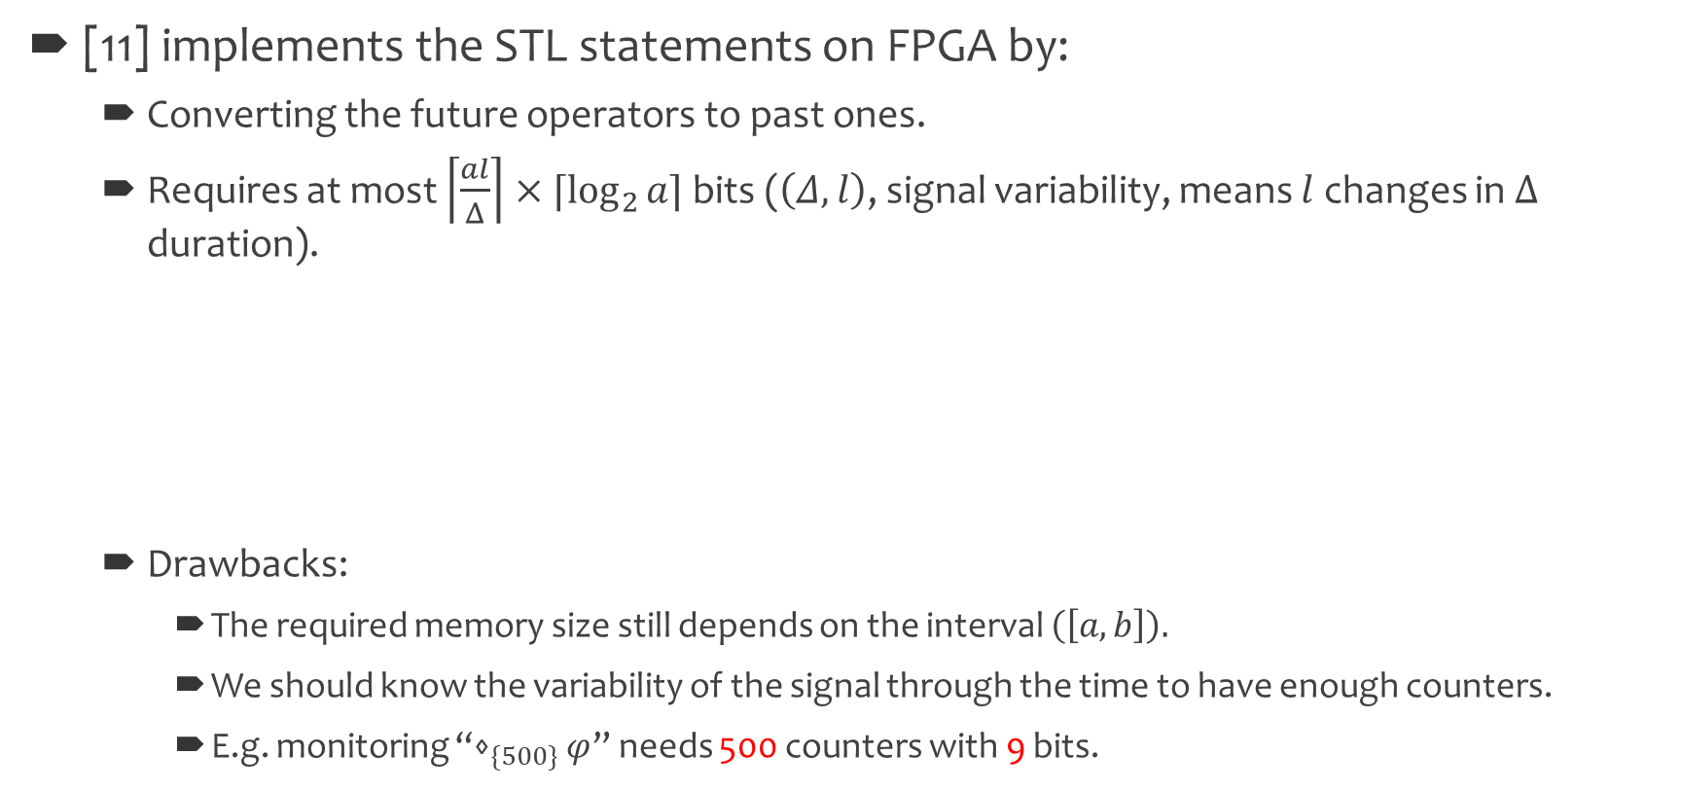


Implementing Monitoring Tool on FPGA
[11] implements the STL statements on FPGA by:
  Converting the future operators to past ones.
  Requires at most $\left\lceil \frac{al}{Δ}\right\rceil ×⌈\log_{2}{a⌉}$ bits ($\left(Δ,l\right)$, signal variability, means $l$ changes in $Δ$ duration).
  Drawbacks:
    The required memory size still depends on the interval $\left(\left[a,b\right]\right).$
    We should know the variability of the signal through the time to have enough counters.
    E.g. monitoring “$⋄_{\{500\}}φ$” needs 500 counters with 9 bits.
$$counter_{1}$$
$$counter_{2}$$
$$l=2$$
$$⊤$$
$$⊥$$
$$Δ=10$$
[11] Jakšić, Stefan, et al. "From signal temporal logic to FPGA monitors." Formal Methods and Models for Codesign (MEMOCODE),
2015 ACM/IEEE International Conference on. IEEE, 2015.

Slide 14




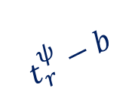







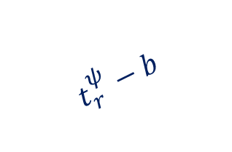



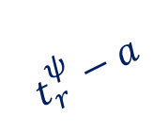








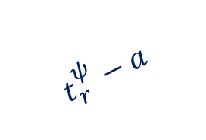






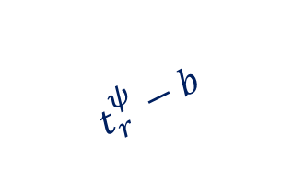













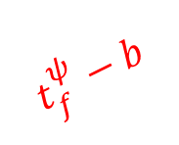

How to Add Calculated Timestamps to the Result
$$⊤$$
$$t_{r}^{ψ}−a$$
$$⊥$$
$$t_{f}^{ψ}−b$$
$$t_{r}^{ψ}−b$$
$$ψ$$
$$ψ$$
$$t_{r}^{ψ}−a$$
$$⊤$$
$$⊥$$
$$□_{\left[3,8\right]}ψ$$
$$□_{\left[a,b\right]}ψ$$
$$t_{f}^{ψ}$$
$$0$$
$$1$$
$$2$$
$$3$$
$$4$$
$$5$$
$$6$$
$$7$$
8
9
time
$$t_{r}^{□}$$
$$t_{f}^{□}$$
$$t_{r}^{ψ}$$
time
What If calculated timestamps are negative
$$t_{r}^{ψ}−b$$
$$t_{r}^{ψ}−a$$
$$t_{r}^{ψ}−a$$
$$ψ$$
$$t_{r}^{ψ}−b$$
$$ψ$$
$$⋄_{\left[a,b\right]}ψ$$
$$□_{\left[a,b\right]}ψ$$
$$0$$
$$1$$
$$2$$
$$3$$
$$4$$
$$5$$
$$6$$
$$7$$
8
9
time
$$0$$
$$1$$
$$2$$
$$3$$
$$4$$
$$5$$
$$6$$
$$7$$
8
9
time
What if calculated falling<rising
If the new rising is in the range of previous pulse

Slide 15



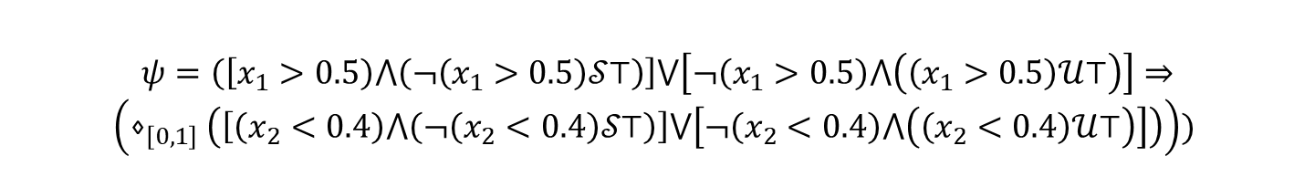
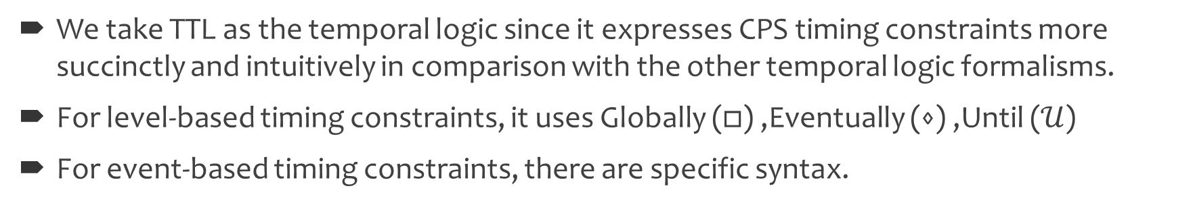






TTL as Logic to Monitor
We take TTL as the temporal logic since it expresses CPS timing constraints more succinctly and intuitively in comparison with the other temporal logic formalisms.
For level-based timing constraints, it uses Globally ($□$) ,Eventually ($⋄$) ,Until ($𝒰$)
For event-based timing constraints, there are specific syntax.
$$x_{1}(t)$$
In TTL:
$$0.6$$
$$ℒ\left(〈x_{1},0.5,↗〉,〈x_{2},0.4,↘〉\right)≤1$$
$$0.4$$
$$Δt=t_{2}−t_{1}≤1$$
$$x_{2}(t)$$
Needs Just one subtraction in TMA
$$t_{1}$$
$$t≤1$$
$$t_{2}$$
In STL:
$$ψ=\left(\left[x_{1}>0.5\right)⋀\left(¬\left(x_{1}>0.5\right)𝒮⊤\right)\right]⋁\left[¬\left(x_{1}>0.5\right)⋀\left(\left(x_{1}>0.5\right)𝒰⊤\right)\right]⇒$$
$$\left(⋄_{\left[0,1\right]}\left(\left[\left(x_{2}<0.4\right)⋀\left(¬\left(x_{2}<0.4\right)𝒮⊤\right)\right]⋁\left[¬\left(x_{2}<0.4\right)⋀\left(\left(x_{2}<0.4\right)𝒰⊤\right)\right]\right)\right))$$

Slide 16




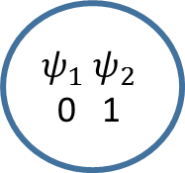





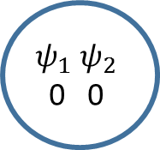





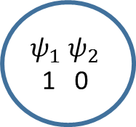








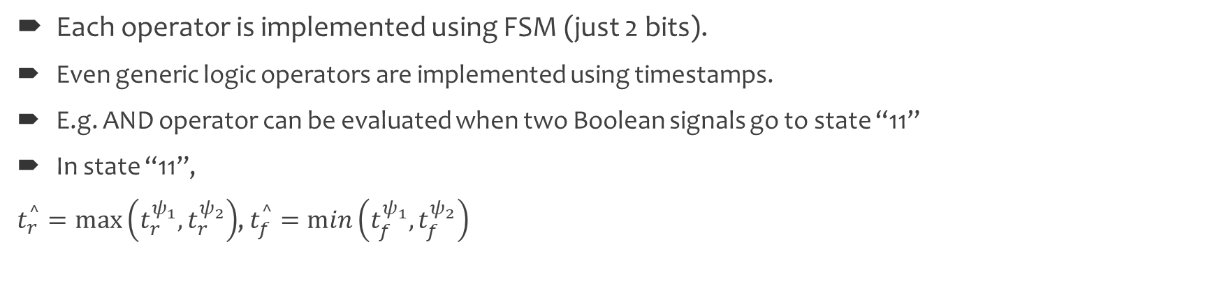
Implementation Logic Operators Using Timestamp
Each operator is implemented using FSM (just 2 bits).
Even generic logic operators are implemented using timestamps.
E.g. AND operator can be evaluated when two Boolean signals go to state “11”
In state “11”,
$t_{r}^{^}=\max\left(t_{r}^{ψ_{1}},t_{r}^{ψ_{2}}\right)$, $t_{f}^{^}=\min\left(t_{f}^{ψ_{1}},t_{f}^{ψ_{2}}\right)$
${ψ_{1}}_{r/}t_{r}^{Λ}$=$t_{r}^{ψ_{1}}$
$$ψ_{1} ψ_{2}$$
0 0
$${ψ_{2}}_{r}/−$$
$$ψ_{1} ψ_{2}$$
0 1
$${ψ_{2}}_{f}/−$$
$${ψ_{1}}_{f},{ψ_{2}}_{r}/−$$
$$ψ_{1}$$
${ψ_{1}}_{f},{ψ_{2}}_{f}/t_{f}^{Λ}$=$t_{f}^{ψ_{2}}$
$${ψ_{1}}_{f}/−$$
$$ψ_{2}$$
$${ψ_{1}}_{r}/−$$
${ψ_{1}}_{r},{ψ_{2}}_{r}/t_{r}^{Λ}$=$t_{r}^{ψ_{1}}$
$${ψ_{1}}_{r},{ψ_{2}}_{f}/−$$
$$ψ_{1}⋀ψ_{2}$$
$$ψ_{1} ψ_{2}$$
1 1
$$ψ_{1} ψ_{2}$$
1 0
${ψ_{2}}_{f}/t_{f}^{Λ}$=$t_{f}^{ψ_{2}}$
Calculating rising edge
${ψ_{2}}_{r}/t_{r}^{Λ}$=$t_{r}^{ψ_{2}}$
$$t_{r}^{ψ_{1}}$$
$$t_{r}^{ψ_{2}}$$
$$t_{f}^{ψ_{1}}$$
$$t_{f}^{ψ_{2}}$$
${ψ_{1}}_{f}/t_{f}^{Λ}$=$t_{f}^{ψ_{1}}$
$$t_{r}^{^}$$
$$t_{f}^{^}$$
Calculating falling edge
Transition links

Slide 17
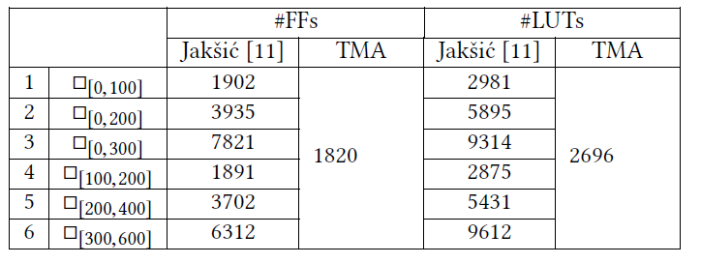
Memory Requirement on FPGA for Globally

Slide 18
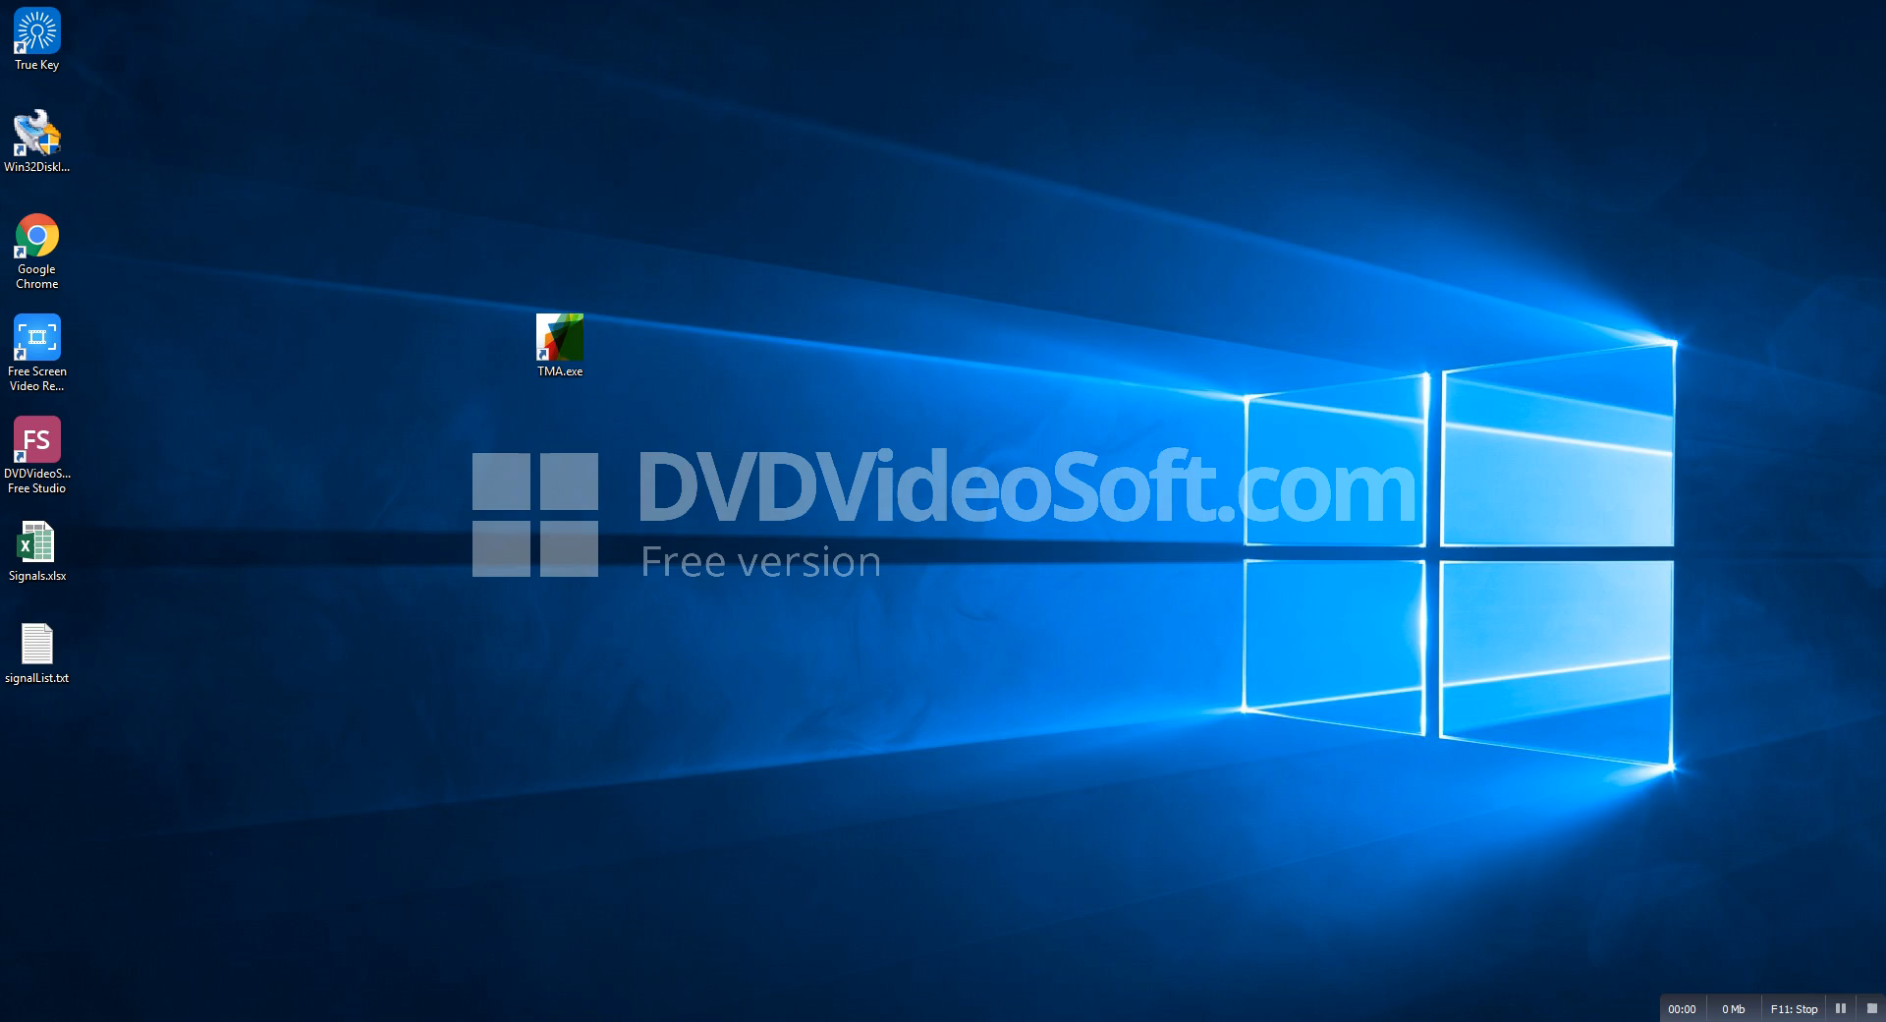
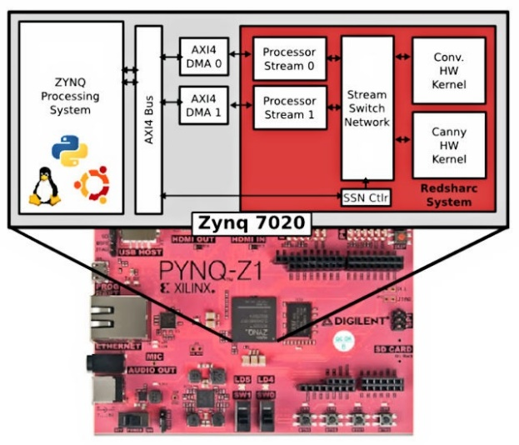
TMA Tool
The value of signals with their corresponding time, are logged in an excel sheet file (Signals.xlsx).
The list of signals that are interested to be monitored is in a text file (signalList.txt).
The timing constraint is written in the related box.

Slide 19
Conclusion
TMA is a lightweight monitoring methodology for CPS timing constraints.
The approach utilizes signal timestamps to compute the range for a constraint, rather than processing the levels of signals, requiring data at each sample.
TMA minimizes computation overhead compared to existing monitoring approaches.
The implementation is independent of the constraint interval, allowing the memory usage to be constant for any interval.
TMA uses FSMs to implement the constraints, therefore, the implementation is so light.
The method utilizes TTL, a more succinct and intuitive logic to express timing constraints. Therefore, implementing TTL timing constraint that are more concise than STL ones, is easier.

Slide 20
Questions

Slide 21
Backup

Slide 22



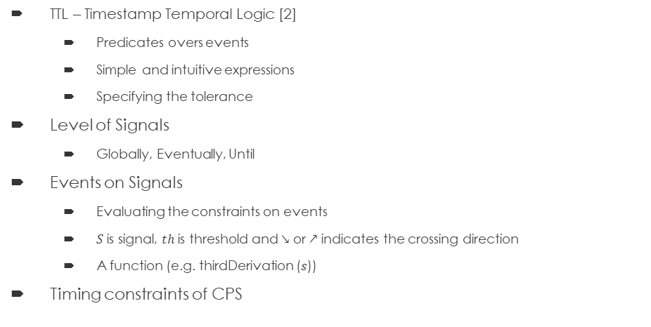

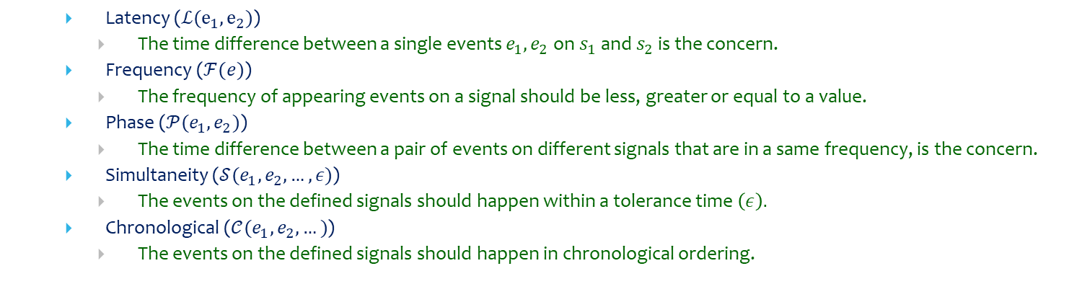

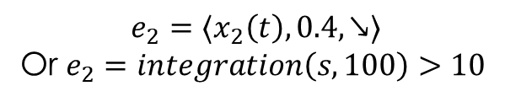


Timestamp Temporal Logic (TTL)
TTL – Timestamp Temporal Logic [2]
  Predicates overs events
  Simple and intuitive expressions
  Specifying the tolerance
Level of Signals
  Globally, Eventually, Until
Events on Signals
  Evaluating the constraints on events
  $S$ is signal, $th$ is threshold and $\text{↘}$ or $\text{↗}$ indicates the crossing direction
  A function (e.g. thirdDerivation ($s$))
Timing constraints of CPS
$$x_{1}(t)$$
$$0.6$$
$$ℒ\left(e_{1},e_{2}\right)≤5$$
$$0.4$$
$$x_{2}(t)$$
$$t≤5$$
$$e_{1}=〈x_{1}\left(t\right),0.6,\text{↗}〉$$
$$e_{2}=〈x_{2}\left(t\right),0.4,\text{↘}〉$$
Or $e_{2}=integration\left(s,100\right)>10$
  Latency ($ℒ(e_{1},e_{2})$)
    The time difference between a single events $e_{1},e_{2}$ on $s_{1}$ and $s_{2}$ is the concern.
  Frequency ($ℱ(e)$)
    The frequency of appearing events on a signal should be less, greater or equal to a value.
  Phase ($𝒫(e_{1},e_{2})$)
    The time difference between a pair of events on different signals that are in a same frequency, is the concern.
  Simultaneity ($𝒮(e_{1},e_{2},…,ε)$)
    The events on the defined signals should happen within a tolerance time $\left(ε\right).$
  Chronological ($𝒞(e_{1},e_{2},…)$)
    The events on the defined signals should happen in chronological ordering.
[2] Mehrabian, Mohammadreza, et al. "Timestamp Temporal Logic (TTL) for Testing the Timing of Cyber-Physical Systems." ACM Transactions on Embedded Computing Systems (TECS) (2017

Slide 23

Testing Low Variability Signals
$⋄_{\left[t_{AOP},t_{AOP}+t_{termination}\right]}\left(↑cut\right)$

Slide 24














$$ψ_{1}$$
$$⊤$$
$$⊥$$
$$⊤$$
$$t_{f_{1}}^{ψ_{2}}$$
$$⊥$$
$$ψ_{2}$$
$$⊤$$
$${ψ_{1}𝒰_{\left[2,4\right]}ψ}_{2}$$
$$⊥$$
$$1$$
$$3$$
$$5$$
$$6$$
$$7$$
8
9
time

Slide 25

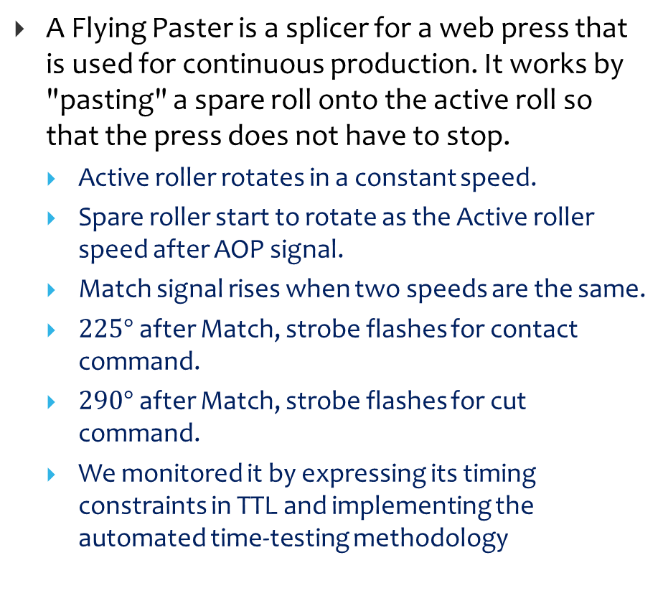
Flying Paster Application as a Testbed
A Flying Paster is a splicer for a web press that is used for continuous production. It works by "pasting" a spare roll onto the active roll so that the press does not have to stop.
  Active roller rotates in a constant speed.
  Spare roller start to rotate as the Active roller speed after AOP signal.
  Match signal rises when two speeds are the same.
  $225°$ after Match, strobe flashes for contact command.
  $290°$ after Match, strobe flashes for cut command.
  We monitored it by expressing its timing constraints in TTL and implementing the automated time-testing methodology
Spare Roller
Active Roller
Spare Roller
Active Roller
Spare Roller
Active Roller

Slide 26

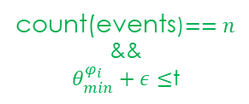













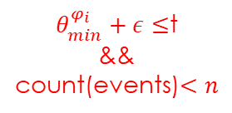



Implementation TTL Timing Constraints
$𝒮_{\left[a,b\right]}\left(φ_{1},…,φ_{n},ε\right):$ The events on the defined signals should happen within a tolerance time (𝜖).
$${θ_{min}:θ}_{1}$$
There is
no event
start
$${θ_{max}:θ}_{3}$$
1
$$ε$$
An event on
$φ_{1}$to${ φ}_{n}$
The constraint
is not met
$θ_{min}^{φ_{i}}+ε≤$t
&&
count(events)$<n$
3
$$θ_{min}−b$$
$$θ_{1}$$
$$θ_{2}$$
2
$$θ_{3}$$
$$θ_{max}−a$$
$$⊤$$
$$𝒮_{\left[a,b\right]}(φ_{1},φ_{2},φ_{3},ε)$$
The constraint
is met
count(events)$<n$
$$⊥$$
count(events)$==n$
&&
$θ_{min}^{φ_{i}}+ε≤$t
$$t_{r}^{𝒮}=min\left(θ^{φ_{i}}\right)−b$$
4
$$t_{f}^{𝒮}=max\left(θ^{φ_{i}}\right)−a$$
$$t_{r}^{𝒮}$$
$$t_{f}^{𝒮}$$

Slide 27
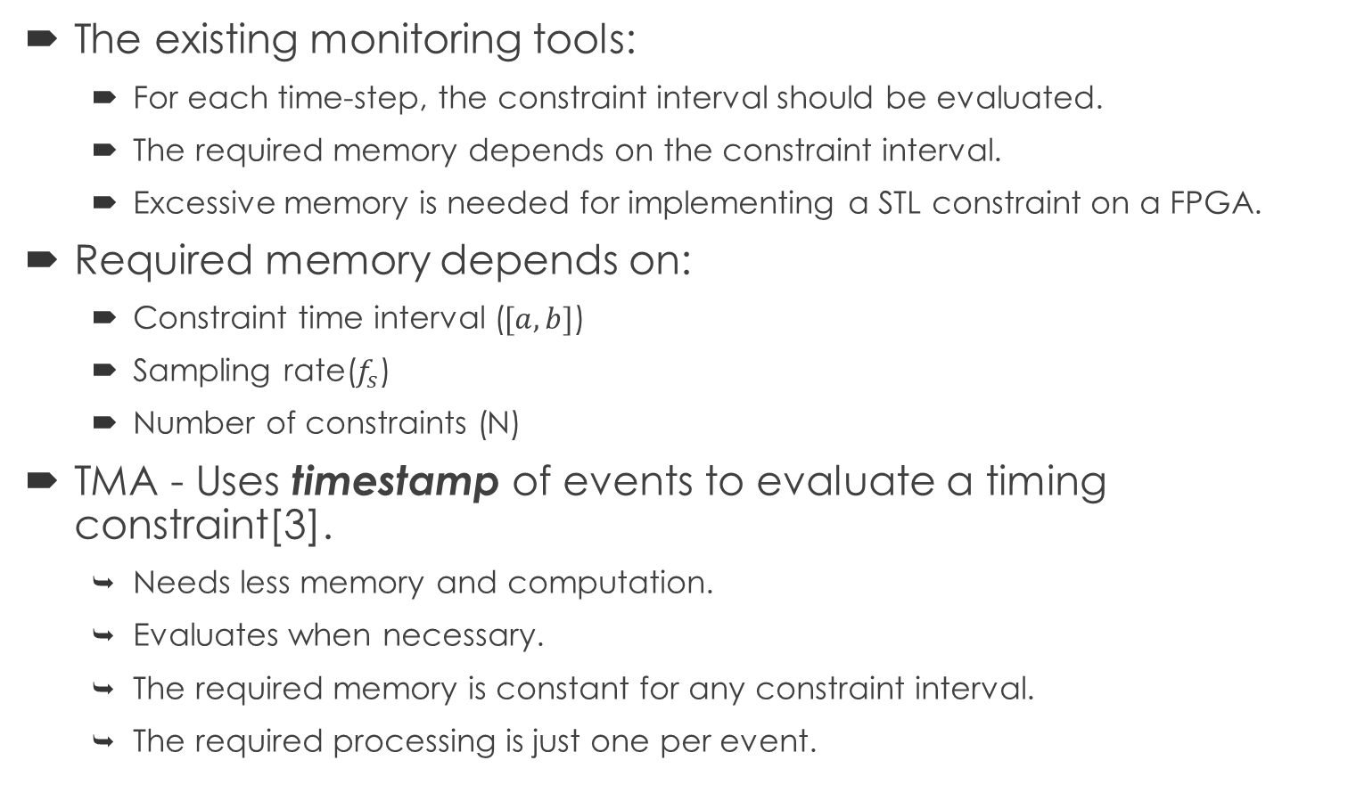
Existing Monitoring Approaches
The existing monitoring tools:
  For each time-step, the constraint interval should be evaluated.
  The required memory depends on the constraint interval.
  Excessive memory is needed for implementing a STL constraint on a FPGA.
Required memory depends on:
  Constraint time interval ($[a,b]$)
  Sampling rate($f_{s}$)
  Number of constraints (N)
TMA - Uses timestamp of events to evaluate a timing constraint[3].
  Needs less memory and computation.
  Evaluates when necessary.
  The required memory is constant for any constraint interval.
  The required processing is just one per event.
[3] Mehrabian, Mohammadreza, et al. “A Timestamp-based Monitoring Approach (TMA) for Online Monitoring of Temporal Behavior of Cyber-Physical Systems" DAC 2018.

Slide 28
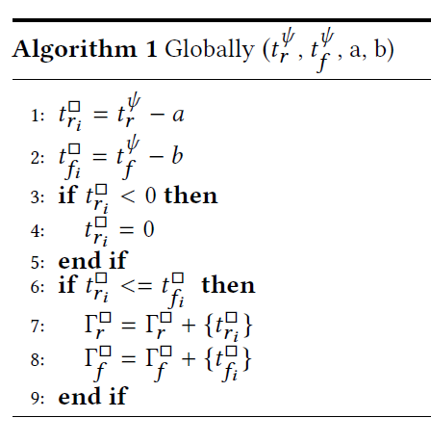
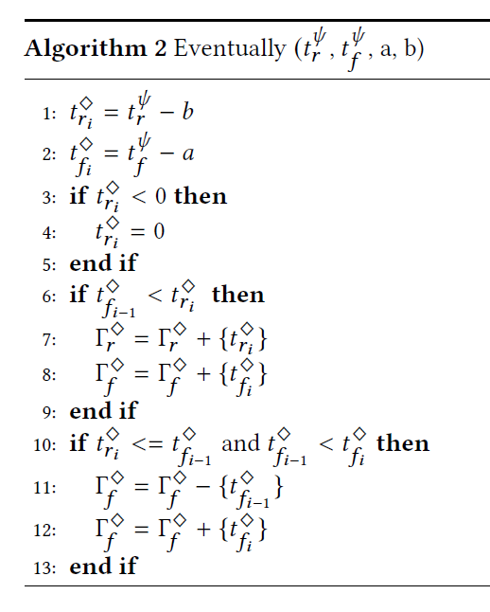
Globally and Eventually Algorithms
We do not add the new rising and falling edges when
They are negative
Rising is before falling
The previous falling edge is replaced when
The new rising is placed between the last rising an falling.

Slide 29
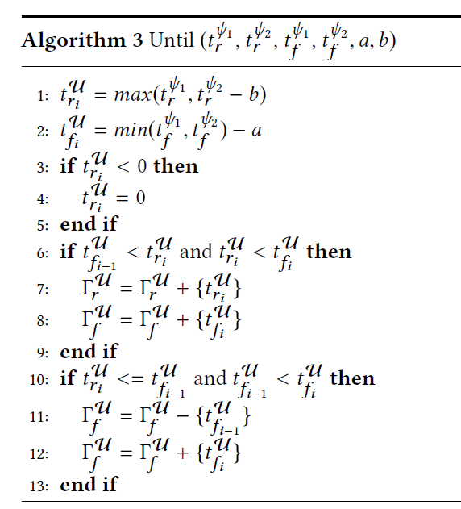
























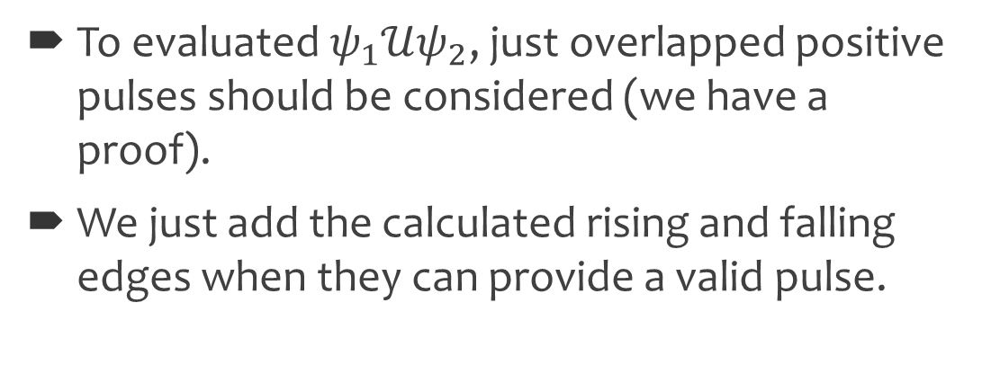
Until Algorithm
To evaluated $ψ_{1}𝒰ψ_{2}$, just overlapped positive pulses should be considered (we have a proof).
We just add the calculated rising and falling edges when they can provide a valid pulse.
$$t_{r_{1}}^{ψ_{1}}$$
$$t_{f_{1}}^{ψ_{1}}$$
$$t_{r_{2}}^{ψ_{1}}$$
$$t_{f_{2}}^{ψ_{1}}$$
$$ψ_{1}$$
$$⊤$$
$$t_{r_{1}}^{ψ_{2}}$$
A
C
D
$$⊥$$
$$t_{f_{1}}^{ψ_{2}}$$
$$⊤$$
B
$$⊥$$
$$t_{f_{1}}^{𝒰}$$
$$t_{f_{2}}^{𝒰}$$
$$t_{r_{2}}^{𝒰}$$
$$ψ_{2}$$
$$t_{r_{1}}^{𝒰}$$
$$⊤$$
$$⊥$$
$${ψ_{1}𝒰_{\left[2,4\right]}ψ}_{2}$$
$$1$$
$$3$$
$$5$$
$$6$$
$$7$$
8
9
time

