Slide 1
SDRM: Simultaneous Determination of Regions and Function-to-Region Mapping for Scratchpad Memories
Amit Pabalkar, Aviral Shrivastava, Arun Kannan and Jongeun Lee
Compiler and Micro-architecture Lab
School of Computing and Informatics
Arizona State University
High Performance Computing (HIPC)
December 2008
http://www.public.asu.edu/~ashriva6

Slide 2
Agenda
Motivation
SPM Advantage
SPM Challenges
Previous Approach
Code Mapping Technique
Results
Continuing Effort
http://www.public.asu.edu/~ashriva6

Slide 3
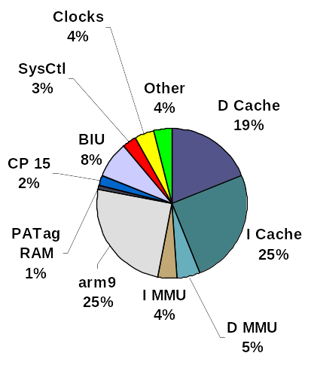
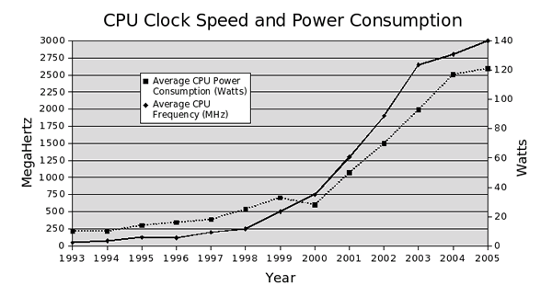
Motivation - The Power Trend
Within same process technology, a new processor design with 1.5x to 1.7x performance consumes 2x to 3x the die area [1] and 2x to 2.5x the power[2]
For a particular process technology with fixed transistor budget, the performance/power and performance/unit area scales with the number of cores.
Cache consumes around 44% of total processor power
Cache architecture cannot scale on a many-core processor due to cache coherency attributed performance degradation.
Go to References
http://www.public.asu.edu/~ashriva6
Notes:
4.1.2 Will we really fit 1000s of cores on one economical chip
This significant reduction in the size and complexity of the basic processor building
block of the future means that many more cores can be economically implemented on a
single die; furthermore, this number can double with each generation of silicon. For
example, the “manycore” progression might well be 128, 256, 512, ... cores instead of the
current “multicore” plan of 2, 4, 8, ... cores over the same semiconductor process
generations.
There is strong empirical evidence that we can achieve 1000 cores on a die when 30nm
technology is available. (As Intel has taped out a 45-nm technology chip, 30 nm is not so
distant in the future.) Cisco today embeds in its routers a network processor with 188
cores implemented in 130 nm technology. [Eatherton 2005] This chip is 18mm by 18mm,
The Landscape of Parallel Computing Research: A View From Berkeley
23
dissipates 35W at a 250MHz clock rate, and produces an aggregate 50 billion instructions
per second. The individual processor cores are 5-stage Tensilica processors with very
small caches, and the size of each core is 0.5 mm2. About a third of the die is DRAM and
special purpose functions. Simply following scaling from Moore's Law would arrive at
752 processors in 45nm and 1504 in 30nm. Unfortunately, power may not scale down
with size, but we have ample room before we push the 150W limit of desktop or server
applications.

Slide 4
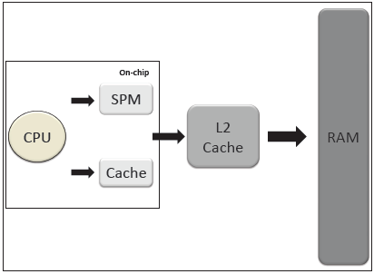
Scratchpad Memory(SPM)
High speed SRAM internal memory for CPU
SPM falls at the same level as the L1 Caches in memory hierarchy
Directly mapped to processor’s address space.
Used for temporary storage of data, code in progress for single cycle access by CPU
http://www.public.asu.edu/~ashriva6

Slide 5


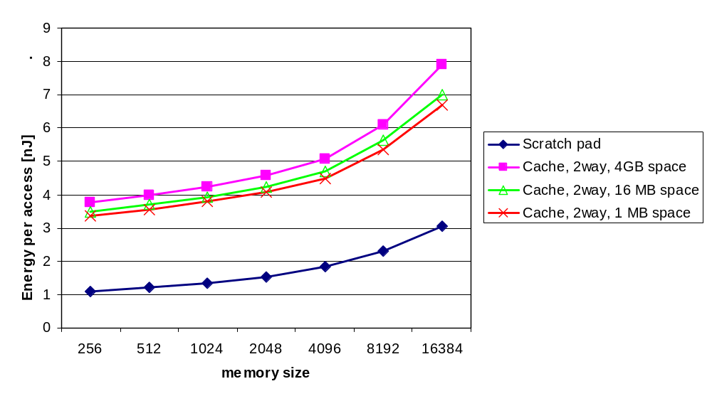



The SPM Advantage
Tag Array
Data Array
Tag Comparators, Muxes
Address Decoder
Address Decoder
Cache
SPM
40% less energy as compared to cache
  Absence of tag arrays, comparators and muxes
34 % less area as compared to cache of same size
  Simple hardware design (only a memory array & address decoding circuitry)
Faster access to SPM than physically indexed and tagged cache
http://www.public.asu.edu/~ashriva6

Slide 6
Challenges in using SPMs
Application has to explicitly manage SPM contents
  Code/Data mapping is transparent in cache based architectures
Mapping Challenges
  Partitioning available SPM resource among different data
  Identifying data which will benefit from placement in SPM
  Minimize data movement between SPM and external memory
  Optimal data allocation is an NP-complete problem
Binary Compatibility
  Application compiled for specific SPM size
Sharing SPM in a multi-tasking environment
Need completely automated solutions (read compiler solutions)
http://www.public.asu.edu/~ashriva6

Slide 7
Using SPM
int global;
FUNC2() {
int a, b;
global = a + b;
}
FUNC1(){
FUNC2();
}
int global;
FUNC2() {
int a,b;
DSPM.fetch.dma(global)
global = a + b;
DSPM.writeback.dma(global)
}
FUNC1(){
ISPM.overlay(FUNC2)
FUNC2();
}
Original Code
SPM Aware Code
Notes:
Code: Predictable due to spatial and temporal locality
Size remains unchanged
Lifetime of a function extends from start of program to the last reference
Read only, no need to write back to main memory
Greater scope of energy reduction by mapping code to SPM

Slide 8
Previous Work
Static Techniques [3,4]. Contents of SPM do not change during program execution – less scope for energy reduction.
Profiling is widely used but has some drawbacks [3, 4, 5, 6, 7,8]
  Profile may depend heavily depend on input data set
  Profiling an application as a pre-processing step may be infeasible for many large applications
  It can be time consuming, complicated task
ILP solutions do not scale well with problem size [3, 5, 6, 8]
Some techniques demand architectural changes in the system [6,10]
http://www.public.asu.edu/~ashriva6

Slide 9
Code Allocation on SPM
What to map?
  Segregation of code into cache and SPM
  Eliminates code whose penalty is greater than profit
    No benefits in architecture with DMA engine
  Not an option in many architecture e.g. CELL
Where to map?
  Address on the SPM where a function will be mapped and fetched from at runtime.
  To efficiently use the SPM, it is divided into bins/regions and functions are mapped to regions
    What are the sizes of the SPM regions?
    What is the mapping of functions to regions?
  The two problems if solved independently leads to sub-optimal results
Our approach is a pure software dynamic technique based on static analysis addressing the ‘where to map’ issue. It simultaneously solves the region size and function-to-region mapping sub-problems
http://www.public.asu.edu/~ashriva6

Slide 10
Problem Formulation
Input
  Set V = {v₁ , v₂ … v_{f} } – of functions
  Set S = {s₁ , s₂ … s_{f} } – of function sizes
  E_{spm/access} and E _{cache/access}
  E_{mbst} energy per burst for the main memory
  E_{ovm} energy consumed by overlay manager instruction
Output
  Set {S₁, S₂, … S_{r}} representing sizes of regions R = {R₁, R₂, … R_{r} } such that ∑ S_{r} ≤ SPM-SIZE
  Function to Region mapping, X[f,r] = 1, if function f is mapped to region r, such that ∑ S_{f} x X[f,r] ≤ S_{r}
Objective Function
  Minimize Energy Consumption
    E^{vi}_{hit} = nhit_{vi} x (E_{ovm} + E_{spm/access} x s_{i})
    E^{vi}_{miss} = nmiss_{vi} x (E_{ovm} + E_{spm/access} x s_{i} + E_{mbst} x (s_{i} + s_{j}) / N_{mbst}
    E_{total} = ∑ (E^{vi}_{hit} + E^{vi}_{miss})
  Maximize Runtime Performance
http://www.public.asu.edu/~ashriva6

Slide 11
Overview
http://www.public.asu.edu/~ashriva6
Application
Static Analysis
GCCFG
Weight Assignment
Compiler Framework
Function Region Mapping
SDRM Heuristic/ILP
Interference Graph
Link Phase
Instrumented Binary
Cycle Accurate Simulation
Energy Statistics
Performance Statistics
http://www.public.asu.edu/~ashriva6

Slide 12
Limitations of Call Graph
MAIN ( ) F2 ( )
F1( ) for
for F6 ( )
F2 ( ) F3 ( )
end for while
END MAIN F4 ( ) end while
F5 (condition) end for
if (condition) F5( )
condition = … END F2
F5()
end if
END F5
main
Call Graph
F1
F2
F5
F6
F3
F4
Limitations
  No information on relative ordering among nodes (call sequence)
  No information on execution count of functions
http://www.public.asu.edu/~ashriva6
Notes:
Problems in profiling, problems in call graphs. GCCFG not needed here

Slide 13
Global Call Control Flow Graph
MAIN ( ) F2 ( )
F1( ) for
for F6 ( )
F2 ( ) F3 ( )
end for while
END MAIN F4 ( ) end while
F5 (condition) end for
if (condition) if()
condition = … F5( )
else else
F5(condition) F1()
end if end if
END F5 END F2
main
Loop Factor 10
Recursion Factor 2
F1
L1
20
I1
T
10
F2
F5
10
F
F
L2
F1
I2
100
L3
F6
F3
F4
100
1000
Advantages
  Strict ordering among the nodes. Left child is called before the right child
  Control information included (L-nodes and I-nodes)
  Node weights indicate execution count of functions
  Recursive functions identified
http://www.public.asu.edu/~ashriva6

Slide 14



Interference Graph
main
  Caller-Callee-no-loop
  Caller-Callee-in-loop
Create Interference Graph.
  Node of I-Graph are functions or F-nodes from GCCFG
  There is an edge between two F-nodes nodes if they interfere with each other.
The edges are classified as
  Caller-Callee-no-loop,
  Caller-Callee-in-loop,
  Callee-Callee-no-loop,
  Callee-Callee-in-loop
Assign weights to edges of I-Graph
  Caller-Callee-no-loop:
    cost[i,j] = (s_{i} + s_{j}) x w_{j}
  Caller-Callee-in-loop:
    cost[i,j] = (s_{i} + s_{j}) x w_{j}
  Callee-Callee-no-loop:
    cost[i,j] = (s_{i}+ s_{j}) x w_{k}, where w_{k}= MIN (w_{i} , w_{j} )
  Callee-Callee-in-loop:
    cost[i,j] = (s_{i}+ s_{j}) x w_{k}, where w_{k}= MIN (w_{i} , w_{j} )
F1
F1
L3
  Callee-Callee-in-loop
20
F2
F5
10
F2
F5
L3
100
F6
F3
L3
1000
F6
F3
F4
100
F4
3000
500
120
500
400
routines | Size
F2 | 2
F3 | 3
F4 | 1
F6 | 4
F1 | 2
F5 | 4
600
700
http://www.public.asu.edu/~ashriva6

Slide 15
SDRM Heuristic
Interference Graph
routines | Size
F2 | 2
F3 | 3
F4 | 1
F6 | 4
Interference Graph
3000
F4
F2
500
500
400
600
F3
F6
F6
700
F2
1
R1
2
Suppose SPM size is 7KB
F4
F4,F3
3
R2
F6,F3
F3
F6
Region
Routine
Size
Cost
F3
4
R3
R1
F2
2
0
5
R2
F6
6
R2
F4
F4,F3
1
3
0
400
R3
F6
7
R3
F6,F3
F6
4
4
700
700
0
Total
Total
Total
7
3
9
10
700
0

Slide 16
Flow Recap
Application
Static Analysis
GCCFG
Weight Assignment
Compiler Framework
Function Region Mapping
SDRM Heuristic/ILP
Interference Graph
Link Phase
Instrumented Binary
Cycle Accurate Simulation
Energy Statistics
Performance Statistics
http://www.public.asu.edu/~ashriva6

Slide 17
Overlay Manager
Overlay Table
F1(){
ISPM.overlay(F3)
F3();
}
F3() {
ISPM.overlay(F2)
F2()
…
ISPM.return
}
ID
Region
VMA
LMA
Size
F1
0
0x30000
0xA00000
0x100
F2
0
0x30000
0xA00100
0x200
F3
1
0x30200
0xA00300
0x1000
F4
1
0x30200
0xA01300
0x300
F5
2
0x31200
0xA01600
0x500
Region Table
Region
ID
0
F1
F2
F1
1
F3
2
F5
main
….
F1
F3
F2

Slide 18
Performance Degradation
Scratchpad Overlay Manager is mapped to cache
Branch Target Table has to be cleared between function overlays to same region
Transfer of code from main memory to SPM is on demand
FUNC1( ) {
computation …
ISPM.overlay(FUNC2)
FUNC2();
}
FUNC1( ) {
ISPM.overlay(FUNC2)
computation …
FUNC2();
}
http://www.public.asu.edu/~ashriva6

Slide 19
SDRM-prefetch
main
Q = 10
C = 10
MAIN ( ) F2 ( )
F1( ) for
for computation
F2 ( ) F6 ( )
end for computation
END MAIN F3 ( )
F5 (condition) while
if (condition) F4 ( ) end while
F5() end for
end if computation
END F5 F5( )
END F2
1
F1
L1
10
F2
C3
10
L2
F5
10
C1
F6
L3
100
C2
1000
F3
100
F4
Modified Cost Function
cost_{p}[vi, vj ] = (si + sj) x min(wi,wj) x latency _{cycles/byte} - (Ci + Cj)
cost[vi,vj] = cost_{e}[vi, vj ] x cost_{p}[vi, vj ]
SDRM
SDRM-prefetch
Region
ID
Region
Region
0
F1
F2
F2,F1
0
F1
F2
F2,F1
1
F4,F5
1
F4
2
F3
2
F3,F6
3
F6
3
F5

Slide 20
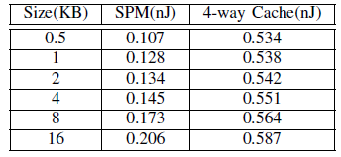
Energy Model
E_{TOTAL} = E_{SPM} + E_{I-CACHE} + E_{TOTAL-MEM}
E_{SPM} = N_{SPM} x E_{SPM-ACCESS}
E_{I-CACHE} = E_{IC-READ-ACCESS} x { N_{IC-HITS} + N_{IC-MISSES} } + E_{IC-WRITE-ACCESS} x 8 x N_{IC-MISSES}
E_{TOTAL-MEM} = E_{CACHE-MEM} + E_{DMA}
E_{CACHE-MEM} = E^{MBST} x N_{IC-MISSES}
E_{DMA} = N_{DMA-BLOCK} x E_{MBST} x 4
http://www.public.asu.edu/~ashriva6

Slide 21
Performance Model
chunks = block-size + (bus width - 1) / bus width (64 bits)
mem lat[0] = 18 [first chunk]
mem lat[1] = 2 [inter chunk]
total-lat = mem lat[0] + mem lat[1] x (chunks - 1)
latency _{cycles/byte} = total-lat / block-size
http://www.public.asu.edu/~ashriva6

Slide 22
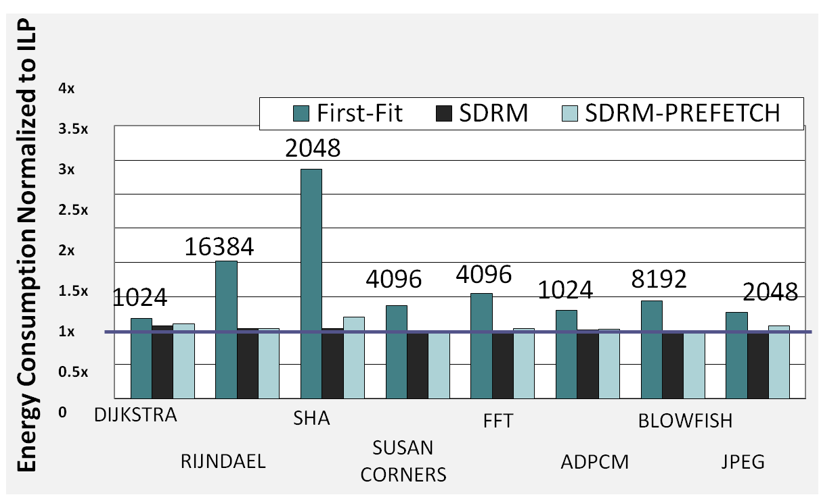
SDRM is power efficient
Average Energy Reduction of 25.9% for SDRM
http://www.public.asu.edu/~ashriva6

Slide 23
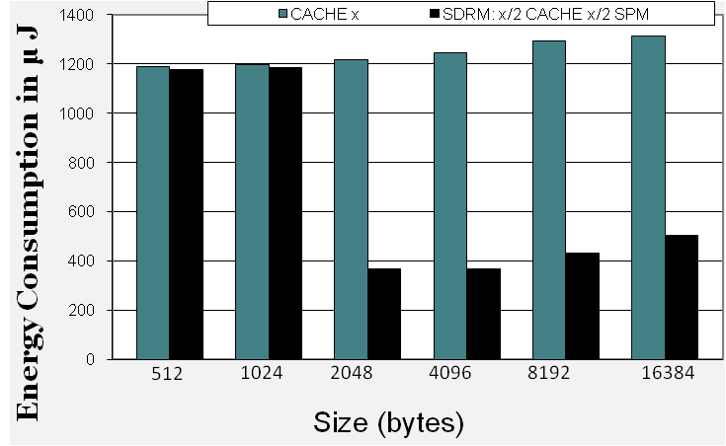
Cache Only vs Split Arch.
ARCHITECTURE 1
X bytes
Instruction
Cache
X bytes
Instruction
Cache
Data
Cache
On chip
ARCHITECTURE 2
x/2 bytes
Instruction cache
Data
Cache
Avg. 35% energy reduction across all benchmarks
Avg. 2.08% performance degradation
x/2 bytes Instruction SPM
On chip
http://www.public.asu.edu/~ashriva6

Slide 24
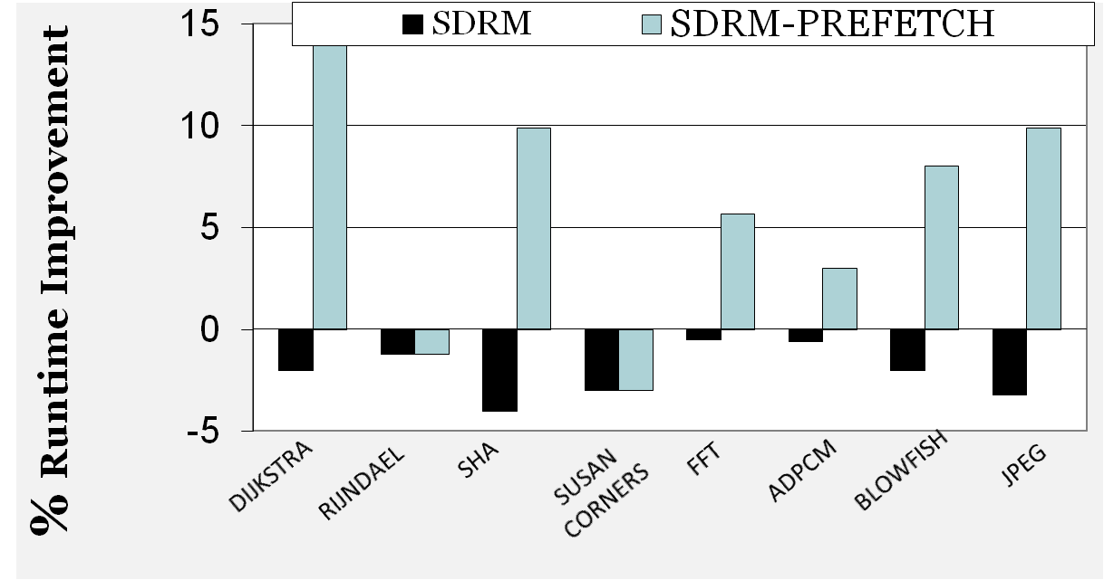
SDRM with prefetching is better
Average Performance Improvement 6%
Average Energy Reduction 32% (3% less)
http://www.public.asu.edu/~ashriva6

Slide 25
Conclusion
By splitting an Instruction Cache into an equal sized SPM and I-Cache, a pure software technique like SDRM will always result in energy savings.
Tradeoff between energy savings and performance improvement.
SPM are the way to go for many-core architectures.
http://www.public.asu.edu/~ashriva6

Slide 26
Continuing Effort
Improve static analysis
Investigate effect of outlining on the mapping function
Explore techniques to use and share SPM in a multi-core and multi-tasking environment
http://www.public.asu.edu/~ashriva6

Slide 27
References
http://www.public.asu.edu/~ashriva6
New Microarchitecture Challenges for the Coming Generations of CMOS Process Technologies. Micro32.
GROCHOWSKI, E., RONEN, R., SHEN, J., WANG, H. 2004. Best of Both Latency and Throughput. 2004 IEEE International Conference on Computer Design (ICCD ‘04), 236-243.
S. Steinke et al. : Assigning program and data objects to scratchpad memory for energy reduction.
F. Angiolini et al: A post-compiler approach to scratchpad mapping code.
B Egger, S.L. Min et al. : A dynamic code placement technique for scratchpad memory using postpass optimization
B Egger et al : Scratchpad memory management for portable systems with a memory management unit
M. Verma et al. : Dynamic overlay of scratchpad memory for energy minimization
M. Verma and P. Marwedel : Overlay techniques for scratchpad memories in low power embedded processors*
S. Steinke et al. : Reducing energy consumption by dynamic copying of instructions onto onchip memory
A. Udayakumaran and R. Barua: Dynamic Allocation for Scratch-Pad Memory using Compile-time Decisions

