Slide 1
IncidentNet
Traffic Incident Detection, Localization
and Severity Estimation with Sparse Sensing
Sai Shashank Peddiraju*, Kaustubh Harapanahalli*, Edward Andert, Aviral Shrivastava
Arizona State University
presented at
IEEE International Conference of Intelligent Transportation Systems (ITSC) 2024
* - indicates equal contribution

Slide 2






Motivation for Incident Detection
Traffic Incident Categories
Impact of Traffic Accident
Broader Issues of Traffic Incidents
28 million incidents, costing of $340 Billion^{[1]}
Emergency response delayed by 5-minutes, increasing fatality rate by 46% ^{[2]}
Cargo Spills
Stalled Vehicles
Traffic Incidents
Traffic Accidents
Delayed emergency
services
Road Maintenance
Traffic Accidents
Commuter’s safety
Emergency response under 7-minutes, decreasing fatality rate by 58% ^{[2]}
Traffic congestion
[1] Lawrence Blincoe et al. The economic and societal impact of motor vehicle crashes, 2019. Technical report, 2022.
[2] James P Byrne et al. Association between emergency medical service response time and motor vehicle crash mortality in the United States. JAMA Surgery, 154:286–293, 2019.
2

Slide 3
Existing Incident Detection Works
Previous Works | Region | Dataset | Sensor Modality | Model | Approach | Limitations
Chen et al.^{[1]} | Highway | Macroscopic | Inductive Loop Detectors | XGBoost | Trained on data from upstream and downstream traffic detectors | Requires data from consecutive detectors
Bao et al.^{[2]} | Highway | Microscopic | Traffic Cameras | YOLOv3 | Detects incidents based on vehicle speed by tracking vehicles in the camera’s field of view | Can detect incidents only in field-of-view
Han et al.^{[3]} | Urban | Microscopic | GPS probes | Clustering | Detects incidents by matching real-time GPS speed vectors with historical incident patterns | Affected by noise and interference and mandates the installation of a GPS probe in every vehicle
Yang et al.^{[4]} | Urban | Macroscopic | Inductive Loop Detectors | Deep Learning | Detects incidents using deep-learning network to detect incidents | Uses Simplistic simulation which does not model real city traffic
Zhu et al.^{[5]} | Urban | Macroscopic | Inductive Loop Detectors | Custom CNN | Detects incidents based on constructed a connectivity matrix of sensors | Uses only traffic counts for detecting incidents
IncidentNet | Urban Highways | Microscopic | Traffic Cameras | XGBoost TabNet | Used Tabular ML models to detect incidents from data derived from microscopic traffic data | -
[1] Chen et al. More robust and better: Automatic traffic incident detection based on XGBoost (ATTCA 2023)
[2] Bao et al. Research on Highway Traffic Event Detection Method Based on Image Processing (IOP EES 2021)
[3] Han et al. Traffic incident detection: A trajectory-based approach, (ICDE 2020)
[4] Yang et al. Traffic Incident Generation And Supervised Learning-Based Detection Via A Microscopic Simulation Platform (ITSC 2023)
[5] Zhu et al. Deep learning approach for traffic incident detection in urban networks, (ITSC 2018)
3

Slide 4
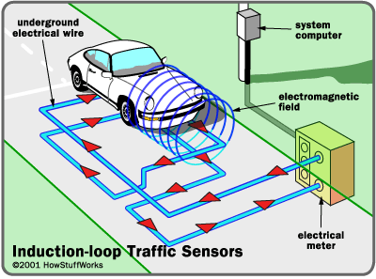
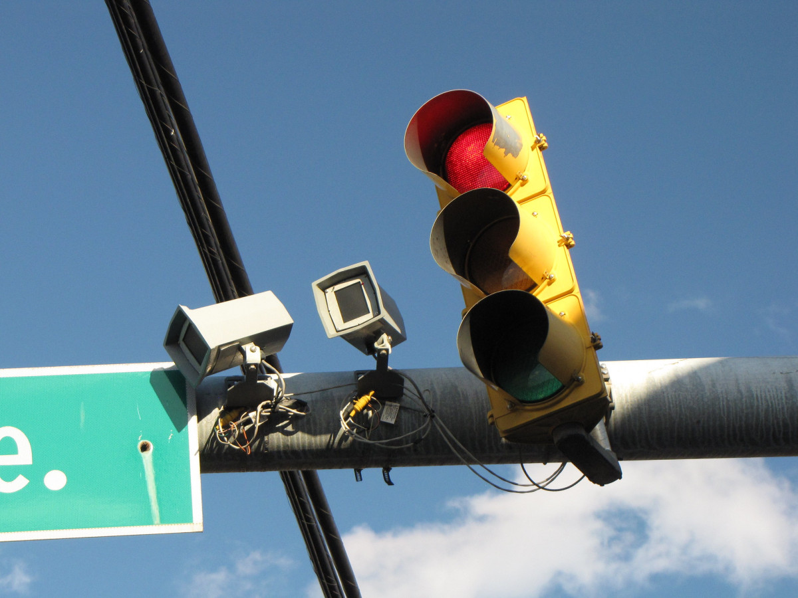
Existing Incident Detection Works (continued…)
Macroscopic dataset
Microscopic dataset
Features: average traffic flow, count, and density calculated over time.
Sensors: Inductive Loop Detectors.
Examples: datasets PEMS Bay, METR-LA, SFO I-880
Features: individual vehicle speed, timestamps, vehicle unique identifiers
Sensors: Cameras, Bluetooth Sensors, GPS.
Example datasets: Highway 99-W, NYC taxi data.
Time | Average Speed | Traffic Count | Average traffic occupancy
5 | 67.04 | 48 | 0.20
10 | 70 | 45 | 0.18
15 | 71 | 59 | 0.15
Timestamp | Vehicle Identifier | Speed | Lane Number
10:00:23 | Purple Sedan | 72 | 3
10:02:11 | Blue SUV | 40 | 1
10:07:00 | Black Sedan | 65 | 3
4

Slide 5
Challenges for Accurate Incident Detection
Our Contributions
A generic approach for generating realistic microscopic datasets using real-world captured macroscopic data
Lack of microscopic datasets
A deep-learning-based algorithm that can detect, localize and estimate severity on microscopic datasets for both urban regions and highways
Algorithm to detect, locate, and estimate severity of incidents in urban regions
5

Slide 6
Our Approach
Workflow of Microscopic Traffic Dataset Generation | Generalized Approach for Traffic Incident Detection, Localization and Severity Estimation

Slide 7



Workflow of Microscopic Traffic Dataset Generation
Traffic Flow Generation
Publicly Available Real-World Macroscopic Data
Construct Traffic Model
Microscopic Traffic Simulator
Generate Microscopic Traffic Incident Dataset
Traffic Incident Generator
7

Slide 8
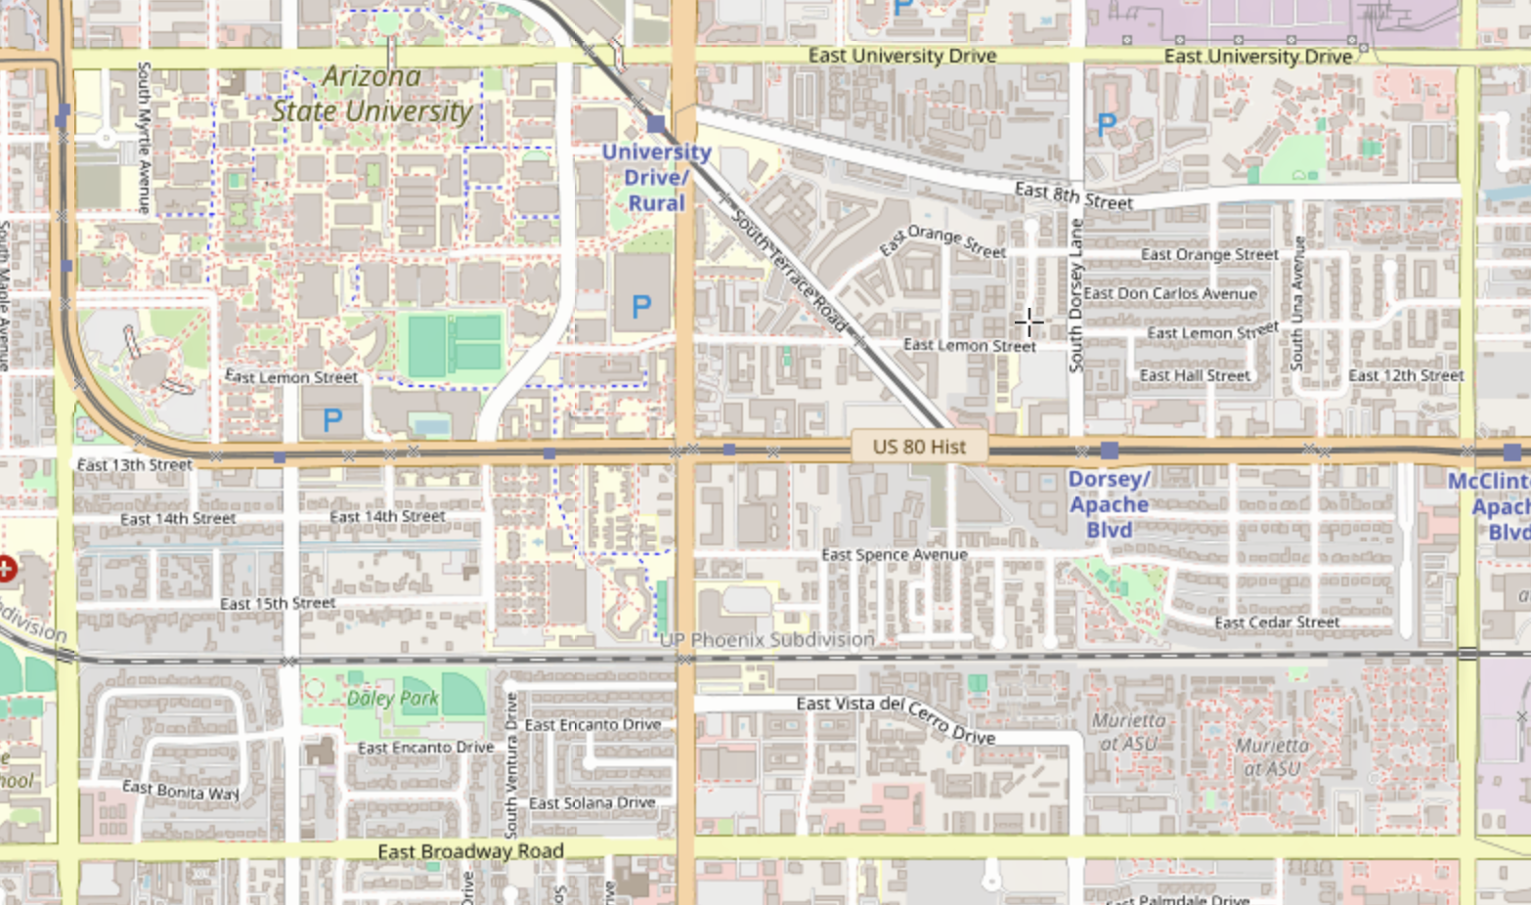
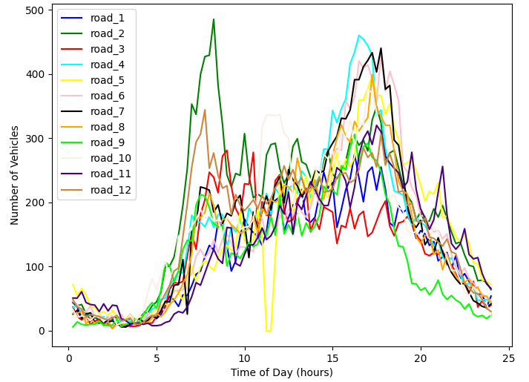
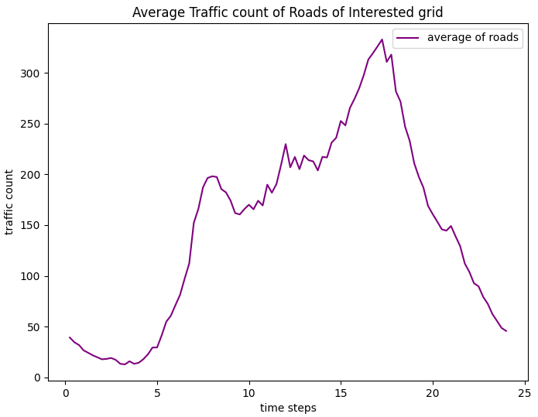
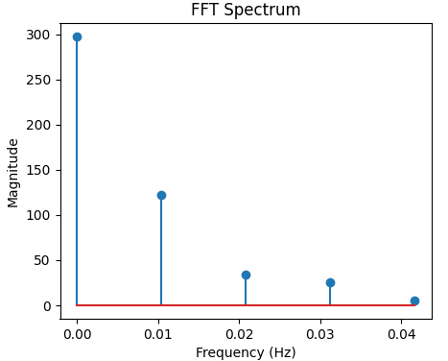
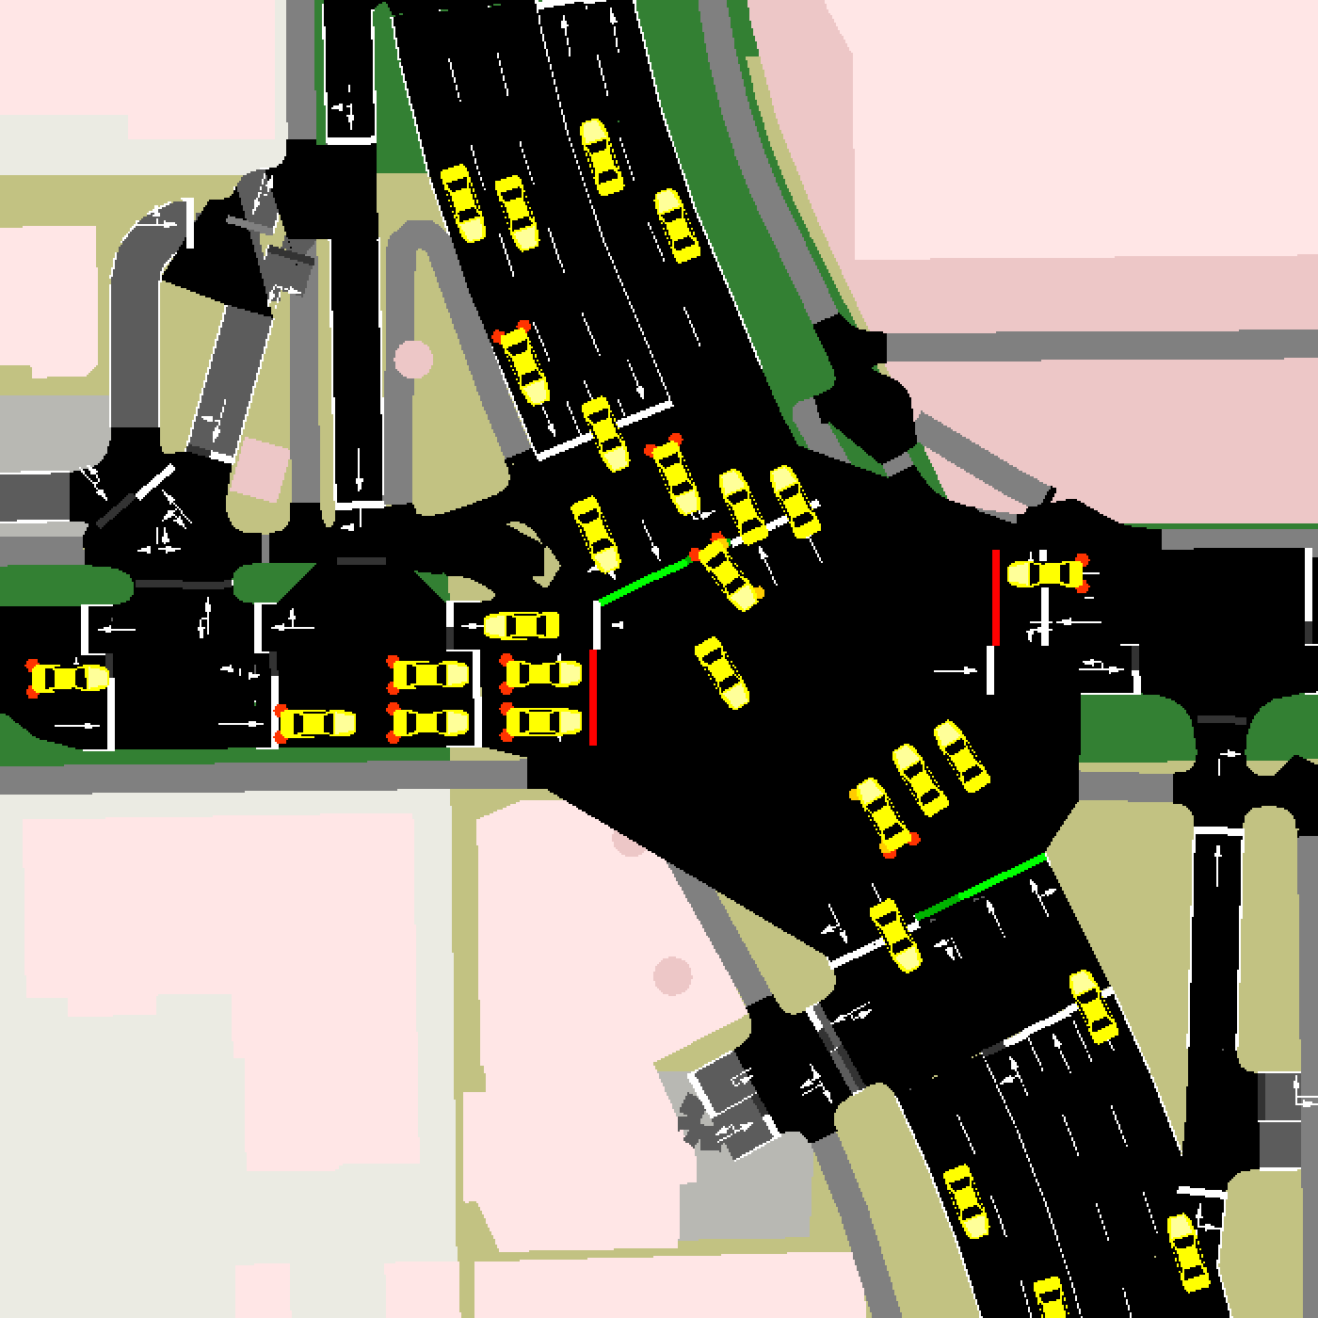
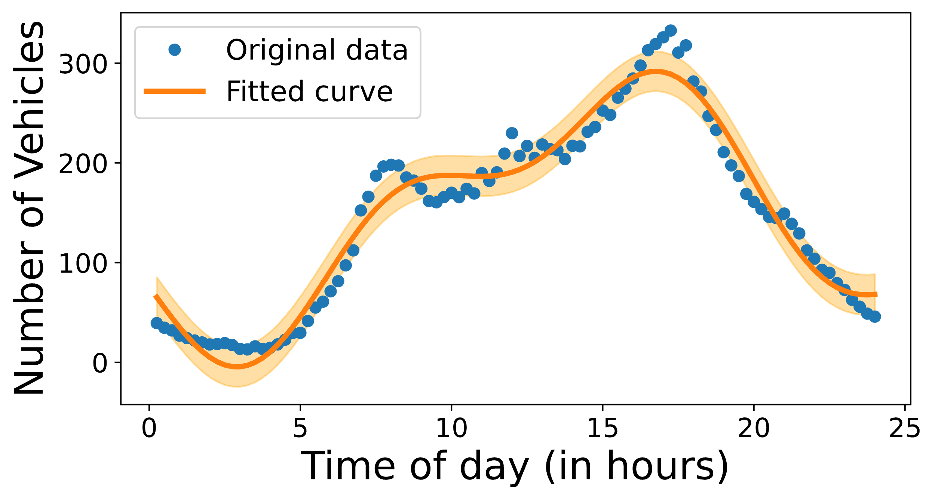

Traffic Flow Simulation
Plot of Traffic Counts vs Timestep
Plot of Average Traffic count vs Timestep
FFT spectrum of average traffic data
Target map region
Tempe DOT vehicle count data
$$f\left(t\right)=A_{1}\sin\left(B_{1}t+ C_{1}\right)+A_{1}\sin\left(B_{1}t+ C_{1}\right)+D+α$$
$$δ=\frac{J^{T}[y−f\left(t\right)]}{J^{T}∙J+ λI}$$
8

Slide 9
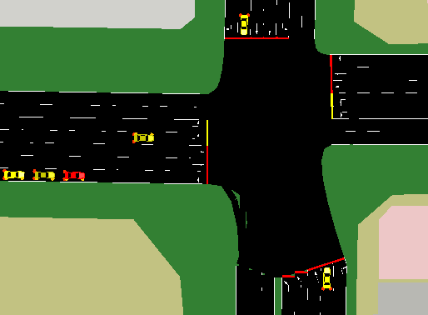
Traffic Incident Simulation
Probability of incident per vehicle
Randomly select Incident severity
Randomly select Incident clearance time
Slow down cars within a radius of incident
Incident occurrence decision function
YES
Total number of vehicles in simulation
NO
9

Slide 10
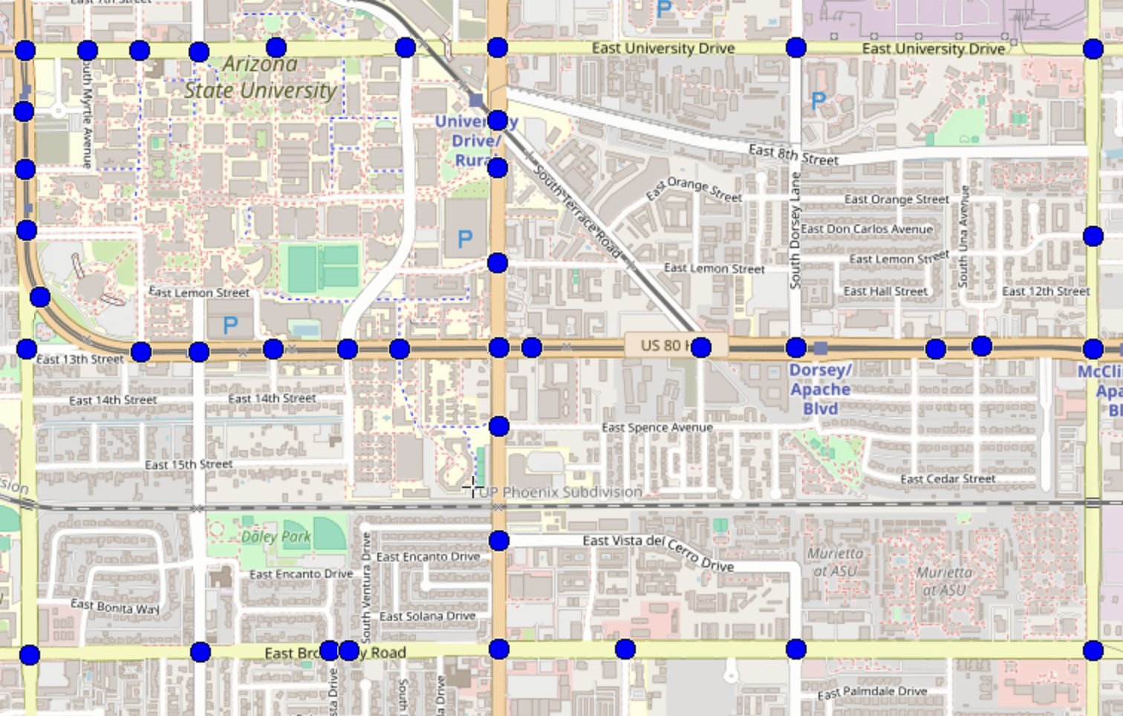
Dataset Generation from Microscopic Traffic Simulators
Raw Features
Individual Vehicle Identifiers
Vehicle Speed
Intersection ID
Timestamp
Traffic Count
Traffic Occupancy
Traffic Cameras placed at traffic signals collect Data
Labels
Incident Occurrence
Incident Severity
Incident Localization
43 traffic signals are marked as blue dots, indicating potential locations for placing traffic cameras to collect data
10

Slide 11

Data Pre-processing and Feature Extraction
Timestamp | Vehicle Identifier | Junction Identified | Vehicle Speed
7:02:10 | Red SUV | 1 | 32
7:04:40 | Blue SUV | 1 | 25
7:08:00 | Red SUV | 2 | 20
Travel Time for junction 1 to 2
Travel Times across all Junction
combinations
Traffic metrics from raw data
Processed Dataset
Rolling Window
Averages
11

Slide 12
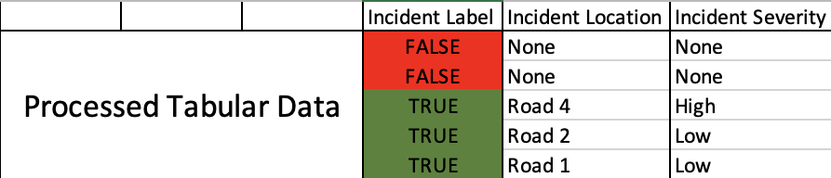
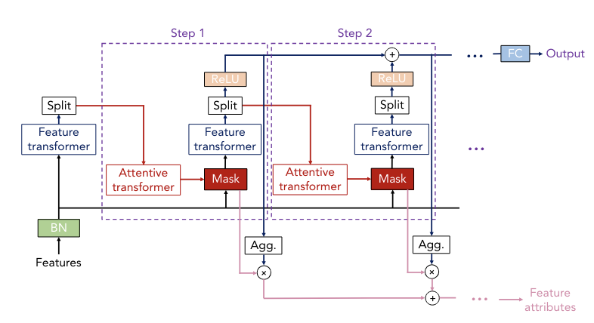
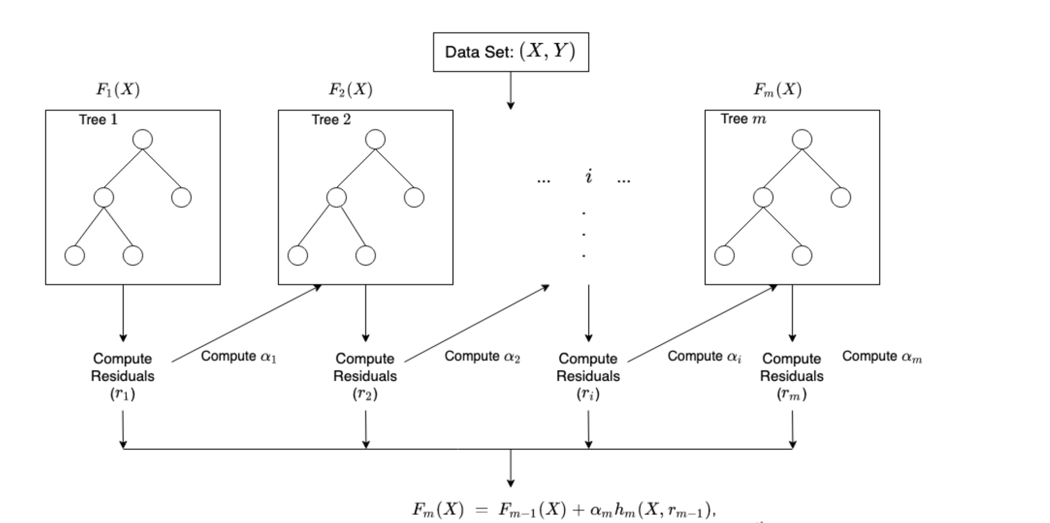
Model Selection and Architecture
XGBoost Architecture
TabNet Architecture
12

Slide 13
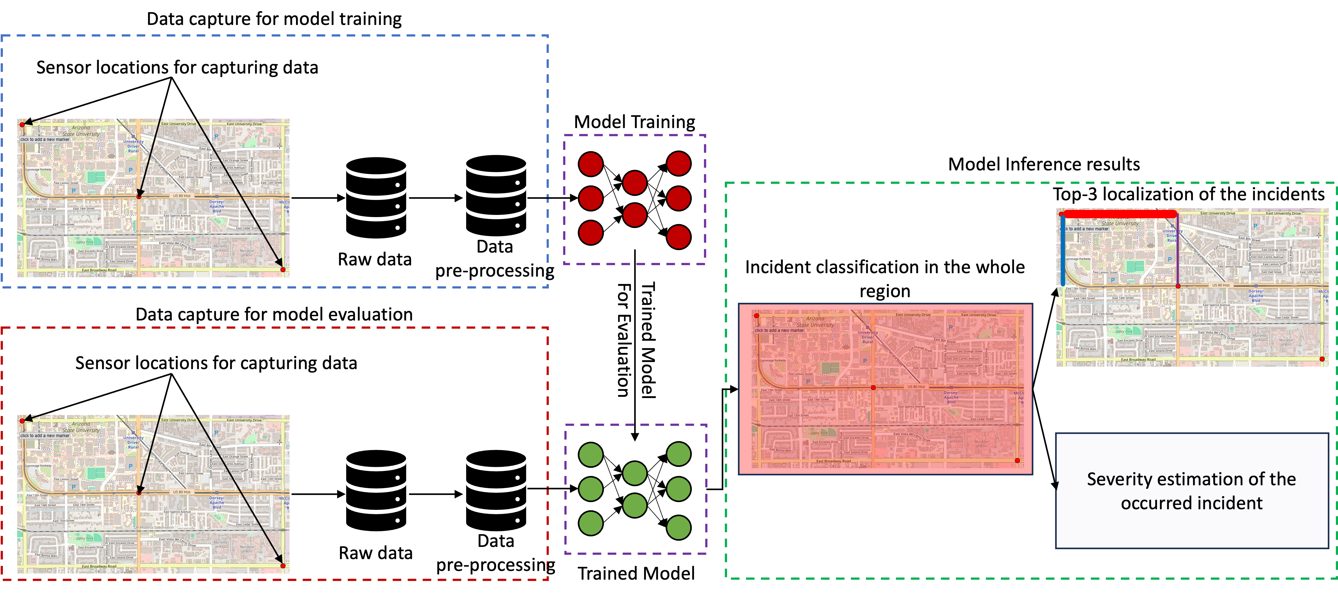
Model Selection and Architecture (continued…)
Raw Data
Feature Extraction
Processed Data
Incident Detection Model
Incident Localization Model
Incident Severity Model
Incident Localization
Incident Detection
Severity Prediction
13

Slide 14
Experiments and Results

Slide 15
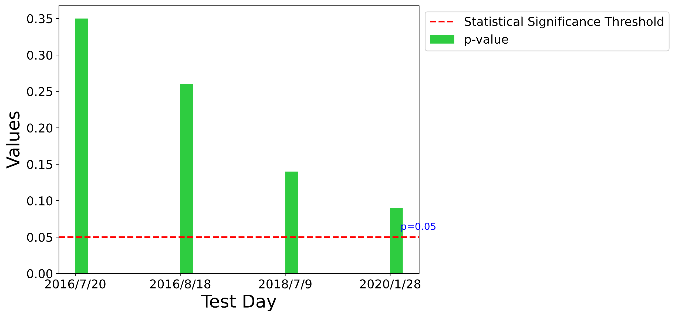
Our Microscopic Data Matches with Real-World Macroscopic Data
Evaluation Metrics
Simulated Microscopic Data
Macroscopic Data
Aggregated over
15-minute window
p-Value
Kolmogorov-Smirnov
test
Real-world Macroscopic Data
KS Statistic
Two similar distributions will have the same cumulative probability distribution function (CDF)
CDF : F(x) = P(X <= x))
Null Hypothesis: The two samples come from same continuous distribution
15

Slide 16
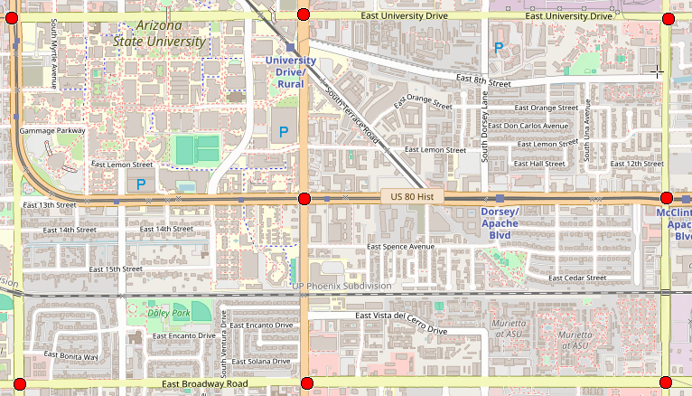
IncidentNet Detects 2x More Incidents with 2.5x Faster Mean-Time-To-Detect while Reducing False Alarms by 6x
8 sensor placement for incident detection evaluation
Evaluation Metrics
Algorithm | DR | MTTD | FAR
IncidentNet (XG Boost) | 96% | 94 secs | 11%
IncidentNet (TabNet) | 98% | 197 secs | 6%
Zhu et al. (CNN) | 51% | 471 secs | 35%
Accuracy | Precision | Recall | F1 Score | AUC-ROC | Specificity
92% | 93% | 90% | 87% | 91% | 95%
93% | 94% | 91% | 92% | 93% | 95%
60% | 40% | 50% | 44% | 51% | 64%
DR: Detection Rate
MTTD: Mean-Time-To-Detect
FAR: False Alarm Rate
16

Slide 17
IncidentNet can also Localize and Estimate Severity of Incidents
Evaluation Metrics
Algorithm | Severity | Localization - Top 1 | Localization - Top 2 | Localization - Top 3
IncidentNet (XGBoost) | 77% | 68% | 75% | 80%
IncidentNet (TabNet) | 82% | 70% | 80% | 85%
17

Slide 18
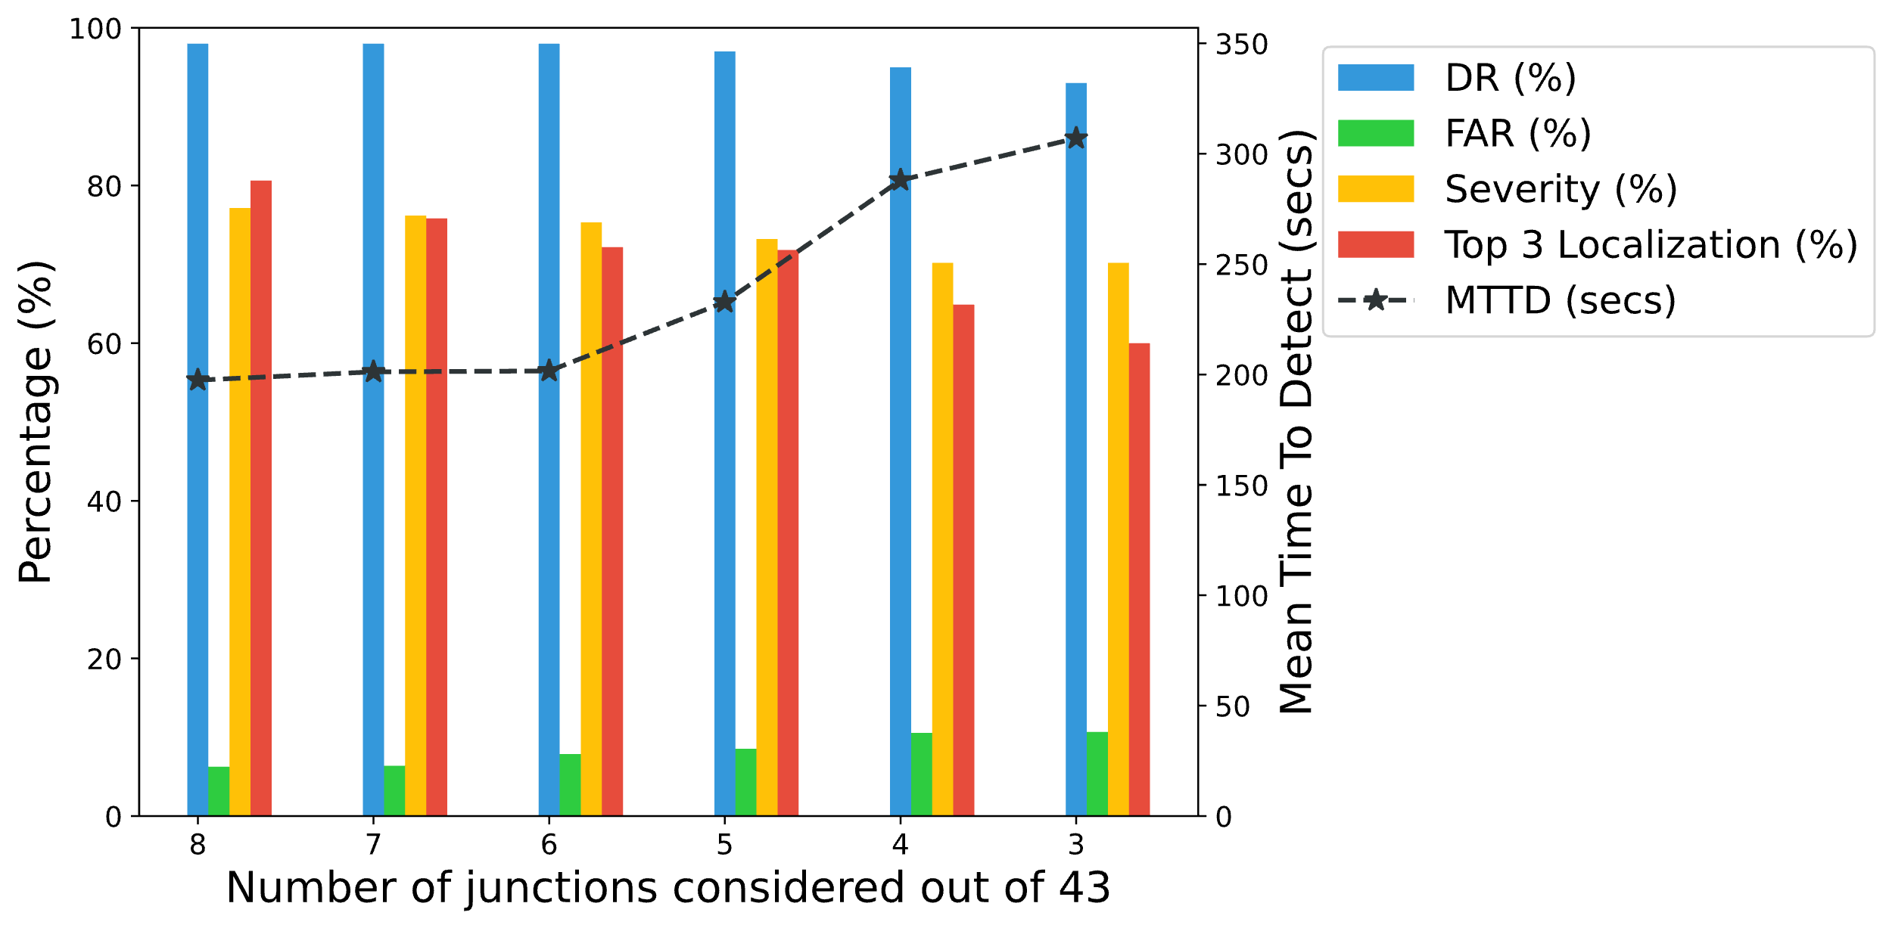
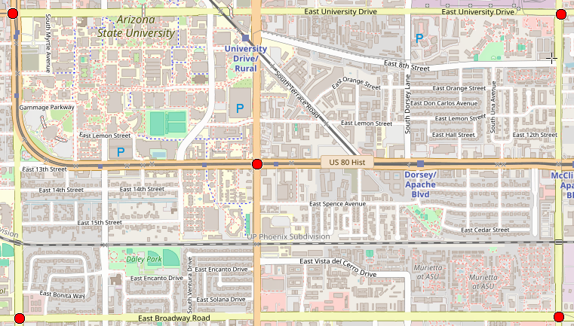
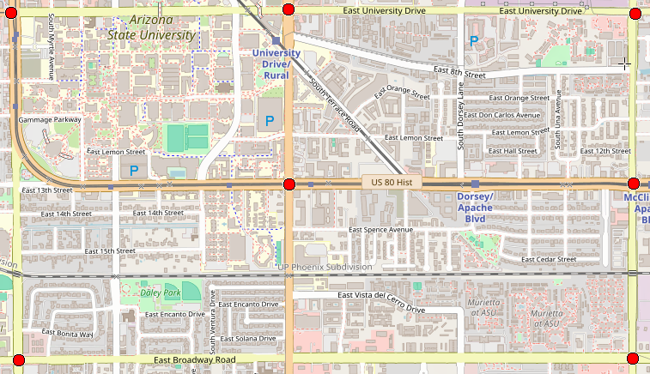
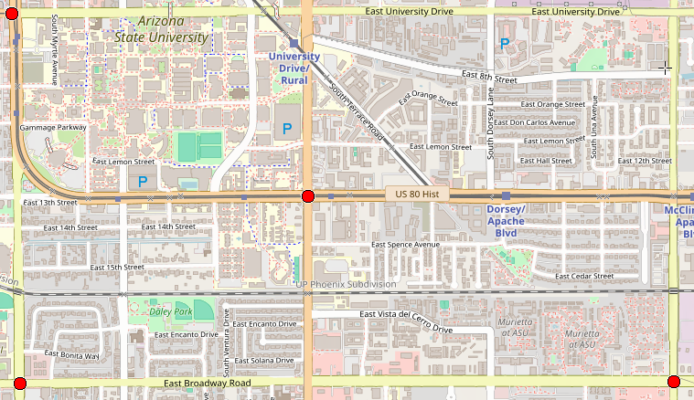
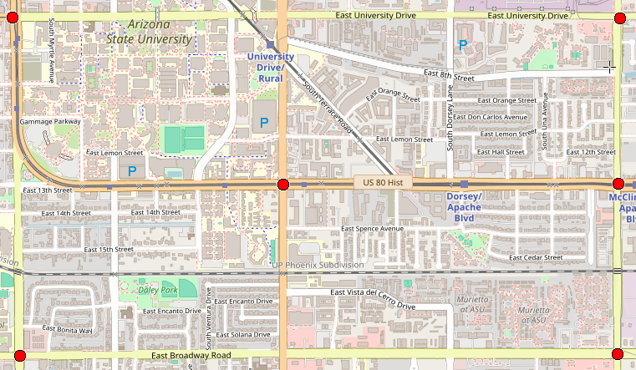
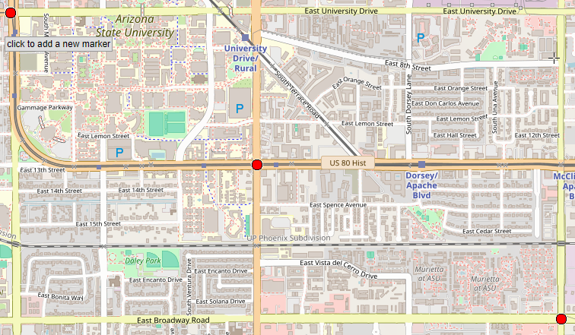
IncidentNet can Accurately Detect, Localize and Estimate Severity with Few (8/43 to 3/43) Sensors
Evaluating IncidentNet up to 8 out of 43 sensors
Evaluation Metrics
8 junctions
5 junctions
7 junctions
4 junctions
9%
10.5%
11%
6%
6.5%
8%
6 junctions
3 junctions
18

Slide 19


IncidentNet can also Accurately Detect Incidents on Highways
Evaluation Metrics
Algorithm | DR | MTTD | FAR
IncidentNet (XGBoost) | 98% | 45 secs | 6.02%
IncidentNet (TabNet) | 99% | 70 secs | 4.17%
19

Slide 20
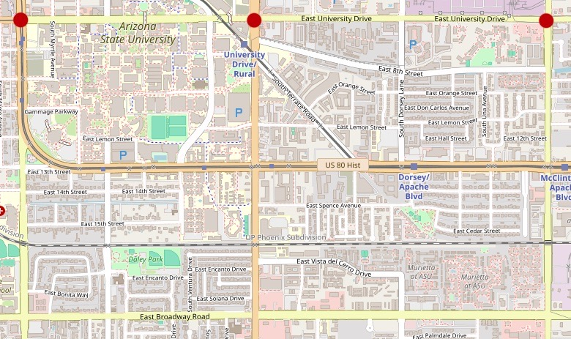
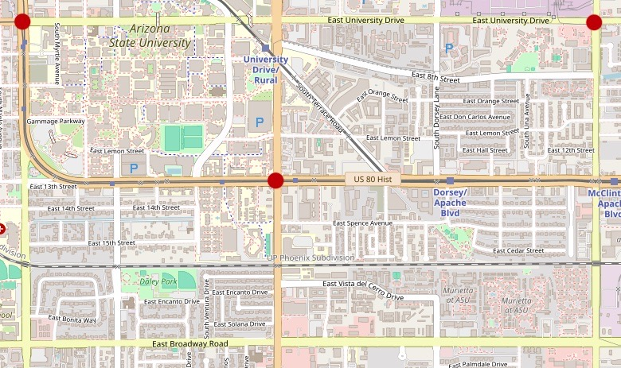

Importance of Sensor Placement (Future Direction)
Randomly selected 3 sensor placements out of 12341 possibilities
Placement 1
Placement 2
Placement 3
Evaluation Metrics
Sensor Placement | Accuracy (%) | F1 score (%)
Placement 1 | 88.22 | 86.17
Placement 2 | 95.73 | 94.96
Placement 3 | 97.85 | 97.46
$\sim$10%
For 3 sensor placement : We have $43C3$= 12341 combinations!!
20

Slide 21




Conclusion
Validation
Simulation-based generated traffic data was similar to real-world macroscopic data
Generalization
IncidentNet can detect incidents for landscapes such as for urban regions and highways
Efficiency
IncidentNet can detect more incidents with minimal false alarms while being faster
Insightful
IncidentNet can also localize the incident and estimate its severity.
21

