Slide 1

Compiler-in-the-Loop ADL-driven
Early Architectural Exploration
Aviral Shrivastava¹ Nikil Dutt¹
Alex Nicolau¹ Eugene Earlie²
¹Center For Embedded Computer Systems,
University of California, Irvine, CA, USA
²Strategic CAD Labs, Intel,
Hudson, MA, USA
S
L
C
Notes:
Good morning,
Today I will present PBExplore, A framework for Compiler-in-the-Loop exploration of partial bypasses in embedded processors.
This work was done in collaboration with Strategic CAD Labs Intel,
at the Center for Embedded Computer Systems at University of California, Irvine.

Slide 2
Bypassing Improves Performance
Pipelining improves performance
  Limited by pipeline hazards
Bypasses eliminate certain data hazards
  Further improve performance
RF
RF
F
D
OR
X1
X2
WB
F
D
OR
X1
X2
WB
R4 ← R4 + R1
R1
R4 ← R4 + R1
R1 ← R2 + R3
R1
R1 ← R2 + R3
Notes:
Pipelining is extensively used in current processors to achieve high performance.
However the performance gains achieved by pipelining are limited by pipeline hazards.
This pipeline has no bypasses. This instruction generates R1, while this one needs R1.
Even though R1 is evaluated in pipeline stage X1, the dependent operation cannot use it until it is written in the register file.
Register Bypasses make the result of a computed operation available to the dependent operations as soon as it is computed.
Thus eliminating certain data hazards, and improving performance.

Slide 3
Impact of Bypassing
Cycle time
  Bypasses may be a part of timing-critical path
Wiring congestion
Overall chip complexity
  deeply pipelined
  out-of-order processors
Area and Power consumption
  Wide multiplexers
  Bypass Control logic
  Bypass wires
M1
F
D
RF
X1
X2
WB
M2
OR
P. Ahuja et al., The Performance Impact of incomplete bypassing in processor pipelines MICRO 1995
A. Abnous and N. Bagerzadeh, Pipelining and bypassing in a VLIW processor, IEEE Trans... 1995.
Notes:
However the performance gains because of bypassing come at a significant cost.
Very often bypasses are a part of timing critical paths in the processor and exert pressure on the cycle time.
Wide multiplexers, bypass wires and the bypass control logic can consume significant area and power.
A lot of 32-bit bypasses to the Operand Read stage of the pipeline can lead to wiring congestion.
As a result of all these, the overall chip complexity can significantly increase for deeply pipelined, out-of-order processors.

Slide 4
Problem, Solution and Problem
Problem – How do I customize bypasses?
  Important for Embedded Systems
Solution –
  Keep only the most beneficial bypasses
  Area, Power and Performance trade-off
RF
F
D
OR
X1
X2
WB
Problems –
  How to Compile for a processor with partial bypassing?
  Requires Compiler-in-the-Loop Exploration
Notes:
Thus the problem for embedded system designer is - how to customize bypasses?
The solution is to keep only the most useful/beneficial bypasses.
Such architectural feature is called partial bypassing.
Partial bypassing presents an opportunity for trade-off between performance, power, area etc.. , which is very important for embedded systems.
However partial bypassing comes with its own set of problems,
how do you compile for a processor with partial bypassing.
how do you accurately evaluate each partial bypass design point – need a CIL exploration.

Slide 5
Compiler-in-the-Loop Exploration
How to compile for Partial Bypassing
Compiler in the exploration loop
Power-Performance-Area Tradeoff
Notes:
Thus the problem for embedded system designer is - how to customize bypasses?
The solution is to keep only the most useful/beneficial bypasses.
Such architectural feature is called partial bypassing.
Partial bypassing presents an opportunity for trade-off between performance, power, area etc.. , which is very important for embedded systems.
However partial bypassing comes with its own set of problems,
how do you compile for a processor with partial bypassing.
how do you accurately evaluate each partial bypass design point – need a CIL exploration.

Slide 6
Bypass Sensitive Scheduling
Bypasses transfer data between dependent operations
Missing bypasses cause pipeline hazard
No Hazard
Hazard
RF
F
D
OR
X1
X2
WB
R4 ← R4 + R1
R1
R1
R1
R1 ← R2 + R3
R1 ← R2 + R3
R1 ← R2 + R3
Bypass-sensitive compiler should be able to
  detect and avoid pipeline hazards
Notes:
Bypasses transfer data between dependent operations.
Absence of bypasses may cause a hazard and cause the processor to stall.
A bypass-aware compiler knows which bypasses are present/absent in the processor,
and therefore it should be able to detect and avoid pipeline hazards in a given schedule.
We model the bypasses in a processor in EXPRESSION architectural description language (ADL).
We model the operations in the processor using Operation Tables.

Slide 7
Operation Table
Operation Table for ADD R1 R2 R3
Details are in the paper !!
1. F
2. D
3. OR
ReadOperands
R2
C1 RF
R3
C2 RF
C5 BRF
DestOperands
R1 RF
4. X1
WriteOperands
R1
C4 BRF
5. X2
6. XWB
WriteOperands
R1
C3 RF
Operation Table is a binding between
  Operation and Processor Resources and Registers
Can detect Resource Hazards
  OTs model processor resources
Can detect Data Hazards
  OTs model processor registers
RF
C1
C2
BRF
C3
C5
C4
F
D
OR
X1
X2
WB
Notes:
Operation Tables can be used to detect all pipeline hazards in a schedule, and try to avoid them.
Operation Table for an operation defines the resources and the registers that the operation may use during various cycles of its execution
For example in the pipeline shown, for the ADD operation, the operation table is shown here.
It shows that the ADD operation uses F pipeline stage during first cycle of execution.
In the next cycle, it needs decode unit, and so on.
Operation Tables describe when the operation reads and writes operands.
It also describes when the operation bypasses and writes back the results.
We use an operation-table based compiler to detect and avoid pipeline hazards.

Slide 8
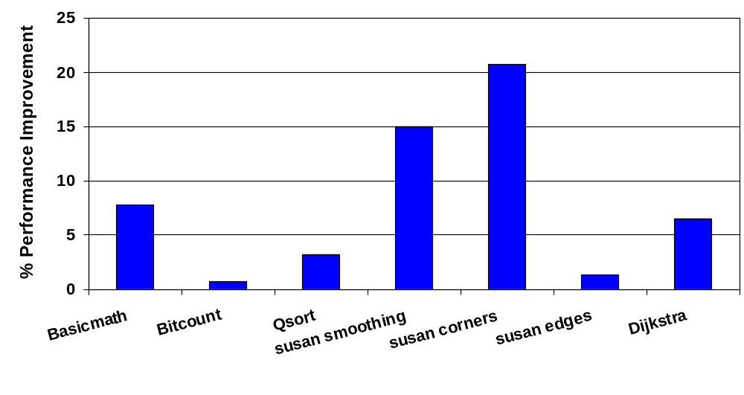
Up to 20% Performance Improvement on MiBench
Up to 20% performance improvement

Slide 9
Compiler-in-the-Loop Exploration
How to compile for Partial Bypassing
Compiler in the exploration loop
Power-Performance-Area Tradeoff
Notes:
Thus the problem for embedded system designer is - how to customize bypasses?
The solution is to keep only the most useful/beneficial bypasses.
Such architectural feature is called partial bypassing.
Partial bypassing presents an opportunity for trade-off between performance, power, area etc.. , which is very important for embedded systems.
However partial bypassing comes with its own set of problems,
how do you compile for a processor with partial bypassing.
how do you accurately evaluate each partial bypass design point – need a CIL exploration.

Slide 10
Compiler-in-the-Loop Exploration
Application
Application
Bypass-sensitive Compiler-in-the-Loop Exploration
Traditional Exploration
OT-based Compiler
gcc –O3
Bypass
Configuration
Executable
Executable
Cycle Accurate
Simulator
Cycle Accurate
Simulator
Traditional Cycles
CIL Cycles
Notes:
The traditional exploration of bypasses would be performed by measuring the performance of an application over processor, or processor model with different bypass configurations.
The generated code remains the same.
In the bypass-sensitive compiler-in-the-loop exploration framework, for each bypass configuration we generate bypass-sensitive code, which is then simulated over a processor model with the given bypass configuration.

Slide 11
Bypass Exploration
D1
D2
DWB
F1
F2
ID
RF
X1
X2
XWB
M1
M2
MWB
7 pipeline stages can bypass result
We vary which pipeline stage bypasses a result
  2⁷ = 128 bypass configurations
  Encode bypass configuration
    <DWB D2 MWB M2 XWB X2 X1>
  Configuration 28 = <0011100>
    Bypass paths from MWB, M2 and XWB are present
Notes:
This is the XScale pipeline diagram.
Only 7 pipeline stages can bypass a result.
In this set of experiments we vary whether a pipeline stage bypasses the result or not.
If it bypasses, the result can be used as any source operands.
Thus there are 2 to the power of 7 = 128 bypass configurations.
If we encode the bypasses by a seven-bit number, with the first bit denoting the presence of bypasses path from DWB, second from D2 and so on.
Thus configuration 28 represents that bypasses from MWB, M2 and XWB are present.

Slide 12
Bypass Explorations on XScale
1250000
bitcount
Traditional
1200000
CIL
1150000
1100000
Execution Cycles
1050000
1000000
950000
900000
850000
0
32
64
96
128
Bypass Source Configurations
CIL-compiler can effectively exploit the bypass configuration
Significant performance difference
Notes:
The blue dots in the graph plot the runtime of each bypass configuration evaluated by the traditional method on bitcount benchmark from MiBench suite.
The red dots in the graph plot the runtime (in terms of execution cycles) as evaluated by our bypass-sensitive compiler-in-the-loop exploration method.
The first observation to be made from this graph is that the red dots are consistently below their corresponding blue dots. The difference
This implies that bypass-sensitive compilation is able to generate schedule sympathetic to bypass configuration.

Slide 13
X-bypass explorations in XScale
1200000
bitcount
Traditional
1150000
CIL
D1
D2
DWB
1100000
F1
F2
ID
RF
Difference in trends
1050000
X1
X2
XWB
Execution Cycles
1000000
M1
M2
MWB
950000
900000
850000
-
XWB
X1
X2
XWB X2
X2 X1
XWB X1
XWB X2 X1
X-bypass Configuration

Slide 14
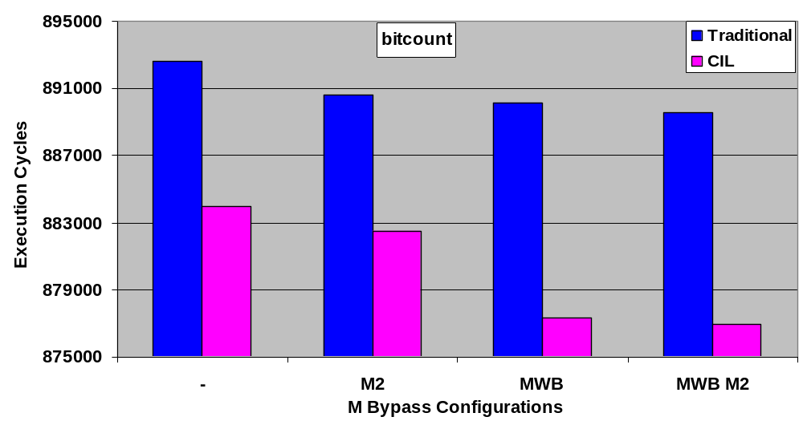
M-bypass explorations in XScale
D1
D2
DWB
F1
F2
ID
RF
X1
X2
XWB
Difference in trends
M1
M2
MWB

Slide 15
D-bypass exploration in XScale
980000
bitcount
Traditional
CIL
960000
D1
D2
DWB
940000
F1
F2
ID
RF
X1
X2
XWB
Execution Cycles
Difference in trends
920000
M1
M2
MWB
900000
880000
860000
-
DWB
D2
DWB D2
D Bypass Configurations

Slide 16
Compiler-in-the-Loop Exploration
How to compile for Partial Bypassing
Compiler in the exploration loop
Power-Performance-Area Tradeoff
Notes:
Thus the problem for embedded system designer is - how to customize bypasses?
The solution is to keep only the most useful/beneficial bypasses.
Such architectural feature is called partial bypassing.
Partial bypassing presents an opportunity for trade-off between performance, power, area etc.. , which is very important for embedded systems.
However partial bypassing comes with its own set of problems,
how do you compile for a processor with partial bypassing.
how do you accurately evaluate each partial bypass design point – need a CIL exploration.

Slide 17
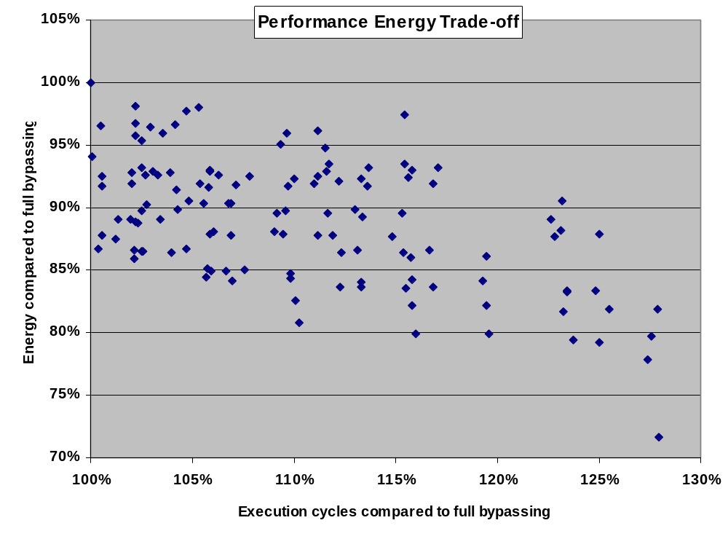
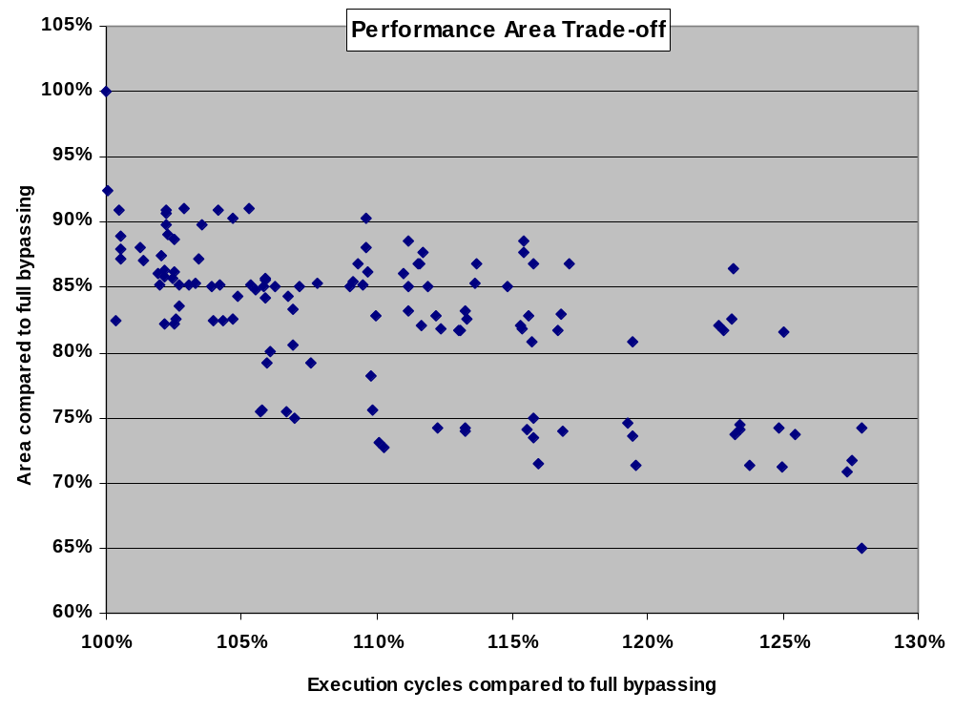
Performance-Energy-Area Trade-off
Point 1
Point 1
Point 2
Point 2
Design Point 1
  no bypass from MWB and XWB to first operand
  18% less area and 14% less energy consumption of bypass control logic
  2% performance loss
Design Point 2
  Only D2 and X2 bypass to first operand
  25% less area and 16% less energy consumption of bypass control logic
  6% performance loss

Slide 18
Summary
Bypassing improves performance but is costly in terms of area and power
Partial bypassing presents valuable trade-offs, however poses challenges in compilation
We propose a compilation approach for partial bypassing
  Up to 20% performance improvement by bypass-sensitive compiler
We propose Compiler-in-the-Loop Exploration of partial bypasses.
  More meaningful exploration of design space
CIL Exploration of bypasses is able to discover interesting pareto-optimal design points

