Slide 1

Aggregating Processor Free Time for Energy Reduction
Aviral Shrivastava¹ Eugene Earlie²
Nikil Dutt¹ Alex Nicolau¹
¹Center For Embedded Computer Systems,
University of California, Irvine, CA, USA
²Strategic CAD Labs, Intel,
Hudson, MA, USA
S
L
C
Notes:
Good morning,
This work on “aggregating processor free time for energy reduction”
was done in collaboration with Strategic CAD Labs Intel,
at the Center for Embedded Computer Systems at UC Irvine.

Slide 2
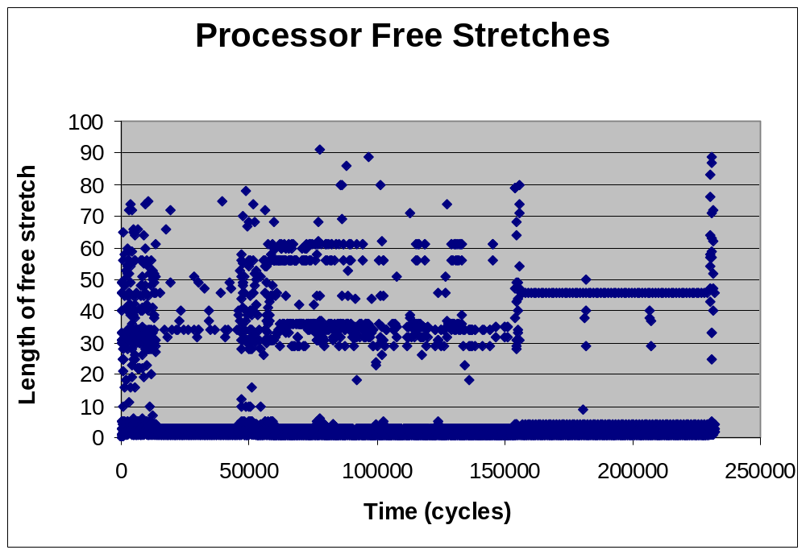
Processor Activity
Cold Misses
Multiple Misses
Single Miss
Pipeline Hazards
Each dot denotes the time for which the Intel XScale was stalled during the execution of qsort application

Slide 3
Processor Stall Durations
With IPC of 0.7
  XScale is stalled for 30% of time
But each stall duration is small
  Average stall duration = 4 cycles
  Longest stall duration < 100 cycles
Each stall is an opportunity for optimization
  Temporarily switch to a different thread of execution
    Improve throughput
    Reduce energy consumption
  Temporarily switch the processor to low-power state
    Reduce energy consumption
But state switching has overhead!!

Slide 4
Power State Machine of XScale
10 mW
450 mW
0 mW
180 cycles
>> 36,000 cycles
IDLE
RUN
SLEEP
180 cycles
>> 36,000 cycles
36,000 cycles
36,000 cycles
DROWSY
1 mW
Break-even stall duration for profitable switching
  360 cycles
Maximum processor stall
  < 100 cycles
NOT possible to switch the processor to IDLE mode
Need to create larger stall durations

Slide 5
Motivating Example
for (int i=0; i<1000; i++)
c[i] = a[i] + b[i];
for (int i=0; i<1000; i++)
c[i] = a[i] + b[i];
Request Buffer
Request Buffer
1. L: mov ip, r1, lsl#2
2. ldr r2, [r4, ip] // r2 = a[i]
3. ldr r3, [r5, ip] // r3 = b[i]
4. add r1, r1, #1
5. cmp r1, r0
6. add r3, r3, r2 // r3 = a[i]+b[i]
7. str r3, [r6, ip] // c[i] = r3
8. ble L
Processor
Data Cache
Processor
Data Cache
1. L: mov ip, r1, lsl#2
2. ldr r2, [r4, ip] // r2 = a[i]
3. ldr r3, [r5, ip] // r3 = b[i]
4. add r1, r1, #1
5. cmp r1, r0
6. add r3, r3, r2 // r3 = a[i]+b[i]
7. str r3, [r6, ip] // c[i] = r3
8. ble L
Load
Store
Unit
Load
Store
Unit
Request Bus
Data Bus
Request Bus
Memory Buffer
Data Bus
Memory Buffer
Memory
Define C (Computation)
  Time to execute 4 iterations of this loop, assuming no cache misses
  C = 8 instructions x 4 iterations = 32 cycles
Define ML (Memory Latency)
  Time to transfer all the data required by 4 iterations between memory and caches, assuming the request was made well in advance
  ML = 4 lines x 4 words/line x 3 cycles/word = 48 cycles
Define Memory-bound Loops – Loops for which ML > C
Computation = 1 instruction/cycle
Cache Line Size = 4 words
Request Latency = 12 cycles
Data Bandwidth = 1 word/3 cycles
Memory
Not possible to avoid processor stalls in memory-bound loops
Notes:
Let me give a simple example to give the intuition behind aggregation of processor free time.
Consider this very simple load store unit of a processor, and the memory architecture.
The processor is very simple, it executes one instruction per cycle, if it gets the data in the cache.
There is a data cache. Assume that the line size is 4 words.
The memory bus is pipelined. There is a request buffer and memory buffer to pipeline the requests, and the request latency is 12 cycles

Slide 6
Normal Execution
for (int i=0; i<1000; i++)
c[i] = a[i] + b[i];
1. L: mov ip, r1, lsl#2
2. ldr r2, [r4, ip]
3. ldr r3, [r5, ip]
4. add r1, r1, #1
5. cmp r1, r0
6. add r3, r3, r2
7. str r3, [r6, ip]
8. ble L
Processor Activity
Activity
Memory Bus Activity
Time
Processor activity is dis-continuous
Memory activity is dis-continuous

Slide 7
Prefetching
for (int i=0; i<1000; i++)
prefetch a[i+4];
prefetch b[i+4];
prefetch c[i+4];
c[i] = a[i] + b[i];
Each processor activity period increases
Memory activity is continuous
Processor Activity
Activity
Memory Bus Activity
Time

Slide 8
Prefetching
for (int i=0; i<1000; i++)
prefetch a[i+4];
prefetch b[i+4];
prefetch c[i+4];
c[i] = a[i] + b[i];
Each processor activity period increases
Memory activity is continuous
Total execution time reduces
Processor Activity
Activity
Memory Bus Activity
Time
Processor activity is dis-continuous
Memory activity is continuous

Slide 9
Aggregation
Aggregated processor free time
Aggregated processor activity
Total execution time remains same
Processor Activity
Activity
Memory Bus Activity
Time
Processor activity is continuous
Memory activity is continuous

Slide 10
Aggregation
Aggregation
  Collect small stall times to create a large chunk of free time
Traditional Approach
  Slow down the processor
  DVS, DFS, DPS
Aggregation vs. Dynamic Scaling
  Easier for hardware to implement idle states, than dynamic scaling
  Good for leakage energy
Aggregation is counter-intuitive
  Traditional scheduling algorithms distribute load over resources
  Aggregation collects the processor activity and inactivity
    Hare in the Hare and Tortoise race!!
Focus on aggregating memory stalls

Slide 11
Related Work
Low-power states are typically implemented using
  Clock gating, Power gating, voltage scaling, frequency scaling
    Rabaey et al. [Kluwer96] Low power design methodologies
Between applications, processor can be switched to low-power mode
  System Level Dynamic Power Management
    Benini et al. [TVSLI] A survey of design techniques for system-level dynamic power management
Inside application
  Microarchitecture-level dynamic switching
    Gowan e al [DAC 98] Power considerations in the design of the alpha 21264 microprocessor
Prefetching
  Can aggregate memory activity in compute-bound loops
    Vanderwiel et al. [CSUR] Data prefetch mechanisms
  But not in memory-bound loops
Existing Prefetching techniques can request only a few lines at-a-time
For large scale processor free time aggregation
  Need a prefetch mechanism to request large amounts of data
No technique for aggregation of processor free time

Slide 12
HW/SW Approach for Aggregation
Hardware Support
  Large-scale prefetching
  Processor Low-power mode
Data analysis
  To find out what to prefetch
  To discover memory-bound loops
Software Support
  Code Transformations to achieve aggregation

Slide 13
Aggregation Mechanism
Aggregation
Request Buffer
Processor
Data Cache
Activity
Processor Activity
Memory Bus Activity
Prefetch Engine
Load
Store
Unit
Time
Request Bus
Programmable prefetch engine
  Compiler controlled
Processor sets up the prefetch engine
  What to prefetch
  When to wakeup the processor
Prefetch engine starts prefetching
Processor goes to sleep
Zzz…
Zzz…
Prefetch Engine wakes up the processor at pre-calculated time
Processor executes on the data
  No cache misses
  No performance penalty
Data Bus
Memory Buffer
Memory

Slide 14
Hardware support for Aggregation
Instructions to control prefetch engine
  setPrefetch a, l
  setWakeup w
Prefetch Engine
  Add line requests to request buffer
    Keep the request buffer non-empty
    Data bus will be saturated
  Round-robin policy
  Generates wakeup interrupt after requesting w lines
  After fetching data, disable and disengage
Processor
  Low-power state
  Wait for wakeup interrupt from the prefetch engine
Request Buffer
Processor
Data Cache
Prefetch Engine
Load
Store
Unit
Request Bus
Data Bus
Memory Buffer
Memory

Slide 15
Data analysis for Aggregation
To find out what data is needed
To find whether a loop is memory bound
Compute ML
  Source code analysis to find what is needed
    Innermost For-loops with
      constant step
      known bounds
    Address functions of the references
      affine functions of iterators
    Contiguous lines are required
Find memory-bound loops (ML > C)
  Evaluate C (Computation)
    Simple analysis of assembly code
  Compute ML (Memory Latency)
for (int i=0; i<1000; i++)
c[i] = a[i] + b[i];
1. L: mov ip, r1, lsl#2
2. ldr r2, [r4, ip]
3. ldr r3, [r5, ip]
4. add r1, r1, #1
5. cmp r1, r0
6. add r3, r3, r2
7. str r3, [r6, ip]
8. ble L
Scope of analysis
Data Analysis in Paper

Slide 16
Code Transformations for Aggregation
Cannot request all the data at once
  Wakeup the processor before it starts to overwrite unused data in the cache
Loop Tiling is needed
Aggregation
Activity
Processor Activity
Memory Bus Activity
for (int i=0; i<N; i++)
c[i] = a[i] + b[i];
Time
w
t
w: Wakeup time
T: Tile size
T
// Set the prefetch engine
1. setPrefetchArray a, N/L
2. setPrefetchArray b, N/L
3. setPrefetchArray c, N/L
4. startPrefetch
-
-
for (i1=0; i1<N; i1+=T)
setProcWakeup w
procIdleMode
for (i2=i1; i2<i1+T; i2++)
c[i2] = a[i2] + b[i2]
Set up prefetch engine
Tile the loop
Set to wakeup the processor
Compute w and T
Put processor to sleep

Slide 17
Computation of w and T
Cache
Memory
Processor
Modeled as a Producer Consumer Problem
Speed at which memory is generating data
  r/ML
Speed at which processor is consuming data
  r/C
Wakeup time w
  Do not overwrite the cache
  w * (r/ML) > L
  w = L* ML/r
Tile size T
  Finish all the prefetched data
  (w+t) * (r/ML) = t * r/C
  T = w*ML/(ML-C)
Aggregation
Activity
Processor Activity
Memory Bus Activity
Time
w
t
T
w: Wakeup time
T: Tile size

Slide 18
Complete Transformation
// Set the prefetch engine
1. setPrefetchArray a, N/L
2. setPrefetchArray b, N/L
3. setPrefetchArray c, N/L
4. startPrefetch
for (int i=0; i<N; i++)
c[i] = a[i] + b[i];
Setup the prefetch engine
// prologue
5. setProcWakeup w1
6. procIdleMode
7. for (i1=0; i1<T1; i1++)
8. c[i1] = a[i1] + b[i1]
Prologue
// tile the kernel of the loop
9. for (i1=0; i1<T2; i1+=T)
10. setProcWakeup w
11. procIdleMode
12. for (i2=i1; i2<i1+T; i2++)
13. c[i2] = a[i2] + b[i2]
Tile the kernel of the loop
// epilogue
14. setProcWakeup w2
15. procIdleMode
16. for (i1=T2; i1<N; i1++)
17. c[i1] = a[i1] + b[i1]
Epilogue

Slide 19
Experiments
Platform – Intel XScale
Experiment 1: Free Time Aggregation
  Benchmarks: Stream kernels
    Used by architects to tune the memory performance to the computation power of the processor
  Metrics: Sleep window and Sleep time
Experiment 2: Processor Energy Reduction
  Benchmarks: Multimedia applications
    Typical application set for the Intel XScale
  Metric: Energy Reduction
Evaluate architectural overheads
  Area
  Power
  Performance

Slide 20
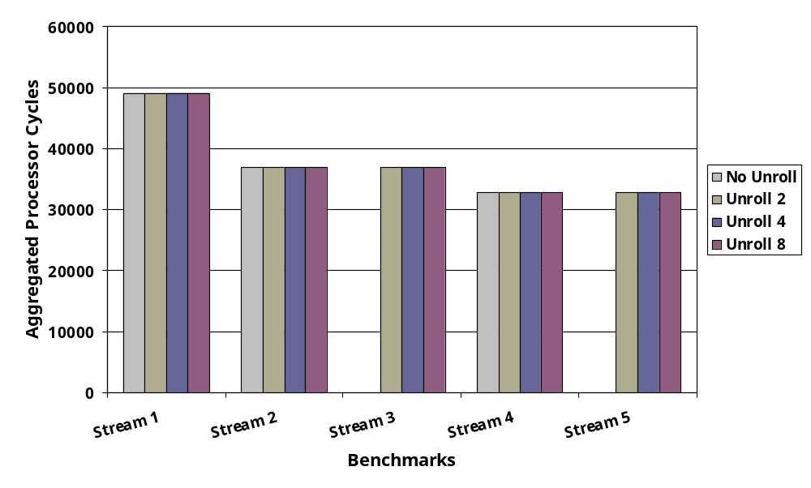
Experiment 1: Sleep Window
Sleep window = L*ML/r
Unrolling
  Does not change ML, but decreases C
  Unrolling does not change sleep window
  More loops become memory-bound (ML > C)
  Increases the scope of aggregation
Up to 50,000 Processor Free Cycles can be aggregated

Slide 21
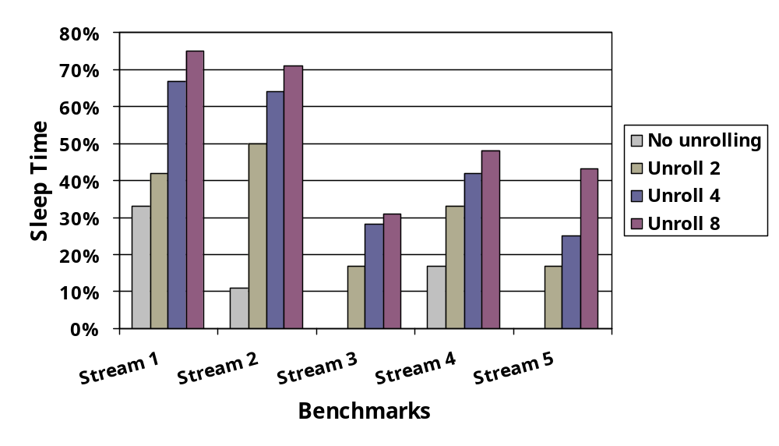
Experiment 1: Sleep Time
Sleep Time : % Loop Execution time when processor can be in sleep mode
Sleep Time = (ML-C)/ML
Unrolling
  Unrolling does not change ML, decreases C
  Increases scope of aggregation
  Increases Sleep Time
Processor can be in low-power mode for up to 75% of execution time

Slide 22
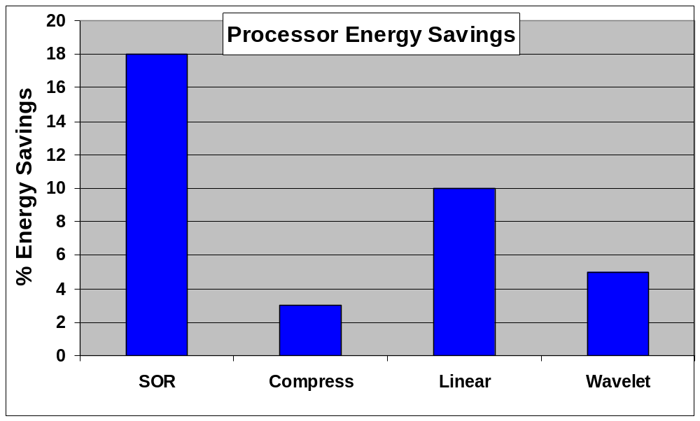
Experiment 2: Processor Energy Savings
P_busy = 450 mW
P_stall = 112 mW
P_idle = 10 mW
P_myIdle = 50 mW
Initial Energy
  E_{orig} = (N_{busy}*P_{busy}) + (N_{stall}*P_{stall})
Final Energy
  E_{final} = (N_{busy}*P_{busy}) + (N_{stall}*P_{stall}) + (N_{my_idle}*P_{my_idle})
Up to 18% savings in Processor Energy

Slide 23
Architectural Overheads
Synthesized Prefetch Engine using
  Synopsys design compiler 2001
  Library lsi_10k
  Linearly scale the area and power numbers
Area Overhead
  Very small
Power Overhead
  Synopsys power estimate
  < 1%
Performance Overhead
  < 1%
Request Buffer
Processor
Data Cache
Prefetch Engine
Load
Store
Unit
Request Bus
Data Bus
Memory Buffer
Memory

Slide 24
Summary & Future Work
Existing prefetching techniques cannot achieve large-scale processor free time aggregation
We presented a hardware-software cooperative approach to aggregate the processor free time
  Up to 50,000 processor free cycles can be aggregated
  Without aggregation, max processor free time < 100 cycles
  Up to 75% of loop time can be free
Processor can be switched to low-power mode during the aggregated free time
  Up to 18% processor energy savings
Minimal Overheads
  Area (< 1%)
  Power (<1%)
  Performance (<1%)
To do
  Increase the scope of application of aggregation techniques
  Investigate the effect on leakage energy

