Slide 1
BO3 (Beyond-O3):
Workload-Specific Compilation Pipelines for Multi-Level Compilers
Megan Kuo
Master’s Thesis Defense: April
Committee:
Aviral Shrivastava
Aman Arora
Jianping Zeng
Notes:
Good morning, and thank you for attending my thesis defense.
My thesis is titled “BO3: Workload-Specific Compilation Pipelines for Multi-Level Compilers.”
This work studies pass ordering in IREE, which is an MLIR-based compiler for machine learning workloads.
The main question this thesis is trying to answer is: is –O3, a fixed-expert designed pipeline for speed in traditional compilers, still the best for multi-level compilers.

Slide 2
Presentation Agenda
Background of IREE compiler and Reinforcement Learning (RL)
Motivation: Fixed pipelines are not generalizable
Research Gap: Can existing approaches answer the question?
Investigation: Why progressive lowering in MLIR amplifies pass ordering problem?
Methodology: 3-stage RL framework
Claims
BO3 Consistently outperforms IREE -O3
BO3 gains not from search budget alone
BO3 performance can be attribute to regime shift
BO3 is robust and practical
Summary and Future work
Notes:
I will first give background on IREE and the RL formulation.
Then I will show the motivation: why fixed pipelines do not generalize across models or even across shapes.
Next, I will explain how related works fit in the question and answer the question: why this problem is important for multi-level compilers.
Then I will present BO3, a three-stage framework.
Finally, I will discuss the experimental claims, summary, and future work

Slide 3
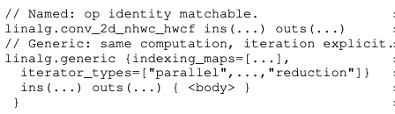
Background for IREE
BO3 studies IREE for pass ordering problem in multi-level compilers.
3 Compilation stages in IREE
Generic vs. named form: linalg-generalize-named-ops
Dispatch: A self-contained executable region. A basic block for backend code generation.
Backend strategies
Double-tiling
Broadcast
Shuffles
MMT4D
Pack
Unpack
Notes:
This thesis targets IREE compiler, which is a multi-level compiler built- on top of MLIR infrastructure
IREE has 3 main abstractions
Preprocessing is where we have the whole IR view, and it is the stage where the thesis target to find pass ordering on.
There are 2 ways to represent a computation, one is the named form another is the generic form
Named form, like the snapshot, expose explicit operation identity to the compiler. It is easier for later pass to pattern match and optimize on one computation but difficult for fusion and simplification
Generic form, beneath the named form, use indexing maps and iterator types to represent a computation. Difficult to recover back to named form, but expose fusion and simplification opportunity for producer, consumer ops.
The trasition from the named form to generic form is by a pass “linalg-generalize-named-ops”
Dispatch creation is where is the partition boundaries are drawn in the IR, where the dispatches are formed
A dispatch is a self-contained executable region.
It is the basic unit that the backend lowers and optimizes.
Codegen is the stage where each dispatch code are generated.
In the code generation stage, there are 2 strategies for tiling
The first is double-tiling, which is a general-purpose path.
It perform multi-level loop tiling on the original tensor layout, but may need more on-the-fly data movement like shuffles and broadcasts to satisfy SIMD constraints.
The second is MMT4D, which is a more specialized path.
It repacks tensors into tiled 4D layouts so that data is contiguous already in memory.
This can improve SIMD efficiency, but it can also add pack and unpack overhead if those operations are not fused well.

Slide 4
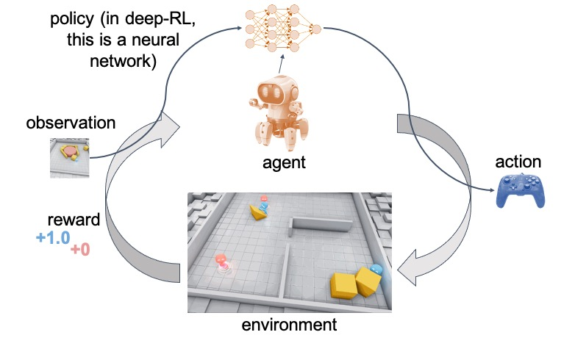
Background for RL
BO3 uses RL as a solution to the automatic compilation path finding problem.
4 components constitute an RL environment:
State & Observation
The information agent receives for its current situation. Observation is derived from a state.
Actions
The set of all possible moves or decisions the agent can make.
Policy
The brain of the agent, decide on action based on observation.
Reward
A signal provided after an action, defining how well the agent performed.
3
1
2
4
Source: anyscale
A trajectory is one full loop from initial state, applying actions, till getting the final reward.
Notes:
BO3 uses RL as a solution to the automatic compilation path finding problem.
So here I mention the RL terminologies use throughout the presentation
An agent is an entity that makes decision to interact with an RL environment.
Environment is formed using 4 components:
The state is the current compiler IR.
The observation is what the agent sees from that IR.
The actions are possible decisions that an agent can make for a state
The policy is the brain of the agent, the one that is making decisions.
The reward is the feedback from the environment, telling the agent how good/bad a decision is.
In RL, we call one sequence, from initial state, apply action step by step until TERMINAL, and getting rewards: a trajectory

Slide 5
O3 is not good enough It Leaves Large Headroom Untouched
Baseline: -O3, the standard way to get optimal performance from a compiler.
Numbers shown are speedup compare to baseline.
We brute-force on ~150 available passes in IREE compiler across stages to get the numbers.
The pipeline found custom for each workload are much faster than baseline –O3.
Notes:
This figure shows that how much performance are under-explored by –O3.
The x-axis shows models obtained from pytorch and compiled through O3.
Numbers shown are speedup comparingcustom pipeline found by bruteforcing and by against -O3
From the figure, we show that
The speedup ranges from 1.3 to near 20 times, meaning O3 is designed good for some models, but significantly suboptimal for others.
A natural question here will be: whether one better fixed pipeline can replace -O3 for everyone?

Slide 6
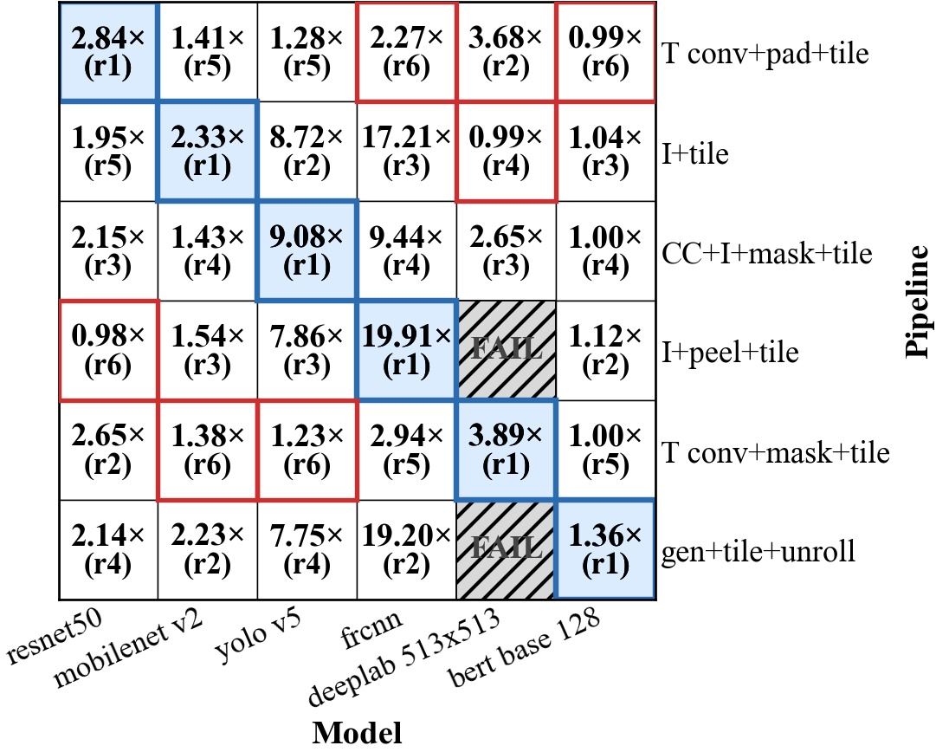
A pipeline that is optimal for one model can perform poorly on another
X-axis: target models
Y-axis: pipelines optimized on different source models
Each cell: speedup relative –O3; rank of custom pipeline applied per model.
Examples:
MobileNetV2’s best pipeline drops to near-baseline on DeepLabV3
DeepLabV3’s best pipeline yields an 8× slowdown on YOLO
Takeaway: Custom pipeline depends on workload structure.
Notes:
This slide shows the answer is No
A pipeline that is optimal for one model can be suboptimal for another
In the figure, x-axis is the models and y-axis is the custom pipeline
2 elements in each cell, where the numbers represent speedup against –O3 and rank of custom pipeline applied per model
To show pipelines optimized for one model transfer poorly on another, we look at mobilenetV2 first
MBV2’s best pipeline drops to near-baseline, having similar performance as –O3 on deeplabv3
Applying different pipeline on deeplabv3 yields 3x speedup.
But applying the pipeline that is best for deeplabv3 yields 8x slowdown compared to the best pipeline for yolov5
This convey a message that pass ordering depends on workload structure.

Slide 7
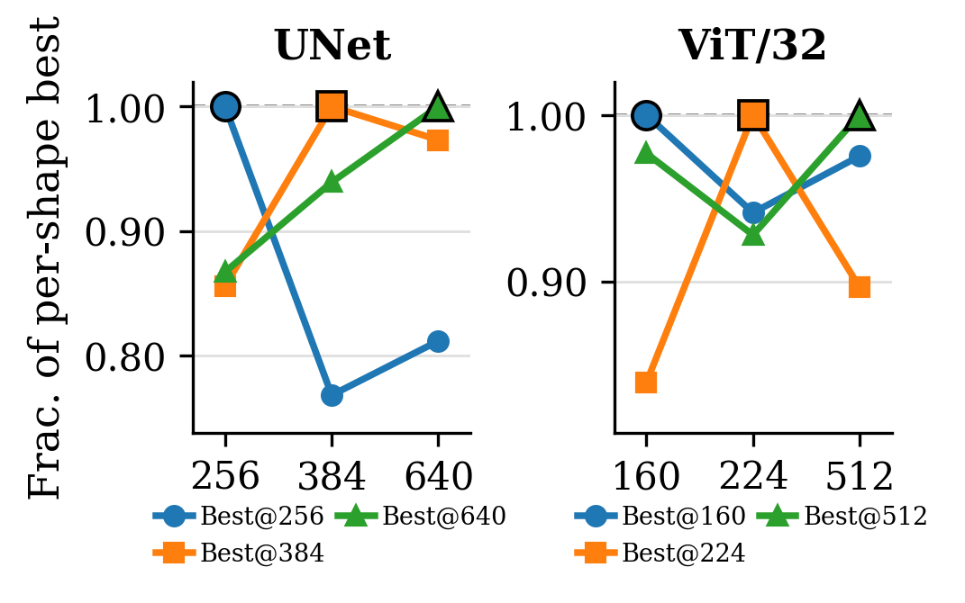
A pipeline that is optimal for one shape can perform poorly on another
X-axis: shape per model.
Y-axis: latency normalized to the best latency for that shape, where 1.0 means it is the fastest.
Each curve: performance shift of one shape’s best-found pipeline transferred to other shapes.
Examples:
UNet 384 incurs ~25% degradation when using pipeline found best for UNet 256.
Vit224 applying the pipeline best for shape 224 loses 10~15% performance on other shapes.
Takeaway: Custom pipeline depends on workload shapes.
Notes:
This slide shows the we need custom pipeline even for different shapes.
A pipeline that is optimal for one model shape can be suboptimal for another
In the figure, x-axis is the shapes of the model and y-axis is the latency normalized to the best latency for that shape. 1.0 means it is the fastest, numbers smaller than 1 is the slow down.
We see that UNet384 incurs ~25% degradation when using pipeline found best for UNet 256.
Vit224 applying the pipeline best for shape 224 loses 10~15% performance on other shapes.
This convey a message that pass ordering depends not only on workload structure but also on shapes

Slide 8
Existing approaches are not good enough to solve pass ordering problem in progressive lowering settings.
No
Are existing approaches sufficient?
Paper | Settings | Contributions and result | Limitation of the method?
AutoPhase (2019) | LLVM/HLS Phase ordering | RL for pass ordering 13K training samples, 24% speedup | Focus on single abstraction (LLVM IR).
Ansor (2020) | Tensor program autotuning | Find high-performing parameter setting 20K trials (~6 hrs) on ResNet50 | Parameters are tuned with a fixed representation.
MLGO (2021) | LLVM Heuristic | Use RL/ES to replace heuristic. 12~60 hrs of training on 28K samples, 7% size reduction | Optimize for size. Not solving pass ordering problem.
MLIR RL (2024) | MLIR loop optimizations | First MLIR + RL environment Train 5 days, speedup is worse than PyTorch compiler | Does not close the gap between O3. Treat RL as black box optimization.
Notes:
openings
The empirical study shows that pipeline combinations in IREE is arch-sensitive and shape-senstive,
This raises a question: can the existing automation approach close this gap?
We therefore survey prior works and find what remains unaddressed in the progressive lowering settings.
These four papers show progress in compiler optimization, but they address different issues.
existing autotuners mainly search over schedules, parameters, or rewrites within a given optimization space,
While existing learned compiler systems mainly treat pass ordering as a black box.
We look at them one by one
AutoPhase (2019) focuses on finding the order of optimization passes in LLVM for high-level synthesis applicationss. It uses reinforcement learning (RL) to find the best sequence of passes. The paper shows 28% better than the LLVM -O3, but it different because it targets pass ordering in LLVM for FPGA, does not cover multi-level compilers.
Ansor (2020) targets a different area: autotuning deep learning programs. Instead of ordering compiler passes, it searches for the best schedules on CPUs and GPUs. It uses a learned cost model and evolutionary search to find high-performance parameter settings. This setting does not fit our problem because it tunes parameter on a fixed representation, but we are targeting multi-level compiler and the representation evolves with different passes.
MLGO (2021) demonstrate heuristic can be replaced by a learned model. It replace LLVM inlineing heuristic with RL and ES and compared to -Oz flag in the compiler. It reduced code size by up to 7% compared to the -Oz setting. This the work focus on size-optimization, and target replacing heuristic decision rather than pass ordering in the pipeline
MLIR RL (2024) is the most relevant for projects using the MLIR framework. It contributes a training environment for RL models to optimize loops in MLIR linalg dialect. The paper focuses on providing a reusable MLIR environment, but treat pass ordering in MLIR as a black box optimization.

Slide 9
Existing approaches are not good enough to solve pass ordering problem in progressive lowering settings.
What remains unanswered:
Why the gap is so large in multi-level compilers?
What is special in multi-level compilers that is relevant with pass ordering?
Notes:
What remains unanswered is why pass-ordering is important in MLIR setting? And what should a solution look like for the problem?
I therefore study this systematically, investigate how upstream pass reordering affect downstream behavior, such as dispatch formation, backend routing, and the downstream optimization space itself.

Slide 10
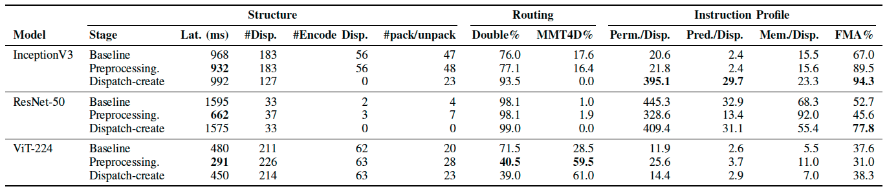
Why progressive lowering amplifies pass ordering problem?
Statistics of Dispatches that constitute the whole program
Def. Proxies: indicators for execution efficiency
Proportion of specialized dispatches
linalg-generalize-named-ops is inserted in each stage to show downstream differences.
For GEMM-dominated inference, higher FMA% is often interpreted as better utilization.
Takeaway:
Regime shift: Upstream pass ordering can change what the backend is optimizing.
Local proxies are insufficient to attribute performance gain because of regime shifts.
Notes:
So I ran experiment using one probe pass: linalg-generalize-named-ops
The table shows even if a pass only changes the representation, has absolutely no effect on the computation, applying at different stages can yield substantial performance difference. These difference are shown in the formation of dispatches, proportion of strategies applied and instruction mix changes per dispatch.
I use 3 indicators to track the downstream changes
Structure column models the statistics of how each dispatches are formed
Routing column models the tiling strategies applied for each dispatch.
Instruction profile columns is the indicator for execution efficiency of the entire model
This experiment shows that changing where a pass is executed change what the backend think it is optimizing on, because the how dispatches are formed changes, strategies for each dispatch changes, even instruction per dispatch changes, I call this phenomenon regime shift.
Additional insight is, local proxies, the indicators for execution efficiency is not enough to explain the performance gain, because the regime is entirely different.

Slide 11
Pass Ordering Must Be Workload-Specific
Takeaways from Motivation and Investigation:
From the motivation, we observe that -O3 does not transfer reliably across architectures or input shapes.
A poor pipeline choice can cause up to 8× performance loss on an individual model.
We attribute this gap to regime shifts: upstream pass ordering changes what the backend effectively optimizes.
Therefore, local proxies alone are insufficient to explain or predict performance differences.
Implication:
We need an automated, per-workload, per-shape, pass-ordering method that accounts for regime shifts rather than relying on unstable local proxies.
Notes:
so now, I can state the constraints, the goal and solution more clearly.

Slide 12
BO3: 3-stage RL Framework as a Solution
A 3-stage framework for the problem.
Fix search space for RL.
Train an RL policy on finding pass ordering in preprocessing stage.
Evaluate the RL stochastically.
Notes:
I therefore develop a 3-stage framework as a solution to the problem, when given an IR of a model, the framework output a good RL policy to generate custom pipeline for the IR.
The first stage, I search for good backend configurations for the IR, rank and select the top-K performing configurations for the next stage.
In the second stage, I trained an RL agent to learn what good pass sequences look like for the input IR and the given configuration. The output of the second stage is a trained policy checkpoint
In the third stage, I evaluate the trained policy and report the latency.
I’ll introduce each component in more detail in the following slides.

Slide 13
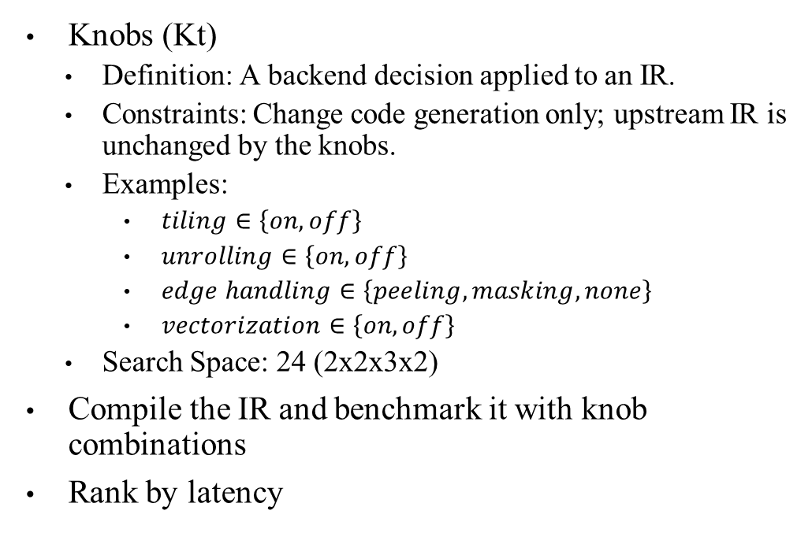
BO3 Stage I: Knob Screening
Knobs (Kt)
Definition: A backend decision applied to an IR.
Constraints: Change code generation only; upstream IR is unchanged by the knobs.
Examples:
$tiling∈\left\{on, off\right\}$
$unrolling∈\left\{on, off\right\}$
$edge handling∈\left\{peeling, masking, none\right\}$
$vectorization∈\left\{on, off\right\}$
Search Space: 24 (2x2x3x2)
Compile the IR and benchmark it with knob combinations
Rank by latency
Notes:
Stage I of the BO3 framework searches the backend code configurations and produce good configuration for Stage 2.
I call one backend decision applied to an IR a knob.
A knob has constraints that it change code generation behavior only, upstream IR is not affect by a knob.
Knob configurations in the BO3 frameworks are whether to tile or not, whether to unroll or not, …
Therefore the total search space for backend configurations is 24.
For each comb, I compile and measure latency.
And select top-K configurations for the second stage.

Slide 14
BO3 Stage I: Knob Screening Result
Model | Top-1 knob comb (unroll, tile, m/p/n, vec) | O3 (F,F,n,F) | Top-1 knob Latency
Bert base (s128) | F, T, p, T | 210 | 185
Alexnet | T, T, m, F | 256 | 245
DenseNet | T, T, p, F | 5980 | 4801
ResNet50 | F, F, m, T | 1592 | 1498
UNet384 | T, F, n, F | 5672 | 5549
ViT224 | F, T, p, T | 1559 | 307
Yolov5 | T, F, p, F | 1108 | 1049
Notes:
This is the result after Stage 1
I obtain the best knob combination for each model.
This shows that different models expects different code-generation configuration
For instance, BB favor tile, peel and vectorization but does not favor unroll
Alexnet favor unroll, tiling and use mask for edge handling but does not favor vectorization

Slide 15
BO3 Stage II: RL Environment and design
Input: An IR and a knob combination.
Encode IR to a SSA graph (Sec: obs)
Produce legality mask (Sec: actions)
Predict action (Sec: policy)
Get feedback (Sec: reward)
Update policy (Sec: policy)
Output: A policy that generates pass sequence for input.
Notes:
After having good knob combinations, BO3 designed an RL environment,
where given an IR and a knob combination, the environment output a policy that generates pass sequences it learned to apply on the IR.
To do this, the environment first model the IR as a SSA dataflow graph;
it produce legality mask, masking out invalid action given the IR, and then the agent predict the action based on the SSA graph and legality mask, and apply the action to the IR.
Trajectory ends when the number of times an agent applies pass reach a limit, or a special action: EVAL is applied,
when this happens a reward is computed and after several rewards available, the policy is updated
We next dig into each component individually.

Slide 16

BO3 Stage II: RL --- IR as a Dataflow Graph
Why model IR as graph?
Dispatch boundaries are related to tensor’s producer-consumer relationships (neighboring nodes)
Node: An operation; Edge: A def-use of a node;
Observation space: A graph derived from the IR
up to 5,000 nodes and 20,000 edges
Features
Node (27): operation type, shape, layout, permutation order, memory/compute proxies, ...
Global (12): conv/matmul counts, permutation/padding/transpose ratios, ...
Context (11): pass history, remaining budget, last action ID
Encoder
2-layer GraphSAGE; hidden size 64
captures 2-hop producer–consumer structure
Output vector dimension: 64+12+11 = 87
Notes:
For Stage II, the policy cannot consume raw IR directly, so I convert the current IR into a structured observation.
I model the IR as an SSA def-use graph because pass profitability is highly depends on producer–consumer structure, such as which op feeds which other op, and those relationships are often related to later dispatch behavior.
Concretely, each node is an operation and each edge is a def-use relation.
On top of the graph, I also add two compact summaries:
global features, which describe the whole module composition,
and context features, which describe the search state, such as pass history and remaining budget.
I then use a 2-layer GraphSAGE encoder with hidden size 64.
The idea is to give the policy a compact structural view of the current compiler state.
Two hops are a reasonable compromise here: they capture many short-range producer–consumer patterns without making the encoder too heavy under the bounded RL budget.
The final embedding is then concatenated with the global and context vectors and fed to the policy.

Slide 17
BO3 Stage II: RL --- Preprocessing-Stage Passes as Actions
Action name | Short-hand
Canonicalize | canon
Common subexpression eliminatin | cse
conv-op to img2col | I
conv-op to channels last | CC
Transpose conv-op | T
Padding | pad
Fold attention | FA
Generalize named ops | generalize
Fold unit dimension | fold
Design Requirement: As the IR changes, the set of legal actions also changes.
Action space: 9 transformation actions + EVAL
EVAL: terminates the trajectory and triggers compile + benchmark
Legality mask: filters invalid actions based on
Per-pass application limits
E.g., a pass is applied at most 2 times in one trajectory.
IR-dependent applicability constraints
E.g., conv passes are masked if no conv ops are in the IR.
Notes:
Next, the action space is designed for decision that can be made in the IREE preprocessing stage.
We use 9 actions + a special EVAL action to form the action space
EVAL is special because it is not natively a pass in IREE
It serves as a termination point where agent can decide when to end a trajectory.
The agent can use it to stop compile and start benchmarking.
Legality mask is used to filter invalid action based on 1. per-pass limit, e.g., each pass is applied at most 2 times in one trajectory; 2. IR-dependent applicability, e.g., convolution passes are masked out if there is no convolution operations in the IR.
The agent samples from the action space and apply the sampled action to the current state, current IR.

Slide 18
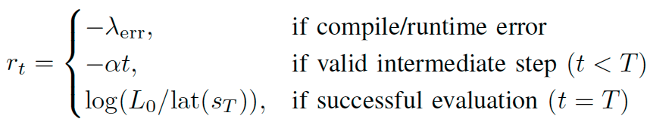
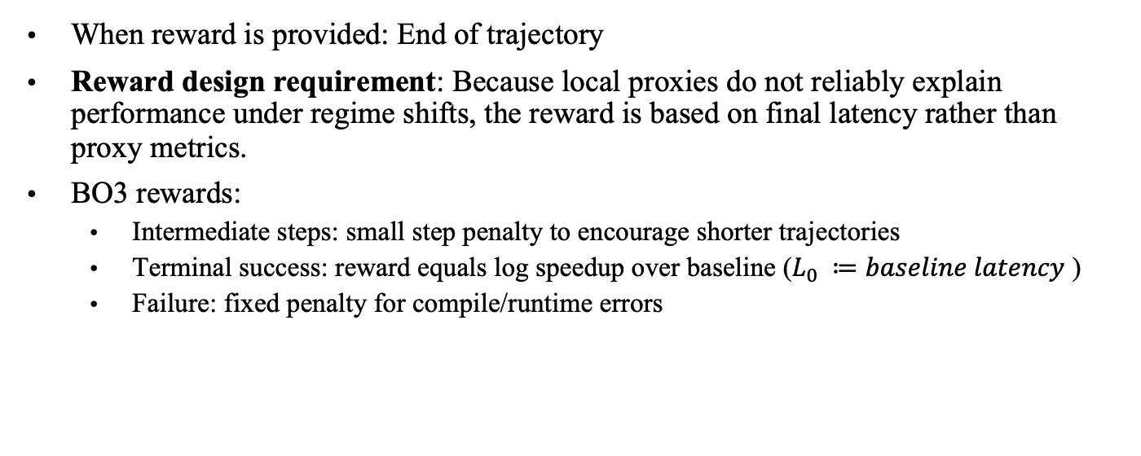
BO3 Stage II: RL --- Final measured latency as Rewards
When reward is provided: End of trajectory
Reward design requirement: Because local proxies do not reliably explain performance under regime shifts, the reward is based on final latency rather than proxy metrics.
BO3 rewards:
Intermediate steps: small step penalty to encourage shorter trajectories
Terminal success: reward equals log speedup over baseline ($L_{0} ≔baseline latency$ )
Failure: fixed penalty for compile/runtime errors
Notes:
In the end of one trajectory, when EVAL is applied or pass limit is reached, we designed a reward for indication how good a trajectory is
The requirement for this design is that

Slide 19
BO3 Stage II: RL --- MaskablePPO best matches the problem
A policy determines how actions will be chosen.
Stable learning under noisy rewards: Latency is a noisy reward signal.
Even same decisions twice, runtime can differ
Unstable learning updates unless policy is conservative
PPO: clipping to stabilize learning + prevent large updates.
More accurate long-horizon credit assignment: Rewards are delayed until end of a trajectory.
Rewards are delayed until EVAL is applied
Earlier decisions are evaluated indirectly through the final reward.
PPO: Advantage estimate to propagate reward backward through the trajectory.
Deal with legality when IR changes: Action space legality is depending on the current IR state.
Legal moves change when IR changes
Maskable PPO: enforce legality right when sampling
Notes:
Next, we need to decide on the brain of the agent, the policy
Policy determines how the actions will be chosen
Several design requirement derived from the problem formulated are needed for the policy
First, stability.
latency as feedback is a noisy signal.
Even if the agent makes exactly the same decisions twice, the measured latency can still be different.
noisy rewards lead to unstable learning updates unless the algorithm is conservative.
PPO helps by clipping policy updates, which keeps the agent from taking destructive, overly large learning steps.
Second, delayed rewards.
The agent doesn't get a reward until the end of a long pass sequence.
This means each earlier decision has to be evaluated indirectly through the final latency.
PPO handles this sparse credit assignment well by using advantage estimation to propagate that final reward backward through the entire trajectory.
Third, dynamic action spaces.
The legal moves change constantly depending on the current IR state.
By using a 'Maskable' variant, we enforce legality right when sampling.
This stops the agent from wasting time exploring impossible states

Slide 20
BO3 Stage III: Post-training evaluation on Trained Policy
After training, we have a policy generates good pass sequences.
Process:
Sample 10 rollout trajectories from the trained policy for the input IR
Evaluate the sampled trajectories and select the best-performing pass sequence
Benchmark the selected sequence 10 times across processes
In each benchmark trial, run the sequence 5 times and record the median latency
Reported result: mean of the 10 median latencies, with standard deviation
$$reported latency=mean\left(medians\left(latency\right)\right)±std$$
Notes:
After stage 2, BO3 learns a good compile sequence for an IR given a knob combination
How to evaluate the goodness of the learned policy?
To do this, I sample 10 rollout trajectories generated by the policy
Evaluate each trajectory and select the best performing pass sequence.
This sequence is then benchmarked 10 times. In each benchmark trial, the sequence is compiled and run 5 times and record the median latency.
The reported result is taking mean of 10 medians with standard deviation

Slide 21
Claim1: BO3 Outperform IREE -O3
Notes:
We benchmark the BO3 framework on single core CPU pinned, and evaluated on 9 workload instances and show the result
The first claim is that BO3 outperforms –O3
Bar chart represent runtime for each model, lower is better
We can see from the bar chart, BO3 outperforms –O3 on every instances
The output are compared to ensure correctness are maintained.
Aggregating the best RL-found result per workload gives a geometric-mean speedup of 5.66×.

Slide 22
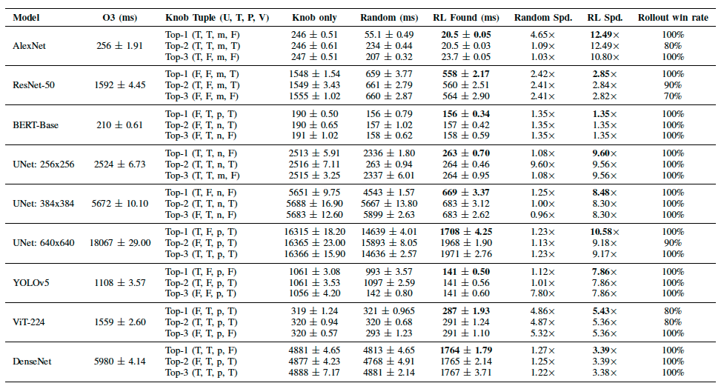
Claim1: BO3 Outperforms IREE -O3
Knob-dominant workloads (ViT-224):
Stage I: 4.9x speedup, brings latency to ~320ms.
Stage II: improves further to 287ms.
Pass-ordering-dominant workloads (e.g., UNet256):
Stage I: nearly unchanged
Stage II: 9.6x speedup
Conclusion: Improvement is consistent, 3-stage design is necessary because relative contributions from stages are workload-dependent.
Notes:
Analyze on the result further, I found improvement are workload-dependent.
Table columns shows O3 latency, top-3 knob configurations selected, latency of the program when applying the knob where no pass ordering happens upstream, latency of random and RL and the relative speedup of random and RL. The last column reports among 10 rollouts, how many times the generated pass sequence outperforms –O3.
The first pattern is spdup comes from knob.
The example is ViT-224.
Stage I alone brings latency down to around 320 ms, which is about 4.9× speedup over O3.
Then Stage II improves it further to 287 ms.
The second is spdup comes from pass sequences
The example is UNet-256.
The best knob barely changes the performance
But the RL-found sequence under that same knob reaches about 9.6× speedup.
From the graph we claim that BO3 consistently outperform O3.
And from analysis we can tell that 3-stage design is necessary, because relative contributions from stages are workload-dependent..

Slide 23
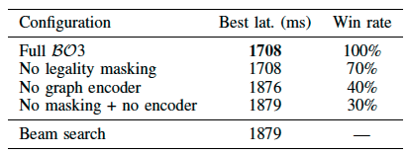
Claim2: Gains are not from search budget alone
Conclusion
Random or beam search can tie RL only when good pipelines are easy to reach.
As the search problem becomes harder, RL gains increase.
Ablation suggests: legality masking reduces wasted exploration, and the graph encoder provides structural signals needed to identify promising trajectories.
Therefore, the improvement is not from search effort alone, but from learned guidance.
Notes:
My second claim is that BO3’s gains are not explained by search budget alone.
Graph shows the comparison of stage 2 policy with beam search. Numbers annotated are the actual runtime.
On some short-sequence tasks, beam matches RL.
But on ResNet-50, ViT-224, and UNet-640, RL still finds lower-latency seqeucnes.
I also ran ablation on UNet640 to isolate which BO3 components matter.
If I remove legality masking, the best-found latency still stays at 1708 ms, but the rollout win rate drops from 100% to 70%. So masking mainly improves reliability.
If I remove the graph encoder, the best-found latency degrades to 1876 ms, and win rate drops to 40%. So graph-structured state is important for solution quality.
If I remove both, performance reaches 1879 ms, which is basically beam-search level.
So BO3’s advantage comes from combining legality-aware exploration with a graph representation of compiler structure.

Slide 24
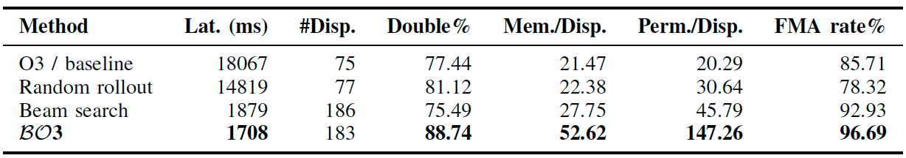
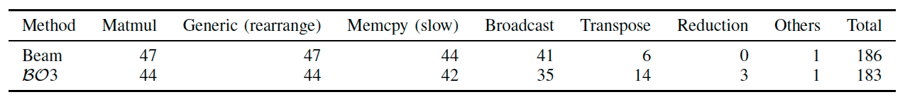
Claim3: Regime shift explains BO3’s gain (UNet640)
Random (T+EVAL) barely changes dispatch structure, latency improves modest
Beam search (I+cse+EVAL) applies img2col, decomposing conv to transpose + matmul (partition + composition regime shifts)
BO3 (canon+CC+I+EVAL) convert data layout from NCHW to NHWC before img2col.
Notably, total dispatch counts from BO3 are comparable to Beam, dispatch formations are also very similar.
Notes:
I next claim BO3’s gain should be explain by regime shift, where upstream pass ordering changes what downstream think it is optimizing
I use UNet640 with top-1 knob as case study
I compare three search outcomes.
A random rollout, which found T + EVAL, brings latency down to 14K ms, by increasing the number of dispatches routed to double tiling.
Beam search, found I + cse + EVAL, applies img2col decompose conv to trans + matmul, changing both partitioning and composition.
BO3 finds canonicalize + CC + I + EVAL, where CC converts layout from NCHW to NHWC before img2col.
We can see from the table that beam and BO3 have comparable dispatch counts and broadly similar semantic work.
So BO3 is not simply “doing much less work” or “taking a completely different route.”
We next investigate on IR diff and hardware counters to attribute the performance gain.

Slide 25
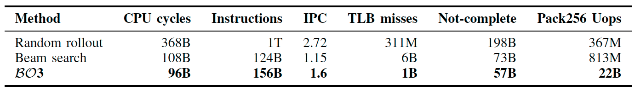
Claim3: Regime shift explains BO3’s gain
Compare to Beam
TLB misses drop 6x: dimension reordering changes memory traversal pattern.
SIMD increases 27x: Under NHCW, memory span aligns more with SIMD registers.
-> BO3 retires more instructions but complete with less cycles
-> Layout change makes downstream compiler deals with different layout per dispatch, dispatch statistics are similar, but what is exposed to the backend is different, leading to better memory access pattern and better SIMD utilization.
Notes:
IR investigation shows that the main difference is tensor layout
Under NCHW, the channel dimension is not innermost, so the backend needs more gathers and less regular access.
Under NHWC, channels become innermost, so it makes memory more contiguous, and align better with SIMD lanes.
Verified through hardware counters
Compared to beam search, BO3 reduces TLB misses by 6×.
It increases packed 256-bit SIMD retirement by 27×.
It also lowers not-complete events and raises IPC from 1.15 to 1.6.
Notably, that BO3 retires more total instructions than beam, 156B versus 124B, but still finishes in fewer cycles and lower wall time.
That means the extra instructions are cheaper than the stall overhead BO3 avoids.
To conclude
two sequences can have similar dispatch statistics, but upstream pass ordering exposes to the backend a different memory layout, diverging the performance reached.

Slide 26
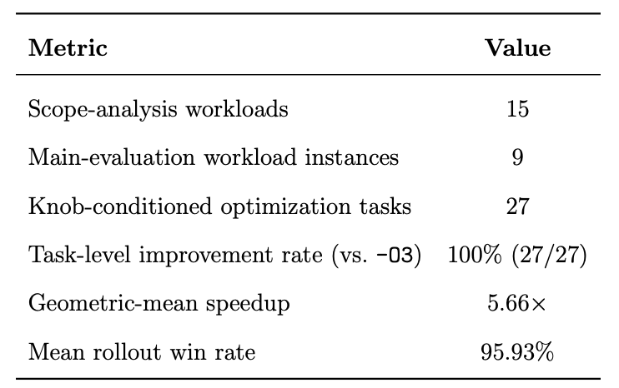
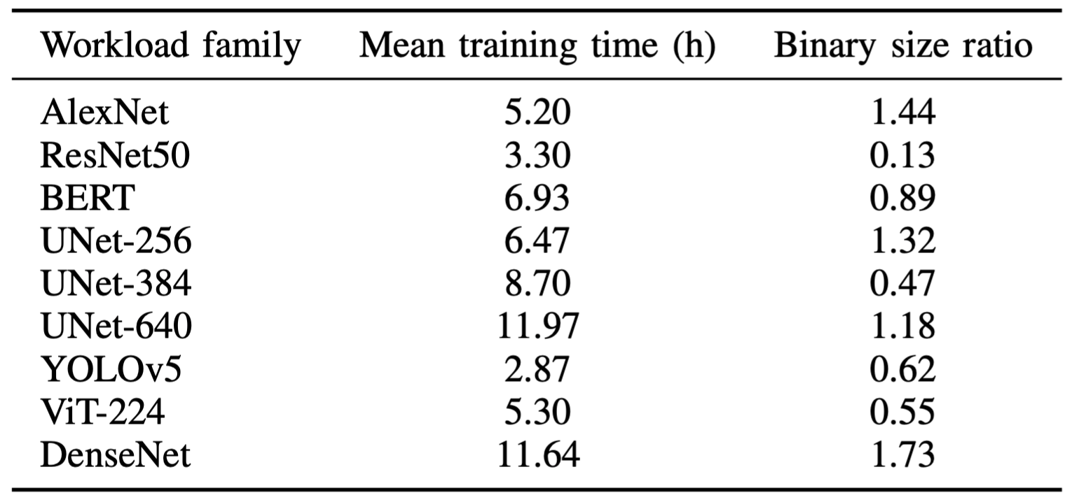
Claim4: BO3 is Robust and Practical
On 9 workload instances, 3-knobs per instance, total 27/27 tasks, BO3 has 95.93% win rate, reliably outperform -O3.
Training cost (2~12 hrs) comparable to typical tensor program autotuning budget (e.g., Ansor).
Notes:
Lastly, I claim BO3 is robust and practical

Slide 27
Summary and Future work for BO3
Summary:
Fixed-pipeline is no longer a good standard for multi-level compilers.
Phase ordering has long-horizon interaction in multi-level compilers because of regime shift.
BO3 addresses this with 3-stage RL framework.
Evaluated on 9 models, it consistently improves over -O3 (yielding 5x geo mean speedup)
Future work:
Joint search for passes across abstraction stages.
Broader hardware targets
Multi-stage Hierarchical RL training
Notes:
Remove limitations
Future work: changing policy

Slide 28


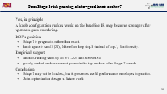








DEFENSE

Slide 29
Is headroom obtained from brute-force reliable?
Impossible for exhaustive search
View brute-force as extensive sampling
Not to prove global optimum, but to demonstrate: there is substantial performance headroom beyond the default -O3 pipeline.
Moreover, Even under a non-exhaustive search, I can already find sequences with very large gains, which supports the claim that fixed pipelines do not generalize well.
48 hours ~= 178200 seconds
For 0.2s baseline application ~= 891K combinations
For 18s baseline application ~= 10K combinations
Notes:
X-axis, y-axis

Slide 30
The core difference between single-level and multi-level for pass ordering problem
Pass ordering on Single-level representation
Passes change the same level of abstraction.
Effect of a pass is more directly reflected on final performance.
Lower through one major commit point (IR to machine code)
Pass ordering on Multi-level representation
Passes change what remain available for the next lowering stage.
Changes in upstream pass ordering does not affect performance directly, but compound through every lowering stage (how IR is partitioned, how dispatches are formed, which route backend took)
Compilation is a sequence of irreversible commitment.
How well you optimize within a fixed problem?
What problem the downstream is optimizing?

Slide 31
Selection of the probe pass
Reason for linalg-generalize-named-ops:
Clean representation-changing pass
Computation stays the same: Its mainly changes how the compiler sees the operation, not the intended computation itself.
Therefore, observed performance differences are more cleanly attributed to downstream optimization-space changes rather than the pass’s own direct algorithmic benefit
In contrast, passes like transpose or img2col introduce confounded effects
direct performance effect of the pass itself
plus downstream dispatch / routing changes
Goal: isolate stage-placement effects as a controlled diagnostic, not claim universality

Slide 32
Investigation:
Routing change
Adding a probe pass as a controlled experiment: linalg-generalize-named-ops
Pattern 1: Routing changes
56 dispatches less in total
Tiling strategy shifts away from MMT4D
Reflects on instruction profile
On-the-fly data rearrangement rise 19x perm/disp., 12x pred/disp.
Although FMA% rises, performance degrade.
Notes:
X-axis, y-axis

Slide 33
Investigation:
Partition change
Adding a probe pass as a controlled experiment: linalg-generalize-named-ops
Pattern 2: Routing similar, partition changes
Strategies are boardly the same
Speedup 2.4x (1595ms -> 662ms)
Reflects on routing and instruction profile
The increased 4 dispatches routed to MMT4D
Data rearrangement overhead trapped per dispatch is reduced, better dispatch structure leads to better performance.

Slide 34
Investigation:
Composition change
Adding a probe pass as a controlled experiment: linalg-generalize-named-ops
Pattern 3: Routing similar, partitioning similar, composition changes
Strategies, partitioning are boardly the same
55% latency overhead
IR level investigation
Dispatch formation effect is amplified by 12 transformer blocks.
Late: monolithic softmax path v.s. Early: reduction path with pack fused in
This changes the memory access pattern, consistent with ~10x fewer L1D TLB misses

Slide 35
Why separating Stage I and Stage II?
What Stage II observes?
Input: preprocessing-stage IR
Observes: Sees whole-program IR
Constraints: Does not directly observe backend effects
Why joint action space is problematic?
Joint space := {preprocessing passes + knobs}
pass actions act on current IR
knob effects appear only after later codegen.
Problematic credit assignment:
Example: anchor check section ViT-224
The policy would be asked to choose backend knobs whose effects are not yet visible in the current IR.

Slide 36
Does Stage I risk pruning a later-good knob anchor?
Yes, in principle
A knob configuration ranked weak on the baseline IR may become stronger after upstream pass reordering.
BO3’s position
Stage I is pragmatic rather than exact.
knob space is small (24), I therefore kept top-3 instead of top-1, for diversity.
Empirical support
anchor-ranking stability on ViT-224 and ResNet-50
poorly ranked anchors are not promoted to top anchors after Stage II search
Conclusion
Stage I may not be lossless, but it preserves useful performance envelopes in practice.
Joint optimization design is future work.

Slide 37
How is action space chosen?
IREE preprocessing stage exposes limited number of preprocessing-passes.
Excluded: transform-interpreter, PDL pattern application, and attr-based pipelines.
These are user-facing transformation interfaces, not fixed atomic compiler passes. Their behavior depends on external scripts and attributes.
BO3 studies ordering over a fixed pass vocabulary, not search over external transformation programs.
The remaining action space is therefore the set of concrete preprocessing passes that can be meaningfully reordered.
Source: IREE preprocessing passes

Slide 38
Why GraphSAGE?
Why GraphSAGE for RL observation?
The IR is already a graph, so producer–consumer structure is preserved.
It is inductive and scalable, so it can handle unseen graphs after each compiler pass.
Two layers capture 2-hop neighborhood information relevant to dispatch boundaries.
Encoder workflow
Input graph (V, E), V: Nx27; E: 2xmax edges
Layer 1: mean-aggregate 1-hop neighbors: H1: Nx64
Layer 2: aggregate again to reach 2-hop structure H2: Nx64
Mean pool: compress node embeddings into graph embeddings h_g: 1x64
Concatenate: [h_g; g_t; c_t]: 1x87

Slide 39
Why MaskablePPO?
Requirement: Latency as reward is sparse and high-variance, action legality evolves with state, deal with long-horizon credit assignment.
Method | Why it fits | Why not
PPO | Stable with sparse terminal rewards; works with action masking; handles long-horizon credit assignment reasonably well | Requires many rollouts.
Hierarchical RL | Natural fit to deal with multi-stage decision. | Complex to design, train and tune.
DQN | Suitable for discrete action spaces | Unstable with noisy terminal rewards; awkward with graph states and changing legal actions.
RINFORCE | Easy to use and implement. | High variance.
Offline RL | Can reuse past search data and reduce online compile cost | Requires broad data coverage; unrealistic for this setting

Slide 40

Deterministic v.s. Stochastic evaluation
PPO optimizes expected return over a trajectory distribution, not a single sequence.
Deterministic (greedy) decoding evaluates a different objective.
Counterargument: A fully converged policy should deterministically output the global optimum.
Reality: In long-horizon, sparse-reward compiler spaces, stepwise PPO updates do not guarantee collapse to a single path.
The policy learns to retain probability mass across multiple promising trajectories.
Deterministic evaluation measures the isolated quality of one arbitrary decoder choice.
Stochastic evaluation accurately measures the probability of generating a successful sequence under a practical rollout budget.
PPO paper: https://arxiv.org/pdf/1707.06347

Slide 41
Investigation:
Regime shift
3 levels of regime shift (from finer grained to coarser grained)
Composition level: Routing, partition stay similar, computation is exposed differently
Example: ViT-224
Pattern: Monothlitic softmax v.s. Decomposed reduction + fused pack
Partition level: Routing stays similar, partition changes
Example: ResNet-50
Pattern: Overhead trapped per dispatch changes.
Routing level: Tiling strategy changes
Example: InceptionV3
Pattern: MMT4D disappears
Insights: local proxy can be misleading when attributing performance gain.
Notes:
The third motivation is stage-dependent regime shifts.
This is a controlled study: same workload, same probe pass, and the same backend knob setting; the only change is where the pass is inserted in the lowering pipeline.
Even under this controlled setup, different insertion stages lead to different downstream regimes and different latencies.
This means pass profitability is not static and cannot be captured by a simple local ranking of passes.
In progressive lowering, the problem is therefore not only which transformation to apply, but also when in the lowering pipeline to apply it.
Explain the terminologies
Standard is not good

Slide 42
Claim1: BO3 Consistently outperforms IREE -O3
Notes:
Clarify: Is the output the same
Bar graph
Why search strategies are compared

Slide 43
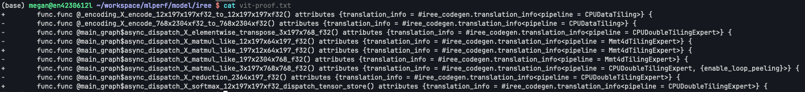
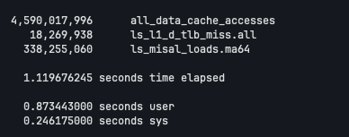
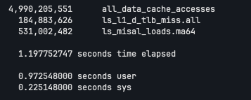
ViT224 IR diff and counter
Left: preprocessing, right: dispatch-creation

