Slide 1
Viyog: Separating Adversarial and Out of Distribution
Aman Singh

Slide 2
Authors
Aman Singh¹
asing651@asu.edu
Arizona State University
Tempe, AZ
Rishab Kashyap³
rkashya6@asu.edu
Arizona State University
Tempe, AZ
Ameya M. Gurjar⁵
agurjar2@asu.edu
Arizona State University
Tempe, AZ
Hwisoo So⁷
hwisoo.so@knu.ac.kr
Yonsei University
Seoul, Korea
Kyoungwoo Lee⁹
agurjar2@asu.edu
Yonsei University
Seoul, Korea
Abhinav Kumar²
akuma294@asu.edu
Arizona State University
Tempe, AZ
Soyeong Park⁴
psy980823@yonsei.ac.kr
Yonsei University
Seoul, Korea
Yohan Ko⁶
yohan.ko@yonsei.ac.kr
Yonsei University
Seoul, Korea
Uiwon Hwang⁸
uiwon.hwang@yonsei.ac.kr
Yonsei University
Seoul, Korea
Aviral Shrivastava¹⁰
avirals@gmail.com
Arizona State University
Tempe, AZ

Slide 3
Agenda
What is Adversarial Attack ? What is Out of Distribution?
Why do we need to separate them?
What is the effect of ADV on early layers?
What has been done previously to separate them? Their limitations?
How Does Viyog Work?
How does ViYog overcome the limitations of existing methods?
What is the Computational overhead of ViYog?
What is the Runtime memory overhead of ViYog?

Slide 4
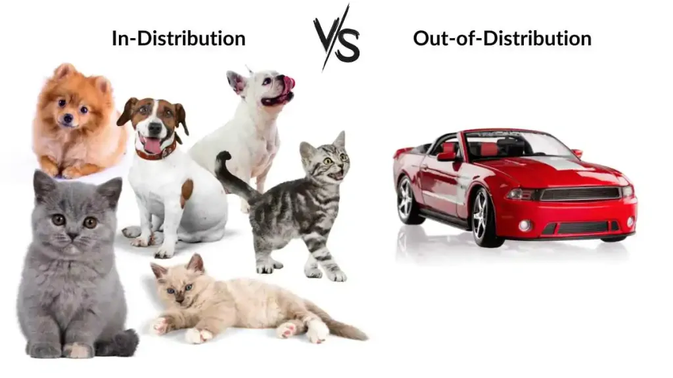
What is OOD?

Slide 5
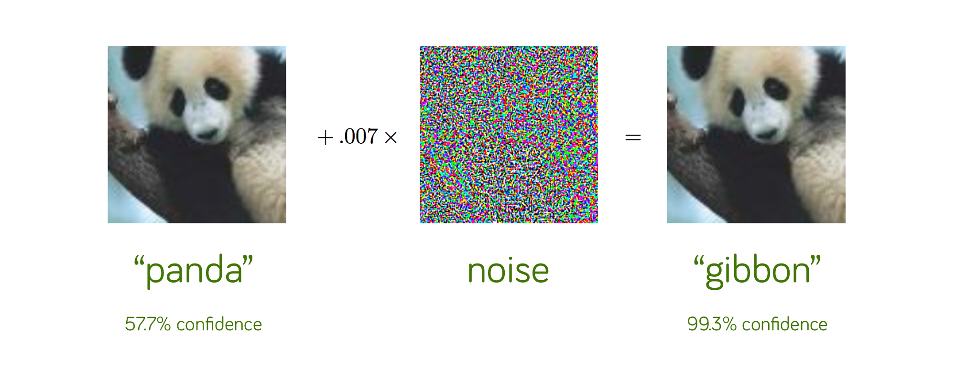
What is ADV?
Image Reference : I. J. Goodfellow, J. Shlens, and C. Szegedy, “Explaining and Harnessing Adversarial Examples,” arXiv preprint arXiv:1412.6572, 2014.

Slide 6
Agenda
What is Adversarial Attack ? What is Out of Distribution?
Why do we need to separate them?
What is the effect of ADV on early layers?
What has been done previously to separate them? Their limitations?
How Does Viyog Work?
How does ViYog overcome the limitations of existing methods?
What is the Computational overhead of ViYog?
What is the Runtime memory overhead of ViYog?

Slide 7
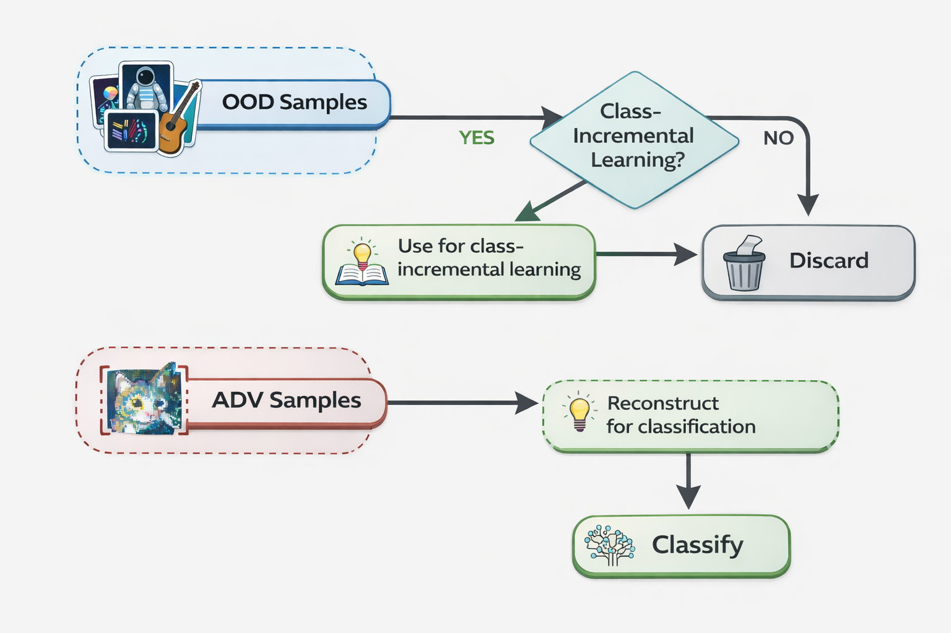
OOD Samples -> Can be used for class-incremental learning or discarded
ADV Samples -> Can be reconstructed for classification
Motivation to Seperate OOD and ADV

Slide 8
Agenda
What is Adversarial Attack ? What is Out of Distribution?
Why do we need to separate them?
What is the effect of ADV on early layers?
What has been done previously to separate them? Their limitations?
How Does Viyog Work?
How does ViYog overcome the limitations of existing methods?
What is the Computational overhead of ViYog?
What is the Runtime memory overhead of ViYog?

Slide 9
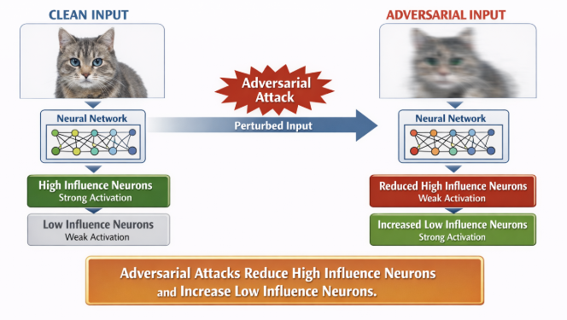
_{Effect of Adversarial Attacks}
Fight Perturbations With Perturbations: Defending Adversarial Attacks via Neuron Influence:Journal: IEEE Transactions on Dependable and Secure Computing (TDSC)

Slide 10
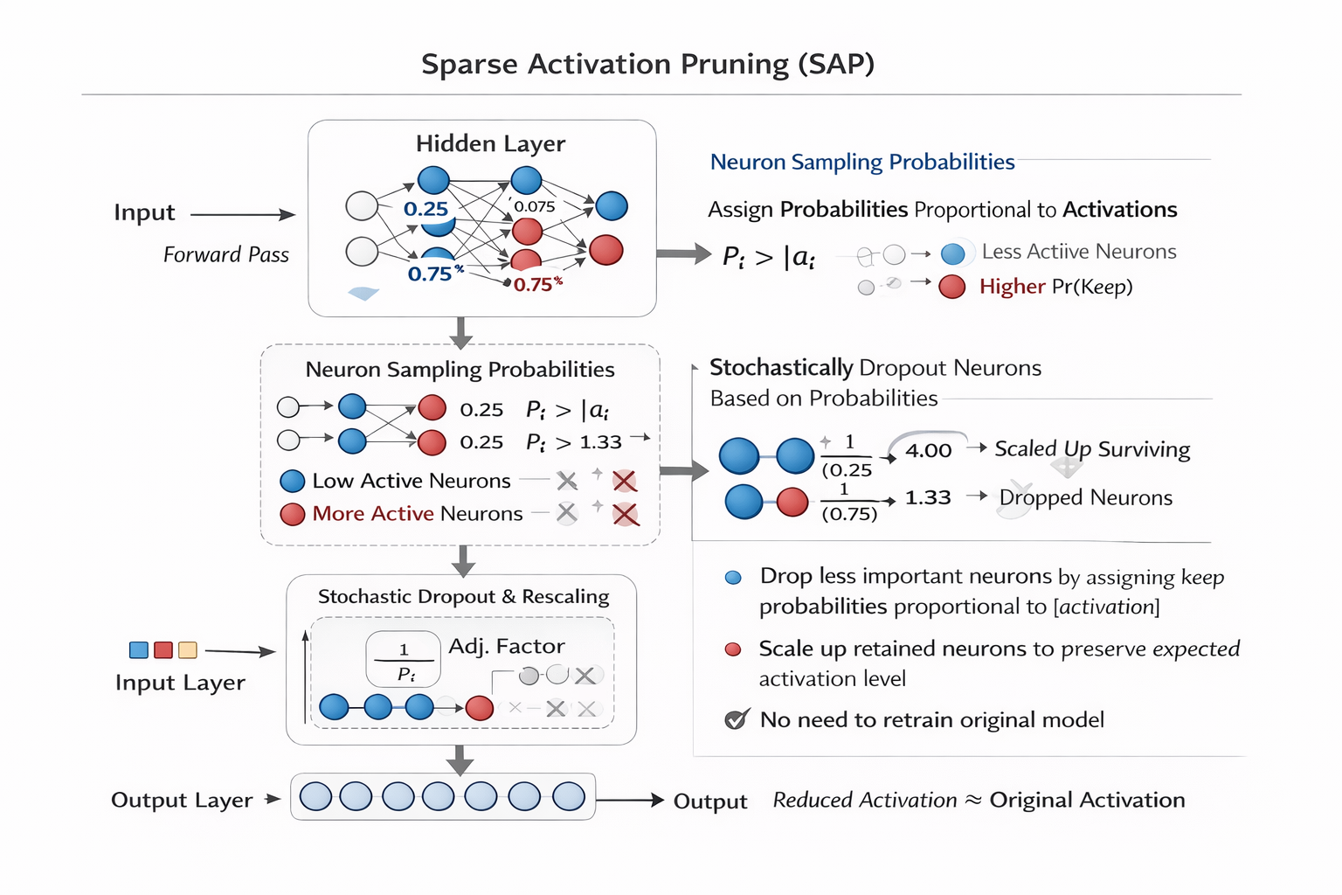
Effect of Adversarial Attack
Based on the fact that adversarial attack reduced the neurons with high activations
ICLR 2018: STOCHASTIC ACTIVATION PRUNING FOR ROBUST ADVERSARIAL DEFENSE

Slide 11
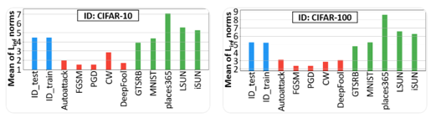
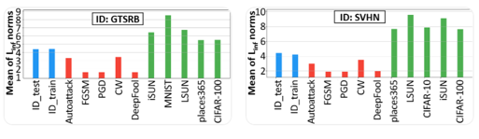
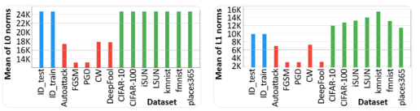
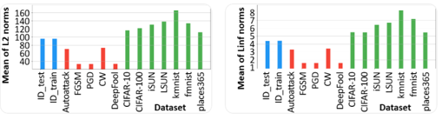

Analysis of Norms across Different Training Datasets
Model: DenseNet-BC 100
Linf Norm : Cifar 10 Cifar100
Linf Norm : GTSRB SVHN
MNIST : L0 Norm L1 Norm
MNIST : L2 Norm Linf Norm

Slide 12
Agenda
What is Adversarial Attack ? What is Out of Distribution?
Why do we need to separate them?
What is the effect of ADV on early layers?
What has been done previously to separate them, and their limitations?
How Does Viyog Work?
How does ViYog overcome the limitations of existing methods?
What is the Computational overhead of ViYog?
What is the Runtime memory overhead of ViYog?

Slide 13
Logit-based Methods
MSP: max softmax probability
Energy: energy score from logits
MaxLogit: maximum raw logit
Entropy: uncertainty from softmax
ODIN: temp scaling + input perturbation

Slide 14
Feature & Distribution Methods
Mahalanobis: distance to class distributions
KNN: nearest neighbor in feature space
MCD: dropout-based uncertainty
KLM: KL divergence mismatch
OpenMax: models unknown class probability

Slide 15
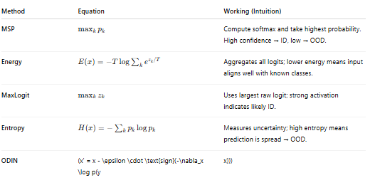
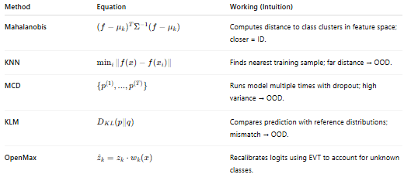

Existing Methods
Logits Based Feature Based

Slide 16
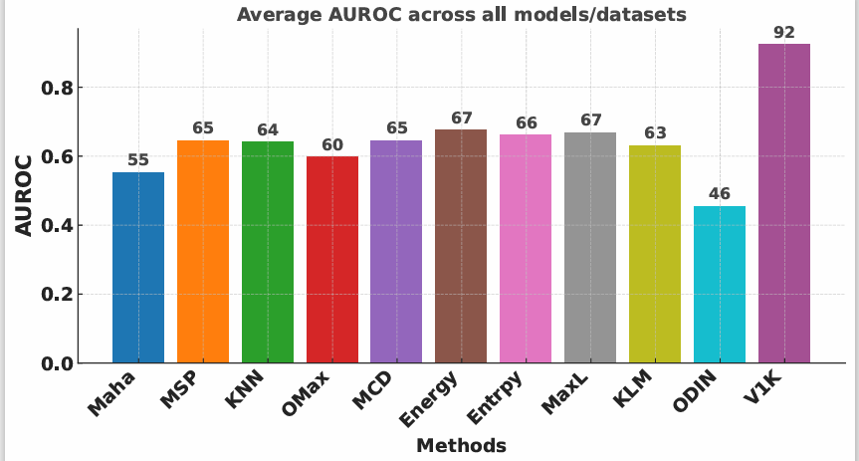
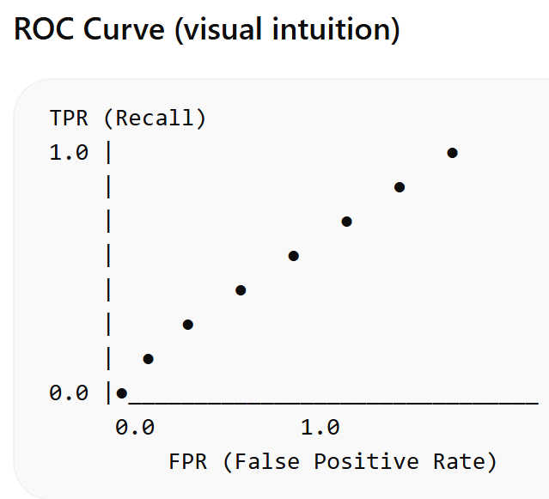
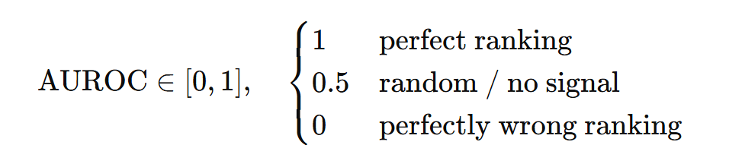
Exiting Methods Dont Effectively Seperate

Slide 17
Agenda
What is Adversarial Attack ? What is Out of Distribution?
Why do we need to separate them?
What is the effect of ADV on early layers?
What has been done previously to separate them? Their limitations?
How does ViYog Work?
How does ViYog overcome the limitations of existing methods?
What is the Computational overhead of ViYog?
What is the Runtime memory overhead of ViYog?

Slide 18
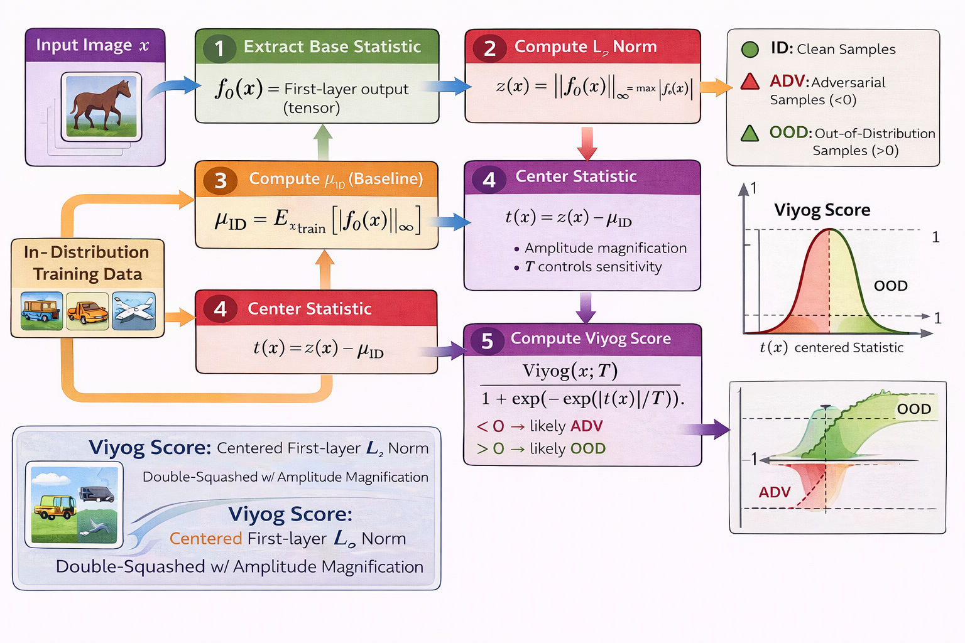


Viyog : Methodology (Overview)

Slide 19
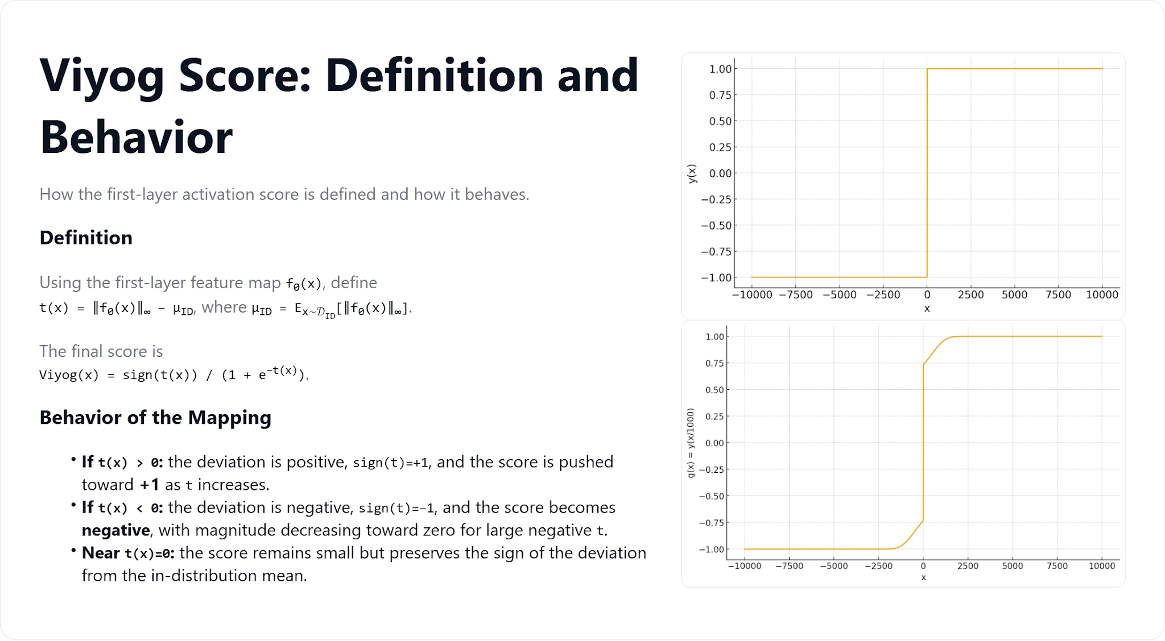

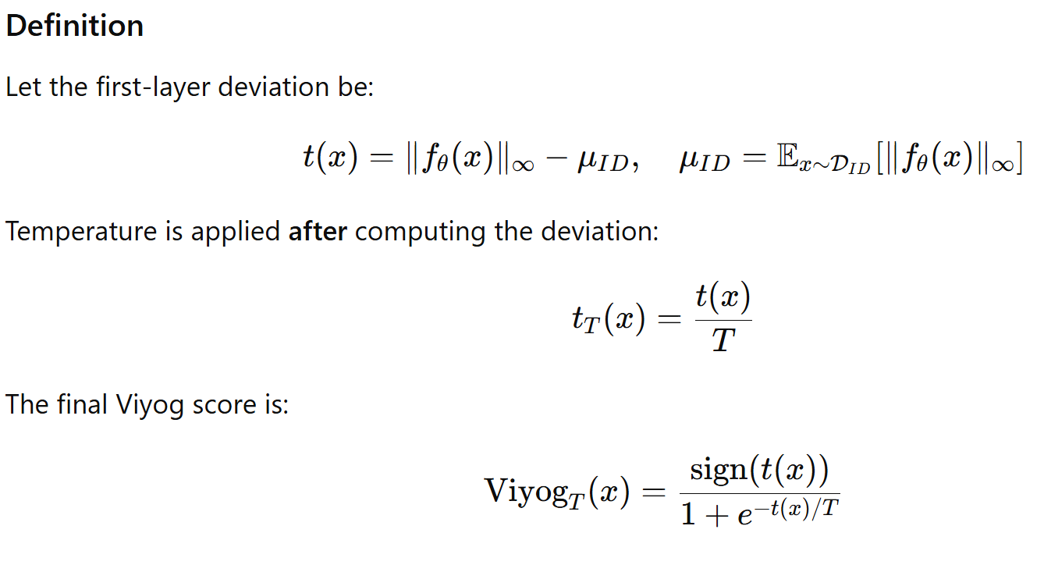
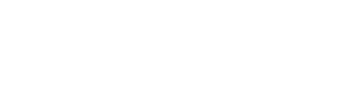
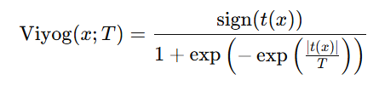

Slide 20
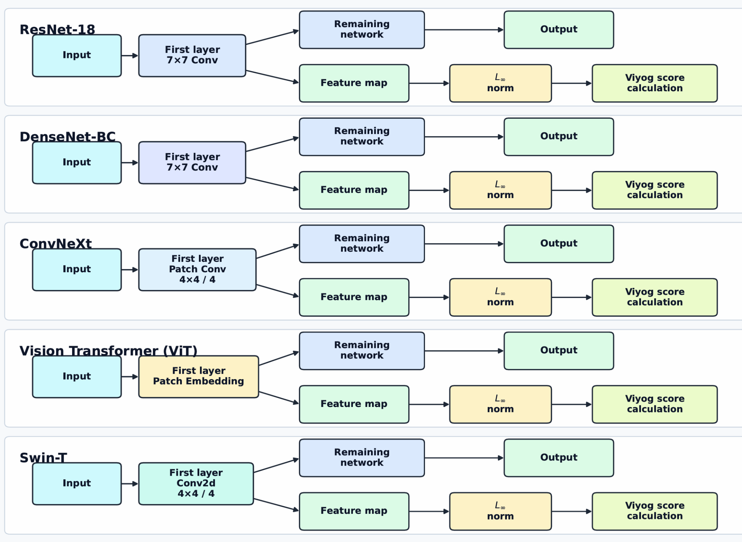
Viyog Pipeline: Collects features from first layer

Slide 21
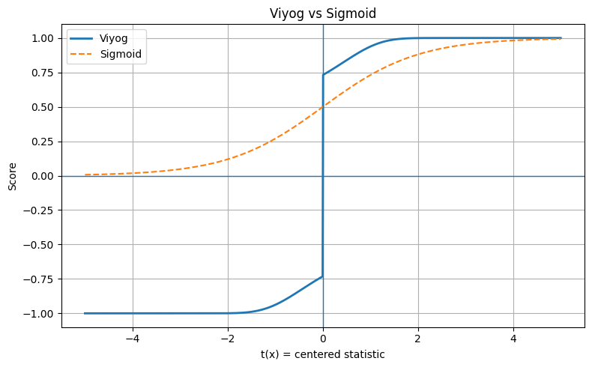
Viyog vs Sigmoid

Slide 22
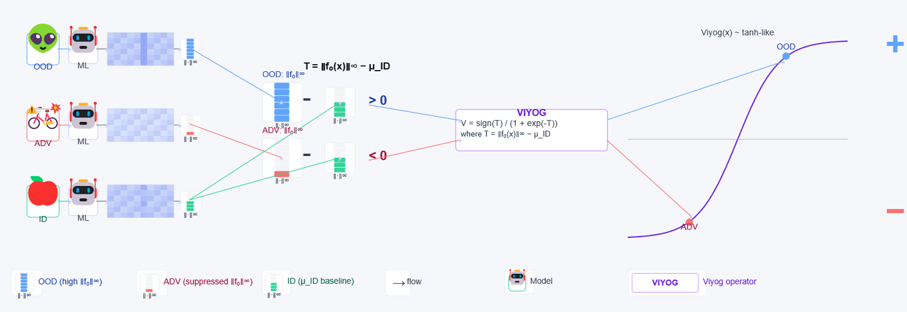

For Aman to do.

Slide 23
Agenda
What is Adversarial Attack ? What is Out of Distribution?
Why do we need to separate them?
What is the effect of ADV on early layers?
What has been done previously to separate them? Their limitations?
How does Viyog Work?
How does ViYog overcome the limitations of existing methods?
What is the Computational overhead of ViYog?
What is the Runtime memory overhead of ViYog?

Slide 24
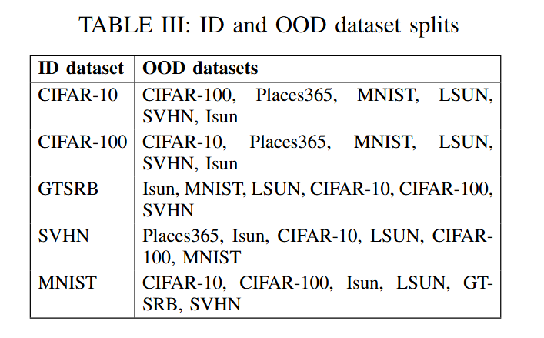
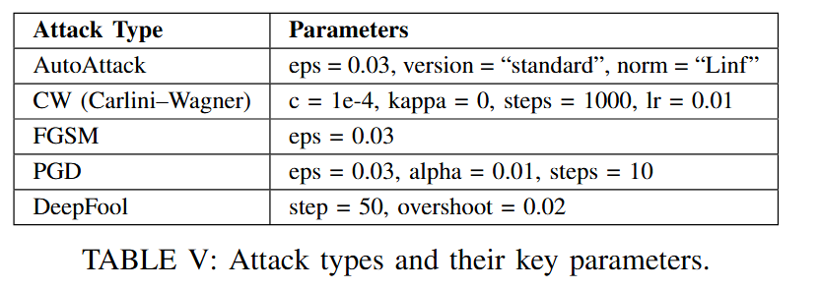
Experimental Setup
OOD ADV

Slide 25
Average Auroc across all models/datasets
Models:
ResNet 18
ResNet 34
ResNet 50
DenseNet-BC (100Layers)

Slide 26
Agenda
What is Adversarial Attack ? What is Out of Distribution?
Why do we need to separate them?
What is the effect of ADV on early layers?
What has been done previously to separate them? Their limitations?
How does wiyog Work
How does ViYog overcome the limitations of existing methods?
What is the Computational overhead of ViYog?
What is the Runtime memory overhead of ViYog?

Slide 27
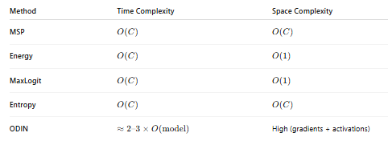
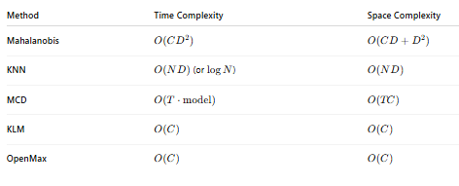
Time and space Complexity per sample

Slide 28
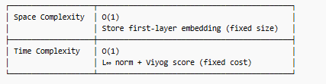
Viyog Time and Space Complexity

Slide 29
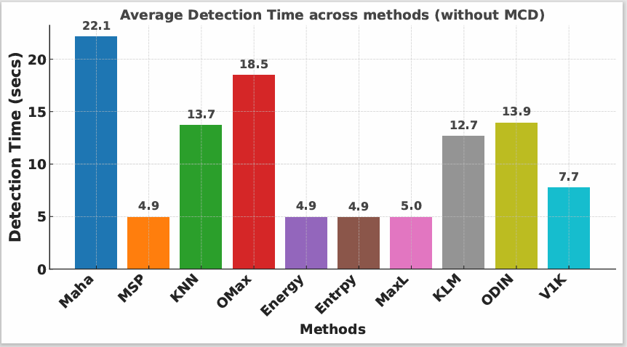
For Aman to do.
Model: DenseNet-BC: 100 Dataset: MNIST

Slide 30
Agenda
What is Adversarial Attack ? What is Out of Distribution?
Why do we need to separate them?
What is the effect of ADV on early layers?
What has been done previously to separate them? Their limitations?
How Does Viyog Work?
How does ViYog overcome the limitations of existing methods?
What is the Computational overhead of ViYog?
What is the Runtime memory overhead of ViYog?

Slide 31
Viyog Time and Space Complexity

Slide 32
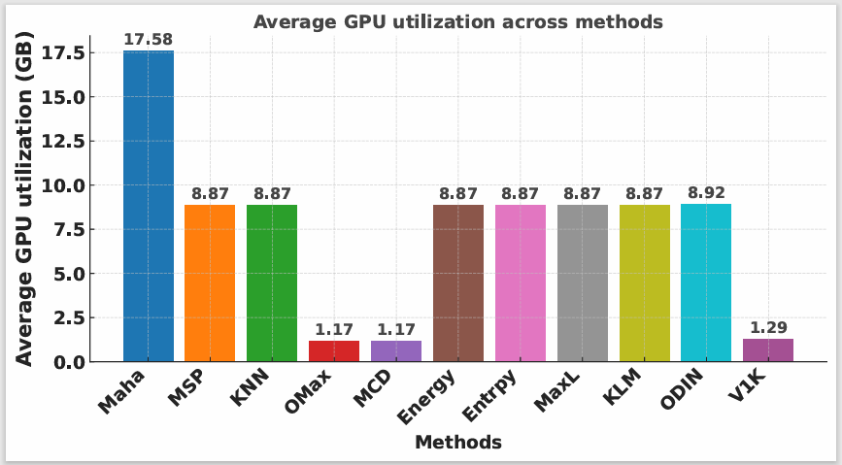
For Aman to do.
Model: DenseNet-BC: 100 Dataset: GTSRB

Slide 33
Summary
Define OOD and ADV
Effect of ADV on early layers
Need for separating OOD and ADV
Prior methods for separating OOD and ADV and their limitations
Working of Viyog
How Viyog overcomes limitations of existing methods
Computational overhead of Viyog
Runtime memory overhead of Viyog
Thank you

Slide 35
DSP-MLIR_Sept23 - Google Slides More References->

Slide 36
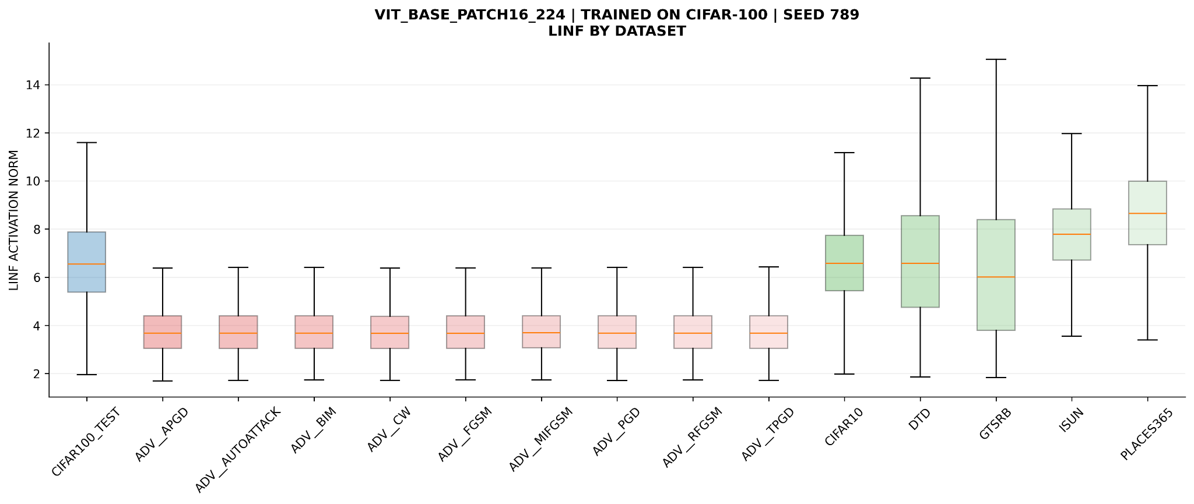

Slide 37
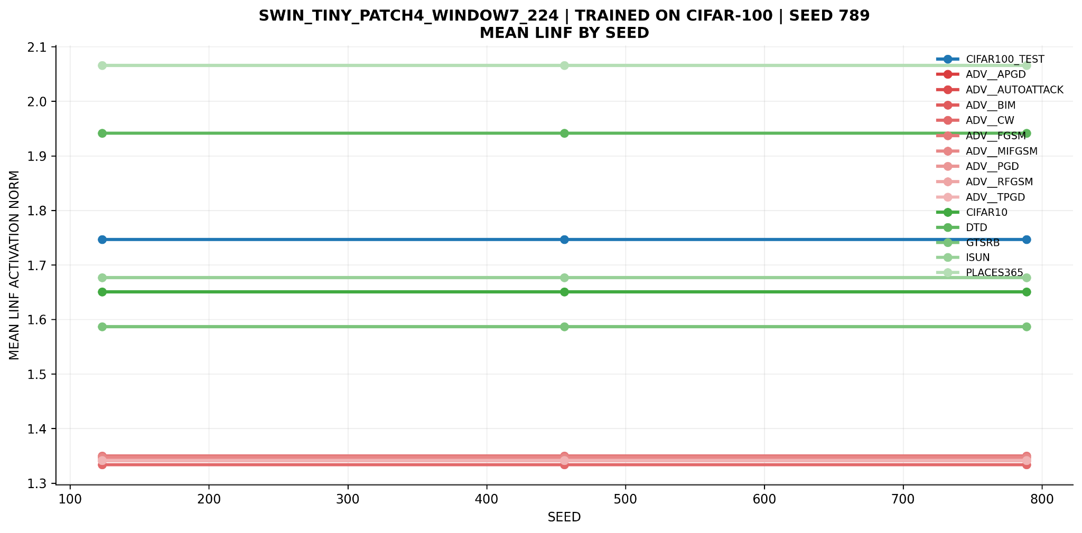

Slide 38
Reliability Issues
Out-of-distribution (OOD): inputs unlike training data
OOD inputs often cause overconfident misclassification
Adversarial examples: x_adv = x + δ, ||δ|| ≤ ε (FGSM,PGD,AA,Deepfool,CW)
δ is optimized to change predictions while remaining imperceptible

Slide 39
Why Study the First Layer?
Neural networks can be confidently wrong in real-world settings
Two major failure modes: OOD inputs and adversarial examples
Empirical evidence shows corruption starts early in the network
Goal: understand early-layer geometry to explain failure and detection

Slide 40
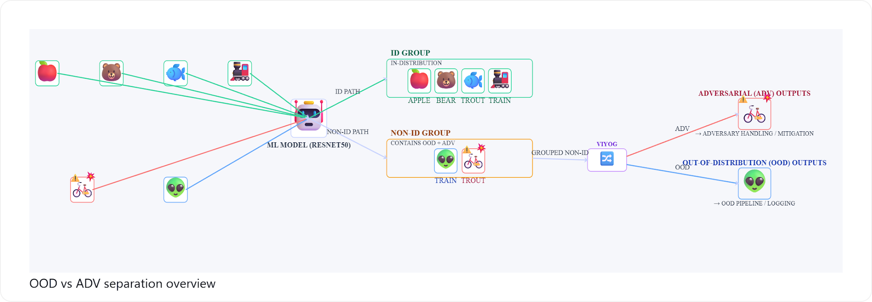

Slide 41
Neural Networks as Geometry
A network is a composition of layers: f = f_L ∘ ... ∘ f_1
The first layer maps pixels to features
All downstream layers depend on this initial representation
Early layers define the geometry of the input space

Slide 42
Why Early Corruption Matters
Adversarial inputs distort activation norms
Small early deviations propagate through depth
Later layers amplify early errors
Result: confident but incorrect predictions

Slide 43
First Layer Computation
Typical form: f_1(x) = σ(Wx + b)
W mixes many pixels into each neuron
σ is a nonlinearity (ReLU, GELU)
Tiny pixel changes affect many activations

Slide 44
Taylor Approximation: Big Picture
Taylor expansion explains local behavior of functions
For small δ: f(x + δ) ≈ f(x) + J_f(x) δ
This is the best local linear approximation
Valid because adversarial perturbations are small

Slide 45
Taylor Approximation Applied to First Layer
First layer: f_1(x) = σ(Wx + b)
Using chain rule: f_1(x + δ) ≈ f_1(x) + J_σ(u(x)) W δ
J_σW maps input directions to feature changes
Locally, the first layer behaves like a linear map

Slide 46
Geometric Meaning of the Jacobian
Jacobian measures sensitivity to input changes
Rows correspond to neurons, columns to pixels
Defines a tangent hyperplane at the input
Jδ equals change in early features

Slide 47
Freezing the First Layer
Freezing enforces: f_1(x + δ) = f_1(x)
Using Taylor: J_σW δ = 0
Perturbations cannot change early features

Slide 48
Geometry of the Constraint
δ must lie in the null space of J_σW
Sensitive directions are removed
Real networks have high-rank Jacobians
Null space is tiny or trivial

Slide 49
Why Attacks Fail Under Freezing
Almost all perturbations violate the constraint
Only δ ≈ 0 remains feasible
Adaptive attacks cannot change geometry
This creates artificial robustness

Slide 50
Viyog: Observe, Don’t Restrict
Do not constrain the attacker
Measure early-layer deviations instead
Use deviations as a detection signal

Slide 52
