Slide 1



dMazeRunner: Optimizing Convolutions on Dataflow Accelerators
Shail Dave¹, Aviral Shrivastava¹, Youngbin Kim², Sasikanth Avancha³, Kyoungwoo Lee²
[1] Compiler Microarchitecture Lab, Arizona State University
[2] Department of Computer Science, Yonsei University
[3] Parallel Computing Lab, Intel Labs
45th International Conference on Acoustics, Speech, and Signal Processing (ICASSP 2020)

Slide 2
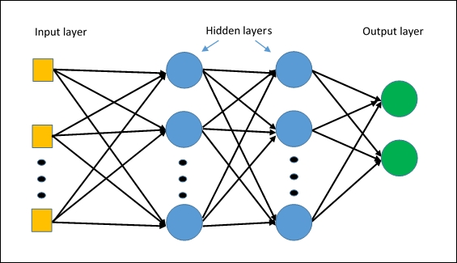
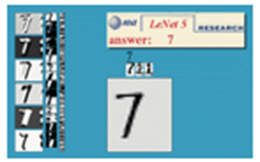
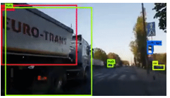
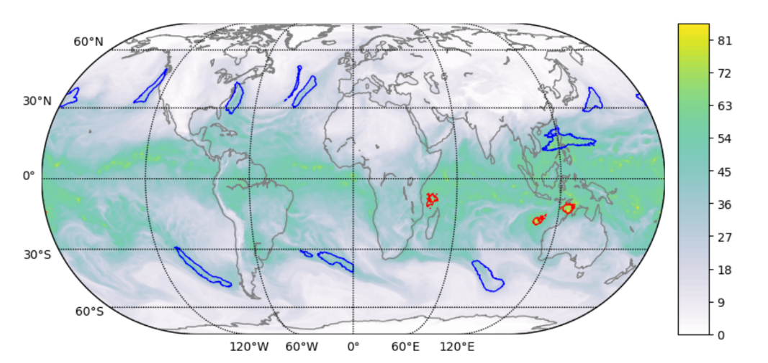


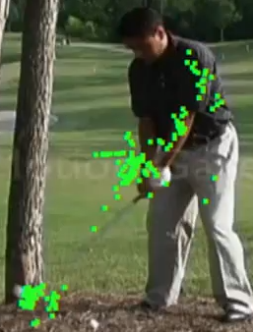
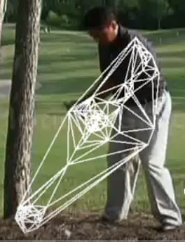
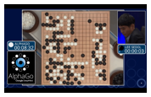
Must-Accelerate Applications in ML Era
Widely Used ML Models
Popular Applications
Multi Layer Perceptrons
Convolution Neural Networks
Object Classification/Detection
Media Processing/Generation
Large-Scale Scientific Computing
Designing Software 2.0
Google shrinks language translation code from 500k LoC to 500
and more …
http://yann.lecun.com/exdb/lenet/
Sequence Models
http://vision03.csail.mit.edu/cnn_art/index.html
https://pjreddie.com/darknet/
Tropical Cyclon Detection
https://insidehpc.com/2019/02/gordon-bell-prize-highlights-the-impact-of-ai/
https://giphy.com
Graph Neural Networks
http://jalammar.github.io/visualizing-neural-machine-translation-mechanics-of-seq2seq-models-with-attention/
https://deeplearning.mit.edu/
Reinforcement Learning
AlphaGo. https://www.nature.com/articles/nature24270
Designing Computer Systems for Software 2.0. Kunle Olukotun, NeurIPS 2018 Invited talk.
Points of Interest
Delaunay Triangulation
YOW! Data 2018 Conference. https://www.youtube.com/watch?v=lDRb3CjESmM
Compute Intensive, Needs Energy-efficient Acceleration

Slide 3
Dataflow Accelerators: Promising Solution
Known variations include - Systolic Arrays, - Spatially Programmable Architecture,
- Coarse-Grain Reconfigurable Array (CGRA)
Massive arrays of processing elements (PEs).
Simple: absence of complex out-of-order pipeline and decoding.
Programmable: accommodate executing all operations within a loop.
Private and shared memory for PEs sustain data reuse.
PEs can be busy performing computations while data is being communicated from lower memories.
Taken care by effective data management i.e., software prefetching, data distribution, data allocation.
Scratch-Pad Memory
DRAM (Off-Chip)
[1] Norman Jouppi et al. In-datacenter performance analysis of a tensor processing unit. In ISCA 2017. [TPU v1]
[2] Yu-Hsin Chen et al. Eyeriss: An energy-efficient reconfigurable accelerator for deep cnns. In JSSC 2016. [Eyeriss System, MIT]
[3] Kamran Khan. 2018. Xilinx DNN Processor (xDNN), Accelerating AI in Datacenters. [Xilinx xDNN]
[4] Bruce Fleischer et al., A Scalable Multi-TeraOPS Core for AI Training and Inference. In VLSI 2018. [IBM AI Accelerator]
[5] Dataflow Processing Unit from Wave Computing. In HOTCHIPS 2017. [Wave DPU]
[6] M. Thottethodi and T. N. Vijaykumar. Why GPGPU is Less Efficient than TPU for DNNs. ACM SIGARCH Blog, Jan 2019. (online)

Slide 4
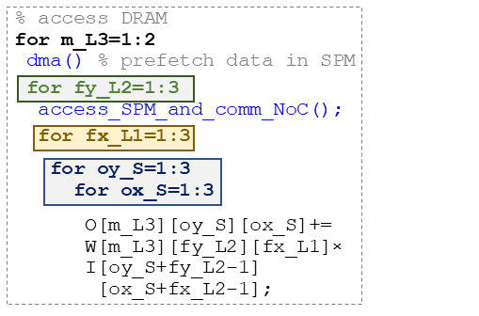
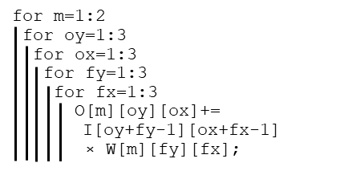
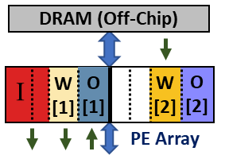
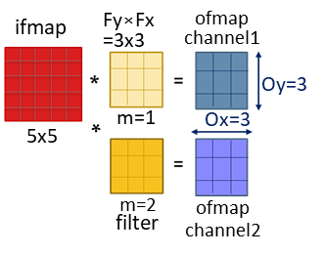
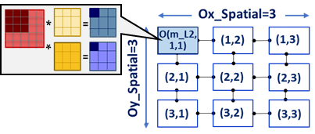


Mapping Computation in Space and Time
% filters
% filter row
DMA
Scratch-Pad Memory
% filter column
(multi-bank, double buffered)
% o/p row
% o/p column
Data in RF of PE(1,1)
I: 1x3 , W: 1x1x3, O: 1x1x1
PEs compute different outputs

Slide 5
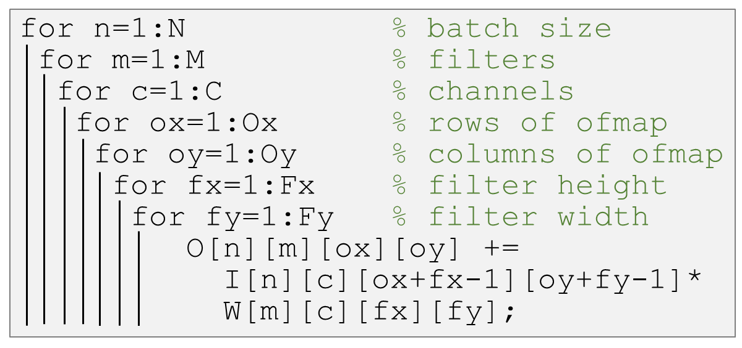
Vast “Execution Method” Space
4D Convolution:
Hardware Accelerator
Many many ways to execute nested loops (of DNN) on a dataflow accelerator
Both software and hardware design space
Hardware: Size, layout, and connectivity of PEs, size of on-chip buffer and registers, etc.
Software: loop mappings, e.g., Spatial: parallelism, data reuse, Temporal: ordering and tiling of the loops, data reuse, data buffering, etc.
Concurrent Execution
on PEs
L1 Accesses
Scratch-Pad Memory
L2 Accesses
<N,M,C,Ox,Oy,Fx,Fy> = <1,512,256,7,7,3,3>
L3 Accesses
DRAM
1 ifmap
1 ofmap
9x9
*
=
256
.
.
512 filters
9x9x256
7x7x512
(padded)
Stride=1
256
3x3
3x3x256
Conv5_1 [ResNet]

Slide 6
Orchestration of Loops
for n_L3 = 1:N_DRAM
for m_L3 = 1:M_DRAM
for c_L3 = 1:C_DRAM
for ox_L3 = 1:Ox_DRAM
for oy_L3 = 1:Oy_DRAM
for fx_L3 = 1:Fx_DRAM
for fy_L3 = 1:Fy_DRAM
{
dma( );
for n_L2 = 1:N_SPM
for m_L2 = 1:M_SPM
for c_L2 = 1:C_SPM
for ox_L2 = 1:Ox_SPM
for oy_L2 = 1:Oy_SPM
for fx_L2 = 1:Fx_SPM
for fy_L2 = 1:Fy_SPM
{
communicate_data_NoC( );
for n_L1 = 1:N_RF
for m_L1 = 1:M_RF
for c_L1 = 1:C_RF
for ox_L1 = 1:Ox_RF
for oy_L1 = 1:Oy_RF
for fx_L1 = 1:Fx_RF
for fy_L1 = 1:Fy_RF
{
for n_S = 1:N_SPATIAL
for m_S = 1:M_SPATIAL
for c_S = 1:C_SPATIAL
for ox_S = 1:Ox_SPATIAL
for oy_S = 1:Oy_SPATIAL
for fx_L3 = 1:Fx_SPATIAL
for fy_L3 = 1:Fy_SPATIAL
O[][][][] +=
I[][][][] *
W[][][][];
}
}
}
Convolution Operator:
Accelerator
Concurrent Execution
on PEs
L1 Accesses
L2 Accesses
Scratch-Pad Memory
7-deep nested loop
L3 Accesses
DRAM
The problem of exploring the “execution methods” for mapping 7-deep nested loop onto dataflow accelerator becomes the problem of exploring all the possibilities of tiling and ordering factors in the 28-deep nested loop
28-deep nested loop

Slide 7
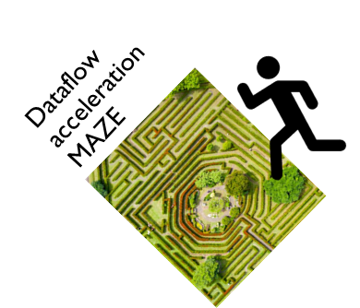
dMazeRunner Demo
Framework Features
1
Estimate performance and energy-efficiency of individual execution method for a specified accelerator hardware and layer dimensions
2
Optimize specific or all layers of common CNN networks
3
Explore efficient accelerator designs for DNNs
Release: https://github.com/MPSLab-ASU/dMazeRunner

Slide 8
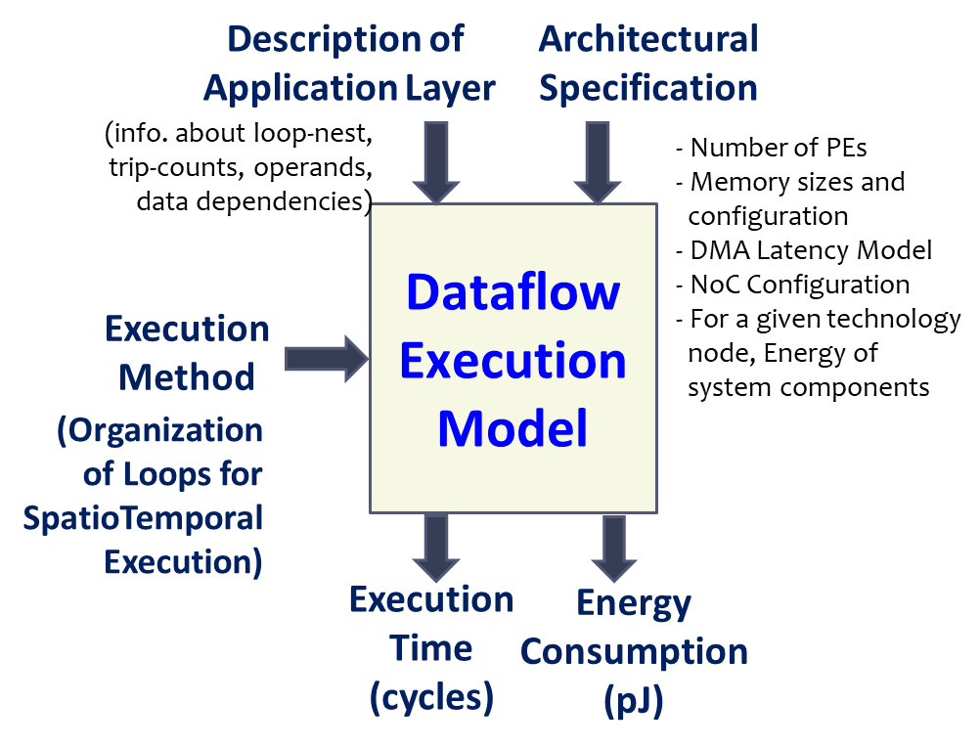
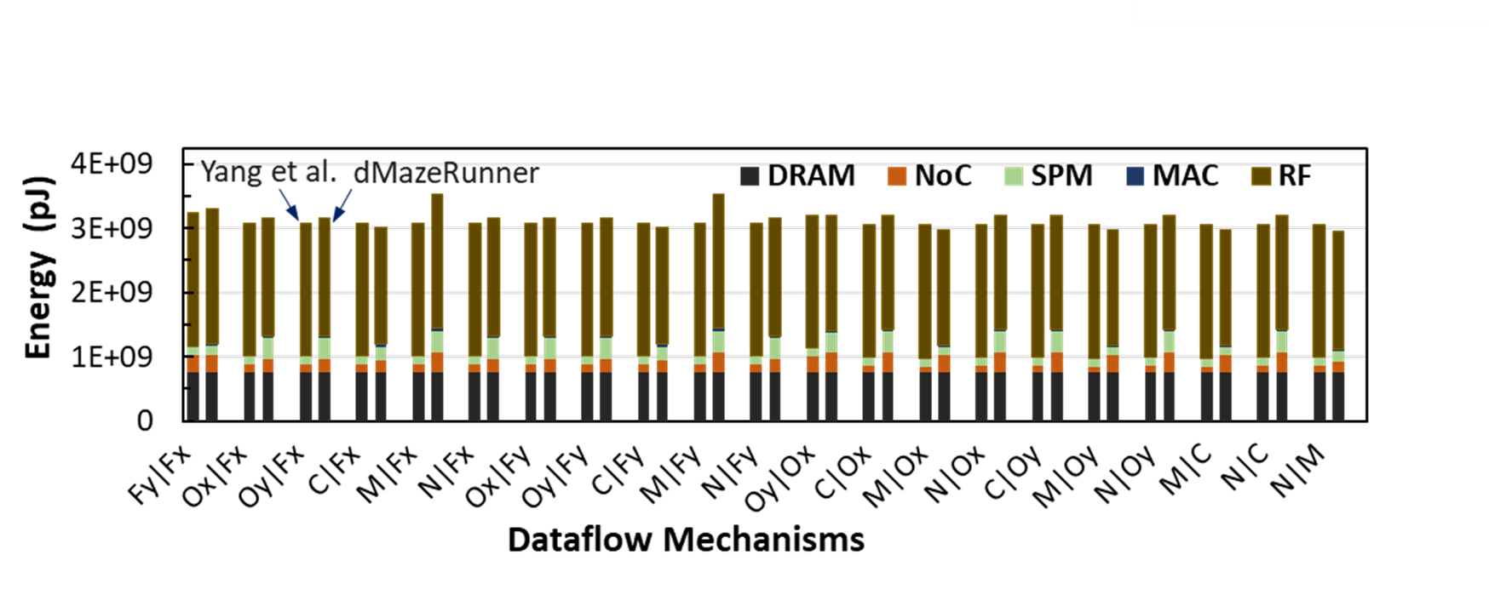
Execution Modeling of Dataflow Accelerators
Features with detailed modeling of
Analyze arbitrary perfectly nested loops.
miss penalty and stall cycles (during PE execution and in managing PE’s local or shared memory).
inter-PE communication.
temporal/spatial data reuse.
Integrated support common ML libraries MXNet/Keras/... (thanks TVM! – leveraging front-end)
Validation against DNN Optimizer of Yang et al.
Yang, Xuan, M. Gao, J. Pu, A. Nayak, Q. Liu, S. Bell, J. Setter, K. Cao, H. Ha, Christos Kozyrakis, and Mark Horowitz. "DNN Dataflow Choice Is Overrated." [arXiv ‘18]
Energy estimate differs by ~4.2% for variety of execution methods.
For efficient mappings, major energy spent in RF accesses.
Step-wise equations and analysis:
Shail Dave, Youngbin Kim, Sasikanth Avancha, Kyoungwoo Lee, Aviral Shrivastava, dMazeRunner: Executing Perfectly Nested Loops on Dataflow Accelerators [CODES+ISSS, TECS 2019].

Slide 9
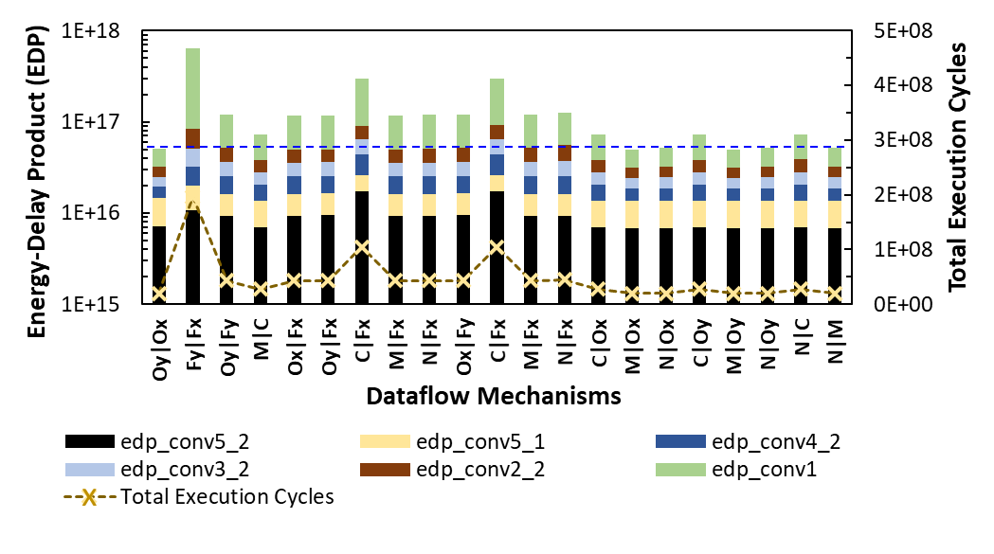
Optimizing Multiple Dataflows
Executing ResNet layers on a 256-PE, 512B RF, 128kB SPM dataflow accelerator
Oy | Ox: Output Stationary
Fy | Fx : Weight Stationary
Oy | Fy : Row Stationary

Slide 10
Adaptable Mappings Yield Better Results
Adapts to layer / hardware architecture characteristics
Scales for layers and tensors of different shapes
Finds non-intuitive mappings that are optimized for various key factors e.g.,
Example Mapping of ResNet Conv5_2 with Output Stationary Dataflow
For data allocated in RFs of PEs,
PE Compute vs. Data comm. Latency:
Total cycles:
Ideal execution cycles for output-stationary:
Reduction in DRAM accesses (ifmaps, weights):
Perf. improvement (normalized to MOC):
Energy-Delay-Product reduction (normalized):
MOC
144 vs. 648
~10,616,832
2,359,296
(1x, 1x)
1x 1x
dMazeRunner
576 vs. 576
~2,459,648
2,359,296
(4.57x, 2x) 4.44x 9.86x
High Resource (PE/memories) Utilization
Maximized Reuse of Multiple Tensors
Minimized DRAM accesses
Hiding Communication Latency Behind Computations on PEs
MOC: Simultaneous spatial processing of Multiple Output Channels
[1] S. Gupta et al. Deep learning with limited numerical precision. In ICML, 2015.
[2] Y. Chen et al. Eyeriss: A spatial architecture for energy-efficient dataflow for CNNs. In ISCA 2016.

Slide 11
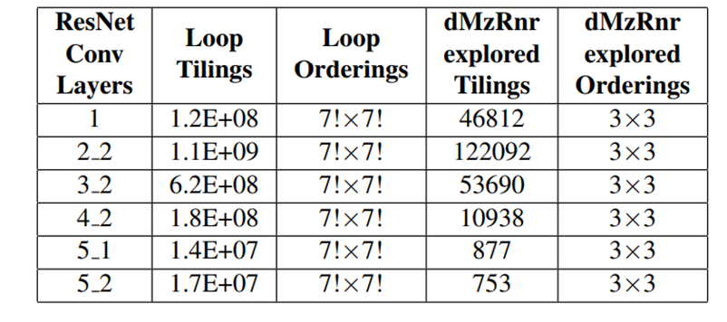
Achieving Close-to-Optimal Solutions in Seconds
Search Space Reduction for DNN Optimizations
Search Space Exploration on an Intel i7-6700 Quad-core CPU
min: ~1 second, ResNet conv5_2 (753*9 methods) max: ~122 seconds, ResNet conv2_2 (122092*9 methods)
AlexNet and ResNet18 models in about 18 and 180 seconds, respectively
Quick exploration:
In-built support for a few common opt strategies.
Implementation – multi-threaded, caches commonly invoked routines of analytical model.
Enables effective Design Space Exploration of architecture, e.g., explore impact of scaling PEs and memory sizes on performance and energy efficiency.
Even domain non-experts can explore the space
Does not preclude experts/programmers from directing the search.
python run_optimizer.py --frontend mxnet --model resnet18 --layer-index 0

Slide 12
Conclusions
Dataflow accelerators: promising for accelerating ML applications.
Need to determine efficient “execution method” for spatiotemporal executions on dataflow accelerators.
dMazeRunner: Automated, succinct, and fast exploration of mapping search space and architecture design space.
Adaptive and non-intuitive mappings enable efficient dataflow acceleration.
[Release] https://github.com/MPSLab-ASU/dMazeRunner
[Project] https://labs.engineering.asu.edu/mps-lab/ml-accelerators

