Slide 1

Agile Methodology for Designing Efficient NPUs
Shail Dave and Aviral Shrivastava School of Computing and AI Arizona State University
Notes:
Thank you Ahmet for the kind introduction.
Good morning everyone. Thanks for coming to this special session on “Agile Methodology for Designing Efficient NPUs”
This is the first talk in the session, and I will mainly motivate for developing an agile methodology for designing NPUs.
This talk presents a language and framework for designing efficient hardware accelerators – with the approach being reusable, explainable, and agile.

Slide 2
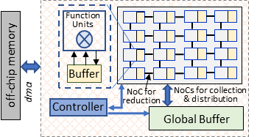
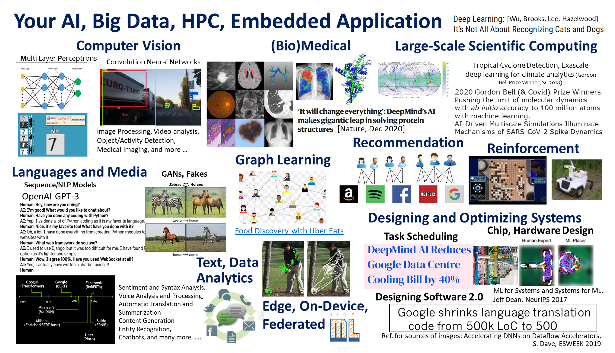
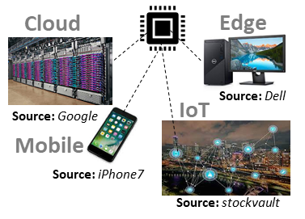


NPUs: Throughout Datacenters and Edge
Neural Processing Units
Google TPU
NVIDIA A100/H100 Tensor Cores
Samsung NPU
Sambanova's RDU
IBM's AI Accelerator
Microsoft Brainwave
ARM ML Processor
Xilinx xDNN
Qualcomm AI 100
Intel-Habana Goya
Cerebras Wafer-Scale Engine
Tesla's Self-Driving computer
Facebook's ML accelerator
Cambricon AI accelerators
Example NPU
NPU
Ref: A Brief Guide of xPU for AI Accelerators. Y Xie. ACM SIGARCH Computer Architecture Today, 2018.
Notes:
Machine learning is now being used or at least people are trying to use it everywhere. Especially because there are several problems that we face that are even hard to define. For example, detecting a tree in an image. This is a problem that is hard to even define formally, let alone solving it..
Machine learning methods have proved to be especially valuable in solving such problems, and problems where approximately correct answer also works fine.
Machine learning is now used in many applications, including language processing, media analysis, text analysis, recommendation system, scientific computing, game players, computer vision, etc. ML is being used at all places, from cloud, edge and all intermediate places also.
As a result a lot of companies – established and startups are proposing new accelerators. Google TPU, Nvidia H100 Tensor cores, Samsung NPUs, Xililnx Versal, Cerebras Wafer-Scale computing etc. are just few of the examples.

Slide 3
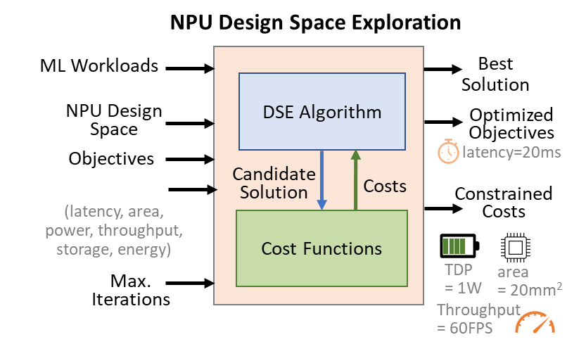
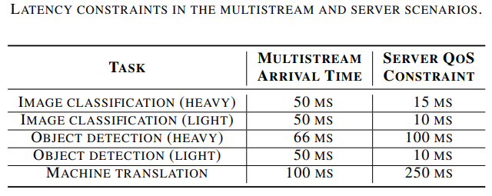
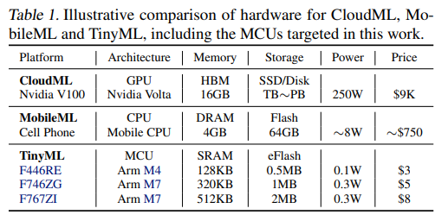
Goal: Fast and Efficient HW/SW Codesign
Need: Minimize objectives while meeting strict constraints on accelerator design and execution under various deployment scenarios.
Latency, energy, chip area, throughput, power, storage, accuracy, resilience, etc.
Different Design Budgets and Execution Constraints
Under Various Deployment Scenarios
Ref: [R1]
[R1] MLPerf Inference Benchmark. V. J. Reddi et al. In ISCA 2020.
[R2] MicroNets: Neural Network Architectures for Deploying TinyML Applications on Commodity Microcontrollers. C. Banbury et al. In MLSys 2021.
Ref: [R2]
Notes:
A lot of the work is in designing suitable NPU or accelerator for the application at hand. The tables in this slide just show the range of designs and design constraints of ML accelerators. For example, a CloudML accelerator could have Peta Bytes of memory, and could have 100s of Watts as power budget and even several thousands of dollars as the price point. On the other hands, a NPU that goes into a cell phone can only have a few GB of memory, with a few watts of power budget and cost can be close to 100 dollars. And on the tiny side, or embedded side, some accelerators may have to work with only a few KB of memory, 1/10th of a watt as power budget and can cost less than a dollar.
So, in summary there is a wide variety of accelerators that are needed. The ML accelerator for a recommendation system can be very different from the one in a smartwatch that is monitoring human activity.
Designing an appropriate accelerator is not only good for the application at hand, but is also important from the power consumption and sustainability perspective. A recent paper from Facebook calculated the carbon footprint of computer chips from manufacturing to disposal – and they found that more than 80% of the footprint is not from the use of the computer, but in the manufacturing. And I think even that is not the whole story. Another aspect of carbon footprint is the time and energy of humans and computing that is used to design the accelerator in the first place. Of course design space exploration is an important step if you want to be able to design an efficient accelerators. You will explore several designs and then pick the one that fits your bill. But the time and power consumption of DSE of ML accelerators itself can be very large! Therefore in this special session, we argue for the need for not only a DSE process that results in a efficient accelerater, but one that is “agile” by itself – that is – it is fast and takes less time.

Slide 4
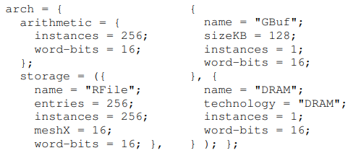
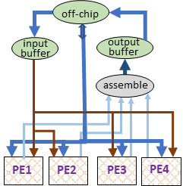
Need to Explore Efficient Architectures Automatically
ADL-based Approaches Limit Design Exploration.
Define single architectures via template—Fixes what kinds of computation and memory units are interconnected how.
Design space is nothing but hyperparameters of fixed architecture.
Architectures unexplored during design process can be much more efficient, over pre-designed template.
Can’t reuse tools from system stack as architectures are modified or designed from scratch for evolving workloads.
Single architecture is defined via template.
Mapping space formulation for code optimization, simulators, cost models—are built for one template. Unsustainable!
Template accelerator with buffer shared among PEs.
Defining Eyeriss-like architecture in Timeloop
Architecture description language (ADL)-driven software toolkit generation for architectural exploration of programmable SOCs. P. Mishra et al. In TODAES 2004.
MAGNet: A Modular Accelerator Generator for Neural Networks. R. Venkatesan et al. In ICCAD 2019.
A Full-Stack Search Technique for Domain Optimized Deep Learning Accelerators. D. Zhang et al. In ASPLOS 2022.
Unexplored accelerator with unicasting tensors to PEs.
Notes:
Most of the DSE approaches or NAS (Neural Architecture Search) approaches that people are working on, are ADL-based.
ADL or Architecture Description Language is a language in which developers specify the design of the accelerator. For example, in an ADL you can specify the components that you want to use, and specify the connections between them. Often developers use design templates to make the design in the ADL. For example, the designer may already use a 2D mesh of PEs with a global buffer as the base computing engine. So the figure shows how the express the Eyeriss accelerator in the Timeloop ADL.
Once the design is specified then the design space is then just the space of the parameters of each component. For example, if you used a buffer the design, then the size of the buffer, width of the buffer will be design space parameters. The DSE is then just a search over these parameters to figure out which works the best for your application.
Once DSE is complete and the design is fixed, the software stack, e.g., compiler, simulator etc.. for the specified architecture are developed.
This ADL-based design space exploration have limited design space. The DSE cannot explore the out-of-template architectures – which, depending on the application may actually fit better. A lot of tools, e.g., cost models, and compilers are not re-usable, since they often assume template architecture, or are optimized for them.

Slide 5
Design Space Specification in DSDL
DSDL: Design Space Description Language
set: {
nodes:{MAC,BUF,DMA}
edges:{P2P,Unicast} }
params: {
MAC:[4,8,16],
BUF:range(4,20)
BUF.size:[256,1024]
}
constr_legal: {...}
constr_opt: {...}
(3) Legality constraints (connection rules, constraints on hyperparameters of components that can be connected)
(4) Optimization constraints for pruning search space
(e.g., homogeneity and hierarchy)
Set of components
(2) Parameters (how many MACs, Buffers) and hyperparameters (sizes of buffers)
IRs: { IR1: { ld %0, %in1 mul %1, %0, 2 st %out1, %1 }}
DSDL Output:
HW/SW codesign (or Pareto front) with minimized objective costs while satisfying all constraints.
Like DSE for ADLs:
(5) IRs or DFGs of target workloads.
dse_constr: [tdp<4W]
dse_obj: [latency]
(6) constraints on execution costs
(7) DSE objectives
Design Space Description Language for Automated and Comprehensive Exploration of Next-Gen Hardware Accelerators. S. Dave et al. In LATTE 2022, collocated with ASPLOS 2022.
Notes:
This slide gives a bit more details about the components of DSDL.
In DSDL we specify the library components that can be used, the limits on the number of components, if any that are allowed.
DSDL also requires the developers to specify how the library components can be connected with each other… which component can receive inputs from the other, and when they are connected, which parameters match. For example, when an ALU is connected to a register file, then the width of the register file should be the same as that of the ALU.
The parameters of the library components should also be specified, since this, in addition to how the components are connected will also become a part of the design space.
DSDL will allow developers to express optimization rules… that reduce the search space for meaningful exploration. For example, optimization rules may restrict the design space to explore designers with only homogeneous child nodes, or force a certain hierarchy for buffers.
DSDL will also allow the application IR at a high-level to be specified. The specification of the application IR is used to drive the software design space exploration.
DSDL allows programmers to specify multiple constraints on the final design, e.g., power is less than 4 watts, or area is less than 2 cm^3. In addition to the constraints the optimization criterion must also be specified.
DSDL will theoretically explore the entire design space of the architectures as well as the software and then come up with the best design.
The basic idea here in DSDL is that instead of informally and inadvertently restricting the design space, it is better to open up the whole design space, and then systematically or even consciously reject some parts of the design space. In other words, move the technical challenge from “making new and good designs” to “expose the design space and search better for a good design”. Or in yet other words, DSDL wants to move the technical challenge from design to design space exploration.

Slide 6
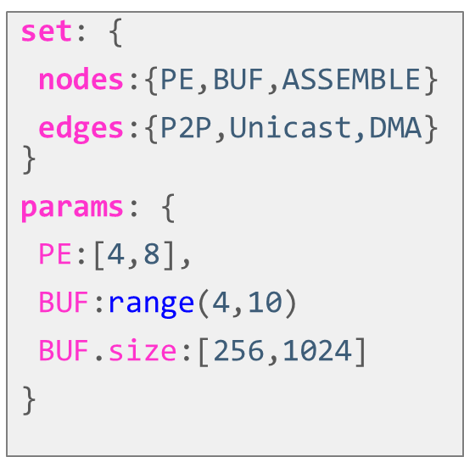
Design Space description Language (DSDL)
Key Idea: Formulate architecture candidates from the design space description.
Notes:
The key idea in our proposal is to just go one step higher in abstraction, and drive the DSE by a Design Space Description Language or DSDL.
A design space description language, as the name says just describes the design space of the accelerator, the constraints, the library of components, the optimization criterion, the applications that we want to accelerate etc. And the idea is that the DSE can explore the very large design space and find the best design – the only challenge that remains is how to systematically express the entire design space, and how to explore it fast.

Slide 7
Highlights
ADL vs. DSDL
Automated and Sustainable System-stack Development [LATTE @ ASPLOS 2022]
Architecture and Microarchitecture Design Space [CODES+ISSS 2019, ICASSP 2020]
Software Design Space [CODES+ISSS 2019, ICASSP 2020]
Data Design Space [Proc. of IEEE 2021]
Explainable DSE [arXiv]
Software: github.com/MPSLab-ASU
Talks: www.youtube.com/channel/UCxBoj3qgn-I2BONJXemYpeQ
Projects & Papers: https://labs.engineering.asu.edu/mps-lab/research

Slide 8
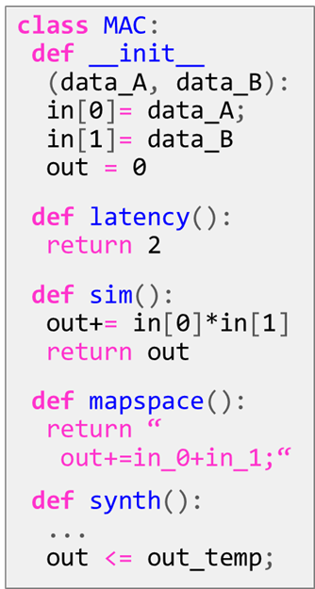
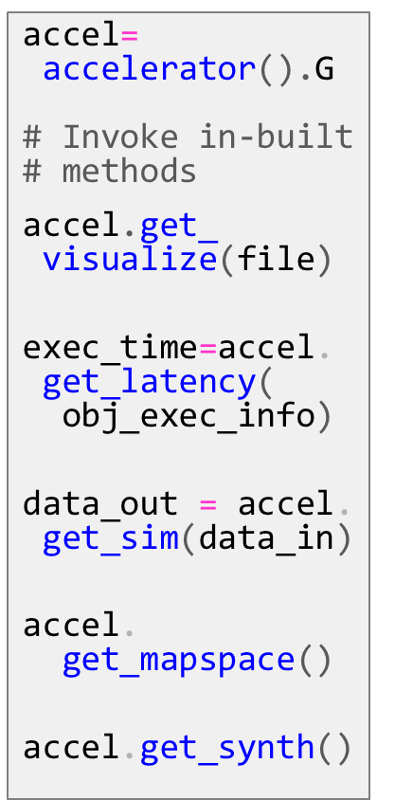
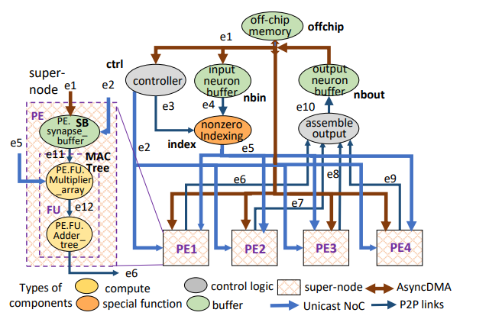
System Stack Automation for Architecture Abstraction
Solution: Develop system stack tools for architecture abstraction (Flow Graphs)
In design library, individual components are attached with definitions for tools.
Functionality, execution costs, program representation, machine instruction, synthesis code, etc.
Overall outputs obtained by parsing the flow graph and processing definitions for nodes and edges.
A flow graph represents an architecture.
Nodes: Compute, Memory, Control units, user-defined components, subgraph
Edges: Fixed or reconfigurable interconnects, synchronous/async
Models arbitrary grouping and hierarchy of components.
Flow Graph of Cambricon-X like Accelerator.
Notes:
DSDL uses flow graph abstraction. So, each architecture is formulated as a flow graph, where nodes are components for computation, memory, or control logic, and edges represent interconnects. These components can be even user-defined like for specialization. The nodes can be even a sub-graph. Thus, DSDL can construct variety of architectures.
In addition to the flow graph representation of the architecture, we have composition rules for the design metrics that allow us to automatically evaluate each architecture for the design metrics including power, performance, area, price etc.
So, for example, simulator of the whole design can be done by simulating each component every cycle. This is very similar to how RTL simulations are done, or even how Gem5 simulator works. So this is relatively straightforward. Composability is key, and is simpler for some metrics, and not so straightforward for others. Power and area metrics are also composable. The power of a bunch of components is just equal to the power consumption of individual components. However, latency is different. It is not simply the addition of the latency of components – it depends on how the components are connected, and where the registers are.
So then, the design space exploration becomes simple – instantiate an architecture in the form of a flow graph, and then estimate it’s various power, performance area, correctness etc. metrics. The design space consists of not only how the components are connected, but also which components are used, and the internal parameter space of each component.
The only thing missing in this is the code generation. For any flow graph of the architecture, we want to automatically generate code for it. And this can be done by taking the application IR, and then tiling it with the flow graph of the functionality of the architecture. The important part here however is that there is not just one code that can be generated for a flow graph of the accelerator. The code can be generated in many ways. There is a whole software design space that must be explored. For example, you can run a nested loop on a simple flow graph consisting of some memories and ALUs. But then the loop can be reordered and executed. That has different data reuse characteristics and may require different sizes of on-chip memories, and may be dramatically different in the overall performance metrics. So we generate many possible codes that will execute the application on the given flow graph of the architecture, and explore all of them.
This is a major strength of the DSDL approach – that it really allows hardware software co-design and co-exploration. We can explore the software space together with the hardware design space. DSDL also allows simultaneous exploration of the data space of the application, but we will come to that in some time.

Slide 9
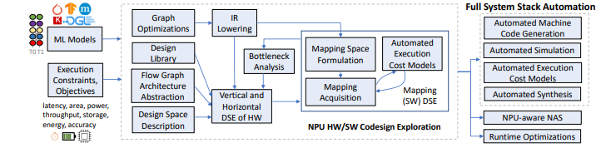
Towards Efficient, Reusable, Explainable, Agile Design Methodology
From ML Models to Efficient Hardware/Software Design
Efficient Hardware and Software Codesigns
Explainable Design Costs and Design Decisions
Agile
Exploration
Automated Full System-Stack
Notes:
So here is the overall flow. DSDL starts with the specification of the ML model, or application, and the constraints, and objective function of the design.
We instantiate a design using components from the design library, and the limits of the design space. This architecture is represented as a flow graph. The application IR is specified, and different mappings can be generated for the given architecture flow graph. For each design DSDL can generate the full system stack, from simulator to compiler and cost models.
Now this architecture and the microarchitecture, and the different codes that can be generated are evaluated using the metric composition rules. This exploration is explainable – in the sense that for each design point, we know not only how good or bad this design is, but also why it is good or bad. For example, the evaluation can show that this hardware software design choice results in a high number of DRAM accesses. So, then you know that you need to increase the buffer size in the hardware or change the loop ordering.

Slide 10
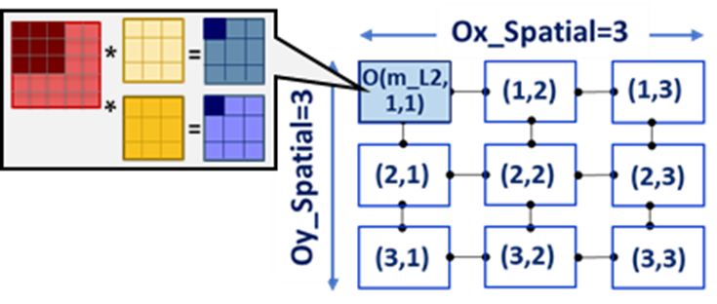


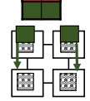

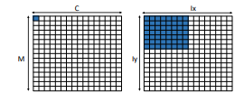
Software Design Space: Fixed Dataflows
Conventional approaches use fixed-dataflow designs for NPUs
Can be inefficient for various tensors shapes & functions of ML operators
Output Stationary [ShiDianNao]
Weight Stationary [TPU]
Ref: Eyeriss Dataflow
Understanding reuse
x
IA_{4x4}
W_{4x4}
Psum
Low PE utilization
Hard to hide communication time, memory accesses behind computation time
Inefficient reuse of various operands at different spatial and temporal levels in NPU
Example: Low utilization of 16×16 PE-array in (a) coarse weight stationary for depth-wise CONV and (b) input stationary for later CNN layers
(a)
(b)
[S. Dave et al., ICASSP 2020]
[S. Dave et al., PIEEE 2021]
Notes:
So one of the most important aspects of designing a system by design space exploration is to expose the entire design space. How do we enumerate and expose all the possibilities on how a neural network can be designed, both hardware and software design space. DSDL does this for hardware in a hierarchical approach. Instead of coming down at transistor level – which RTLs do – breaks down the hardware design space at the architecture level by component-based design. The neural network is represented as a flow graph of components, and then there are two design spaces… one is how the components and connected, and the second is the design space of each component.
So the hardware design space makes sense. The software design space is less intuitive and is less studied. So let me explain that a bit.
Given a simple CNN application, say AlexNet, and you want to run it on PE array – there are many ways to setup the execution and data movement. For example, you can put all the input image values in the PEs and being the weights to them to multiply – this is called input stationary dataflow. Or you can keep the weights stationary in the PEs and move the input values around. That is called weight stationary. Another intuitive one is to compute all the partial sums of the output onto the same PE, and this is called output stationary. All these have different performance, and also may have different optimal hardware configurations.
Typically in ADL-based NN design methodologies, people do not explore these choices, and only explore the hardware design choices. While clearly, as you can see, the choice of the dataflow can have significant impact on the performance, and therefore on the goodness of the hardware configuration.

Slide 11
NPU Code Optimization: Comprehensive Map Space
Many many ways to execute nested loops (of DNN) on a dataflow accelerator
Both software and hardware design space
Hardware: Size, layout, and connectivity of PEs, size of on-chip buffer and registers, etc.
Software: loop mappings, e.g., Spatial: parallelism, data reuse, Temporal: ordering and tiling of the loops, data reuse, data buffering, etc.
Transformer GEMM
for b_L3 = 1:B_DRAM
for oa_L3 = 1:OA_DRAM
for ia_L3 = 1:IA_DRAM
{
dma();
for b_L2 = 1:B_SPM
for oa_L2 = 1:OA_SPM
for ia_L2 = 1:IA_SPM
{
communicate_data_NoC( );
for b_L1 = 1:B_RF
for oa_L1 = 1:OA_RF
for ia_L1 = 1:IA_RF
{
for b_S = 1:B_SPATIAL
for oa_S = 1:OA_SPATIAL
for ia_S = 1:IA_SPATIAL
tOA[b][oa] += tIA[b][ia]*tW[ia][oa];
}
}
}
for b = 1:B #batch
for oa = 1:OA #output act.
for ia = 1:IA #input act.
tOA[b][oa] += IA[b][ia]* W[ia][oa];
3-deep nested loop
NPU
Concurrent Execution
on PEs
L1 Accesses
L2 Accesses
Scratchpad
L3 Accesses
12-deep nested loop
DRAM
The problem of exploring “execution methods” for mapping 3-deep nested loop onto dataflow accelerator becomes the problem of exploring all possibilities of tiling and ordering factors in the 12-deep nested loop.
7!
Notes:
The key idea of the DMazeRunner paper was that all these different dataflows and actually, all the possible dataflows can be captured by the space of the different ways to order and tile the loops. That opens up the software design space. So for each design, we can explore all the possible ways to tile and order the loops, and then we would have explored all the possible ways of data flow and data reuse in the hardware. The problem only is that the design space just explodes.

Slide 12
NPUs for Compact Models: Background
Tensor Compression: Needed for efficient on-device inference/learning.
Compute and memory requirements double every few months!
E.g., for language tasks, 50-100M (Transformers) → 175B (GPT-3)
Tensor Compression
Value Approximation
Size Reduction
Sparsity
Unstructured/Structured
Quantization, Value Similarity
Reduction of Dimension/Shape, Decomposition
2.6 | 14.9 | 141.3 | -10.5
-21.1 | 58.4 | -2.7 | -191.3
25.8 | 4.5 | 161.1 | 1.7
-4.6 | 52.7 | -0.5 | 84.5
0 | 0 | 148.9 | 0
-24.3 | 57.9 | 0 | -190.9
27.4 | 0 | 171.5 | 0
0 | 57.6 | 0 | 87.2
4 | 5 | 7 | 3
2 | 6 | 3 | 0
5 | 4 | 7 | 4
3 | 6 | 3 | 6
58.4 | -191.3
52.7 | 161.1
Reduce Number of Values To Be Processed
4x4 Matrix
Discard Unimportant Values
Limit Range of Values,
Eliminate Redundancy
“Special HW/SW mechanisms are needed for exploiting the benefits”
Notes:
Another aspect that needs exposing the design space is from data. NN designs started with dense models, but dense models are not very common, and are actually quite inefficient.
A lot of values in both the inputs and the filters are 0s. Even more so, most often a lot of the values can be made zeros without significantly impacting the quality of the model.
This is called sparsity – the fact that many values are 0s. 90% sparsity is not so uncommon.
And this matters is because if possible, you do not want to do the multiplications by 0, you do not want to fetch data that is 0 etc. All this can be optimized.
As a result, there is a lot of work going on sparse models, and how to handle sparsity. Handling sparsity means that you do work proportional to the amount of non-zeros in your data.

Slide 13
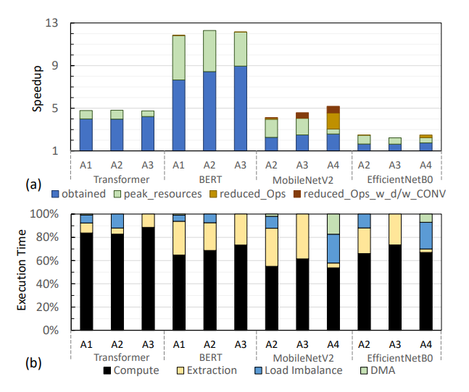
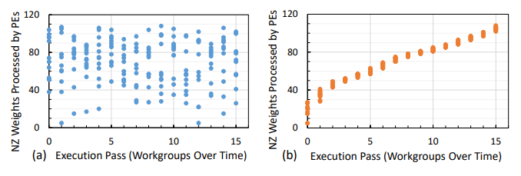
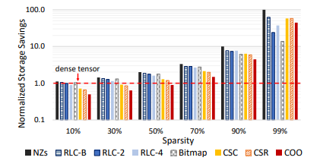
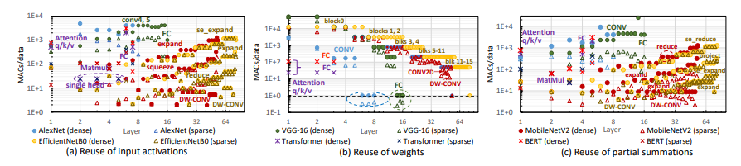
Analyzing NPUs for Recent Dense/Sparse DNNs
Obtained Speedups and Execution Overheads
Understanding Load Balancing and Structured Structures
Understanding Data Reuse of Recent Computer Vision and Language Models
Storage Savings for Different Encodings
Hardware Acceleration of Sparse and Irregular Tensor Computations of ML Models: A Survey and Insights. S. Dave et al. In Proceedings of the IEEE, volume 109, no 10, 2021.

Slide 14
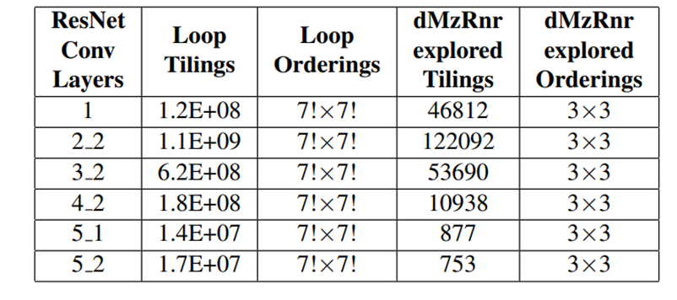
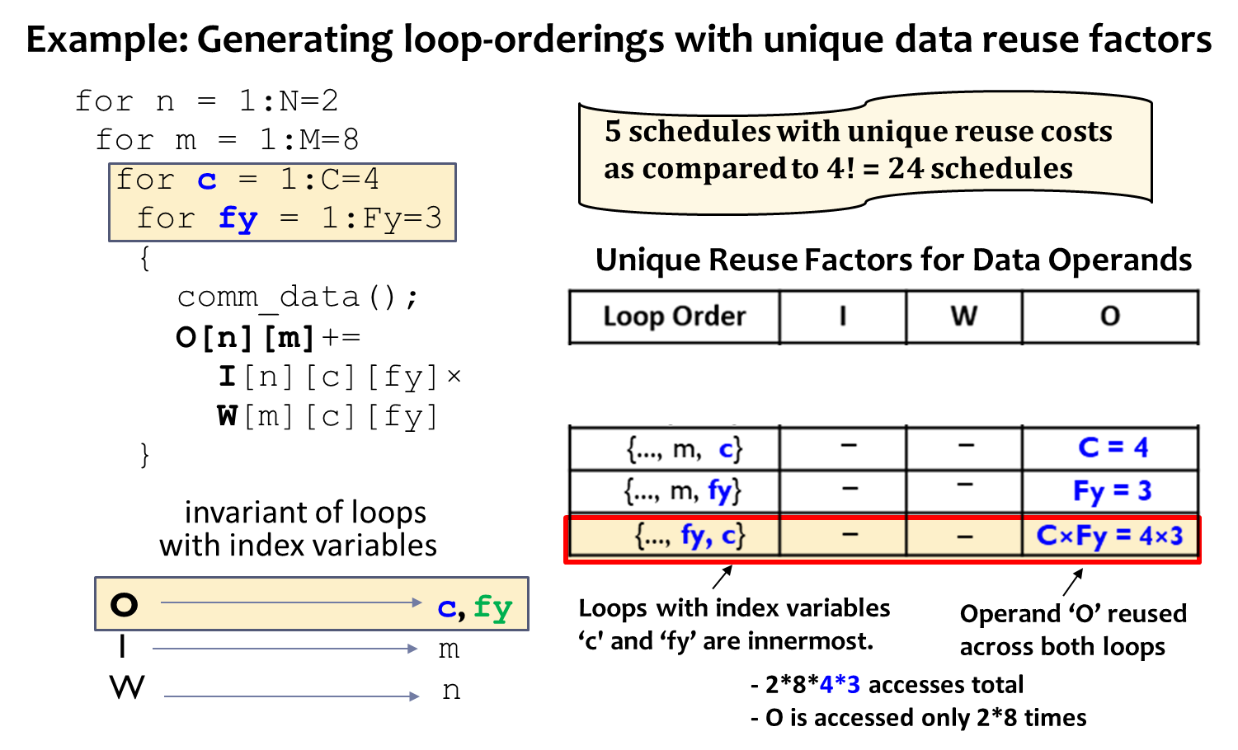
DSE: Drastic but Systematic Pruning
Quick Algorithms for Finding All Schedules for Unique Data Reuse
3x10¹⁷ → 2x10⁶ (within 4% EDP)
Current tool can
do even more aggressive optimization
[S. Dave et al., ICASSP 2020]
Quick Exploration:
In-built support for a few common optimization strategies
Adaptive tuning of resource utilizations based on effective methods found
Data Reuse calculation algorithms
[S. Dave et al., TECS 2019]
Notes:
Loop invariance of ‘O’
How to prune the loop orders
Still left with many valid methods with unique costs. So how to reduce search? Heuristics. Explained in the paper.

Slide 15
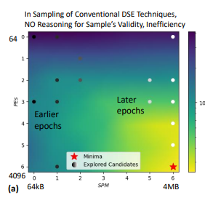
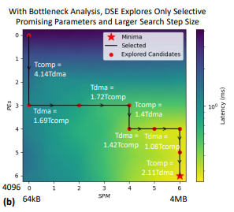

Efficient HW/SW Codesign: Need Explainability
Existing DSE approaches are inefficient
Black-box or NPU-agnostic
Can’t reason inefficiencies causing high costs
Constraint-unaware
Target minimizing objectives even when constraints are not met
Often uses a fixed dataflow, with exploration focus on hardware
Lacks NPU/dataflow codesign
Thousands of trials (days!)
Cannot support emerging apps e.g., smart-city and dynamic deployment on large-scale reconfigurable edge*
DSE of #PEs and shared memory sizes for ResNet CONV5_2b
(a) HyperMapperV2
(b) Explainable-DSE
DSE figures out appropriate scaling of PEs or SPM, based on computation time and DMA time.
Luigi Nardi, David Koeplinger, and Kunle Olukotun. "Practical design space exploration." In MASCOTS 2019.
Sheng-Chun Kao, Geonhwa Jeong, and Tushar Krishna. "Confuciux: Autonomous hardware resource assignment for DNN accelerators using reinforcement learning." In MICRO 2020.
Brandon Reagen, José Miguel Hernández-Lobato, Robert Adolf, Michael Gelbart, Paul Whatmough, Gu-Yeon Wei, and David Brooks. "A case for efficient accelerator design space exploration via bayesian optimization." In ISLPED, 2017.
* TickTalk - Timing API for Dynamically Federated Cyber-Physical Systems. B. Iannucci et al. 2019.

Slide 16
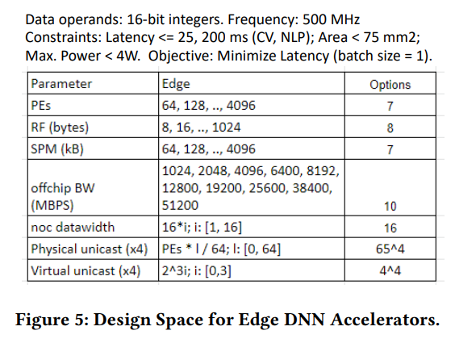
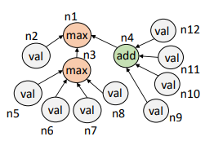
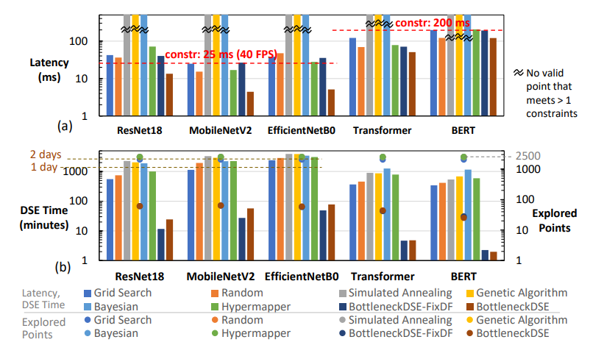
Enabling Explainability with Bottleneck Analysis
Cost graphs are constructed from the cost models of NPU flow graphs.
Bottleneck analysis based DSE ensures explainability and usually quick convergence.
Example: Edge DNN NPU
NPU with buffer shared among PEs.
Example: n1: Latency; n2: Tcomp; n3: Tnoc; n4: Tdma; n5: Tnoc_I, n6: Tnoc_W, n7: Tnoc_PsumIn; n8: Tnoc_PsumOut; n9: Tdma_I, n10: Tdma_W, n11: Tdma_PsumIn; n12: Tdma_PsumOut p1: num_PEs; P2: RF_size; P3: SPM_size, …
3.74x low latency, on average.
Bottleneck analysis on cost graphs yield bottleneck factors and feedback about mitigation strategies.
e.g., bottleneck: ‘n2’
Relevant params: [p1]
124x less search time, on average.
2500 trials→<50 attempts (days → minutes)
Explainable-DSE: Explainable and Agile Exploration of Hardware/Software Codesigns of DNN Accelerators with Bottleneck Analysis. S. Dave et al.
Notes:
We can have explainability because we do bottleneck analysis of flow graphs. It informs us about major factors that contribute to the cost by parsing the cost graph. For instance, computation time is 4 times higher than time to communicate over interconnects. So, it can point to such bottleneck information, and usually also the parameters associated. With the required scaling, we can predict the next values of those parameters. It helps us for driving explainable DSE. Thus, it helps in building agile design flow.

Slide 17
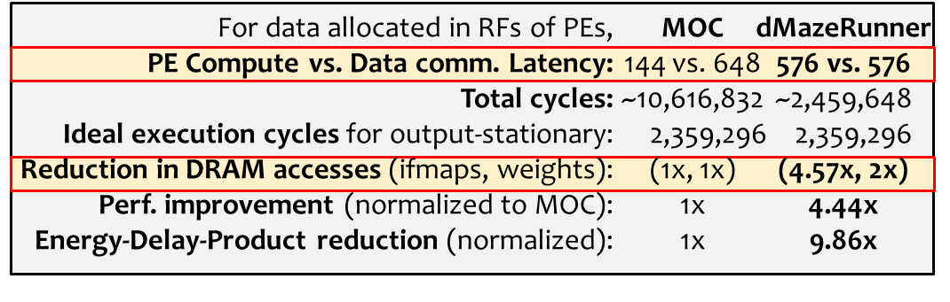
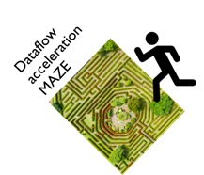
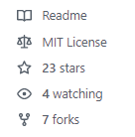
NPU Code Optimization: Adaptive Mappings in Seconds
Adapts to layer / hardware architecture characteristics
Scales for layers and tensors of different shapes
Finds non-intuitive mappings that are optimized for various key factors e.g.,
Example Mapping of ResNet Conv5_2 with Output Stationary Dataflow
High Resource (PE/memories) Utilization
Maximized Reuse of Multiple Tensors
Minimized DRAM accesses
Comm. Latency Hidden Behind Computations
MOC: Simultaneous spatial processing of Multiple Output Channels
[1] S. Gupta et al. Deep learning with limited numerical precision. In ICML, 2015.
[2] Y. Chen et al. Eyeriss: A spatial architecture for energy-efficient dataflow for CNNs. In ISCA 2016.
python run_optimizer.py --frontend mxnet --model resnet18 --layer-index 0
Full model optimization of BERT-base and ResNet18 models in about 3 and 38 seconds.
Try today!
github.com/MPSLab-ASU/dMazeRunner
[S. Dave et al., TECS 2019, ICASSP 2020]

Slide 18
Integrating Security and Reliability as First-Hand Metric
Integrate from beginning
Specify these metrics in design requirements
Quantification for cost modeling (used in DSE)
Compiler/NPU codesign makes feasible
Can effectively explore various designs, accounting for known execution implications at design time.
Datasets
Security analysis from
Secure ML Training
AI/ML Models
Efficient, Reliable & Secure NPU
Efficient NPU Designs
Design Objectives
Automated Cost Models and Full Stack
NPU-Aware NAS
Error Resiliency Analysis
Execution Constraints
Gray-box HW/SW Exploration
Design Space Description & Abstraction

Slide 19
Highlights
ADL vs. DSDL
Automated and Sustainable System-stack Development [LATTE @ ASPLOS 2022]
Architecture and Microarchitecture Design Space [CODES+ISSS 2019, ICASSP 2020]
Software Design Space [CODES+ISSS 2019, ICASSP 2020]
Data Design Space [Proc. of IEEE 2021]
Explainable DSE
Software: github.com/MPSLab-ASU
Talks: www.youtube.com/channel/UCxBoj3qgn-I2BONJXemYpeQ
Projects & Papers: https://labs.engineering.asu.edu/mps-lab/research

