Slide 1



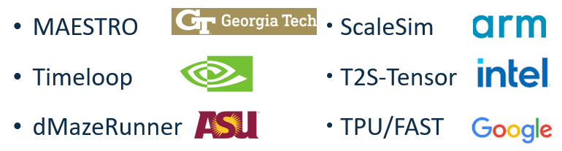
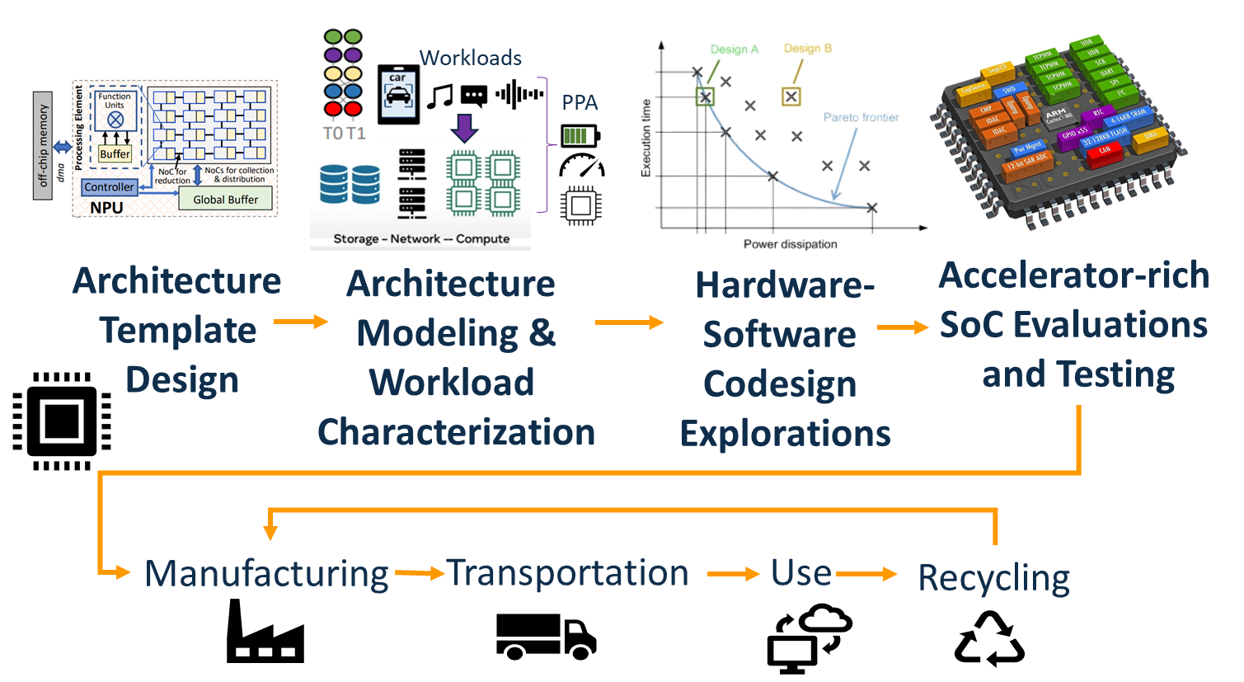
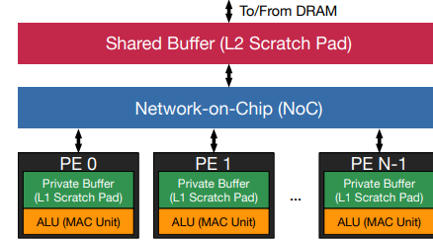
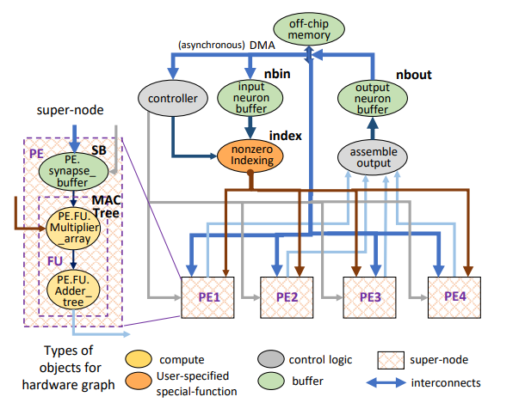

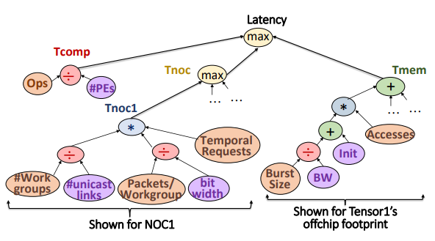

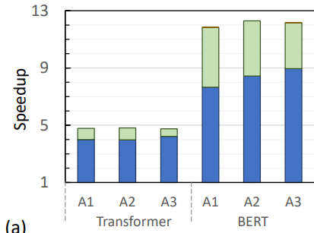
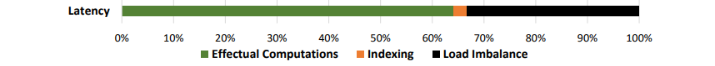
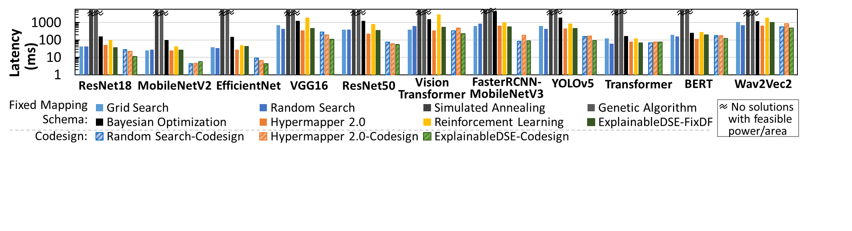
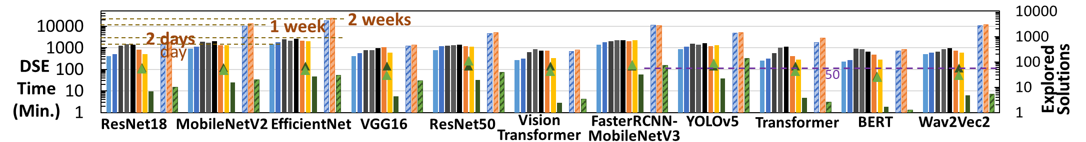
Automatic & Sustainable Execution Modeling & Characterization of Domain-Specific Architectures
Shail Dave and Aviral Shrivastava
School of Computing and AI, Arizona State University
Motivation
Status Quo: Experts Build New Models, Simulators for Every New Architecture
Develop a framework for modular, reusable execution modeling and evaluation of various domain-specific architectures and automatic characterization of their execution bottlenecks
Writing analytical models and simulators specific to architecture template needs redesign as workloads evolve
E.g., tools evaluate ML accelerators for systolic array or Eyeriss-like architecture
10000s of lines of code
Infeasible to extend for new architecture specialization; Efforts take weeks-months!
Design: Pivotal yet Unaccounted Factor in Computing’s Embodied Carbon
Template architecture in MAESTRO
[MICRO19]
What is not focused on much:
Challenges: Unitary Modeling + Lack of Automation for Embedding Architectural Activity in Analytical Models/ Simulation
Unitary models make reuse non-trivial, likely erroneous.
Unitary models offer no insights in obtained execution costs like latency
Execution activity is calculated manually and embedded within analytical model or supplied externally - differently for every new architecture template
Embodied carbon primarily studied today:
DSAProf: Modular, Dataflow-driven Framework for Sustainable Architecture Modeling
Specifying Architectures as Flow-Graphs allow Modeling and Evaluating Wide Range of Accelerators
Modularity with Component-wise Modeling enables Extensibility
Modularity and dataflow-driven activity information enables Automatic Bottleneck Analysis. Informed decisions about mitigating bottlenecks makes design optimization Explainable.
Each module is associated with related definitions about power, performance, execution functionality, etc.
Overall methodologies are defined for architecture abstraction, so when extended, it works just by defining custom modules that are new nodes/ subgraphs in DSA flow graph.
Dataflow-driven exchange of execution related information among the DSA components obviates calculating execution activity manually and makes it possible to quantify or simulate each component separately.
DSL with APIs for flexible specification of nodes, edges, hierarchy, associating those to custom objects for processing.
Architecture-level library for modeling common modules
Example of Bottleneck Graph for Latency of a Deep Learning Accelerator. Automatic Characterization help identify underlying inefficiencies and mitigations for related hardware or software parameters to improve.
Results: Validation, Analysis, Demonstration
Conclusions
10s vs. 10,000s of LoC, Days vs. Months of Design/Analysis Time
Estimates in ~1%-7% of reported results
Agile and sustainable design methods for domain-specific architectures need techniques for automatic architectural modeling and characterization.
For every new architecture, developing unitary model or simulation is highly unsustainable.
A modular, dataflow-driven framework can be flexible and extensible for execution modeling and characterization for a wide range of DSAs, without building a new tool from scratch for new DSAs.
Modularity and dataflow-driven analysis also leads to automatic bottleneck characterization for DSAs and efficient hardware/software codesigns in agile manner.
Explainability can be enabled with bottleneck analysis of costs and gray-box estimations for mitigations.
Latency and energy of dense and sparse tensor accelerators (Eyeriss, EIE, Cambricon, ZENA, etc.)
E.g., why Cambricon-like AI chip would achieve ~7.7-8.9x speedup for sparse BERT vs. 12.2x achievable w/ 92% sparsity
Architecture Definition (~40 LoC, same/more flexible vs. unitary models)
Execution Cost Modeling Only for few new component vs. constructing whole new unitary model or notable extensions (10s vs 10000s LoC, days vs months)
Automatic bottleneck analysis reveals underlying inefficiencies
[Proc. of IEEE21]
Workload Mapping (~30 LoC, same; Code gen by library/compiler, same)
Bottleneck Characterization (Automatic/immediate vs. Manual in weeks, 0 vs. 1000s LoC)
Description
Description
Publications & Tech. Impact
Working with SRC, ASU, UCLA to file non-provisional US patents. SRC members & others are interested.
ASPLOS 2024 paper on bottleneck-mitigating design space exploration of deep learning accelerators
ACM SRC 2022-2023 Silver Medal (SIGBED)
Papers/talks at ASPLOS, VTS, DAC 2022
Seminars/talks at Intel Labs, IBM AI Compute Symp.
Findings impacted technical report to NSF on sustainable computing (comp. architectures)
Featured on ASU news cover, ACM news.
Explainable-DSE w/ bottleneck analysis achieved (a) 6x lower latency codesigns for edge DL accelerators (b) in 47x fewer iterations (mins vs. days–weeks) [ASPLOS24]
Website and Related Material:

