Slide 1



dMazeRunner: Executing Perfectly Nested Loops on Dataflow Accelerators
Shail Dave¹, Youngbin Kim², Sasikanth Avancha^{3,}
Kyoungwoo Lee², Aviral Shrivastava¹
[1] Compiler Microarchitecture Lab, Arizona State University
[2] Department of Computer Science, Yonsei University
[3] Parallel Computing Lab, Intel Labs
Notes:
How to map application loops on programmable dataflow accelerators

Slide 2
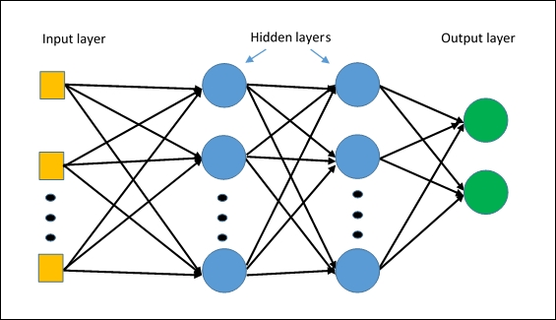
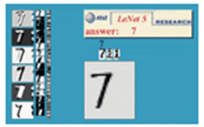
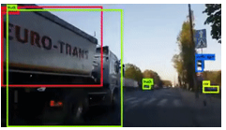
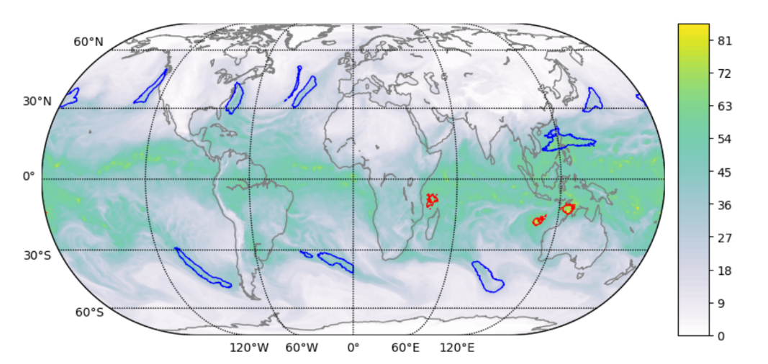


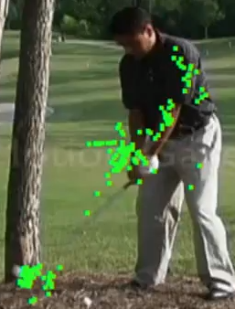
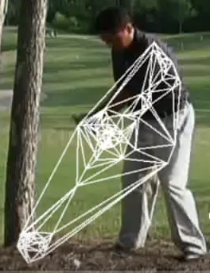
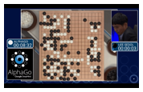
Must-Accelerate Applications in ML Era
Widely Used ML Models
Popular Applications
Multi Layer Perceptrons
Convolution Neural Nets
Object Classification/Detection
Media Processing/Generation
Large-Scale Scientific Computing
Designing Software 2.0
Google shrinks language translation code from 500k LoC to 500
and more …
http://yann.lecun.com/exdb/lenet/
http://vision03.csail.mit.edu/cnn_art/index.html
https://pjreddie.com/darknet/
Sequence Models
Graph Neural Networks
Tropical Cyclon Detection
https://insidehpc.com/2019/02/gordon-bell-prize-highlights-the-impact-of-ai/
https://giphy.com
http://jalammar.github.io/visualizing-neural-machine-translation-mechanics-of-seq2seq-models-with-attention/
https://deeplearning.mit.edu/
Reinforcement Learning
Points of Interest
Delaunay Triangulation
https://jack-clark.net/2017/10/09/import-ai-63-google-shrinks-language-translation-code-from-500000-to-500-lines-with-ai-only-25-of-surveyed-people-believe-automationbetter-jobs/ Kunle Olukotun, NeurIPS 2018 Invited talk.
YOW! Data 2018 Conference. https://www.youtube.com/watch?v=lDRb3CjESmM
AlphaGo. https://www.nature.com/articles/nature24270
Notes:
Data intensive Machine learning models are important, they bring intelligence in the system.
Compute intense and memory bound – critical to accelerate.

Slide 3
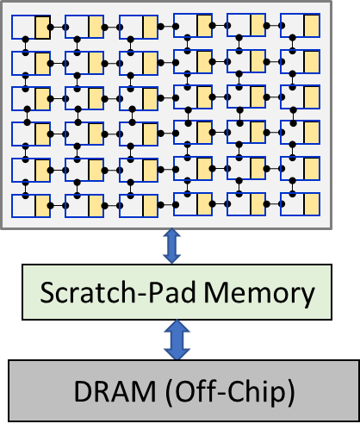
Dataflow Accelerators: Promising Solution
Variations known as: - systolic arrays,
- spatially programmable architecture,
- coarse-grained reconfig. arrays
Massive array of processing elements (PEs).
Simple: No complex OoO pipeline.
Programmable: can execute all loop operations.
Private & shared memory for PEs sustain data reuse.
PEs can be engaged in computations while data communicated from lower memories.
Done by effective data management (software prefetching, data distribution and allocation).
[1] Norman Jouppi et al. In-datacenter performance analysis of a tensor processing unit. In ISCA 2017.
[2] Yu-Hsin Chen et al. Eyeriss: An energy-efficient reconfigurable accelerator for deep cnns. In JSSC 2016
[3] Dataflow Processing Unit from Wave Computing. In HOTCHIPS 2017.
[4] M. Thottethodi & T. N. Vijaykumar. Why GPGPU is Less Efficient than TPU for DNNs. ACM SIGARCH Blog, Jan 19.
[5] Bruce Fleischer et al., A Scalable Multi-TeraOPS Core for AI Training and Inference. In VLSI 2018.
[6] Manupa Karunaratne et al. Hycube: A cgra with reconfigurable single-cycle multi-hop interconnect. In DAC 2017.
Notes:
Dataflow accelerators and their variants like (sys array based accels, cgras or spatial architectures) repeatedly demonstrated for energy-efficient accel of ML kernels
What is DFA? What is PE? Why energy-efficient? Simple PEs. Most management is in SW. (overall over 100x better power-efficient compared to edge GPU)
Maximize throughput – how?

Slide 4
Demo: DiRAC – Cycle-level μarch Sim
DiRAC Demo
[Alpha Release] https://github.com/cmlasu/DiRAC
Notes:
No community infrastructure on understanding DFA design
What is DiRAC?
How the programmer can use it?
What example I am running?
How to run it?
What is output: should be 7776 ops on 9 PEs – 864 ticks. It is almost double, why because it also includes latency for loading data from DRAM (for first time) and write-back to DRAM (for last time).
What programs it can run?

Slide 5
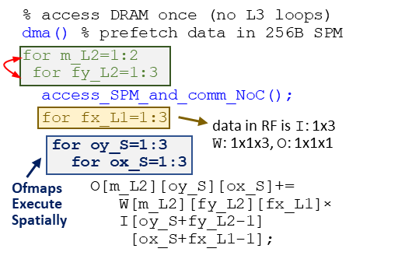
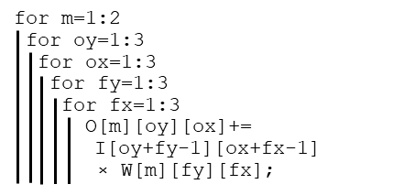
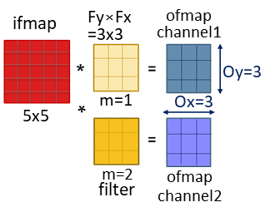
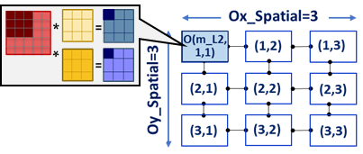
Spatiotemporal Execution of Loops
Convolution kernel
Notes:
Convolution kernel. How convolution works
Big question: What is mapping?
If I need to map – find out what data each PE executes, i.e., ‘O’ loops are in space
Then, need to find out what data gets accessed from each memory level. E.g. in registers, and in scratchpad
Different mappings imply different accelerations. Can be significant.

Slide 6
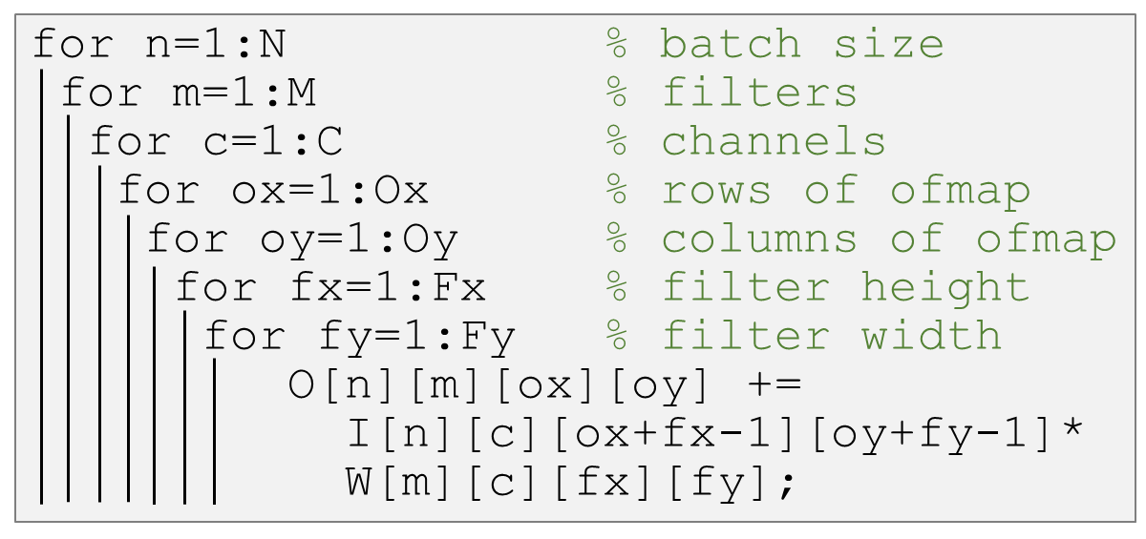
Loop Orchestration
for n_L3 = 1:N_DRAM
for m_L3 = 1:M_DRAM
for c_L3 = 1:C_DRAM
for ox_L3 = 1:Ox_DRAM
for oy_L3 = 1:Oy_DRAM
for fx_L3 = 1:Fx_DRAM
for fy_L3 = 1:Fy_DRAM
{
dma( );
for n_L2 = 1:N_SPM
for m_L2 = 1:M_SPM
for c_L2 = 1:C_SPM
for ox_L2 = 1:Ox_SPM
for oy_L2 = 1:Oy_SPM
for fx_L2 = 1:Fx_SPM
for fy_L2 = 1:Fy_SPM
{
communicate_data_NoC( );
for n_L1 = 1:N_RF
for m_L1 = 1:M_RF
for c_L1 = 1:C_RF
for ox_L1 = 1:Ox_RF
for oy_L1 = 1:Oy_RF
for fx_L1 = 1:Fx_RF
for fy_L1 = 1:Fy_RF
{
for n_S = 1:N_SPATIAL
for m_S = 1:M_SPATIAL
for c_S = 1:C_SPATIAL
for ox_S = 1:Ox_SPATIAL
for oy_S = 1:Oy_SPATIAL
for fx_L3 = 1:Fx_SPATIAL
for fy_L3 = 1:Fy_SPATIAL
O[][][][] +=
I[][][][] *
W[][][][];
}}}
Accelerator
Concurrent
execution
on PEs
L1 Accesses
L2 Accesses
Scratch-Pad Memory
L3 Accesses
Convolution kernel
DRAM (Off-Chip)
All the tilings and orderings capture a vast space of “hardware-software execution methods” of the nested loops on the dataflow accelerator
7-deep nested loop
28-deep nested loop
Notes:
Can visualize each loop into 4 level, 7 to 28
What each level represent
How tiling and ordering captures the vast space

Slide 7
Configuring 2D Spatial Execution
for ox=1:3
for oy=1:3
for fx=1:3
for fy=1:3
O[ox][oy]+= W[fx][fy]×
I[ox+fx-1][oy+fy-1];
Loops for Filters execute Temporally on every PE
for fx_T=1:3
for fy_T=1:3
#pragma unroll spatial for ox_S=1:3 for oy_S=1:3
O[ox][oy]+=
W[fx][fy]×
I[ox+fx-1][oy+fy-1];
Each PE computes 1 output value out of 9 in 2D ofmap.
*
=
Ofmap channel1
Fx×Fy=3x3
Ox×Oy=3x3
=
Oy_Spatial=3
*
Ox=3
(1,1)
(1,2)
(1,3)
Output Stationary Dataflow Mechanism
O(1,1)
m=1
Oy=3
5x5
filter
Ox_Spatial=3
(2,3)
(2,1)
(2,2)
ifmap
(3,1)
(3,2)
(3,3)
PE(1,1) computes O(1,1), PE(1,2) computes O(1,2), and so on
Notes:
Each PE computes unique ‘O’, PE(1,1) computes O(1,1)

Slide 8
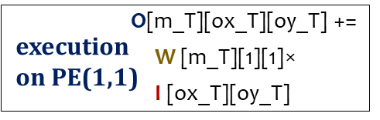
Different tiling → Different dataflow
for ox=1:3
for oy=1:3
for fx=1:3
for fy=1:3
O[ox][oy]+= W[fx][fy]×
I[ox+fx-1][oy+fy-1];
Loops for Ofmaps execute Temporally on every PE
for ox_T=1:3
for oy_T=1:3
#pragma unroll spatial for fx_S=1:3 for fy_S=1:3
O[ox][oy]+=
W[fx][fy]×
I[ox+fx-1][oy+fy-1];
O
Ofmap channel1
Fx×Fy=3x3
Ox×Oy=3x3
=
O(m,1,1)
Fy_Spatial=3
*
Ox=3
(1,1)
P2
(1,3)
Weight Stationary Dataflow Mechanism
P1
(1,2)
P3
m=1
Oy=3
5x5
filter
Fx_Spatial=3
P5
(2,3)
(2,1)
(2,2)
P6
ifmap
P4
(3,1)
P8
(3,3)
P7
(3,2)
P9
Each PE computes 1 MAC out of 9 for each output value.
P1 + P2 + … + P9 = O(1,1,1)
Notes:
What is weight stationary.

Slide 9
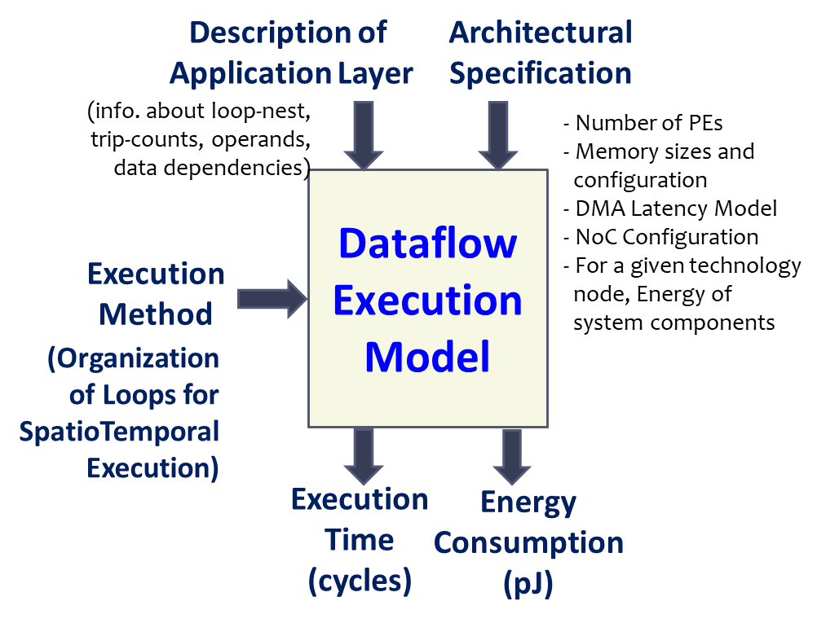
Modeling Dataflow Execution
Features with detailed modeling of
Analyze arbitrary perfectly nested loops.
miss penalty and stall cycles (PE execution, managing PE’s private and shared memory).
inter-PE communication.
temporal/spatial data reuse.
Integrated support for common ML libraries MXNet, Keras, etc. (leveraging TVM front-end)
Step-wise equations and analysis in the paper
Notes:
Analytical models are becoming the norm. Why? –
HW is Simple, Feasible to achieve near-actual estimate of execution metrics.
Mapping search-space and architecture design-space is just too large. Faster to explore compared to running on actual architecture,
and importantly Comprehensive static estimate of accelerator system
What features our model considers?

Slide 10
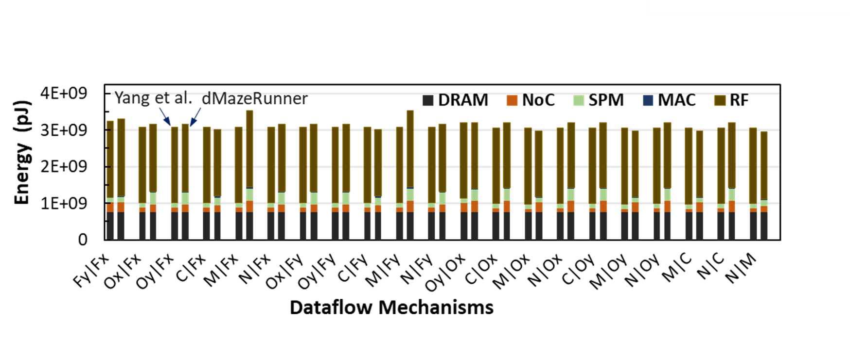
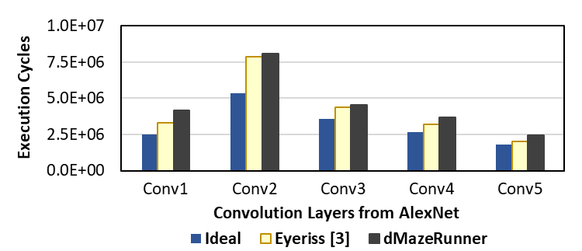
Validation of Execution Model
Validation against DNN Optimizer of Yang et al.
Energy estimate differs by ~4.2% for various execution methods
For efficient mappings, major energy spent in RF accesses
Yang, Xuan, M. Gao, J. Pu, A. Nayak, Q. Liu, S. Bell, J. Setter, K. Cao, H. Ha, Christos Kozyrakis, and Mark Horowitz. "DNN Dataflow Choice Is Overrated." [arXiv ‘18]
Validation against Eyeriss Chip
~11% perf. difference vs. real-chip execution
Chen, Yu-Hsin et al. "Eyeriss: An energy-efficient reconfigurable accelerator for deep convolutional neural networks." [JSSC ’17]

Slide 11
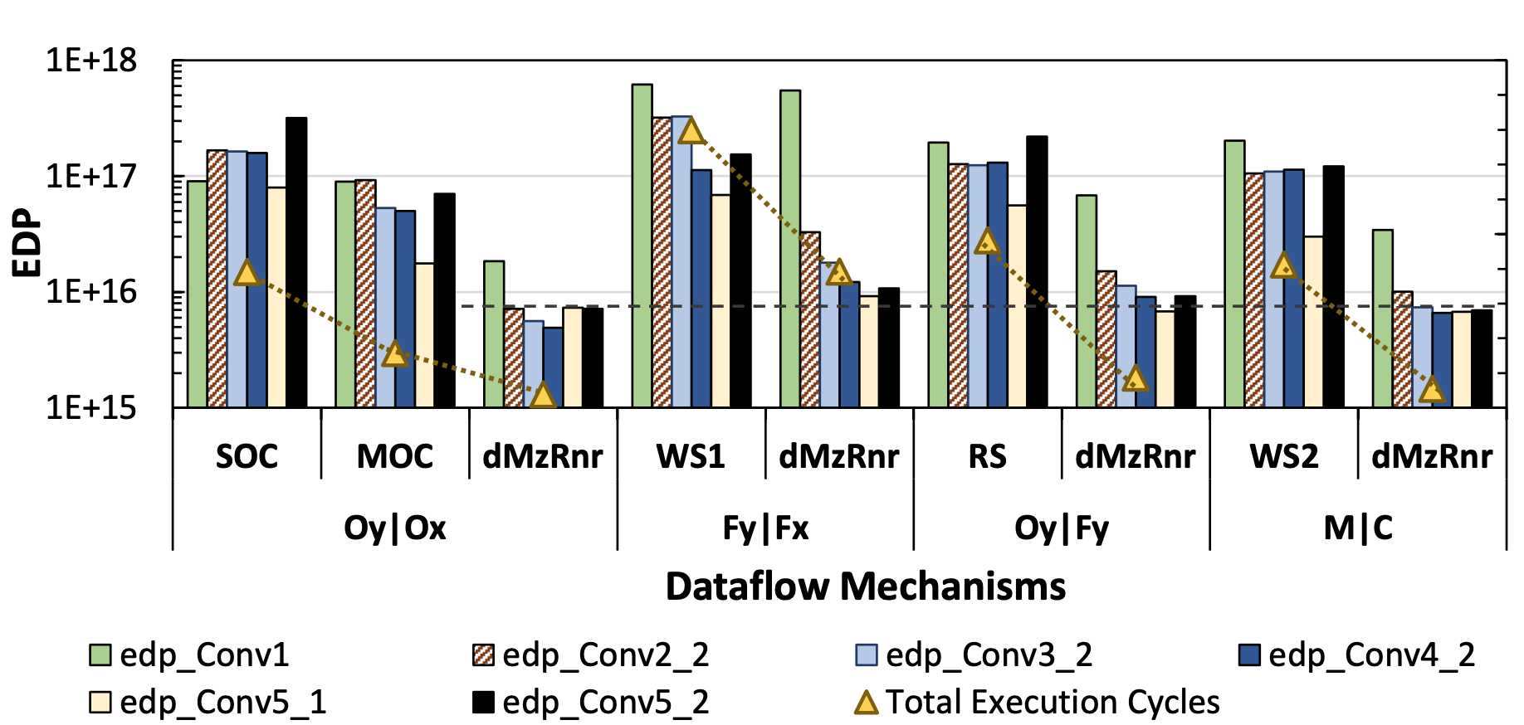
Results: 9X reduction in EDP
Executing ResNet layers on 256-PE, 512B RF, 128kB SPM dataflow accelerator
Weight Stationary
Row Stationary
Coarse Weight Stationary
Output Stationary
Total Execution Cycles
EDP (Energy-Delay Product)
Notes:
What results we do simulate?
Above 4x better in perf, and > 9x in EDP. Later I’ll explain why better

Slide 12
Demo: dMazeRunner
dMazeRunner Demo
Release: https://github.com/cmlasu/dMazeRunner
Notes:
What are the tool options
Auto-optimizer for one layer
Architecture options
What is execution method
Optimize for the whole model – all gemm and conv layers
Why fast?
Programmer directed search
DSE
Examples for analyzing conv and gemm execution methods

Slide 13
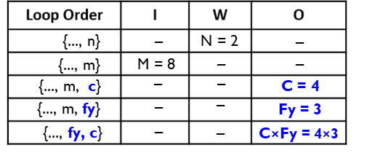
Drastic Pruning of Search Space
Example: Generating loop-orderings with unique data reuse factors
for n = 1:N=2
for m = 1:M=8
for c = 1:C=4
for fy = 1:Fy=3
{
comm_data();
O[n][m]+= I[n][c][fy]× W[m][c][fy]
}
5 schedules with unique reuse costs as compared to 4! = 24 schedules
Unique Reuse Factors for Data Operands
invariant of loops with index variables
O c, fy
I m
W n
Loops with index variables ‘c' and ‘fy’ are innermost.
Operand ‘O’ reused across both loops
- 2*8*4*3 accesses total - O is accessed only 2*8 times
Notes:
Loop invariance of ‘O’
How to prune the loop orders
Still left with many valid methods with unique costs. So how to reduce search? Heuristics. Explained in the paper.

Slide 14
Adaptable Mappings Yield Better Results
Adapts to kernel/arch characteristics
Scales for layers/tensors of different shapes
Finds non-intuitive mappings that optimizes various factors e.g.,
High resource utilization
Maximized reuse of multiple data operands
Minimized DRAM accesses
Efficient interleaving of computation with communication latency
Example Mappings of ResNet Conv5_2 for Output-Stationary Dataflow
For data allocated in RFs of PEs,
PE Compute vs. Data comm. Latency:
Total cycles:
Ideal execution cycles for output-stationary:
Reduction in DRAM accesses (ifmaps, weights):
Perf. improvement (normalized to MOC):
Energy-Delay-Product reduction (normalized):
MOC
144 vs. 648
~10,616,832
2,359,296
(1x, 1x)
1x 1x
dMzRnr
576 vs. 576
~2,459,648
2,359,296
(4.57x, 2x) 4.44x 9.86x
MOC: Simultaneous spatial processing of Multiple Output Channels
[1] S. Gupta et al. Deep learning with limited numerical precision. In ICML, 2015.
[2] Y. Chen et al. Eyeriss: A spatial architecture for energy-efficient dataflow for CNNs. In ISCA 2016.
Notes:
Different factors of the system
Explain example

Slide 15
Conclusions
Dataflow accelerators: promising for ML applications.
DiRAC: Cycle-level microarchitecture simulation of executing nested loops on dataflow accelerators.
Need to determine efficient “execution method” for spatiotemporal executions on dataflow accelerators
dMazeRunner: Automated, succinct, and fast exploration of mapping search space and architecture design space
Adaptive and non-intuitive mappings enable efficient dataflow acceleration

