Slide 1
SIGN: A Scalable Incident Detection, Localization, and Severity Estimation using Graph Neural Networks
Master’s Thesis Defense
Presented by: Kaustubh Manoj Harapanahalli
Thesis Committee
Dr. Aviral Shrivastava (Chair)
Dr. Nakul Gopalan
Dr. Ashif Iquebal

Slide 2








Motivation for Traffic Incident Detection
Traffic Incident Categories
Impact of Traffic Accident
Cargo Spills
Stalled Vehicles
$1.4 Trillion annual cost to U.S.A^{[1]}
For each extra 1 min uncleared
traffic incident, +2.8 %
chance of a secondary
crash. ^{[2]}
Traffic Incidents
Traffic Accidents
Road Maintenance
Traffic Accidents
Emergency response
delayed by 5-minutes,
Increasing fatality rate by 46% ^{[3]}
Emergency response
under 7-minutes,
decreasing fatality rate by 58% ^{[3]}
Only 30% of all traffic incidents are verified
Broader Issues of Traffic Incidents
Delayed emergency
services
Commuter’s safety
Traffic congestion
[1] Lawrence Blincoe et al. The economic and societal impact of motor vehicle crashes, 2019. Technical report, 2022.
[2] Salum, J. H., A. E. Kitali, T. Sando and P. Alluri, “Evaluating the impact of road rangers in preventing secondary crashes”, Accident Analysis & Prevention 156, 2021.
[3] James P Byrne et al. Association between emergency medical service response time and motor vehicle crash mortality in the United States. JAMA Surgery, 154:286–293, 2019.

Slide 3



Impact of Faster Traffic Incident Detection
Lowers the secondary-incident likelihood by about 20%
Allows for better traffic re-routing when incidents are detected at scale
Increases victim survival rate by 6% for every minute faster emergency response

Slide 4
Existing Incident Detection Works
Previous Works | Region | Dataset | Sensor Modality | Model | Approach | Limitations
Chen et al.^{[1]} | Interstate (Freeway) | Macroscopic | Inductive Loop Detectors | XGBoost | Trained on data from upstream and downstream traffic detectors | Requires data from consecutive detectors and given that they use inductive loop detectors it might not be available all the time.
Bao et al.^{[2]} | Interstate (Freeway) | Microscopic | Traffic Cameras | YOLOv3 | Detects incidents based on vehicle speed by tracking vehicles in the camera’s field of view | Can detect incidents only in field-of-view
Han et al.^{[3]} | Arterial (Urban) | Microscopic | GPS probes | Clustering | Detects incidents by matching real-time GPS speed vectors with historical incident patterns | Affected by noise and interference and mandates the installation of a GPS probe in every vehicle
Yang et al.^{[4]} | Arterial (Urban) | Macroscopic | Inductive Loop Detectors | Deep Learning | Detects incidents using deep-learning network | Uses Simplistic simulation which does not model real city traffic
Zhu et al.^{[5]} | Arterial (Urban) | Macroscopic | Inductive Loop Detectors | Custom CNN | Detects incidents based on constructed a connectivity matrix of sensors | Uses only traffic counts for detecting incidents
SIGN (Ours) | Arterial (Urban) | Microscopic | Traffic Cameras at Intersections | GNN-based | Scalable GNN-based model
[1] Chen et al. More robust and better: Automatic traffic incident detection based on XGBoost (ATTCA 2023)
[2] Bao et al. Research on Highway Traffic Event Detection Method Based on Image Processing (IOP EES 2021)
[3] Han et al. Traffic incident detection: A trajectory-based approach, (ICDE 2020)
[4] Yang et al. Traffic Incident Generation And Supervised Learning-Based Detection Via A Microscopic Simulation Platform (ITSC 2023)
[5] Zhu et al. Deep learning approach for traffic incident detection in urban networks, (ITSC 2018)

Slide 5
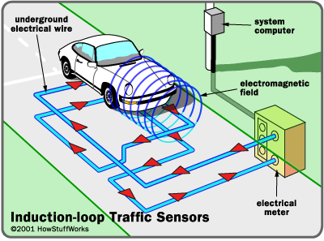
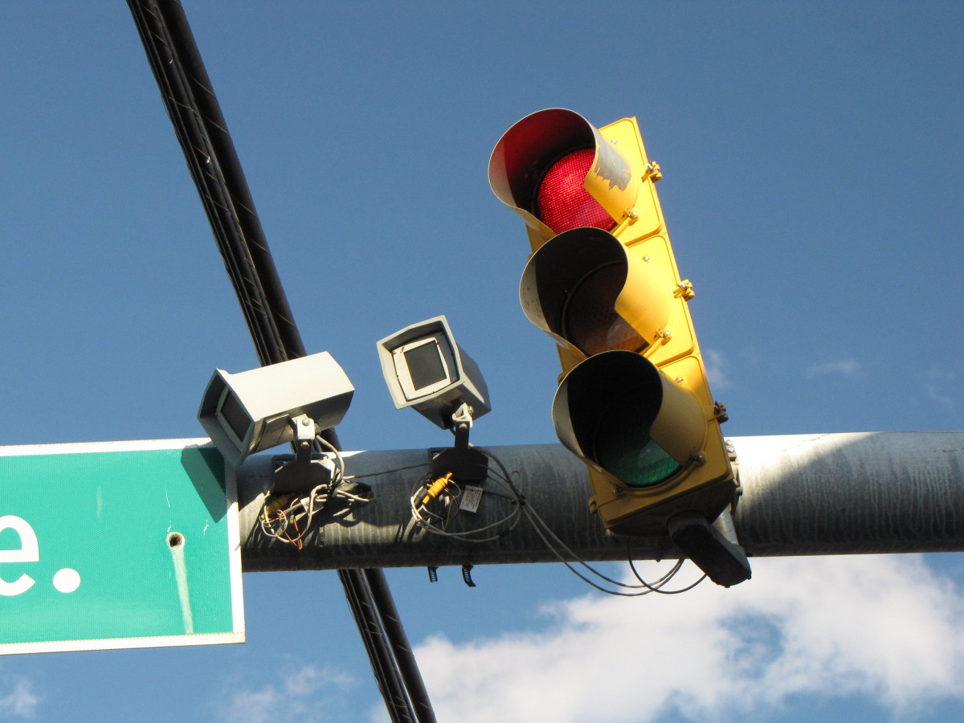
Understanding Dataset Types
Macroscopic dataset
Microscopic dataset
Features: average traffic flow, count, and density calculated over time.
Sensors: Inductive Loop Detectors.
Examples: datasets PEMS Bay, METR-LA, SFO I-880
Features: individual vehicle speed, timestamps, vehicle unique identifiers
Sensors: Cameras, Bluetooth Sensors, GPS.
Example datasets: Highway 99-W, NYC taxi data.
Time | Average Speed | Traffic Count | Average traffic occupancy
5 | 67.04 | 48 | 0.20
10 | 70 | 45 | 0.18
15 | 71 | 59 | 0.15
Timestamp | Vehicle Identifier | Speed | Lane Number
10:00:23 | Purple Sedan | 72 | 3
10:02:11 | Blue SUV | 40 | 1
10:07:00 | Black Sedan | 65 | 3

Slide 6
Our Contributions
Limitation
Contribution
No methodology to detect, locate, and estimate severity of incidents occurring between intersections
A deep-learning-based algorithm that can detect, localize and estimate severity on microscopic datasets
A feature projection vector that constructs feature vectors irrespective of the size of input data, making the model architecture inductive
Lack of scalable approaches for incident identification
A generic approach for generating microscopic datasets using real-world captured macroscopic data
Lack of microscopic datasets

Slide 7
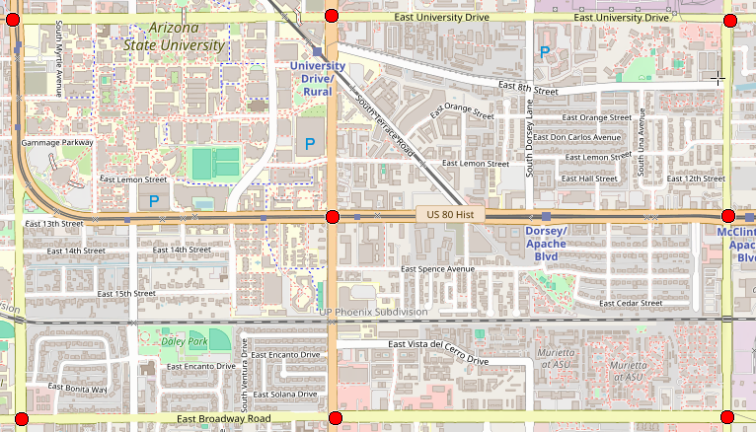



Why Graph Neural Networks for Incident Detection
$$x_{v}$$
$$a_{uv}$$
Junction
1
Junction
2
Junction
3
$$a_{vu}$$
Junction
4
Junction
5
Junction
6
Junction
7
Junction
8
Road Networks are Graphs
Captures spatial relationships
Enables scalability through inductive learning processes

Slide 8







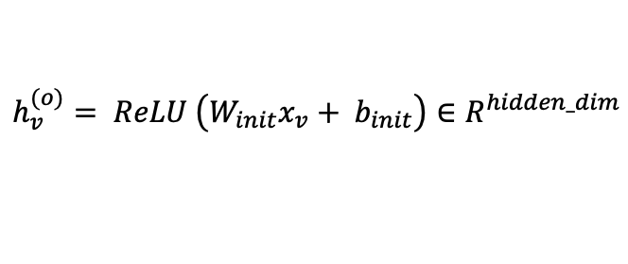
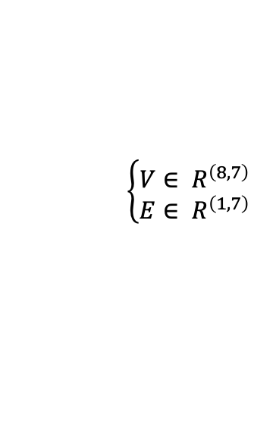




SIGN – Model for Inductive Training
Input Graph $G=\left(V, E\right)$
$$\left\{\begin{aligned}V∈ R^{\left(8,7\right)} \\ E∈ R^{\left(1,7\right)}\end{aligned}\right.$$
$$h_{v}^{(o)}= ReLU \left.\left(W_{init}x_{v}+ b_{init}\right.\right)∈R^{hidden_dim}$$
Feature Projection Map per node (MLP)
$$NNConv=\left\{\begin{aligned}M_{uv}^{l}= reshape\left.\left(MLP_{edge}^{(l)}\left.\left(a_{uv}\right.\right)\right.\right) \\ h_{v}^{(l+1)}= ReLU\left.\left(W_{root}^{(l)}{ h}_{v}^{(l)}+mean\left.\left(M_{uv}^{\left(l\right)}⋅h_{u}^{\left(l\right)}\right.\right)\right.\right)\end{aligned}\right.$$
Message Passing Layers over graph $(L × NNConv)$
$$g = Set2Set\left(H\right)∈ R^{hidden_dim∗ 2}$$
Graph Pooling
(Set2Set)
$$x_{2}$$
$$a_{32}$$
$$x_{3}$$
Dropout
I1
I2
I3
Graph Embedding (g)
$$a_{23}$$
$$z_{det}= MLP_{det}\left(g\right)∈ R^{1}$$
Severity
(MLP)
Detection
(MLP)
Localization
(MLP)
$$z_{loc}= MLP_{loc}\left(g\right)∈ R^{loc}$$
I4
I5
$$z_{sev}= MLP_{sev}\left(g\right)∈ R^{sev}$$
Final Predictions
I6
I7
I8

Slide 9
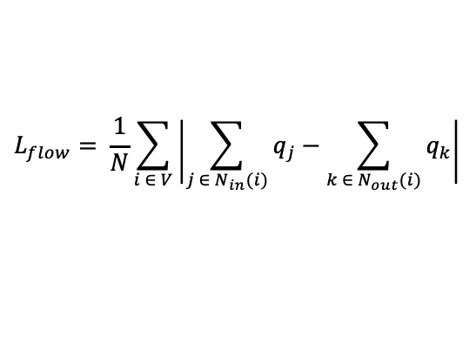


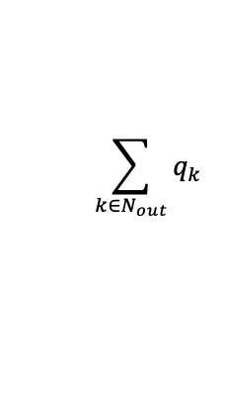

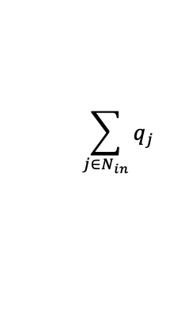





Model Training Objective and Composite Loss
Input Graph $G=\left(V, E\right)$ $$(X, A, E_{idx})$$
Message Passing Layers $$(L × NNConv)$$
Feature Projection Map
(MLP)
Node Speed Predictions
Message Passing Layers $$(L × NNConv)$$
Speed to Density Conversion
$$ρ= ρ_{max}\left(1−\frac{s}{s_{max}}\right)$$
Graph Pooling
(Set2Set)
Speed Flow-based loss
Density to Flow Conversion
$$q\left(ρ\right)= s\left(ρ\right)⋅ρ$$
Dropout
$$λ_{loc}$$
×
$$\sum_{j∈N_{in}}{q_{j}}$$
Edge Flow Computation
$$\sum_{k∈N_{out}}{q_{k}}$$
Graph Embedding (g)
Aggregated Incoming Flows
Aggregated Outgoing Flows
Severity
(MLP)
Detection
(MLP)
Localization
(MLP)
Compute Flow Imbalance
$$L_{flow}= \frac{1}{N}\sum_{i ∈ V}{\left|\sum_{j ∈ N_{in}(i)}{q_{j}}−\sum_{k ∈ N_{out}(i)}{q_{k}}\right|}$$
Cross-Entropy
BCE
Cross-Entropy
+
Total Loss
$$λ_{sev}$$
$$λ_{loc}$$
Mean Flow Loss
×
×

Slide 10
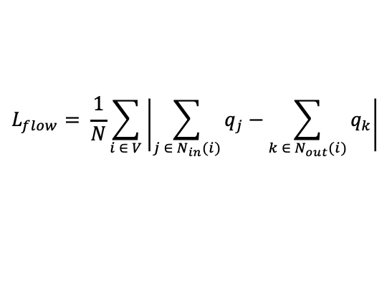

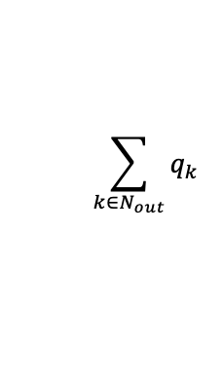
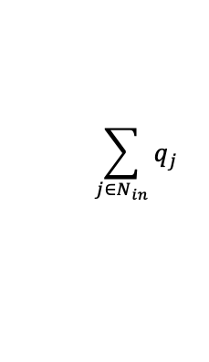


Interpretation of Greenshield’s Fundamental Diagram
Message Passing Layers $$(L × NNConv)$$
At high speed → low density → low flow
At moderate speed → moderate density → maximum flow
At low speed → high density → low flow
Node Speed Predictions
Speed to Density Conversion
$$ρ= ρ_{max}\left(1−\frac{s}{s_{max}}\right)$$
Visual Representation of Flow vs Traffic Density
Density to Flow Conversion
$$q\left(ρ\right)= s\left(ρ\right)⋅ρ$$
Empty Roads
$$\sum_{j∈N_{in}}{q_{j}}$$
Edge Flow Computation
$$\sum_{k∈N_{out}}{q_{k}}$$
Moderate Traffic
Flow
Aggregated Incoming Flows
Aggregated Outgoing Flows
Congestion
Compute Flow Imbalance
$$L_{flow}= \frac{1}{N}\sum_{i ∈ V}{\left|\sum_{j ∈ N_{in}(i)}{q_{j}}−\sum_{k ∈ N_{out}(i)}{q_{k}}\right|}$$
Mean Flow Loss
Traffic Density

Slide 11



Workflow of Microscopic Traffic Dataset Generation
Traffic Flow Generation
Publicly Available Real-World Macroscopic Data
Construct Traffic Model
Microscopic Traffic Simulator
Generate Microscopic Traffic Incident Dataset
Traffic Incident Generator

Slide 12
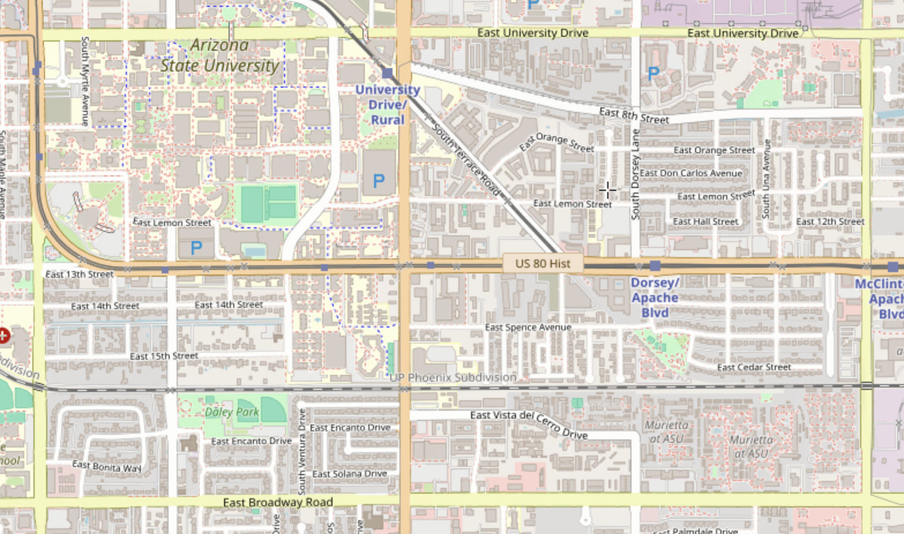
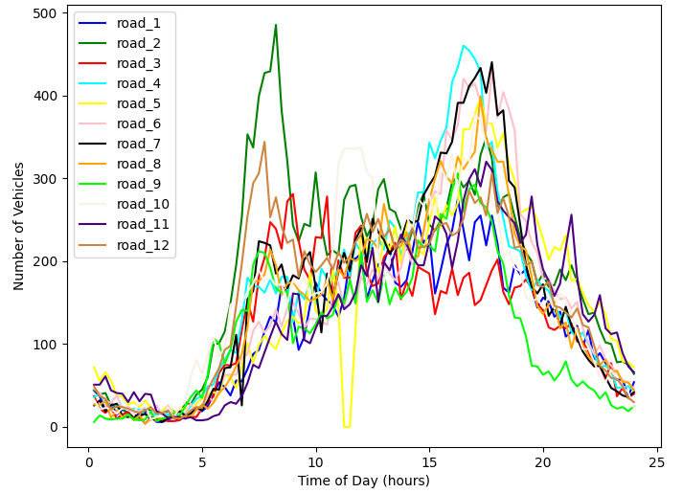
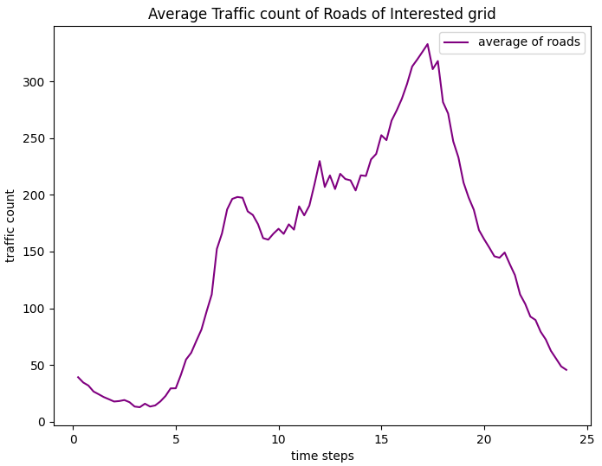
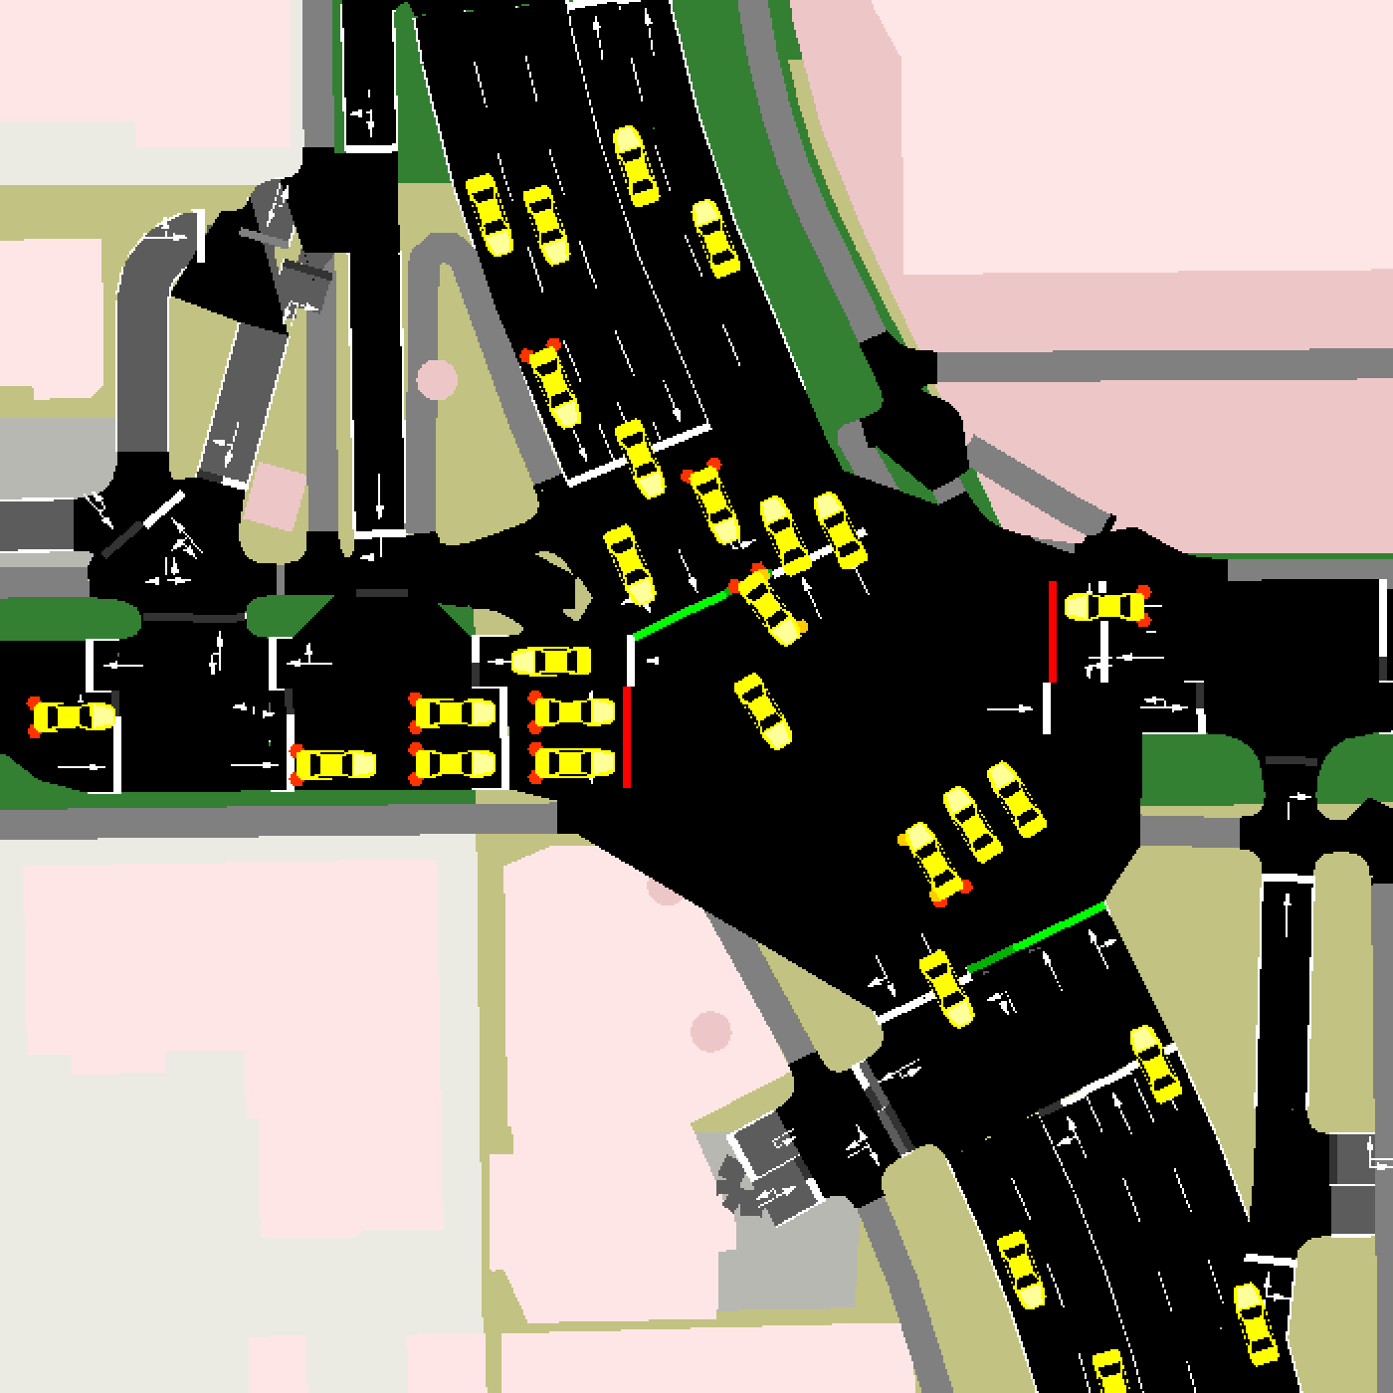
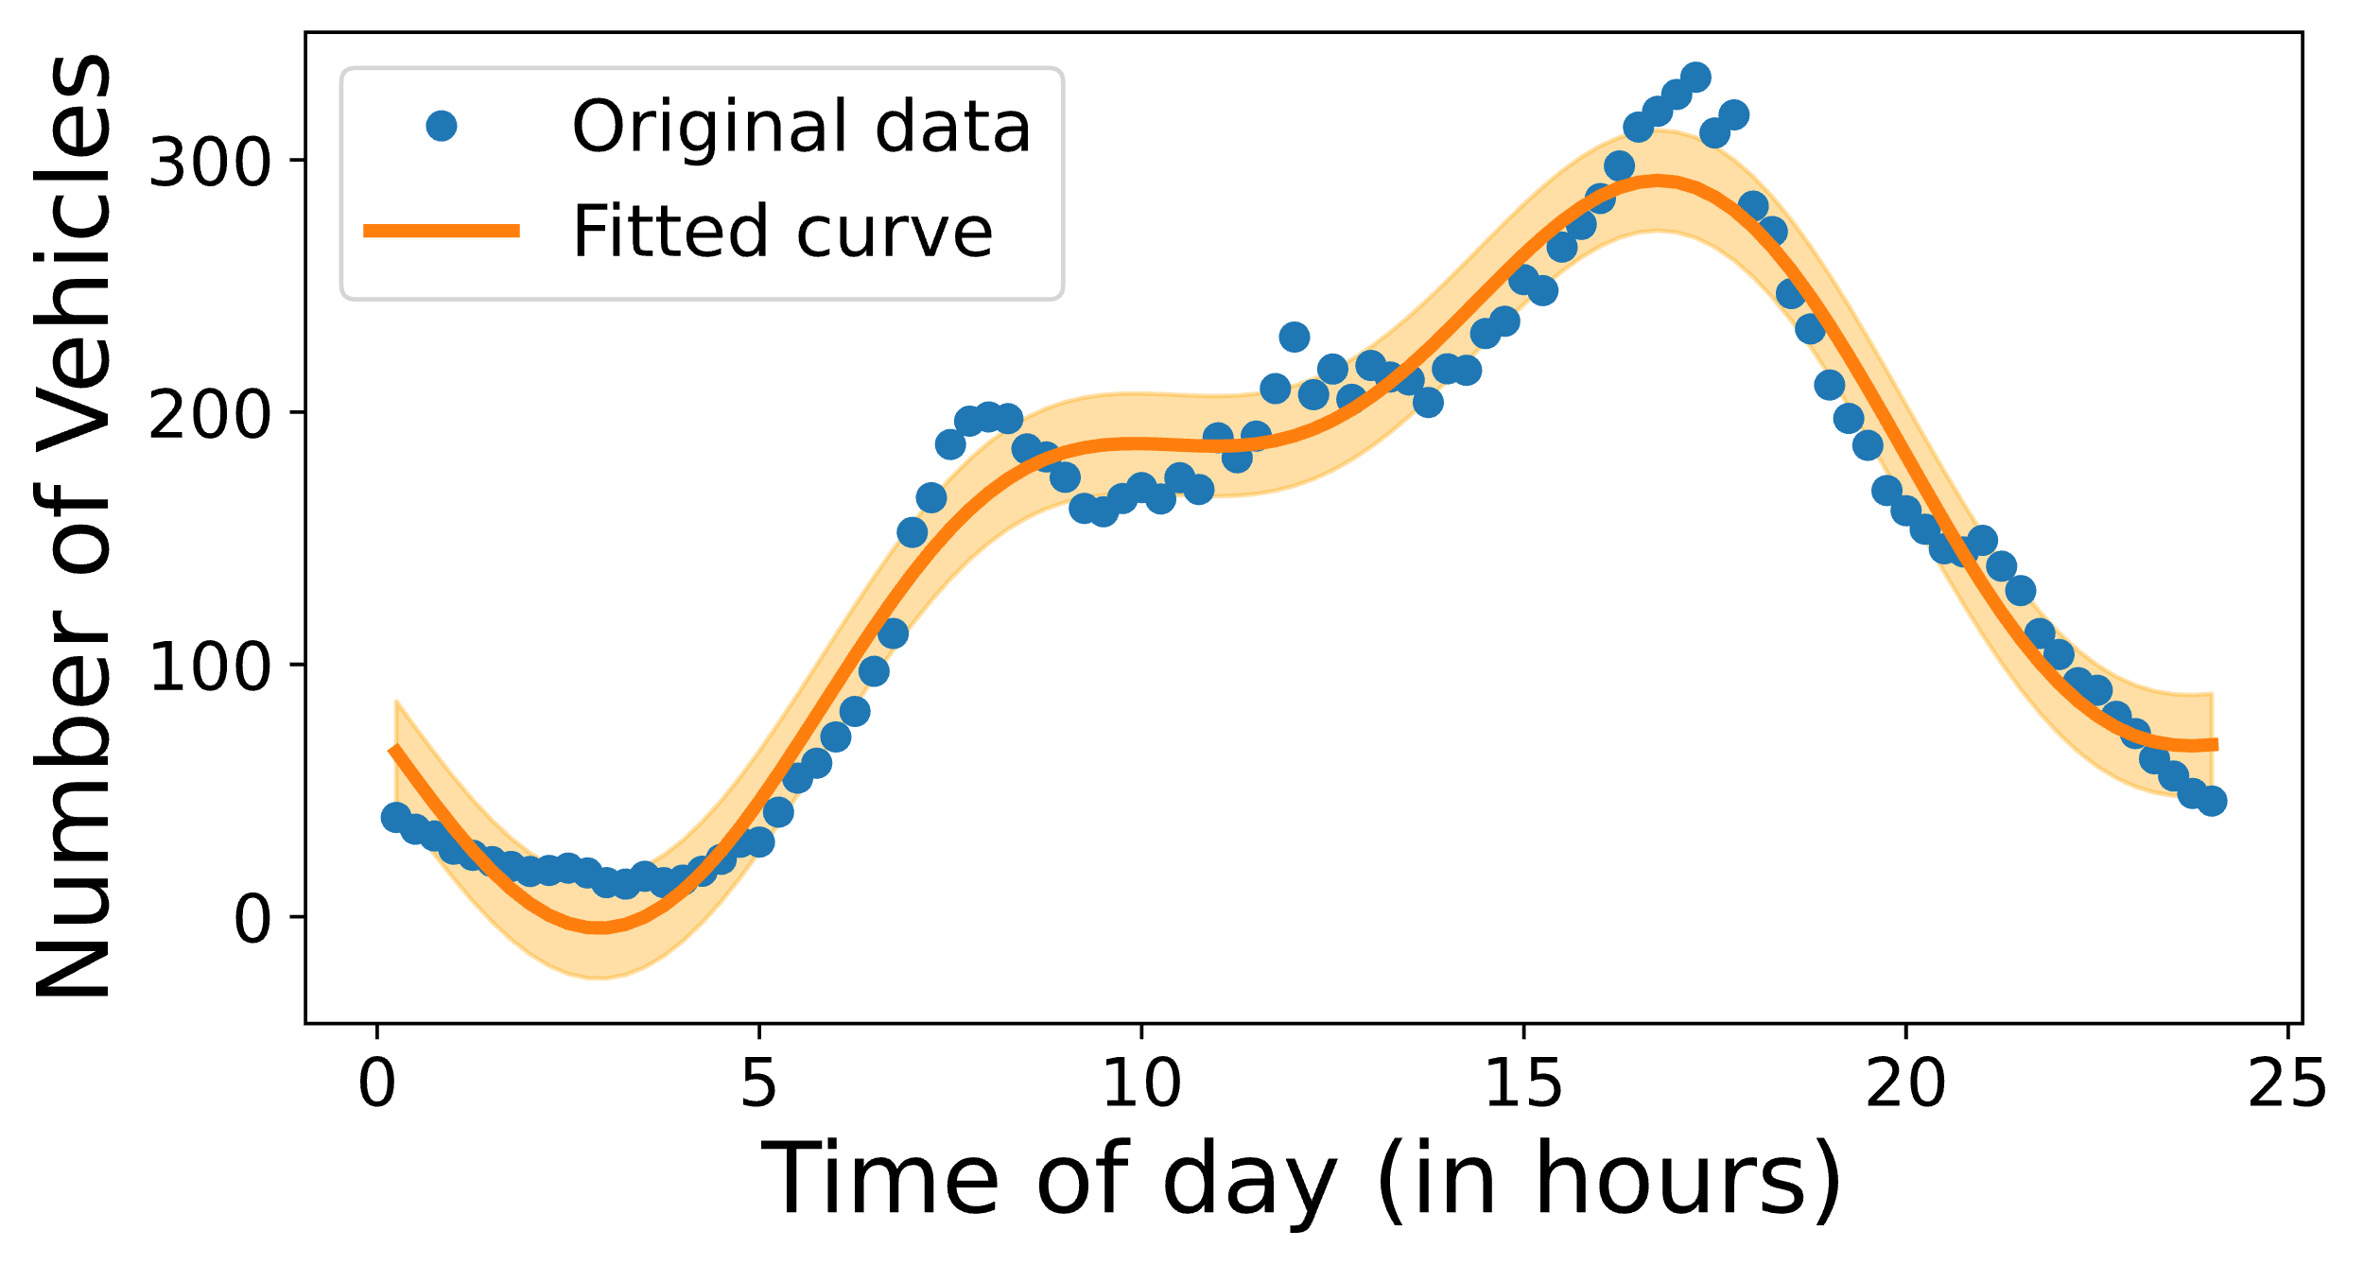

Traffic Flow Simulation Model
Plot of Traffic Counts vs Timestep
Plot of Average Traffic count vs Timestep
Target map region
Tempe DOT vehicle count data
$$f\left(t\right)=A_{1}\sin\left(B_{1}t+ C_{1}\right)+A_{1}\sin\left(B_{1}t+ C_{1}\right)+D+α$$
$$δ=\frac{J^{T}[y−f\left(t\right)]}{J^{T}∙J+ λI}$$

Slide 13
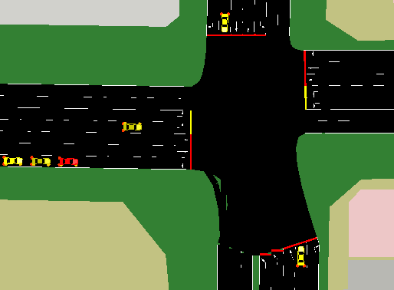
Traffic Incident Simulation Model
Probability of incident per vehicle
Randomly select Incident severity
Randomly select Incident clearance time
Slow down cars within a radius of incident
Incident occurrence decision function
YES
Total number of vehicles in simulation
NO

Slide 14
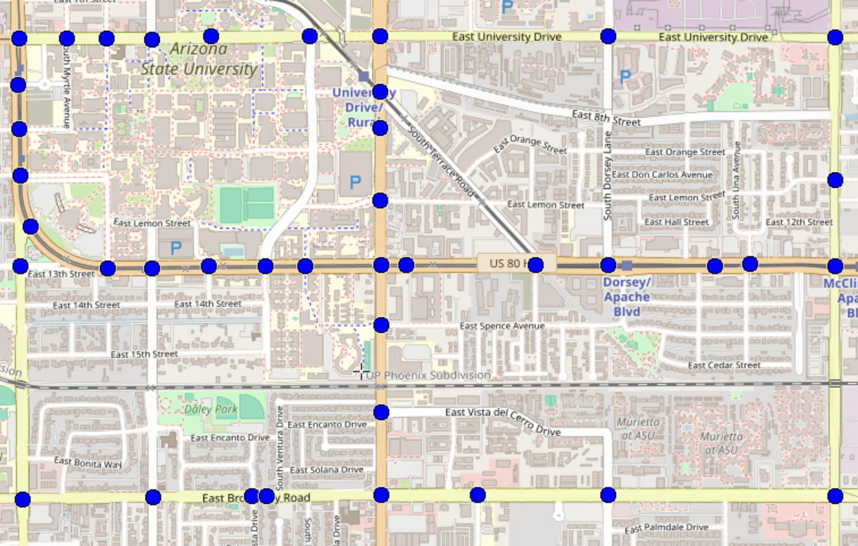

Dataset Generation from Microscopic Traffic Simulators
Raw Vehicle Features
Individual Vehicle ID
Intersection ID
Timestamp
Lane Index
Vehicle Speed
Vehicle Acceleration
Raw Traffic Features
Sensor ID
Occupancy of road
Vehicle Count
Mean Speed
Mean Acceleration
Incident Location
Processed Features
Sensor ID
Rolling mean Speed
Rolling Occupancy
Rolling vehicle count
Traffic Count
Incident Duration
Rolling Window
Averages
Traffic Cameras placed at traffic signals collect Data
Labels
Incident Occurrence
Incident Severity
Incident Localization
Labels
Incident Occurrence
Incident Severity
Incident Localization
43 traffic signals are marked as blue dots, indicating potential locations for placing traffic cameras to collect data

Slide 15
Dataset Generation for Inductive Model Training
Feature Representation
Edge Feature Vector (a_{(uv)})
Feature Name | Description
Rolling_speed_(u) | Rolling mean speed at the source sensor
Rolling_count_(u) | Rolling vehicle count at the source sensor
Rolling_occupancy_(u) | Rolling vehicle occupancy at the source sensor
Rolling_speed_(v) | Rolling mean speed at the target sensor
Rolling_count_(v) | Rolling vehicle at the target sensor
Rolling_occupancy_(v) | Rolling vehicle occupancy at the target sensor
Rolling_travel_time | Rolling travel time across the graph
Inductive Node Feature Vector (x_{u})
Aggregation Approach | xv = mean(a_{uv} ∀ u at x)
Junction
1
Junction
2
Junction
3
Junction
4
Junction
5
Junction
6
Junction
7
Junction
8

Slide 16
Baseline Development using TabNet
TabNet-based Baseline Model
TabNet Encoder Model Architecture
L1
…
L3
Raw Data
+
Overall output
ReLU
ReLU
Feature Extraction
Split
Split
Split
Processed Data
Feature Transformer
Feature Transformer
Feature Transformer
Attentive Transformer
Mask
Attentive Transformer
Mask
Incident Detection Model
Features
Aggregation
Aggregation
×
×
Incident Localization Model
Incident Severity Model
Global Feature Attributes
+
Incident Localization
Incident Detection
Severity Prediction

Slide 17
SIGN Detects Incidents 2.5X times better
Evaluation Metrics
Algorithm | DR | MTTD | FAR
Zhu et al. (CNN) | 51% | 471 secs | 35%
TabNet | 98% | 197 secs | 6%
SIGN | 99% | 116 secs | 11.94%
8 sensor placement for incident detection evaluation

Slide 18
SIGN can also Localize and Estimate Severity of Incidents
Evaluation Metrics
Algorithm | Severity | Localization - Top 1 | Localization - Top 2 | Localization - Top 3
TabNet | 82% | 70% | 80% | 85%
SIGN | 87.77% | 69.58% | 81.23% | 85.57%

Slide 19
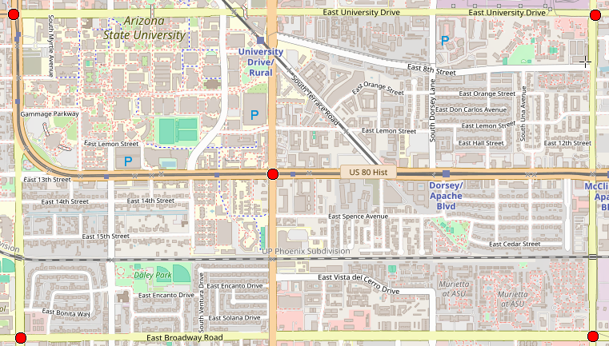
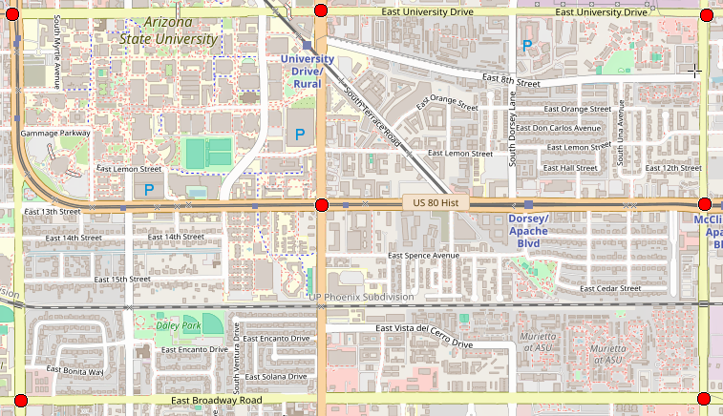
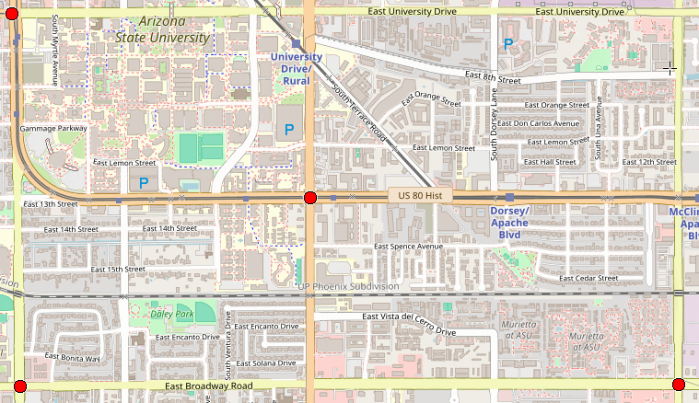
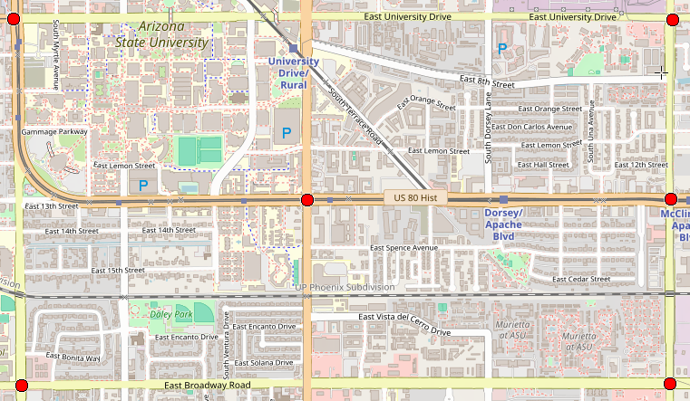
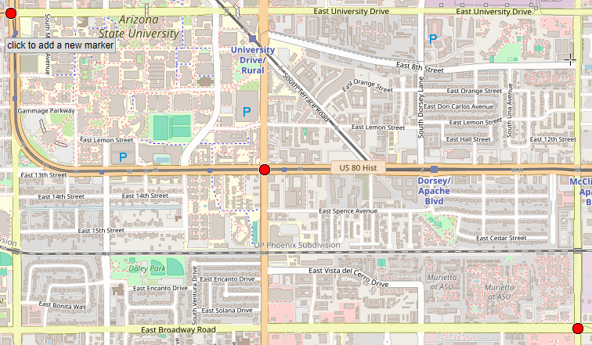
SIGN can scale to fewer (8/43 to 3/43) Sensors
Evaluating SIGN up to 8 out of 43 sensors
Evaluation Metrics
Nodes | Model | DR | Top-3 Localization | Severity | FAR | MTTD
8 Nodes | SIGN | 99% | 85.57% | 87.77% | 11.94% | 116 secs
 | TabNet | 98% | 78.15% | 79.69% | 6.26% | 197 secs
7 Nodes | SIGN | 99% | 68.45% | 85.23% | 15.15% | 143 secs
 | TabNet | 97% | 77.07% | 77.19% | 7.12% | 199 secs
6 Nodes | SIGN | 96% | 58.31% | 84.07% | 14.12% | 168 secs
 | TabNet | 97% | 75.27% | 76.34% | 8.24% | 200 secs
5 Nodes | SIGN | 95% | 45.26% | 82.24% | 17.85% | 173 secs
 | TabNet | 95% | 73.65% | 74.51% | 8.95% | 236 secs
4 Nodes | SIGN | 96% | 48.34% | 83.53% | 18.08% | 175 secs
 | TabNet | 92% | 67.65% | 72.18% | 11.28% | 286 secs
3 Nodes | SIGN | 99% | 32.43% | 73.67% | 36.59% | 178 secs
 | TabNet | 90% | 62.12% | 72.15% | 11.57% | 314 secs
8 intersections
5 intersections
7 intersections
4 intersections
6 intersections
3 intersections
TabNet model is only retrained for each node, while SIGN is trained only for 8 node

Slide 20



Conclusion
Scalable architecture for real-world Networks
SIGN can detect incidents for landscapes such as for urban regions and highways without requiring retraining for varying graph representation
Previous publication with baseline approach
Peddiraju, Sai Shashank, Kaustubh Harapanahalli, Edward Andert, and Aviral Shrivastava. "IncidentNet: Traffic Incident Detection, Localization and Severity Estimation with Sparse Sensing." In 2024 IEEE 27th International Conference on Intelligent Transportation Systems (ITSC), pp. 1470-1475. IEEE, 2024.
Faster Incident Detection
SIGN can detect more incidents with minimal false alarms while being faster
Multi-task capability
SIGN can also localize the incident and estimate its severity.

