Slide 1




Agile and Explainable Exploration of HW/SW Codesigns of Deep Learning Accelerators
Shail Dave*, Aviral Shrivastava*, and Tony Nowatzki^ *School of Computing and AI, Arizona State University
^University of California at Los Angeles
Appears at ASPLOS 2024
Won Silver Medal at ACM SIGBED SRC 2022
Notes:
In this talk, I will present on the need and solutions for agile and explainable explorations in designing efficient AI accelerators.

Slide 2
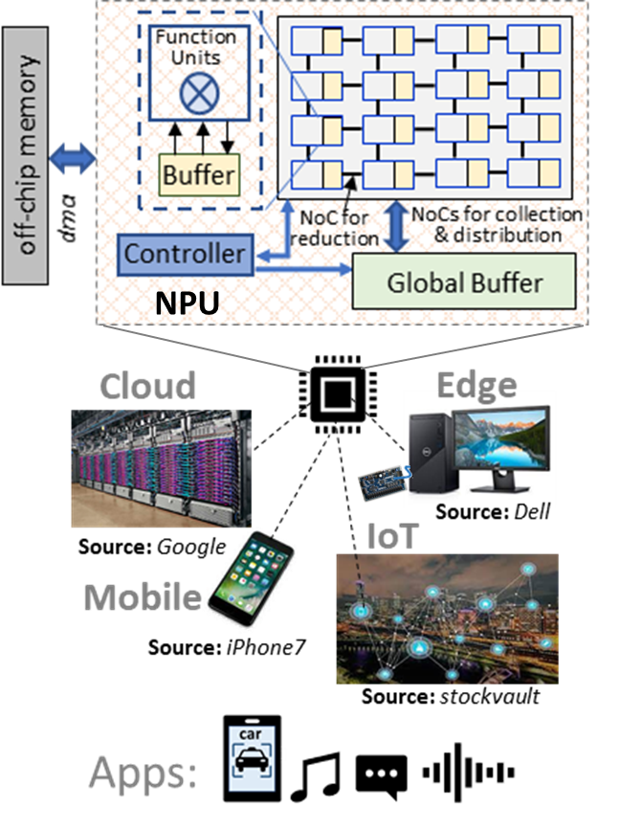
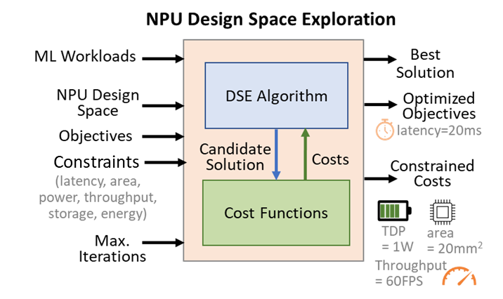
Goal: Fast and Efficient DNN HW/SW Codesign
Minimize objective costs within strict constraints on accelerator design & execution.
Latency, energy, chip area, throughput, power, storage, accuracy, resilience, etc.
Crucial for smooth end-user experience, low costs, sustainability, and dynamic resource management.
Towards An Agile Design Methodology for Efficient, Reliable, and Secure ML Systems. S. Dave et al. In VTS 2022. (invited special session)
Notes:
With the rise in embedded machine learning, domain-specific accelerators are increasingly deployed at the edge and IoT.
Designing an efficient accelerator appropriately is important for low price, smooth processing at the user end, and from the energy consumption and sustainability perspective.
So, we need effective design space exploration or DSE. The DSE needs to address several strict and often conflicting constraints and optimization objectives, such as latency, energy consumption, chip area, throughput, reliability, and price.
DNN hardware/software codesign space is vast. Even with modest options for the parameters of hardware design like power-of-two values of parameters, solutions can range from millions to quadrillions. For example, for Google TPU full stack architecture search, edge DNN accelerator design can have 10^14 solutions. And, for every hardware design, valid solutions for software can be 10^14 -- 10^36. So, the collective space is vast.
The challenge is that given this vast space, the exploration must not just yield a feasible and efficient solution – meaning constraints-meeting solution with the least cost of objective say latency, but exploration should also be quick for dynamic optimizations.

Slide 3
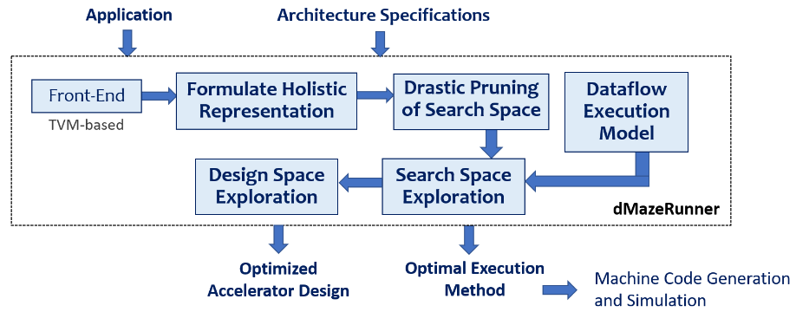
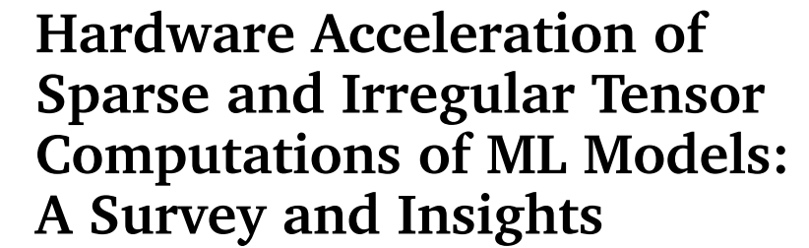
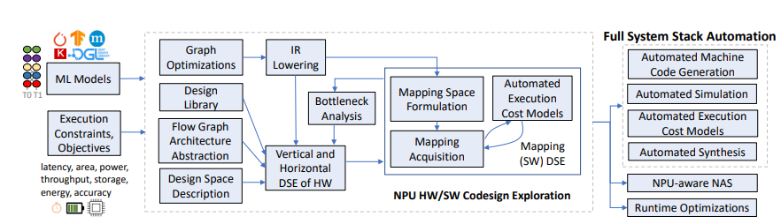
Related Recent Works
[Proceedings of the IEEE ’21] Efficient Sparse Tensor Processing at Circuits-Architecture-Mapping-Model level
dMazeRunner [CODES+ISSS, TECS, ESWEEK’19] Efficient Full-DNN Mapping Optimizations in Seconds.
Agile Design Methodology for Efficient ML Systems [VTS’22, LATTE ’22, SRC AIHW Project]
Notes:
Highlight our related works.
Sparsity survey – state-of-the-art techniques in terms of sparse DNN accelerator design, their mappings, accelerator-aware model pruning, structured sparsity, and all. Commonly studied by practitioners and industry in design automation community, computer architecture, circuits, and machine learning community.
dMazeRunner. You may already be familiar. Quick mapping optimizations for layer-sequential execution of DNNs. Most downloaded ESWEEK’19 work and most downloaded paper of ACM TECS from ACM DL in last 6 years.
Recent work is automating modular design and architectural explorations. This design methodology is described in our VTS paper and in ASPLOS talk last year. This is focus of our current AI HW project with SRC.

Slide 4
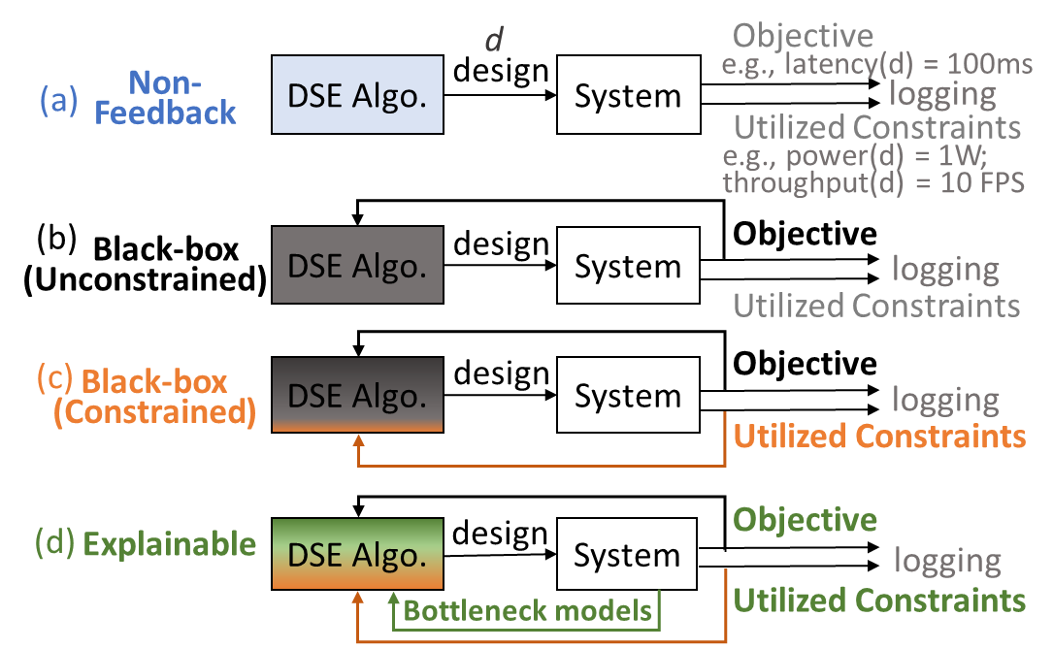
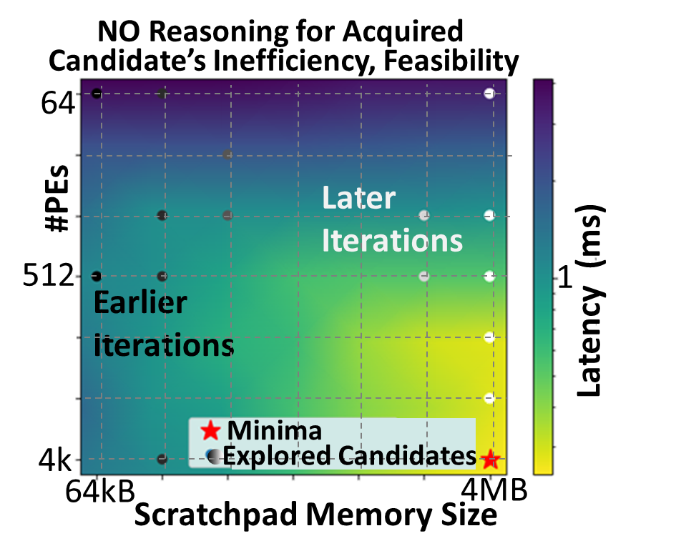
Efficient HW/SW Codesign: Need Explainability
Example: DSE of #PEs and shared memory sizes for ResNet CONV5_2b with HyperMapper 2.0
Related Works
- HyperMapper 2.0 (Bayesian optimization based). Luigi Nardi, David Koeplinger, and Kunle Olukotun. In MASCOTS 2019.
- Confuciux (reinforcement learning). Felix Cao and Tushar Krishna. In MICRO 2020.
- Google FAST. In ASPLOS 2022
E.g., obtained solutions take: - 5x higher latency
- 50x higher search time (days-weeks)
- only 20% of 1000s of sampled iterations are feasible
Black-box or NPU-agnostic DSEs are Non-Explainable:
Process single cost value for a DNN vs. per-layer costs and domain-specific bottleneck model
Can’t reason about why sampled configurations cause higher costs and how to change parameters for addressing underlying design/execution inefficiencies.
Notes:
Existing DSE techniques use black-box optimizations, including evolutionary algorithms or AI approaches like bayesian optimization and reinforcement learning.
These techniques sample some configuration, see what are associated costs like latency, and try to acquire candidates to minimize the objective.
One key challenge is that they may know which trials reduce the objective but they cannot reason about why. They cannot explain why their evaluated configurations cost higher and how to address the underlying inefficiencies.
Without such explainability, they take excessive trials like many thousands of iterations or days, while still obtaining solutions far from the optimal. Because, in a practical exploration budget, you can only afford some thousands of sampling – because space is vast and each evaluation could take some time.
One example is accelerator-specific DSE with Hypermapper version two. It’s a great optimizer based on Bayesian optimization, but it takes a lot of trials, not even closer to efficient subspaces in this mini example. Not just in earlier iterations, but even in the last iterations. And, note this happens even when we have two parameters and a very small space. Even it figures out efficient regions, many of subsequent trials could still be exploring many inefficient regions as there is no reasoning for inefficiencies of the solutions.

Slide 5
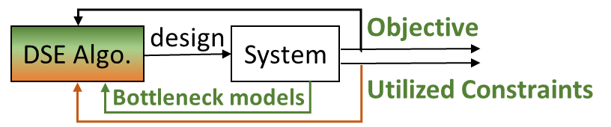
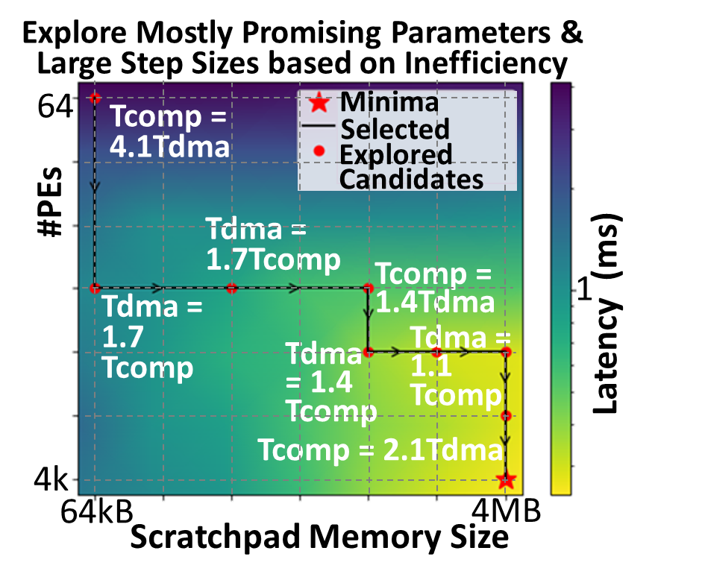
Enabling Explainability Using Bottleneck Analysis
Mini Example: DSE for ResNet CONV5_2b with Explainable-DSE
Leverage Information about Costs to Mitigate Bottlenecks Incurring Inefficiencies
Rich bottleneck models embedding breakdown factors of costs and their mitigations vs. a single latency value.
Per DNN-layer cost value and bottleneck analysis vs. a single latency/energy value for whole DNN.
Bottleneck analysis suggests which parameters need update and what scaling.
Notes:
Now, let’s take a look at how explainability can help. For instance, lets say there are two factors involved in execution latency, compute time and memory access time. Now if we can find that compute time is 4 times larger than communication time, we want to increase number of PEs by at least 4 times. Then, memory access time becomes the bottleneck, and based on data reuse available, we increase the size of the shared scratchpad.
With such reasoning, DSE can likely improve the objective at almost every search-attempt, finding outperforming designs in a fraction of the time. We also provide and embed bottleneck analysis for deep learning acceleration.
So, you can see that there is reduction in latency in almost every attempt, and we move from this high-cost region on top-left to low-cost region on bottom-right.
Our DSE framework leverages domain-specific, execution-related characteristics from domain-specific bottleneck models.

Slide 6
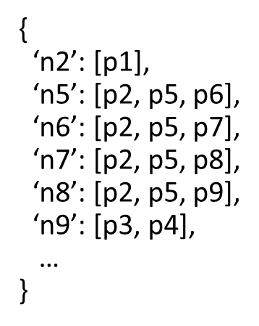
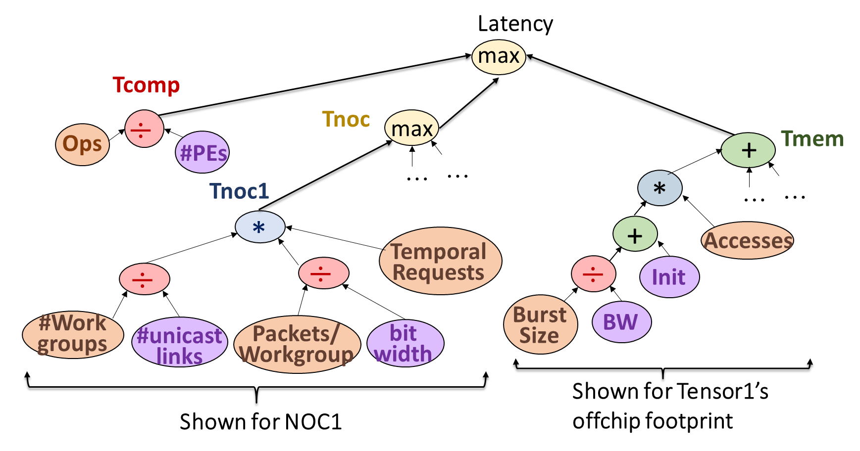
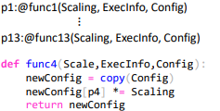
Bottleneck Model – The data structure for Bottleneck Analysis
API for Expressing Domain-Specific Bottleneck Model:
(b) Relationship of Parameters and Bottlenecks
(c) Predicted Values of Parameters based on Required Scaling for Reducing Bottleneck
Simplified Latency Bottleneck Graph for Eyeriss-like DSA
(a) Bottleneck Graph of Cost Function
Notes:
We can enable explainability in the DSE with bottleneck analysis. So, we want to analyze a cost and then find the underlying bottleneck and then address it.
We developed API and data structures, through which our framework can be applied in any domain where designers can express the relationship between the parameters and execution characteristics like compute/bandwidth usage.
We can do this by analyzing bottleneck graphs. So, we can form a graph of cost factors. Root indicates total cost say latency, and child nodes indicate then factors for that, for example, a node can indicate on-chip communication latency, and that in turn, is coming from costs of other nodes, like individual NoCs and their design hyperparameters. Actually, all leaf nodes are design’s hyperparameters or related execution characteristics like data footprint.
Once we apply bottleneck analysis to this cost graph and parse this graph, it informs us about major factors that contribute to the cost. For instance, computation time is 4 times higher than the time to communicate over interconnects. So, it can point to such bottleneck information, and usually also the parameters associated with the bottleneck cost factor. With the required scaling, we can predict the next values of those parameters. It helps us for driving an explainable and systematic DSE.

Slide 7
Outline
How do you create Bottleneck models?
How do you populate Bottleneck models?
How do you use Bottleneck models in DSE?
How do we handle multiple kernels and workloads?
How do we make DSE aware of constraints?
How Bottleneck DSE enables tightly coupled hardware/software codesign?

Slide 8
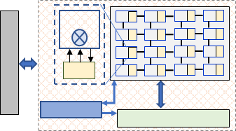
Example: Accelerating ResNet18 Layer
A DNN-18. Unique layers L: 9
FUs
dma
Layer 1: Inputs: 3 x 224 x 224
Weights: 64 x 3 x 7 x 7
Outputs: 64 x 112 x 112 Batch size 1.
Off-chip Memory
L1
PE
collection & distribution NoCs
Controller
L2 Buffer
NPU
NoC for reduction
Example DNN accelerator
Example Design Point
{PEs: 256, L1_size: 128B, L2_size: 64KB, offchip_BW: 51.2GBPS, NoC1_unicast_links: 1, NoC2_unicast_links: 1, NoC3_unicast_links: 64, NoCs_bitwidth: 48b, frequency: 500 MHz}
Example workload
Notes:
This is example of how can we design a bottleneck model for a DNN accelerator.
Suppose we want to process ResNet18 model with nine unique convolution or feed-forward layers. Suppose we want to find accelerator designs for just this first layer.
This is our DNN accelerator architecture. The PE array contains scalar MAC units and each PE has L1 memory, and all PEs share L2 buffer. There are three NOCs for distributing or collecting input and output activations and weights. There is DMA for off-chip accesses. And we can see an example design point.
Let’s say we want to minimize the latency of this layer.

Slide 9
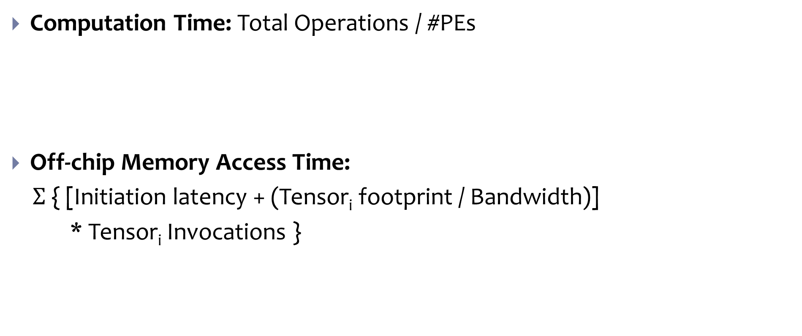


Execution Model and Constructing Bottleneck Graph
Computation Time: Total Operations / #PEs
Off-chip Memory Access Time:
$Σ$ { [Initiation latency + (Tensor_{i} footprint / Bandwidth)]
* Tensor_{i} Invocations }
Tcomp
$$÷$$
Ops
#PEs
+
Tmem
Tdma-1
*
…
…
Tdma-n
+
$$÷$$
Accesses
Init
Initiation Latency
Burst Size
BW
Bandwidth (Bytes/Cycle)
Tensor1 Burst Size (Bytes)
Notes:
Now, to create the bottleneck graph for latency, we need to understand and use the execution model.
Simplistically, the latency can be derived from time spent on computations, memory accesses, and NOC communications. They all are interleaved, and we can take maximum of these three values as overall latency.
Let’s consider them one by one.
Modeling computational time is simplest. Consider total operations and functional units. It is their division.
Off-chip memory access time depends on DMA transfers for each tensor. Given a mapping and obtained data reuse, memory accesses of tensors are several DMA invocations of some burst size. There is DMA latency associated with each invocation, and it is found from this linear equation (initiation latency + burst transfer latency). Burst latency is burst size divided by bandwidth. This one DMA access latency is repetitive for all DMA invocations for accessing a single tensor. The graph shows it also for one tensor – Tensor 1. And we need to add up all such latency for communicating all the tensors between off-chip and on-chip memories.

Slide 10
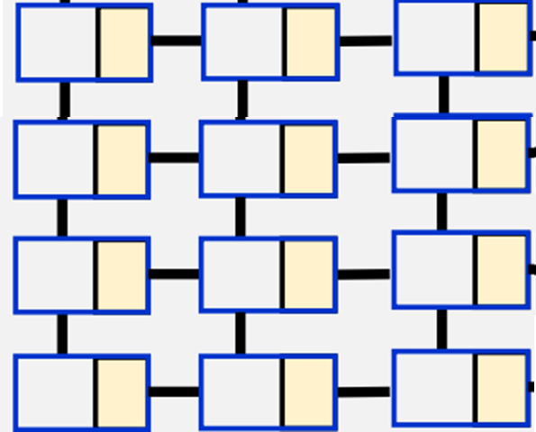


Execution Model and Constructing Bottleneck Graph
Communication Time (NoCs):
Maximum of time taken by an NOC for distribution/collection
Multiplicative of:
Accesses of shared NOC to communicate unique data concurrently via #unicast links to #workgroups that process unique data
Time taken for broadcasting data to each workgroup (based on link bitwidth)
Temporal accesses due to memory hierarchy
Tnoc
max
…
…
Tnoc-1
Tnoc-n
*
$$÷$$
Temporal Requests
$$÷$$
All PEs receive Tensor[0:x]
#Work groups
#unicast links
Source Buffer
NOC: 2 links of width 32bits
Workgroup1
Workgroup2
Packets/ Workgroup
Workgroup3
bit width
Workgroup4
All PEs receive Tensor[3x:4x]
Notes:
The data can be communicated to PEs via one of the NoCs. Typically, multiple PEs in an PE-array form a workgroup and they all process the same data of a tensor, say weights (but different data of some other tensor, say activations). So, the time can be communicated based on link bitwidth and size of data packets to be broadcast to PEs in a workgroup. Now, there can be many workgroups that process different data. This different workgroups need to be provided unique data via different unicast links of the NOC. Now, this is about one pass of communicating data from on-chip buffer to NOC. This is repetitive based on low-level memory hierarchy accesses. So, overall multiplication represents the time taken to communicate a tensor to workgroups over an NOC. Then, there are multiple NOCs that operate in parallel.

Slide 11




Constructing Bottleneck Graph: Putting Altogether
Simplified Latency Graph for DNN Layer Accelerator
Latency
max
Tcomp
$$÷$$
Tnoc
max
+
Tmem
Ops
#PEs
…
…
Tnoc1
*
…
…
*
+
$$÷$$
Temporal Requests
$$÷$$
Accesses
$$÷$$
Init
#Work groups
Burst Size
BW
#unicast links
Packets/ Workgroup
bit width
Shown for Tensor1’s offchip footprint
Shown for NOC1
Notes:
This is overall latency graph that is constructed from the three major cost factors. Total latency is maximum of computational time, NOC time, and off-chip memory access time.

Slide 12

Populating Bottleneck Graph
Example: ResNet18 Layer 1; Same design point as listed previously (DSE attempt #13).
Operators Used In This Bottleneck Graph
Weight DMAs
21.5k
98
Latency (cycles)
Design Parameter
224
452k
1
Tcomp
1054k
20
Execution Characteristic
527k
Tdma
21
689k
Input Act. DMAs
3.2k
Max
1.3k
1054k
32
Mul
118M
Tnoc
70k
102
Add
52
$$\left\lceil \frac{a}{b}\right\rceil$$
165k
224
94k
300k
3
9k
448
23
1054k
7.2k
1
10
224
3
Output Activation DMAs
9k
4
224
16
NoC Accesses for Input Activations
56
2
64
1
56
NoC Accesses for Output Activations
56
1
9
6
NoC Accesses for Weights
Notes:
Now once we have a design point for a loop-kernel (ResNet18 layer 1 of our example), then we can analyze the optimized mapping and the design point, and populate this graph.
You can see that total latency is 1M cycles and it is coming from NOC time.

Slide 13

Analyzing Bottleneck Graph of DL Accelerator
Latency (cycles)
Computational Time
Analyzing ResNet18 Layer1:
Communicating input tensors takes 2X more latency than other interleaved factors
Solution 1: Increase NoC bit-width by 2X
Solution 2: Increase NoC1 unicasting capability by 2X
Solution 3: Increase L1 buffer size (in PEs) for leveraging unexploited reuse
1054k
DMA Time
527k
689k
3
Tnoc1
1054k
Temporal Requests
per
Group
NOC Time
1054k
9k
Tnoc3
Tnoc2
94k
300k
1
56
2
9k
1
10
448
224
56
1
56
2
#Work Groups
9
4
224
3
64
1
#Unicast Links
#Bytes- per-Packet
NoC2
NoC3
16
2
NoC1
3
6
1
Bit-Width for all NoCs (in Bytes)
Max
Mul
Values shown for the solution at acquisition attempt 13
Add
$$\left\lceil \frac{a}{b}\right\rceil$$
Bottleneck Path
Notes:
Now lets analyze the bottleneck.
You can see that total latency is 1M cycles and it is coming from NOC time, and specifically from NOC1.
Suppose we want to scale down NOC latency by 2X to match the computational time.
Now, there are three ways to do this, and we could find it out by traversing this bottleneck graph.
One option is to reduce this factor of 2 (red node) by 2, which is essentially increasing bitwidth of links by 2X, so that all data can be communicated within workgroups in one shot (9 bytes at a time).
Another option is to increase unicast links by 2X. There are 56 workgroups that timeshare a single unicast link. We can double it so time sharing of NOCs is cut by half.
Last option is to reduce the off-chip memory accesses by more data reuse. So, there are 9k temporal requests for each workgroup and we could cut it by half by increasing L1 memory in PEs and exploiting more data reuse.

Slide 14
Using Bottleneck Mitigation in DSE
New parameter values of candidates correspond to bottleneck mitigation
These selected candidates are evaluated to find the next best design
Current Design
{PEs: 256, L1_size: 128B, L2_size: 64KB, offchip_BW: 51.2GBPS, NoC1_unicast_links: 1, NoC2_unicast_links: 1, NoC3_unicast_links: 64, NoCs_bitwidth: 48b, frequency: 500 MHz}
Candidate1
{PEs: 256, L1_size: 256B, L2_size: 64KB, offchip_BW: 51.2GBPS, NoC1_unicast_links: 1, NoC2_unicast_links: 1, NoC3_unicast_links: 64, NoCs_bitwidth: 48b, frequency: 500 MHz}
Candidate2
{PEs: 256, L1_size: 128B, L2_size: 64KB, offchip_BW: 51.2GBPS, NoC1_unicast_links: 2, NoC2_unicast_links: 1, NoC3_unicast_links: 64, NoCs_bitwidth: 48b, frequency: 500 MHz}
Candidate3
{PEs: 256, L1_size: 128B, L2_size: 64KB, offchip_BW: 51.2GBPS, NoC1_unicast_links: 1, NoC2_unicast_links: 1, NoC3_unicast_links: 64, NoCs_bitwidth: 80b, frequency: 500 MHz}
Candidate# | Objective
1 | 26
2 | 23
3 | 41
New Solution
Notes:
We came up with three options to modify the current design. We can modify the current design point with one mitigation at a time, and corresponding to these three options, there are three new design candidates.
Then we can acquire them and evaluate them and find the best one. (Let’s not worry about design constraints at the moment.)
For instance, candidate 2 reduces objective the most, and it becomes the new design solution, and we analyze its execution for the bottleneck.

Slide 15
Outline
How do you create Bottleneck models?
How do you populate Bottleneck models?
How do you use Bottleneck models in DSE?
How do we handle multiple kernels and workloads?
How do we make DSE aware of constraints?
How Bottleneck DSE enables tightly coupled hardware/software codesign?

Slide 16
Need to Find Single Efficient Solution for Multi-Functionality
Current DSE approaches work for single loop-kernel/workload
Use single cost value for objective minimization or constraints checking
Find solutions for each loop-kernel or workload and then choose the solution that is better overall – finds inefficient design as compared to searching single solution.
Need for mitigating bottlenecks in multiple-kernel/workload executions
Need to analyze costs of each loop-kernel and workload individually, as applying bottleneck analysis on collective value is least useful.
Workloads can have many loop kernels with diverse execution characteristics; their bottleneck mitigations can lead to many design parameters and multiple values of single parameter.
Notes:
Our framework generalizes bottleneck-based DSE to multi-workload cases and aggregates bottleneck mitigations.
Applications can use multiple DNNs and they can have many loop-nests that significantly differ in execution characteristics, so analyzing the total execution costs for whole DNN could not be useful. Therefore, our DSE analyzes costs of each loop-kernel in each workload and find out their bottlenecks.

Slide 17
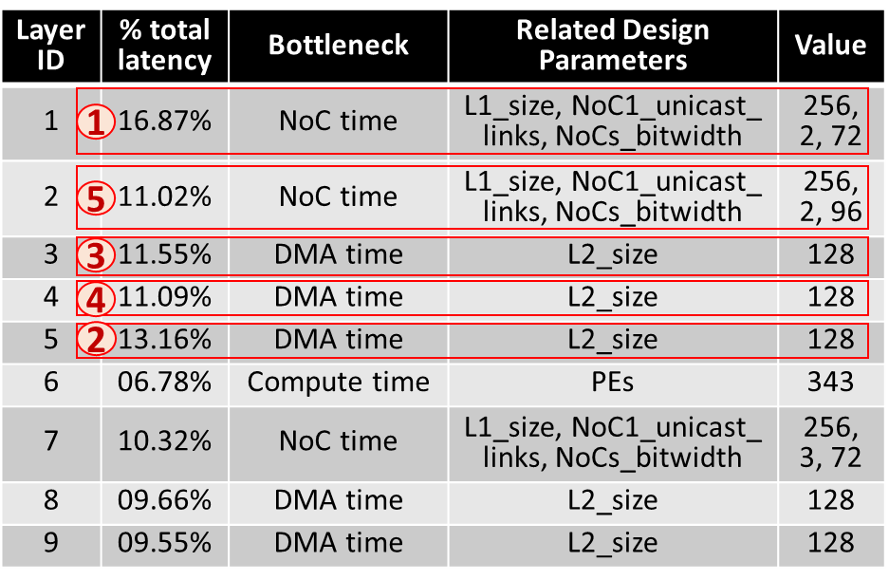

Mitigating Bottlenecks for Multiple Kernels/Workloads
Need to mitigate diverse bottlenecks in executing several DNN layers
Different DNNs and their layers have diverse execution characteristics; there can be many candidates for bottleneck mitigations (e.g., for a 1000-layer DNN)
Not all kernels/workloads are equally important for total execution cost.
Filter out candidates by considering execution criticality
Consider estimations for bottlenecks of Top-K layers (total L layers) that contribute to at last %threshold of the total cost. Set K=5, threshold=$\frac{1}{2}×\frac{1}{L}×$100%.
Before: 7 candidates for next attempt
After: 5 candidates for next attempt
Notes:
Our DSE goes to the costs of all functionality – like each nested loop or a DNN layer, and then, applies bottleneck analysis individually. Now, the challenge is that now there are different sets of parameters to try, and even more than one value of a parameter to try. If there are 1000s of layers, there can be many parameters to change for bottleneck mitigations, and there can be many values of each parameter. So, DSE does systematic aggregation of the feedback from the bottleneck analysis. For simplicity, it considers bottlenecks for only execution-critical layers, so only effective configurations remain.

Slide 18



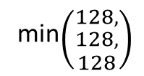
Aggregating Multiple Bottleneck Mitigations
Diverse execution characteristics of kernels/workloads lead to drastically different values of bottleneck mitigating parameter.
Need to aggregate mitigations
Going by larger value could miss range of values and too aggressive/greedy
Conservatively select values (e.g., minimum of possible predictions)
Layer ID | Bottleneck | Related Design Parameters | Value
1 | NoC time | L1_size, NoC1_unicast_ links, NoCs_bitwidth | 256, 2, 72
2 | NoC time | L1_size, NoC1_unicast_ links, NoCs_bitwidth | 256, 2, 96
3 | DMA time | L2_size | 128
4 | DMA time | L2_size | 128
5 | DMA time | L2_size | 128
NOC1_ unicast_ links
NOCs_ bitwidth
L1_size
L2_size
min$\left({256, \atop 256}\right)$
min$\left({128, \atop \begin{aligned}128, \\ 128\end{aligned}}\right)$
min$\left({2, \atop 2}\right)$
min$\left({72, \atop 96}\right)$
= 256
= 128
= 2
= 72
Aggregating Predictions for Bottlenecks in Multi-Functional Workload Executions
Notes:
Even after focusing on execution-critical functions that need bottleneck alleviation, there can be multiple new values to try for the same design parameter. So, for limiting the candidates, our DSE aggregates these values through the “minimum” function. By taking minimum of possible values, it could move forward conservatively, but still prune the candidates to be acquired.

Slide 19
Outline
How do you create Bottleneck models?
How do you populate Bottleneck models?
How do you use Bottleneck models in DSE?
How do we handle multiple kernels and workloads?
How do we make DSE aware of constraints?
How Bottleneck DSE enables tightly coupled hardware/software codesign?

Slide 20
Strive for Finding Feasible Sub-Spaces
Almost all black-box DSEs keep minimizing objective, even when constraints are not met.
If constraints are unmet, explore solutions that meet most constraints and have higher unused budget of constraints.
Most of the acquired solutions turn out to be feasible.
E.g., 90% vs. 20% of acquired designs.
Budget: Cost X’s Value ÷ Constraint X’s Value
A Constraint is Met When Budget <= 1
X: Don’t Care about Objective
Check Utilized Budgets of Constraints
Candidate# | Obj. | Constr1 | Constr2 | Constr3 | Average | # Met
1 | X | 1.719 | 0.104 | 0.196 | 0.673 | 2/3
2 | X | 1.592 | 0.097 | 0.171 | 0.620 | 2/3
3 | X | 1.485 | 0.081 | 0.168 | 0.578 | 2/3
4 | X | 1.889 | 0.091 | 0.172 | 0.717 | 2/3
New Solution
Notes:
Additional unique feature of our DSE is that it strives to meet the constraints instead of blindly reducing costs. So, in making design decisions, like selecting the best solution from several candidates evaluated, DSE first checks what is the configuration that meets all constraints. So, it attempts to meet constraints first. Once a valid solution is found, optimization likely explores among valid subspaces, and it will always have a valid solution up to termination.

Slide 21
Updating New Solutions with Constraints-Awareness
Acquire/Update Solutions based on Constraints-Utilization
If all evaluated candidates are valid, select the one that is lower-objective, but while using the least budget of constraints.
Also helps avoiding greedy chasing after objective minimization.
Budget: Cost X’s Value ÷ Constraint X’s Value
Candidate# | Obj. | Average Constr. Budget | Obj. x Constr. Budget
1 | 15.7 | 0.58 | 9.20
2 | 15.2 | 0.54 | 8.14
3 | 15.8 | 0.42 | 6.63
4 | 38.3 | 0.42 | 16.23
Check for Low Value of Objective at Low Constraints-Budget
New Solution
Notes:
Among evaluated designs, suppose several or all candidates meet all the constraints. Then, the DSE does not just pick the one that minimizes the objective the most, but rather checks what is the configuration that reduces objective but with the least budget utilized for constraints. This way, there can be possibility for further optimization without quickly exhausting the resource budgets.
And, in results, we would see how constraints awareness help DSE to get more feasible solutions and have higher chances for finding efficient solutions quickly.

Slide 22
Outline
How do you create Bottleneck models?
How do you populate Bottleneck models?
How do you use Bottleneck models in DSE?
How do we handle multiple kernels and workloads?
How do we make DSE aware of constraints?
How Bottleneck DSE enables tightly coupled hardware/software codesign?

Slide 23
Tightly Coupled Hardware/Software Codesign
Fixing hardware/software design schema and exploring configurations of just either hardware or software [Confuciux, MICRO’20]
Isolated optimization of hardware and software configurations [HyperMapper2, MASCOTS’19, DiGamma, DATE22]
Optimize upon new bottleneck in hardware/software counterpart => Tightly coupled codesign
HW Design Optimizer
Efficient yet Fixed Dataflow Mapping (X-Stationary)
Generated HW incompatible with needs of chosen mapping style (e.g., insufficient on-chip bandwidth to unicast data as per mapping)
HW Design Optimizer
Mapping Optimizer
Generated HW incompatible/inefficient for explored mappings. Next HW design does not consider previous mapping optimization.
Joint Co-Optimizer for HW Design + Mapping
Co-generated HW/mappings incompatible/inefficient with each other.
HW Design Optimizer
Mapping Optimizer
Mappings optimize execution on the new design. Next HW design alleviate inefficiencies in execution of optimized mapping.

Notes:
Agile exploration of efficient and feasible solutions require tightly coupled hardware/software codesign.
Previous approaches, especially for DNN accelerator explorations, follow loosely coupled codesign. For instance, most approaches cant afford very large search times, so they fix mapping schema and only optimize hardware configurations. But our evaluations show that their trials could generate designs that are incompatible with mapping needs.
Better approach is also optimizing the mapping. But these optimizations are in isolation, in a sense that there is no feedback loop. So once a hardware design is found and mappings are optimized for it, there is no guarantee that the next generated hardware designs would consider inefficiencies in execution that previous mapping optimization achieved. So, resultant generated designs can still be inefficient and need many trials.
There are some approaches for collectively generating both hardware and mapping configurations at the same time, but this can be very time consuming, and it still have the same problem of isolated optimization.
Now, when we use bottleneck analysis, it makes a feedback loop. DSE generates hardware design points and mappings are optimized for each of them. Then, the best working design is found as a new design, and before generating next set of hardware design candidates, the bottlenecks in executions of the optimized mapping of the selected hardware design is found. This feedback drives the DSE and thus is a tightly coupled hardware/software codesign. Here, mappings are optimized for a hardware design, and hardware design is optimized in turn, alleviating inefficiencies in execution of optimized mapping.
This helps achieving not just compatible hardware-mapping configurations, but also efficient ones, and quickly.

Slide 24
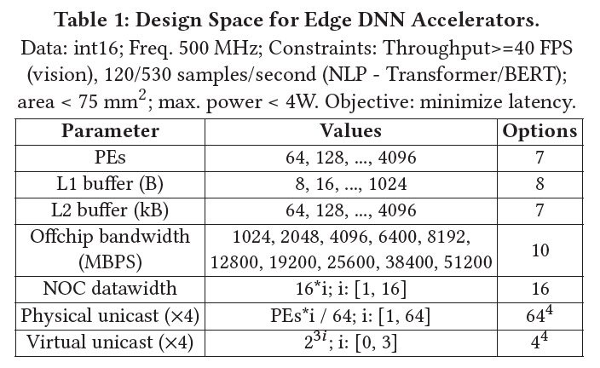
Experimental Methodology
Design Space
HW: Edge Accelerators (Table)
SW: Optimizing Mappings of DNNs on a HW
Fixed: Output stationary
Codesign: Holistic mapping optimizations through dMazeRunner [ESWEEK 2019] or Timeloop-like black-box DSE (random search)
Workloads
Computer Vision: EfficientNets, MobileNetV3, YOLOv5
Language Models: Transformer, BERT, ASR
Techniques
Explainable-DSE vs. Grid Search , Random Search, Bayesian Optimization, Constrained Reinforcement Learning, Genetic Algorithm, Simulated Annealing.
vs. DSEs for Accelerators – HyperMapper 2.0, Confuciux.
Estimates of Costs (Cost Functions)
Latency, Energy: dMazeRunner [ESWEEK 2019]
Area, Power: Accelergy [ICCAD 2019]
Exploration Budget
Static: 2500 iterations (total candidates)
Dynamic: 100 iterations (total candidates)
Notes:
This is our experimental setup for designing edge DNN accelerators.
Hardware space contains not just computational or memory parameters, but also NoC parameters like links, bit-widths, and time-shared communication within workgroups. For software space, previous techniques used fixed dataflow – so we evaluate them with the optimized output stationary dataflow. Then, for our codesign, we use our holistic mapping optimizer – the maze runner. It makes a comprehensive mapping space formulation, and it can help find the best mappings in seconds.
We compare the effectiveness of Explainable DSE against Grid Search, Random Search, Bayesian Optimization, Constrained Reinforcement Learning, Genetic Algorithm, and Simulated Annealing. We also compare against accelerator-specific DSEs of Hypermapper two and Confuciux.
We use fixed mapping schema for output stationary and compare all techniques.
Then we take two best performing techniques – random search and hypermapper for codesign and use them for hardware generation, with nvidia’s Timeloop-like random search as mapping optimizer.

Slide 25
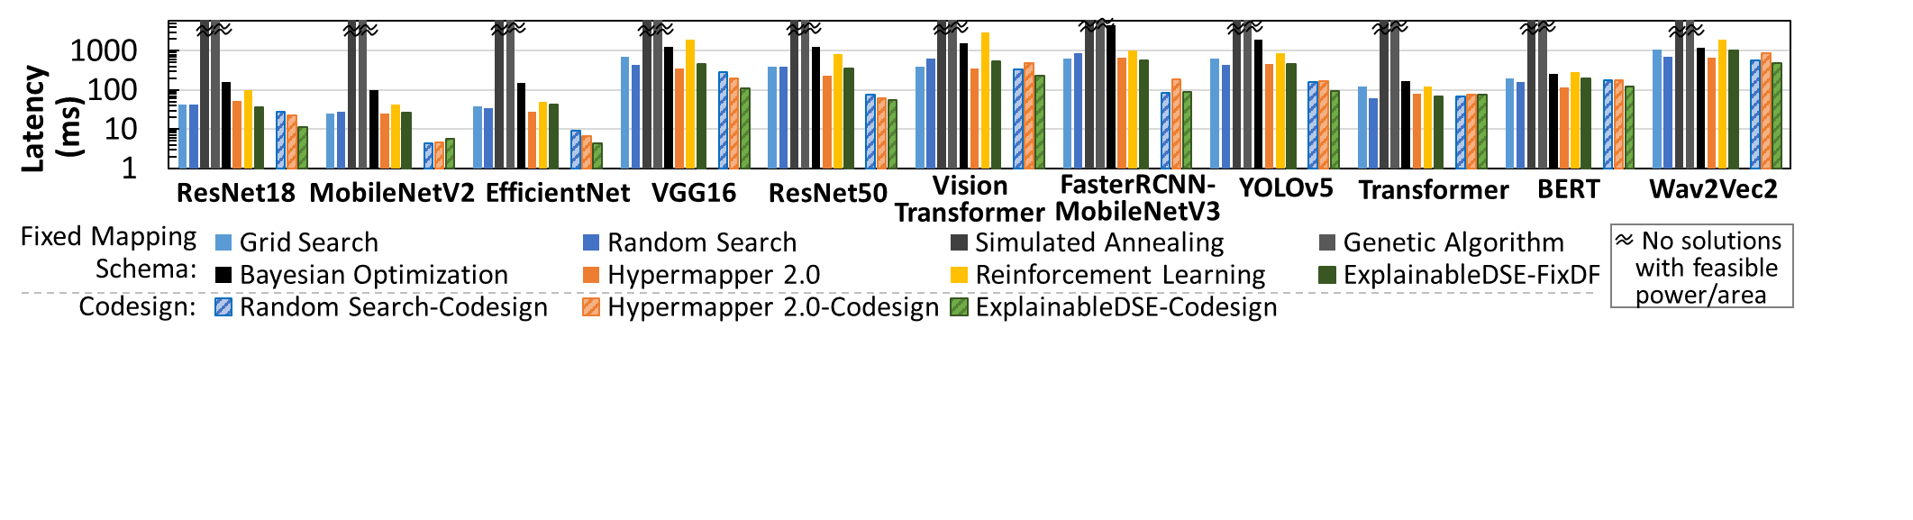
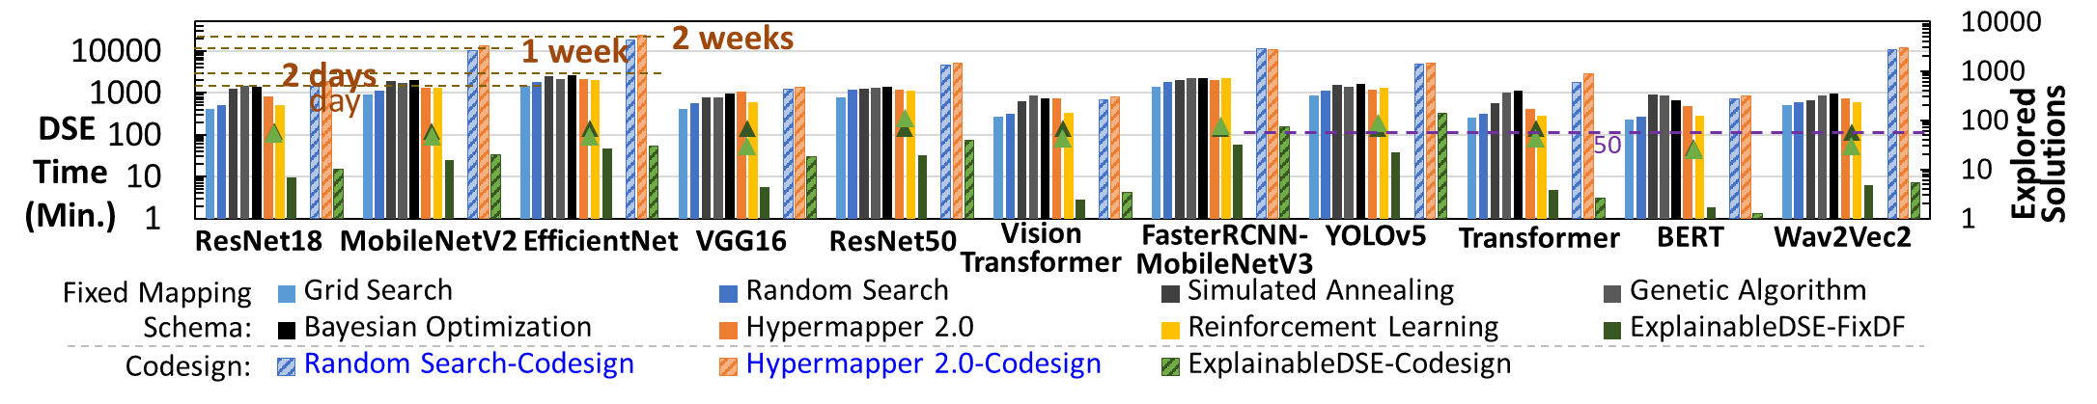
Efficient HW/SW Codesigns Explored in Minutes
For designing edge DNN accelerators, finds ~6X low latency edge DNN accelerators in 47X less iterations (minutes vs. days--weeks; 36X lower search time)
Notes:
For designing edge AI accelerators, here are key results.
With bottlenecks-mitigation, the exploration achieves 6 times low latency solutions under constraint budgets than all previous DSEs, and takes minutes or 36 times less time.
This is because, it reasons about inefficiencies in high costs; Reduce costs at every DSE iteration.
Obtained codesigns outperform off-the-shelf edge accelerators like edge TPU or Eyeriss by up to order of magnitude in area-efficiency and several-fold higher energy-efficiency.
The DSE is compiler-aware, so there is tightly coupled hardware/software codesign, and obtained hardware solutions work in tandem with mapping optimizations. The compiler-aware codesign helps achieving efficient solutions because objective is reduced by mapping optimizations without exhausting any additional hardware resources or constraints. So there is more room left for constraints budget and overall reduction in objective is large.
Note that the time taken for codesign in Explainable-DSE is relatively small as compared to using fixed mapping schema ( 3× on average, from 21 minutes to 64 minutes). In fact, for all but heavy object detection models, the DSE time increased from 16 minutes to only 26 minutes. This is because of fast mapping optimizations by our dMazeRunner infrastructure (in seconds) and also using bottleneck analysis on efficient mappings required up to 1.9X fewer DSE iterations.
The codesigns obtained by Explainable-DSE were 1.6X better (low latency) than black-box codesigns, while consuming 103×less search time. Instead of an hour or a day, black-box codesigns took 7-16 days for four workloads!!!
(The codesigns obtained by Explainable-DSE were 4.2X better than using fixed mapping schema in Explainable-DSE. )

Slide 26
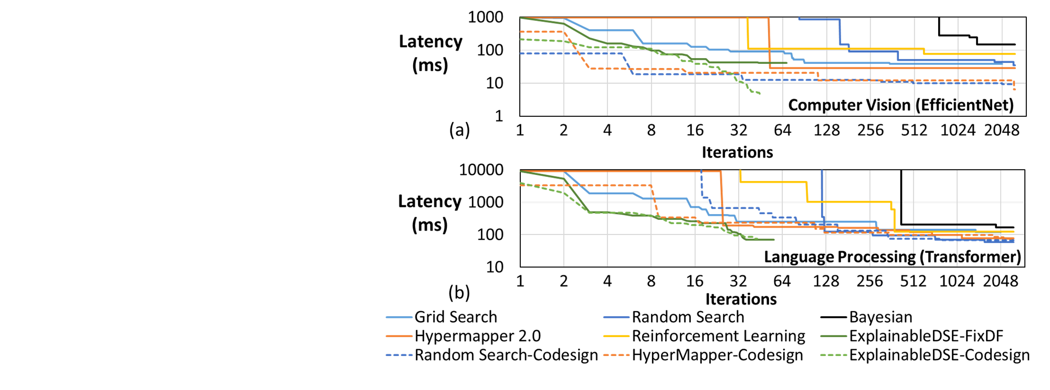
Quick/Consistent Objective Reduction Over Iterations
At every acquisition, Explainable-DSE reduces objective by 30% vs ~1% by non-explainable DSEs
Notes:
The main reason behind getting efficient design quickly is using the bottleneck analysis and doing explainable and systematic design exploration. Overall, at every attempt, Explainable-DSE reduced the values of objective for feasible acquisitions by
geomean 1.30×, as compared to merely 1% in thousands of trials in black-box DSEs.
See difference in sloppy line (consistently decreasing) vs. flattened stages (decrease after very long intervals)
sloppy line terminate 50X faster than flattened stages

Slide 27
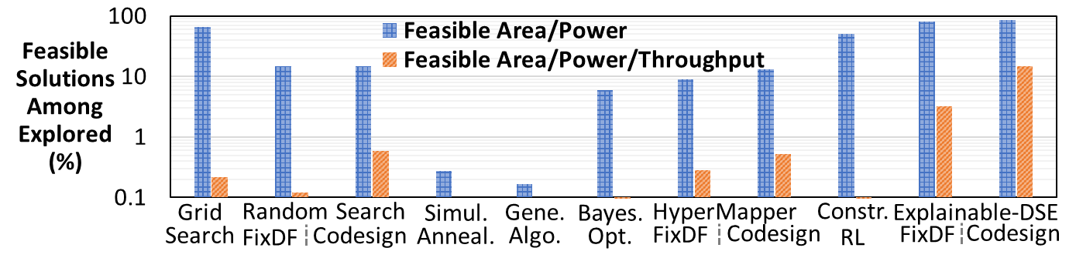
Constraints-Aware DSE Majorly Explores Feasible Solutions
FixDF
FixDF
FixDF
FixDF
FixDF
Most acquisitions by Explainable-DSE met area and power constraints (~90%), as compared to non-explainable techniques (~20% on average; 50% for constrained RL).
Solutions obtained by all but Explainable-DSE mostly did not meet tight throughput requirements (~15% vs. < 1%).
Notes:
By Considering the Utilization of Constraints, DSE Mostly Focuses on Feasible Solutions
Non-explainable approaches, e.g., with Genetic Algorithm or Bayesian Optimization, did not know which configurations could likely lead to feasible subspaces. Therefore, even after exploration over days, they almost did not obtain a single feasible solution. When considering only area and power constraints, feasibility of explored solutions was higher for mostly all techniques, e.g., 15% for the random search and 50% for constraints-aware reinforcement learning.
However, when considering throughput requirement for inference, the feasibility of the explored solutions was barely ∼0.1%–0.3%. Although black-box codesigns improved feasibility by 2×-5×, but the overall feasibility was still ∼0.6%. Such low
feasibility for DSE in humongous space is presumably caused due to DSEs not accommodating constraints during exploration
and bottlenecks-unaware acquisition trials. Contrarily, Explainable-DSE prioritized to meet the constraints for its acquisitions and update of the best solutions, which helped avoid infeasible subspaces. Plus, addressing bottlenecks in executions helped acquiring high-performance solutions. Hence, 87% and 15% of solutions explored by Explainable-DSE codesigns were feasible when considering area and power constraints and all the three constraints, respectively. For DNNs like BERT and MobileNetV2, 89%–98% of the explored solutions met area and power constraints.

Slide 28
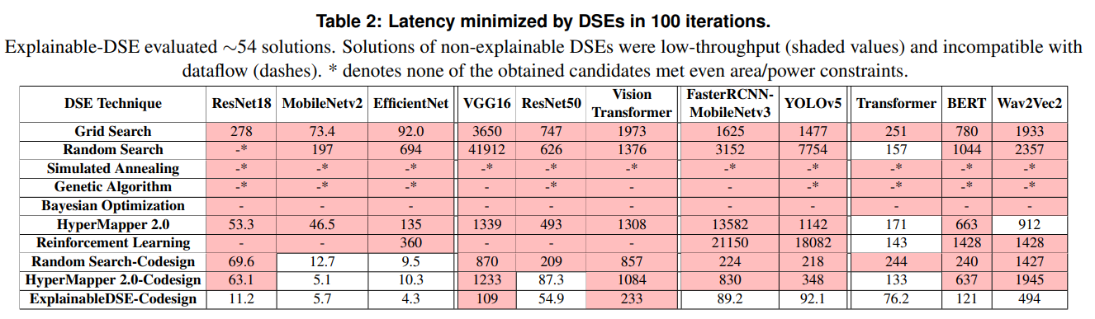
Runtime DSE Capabilities
Notes:
This slide shows the capabilities of DSE approaches for doing runtime exploration. In 100 iterations budget, previous approaches may not find even a valid solution that meets even area or power constraints (See * in simulated annealing, genetic algorithm, or random search). That’s because, they are constraint-unaware in decision making.
Then, when using a fixed mapping schema, trials of almost all techniques generated invalid hardware configurations that are incompatible with the mapping schema (see -).
For codesigns with black-box DSEs, they were valid but inefficient as compared to real-world needs (see shaded cells).
Explainable DSE achieved orders of magnitude efficient solutions.
Because Explainable DSE improved objective at every iteration, it could find the best solution after evaluating just a few tens of candidates.
Such agile exploration enables dynamic design optimization, which is crucial for the runtime deployment of DNN models and for emerging applications like resource scheduling smart-city applications on wide-scale reconfigurable infrastructure.

Slide 29
Conclusions: Know what designs you explore and why!
Black-box DSE cannot explain why solutions incur high costs and underlying inefficiencies or goodness of potential configurations to try.
Explainability can be enabled with bottleneck analysis of costs and gray-box estimations for improving the costs.
Proposed API allows embedding domain-specific bottleneck models for a highly effective and systematic DSE.
The DSE addresses diverse bottlenecks in multi-workload executions by aggregating mitigation predictions.
Compiler-aware DSE can enable tightly coupled HW/SW codesign.
Explainable-DSE with bottleneck mitigations helps find even an order of magnitude efficient solutions at runtime (minutes vs. days– weeks).
Notes:
(We plan to put full paper on arXiv soon)

