Slide 1








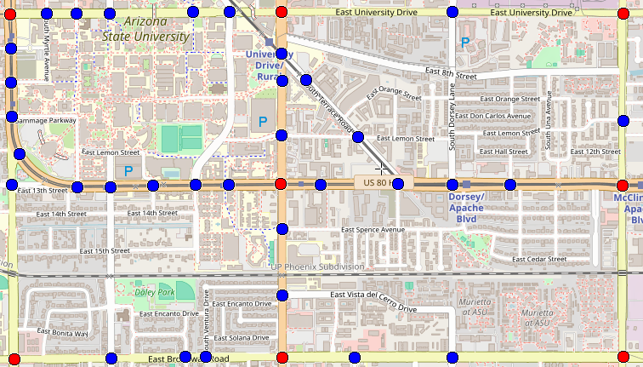
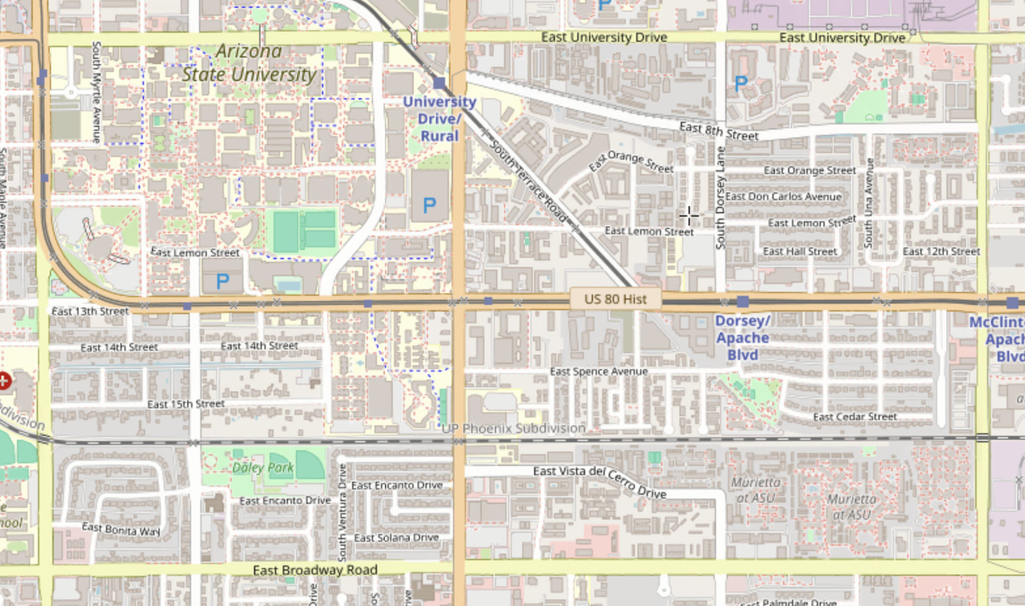
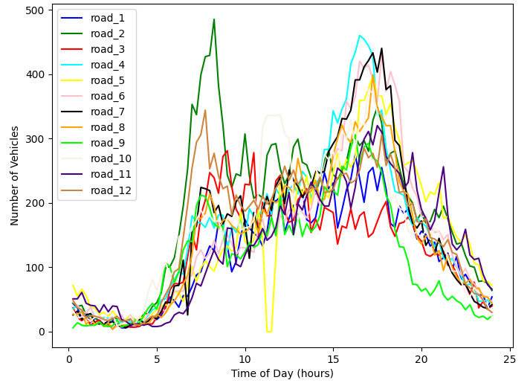
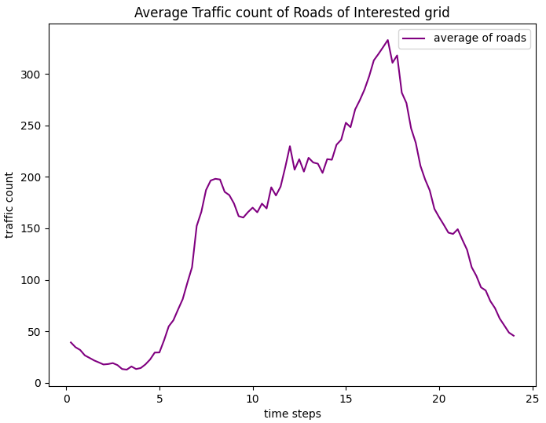
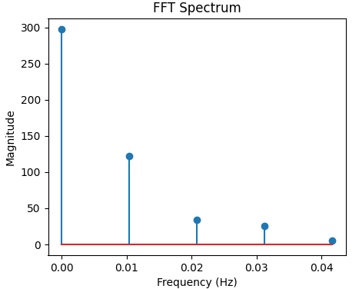
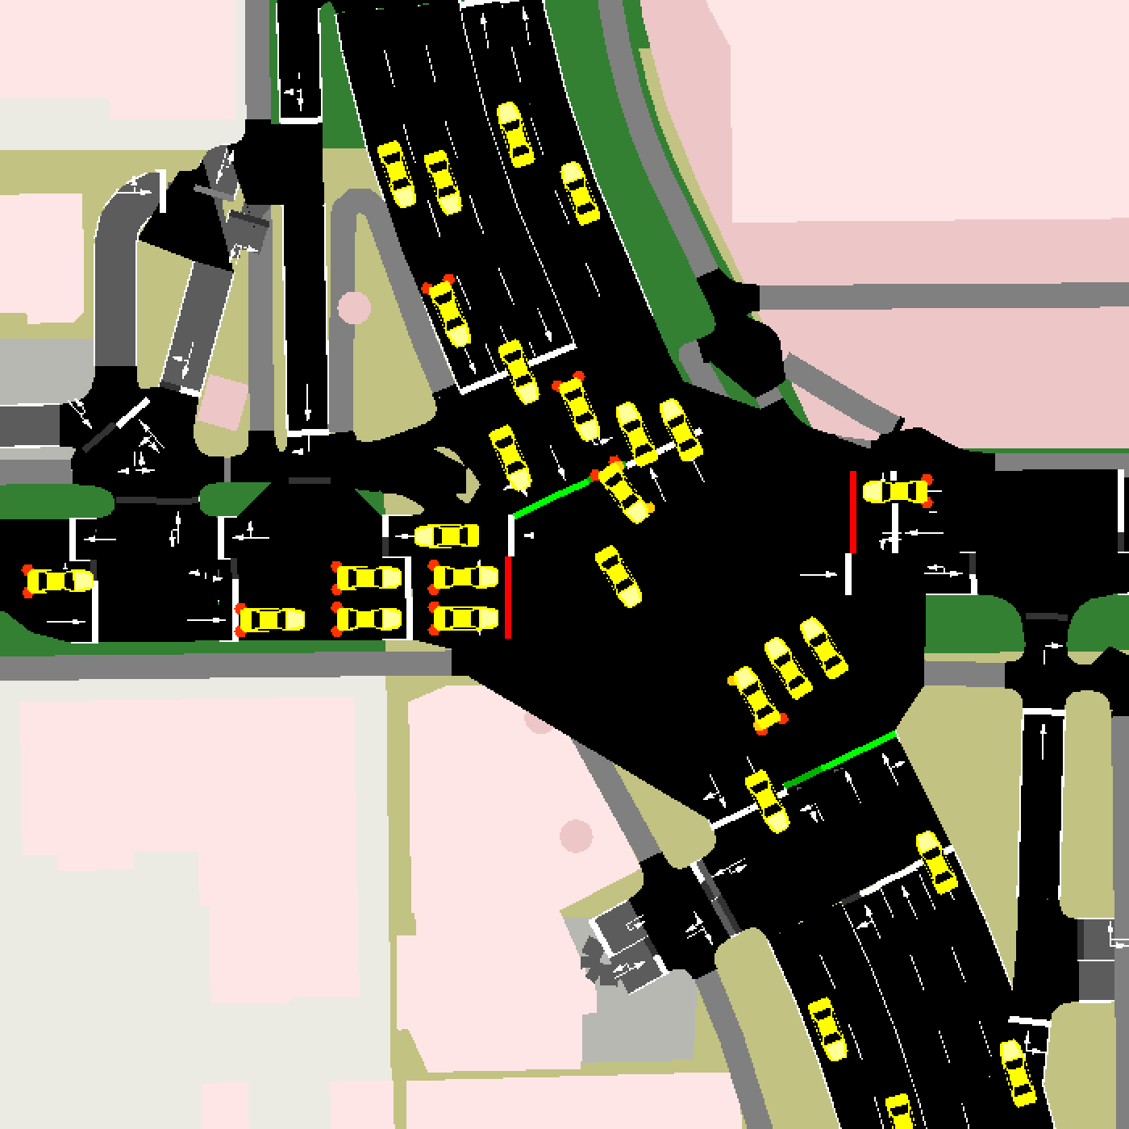
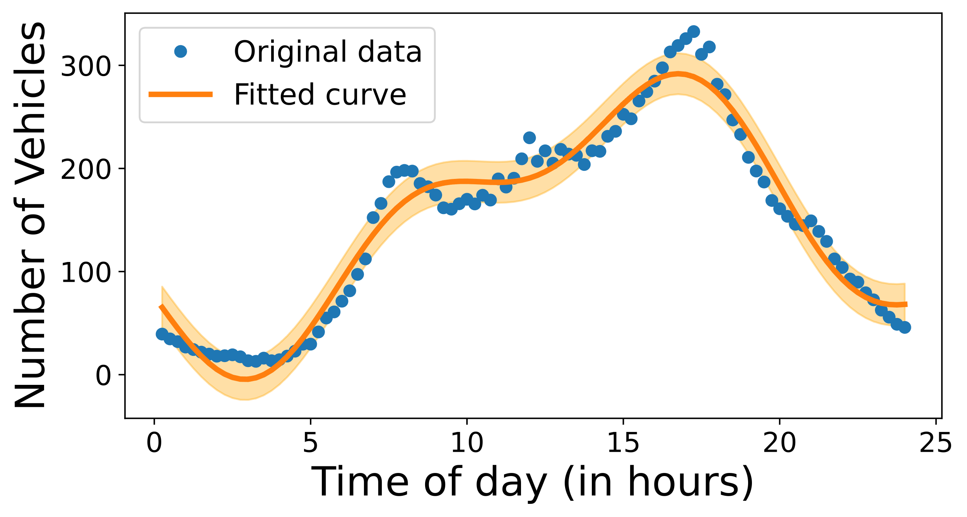
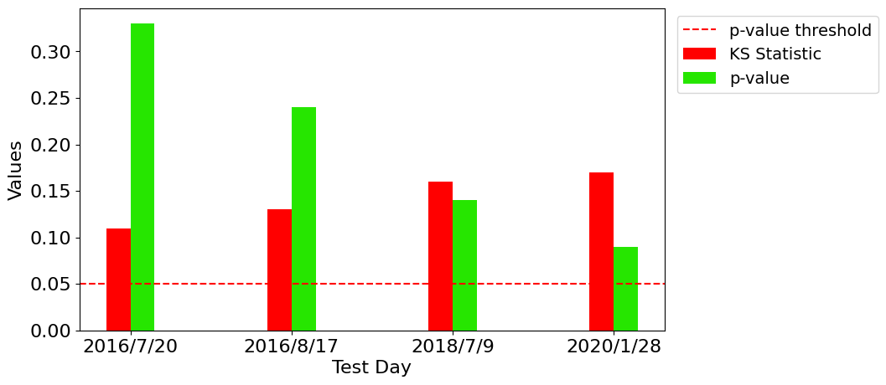
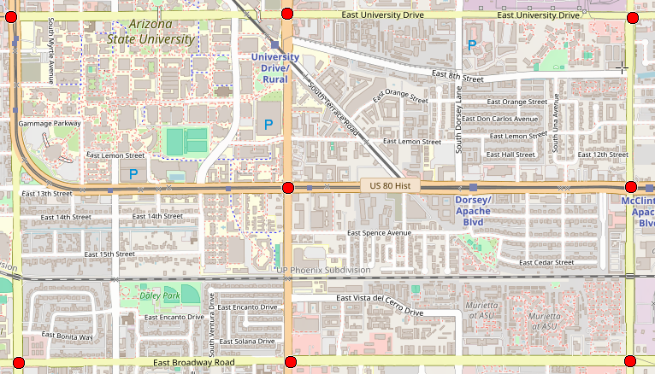
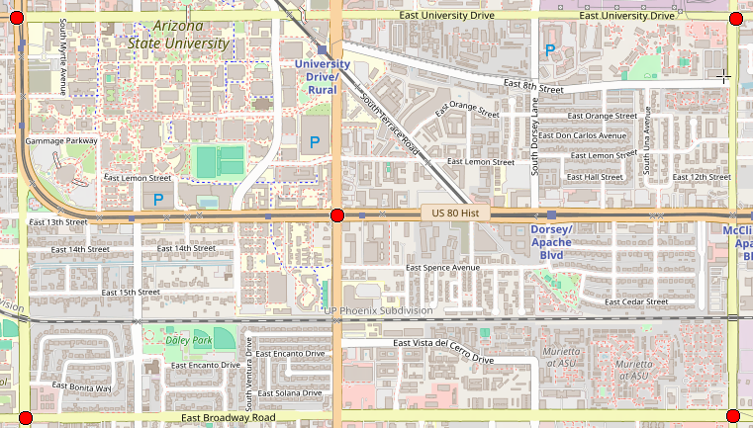
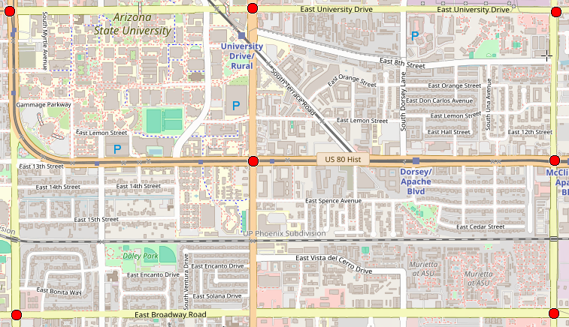
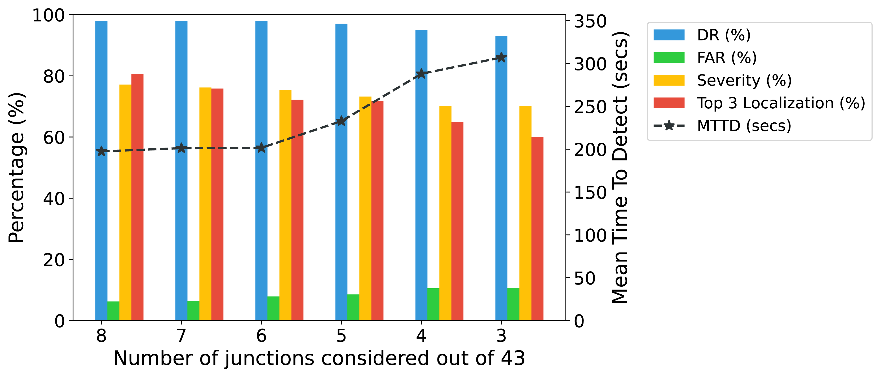
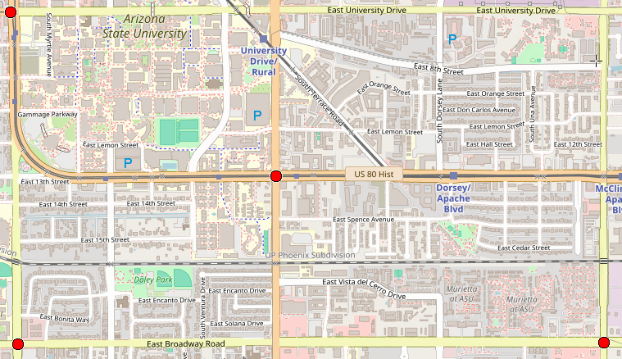
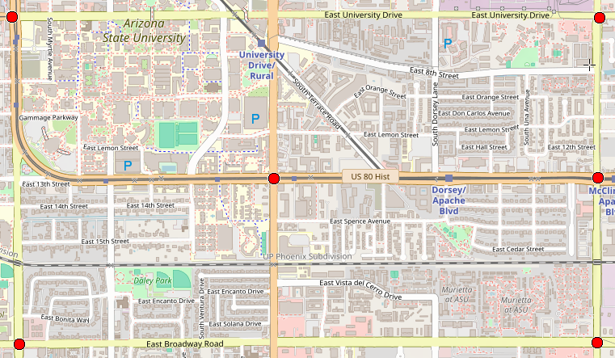
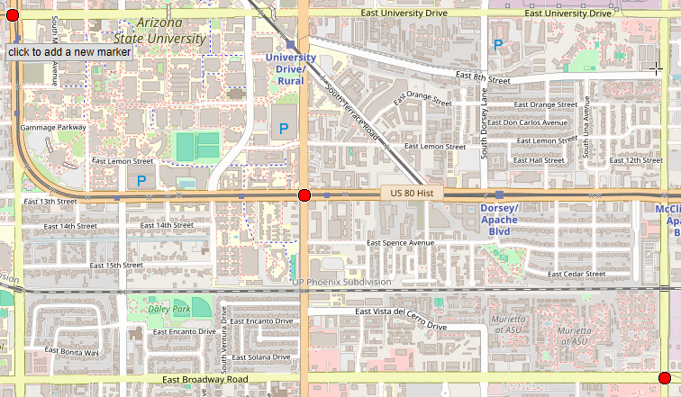

IncidentNet: Traffic Incident Detection, Localization, and Severity Estimation with Sparse Sensing
Sai Shashank Peddiraju*, Kaustubh Harapanahalli*, Edward Andert, Aviral Shrivastava
* - indicates equal contributions
Motivation and Introduction
Previous Works
Traffic incidents cause significant congestion, delays, and accidents, leading to millions of events annually.
Previous Works | Region | Dataset | Sensor Modality | Model | Approach | Limitations
Chen et al.^{[1]} | Highway | Macroscopic | Inductive Loop Detectors | XGBoost | Trained on data from upstream and downstream traffic detectors | Requires data from consecutive detectors
Bao et al.^{[2]} | Highway | Microscopic | Traffic Cameras | YOLOv3 | Detects incidents based on vehicle speed by tracking vehicles in the camera’s field of view | Can detect incidents only in field-of-view
Han et al.^{[3]} | Urban | Microscopic | GPS probes | Clustering | Detects incidents by matching real-time GPS speed vectors with historical incident patterns | Affected by noise and interference and mandates the installation of a GPS probe in every vehicle
Yang et al.^{[4]} | Urban | Macroscopic | Inductive Loop Detectors | Deep Learning | Detects incidents using deep-learning network to detect incidents | Uses Simplistic simulation which does not model real city traffic
Zhu et al.^{[5]} | Urban | Macroscopic | Inductive Loop Detectors | Custom CNN | Detects incidents based on constructed a connectivity matrix of sensors | Uses only traffic counts for detecting incidents
IncidentNet | Urban Highways | Microscopic | Traffic Cameras | XGBoost TabNet | Used Tabular ML models to detect incidents from data derived from microscopic traffic data | -
Traffic Incident Categories
Impact of Traffic Accident
Broader Issues of Traffic Incidents
Cargo Spills
Stalled Vehicles
28 million incidents, costing of $340 Billion^{[1]}
Emergency response delayed by 5-minutes, increasing fatality rate by 46% ^{[2]}
Delayed emergency
services
Traffic Incidents
Traffic Accidents
Road Maintenance
Traffic Accidents
Commuter’s safety
Emergency response under 7-minutes, decreasing fatality rate by 58% ^{[2]}
Traffic congestion
Current incident detection models primarily focus on highway scenarios, relying on macroscopic data from sensors like inductive loops, which lack the detail needed for urban environments.
Common limitations:
Heavy dependence on thresholds and predefined traffic patterns.
Public datasets like PEMS and I-880 provide only macroscopic traffic data (average speed, flow rate) from highways, making them unsuitable for detailed urban traffic incident detection.
Challenges:
Non-availability of microscopic datasets for urban environments.
Sensor networks often experience failures (e.g., 25% of NYC sensors are non-functional), reducing the effectiveness of existing methods.
IncidentNet is a deep learning framework designed to:
Detect, localize, and estimate the severity of traffic incidents.
Operate effectively with sparse sensor data in urban regions.
Leverages microscopic traffic simulations to provide highly accurate incident detection with 20% sensor coverage.
IncidentNet offers fast, reliable, and cost-effective solutions for urban traffic management, enhancing emergency response and reducing fatalities.
Microscopic Traffic Dataset Generation
Methodology
Traffic Incident Detection, Localization, and Severity Estimation
Traffic Flow Simulation
Feature Extraction:
Travel times between intersections, vehicle counts, and average speeds are computed and integrated into the dataset.
Outliers and noise are reduced using a rolling window average to smooth the data.
Model Selection:
TabNet model architecture is used because it can handle missing data and perform interpretable feature learning due to its unique attention mechanism.
IncidentNet is an ensemble model with dedicated sub-models for detection, localization, and severity estimation.
IncidentNet Architecture:
Incident Detection Model: Detects whether an incident has occurred across the urban region.
Incident Localization Model: Predicts the road segment where the incident occurred.
Severity Estimation Model: Classifies the incident’s severity (minor or severe).
Advantages:
Robust to sparse sensor placement, working with as low as 20% coverage of intersections.
Capable of real-time detection, operating with microscopic traffic data from urban intersections.
Microscopic data is essential for detecting incidents in urban environments with complex traffic dynamics.
Plot of Traffic Counts vs Timestep
Plot of Average Traffic count vs Timestep
FFT spectrum of average traffic data
Target map region
Tempe DOT vehicle count data
Traffic Flow Simulation
$$f\left(t\right)=A_{1}\sin\left(B_{1}t+ C_{1}\right)+A_{1}\sin\left(B_{1}t+ C_{1}\right)+D+α$$
Traffic Incident Simulation
$$δ=\frac{J^{T}[y−f\left(t\right)]}{J^{T}∙J+ λI}$$
Raw Data
Vehicle counts (Macroscopic dataset) are modeled using a non-linear equation derived from Fourier transforms and Levenberg-Marquardt optimization.
Feature Extraction
Processed Data
Traffic Incident Simulation
Incident Detection Model
Probability of incident per vehicle
Incident occurrence decision function
YES
Randomly select Incident severity
Randomly select Incident clearance time
Slow down cars within a radius of incident
Incident Localization Model
Incident Severity Model
Total number of vehicles in simulation
NO
Incident Localization
Incident Detection
Severity Prediction
Two classes of traffic incidents (stalled vehicles and multi-vehicle crashes) are simulated based on real-world probabilities and inserted into the simulation.
Experiments and Results
Conclusions
[1] Our microscopic data is similar to the real-world macroscopic data
[3] IncidentNet can also Localize and Estimate the Severity of Incidents
IncidentNet demonstrates a high detection rate (98%) with a low false alarm rate (6.26%), making it highly effective for urban traffic incident detection.
The model remains robust in scenarios with sparse sensor coverage, accurately detecting incidents with only 20% of intersections instrumented.
IncidentNet outperforms existing methods, especially in dynamic urban environments, and is also applicable to highway scenarios with a 99% detection rate.
Simulated Microscopic Data
Aggregated over
15-minute window
Macroscopic Data
Kolmogorov-Smirnov
test
p-Value
Algorithm | Severity | Localization - Top 1 | Localization - Top 2 | Localization - Top 3
IncidentNet (XGBoost) | 77% | 68% | 75% | 80%
IncidentNet (TabNet) | 82% | 70% | 80% | 85%
Real-world Macroscopic Data
KS Statistic
[4] IncidentNet can Accurately Detect, Localize and Estimate Severity with Few (8/43 to 3/43) Sensors
Future Work
8 junctions
5 junctions
Developing a semi-supervised version of IncidentNet to improve model accuracy in real-world deployments and handle recurring congestion.
Further research could focus on:
Optimal sensor placement for maximizing detection performance with minimal sensors.
Extending the model to categorize incidents into more detailed classes.
Improving localization accuracy by estimating incident distance from intersections.
Two similar distributions will have the same cumulative probability distribution function (CDF)
Null Hypothesis: The two samples come from the same continuous distribution
7 junctions
4 junctions
6 junctions
3 junctions
[5] IncidentNet can also Accurately Detect Incidents on Highways
[2] IncidentNet Detects 2x More Incidents with 2.5x Faster Mean-Time-To-Detect while Reducing False Alarms by 6x
Algorithm | DR | MTTD | FAR
IncidentNet (XGBoost) | 98% | 45 secs | 6.02%
IncidentNet (TabNet) | 99% | 70 secs | 4.17%
Algorithm | DR | MTTD | FAR
IncidentNet (XG Boost) | 96% | 94 secs | 11%
IncidentNet (TabNet) | 98% | 197 secs | 6%
Zhu et al. (CNN) | 51% | 471 secs | 35%
Accuracy | Precision | Recall | F1 Score | AUC-ROC | Specificity
92% | 93% | 90% | 87% | 91% | 95%
93% | 94% | 91% | 92% | 93% | 95%
60% | 40% | 50% | 44% | 51% | 64%
Acknowledgments
This work was partially supported by funding from National Science Foundation grants

