Slide 1


PathSeeker: A Fast Mapping Algorithm for CGRAs
Mahesh Balasubramanian and Aviral Shrivastava
MPS Lab, Arizona State University

Slide 2
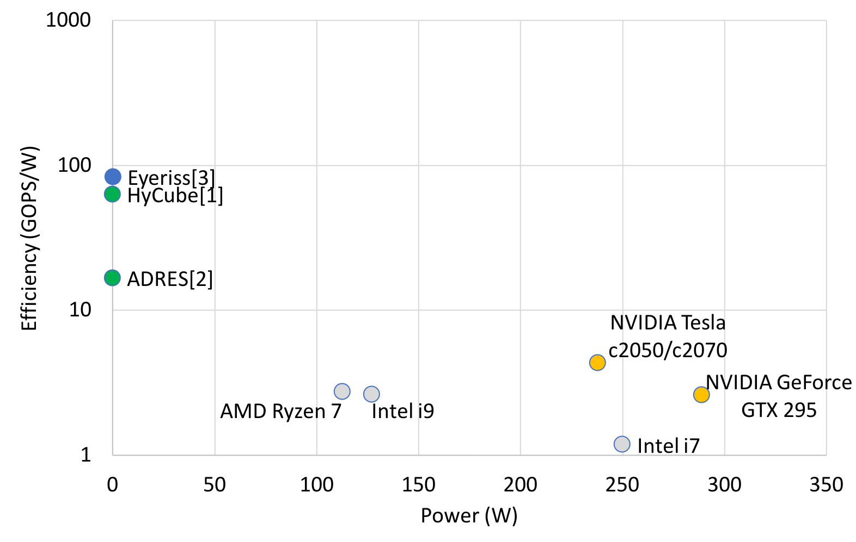
Need for Efficient Accelerators
ASIC
CGRA
CPU
GPU
[1] Karunaratne, M., Mohite, A. K., Mitra, T., & Peh, L. S. (2017, June). Hycube: A cgra with reconfigurable single-cycle multi-hop interconnect. In Proceedings of the 54th Annual Design Automation Conference 2017 (pp. 1-6).
[2] Bouwens, F., Berekovic, M., Kanstein, A., & Gaydadjiev, G. (2007, March). Architectural exploration of the ADRES coarse-grained reconfigurable array. In International Workshop on Applied Reconfigurable Computing (pp. 1-13). Springer, Berlin, Heidelberg.
[3] Chen, Y. H., Krishna, T., Emer, J. S., & Sze, V. (2016). Eyeriss: An energy-efficient reconfigurable accelerator for deep convolutional neural networks. IEEE journal of solid-state circuits, 52(1), 127-138.

Slide 3
Application/Domain Specific Accelerators
There is an increased interest in accelerating neural networks application like, Convolution Neural Network (CNN), Deep Neural Networks etc.
These accelerators have array of Processing Elements (PEs) that can perform application specific operations like multiply-and-add, and can accumulate the intermediate results across the PEs via an interconnect network.
Example, Eyeriss[1], Marvel[2], etc.
The compiler and hardware are optimized for power, performance, area, and energy for a particular application with:
Minimum interconnects
Data fed into the PEs in a particular fashion (like output stationary)
Values stored in the register.
[1] Chen, Y. H., Krishna, T., Emer, J. S., & Sze, V. (2016). Eyeriss: An energy-efficient reconfigurable accelerator for deep convolutional neural networks. IEEE journal of solid-state circuits, 52(1), 127-138.
[2] Chatarasi, Prasanth, Hyoukjun Kwon, Natesh Raina, Saurabh Malik, Vaisakh Haridas, Angshuman Parashar, Michael Pellauer, Tushar Krishna, and Vivek Sarkar. "Marvel: A data-centric compiler for dnn operators on spatial accelerators." arXiv preprint arXiv:2002.07752 (2020).

Slide 4
Compiler Design for ASICs is Selective
The compiler design for neural network accelerator is targeted for a particular type of application.
Marvel [1] formulates the constraints for the application specific accelerators as follows:
The application should be perfectly nested.
The order of the loops can be interchanged.
The loops should not contain conditional statements (branches).
The loops should not have inter-dependences. (loop carried dependencies).
A compiler and hardware design for loops is important to accelerate applications that are compute-intensive yet non-parallel, which cannot be accelerated through ASICs.
[1] Chatarasi, Prasanth, Hyoukjun Kwon, Natesh Raina, Saurabh Malik, Vaisakh Haridas, Angshuman Parashar, Michael Pellauer, Tushar Krishna, and Vivek Sarkar. "Marvel: A data-centric compiler for dnn operators on spatial accelerators." arXiv preprint arXiv:2002.07752 (2020).

Slide 5
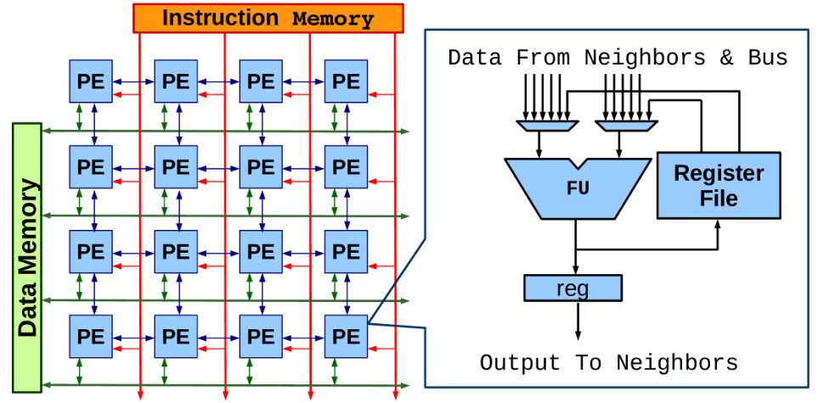
Coarse Grained Reconfigurable Array (CGRA)
An array of Processing Elements (PEs); each PE has ALU-like functional unit that works on an operation at every cycle.
Array configurations vary in terms of –
Array Size
Functional Units
Interconnect Network
Power Efficient Acceleration
Embedded Systems and Multimedia [Samsung SRP processor]

Slide 6
Envisioned Use of CGRAs
Processor
co-processor
Program thread
Kernel to accelerate
E₀
E₁
E₂
E₃
E₄
E₅
E₆
E₇
E₈
E₉
E₁₀
E₁₁
E₁₂
E₁₃
E₁₄
E₁₅
Specific kernels in an application can be power/performance critical
The kernel can be scheduled and mapped for execution on CGRA by compiler
Using the CGRA as a co-processor (accelerator)
The kernel is now executed in a power-efficient manner.

Slide 7
Accelerating loops on CGRA
Mapping
Iteration: i-1,i
Iteration: i,i+1
Time
Modulo Scheduling
a
a
g
T_{i}
c
%
time
b
c
b
g
a
g
0
a
f
e
f
e
T_{i+1}
b
c
1
b
c
II = 3
g
g
f
e
f
2
e
(a) DFG of a loop
T_{i+2}
1
2
Iterative Modulo Scheduling
Each loop iteration is executed at II cycles [Bob Rau, MICRO 1994]
T_{i+3}
a
(b) Target CGRA
Software Pipelining
Operations from 2 different iterations execute simultaneously

Slide 8
Classification of Mapping Algorithm
Scheduling and Mapping :
Scheduling – Finds a timeslot in which a node needs to be executed (Temporal)
Mapping – Finds a Processing Elements (PE) in which a node is executed (Spatial)
Mapping algorithms can be classified into two categories:
Restart : On a failure to find a mapping for a node, the current mapping is discarded and a new mapping process is started.
Simulated Annealing, RAMP.
Backtracking : On a failure to find a mapping for a node, the previously mapped nodes is recursively unmapped and remapped to a new position until a valid mapping is found.
GraphMinor.

Slide 9
Limitations of existing techniques
Restarting techniques like RAMP, explores different routing options like memory etc., but does not address the mapping failure.
Backtracking does not address the mapping failure pertaining to the failed nodes.
Backtracking is not a suitable solution:
Unmapping the previously mapped node may not be right since the root of the problem may not be the previous node.
They do not learn from the failure and take corrective actions to rectify it.

Slide 10
Motivating Example
Attempts:
0
0
0
1
Time
2
5
2
5
Mapped | Unmapped
4
4
6
6
T_{i}
3
2
1
1
1
1
4
3
3
T_{i+1}
r
r
(a) DFG of a loop
5
0
1
2
3
4
T_{i+2}
R
R
6
(b) Target CGRA

Slide 11
Motivating Example
0
1
0
Attempts:
1
Time
2
5
2
Mapped | Unmapped
4
6
T_{i}
1
0
3
2
1
1
1
4
3
T_{i+1}
3
r
5
r
(a) DFG of a loop
5
0
1
2
3
4
T_{i+2}
4
R
6
R
6
(b) Target CGRA

Slide 12

Motivating Example
1
Attempts:
2
0
0
1
Time
2
5
2
5
Mapped | Unmapped
4
1
0
4
6
6
T_{i}
3
2
1
1
1
6
1
4
3
T_{i+1}
3
r
5
r
(a) DFG of a loop
5
0
1
2
3
4
T_{i+2}
4
R
R
R
(b) Target CGRA

Slide 13
Motivating Example
3
Attempts:
2
0
0
1
Time
2
5
2
5
Mapped | Unmapped
4
1
0
4
6
6
T_{i}
3
2
1
1
1
6
1
4
3
T_{i+1}
3
r
5
r
(a) DFG of a loop
5
0
1
2
3
4
T_{i+2}
4
R
R
(b) Target CGRA

Slide 14
Motivating Example
Attempts:
3
0
0
1
Time
2
5
2
5
Mapped | Unmapped
4
1
0
4
6
6
T_{i}
3
2
1
1
1
6
1
4
3
T_{i+1}
3
r
5
r
(a) DFG of a loop
5
0
1
2
3
4
T_{i+2}
4
R
(b) Target CGRA

Slide 15
Motivating Example
3
4
0
Attempts:
0
1
Time
2
5
2
5
Mapped | Unmapped
4
1
0
0
4
6
6
T_{i}
3
2
1
1
1
6
1
4
R
3
T_{i+1}
3
r
5
r
(a) DFG of a loop
5
0
1
2
3
4
T_{i+2}
4
(b) Target CGRA

Slide 16
Motivating Example
5
Attempts:
4
0
0
1
Time
2
5
2
5
Mapped | Unmapped
4
1
0
4
6
6
T_{i}
3
2
1
1
1
6
1
4
R
3
T_{i+1}
3
r
5
r
(a) DFG of a loop
5
0
1
2
3
4
T_{i+2}
4
(b) Target CGRA

Slide 17
Motivating Example
Fast Forward (24 attempts)

Slide 18
Motivating Example
Attempts:
29
0
0
1
Time
2
5
2
5
Mapped | Unmapped
4
1
4
6
6
T_{i}
3
2
1
1
1
6
1
R
3
T_{i+1}
3
0
(a) DFG of a loop
5
r
1
2
3
4
T_{i+2}
4
(b) Target CGRA

Slide 19
Motivating Example
30
Attempts:
29
0
0
1
Time
2
5
2
5
Mapped | Unmapped
4
1
4
6
6
T_{i}
3
2
1
1
1
6
1
4
R
3
T_{i+1}
3
r
0
(a) DFG of a loop
5
5
0
r
1
2
3
4
T_{i+2}
R
4
6
2
(b) Target CGRA

Slide 20
PathSeeker
Key Contributions:
Identify the problem node and analyze the predecessor and successor. Create data structures for each node to hold the current position and possible positions based on predecessor and successor.
Level One Recovery: Make changes to predecessor or successor nodes connected to the failed node.
Level Two Recovery : Novel Timeslot level remapping of nodes in the failed node’s timeslot. Update the predecessors and successors if there are any modifications.
Level Three Recovery: Timeslot level remapping of the nodes in the predecessor and successor’s timeslot.
Randomized placement if there are more than one possible positions.

Slide 21
PathSeeker in action
Attempts:
0
0
0
1
Time
2
5
2
5
Mapped | Unmapped
4
4
6
6
T_{i}
3
2
1
1
1
1
4
3
3
T_{i+1}
r
r
(a) DFG of a loop
5
0
1
2
3
4
T_{i+2}
R
R
6
(b) Target CGRA

Slide 22
PathSeeker in action
0
1
0
Attempts:
1
Time
2
5
2
Mapped | Unmapped
4
6
T_{i}
1
0
3
2
1
1
1
4
3
T_{i+1}
3
r
5
r
(a) DFG of a loop
5
0
1
2
3
4
T_{i+2}
4
R
6
R
6
(b) Target CGRA

Slide 23
PathSeeker in action
1
2
0
Attempts:
1
Time
2
5
2
Mapped | Unmapped
4
6
T_{i}
1
0
3
2
1
1
1
4
3
T_{i+1}
3
r
5
r
(a) DFG of a loop
5
0
1
2
3
4
T_{i+2}
4
R
6
R
6
(b) Target CGRA

Slide 24
PathSeeker in action
2
0
Attempts:
1
Time
2
5
2
Mapped | Unmapped
4
6
T_{i}
1
0
3
2
1
1
1
3
4
r
3
T_{i+1}
r
5
(a) DFG of a loop
5
0
1
2
3
4
T_{i+2}
4
R
6
R
6
(b) Target CGRA

Slide 25
PathSeeker in action
3
2
0
Attempts:
1
Time
2
5
2
Mapped | Unmapped
4
6
T_{i}
1
0
3
2
1
1
1
4
3
T_{i+1}
3
r
5
r
(a) DFG of a loop
5
0
1
2
3
4
T_{i+2}
4
R
6
R
6
(b) Target CGRA

Slide 26
PathSeeker in action
Attempts:
3
0
1
Time
2
5
2
Mapped | Unmapped
4
6
T_{i}
1
0
3
2
1
1
4
1
4
R
3
T_{i+1}
3
r
5
r
6
(a) DFG of a loop
5
0
1
2
3
4
T_{i+2}
R
6
(b) Target CGRA

Slide 27
PathSeeker in action
3
4
0
Attempts:
1
Time
2
5
2
Mapped | Unmapped
4
6
T_{i}
1
0
3
2
1
1
1
4
3
T_{i+1}
3
r
5
r
(a) DFG of a loop
5
0
1
2
3
4
T_{i+2}
4
R
6
R
6
2
(b) Target CGRA

Slide 28
Experimental Setup
Setup
Profiled 35 performance-critical loops from MiBench, Rodinia, and Parboil
Innermost loop was chosen in nested loop cases
Vectorizable loops and Memory bound loops were not considered.
Compilation
LLVM 4.0
Partial Predication for if-then-else and nested if-then-else.
Path-sharing to reduce the routing nodes.
Backtracking – GraphMinor, Restart – Simulated Annealing and RAMP.
4x4, 5x5, 6x6, 7x7, 8x8 CGRA sizes.
Threshold time of 100,000 seconds (27 hours).

Slide 29
PathSeeker maps all the loops on a 4x4 CGRA

Slide 30
PathSeeker maps all the loops on a 4x4 CGRA
GraphMinor : No mapping for 20 loops
RAMP: No Mapping for 5 loops

Slide 31
PathSeeker mapped all the loops on all CGRA sizes

Slide 32
PathSeeker finds a valid mapping fast for various CGRA sizes

Slide 33
The Quality of mapping achieved is comparable to SoA
Closer to 1 is better

Slide 34
Summary
PathSeeker addressed the problems with current backtracking and restarting mapping algorithms.
The main contributions of this PathSeeker are:
Failure node level analysis and changing the course of mapping path, thereby by seeking the valid mapping.
Novel failure, predecessor, and successor timeslot level remapping. As far as we know this is the first approach to propose a timeslot level remapping for CGRA.
Randomized node placement for better exploration of the mapping.
PathSeeker was able to map all the loops quickly with closer to state-of-the-art quality of mapping.

