Slide 1

An Agile Methodology for Designing Efficient Domain-Specific Architectures
Shail Dave
Ph.D. Dissertation Defense

Slide 2
Publications
Total Citations: Over 400 (as per Google/Semantics Scholar)
[ASPLOS ‘24] Explainable-DSE: An Agile and Explainable Exploration of Efficient HW/SW Codesigns of Deep Learning Models Using Bottleneck Analysis.
[IEEE TC ‘23] Cyclebite: Extracting Task Graphs From Unstructured Compute-Programs. B. Wills et al.
[TECHCON ‘23] Automating the Architectural Execution Modeling and Characterization of Domain-Specific Architectures.
[DATE ‘23] Learning-Oriented Reliability Improvement of Computing Systems From Transistor to Application Level.
[VTS ‘22] Special Session: Towards an Agile Design Methodology for Efficient, Reliable, and Secure ML Systems.
[LATTE ‘22] Design Space Description Language for Automated, Comprehensive Exploration of Hardware Accelerators.
[Proceedings of the IEEE ‘21] Hardware Acceleration of Sparse and Irregular Tensor Computations of ML Models: Survey and Insights.
[ICASSP ‘20] dmazerunner: Optimizing convolutions and GEMMs on dataflow accelerators.
[TACO ‘20] SPX64: A Scratchpad Memory for General-purpose Microprocessors. A Singh and S. Dave et al.
[CODES+ISSS/ESWEEK ‘19] dMazeRunner: Executing Perfectly Nested Loops on Dataflow Accelerators.
[DAC ‘18] RAMP: Resource-Aware Mapping for CGRAs.
[DATE ‘18] CCF: CGRA Compilation and Simulation Framework.
[DATE ‘18] LASER: A Hardware/Software Approach to Accelerate Complicated Loops on CGRAs. M. Balasubramanian et al.
[DATE ‘18] URECA: A Compiler Solution to Manage Unified Register Files for CGRAs.
[Advisory Report] Chapter: Sustainable Computing Architectures. In a Report for National Science Foundation (NSF) Workshop on Sustainable Computing, 2023.
[US Nonprovisional Patent Application] Systems and methods for agile and explainable optimization of efficient hardware/software codesigns for domain-specific computing systems using bottleneck analysis.
[US Nonprovisional Patent Application] Hybrid and efficient approach to accelerate complicated loops on coarse-grained reconfigurable arrays (cgra) accelerators

Slide 3
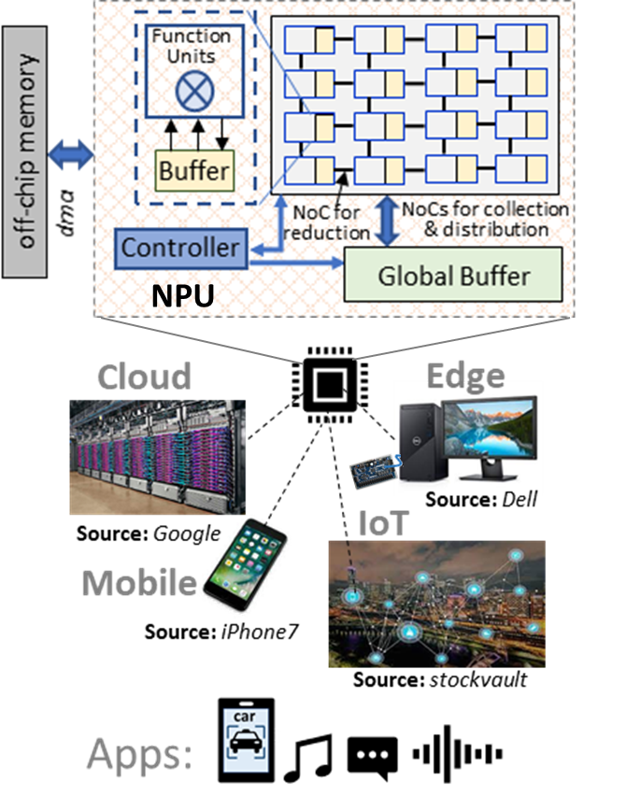
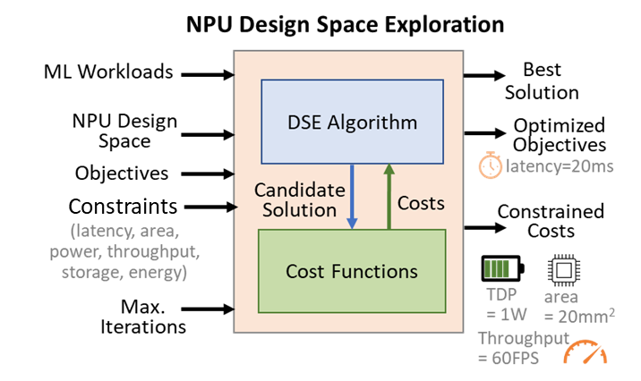
Goal: Fast and Efficient Accelerator HW/SW Codesign
Minimize objective costs within strict constraints on design and execution.
Latency, energy, chip area, throughput, power, storage, accuracy, resilience, etc.
Domain-Specific Architecture (DSA)
Towards Agile Design Methodology for Efficient, Reliable, and Secure ML Systems. S. Dave et al. VTS 2022 (Invited)

Slide 4


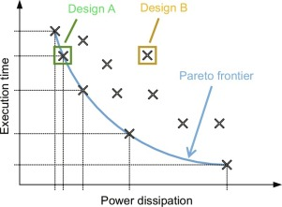
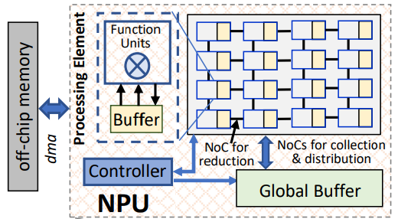

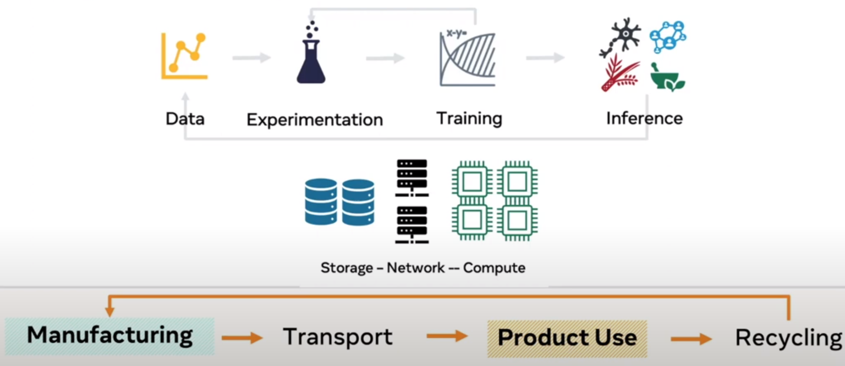




Current Approaches: Architecture-Specific Design and Black-Box Design Optimization
Workloads
PPA
Architecture Modeling, Workload Characterization and Optimization for Specific Architecture Template/Dataflows
Black-Box Design Space Explorations
Architecture
Template
Design

Slide 5
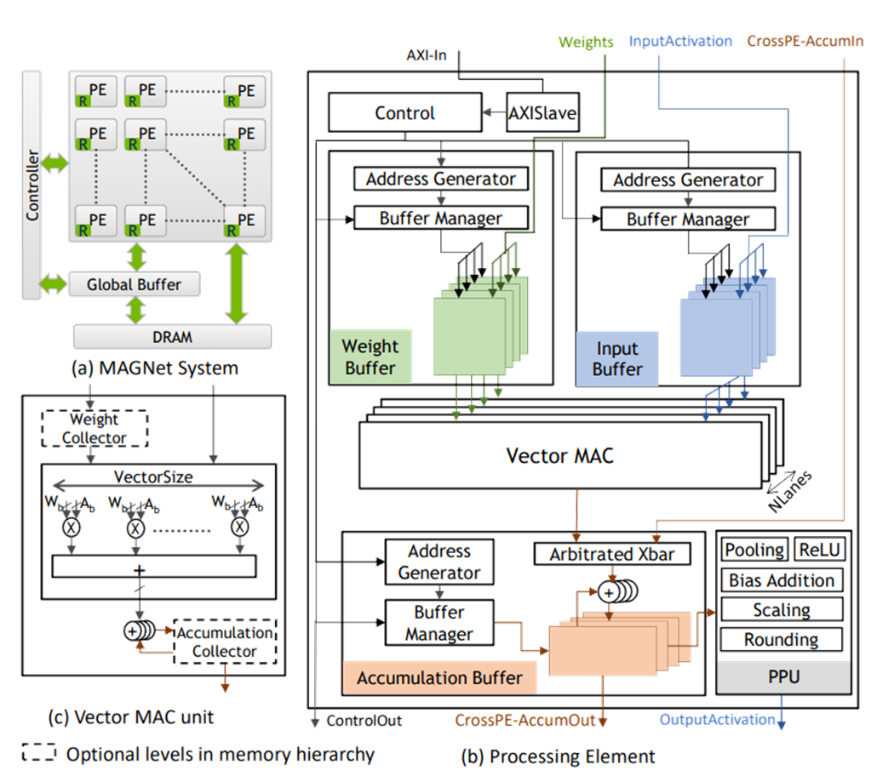
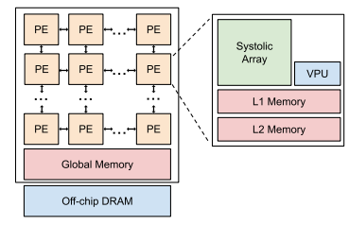
Current Approaches: Examples
Google TPU Based Architecture Template [ASPLOS 2022]
NVIDIA MAGNet: Modular Accelerator Generator for Neural Networks [ICCAD 2019]

Slide 6




Challenges with Limiting Design Space and Black-Box Optimizations
Inefficiency
Fixed dataflows or mappings do not adapt to workloads or new hardware features
Excessive samples searched by black-box explorations lead to invalid/inefficient designs
Non-Explainability
Lacks insights about why certain design configuration leads to some costs ➔ impacts analysis, sampling, and fine-tuning of designs by tools/experts
Lack of Agility
Excessive sampling takes days—weeks for exploration, preventing runtime optimization
Months-long tooling efforts for architecture-specific design quantification and characterization impacts time to market and further reusability of design tools
?

Slide 7
Thesis Statement
“Accelerator design exploration methodology needs to be:
Comprehensive for achieving efficient designs from vast design space
Explainable for achieving efficient designs and designer productivity
Agile for dynamic optimization and broader reusability of design tools”

Slide 8
Overview of Proposed Design Methodology
Domain Workloads
1
Comprehensive Design Space Formulation
Comprehensive Design Space Formulation
2
Efficient Design (HW/SW Configuration)
DSA Design Space
Explainable Codesign Exploration
Explainable Codesign Exploration
Objectives
Optimized Objectives
Constraints
(latency, die area, power, throughput, storage, energy, accuracy, price)
Constraints Utilized
3
Agile Execution Modeling
Agile Execution Modeling
Optimized Code for Execution
Time-To-Design

Slide 9
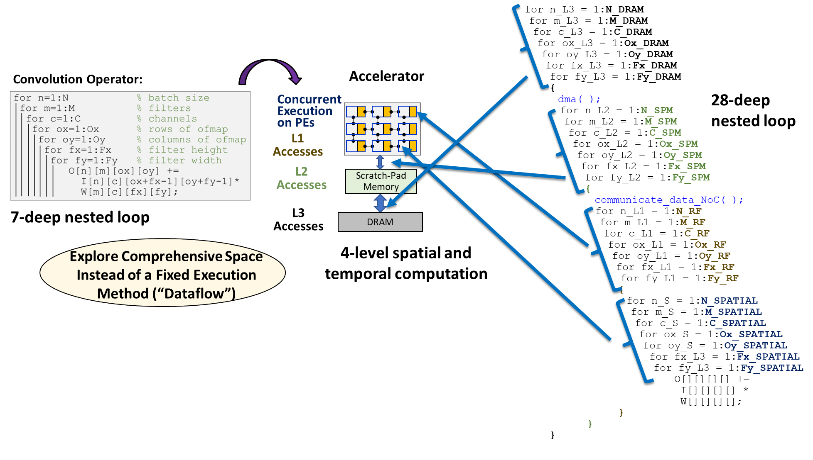
Formulating Comprehensive Mapping Space
Consider optimizing each loop at every level of spatial and temporal hierarchy/sequence of execution.
E.g., 7-deep loop nest → 28-deep loop nest covers all dataflows
dMazeRunner [CODES+ISSS / ESWEEK ’19]

Slide 10
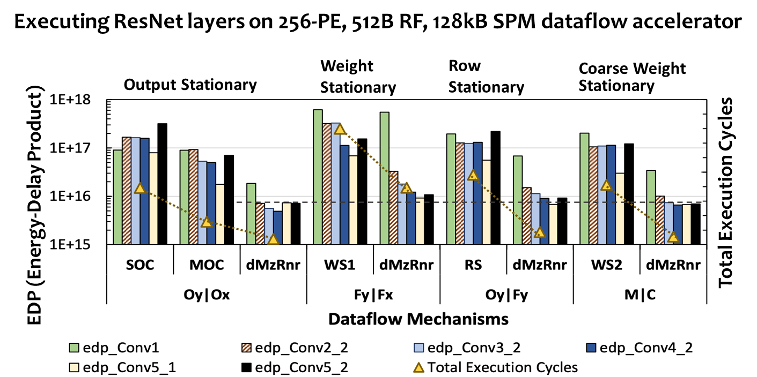
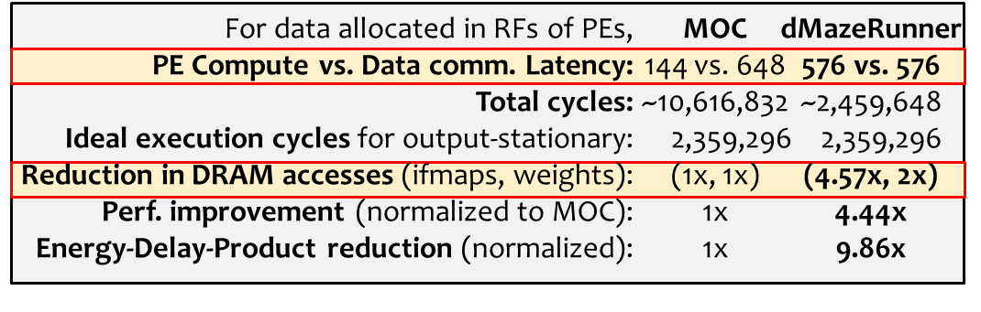
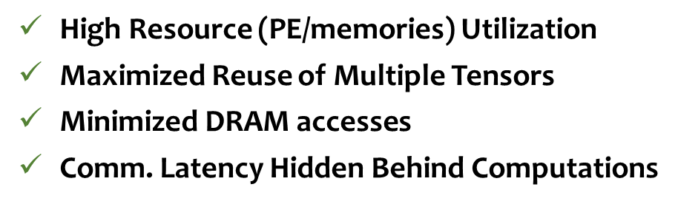
Comprehensive MapSpace Leads to More Efficient Solutions than Fixed Dataflows
Example Mapping of ResNet Conv5_2 with Output Stationary Dataflow
~9X Reduction in EDP and ~6X Low Latency
Adapts to characteristics of DNN layer/tensors & hardware architecture
Non-intuitive mappings that are optimized for various key factors
dMazeRunner [CODES+ISSS / ESWEEK ’19]

Slide 11
Quick Demo
Release: https://github.com/MPSLab-ASU/dMazeRunner

Slide 12
Overview of Proposed Design Methodology
Domain Workloads
1
Comprehensive Design Space Formulation
2
Efficient Design (HW/SW Configuration)
DSA Design Space
Explainable Codesign Exploration
Objectives
Optimized Objectives
Constraints
(latency, die area, power, throughput, storage, energy, accuracy, price)
Constraints Utilized
3
Agile Execution Modeling
Optimized Code for Execution
Time-To-Design

Slide 13
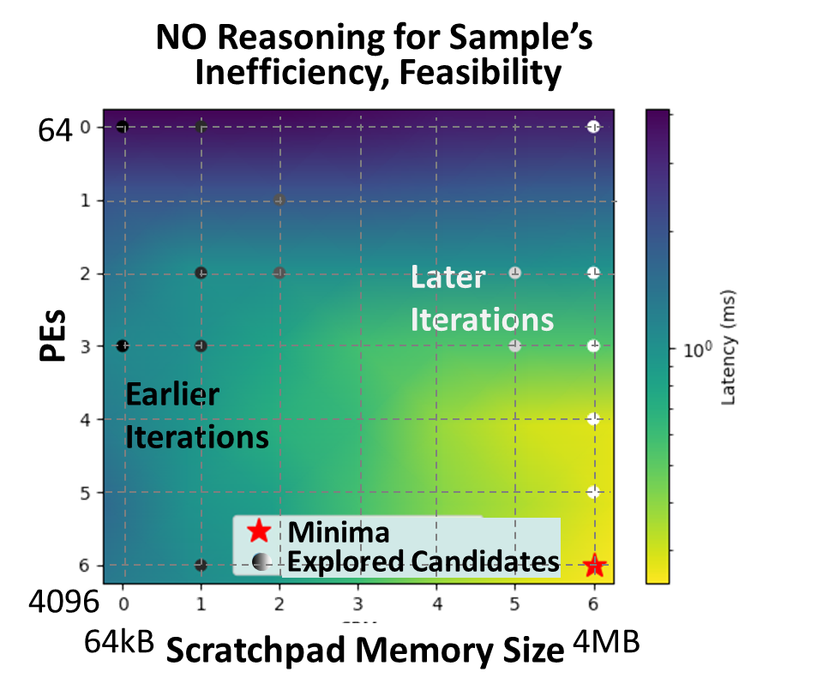
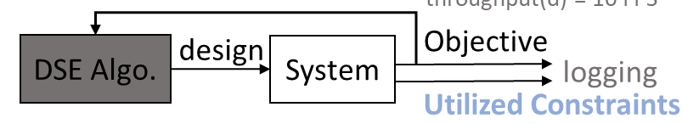
Existing Techniques Lack Explainability about Inefficiency of Explored Designs
Total Cost Value
Latency
Can’t reason why a sampled configuration leads to specific cost and how to mitigate it
Implications:
- Inefficient solutions
- Massive search time (Days—Weeks for 1000s of Trials!)
[1] Luigi Nardi, David Koeplinger, and Kunle Olukotun. "Practical design space exploration." In MASCOTS 2019. (HyperMapper 2.0)
[2] Sheng-Chun Kao, Geonhwa Jeong, and Tushar Krishna. "Confuciux: Autonomous hardware resource assignment for dnn accelerators using reinforcement learning." In MICRO 2020.
[3] Brandon Reagen, José Miguel Hernández-Lobato, Robert Adolf, Michael Gelbart, Paul Whatmough, Gu-Yeon Wei, and David Brooks. "A case for efficient accelerator design space exploration via bayesian optimization." In ISLPED, 2017.
Explainable-DSE [ASPLOS ’24]
Notes:
Existing exploration techniques use black-box optimizations, which basically do not reason about efficiency of samples, leading to huge exploration time and inefficient solutions.

Slide 14
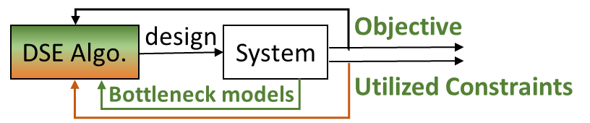
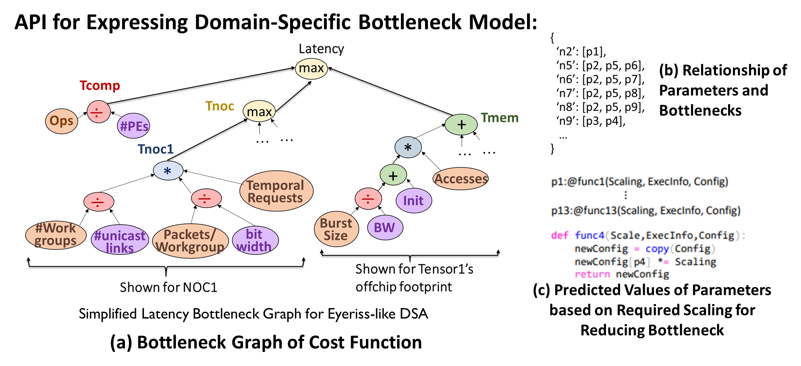
Bottleneck Model-Driven Design Space Exploration
Key Idea: Develop and Use Bottleneck Models for Making Bottleneck Analysis of Cost Functions Explicit and Accessible to Exploration Framework
Explainable-DSE [ASPLOS ’24]
Notes:
The key idea here is to make exploration explainable by using bottleneck analysis. We do so by developing graph-based bottleneck characterization models of cost functions and use them to drive the constrained exploration for multiple workloads.

Slide 15
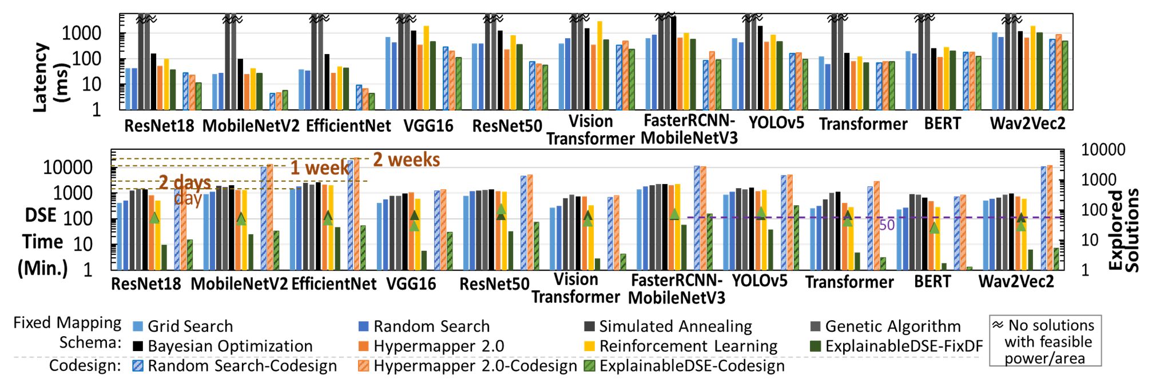
Efficient HW/SW Codesigns Explored Quickly
Finds ~6X low latency edge deep learning accelerators in 36X less search time (minutes–hours vs. days–weeks; 47X fewer DSE iterations)
Reasons about inefficiencies in high costs; Reduce costs at every DSE iteration.
Explainable-DSE [ASPLOS ’24]
Notes:
Our results show that for exploring edge deep learning accelerator designs for vision and language models, bottleneck-driven exploration could achieve about 6 times efficient solutions quickly, which is minutes or hours as compared to taking days or weeks. Thank you for your attention, and we look forward seeing you at our full presentation talk.

Slide 16
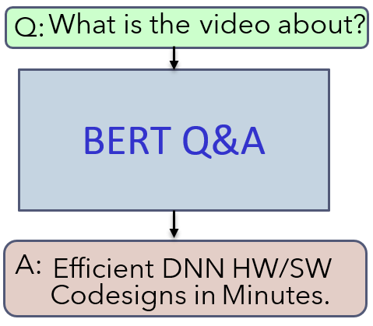
Quick Demo: HW/SW Codesign Exploration for BERT
ZD
Command
DSE Technique
DNN Model
Dataflow Optimization
Total DSE Iterations
- Our Agile DSE
- Constrained Reinforcement Learning
- Bayesian Optimization
- Random Search
- Grid Search
- Genetic Algorithm
- Simulated Annealing
Initial Samples (optional)
Set Initial Point?
Display Output?
python optimizer.py [--dse-method] [--constraints] [--objectives] [--convergence-threshold] [--design-space] [--dnn-models] [--output] [--dataflow-opt] [--epochs] [--initial-points]

Slide 17
Overview of Proposed Design Methodology
Domain Workloads
1
Comprehensive Design Space Formulation
2
Efficient Design (HW/SW Configuration)
DSA Design Space
Explainable Codesign Exploration
Objectives
Optimized Objectives
Constraints
(latency, die area, power, throughput, storage, energy, accuracy, price)
Constraints Utilized
3
Agile Execution Modeling
Optimized Code for Execution
Time-To-Design

Slide 18
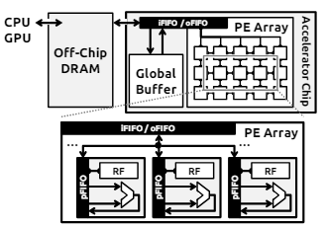
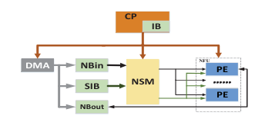
Highly Customized Analytical Cost Models Lack Reusability
DNN operator
Dense DNN Accelerator Analytical Model
Performance
DNN operator
Performance
Sparse DNN Accelerator Analytical Model
Mapping
Energy
Mapping
Energy
Architecture Parameters
Area
Architecture Parameters
Area
Sparsity
Sparsity Encoding
Nonzero handling scheme
E.g., Timeloop [ISPASS19], dMazeRunner [CODES+ISSS19], MAESTRO [MICRO19]
E.g., Sparseloop [MICRO22], Dave et al. [PIEEE21]
[ISCA’16]
[TC’20]

Slide 19
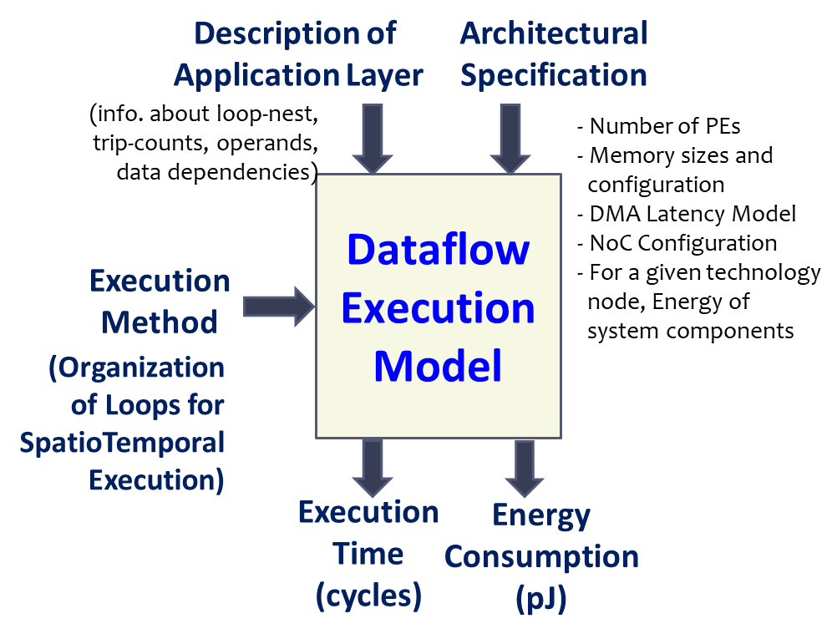
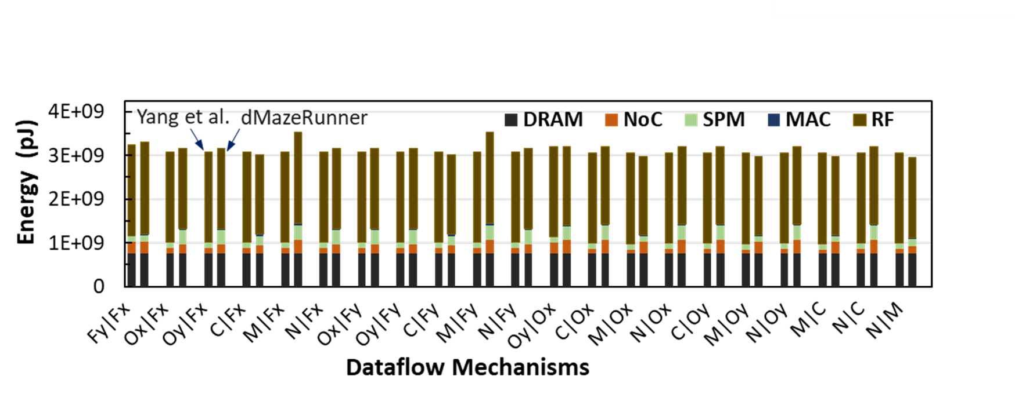
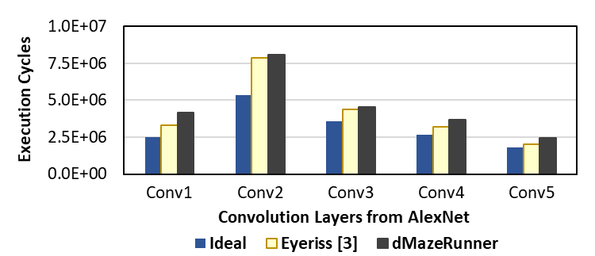
Example 1: Dense Tensor Accelerator Execution Modeling
Detailed modeling of common features like
analyze arbitrary perfectly nested loops.
miss penalty and stall cycles
inter-PE communication.
temporal/spatial data reuse.
Integrated support for common ML libraries
Energy Validation for Various Dataflows
Performance Validation against Eyeriss Chip
~4.2% difference
dMazeRunner [CODES+ISSS / ESWEEK ’19]
~11% performance difference vs. real-chip execution

Slide 20
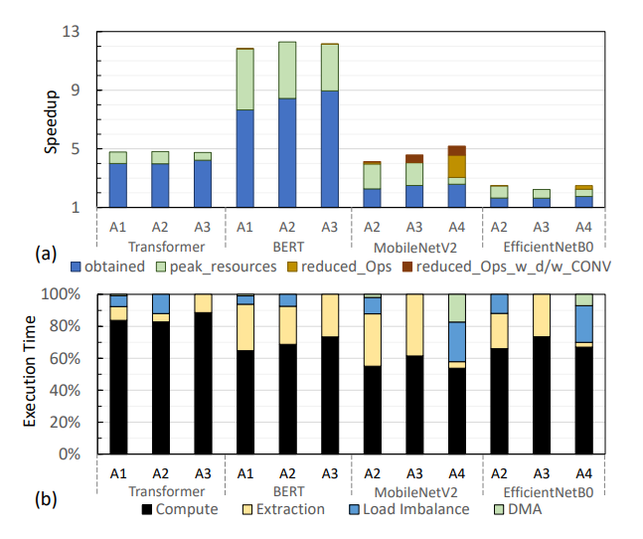
Example 2: Sparse Tensor Accelerator Execution Modeling
Taxonomy and modeling of features like
Sparsity value and pattern
Storage/encoding format
Non-zero extraction and matching mechanism
Load balancing (via software/hardware)
Communication and irregular memory accesses
Algorithm-hardware-compiler co-design
Introducing new features, e.g., for exploiting sparsity, requires heavy design tooling efforts
Survey and Insights [Proceedings of the IEEE ’21]

Slide 21

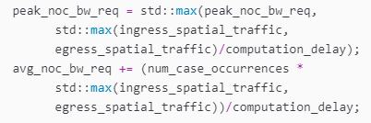

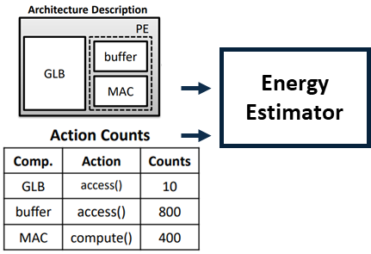
Why current modeling approach is not extensible?
?
Single, Architecture-specific Modeling
Several 1000s of LoC
Identifying the reuse or introducing new specialization is non-trivial and can be erroneous.
Provides total cost like latency, no further insights
Calculating and Embedding Execution Activity
Activity: Total invocations of each architectural component, data transfers among components, data properties, etc.
Needs to be fed or found by hard-coded calculation for every architecture template, based on workload mappings.
// New code for attempting extension
Q: How can we define model just once and make it easily reusable?
Q: How can we auto-calculate meta-information?
[Accelergy, ICCAD 2019]
DSAProf [LATTE ‘22, TECHCON ’23]

Slide 22
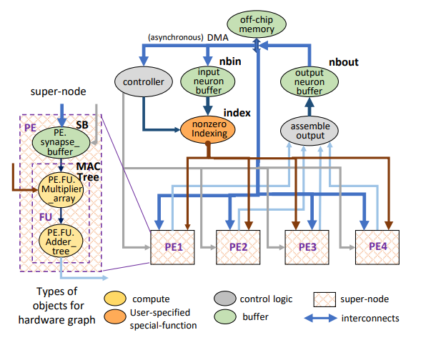


Approach: Modular, Dataflow-driven Execution Modeling
Flow-graph based abstraction for expressing and evaluating DSAs
Nodes are custom objects for compute, memory, interconnect, control. Edges are data dependencies.
Flexible for variety of hierarchy, parallelism, heterogeneity, pipelines
DSL for expressing, visualizing, evaluating DSAs
Modular → Extensible
Each module is associated with definitions about power, performance, functionality, etc.
Overall methodologies can be defined for architecture abstraction rather than a fixed template architecture.
Defining Cambricon-like DSA for Sparse DNNs
DSAProf [LATTE ‘22, TECHCON ’23]

Slide 23
Dataflow-driven Evaluation Auto-Embeds Activity and Help Bookkeep Costs for Characterization
Host/controller triggers modeling as per mapping
Each module’s definition takes the obtained input values or data properties, calculates metrics (performance, energy), populates output meta-information accordingly.
Overall performance/energy for DSA determined by repeatedly traversing DSA graph with height-based search from root nodes throughout mapping.
Aggregate (Add/Max) values based on whether connected nodes are in pipeline or not.
Traversals repeat/advance as per invocations in mapping
Several modes for faster, approximate, or data-driven analysis/simulations.
Library for modeling, simulating common components
Write data onchip
DMA(rd_addr_offchip, wr_addr_onchip, …)
Read data offchip
Based on the mapping, host or the controller triggers the input data/control (for functionality/accuracy) or meta-data to architecture (e.g., size of tensors, sparsity, for fast estimations)
Architecture-internal dataflow drives the execution activity or simulation of architectural components
Bookkeeping costs help construct a simple breakdown of total costs for all component → identify first-hand bottlenecks automatically
DSAProf [LATTE ‘22, TECHCON ’23]

Slide 24
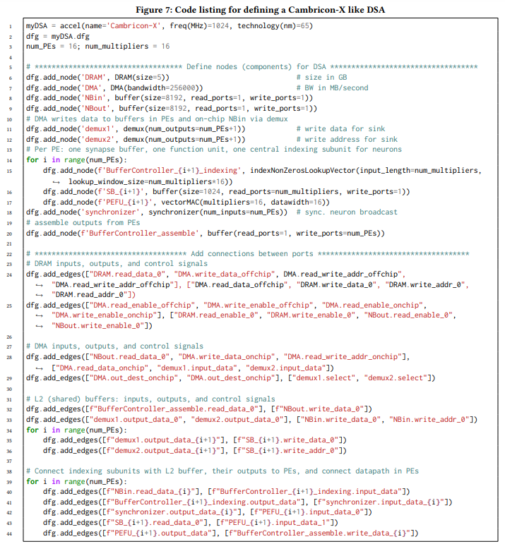
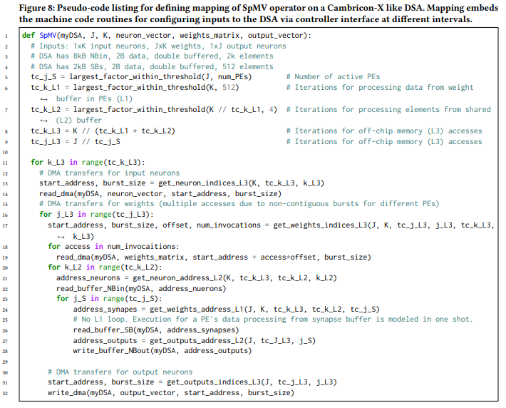
Demo Example: LoC Reduction and Automation
Steps for defining and evaluating a new DSA (DSAProf. vs. architecture-custom model)
Architecture Definition (~40 LoC, same/more flexible)
Mapping (~30 LoC, same)
Example: SpMV on Cambricon-X
Define tiled spatiotemporal execution
Define modules
Bottleneck Characterization (Automatic or immediate vs. Manual in weeks, 0 vs. 1000s LoC)
Define datapaths/interfacing
Execution Cost Modeling Only for a few new component vs. constructing whole new unitary model or notable extensions (Several 10s vs. 1000s of LoC)

Slide 25
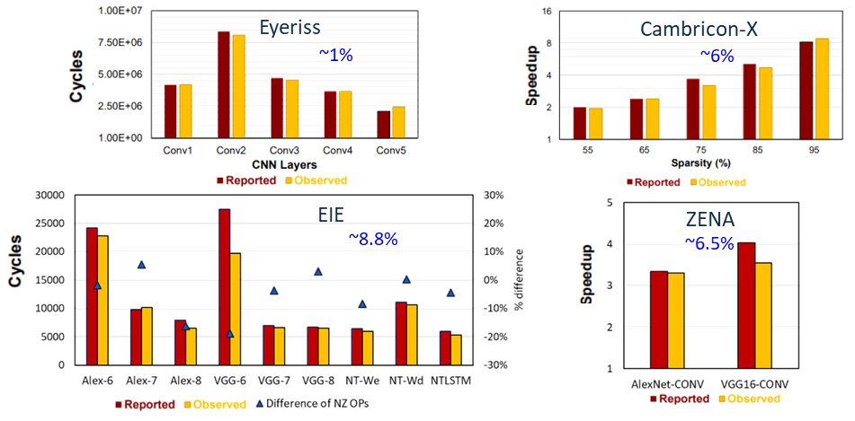
Validation: Dense/Sparse Deep Learning Accelerators
Flexibly model accelerators covering various memory hierarchy, spatial parallelism, structured/irregular computation patterns, dataflows.
Estimates latency and energy within about 1%--9% of reported results.
Differences mainly due to asynchronous execution, approximations for sparsity, etc.
DSAProf [TECHCON ’23]

Slide 26
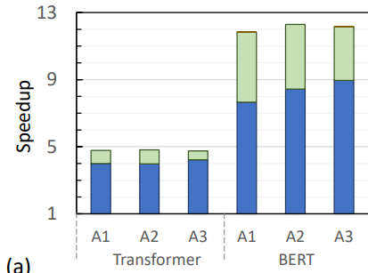
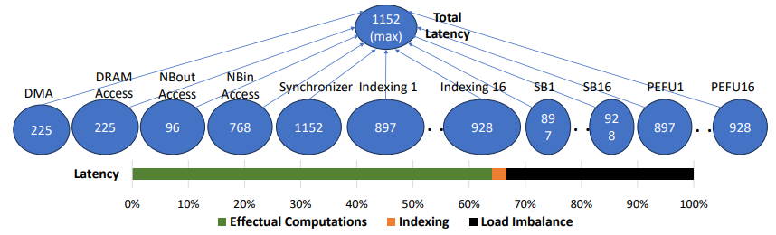
Analysis: Bottlenecks in Exploiting Sparsity
DSAs for sparse BERT achieve ~7.7x-8.9x speedup (w/o or w/ structured sparsity), out of ~12.2x achievable speedup with peak use of resources. Why?
Bottleneck analyzer can reveal those overheads/inefficiencies instantly.
Automatic evaluation of Cambricon-X’s latency shows overheads of non-zero extraction and load imbalance incurred 56% excess time.
S. Dave et al., Proceedings of the IEEE, 2021.
Automatic Bottleneck Analysis for Accelerating SpMV on Cambricon-X
DSAProf [TECHCON ’23]

Slide 27












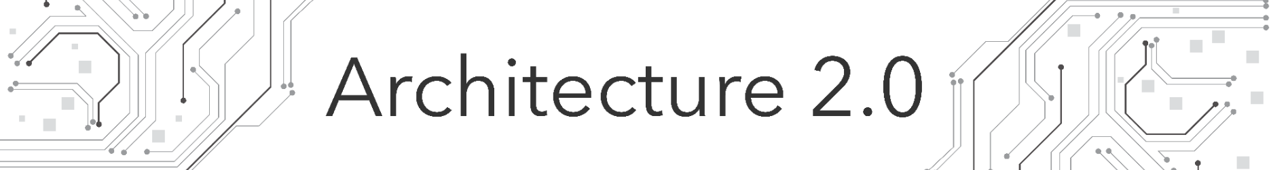














Outcomes and Impact
Panels and Vision Workshops
Media and Features
Awards and Fellowships
Sustainable Computing
Silver Medal from ACM for Student Research Competition
Invited Talks
Infrastructure Downloads and Usage
in PhD/masters dissertations/thesis, seminar courses, academic/industry R&D
CAPA Center

Slide 28
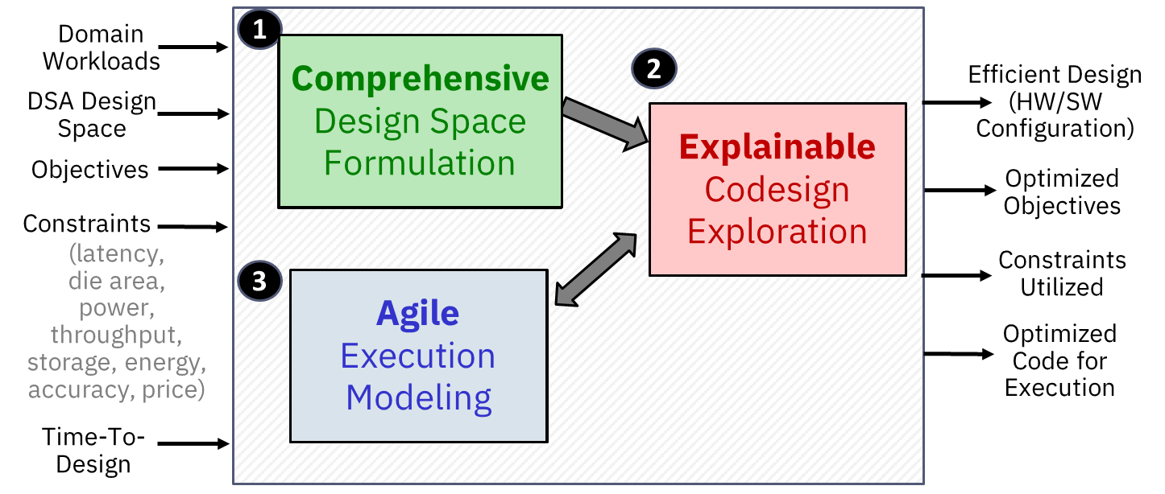
Conclusions
“Accelerator design exploration methodology needs to be:
Comprehensive for achieving efficient designs from vast design space;
Explainable for achieving efficient designs and designer productivity;
Agile for dynamic optimization and broader reusability of design tools”

Slide 29
Backup slides

Slide 30
Q: What are the novel contributions/claims?
Formulating comprehensive mapping space for each levels of spatial and temporal execution (of loops in DNNs) on accelerators
Comprehensive taxonomy of hardware/software design options and their quantitative/qualitative analysis for accelerators for sparse tensor computations
Developing and using bottleneck model abstraction to drive the DSE, which also generalizes bottleneck analysis and bottleneck-driven DSE
Generalized, constrained bottleneck-driven DSE framework for multiple workloads
Modular, dataflow-driven modeling for analytically estimating costs, especially latency, for multiple architectures through a flow graph-based modeling methodology

Slide 31
Q: What are some future research directions?
Automatic comprehensive mapping formulation for arbitrary architecture with arbitrary spatial and temporal hierarchy/organization
Automatic construction of bottleneck models from existing analytical modeling libraries
Automatic exploration of novel hardware architecture templates from the design library

Slide 32
Q: Automating the bottleneck model generation
Learning-based approaches for transforming analytical model of a module or its simulation module to graph-based cost estimations
Designers define cost model in the library, but in the graph form; overall methodology needs to aggregate the bottleneck models of components/modules.

Slide 33
Q: Related works using architecture graphs
Accelergy: Allows specifying hierarchy, but not explicit connections between nodes. Makes infeasible to model performance or functionality simulation
DSAGen: Through its Scala-based DSL, DSAGen allows specifying connections between the nodes of architecture graph via switches (NoC nodes).
connections may need to be defined in a certain order for correctness, as there is no way to indicate connecting a specific input/output of a node to that of another node.
lacks constructs for concealing the low-level components into a higher-level module.
For performance modeling, requires cycle-level simulation of the functionality or hardware synthesis of each component, which is highly time-consuming.

Slide 34
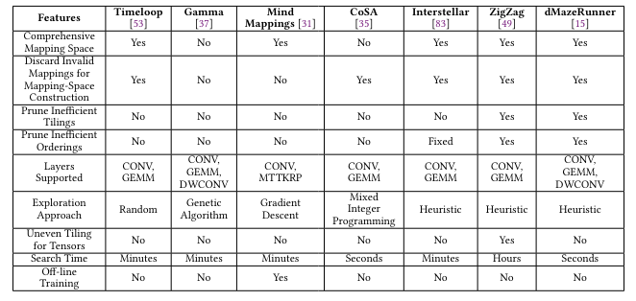
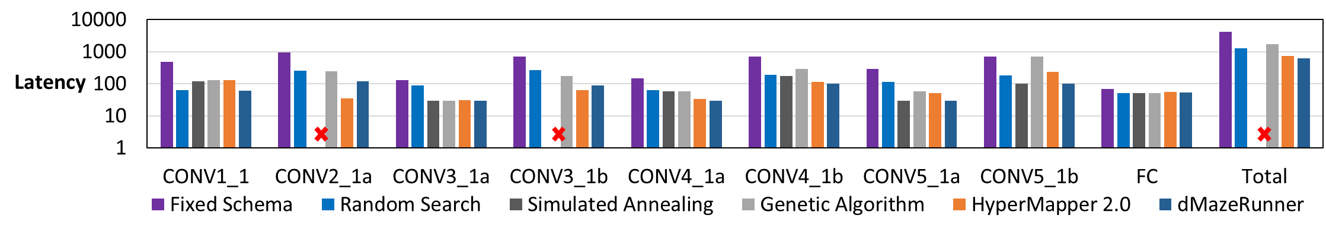
Q: Comparison with state-of-the-art mappers

Slide 35
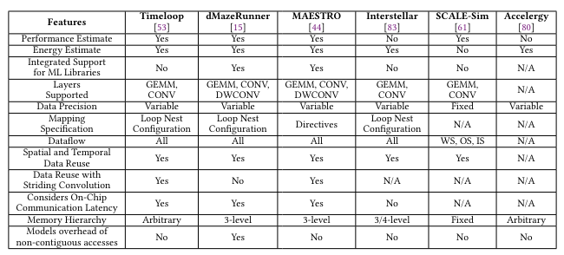
Q: Comparison with other analytical models

Slide 36
Q: Why not demonstrate more accelerators?
Needs design modeling of specific components
Works often lack details on microarchitectural implementation
Power/area/latency modeling for specific microarchitecture may not be publicly available
Lack of automatic code generation
Works often do not provide exact dataflow or execution method details
Defining tiled mapping and its code representation for invoking the evaluation could be challenging (time consuming) due to lack of access to optimized code for a given architecture/loop-kernel

