Slide 1
CCF Tutorial
MPSLab Accelerated Computing Group @ ASU

Slide 2
What is CCF?
CCF 20.04 (CGRA Compilation Framework) is an end-to-end prototype that generates machine code for CGRAs (Coarse-Grained Reconfigurable Arrays) and simulate their performance.
Through CCF, users can benchmark how CGRAs accelerate kernels designed for general-purpose applications.
Currently, CCF 20.04 can execute benchmarks from three benchmark suites, Parboil, MiBench, and Rodinia. It is named CCF 20.04 because this framework has been built and verified on Ubuntu 20.04.
This framework can be seen in three parts: Scheduling and Mapping, Instruction Generation, and Simulation.
The Scheduling and Mapping part of CCF is built upon the foundations of the cross-compiler LLVM 13.
Simulation part of CCF is built upon the cycle-accurate computer architecture simulation gem5.
Instruction Generation is what bridges the two parts together.

Slide 3
Compilation Simulation Framework -- CCF
Loop Extraction
LLVM frontend passes to extract the loop
DFG generation
Frontend pass to extract loop from IR
Support for nested loops
Mapping on Target CGRA
Loop Annotation
Pragma CGRA on the loop of C file
Include Target CGRA CSV and the execution script
Generate IR for the CGRA
Schedules and Maps on the CGRA
Includes support for IMS CRIMSON -- Also support for multiple mapping algos.
Generate Machine Instructions
From the mapping and DFG generate machine instructions.
Support for multiple DFG structures, single precision floating point support.
Architectural Simulation
gem5 based CGRA simulation. Support for multiple CGRA dimensions.
Support for Single Precision FP Executions.
App
LLVM
C++
C++
gem5

Slide 4
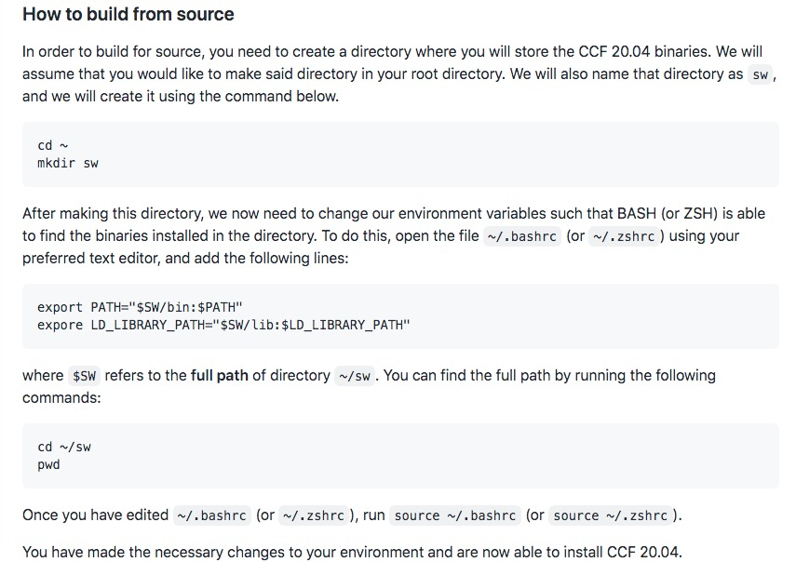
Getting Started with CCF
Pull from github CCF20.04 repository.
https://github.com/MPSLab-ASU/CCF-20.04.git
The README.md file in the repo will give you the next steps to install the CCF.
The install.sh file will look for the dependencies and install the LLVM and gem5 modules.

Slide 5
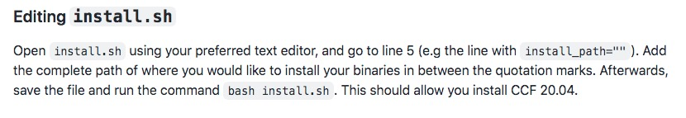
Getting Started with CCF (1)

Slide 6
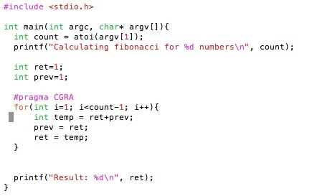
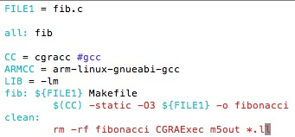
App Setup
(b) Makefile for the app with cgracc
(a) fib.c : program to calculate Fibonacci

Slide 7
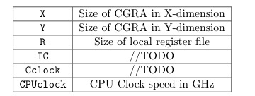
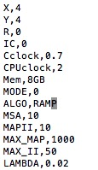
App Setup – CGRA_config.csv
CGRA_config.csv file with the app files.
ALGO: RAMP, GraphMinor, REGIMap, Simualted Annealing are supported.

Slide 8
Compiling the app
Since, gcc has been substituted with cgracc, the annotated loop will be compiled for CGRA.
Make the Fibonacci in the directory
> make

Slide 9
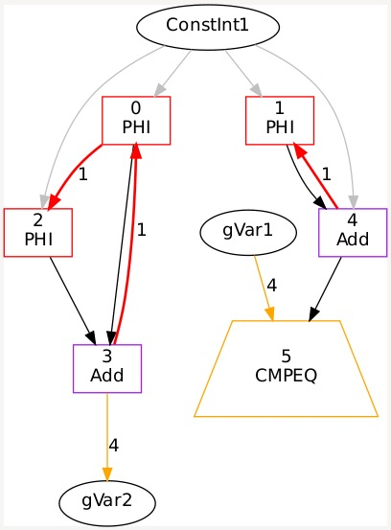
LLVM – Converting loop to DFG.
LLVM frontend will identify the annotated loop with #pragma CGRA.
It then converts the loop into the data flow graph (DFG) from the loop IR.
Each node represents a nodeID and an operation.
You can find the corresponding node and edge files in a directory called CGRAExec/L1.

Slide 10
Mapping the DFG onto the CGRA
CGRA_config.csv has the dimension of the CGRA X,Y, the registers required (R) and the mapping algorithm for the mapping (ALGO).
We currently support the following IMS based mapping algorithms
GraphMinor
Simulated Annealing
REGIMap
RAMP
Following the software pipelining the mapping will have three parts, (1) Prolog, (2) Kernel, and (3) Epilog.

Slide 11
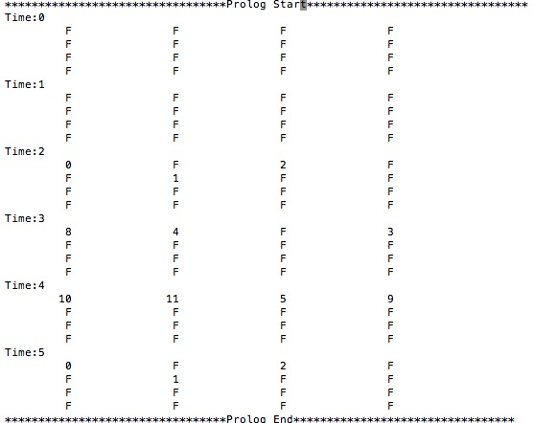
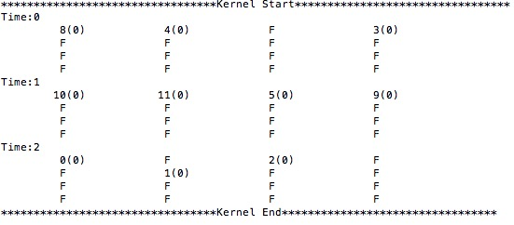
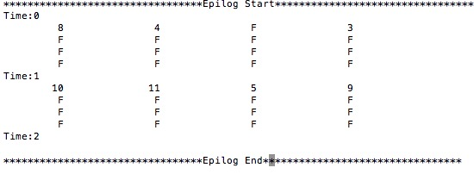
Mapping
(a) Prolog
(b) Kernel: Executes for the longest time. The Kernel cycles is the II, which is 3.
(c) Epilog

Slide 12
Instruction Generation
The mapping essentially allots a node of the DFG, a time and a PE (in the time extended CGRA).
The instruction generator, with the DFG information and the mapping information, creates CGRA instructions to execute the prolog, epilog and kernel, which together constitutes the loop execution, for execution on CGRA.
The instruction generator can be found in the InstructionGenerator directory.
The generated instructions can be found cgra_instruction.debug in the CGRAExec/L1 directory.

Slide 13
Gem5 -- AtomicCGRA
CPU+CGRA execution is simulated on gem5 with the AtomicSimpleCPU model.
The main CPU core executes all the instructions that are not annotated by #pragma CGRA.
The main CPU core in ARMv7 like core, for which the sequential sections of the code is compiled for.
Additional instructions are added to the app object file to transfer the execution control from the CPU to CGRA.
After the CGRA execution (updating respective memory locations) the control comes back to CPU.

Slide 14
Executing the benchmark
As per the Makefile, an object file will be available, in this case fibonacci.
The LLVM frontend deletes the loop in the object file and substitutes it with calls to prolog kernel and epilog instruction.
cgraexe is a script that takes the obj file and the program args as input to execute it on the user-defined size of the CGRA.
> cgraexe fibonacci –prog-args 6 &> out

Slide 15
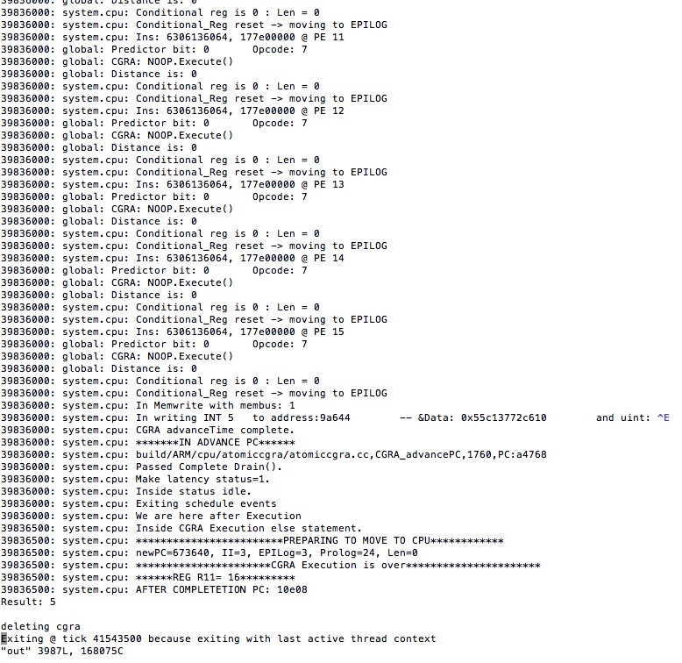
Output file
We can see that the 6th fibonacci element is 5 in the output file.
The user can edit the cgraexe file in ~/sw/bin directory to print more stats from the AtoicCGRA model in gem5.

Slide 16
Understanding LLVM
The clang compiler modules are modified to identity the CGRA pragma.
The program Intermediate Representation (IR) becomes the input for later models.
Generating the DFG
The DFG is generated from CondDDGGen module in the LLVM. (llvm/lib/Transforms/CondDDGGen).
This analyzes the loop with pragma and creates the nodes for the operations in IR and creates edges for data dependencies.
For conversion of conditional statements, CCF uses PartialPredication method using select nodes. CGRA ISA is equipped to execute the select instruction.
Deleting the loop in IR:
The LLVM modules CGRAGen and InvokeCGRA are responsible to delete the loop from the IR and substitute with appropriate CGRA execution functions.

Slide 17
Understanding DFG
The instruction names are provided in each node. The nodeIDs are used for mapping and reference purposes.
The numbers seen in the mapping is the number associated with the nodeID.
Edge color representation:
Black: normal data dependency
Red: Loop Carried dependency
Yellow: Live variables dependency.
Blue: Memory.
Gray: Constant node dependency.

Slide 18
Understanding AtomicCGRA – gem5
On hitting the loop execution, the CPU transfers the control to CGRA by setting Prolog, Kernel, Epilog instruction start addresses, and the II in a shared memory location.
The gem5 CGRA instructions can be found in gem5/src/cpu/atomiccgra/atomiccgra.cc
Per tick the instructions are fetched and executed by CGRA and the state (pro, kern, epi) are computed based on the compare instructions.
CGRA execution details can be found in gem5/src/cpu/atomiccgra/CGRAPE.cpp

