Slide 1

Linked Lists

Slide 2
Our team
Scrum Trainer – Marieta Stoycheva 10G
Front-End – Georgi Hrisimov 10V
Back-End – Egor Semenov 10A
QA – Yoan Tanev 10B

Slide 3



Stages of realization
Second stage –
realization
Third stage –
presentation
FIRST STAGE –
PLANNING

Slide 4






Programs we used

Slide 5
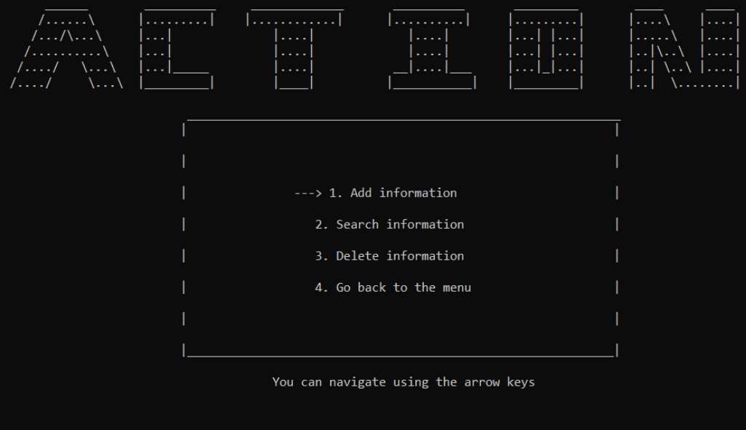
Our goal

Slide 6
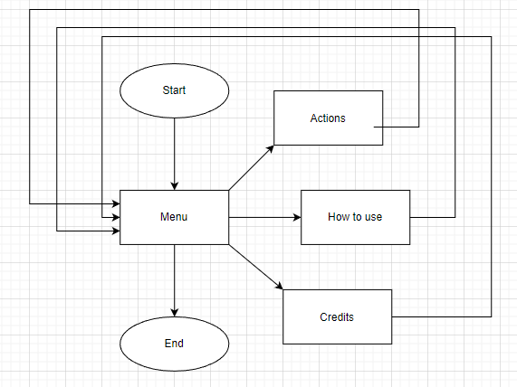
Flowchart

Slide 7
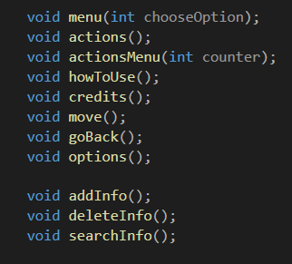
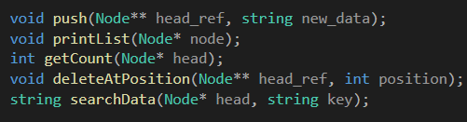
Functions we used

Slide 8

Thank you for your attention!

