Slide 1
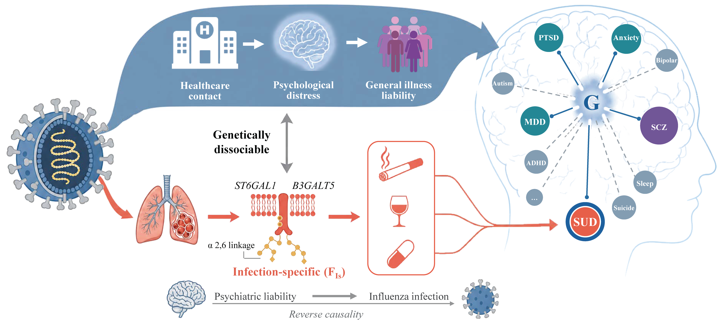

Slide 2
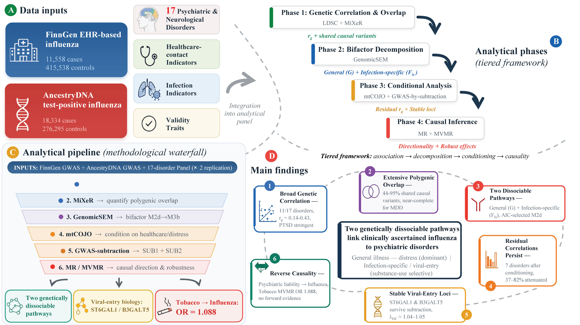
Notes:
Figure 1

Slide 3
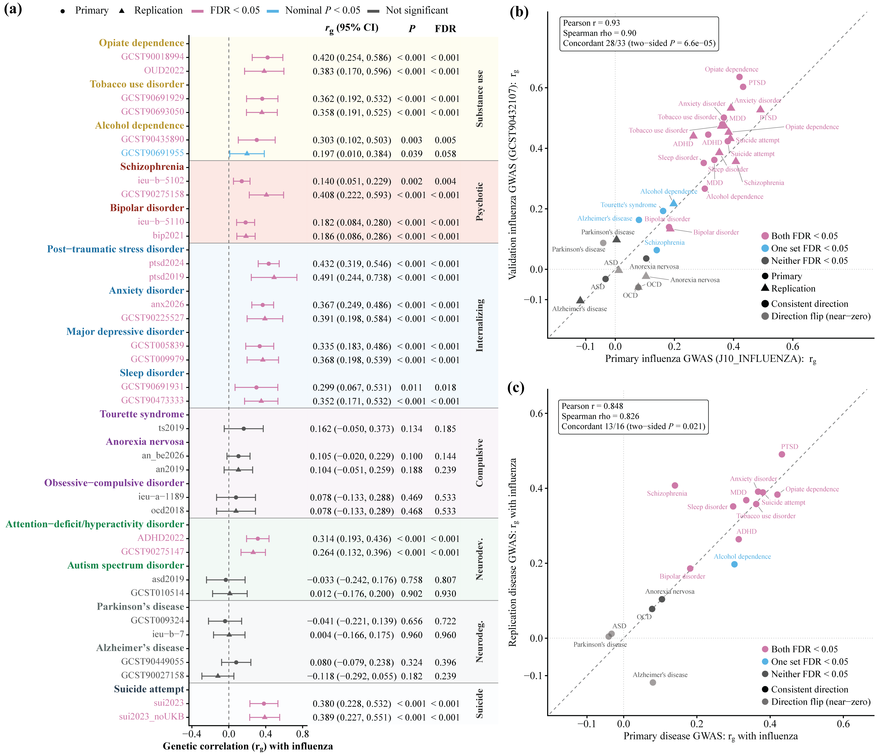
Notes:
Figure 2

Slide 4
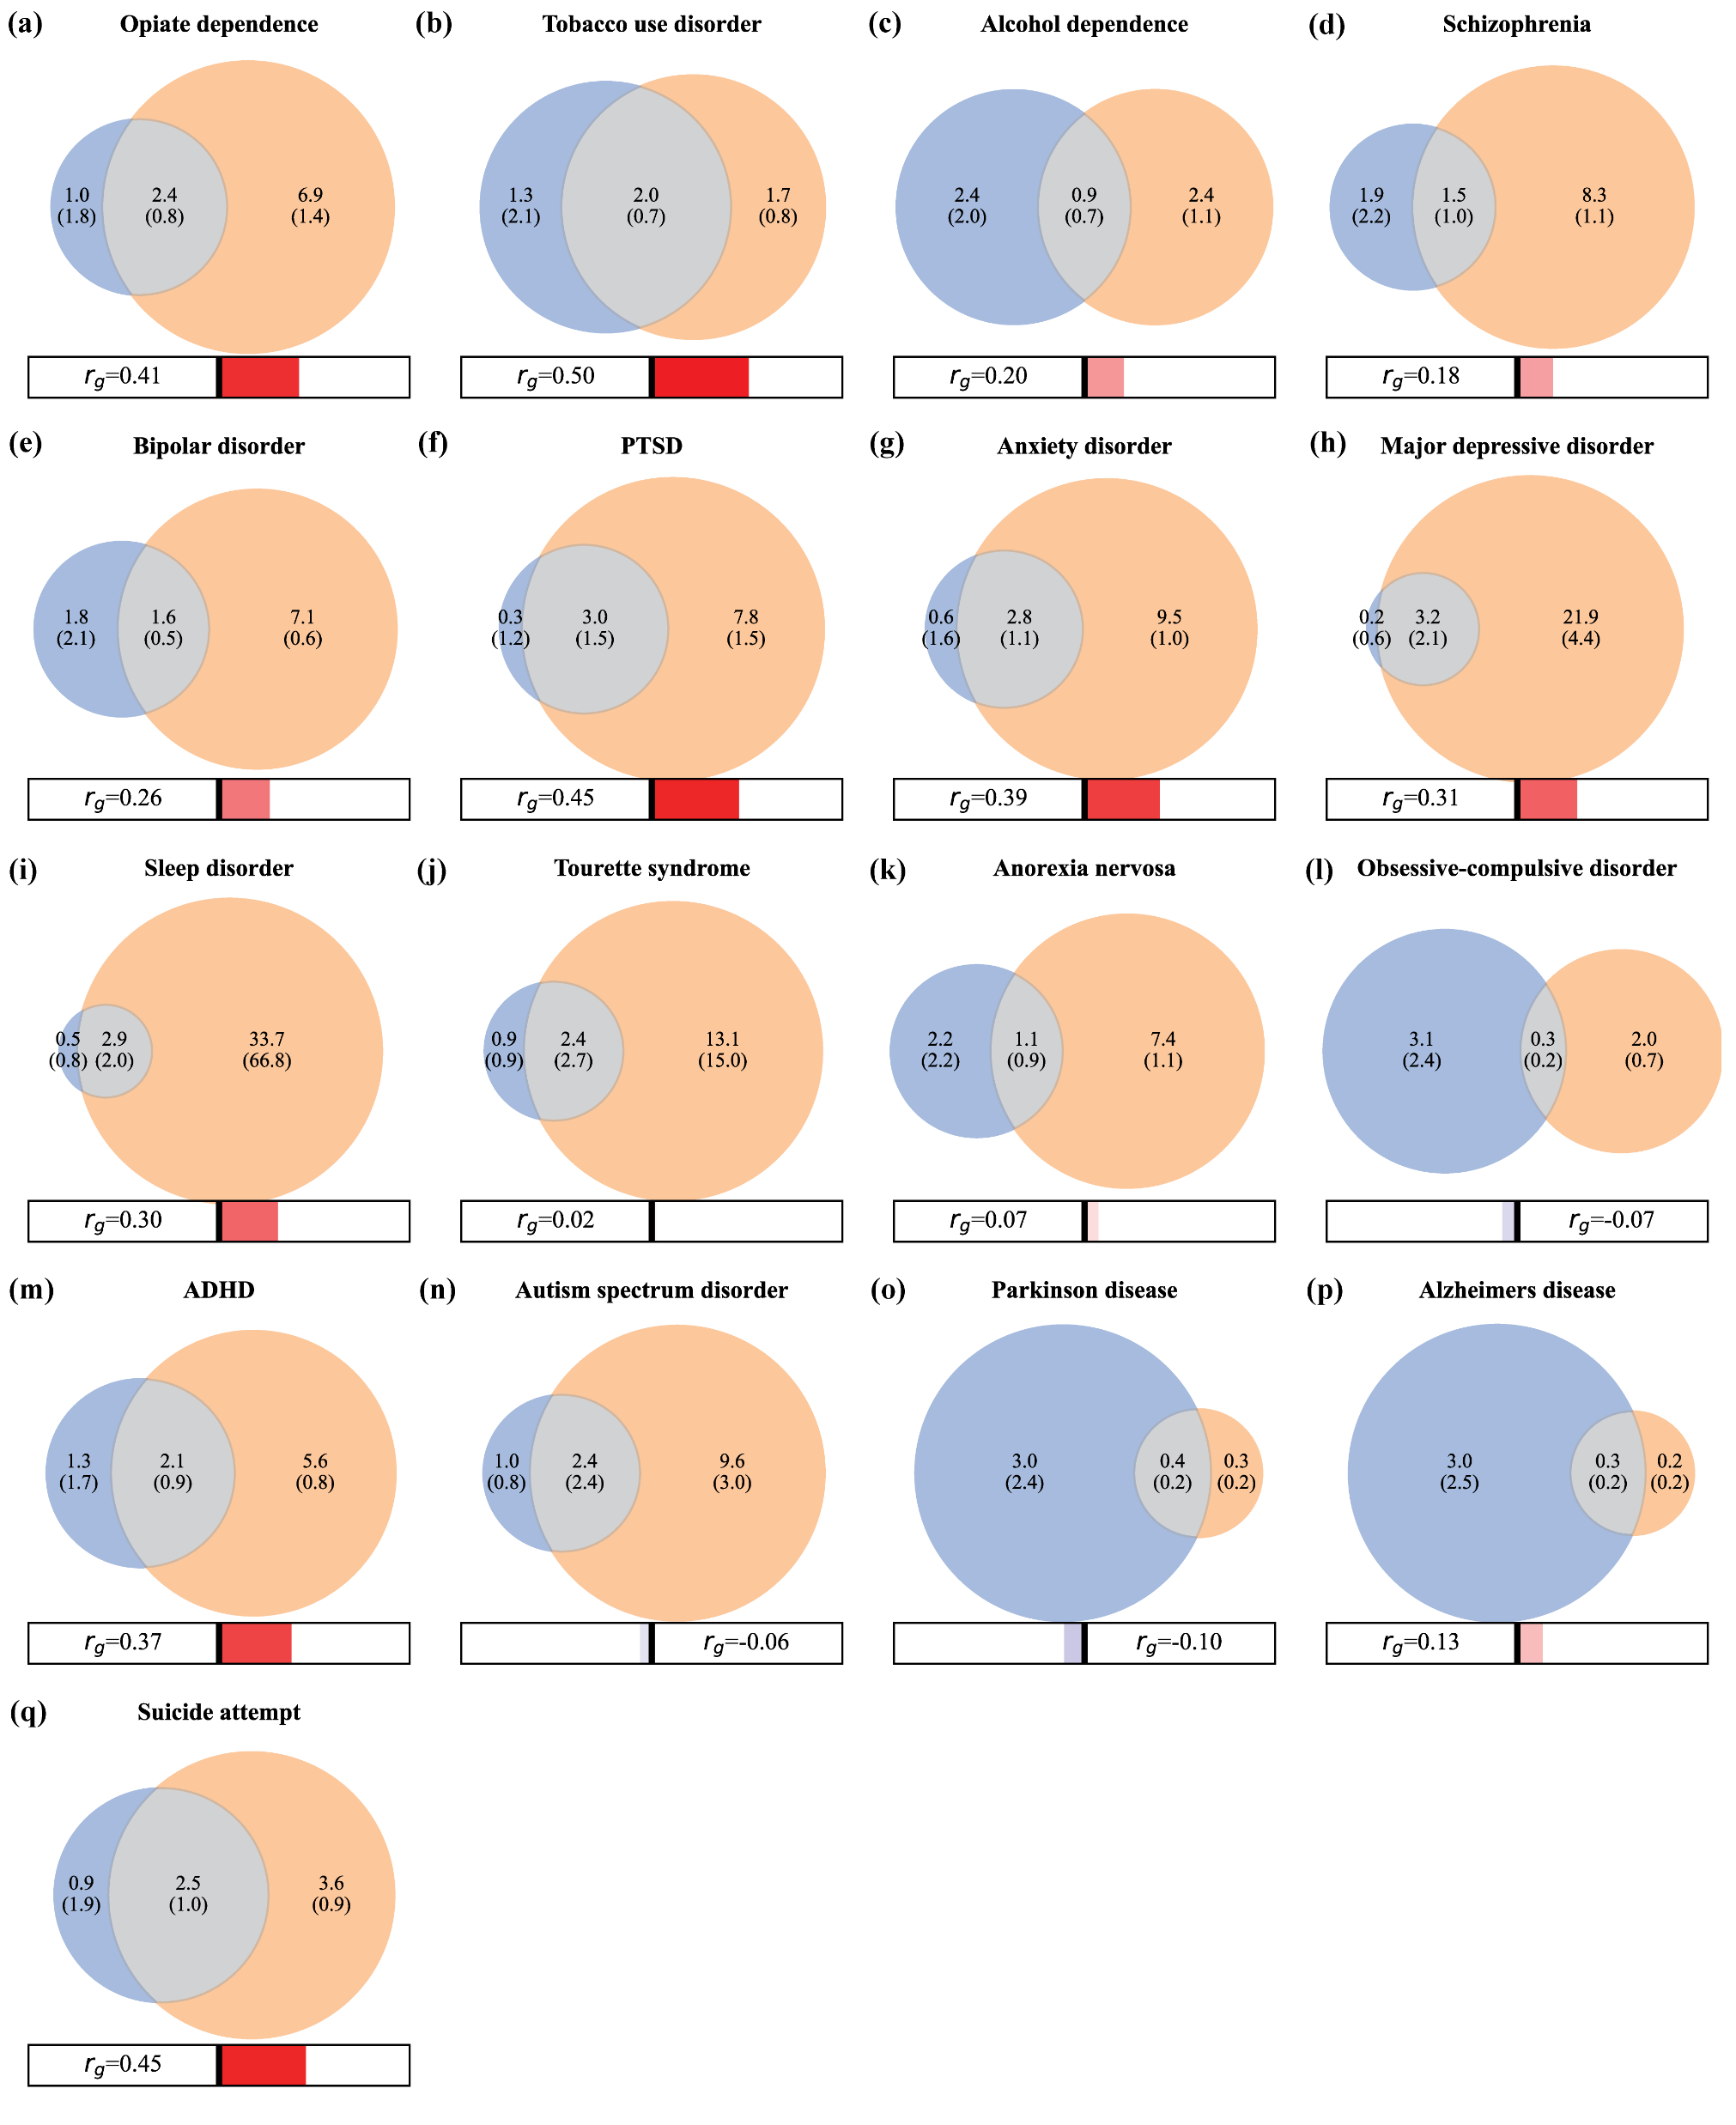
Notes:
Figure 3

Slide 5
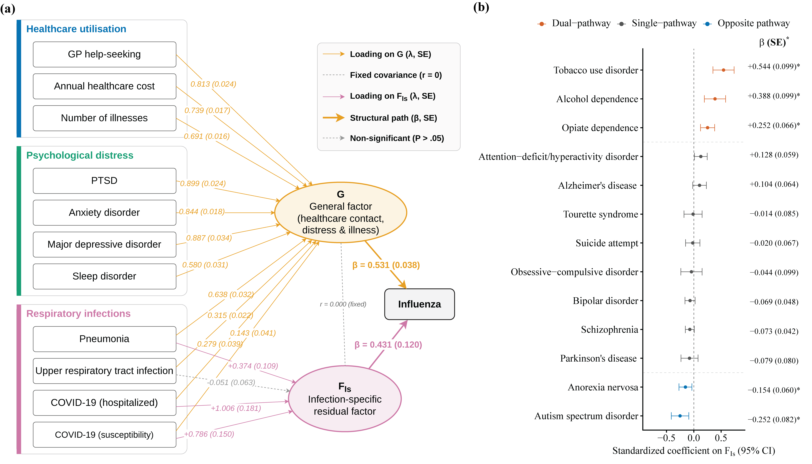
Notes:
Figure 4

Slide 6
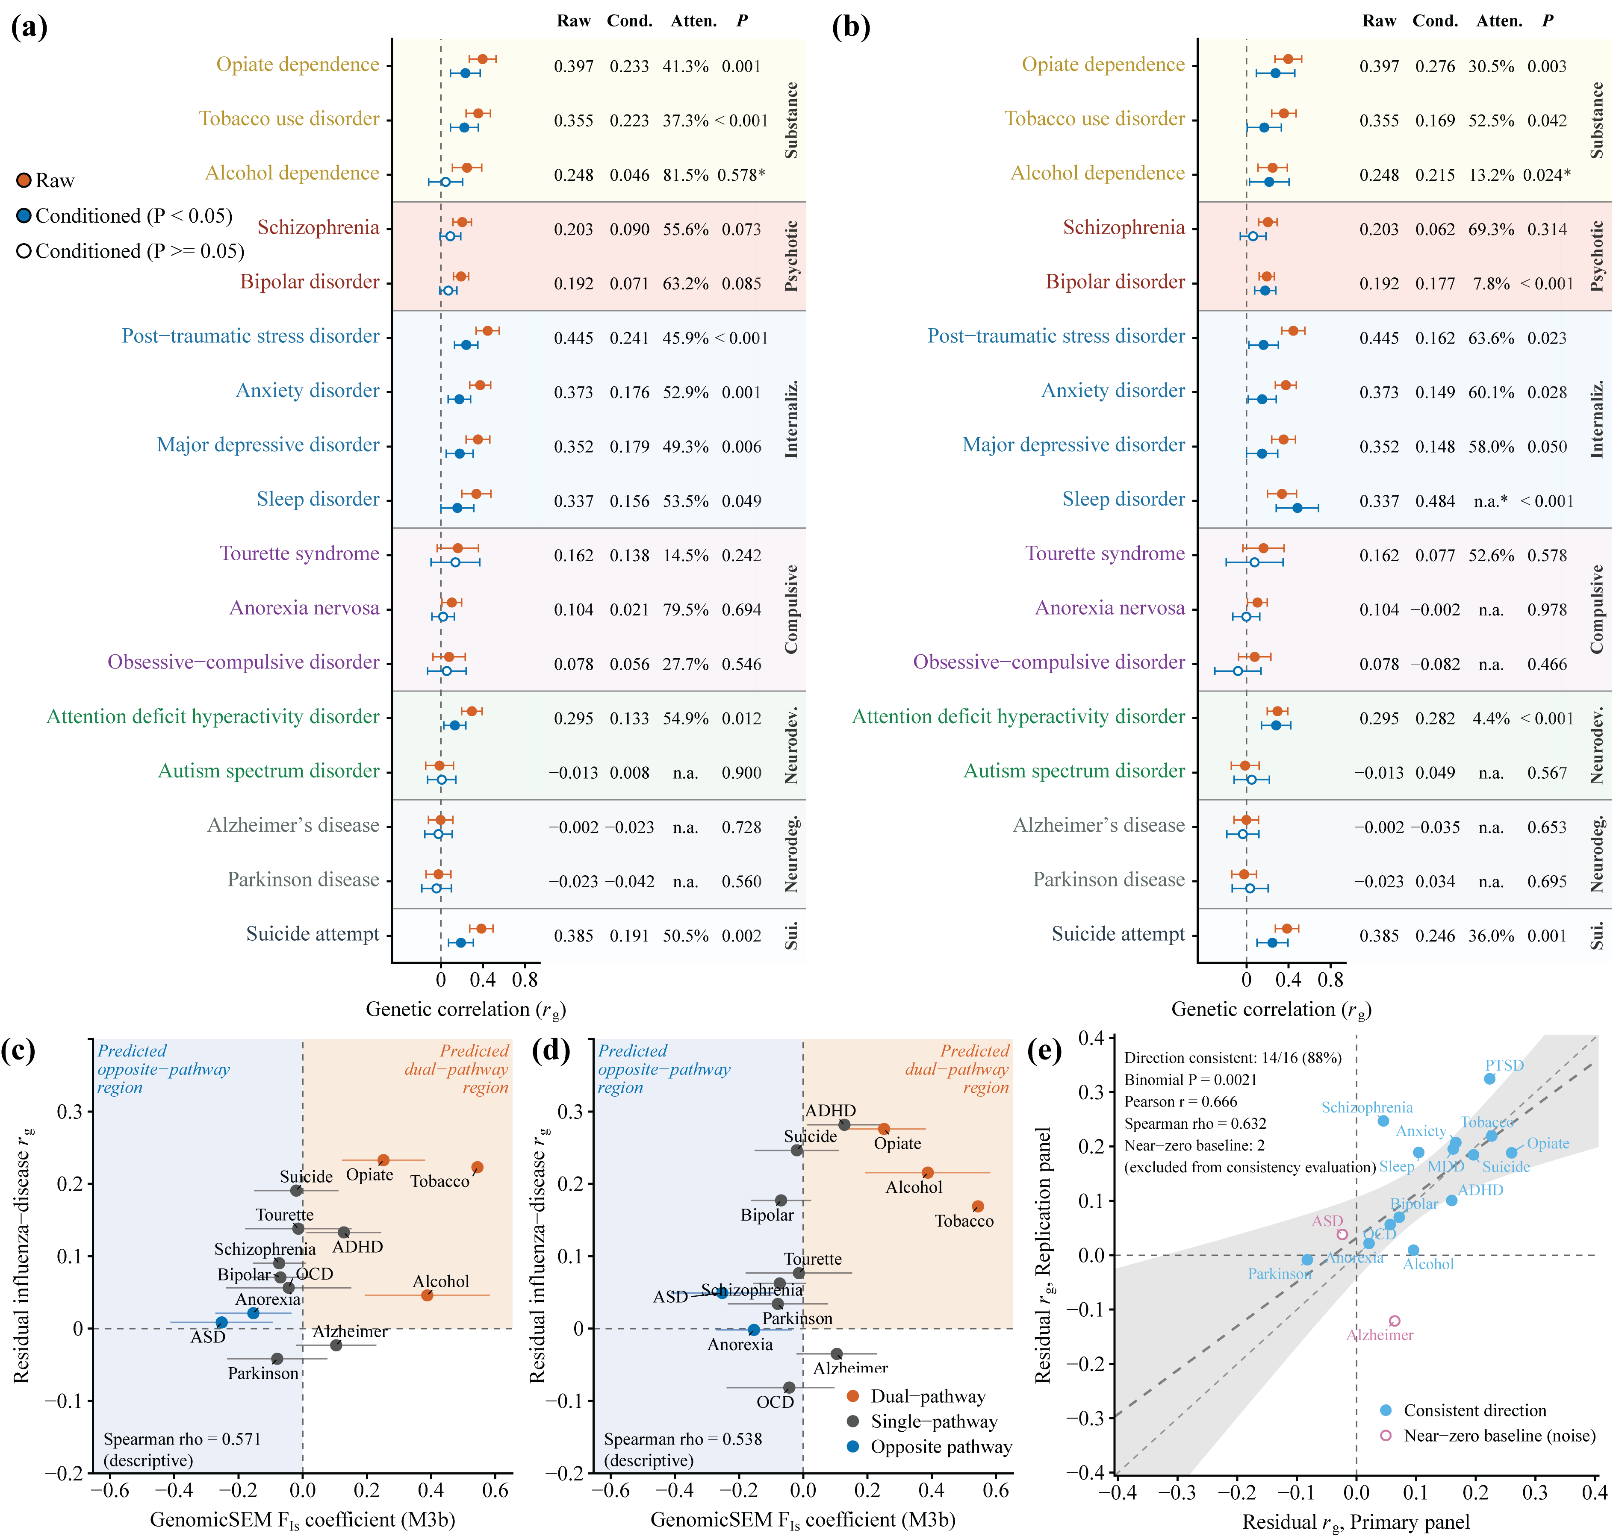
Notes:
Figure 5

Slide 7
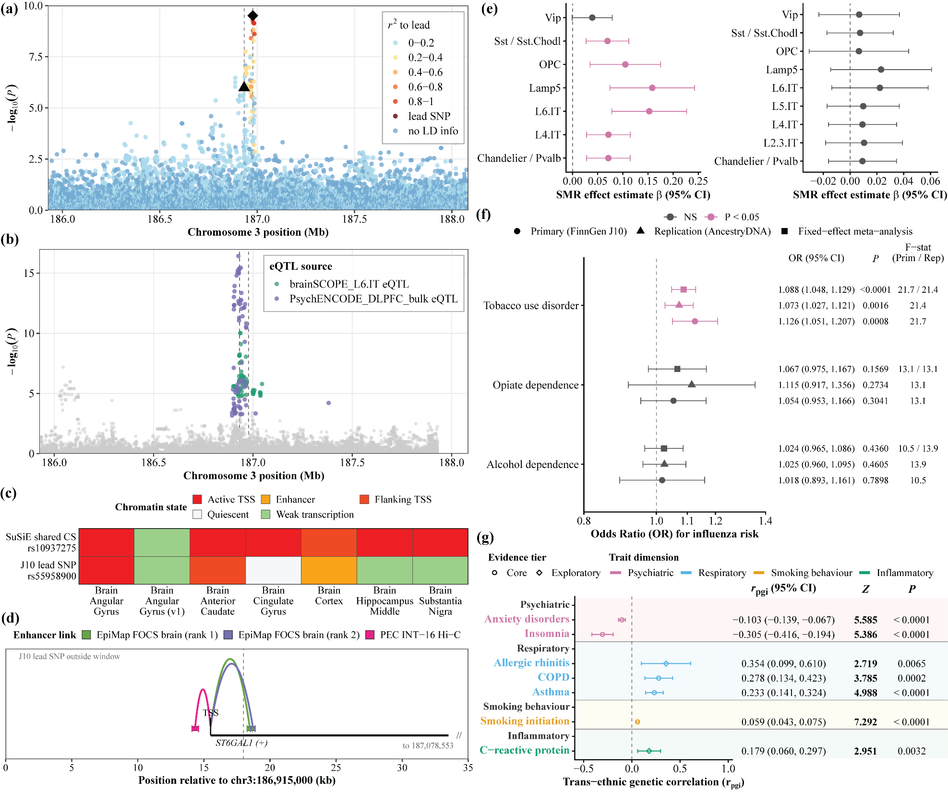
Notes:
Figure 6

Slide 8
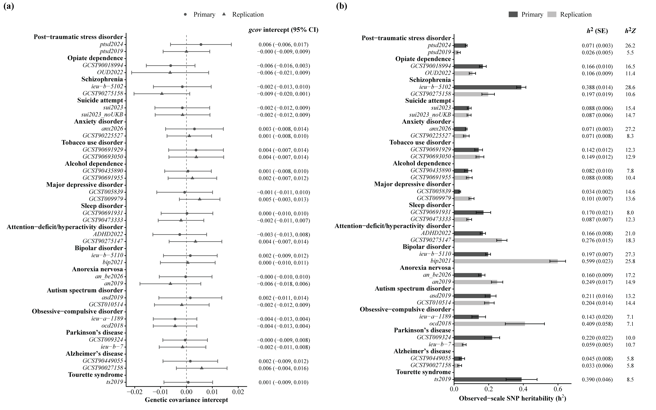
Notes:
Supplementary Figure 1

Slide 9
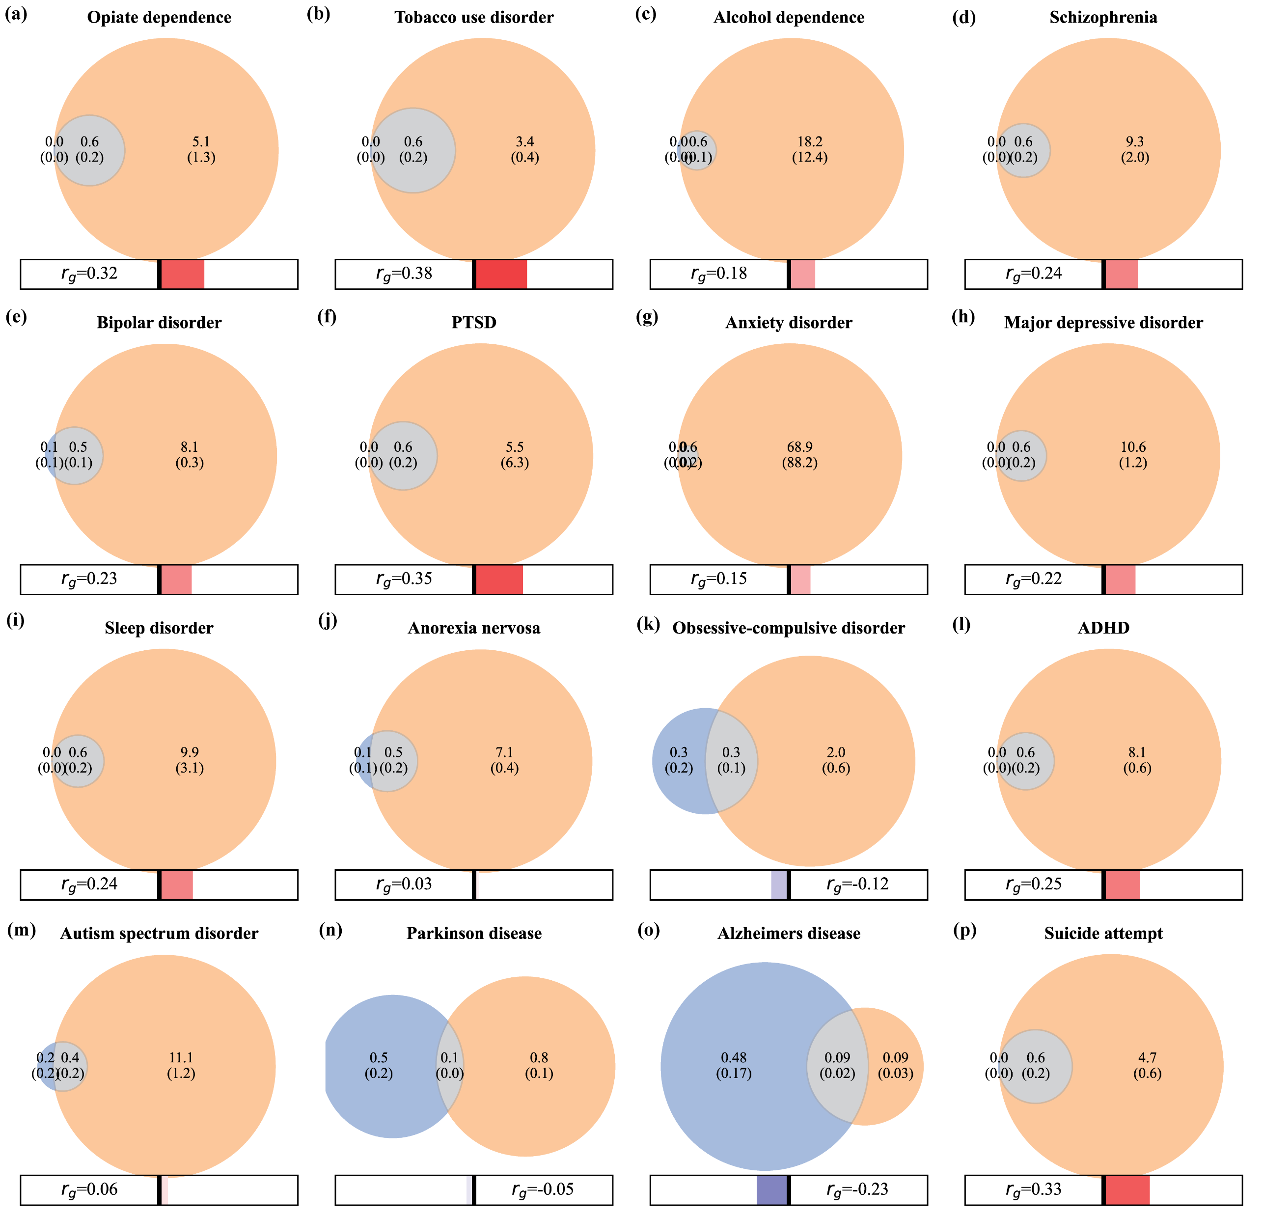
Notes:
Supplementary Figure 2

Slide 10
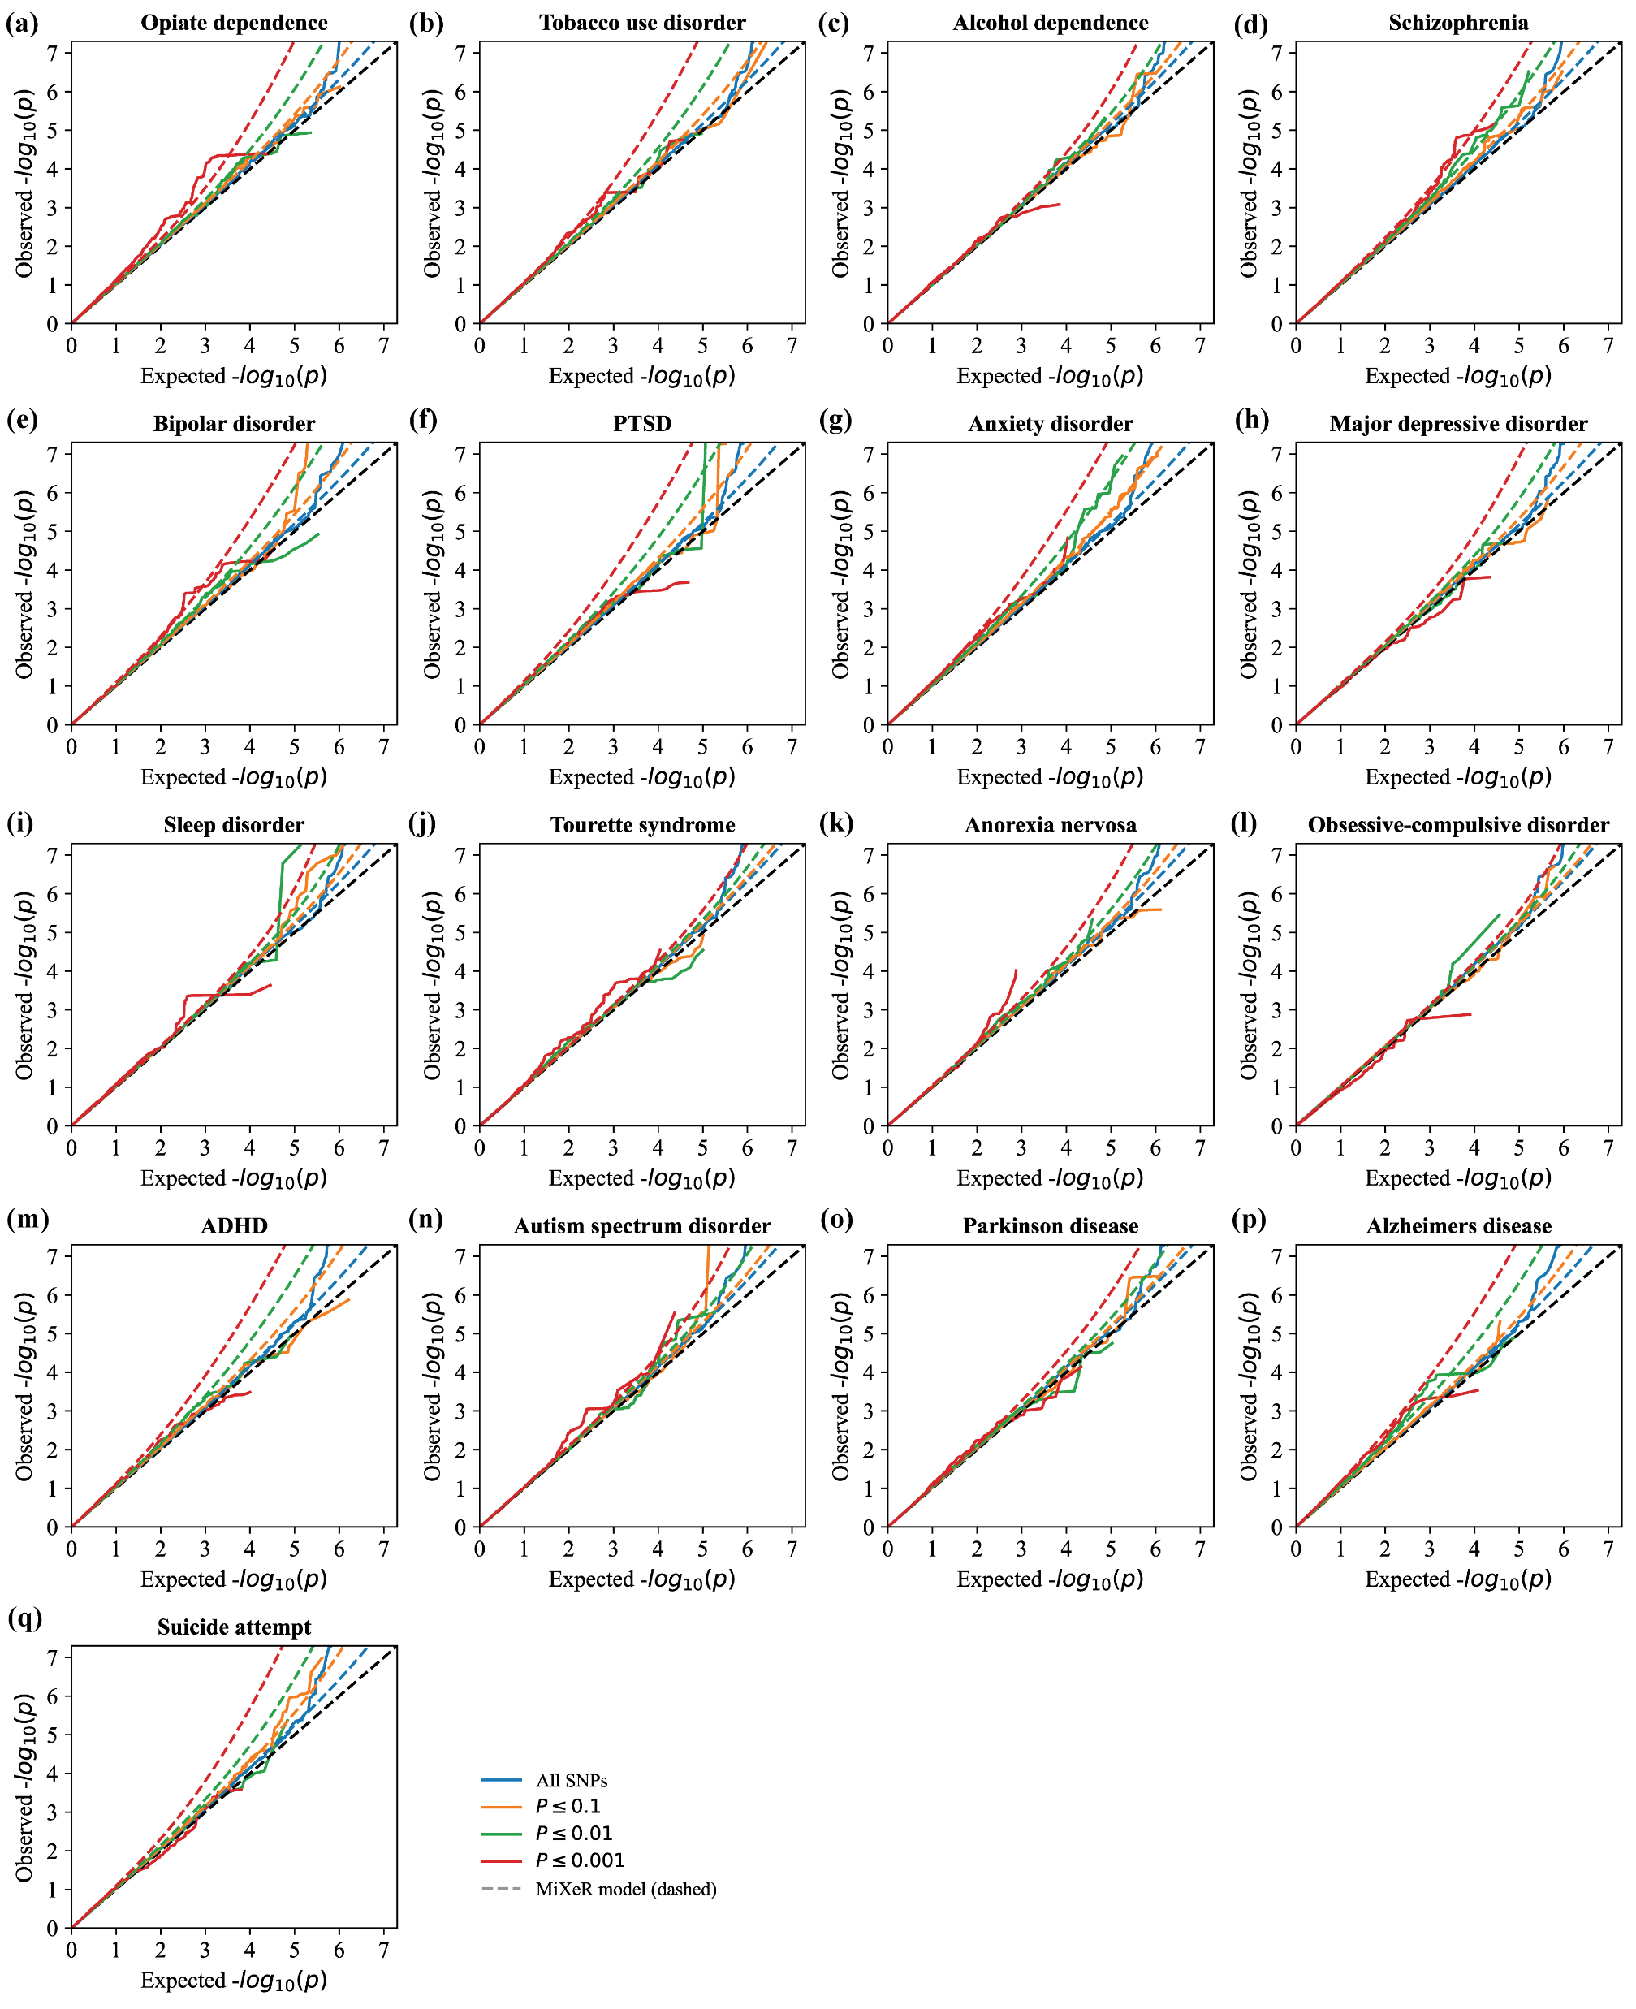
Notes:
Supplementary Figure 3

Slide 11
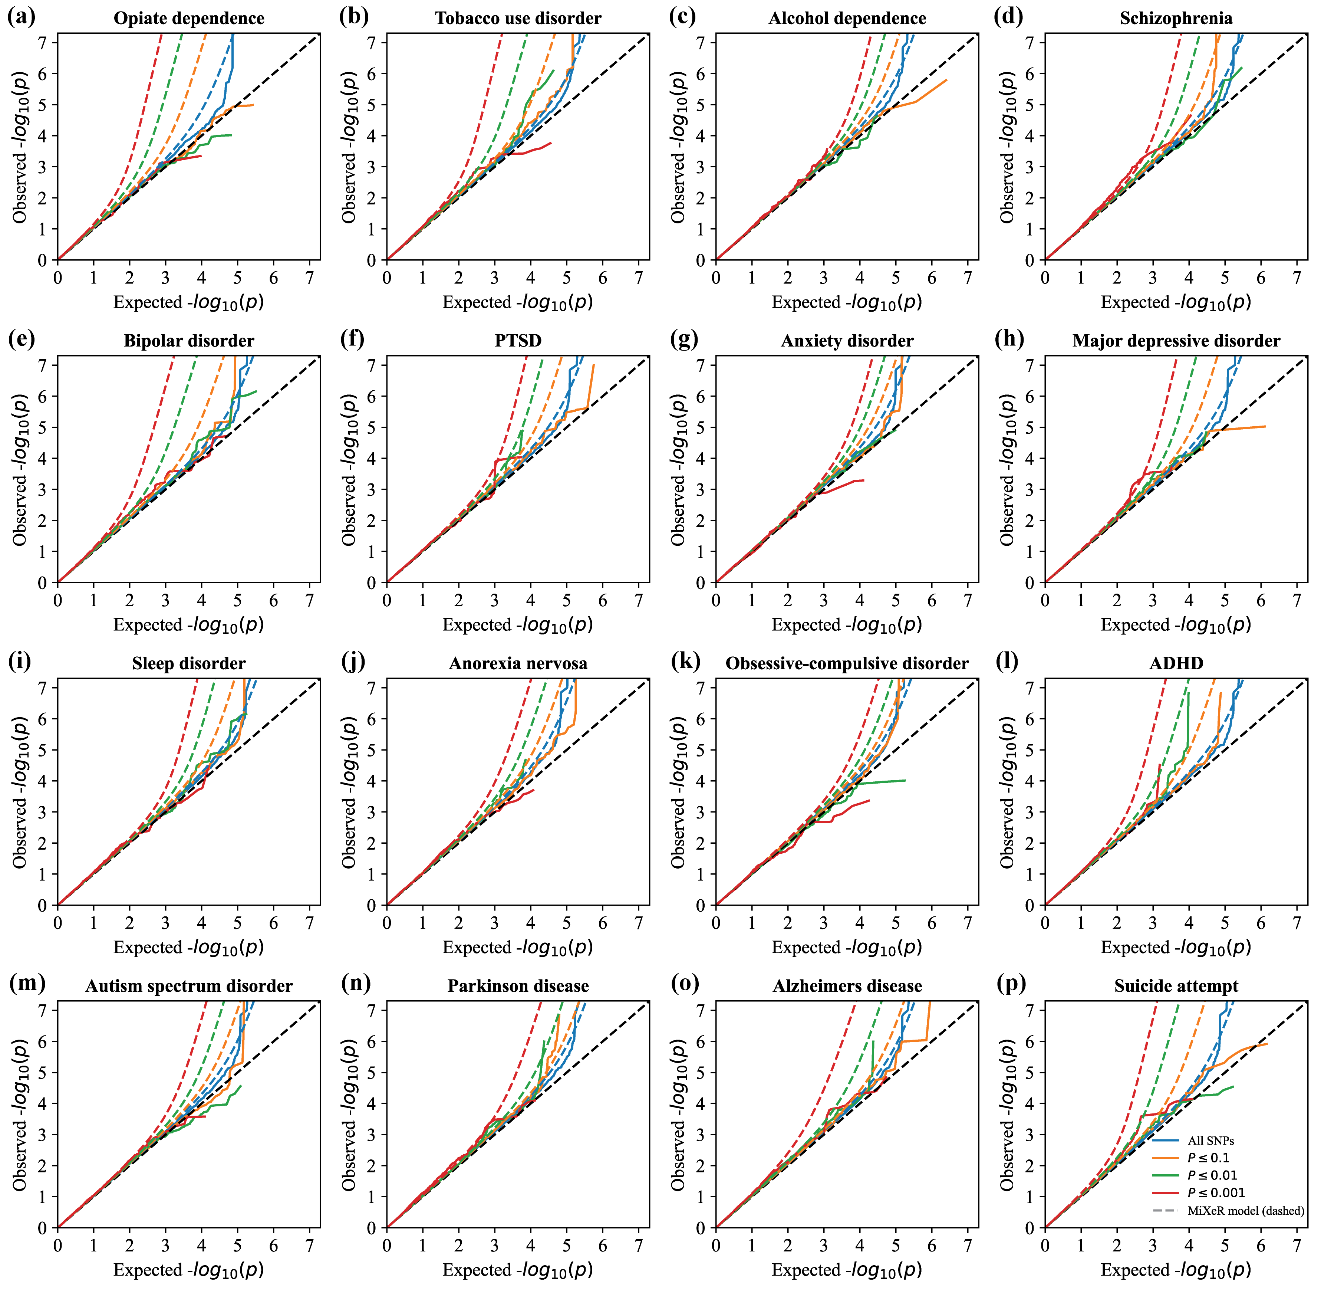
Notes:
Supplementary Figure 4

Slide 12
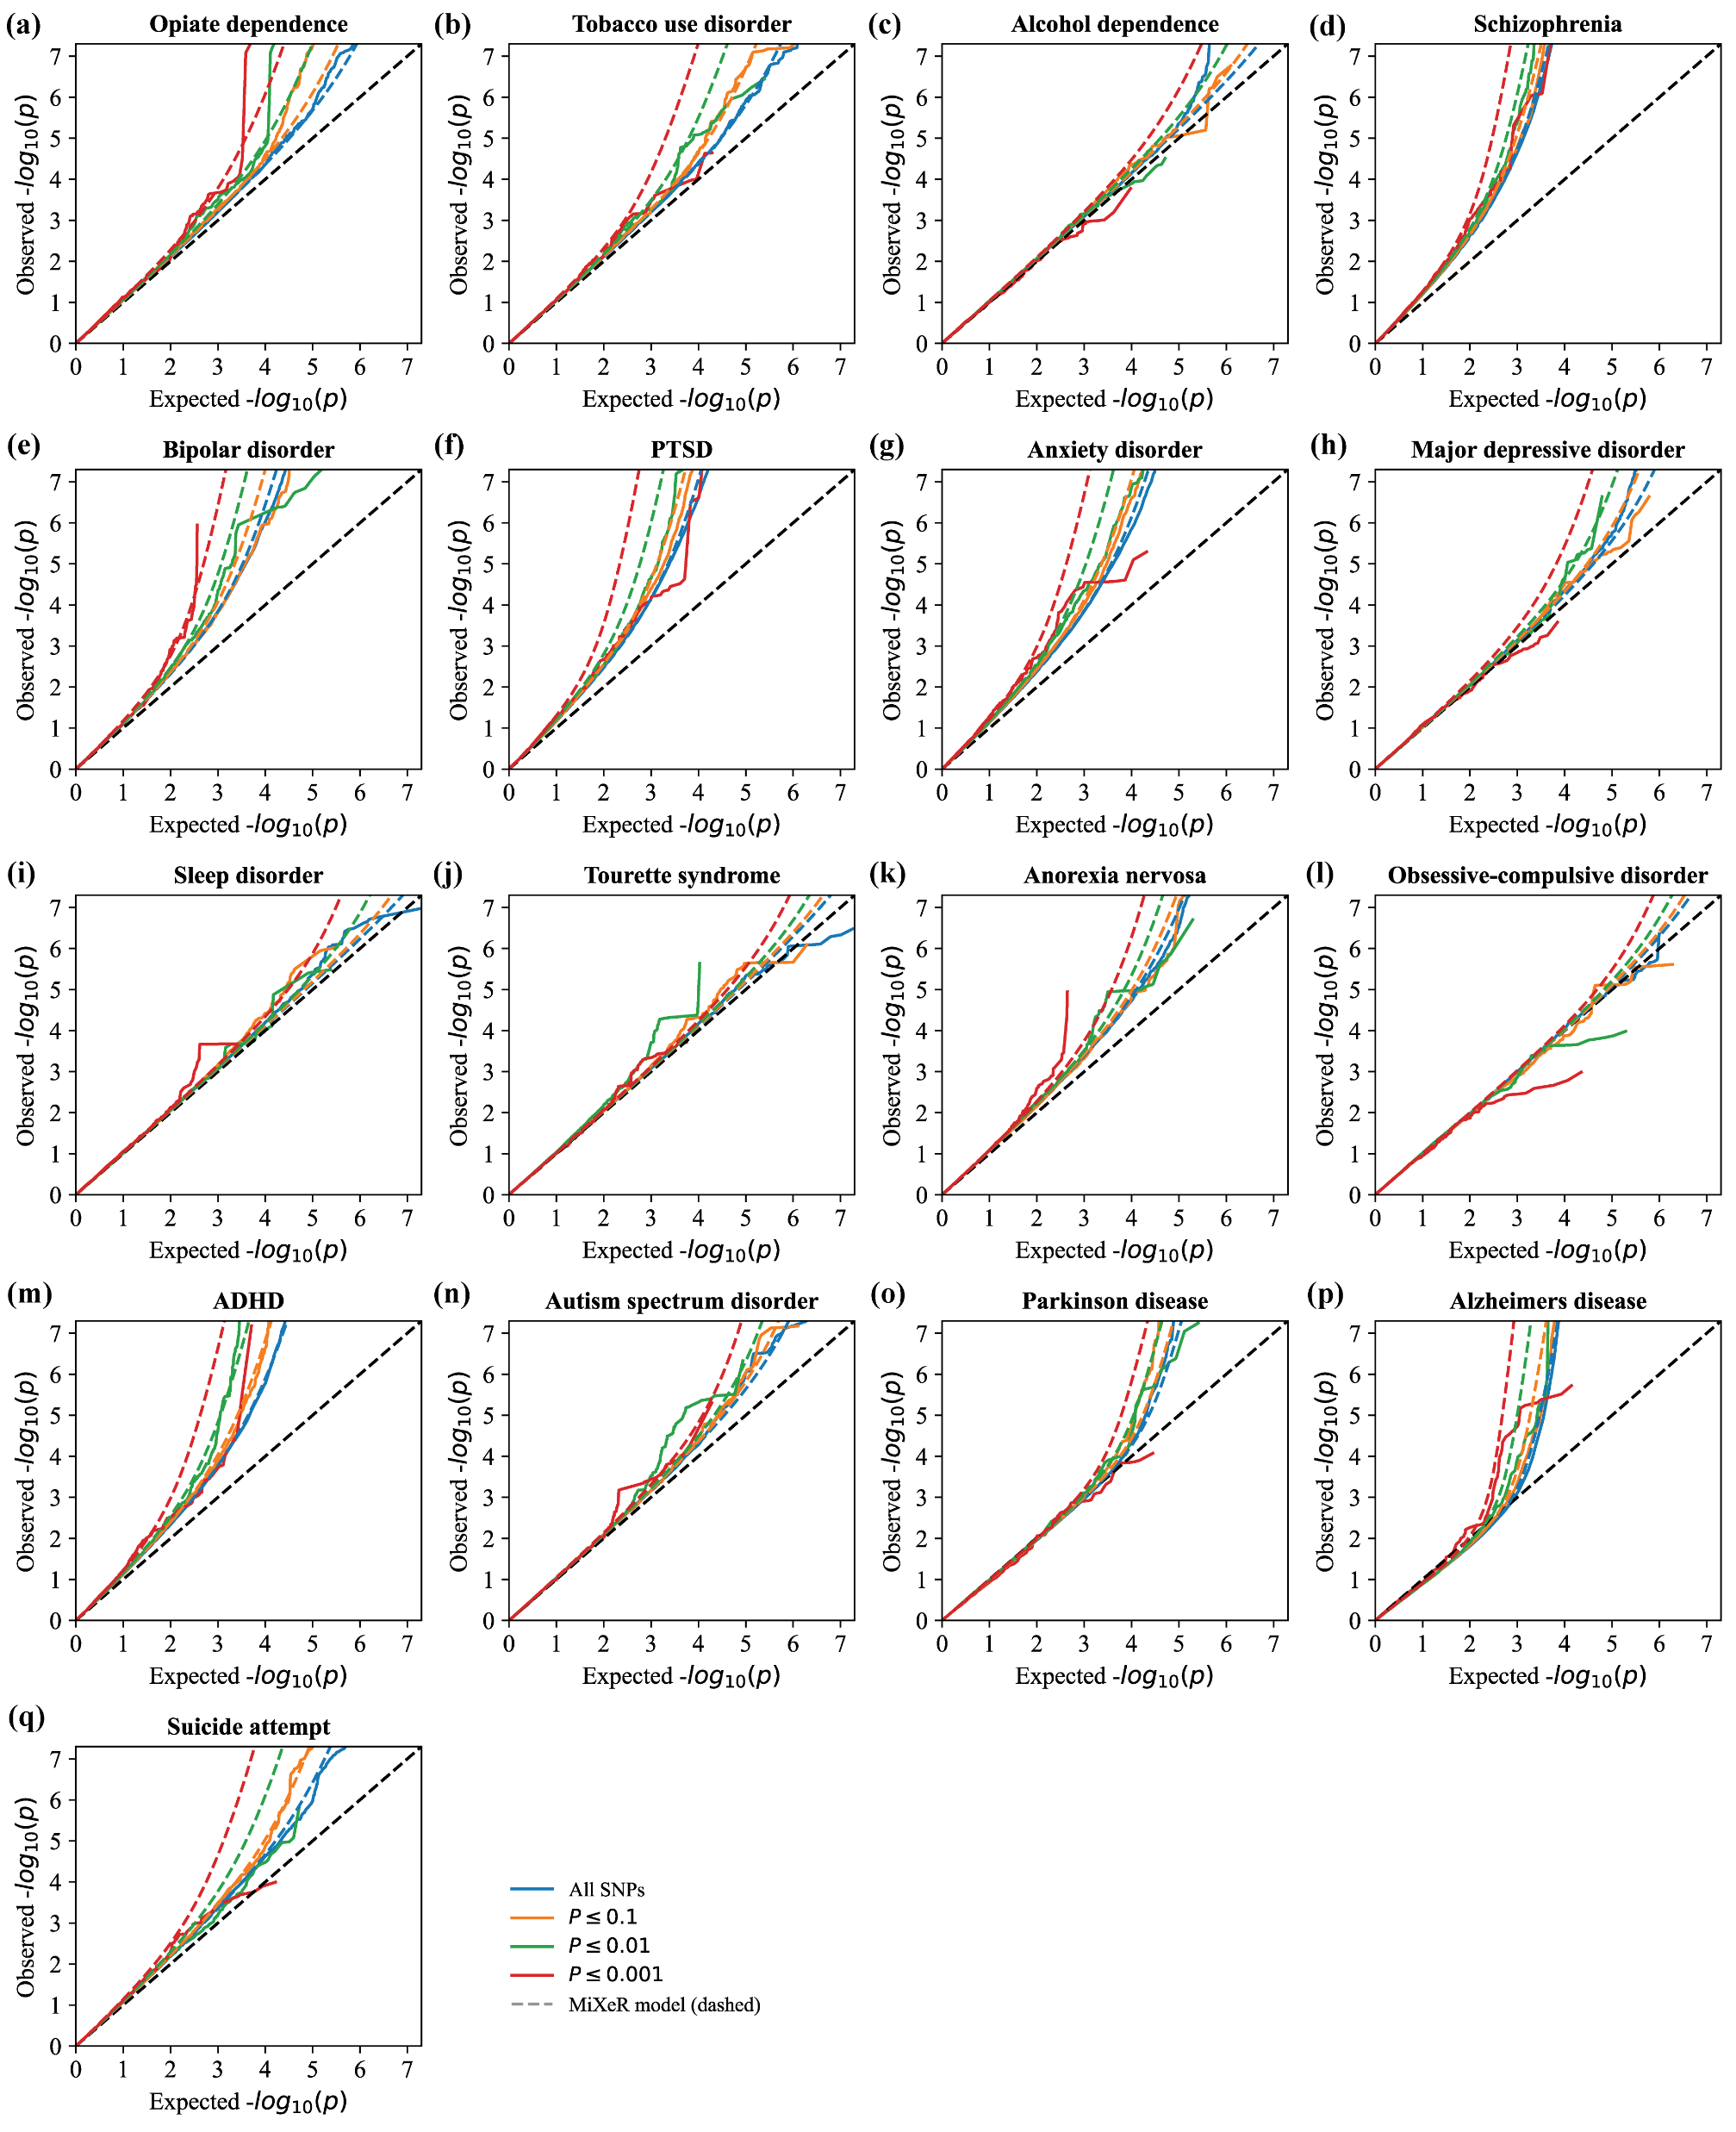
Notes:
Supplementary Figure 5

Slide 13
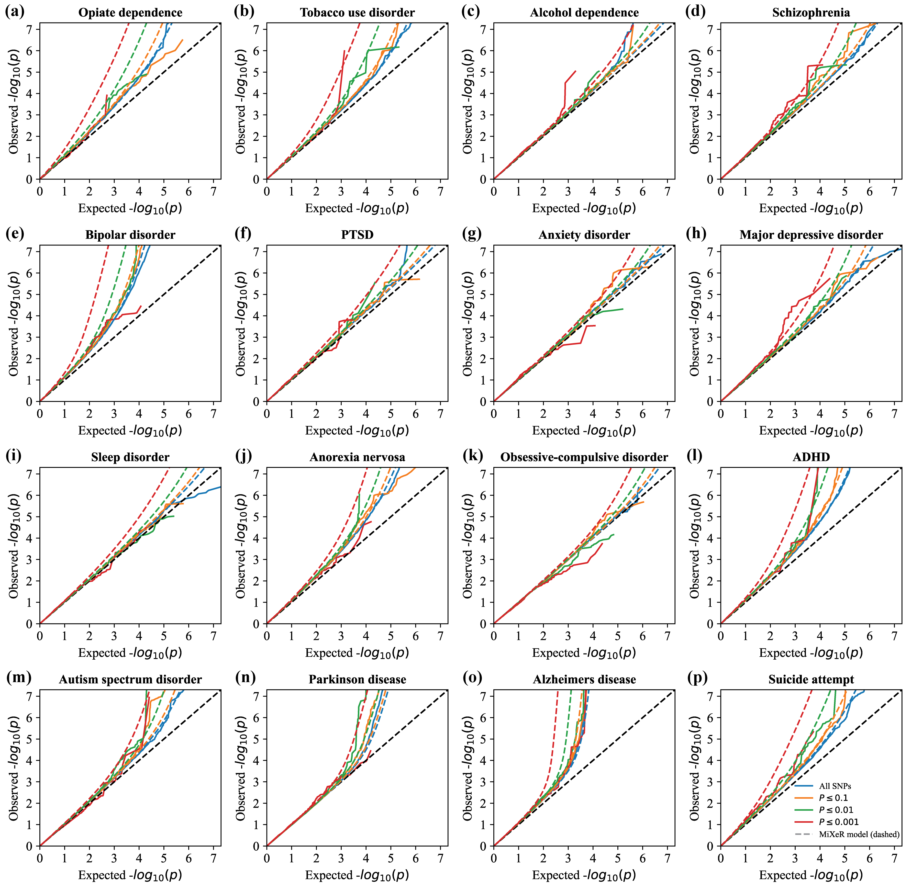
Notes:
Supplementary Figure 6

Slide 14
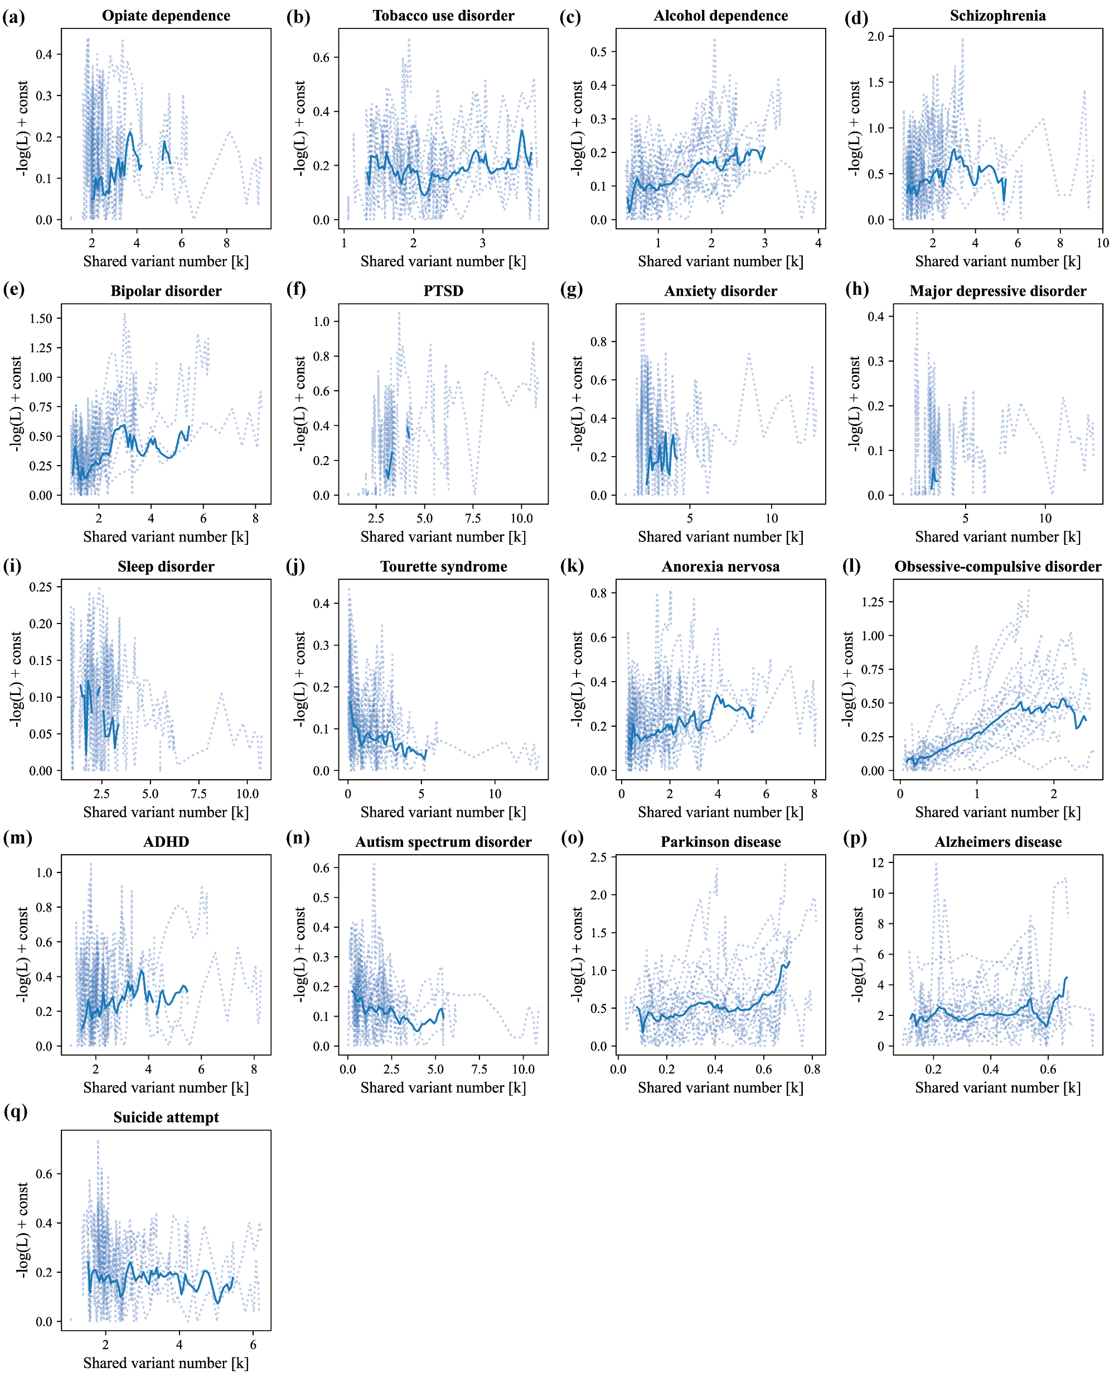
Notes:
Supplementary Figure 7

Slide 15
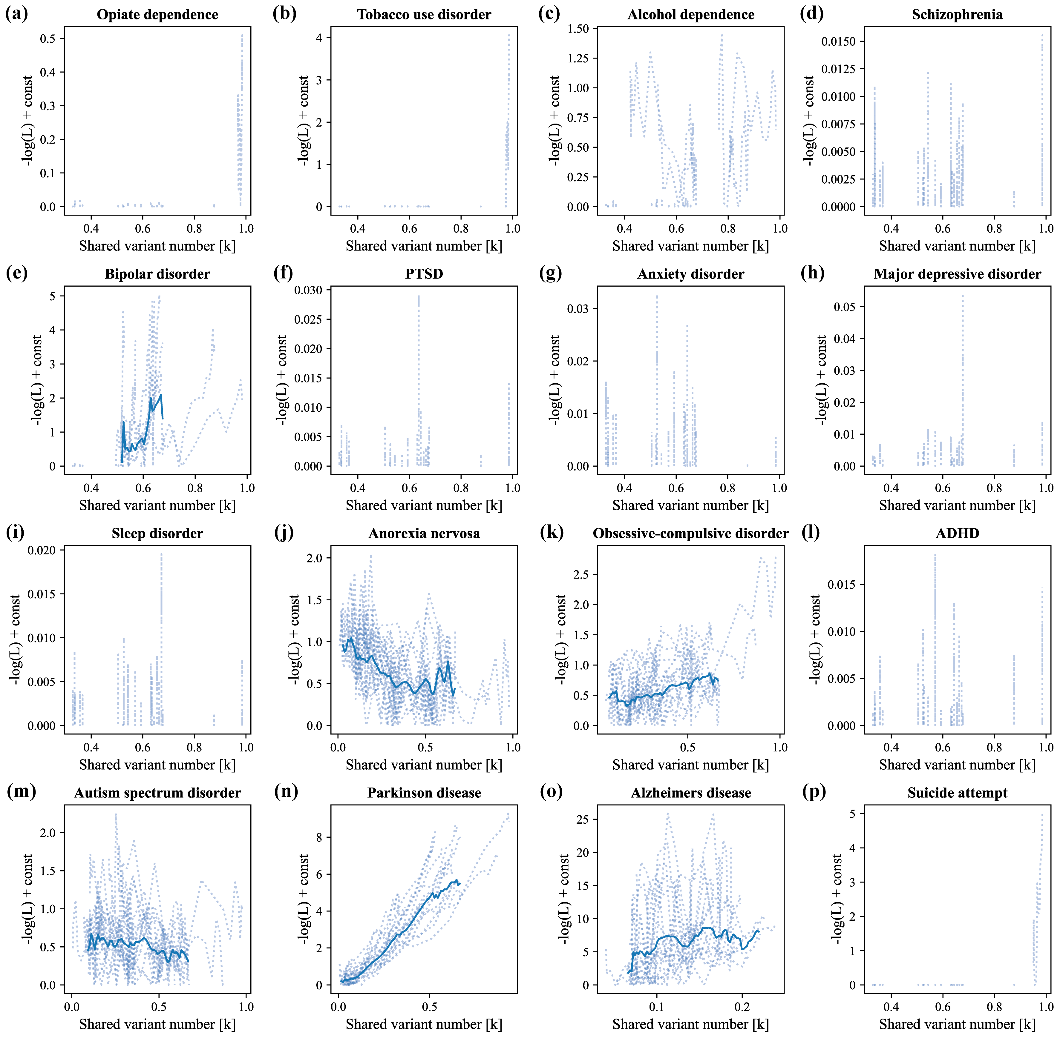
Notes:
Supplementary Figure 8

Slide 16
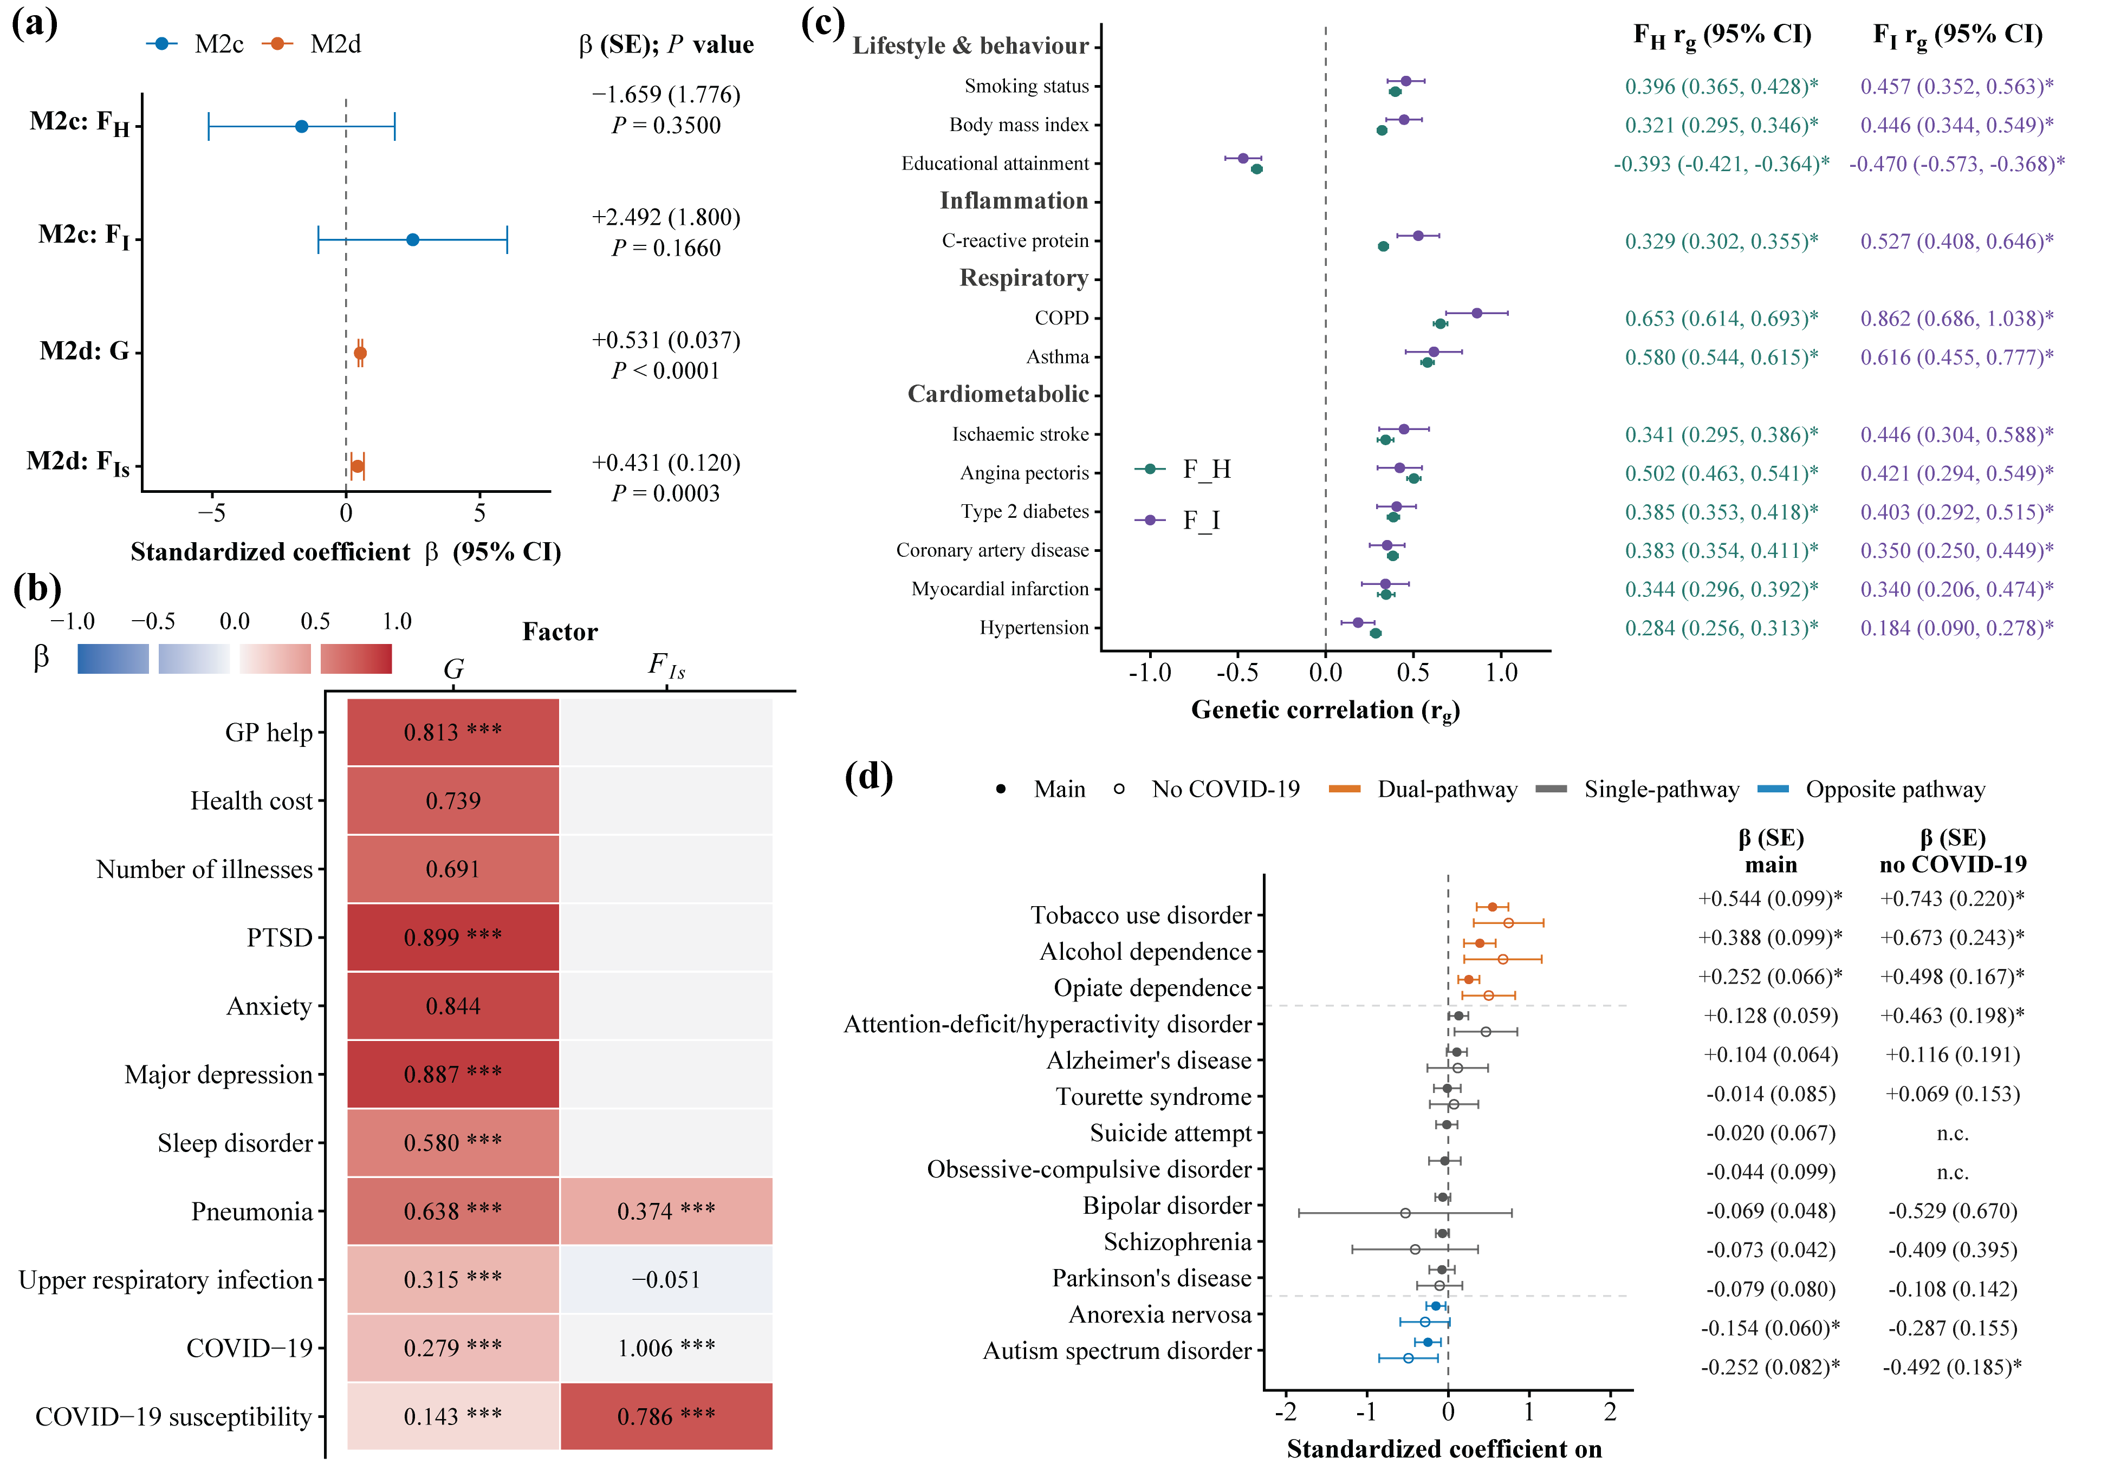
Notes:
Supplementary Figure 9

Slide 17
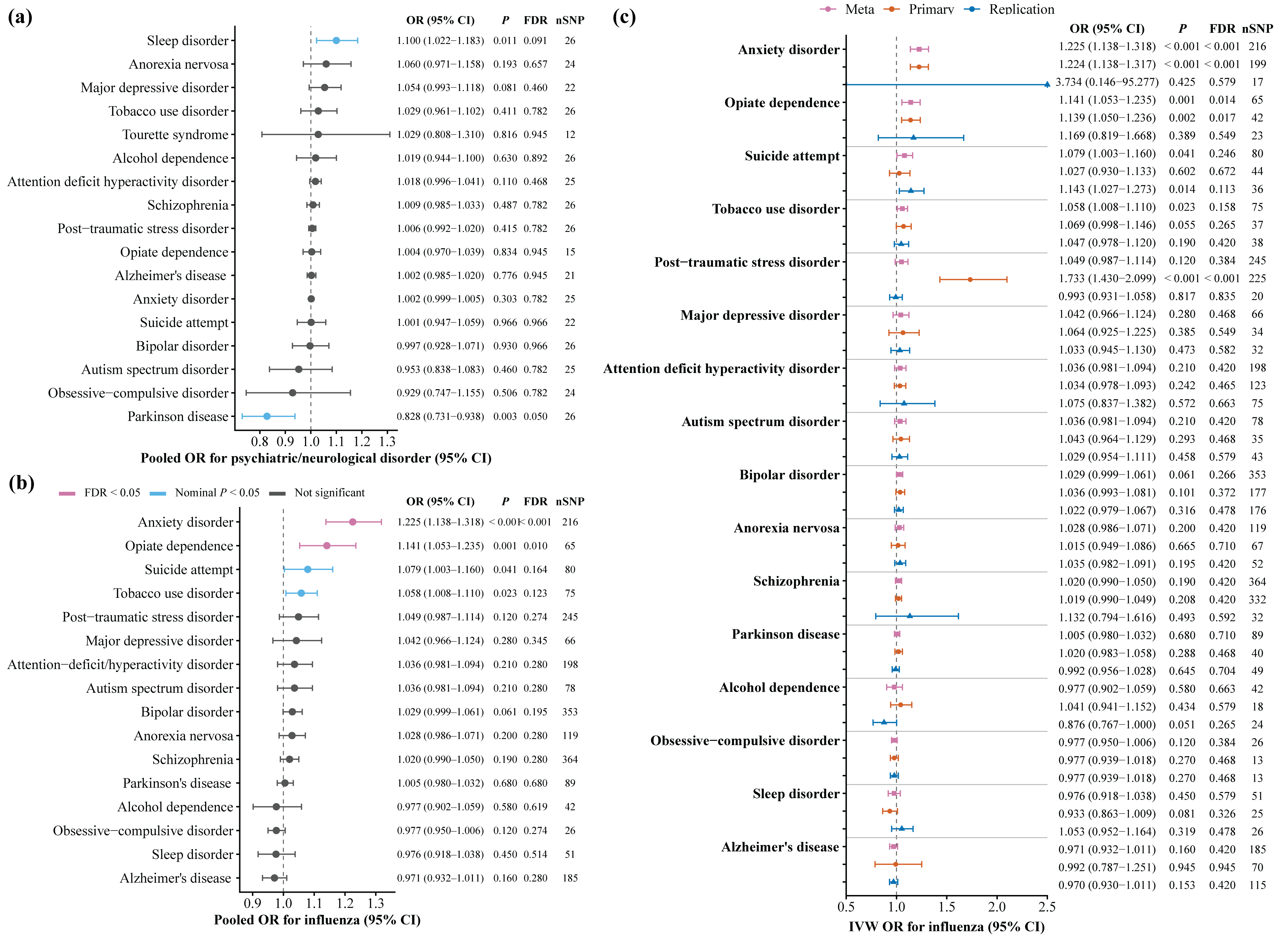
Notes:
Supplementary Figure 10

Slide 18
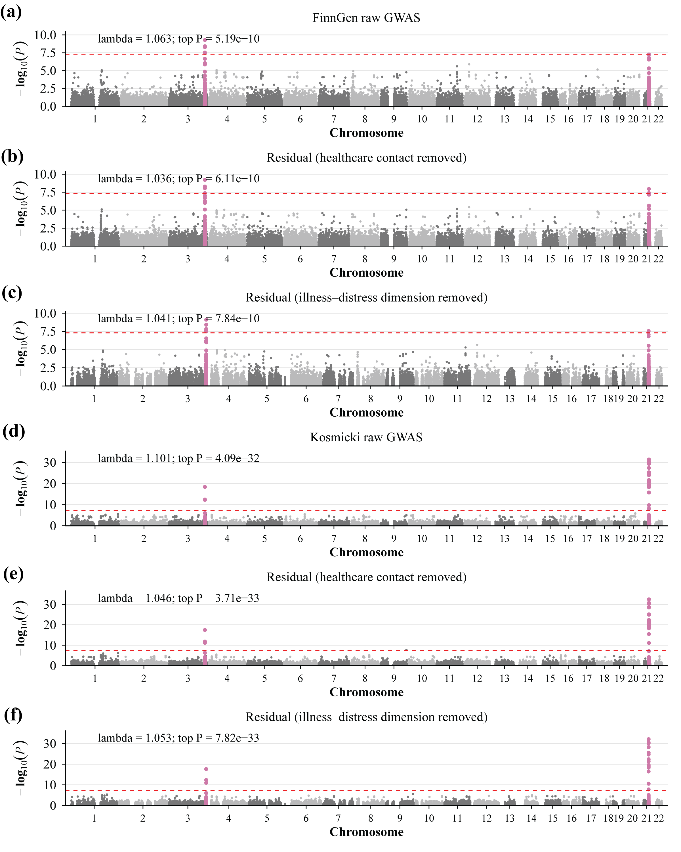
Notes:
Supplementary Figure 11

Slide 19
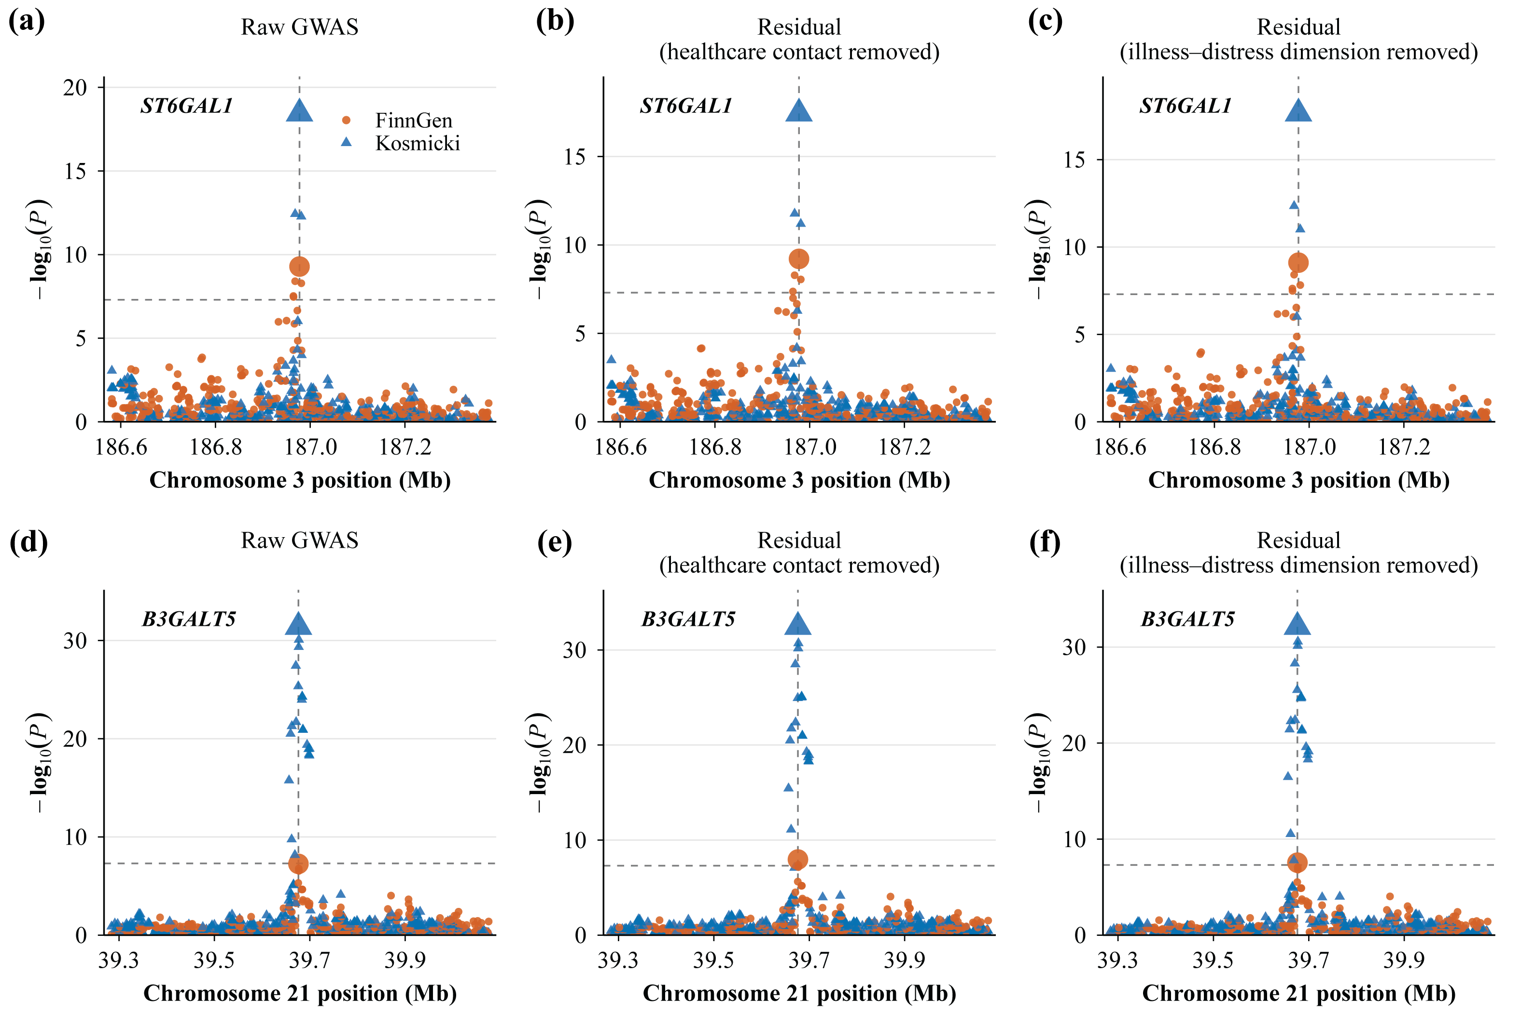
Notes:
Supplementary Figure 12

Slide 20
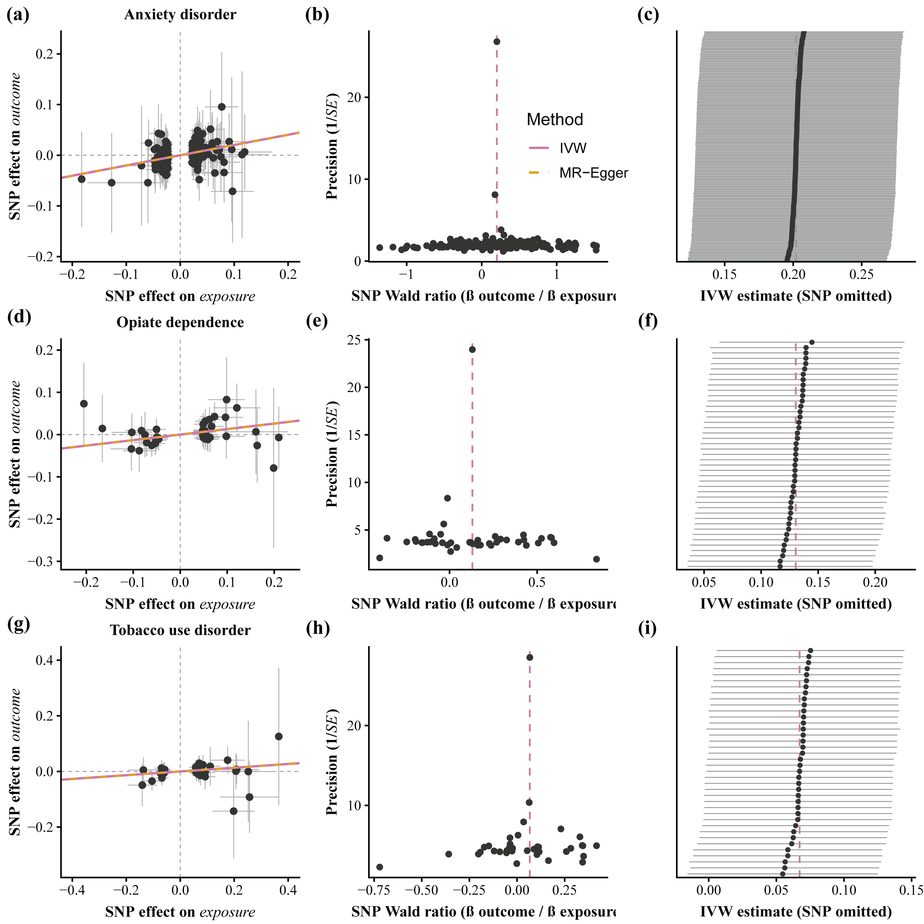
Notes:
Supplementary Figure 13

Slide 21
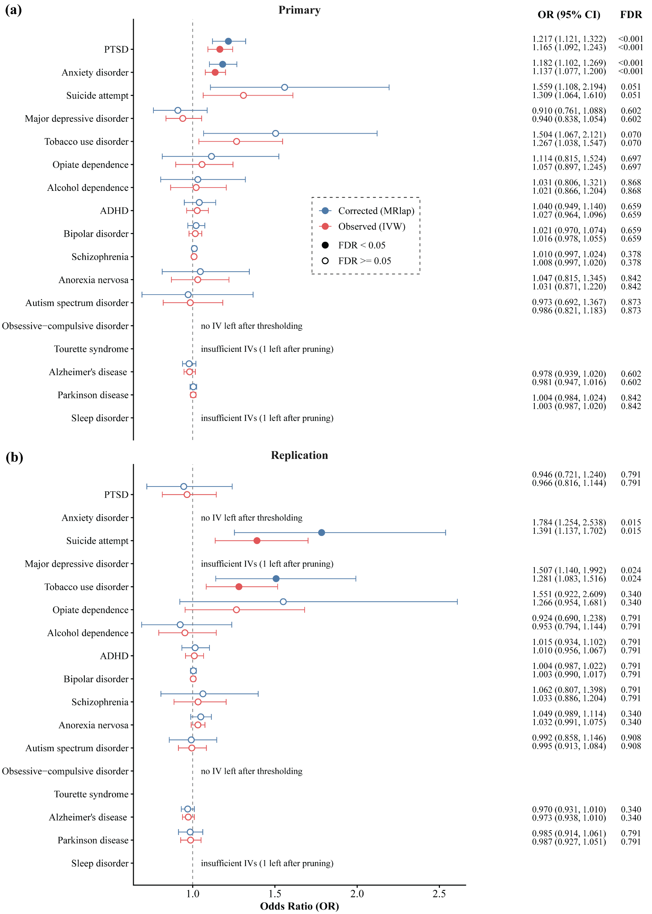
Notes:
Supplementary Figure 14

Slide 22
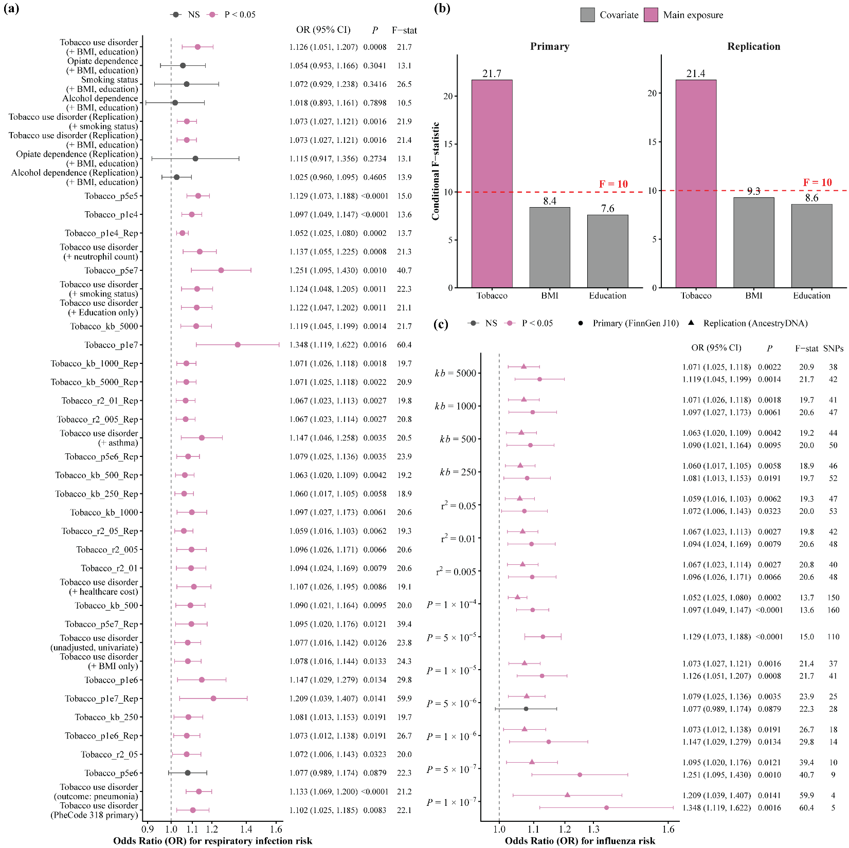
Notes:
Supplementary Figure 15

Slide 23
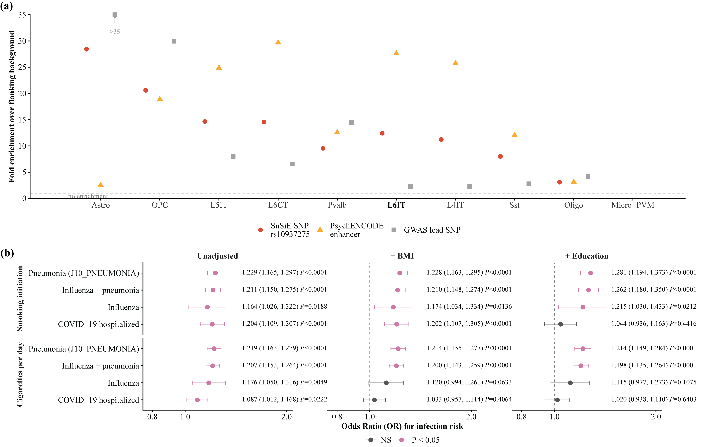
Notes:
Supplementary Figure 16

Slide 26
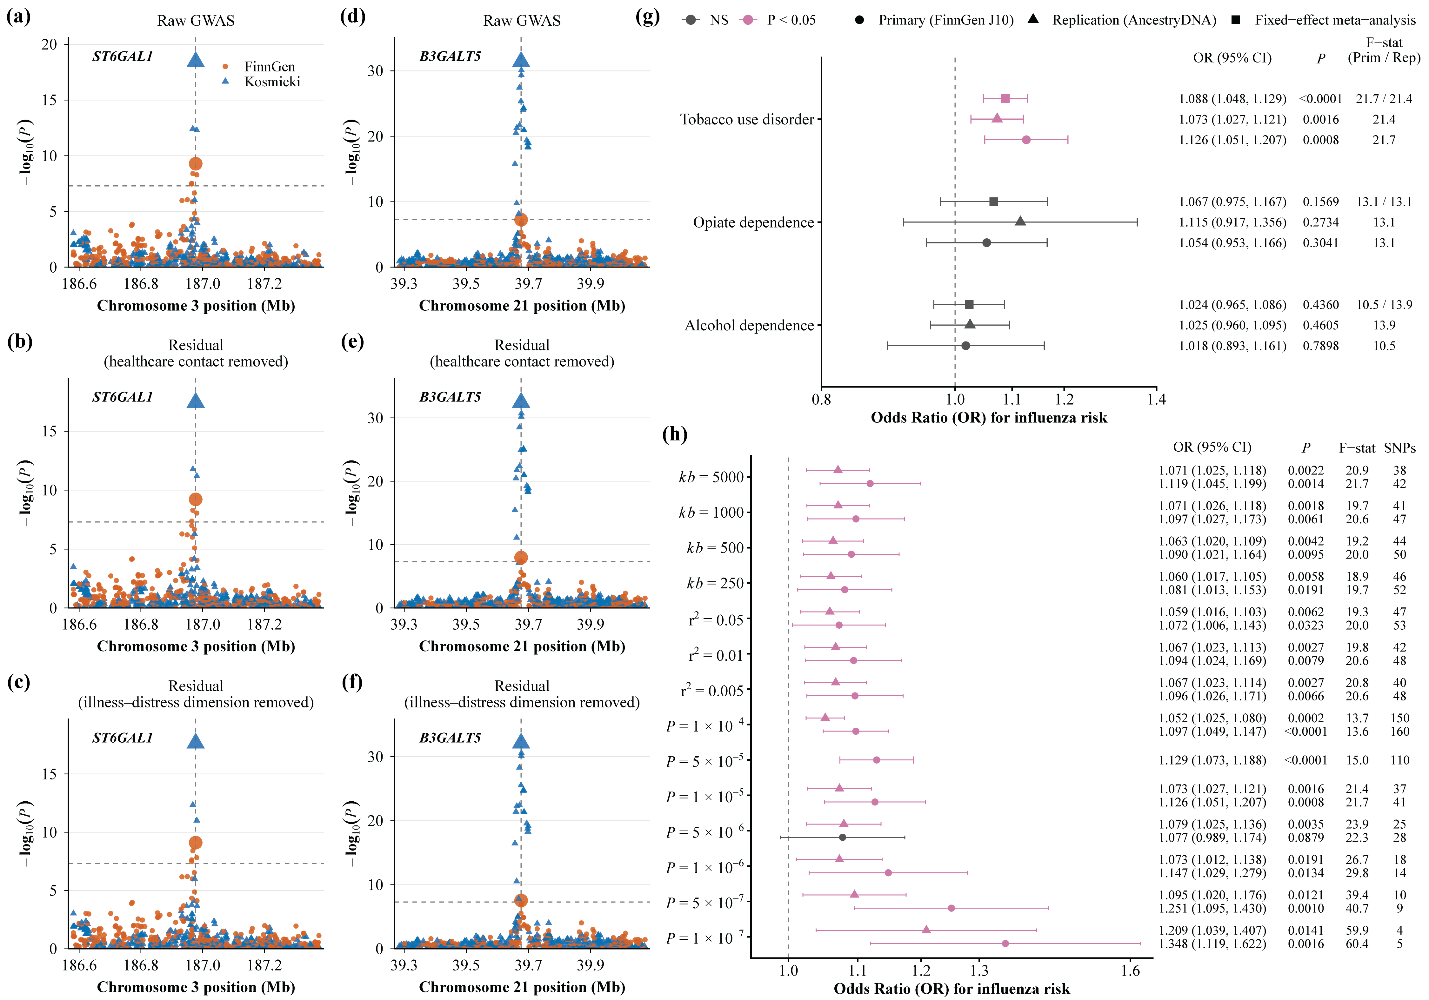
Notes:
Figure 6

