Slide 1

Maryi Tatiana Palacios Giraldo Master of Science in Data Science Regis University MSDS 692 Practicum I June 2026
Predicting Profitability in Logistics Operations Using ML

Slide 2

Context
Gallagher Transport International is a U.S. based customs brokerage and freight logistics company.
The company manages international shipments through multiple transportation modes, including air, ocean, and ground freight.
Main business are companies that import products to the US, also household goods imports.

Slide 3
Objective
Develop a machine learning model to predict shipment profitability and identify factors associated with successful shipment outcomes.

Slide 4
Data Understanding
8,270 shipment records
49 variables
Data extracted from CargoWise
Study period: Dec 2025 – May 2026
Key Data Categories:
Transportation: Mode, Transport Type, Origin Port, Destination Port
Financial: Revenue, Cost, Total Expense, Job Profit
Time Variables: ETD, ETA, ATA, Job Opened
Operational: Weight, Volume, TEU, Packs
Business Entities: Suppliers, Importers, Clients

Slide 5
Data Cleaning
Removed high-missing columns
Imputed categorical with "Unknown“
Used median for numeric variables
Applied logical imputation for dates

Slide 6
EDA
1. Shipment Characteristics
Declarations by Month
Transport Type Distribution
Branch Distribution
2. Profitability Analysis
Monthly Profit Trend
Profit by Branch
Revenue vs Profit
3. Delay Analysis
Delay Distribution
Delay by Transport Type
Delay vs Profit

Slide 7
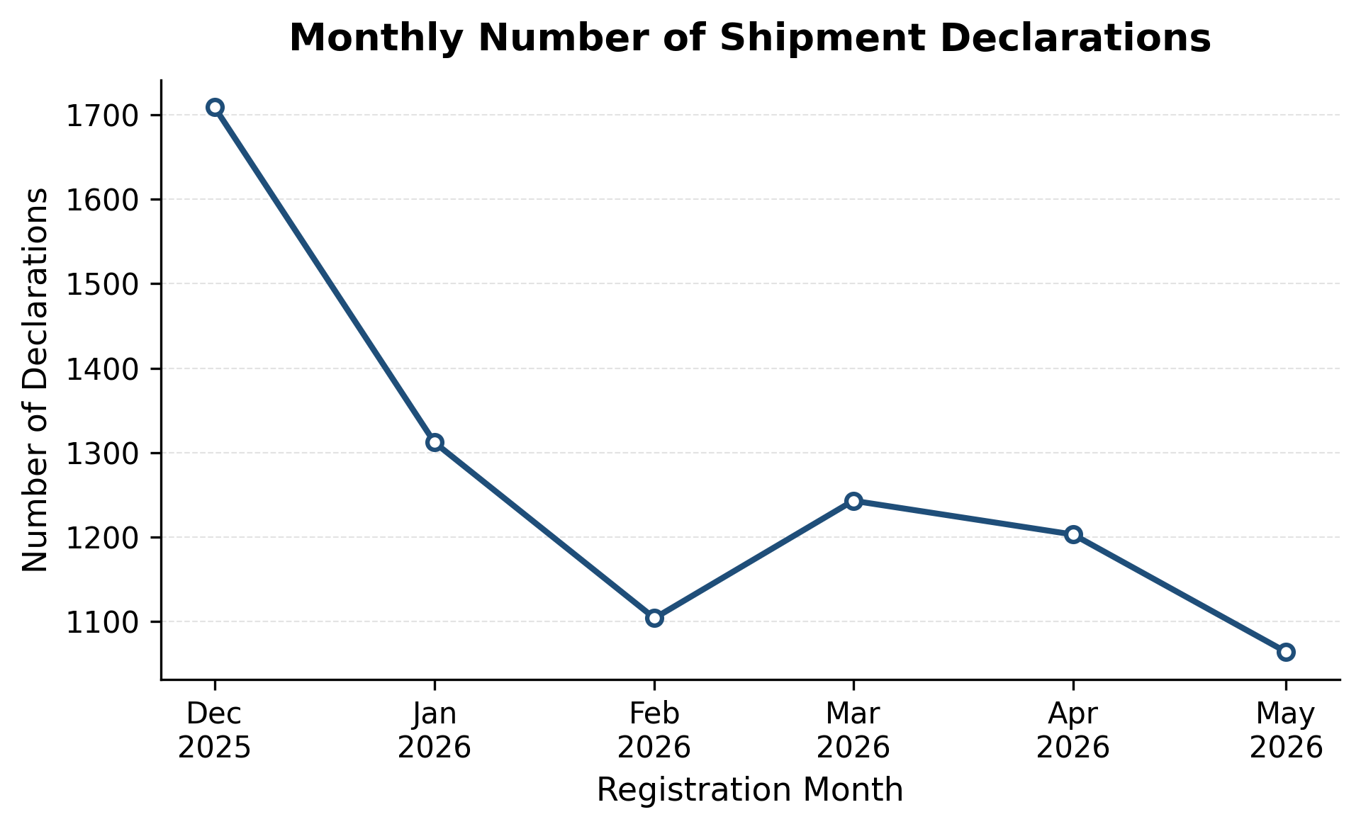
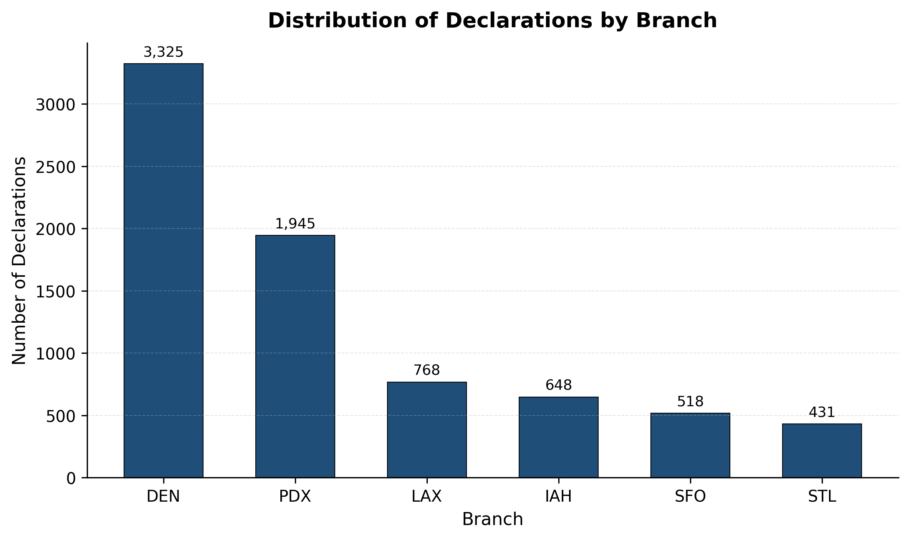
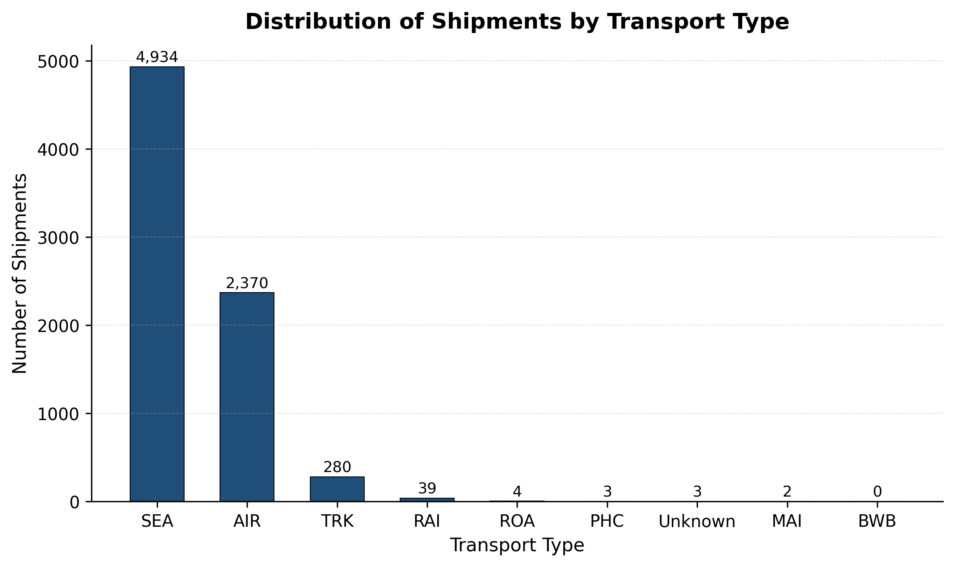
Shipment Characteristics
Shipment volume decreased after December 2025.
DEN and PDX handled most declarations.
Ocean freight dominated shipment activity.

Slide 8
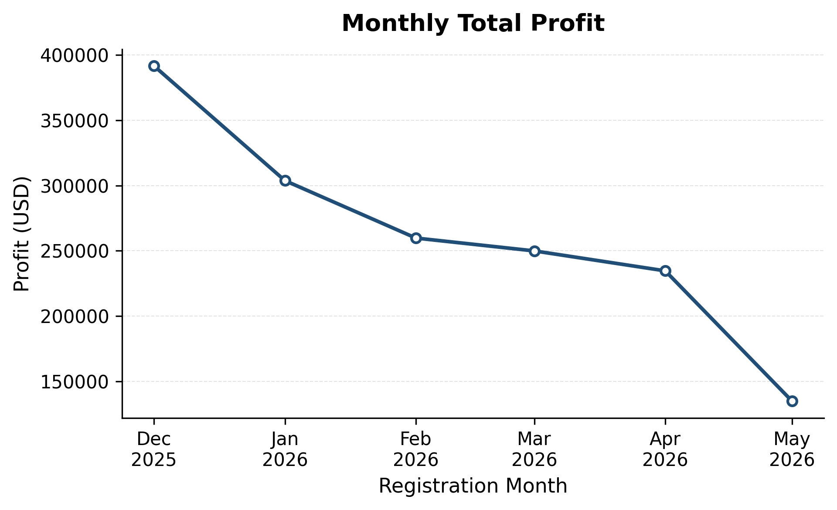
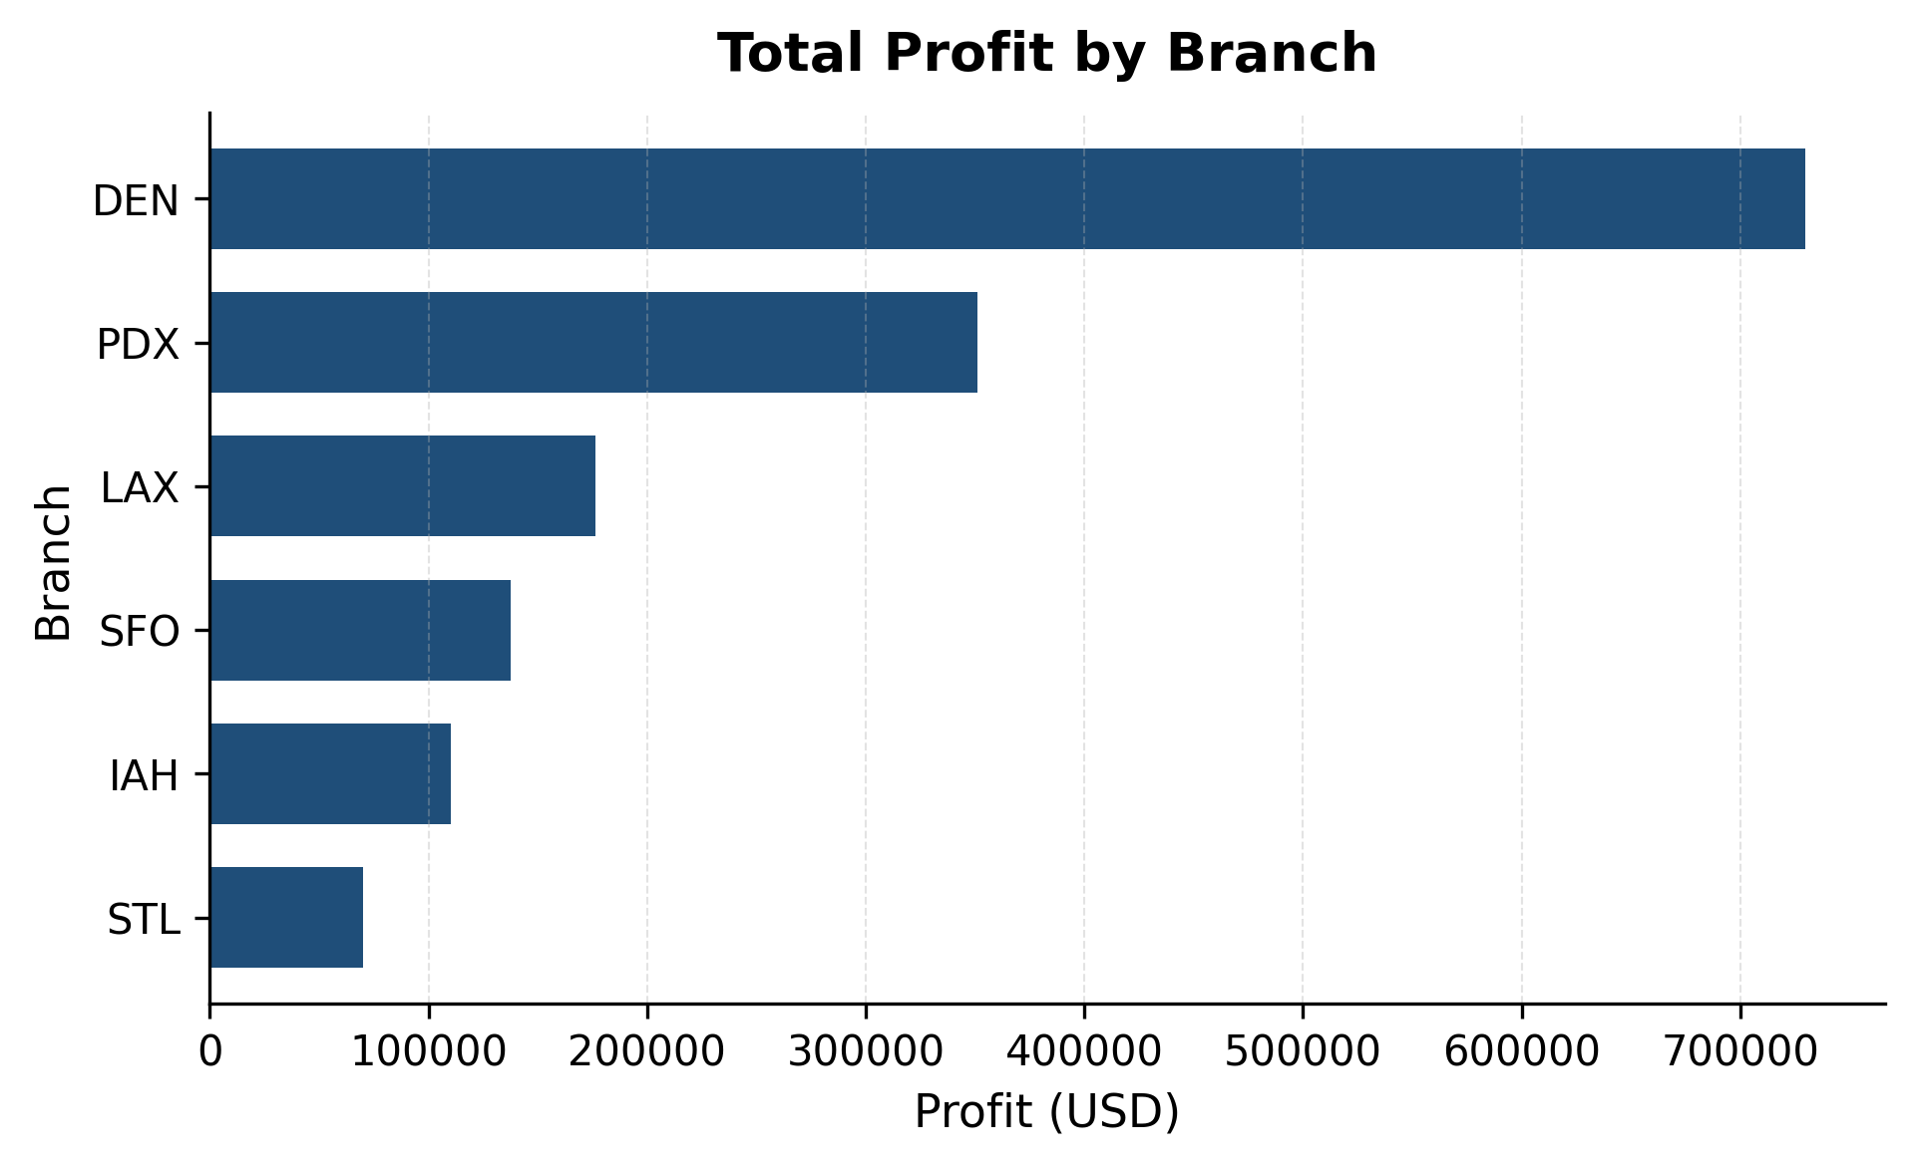
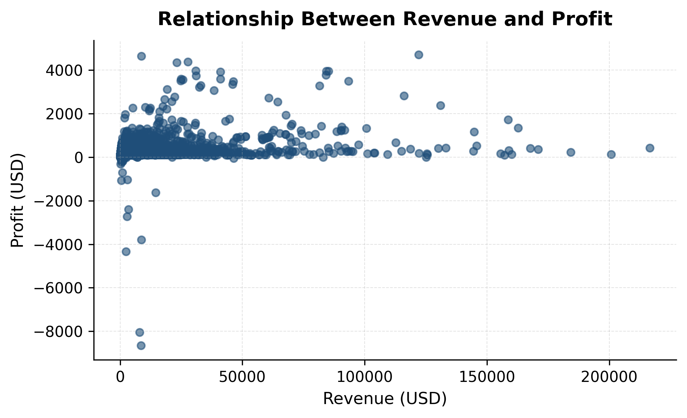
Profitability Analysis
Total profit declined steadily throughout the study period.
DEN generated the highest profit, followed by PDX.
Higher revenue does not always result in higher profit.

Slide 9
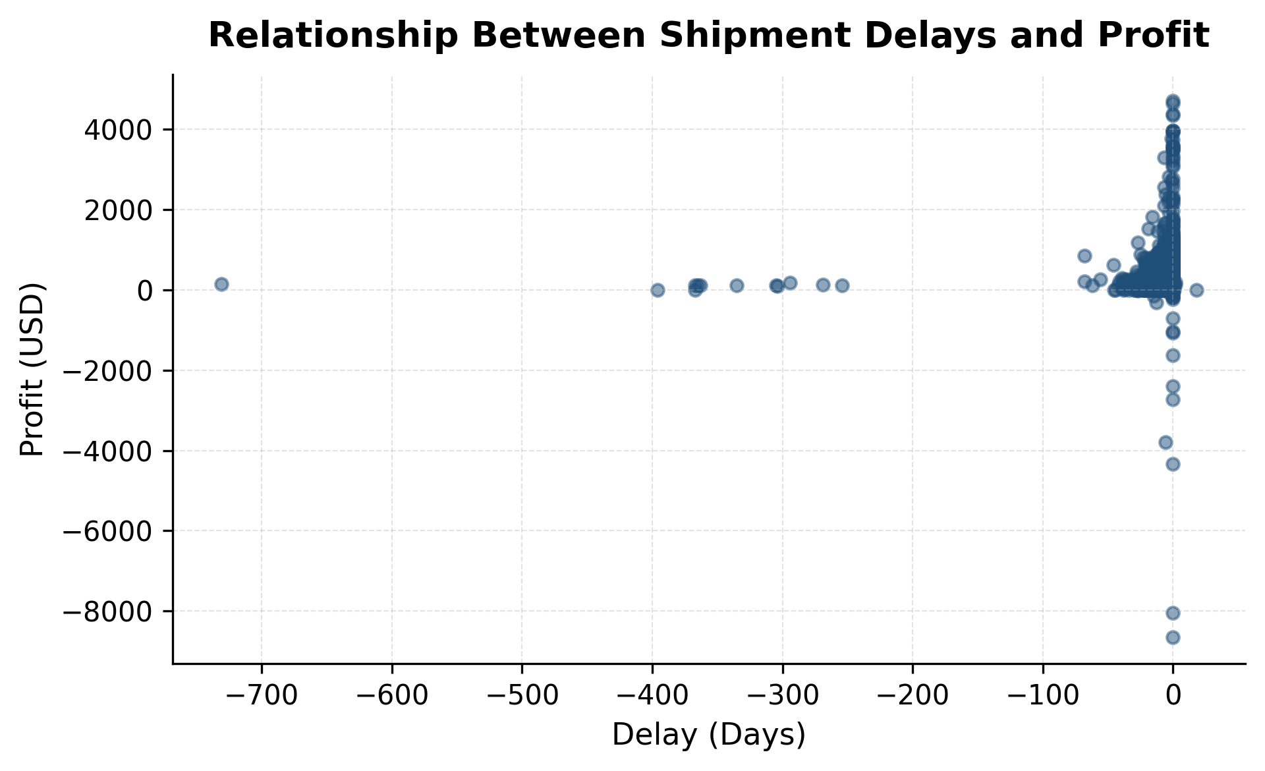
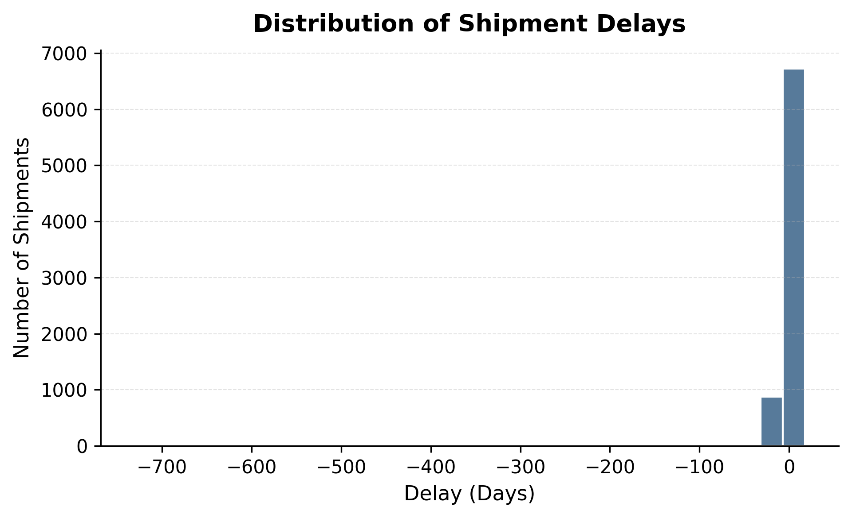
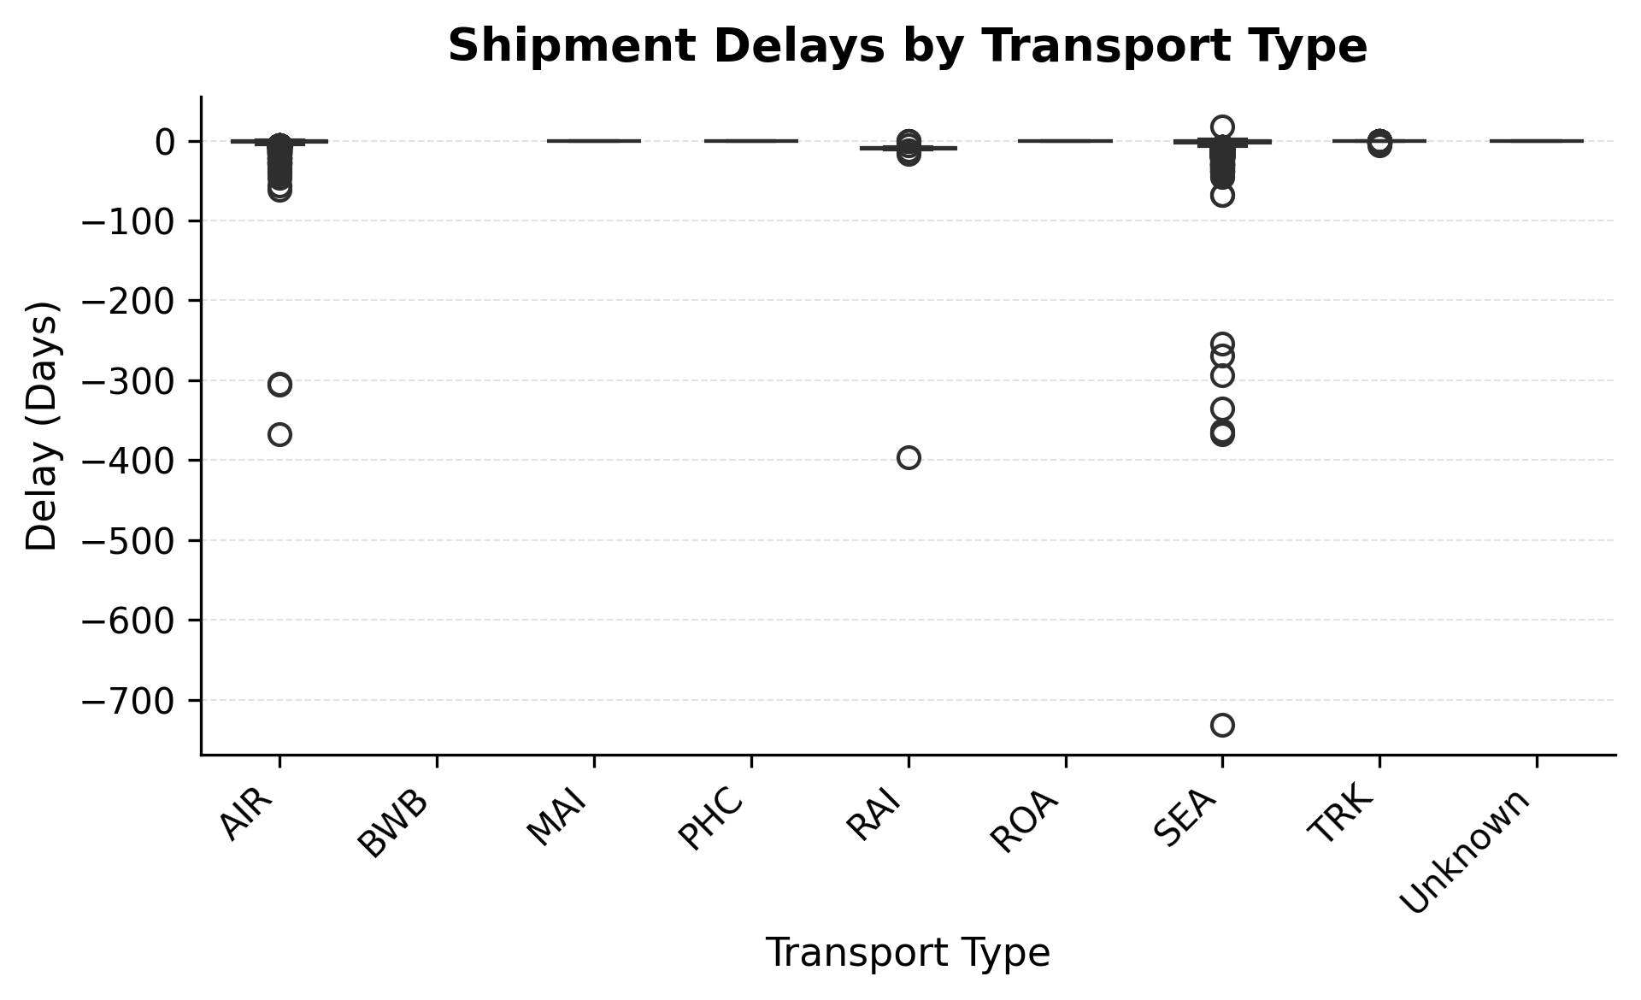
Delay Analysis
Most shipments experienced little to no delay.
Delay patterns were similar across transport types.
No clear relationship was observed between delays and profitability.

Slide 10
Feature Engineering
Created new features to capture seasonality, operational efficiency, and shipment structure.
Category | Features Created
Temporal | Month, Quarter, Weekday
Operational | Transit Time, Total Process Time
Shipment | Weight-to-Volume Ratio

Slide 11
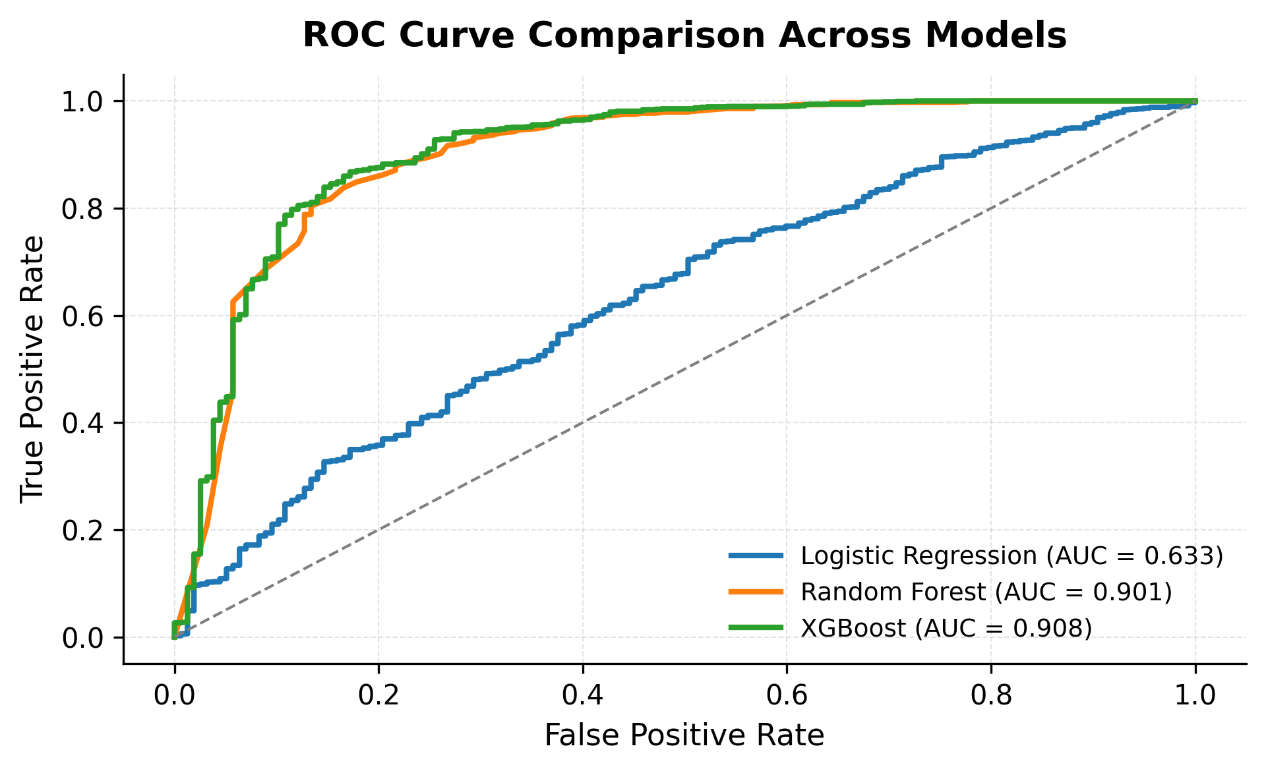
Model Comparison
Model Comparison
Model | Accuracy | ROC-AUC
Logistic Regression | 0.89 | 0.67
Random Forest | 0.93 | 0.93
XGBoost | 0.94 | 0.93
Tree-based models outperformed Logistic Regression.
Profitability depends on complex operational patterns.
Random Forest was selected for its strong performance and interpretability.

Slide 12
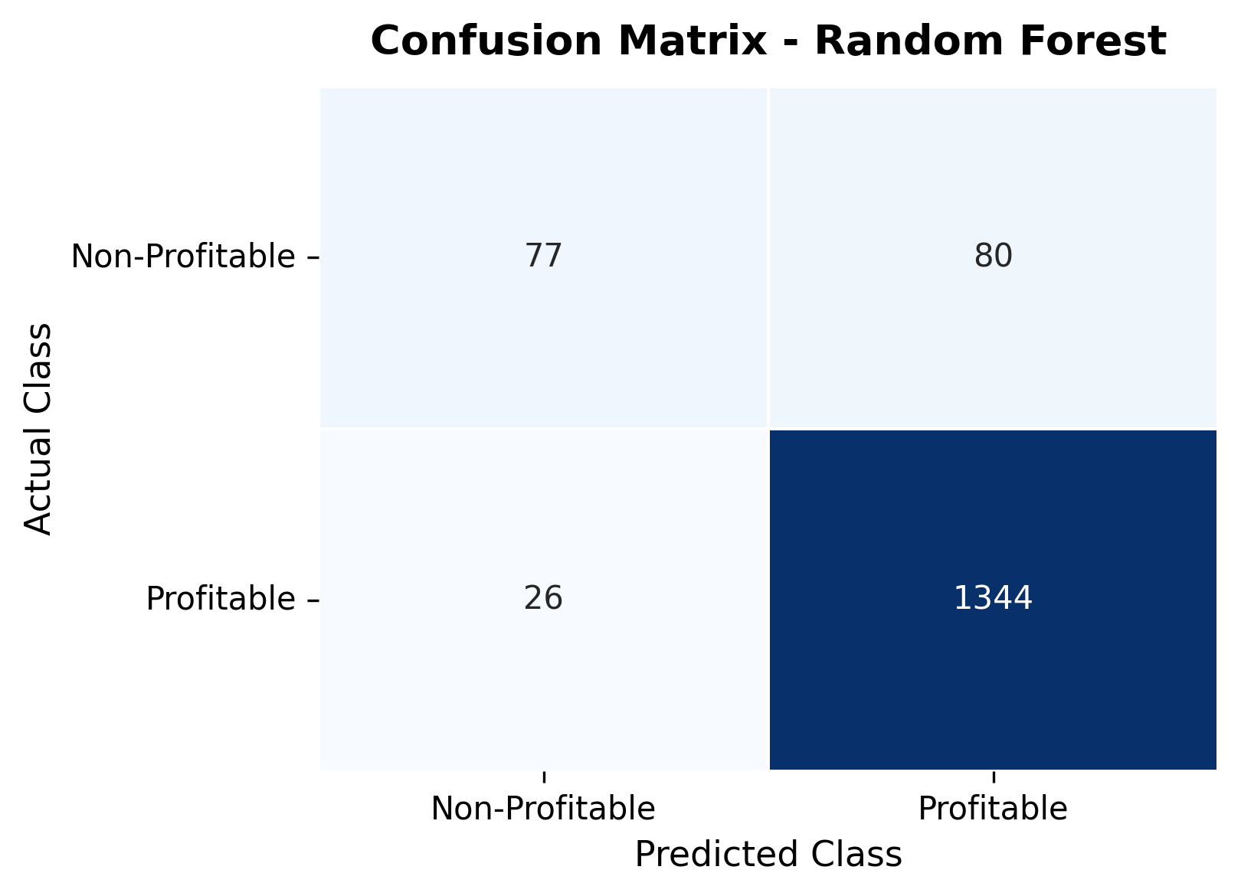
Model Selection
Highest overall predictive performance.
Strong ROC-AUC and classification results.
Better captured nonlinear shipment patterns.
More interpretable than XGBoost.
The Random Forest model correctly classified the majority of shipments, with relatively few prediction errors, demonstrating strong overall performance.

Slide 13
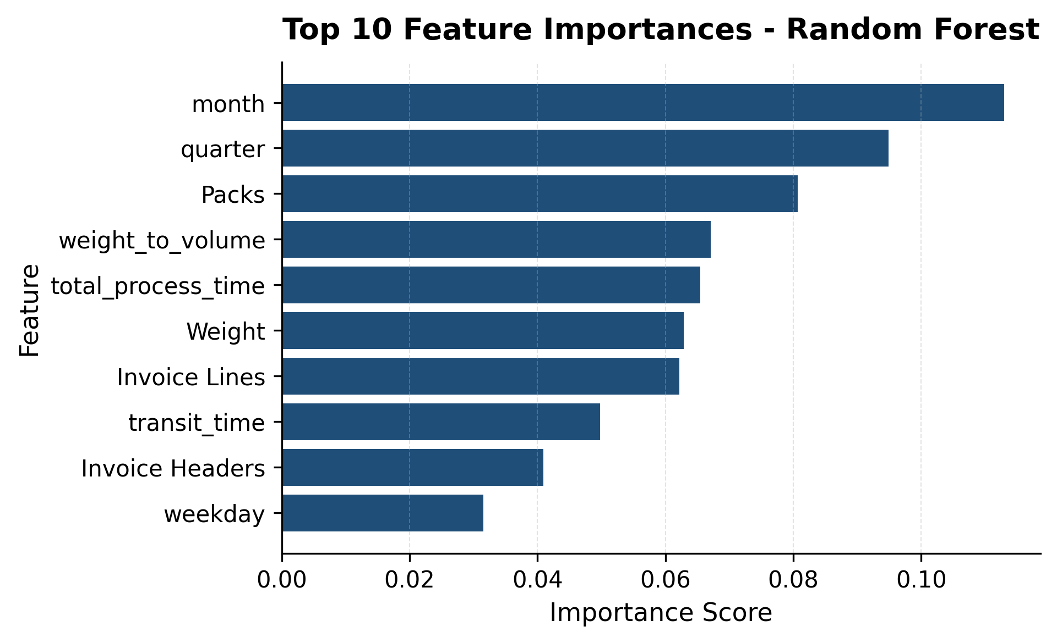
Feature importance

Slide 14
Conclusions
Profitability depends on multiple operational factors.
Seasonality and shipment characteristics matter most.
Random Forest was the best-performing model.
The model supports proactive shipment planning.

Slide 15
Thank you

