Slide 1
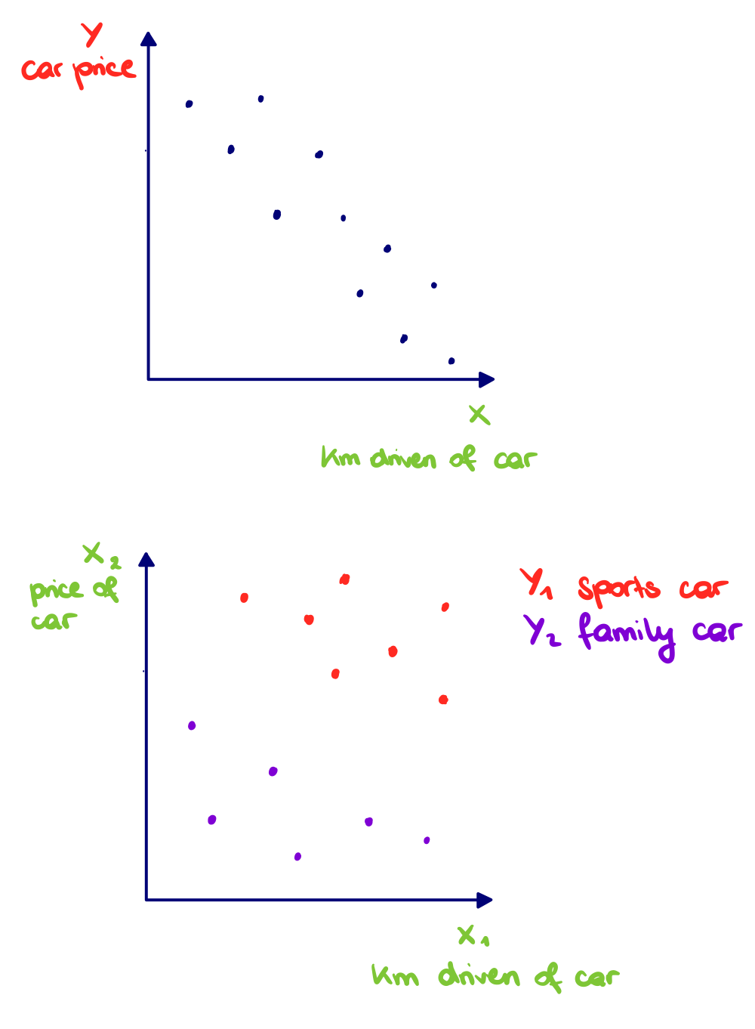
Features, Target
Data contains detail information about an object, which can be a numerical value or category. The detail information is saved as features (denoted X) and are used to explain and/or predict a dependent variable. They are also called: explanatory-, input- , independent-, predictor variables.
A labeled dataset contains the target (denoted Y). They are used during a supervised machine learning workflow to minimize the error between the model result and true result and to determine the model parameters. They are also called: explained-, output-, dependent-, predicted variable.

Slide 2
Supervised machine learning workflow
During a supervised machine learning workflow, data with features and their known target values are used. Machine learning models are developed by minimizing the error between model and true result.
1
2
3
4
5
6
7
8
9
Define the problem
Search for suitable data
Analyse data
Algorithm selection
Split of data
Model develop-ment
Hyper-parameter tuning (optional)
Testing of model
Results
Which research question should be investigated?
Is enough data with needed granularity for all wanted segments available?
Is data quality sufficient? How to handle missing values, outliers, invalid entries etc.?
Select one or more suitable algorithms
Data is separated into training-, test- and possible validation sample
Model is fitted to training sample to determine parameters
Models with different hyperparameter settings are developed using validation sample and compared to further improve results
Model is checked for overfitting on test sample
Derive answers for research question from results

Slide 3
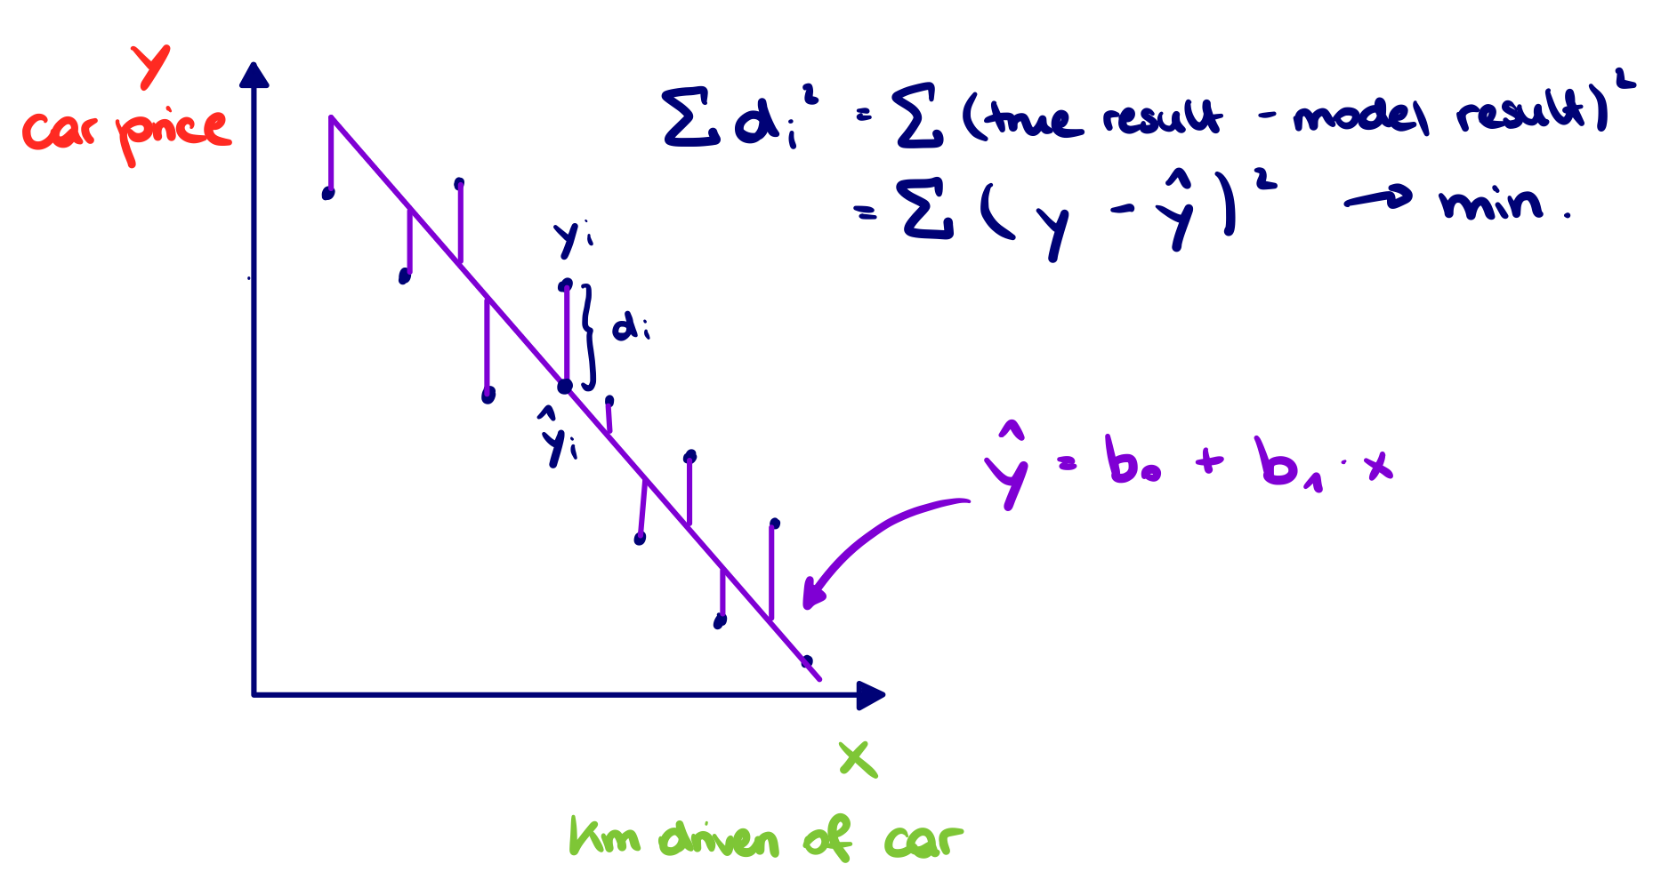
Regression
Regression is a process, where a relationship between a variable Y (target) and one or more variables X_i (features) is estimated to predict future values or to determine the strength of the dependency. One simple type is the linear regression, where the relationship between Y and X_i is linear. A common method to estimate the relationship is ordinary least squares (OLS). During this process, the sum of the squared distances between the data points and regression line is minimized and the parameters (intercept, coefficients) are determined.

Slide 4
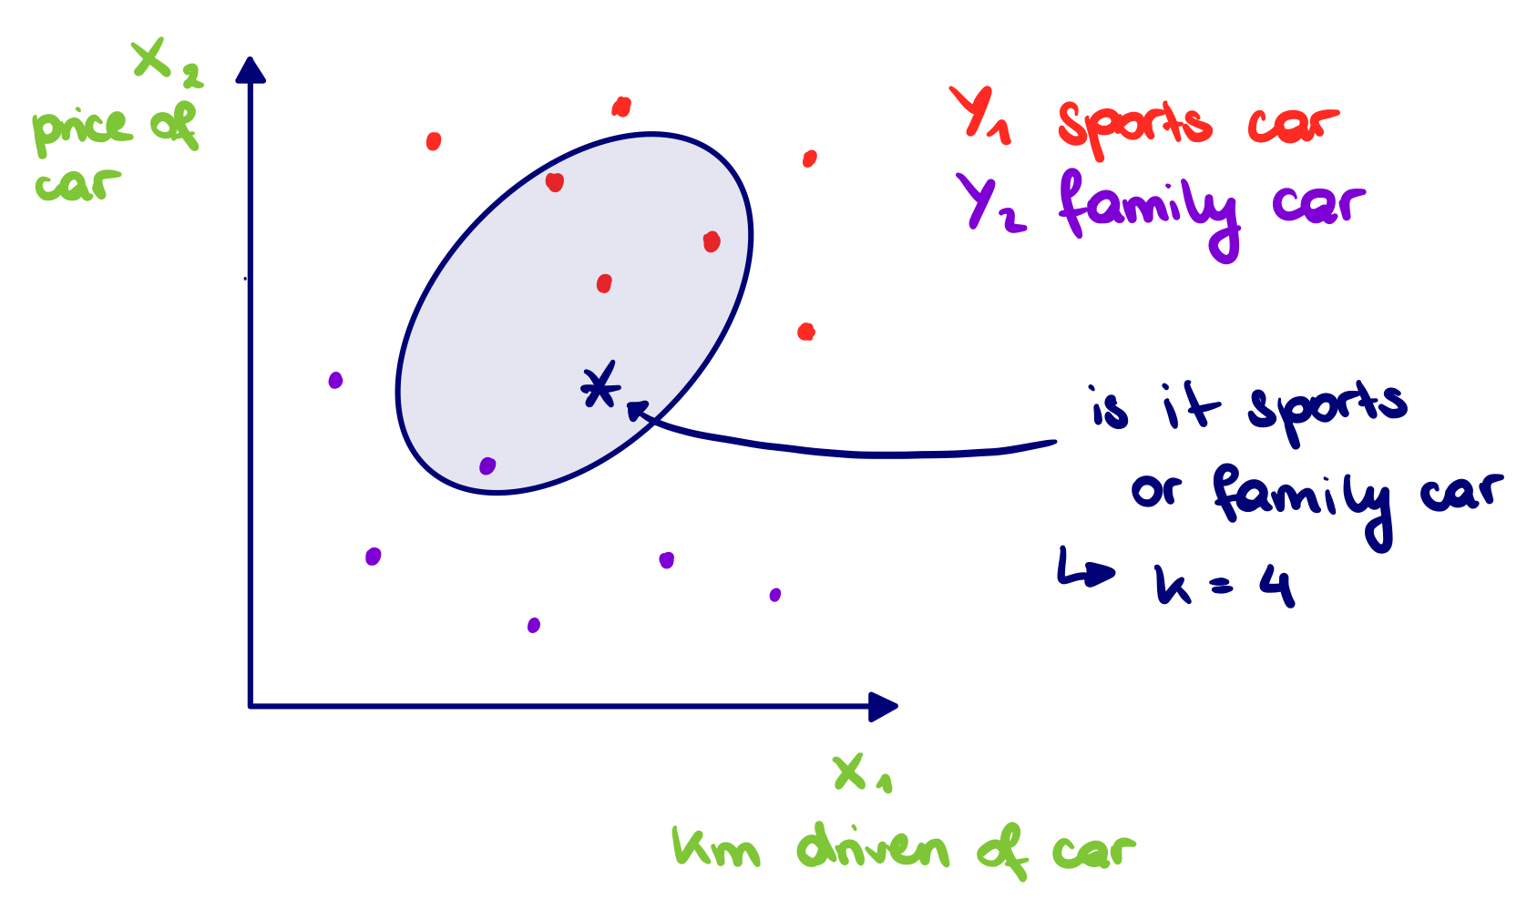
Classification
During a classification process, datapoints are categorized to a target class Y_i using features X_i. One method is the kNN classification, where the nearest k neighbours of datapoint are considered for the categorization.
Examples of classifications are:
Binary: Will it rain or not
Multi-Class: Detection of letters, numbers
Multi-Label: Multiple objects are detected on picture

