Slide 1
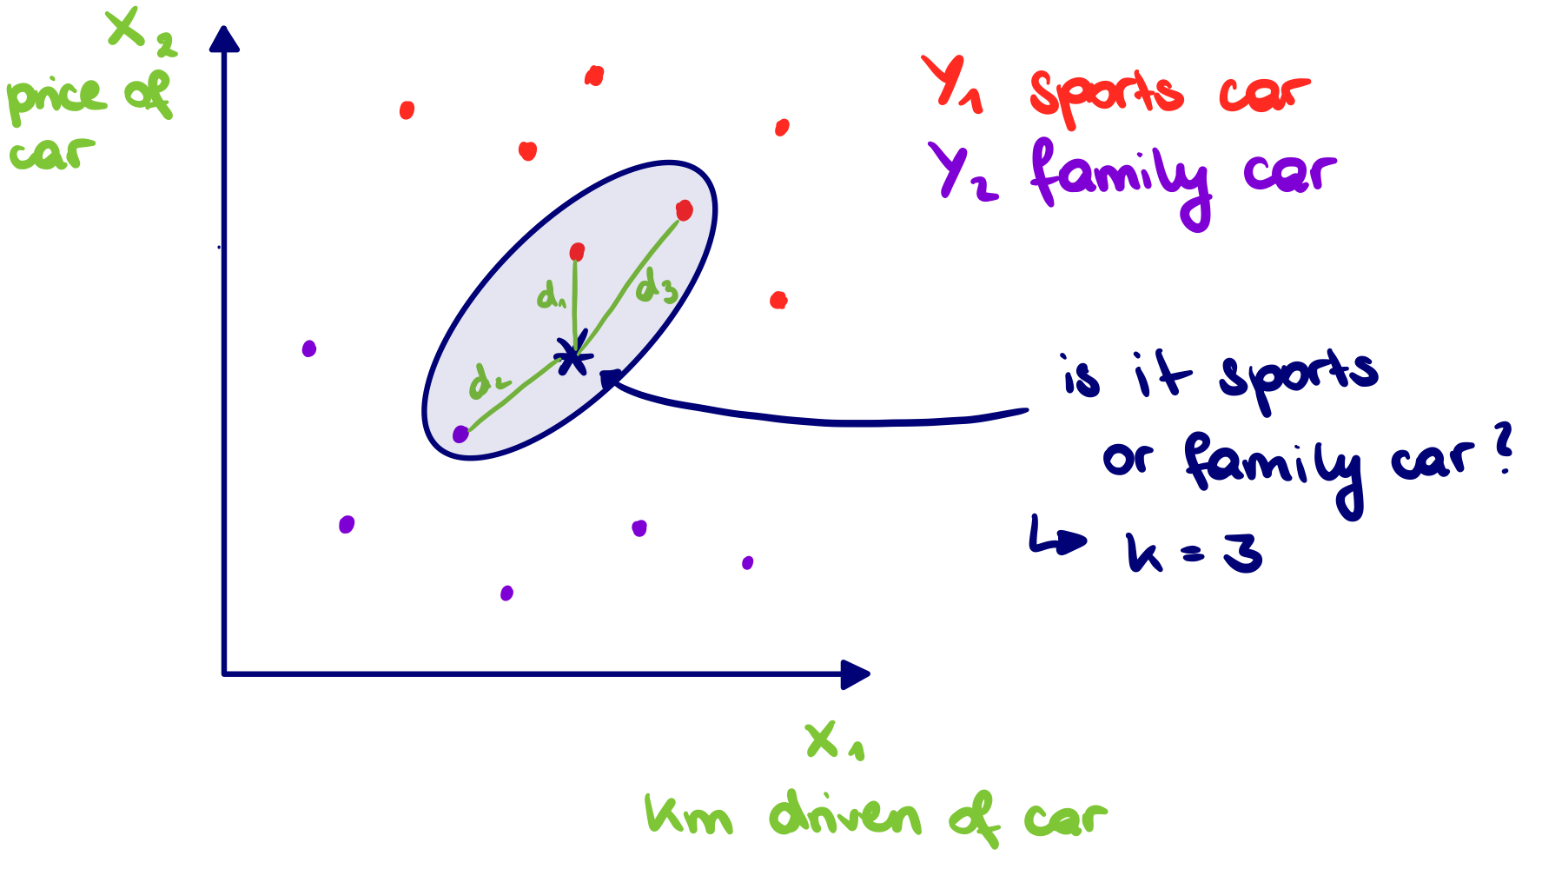

k nearest neighbours
Belongs to the group of supervised machine learning algorithms
Can be used for classification and regression
Classification: classes of the k-nearest neighbors are considered, the most often occurring class among those is the predicted class
Regression: values of the k-nearest neighbors are considered, the average value of those is the predicted value
Relies on the distance between data points, so if the ranges of feature values are vastly different, a scaling can be helpful, e.g. standardization, mean normalization, min-max normalization
Additionally, one can put different weights on the neighboring values, so that e.g. nearest values have a higher impact on the prediction

Slide 2
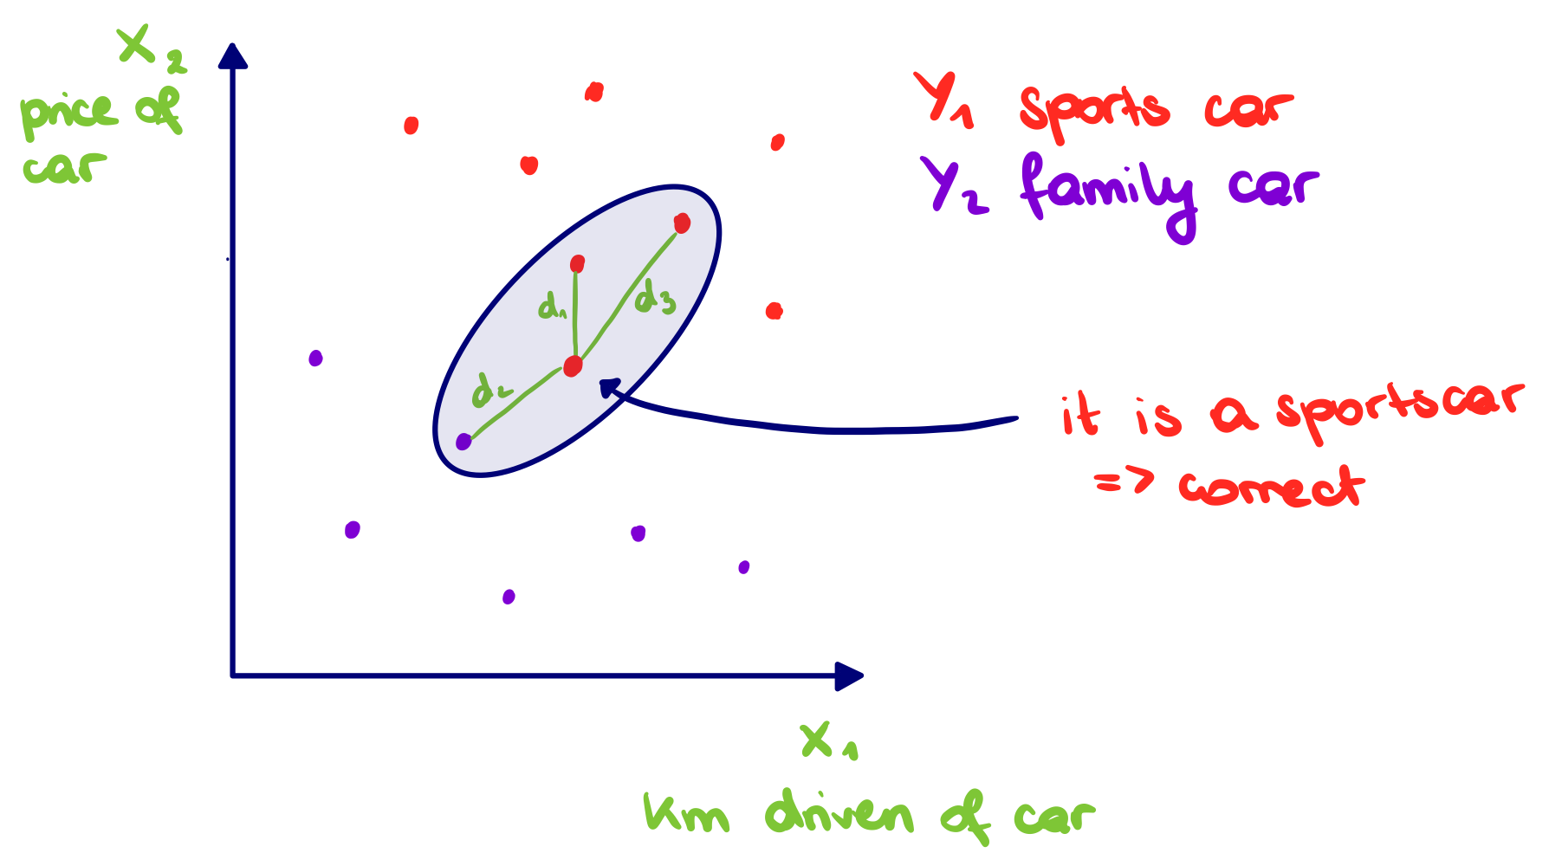

k nearest neighbours
Process:
Split data into test- and training-sample using 10-fold cross validation process
Predict class for each data point of test-sample by using training sample:
Calculate Euclidean distance of first data point in test sample to each row of training sample and sort by ascending distance
Most occurring class among k nearest data points is predicted value
Repeat step 1 and 2 for each row of test sample and compare each predicted value to actual value
Calculate ratio where prediction was correct in relation to total sample
Repeat step 1 – 4 for each cross validation run
Final performance evaluation is average of all cross validation runs
To evaluate the effect of:
hyperparameter k, the value was varied (3, 5, 7)
feature scaling, the features were adapted beforehand (standardization: $\frac{x_{i}− μ}{σ}$)

