Slide 1
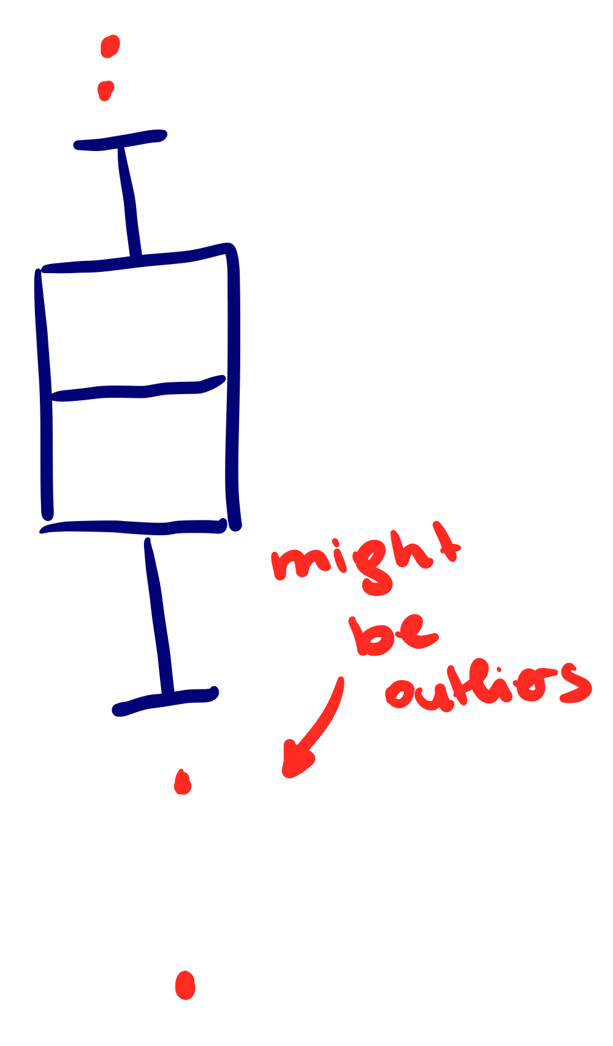
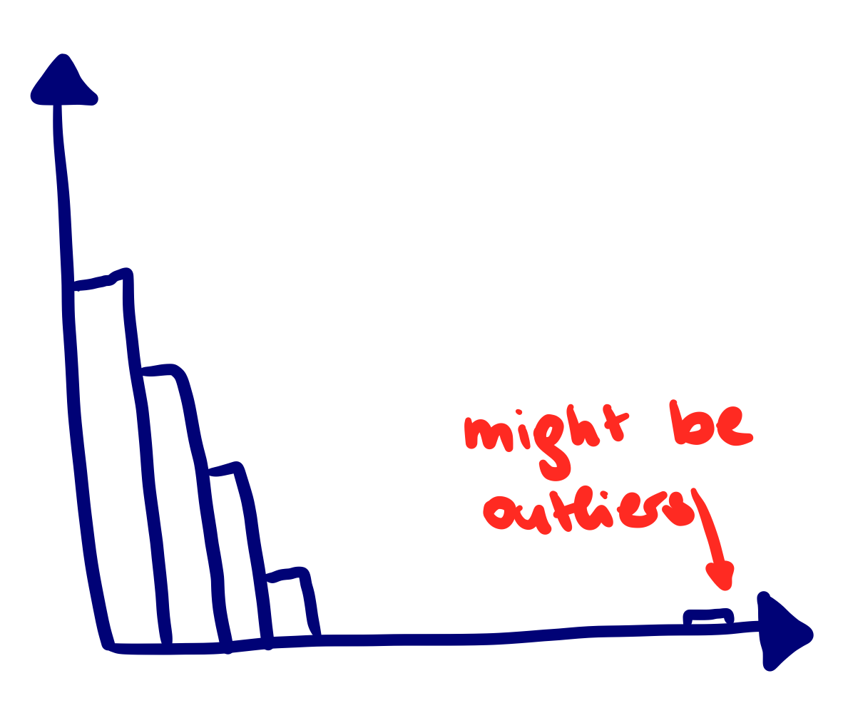

Data Handling
Before an AI model can be trained, the data must be prepared
This task usually takes the most time and is the most important part, else the result will be incorrect/biased (“garbage in, garbage out”)
Data must be analysed first to detect any errors: summary statistics, distribution plot, box plot, etc.
Additionally, one might ask an expert to determine erroneous data entries (implausible values)
Errors include:
missing data and mixed NULL-values
outliers
inconsistent data entries, especially for categorical attributes
invalid data: character values in numerical variable and v.v.
inconsistent delimiters: semi-colon instead of comma
different decimal points: comma instead of dot
columns not correctly split
additional head- and footnote
duplicated rows
wrong datatype
switched month and date

Slide 2
Missing data, Class imbalance, Outliers
Outliers can be detected by visually analysing a distribution plot or box plot, calculating the quantiles and consulting with an expert
Missing, invalid data entries and outliers might be:
Investigated: analyse data source to fill in or correct the values
Removed: complete data entry or column
Imputed: median/mean impute, kNN Imputer
Class Imbalance: If one target class is underrepresented in data, it can lead to a biased model - possible solutions:
Increase number of data entries for minority class by:
collecting more data
using the bootstrapping: draw random sample with replacement from each class
SMOTE method: artificially create same sized samples per class
Decrease number of data entries for majority class by using only subsample

