Slide 1
Electronic Logbook (Elog)
Eric Berryman Software Engineer

Slide 2
Overview
Requirements
Implementation
Architecture
Technologies
Integration
Service
Client
Plan
Summary

Slide 3
Requirements
Basic functionality
Web service
Authentication
Multiple logbooks, tags
Create log entry
Edit log entry
Attach files
Search
Simple Web client
Integration
IRMIS
Component/Inventory
Physics data
Save/restore
CSS plug-in
Operations
Beam statistics
Down time/tuning time/beam on target
Bypass records
On shift records
Trouble Reports
Experiment records

Slide 4
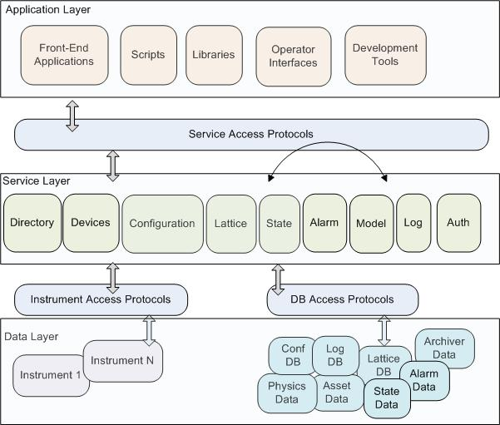
Implementation - Architecture

Slide 5
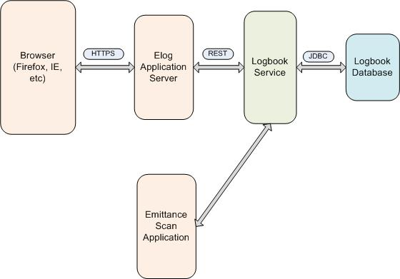
Implementation - Architecture
Applications -- Services -- Data

Slide 6
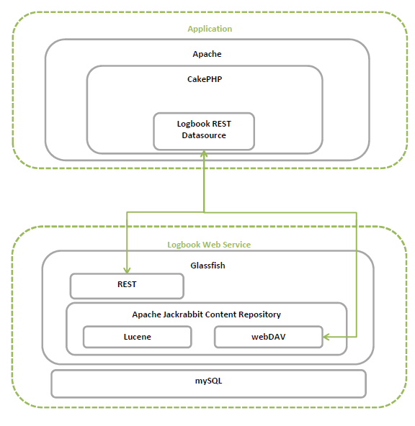
Implementation - Technologies
Technologies
Web application
Built with CakePHP
Using REST datasource
Web service
Built on Glassfish
Apache Jackrabbit embedded for attachments
Log data in mySQL
Lucene in Jackrabbit allows searching of attachments

Slide 7
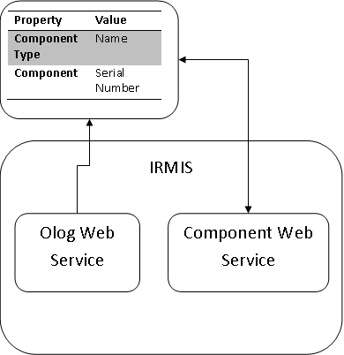
Implementation - Integration
Integration with IRMIS
Log entry property => component in IRMIS

Slide 8
Implementation - Service
All logic is in the logbook service
Performed logic
Authorizes users
Manages log threads
Searches logs
Edit history
New entry is hashed with last 10 entries on creation
Front end application deals with presentation
Examples
Create log entry in operations logbook
Give the log entries of operations logbook from last 3 days
Attach given file to log entry ID XXX
Can be accessed through most languages

Slide 9
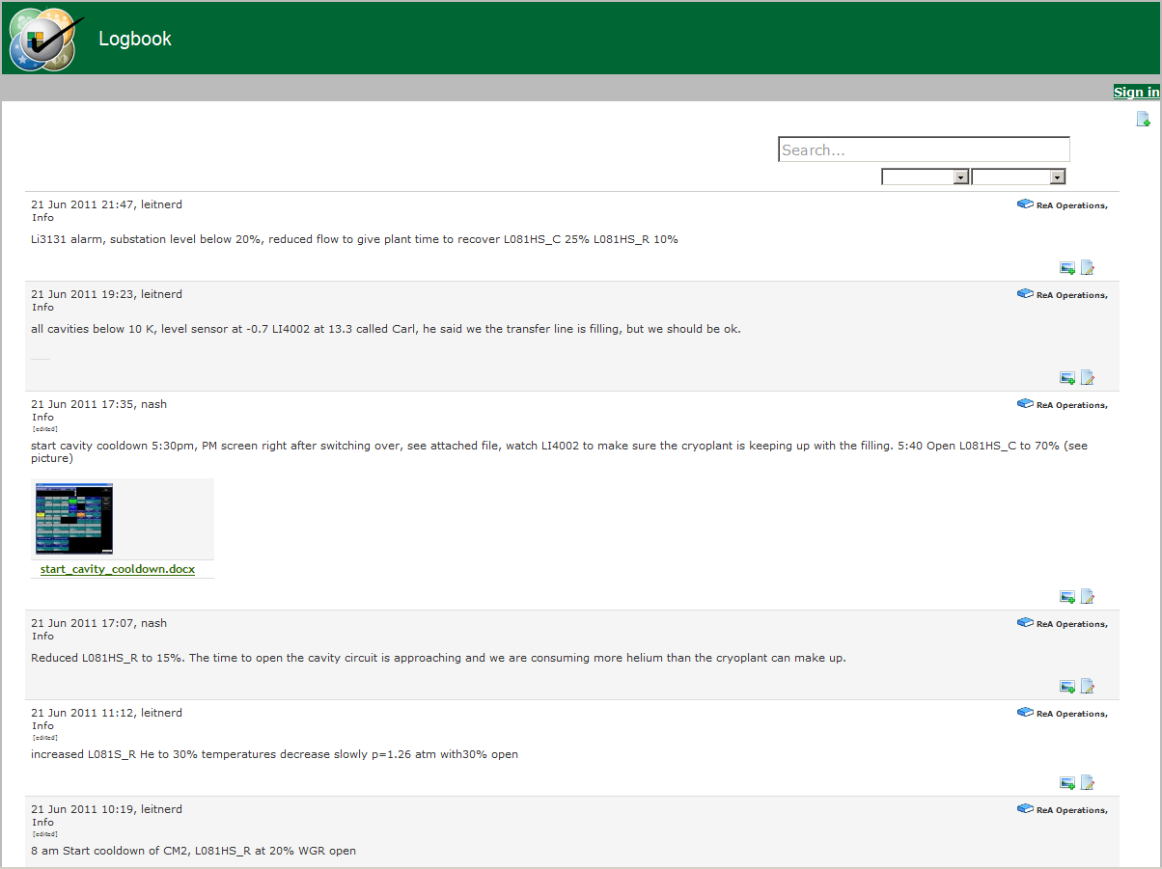
Implementation - Client

Slide 10
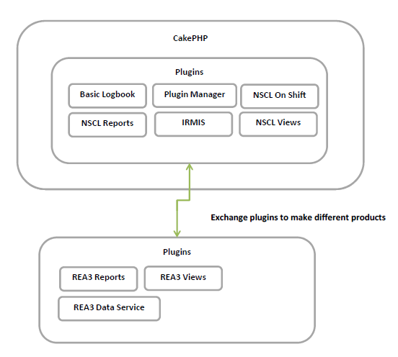
Implementation - Client
Web client technologies
Plug-in manager allows information to be shared between plug-ins allowing plug-ins to have APIs and hooks

Slide 11
Plan
Implement for ReA and NSCL
Selection of stakeholders: Stolz, D. Leitner
Requirements specifications
Effort estimates
Cost/resources
Schedule
Collaborating with BNL
Near-term milestones
IRMIS integration by December 2011
Replace NSCL Hourlog by March 2012

Slide 12
Summary
Integrated
Standard: user interface, API, signal behavior
Easy to access information
Easy to program
Extensible: easy to add functionality
Sustainable
Secure
Software engg rigor: process, docs, release, QA

Slide 13
Elog Details: Next Steps
User training session – rea3
Setup: users, logbooks, server
Rea3 operations
Rea3 maintenance
Rea3 EBIT
Rea3 SRF linac
Rea3 diagnostics
Rea3 external injector sources
Rea3 interlock and alarms
Rea3 radiation survey
NSCL and FRIB?
Project plan for the elog application
Selection of stakeholders: Stolz, D. Leitner, …?
Requirements specifications
Effort estimates
Cost/resources
Schedule

Slide 14
Elog Details: REST API [1]
Resources {GET, PUT, POST, DELETE}:
/logs/
/logs/{logId}
/tags/
/tags/{name}
/logbooks/
/logbooks/{name}
Query:
logs?search=searc? e*erything for key words, including files
logs?tag=TagName
logs?logbook=LogbookName
logs?key=value (ie. logs?Component=K5Coupler1)
logs?start=1307332800&end=1307451299
logs?page=2&limit=20
logs?logbook=Operations&start=1307332800&end=1307451299&page=2&limit=20

Slide 15
Elog Details: REST API [2]
http GET:
http://irmis3.nscl.msu.edu/Olog/resources/logs?Component%20Type=Coupler
Response:
<?xml version="1.0" encoding="UTF-8" standalone="yes"?><logs>
<log createdDate="2011-02-17T13:26:21-05:00" id="197" level="Info" owner="berryman" version="0">
<description>test</description>
<subject>test</subject>
<logbooks>
<logbook name="Operations"/>
</logbooks>
<tags>
<tag name="RF" status="" />
</tags>
<properties>
<property name="Component Type" value="Coupler" />
<property name="Component" value="K5Coupler1" />
</properties>
<attachments>
<attachment name="test.txt" uri="http://irmis3.nscl.msu.edu/Olog/repository/olog/197/test.txt"/>
</attachments>
</log>
</logs>

Slide 16
Elog Details: Java Client
Ologclient client = OlogClient.getInstance("berryman","XXXXXX");
Log.Builder log1 = log("subject")
.description("some details")
.level("Info")
.in(logbook("Operations")
.with(tag("SomeTag"));
// atomic attachments not implemented yet
// .attach(new File("test.txt"));
// Add logbook and Tag
client.add(logbook("Operations").owner("operatorg"));
client.add(tag("Operations"));
// Add log
Log returnLog = client.add(log1);
// Add another file
client.add(new File("test2.txt"), returnLog.getId());
// Returns all active log entries with tag SomeTag
client.findLogsByTag("SomeTag");
// Removes log entry (marks inactive)
client.remove(returnLog.getId());

Slide 17
Elog Details: NSCL Functionalities
Current Hourlog functionalities
Beam current log
Interruption compensation
911 log
Location/system information
Beam/machine status
Message to experimenters
Who is on shift/on call
Event trigger (email/SMS on UOF and back up)
RSS feed
PHP API
Reports
Breakdown
Operations (shift)
Experiment
Primary beam
Primary beam sequence
Beam system summary

Slide 18
Elog Details: NSCL Plan
Current Hourlog Milestones
Ability to create the following reports
Operations (shift)
Breakdown
Experiment
Primary beam
Primary beam sequence
Beam system summary

