Slide 1
Arty board

Slide 2
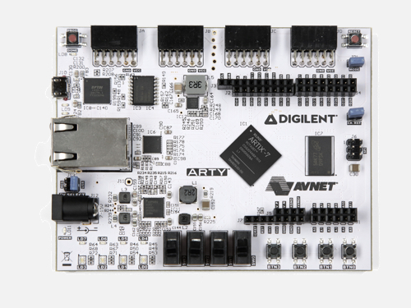

snake_game on FPGA
Press any direction to start playing.
Get to 10 points to win!
Every time you score a point the snake becomes faster. This increase can be turned off using this switch.
Score is shown on the RGB LEDs.
You lose if you touch an edge or eat part of yourself.
Use the reset switch to start over in the event of a win or lose screen.
The directions the press buttons control are shown to the right.

Slide 3
Boolean board (square directions)

Slide 4
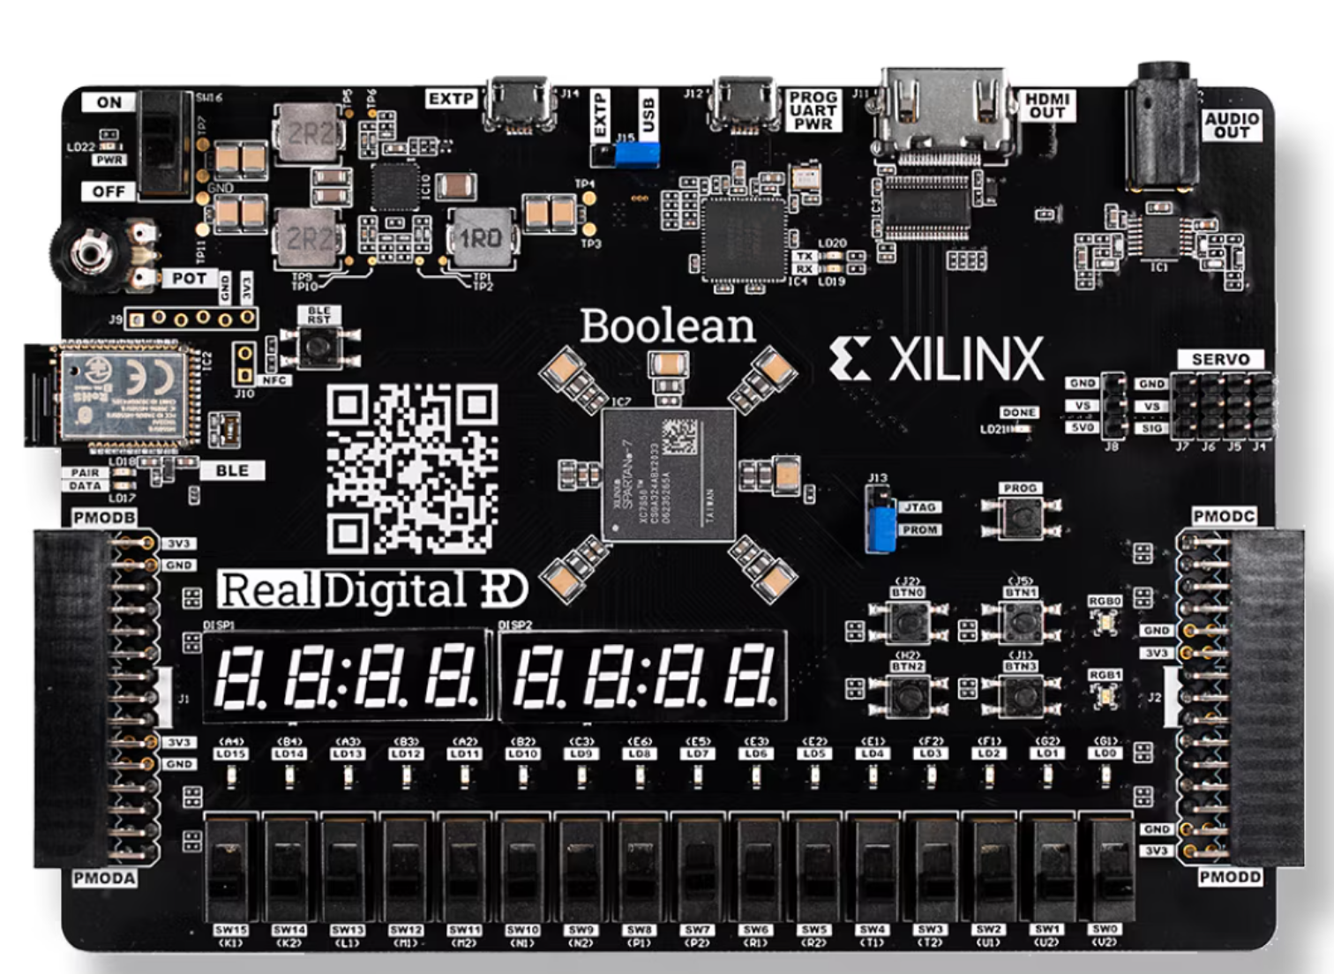
snake_game on FPGA
Press any direction to start playing.
Get to 10 points to win!
Every time you score a point the snake becomes faster. This increase can be turned off using this switch.
Score is shown on the 7-Seg displays.
You lose if you touch an edge or eat part of yourself.
Use the reset switch to start over in the event of a win or lose screen.
The directions the press buttons control are shown to the right.

Slide 5
Boolean board (diagonal directions)

Slide 6
snake_game on FPGA
Press any direction to start playing.
Get to 10 points to win!
Every time you score a point the snake becomes faster. This increase can be turned off using this switch.
Score is shown on the 7-Seg displays.
You lose if you touch an edge or eat part of yourself.
Use the reset switch to start over in the event of a win or lose screen.
The directions the press buttons control are shown to the right (hint: try using the board at a diagonal!).

Slide 7
Boolean board (external button board)

Slide 8
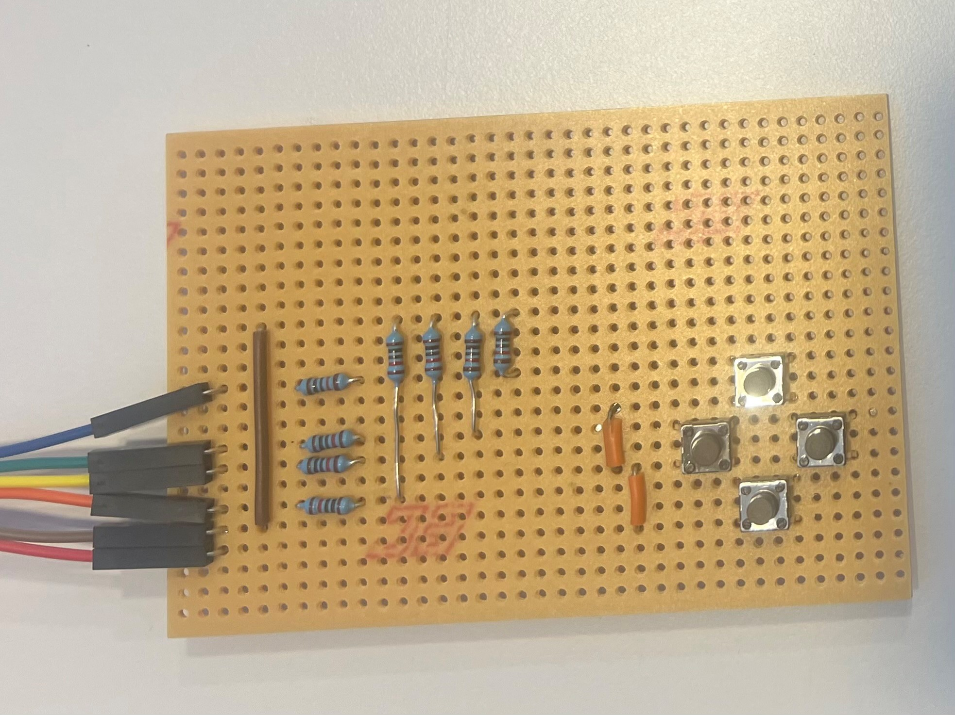
snake_game on FPGA
Press any direction to start playing.
Get to 10 points to win!
Every time you score a point the snake becomes faster. This increase can be turned off using this switch.
Score is shown on the 7-Seg displays.
You lose if you touch an edge or eat part of yourself.
Use the reset switch to start over in the event of a win or lose screen.
The directions the press buttons control are shown to the right.

