Slide 1
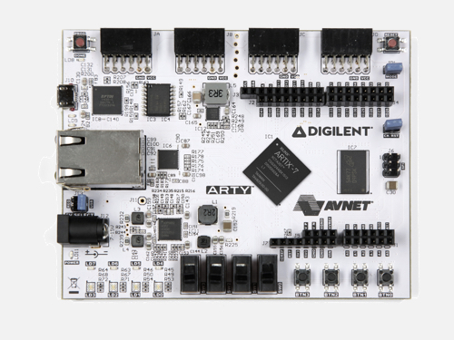

snake_game on FPGA
Press any direction to start playing
Get to 10 points to win!
Score is shown on the RGB LEDs
Every time you score a point the snake becomes faster
You lose if you touch an edge or eat part of yourself
Use the reset switch to start over in the event of a win or lose screen
The directions the press buttons control are shown to the right

