Slide 1
Improving the Editing Experience

Slide 2
Project Purpose :
Editing Wikipedia can be complex for new users.
This project aims to make the process easier by customizing the interface.
Motivation :
Facing few complications while editing in the Wikipedia application lead to the act of implementation of this project.
The project is meant particularly for the beginners who aim to contribute for the Wikipedia showcasing their editing skills.

Slide 3
Project Description :
This project contributes in the Development/Improvement of the Wikipedia website by adding tools which are more user friendly for better editing experience and accessing information.
Solution :
Developing a browser extension or script that tailors the editing experience for each user.
This could involve highlighting relevant resources,suggesting improvements and overall making editing more userfriendly.

Slide 4
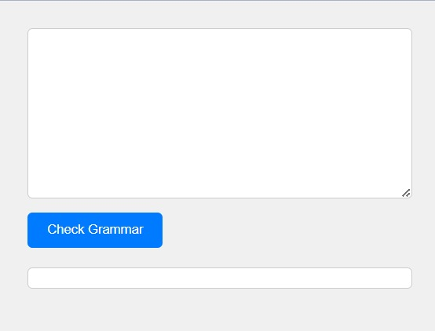
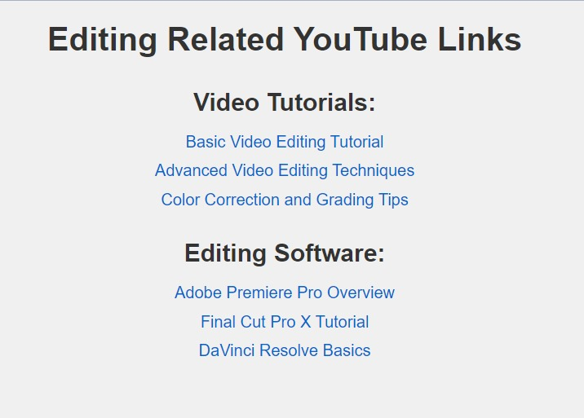
Technology used is APIs
Key Features:
Checks Grammatical mistakes
Provide You tube links for editing

Slide 5
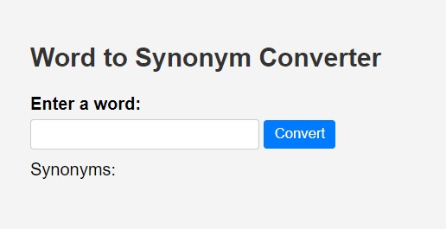
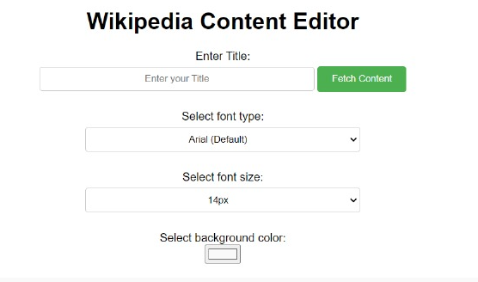
Provides a precise word
Provides the needed font style and font size

Slide 6
DEMONSTRATION
Now Let’s have a quick demo of our project

Slide 7
Potential Impact
Improved user Experience
Increase Productivity
Quality Enhancement
Personalization
Learning Opportunities

Slide 8
Future Work
Data Privacy and Security
Integration with the existing tools

Slide 9
THANKYOU

