Slide 1
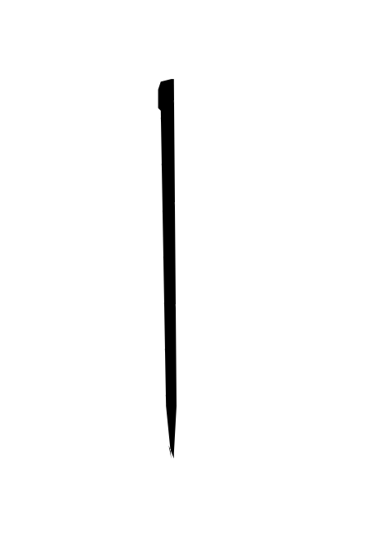

How and Why Conventional Implicatures Project
Noortje Venhuizen, Johan Bos, Petra Hendriks, and Harm Brouwer, University of Groningen
Observations on supplemental CIs
John, a linguist, smiles.
i. Each supplemental CI attaches to an anchor;
ii. The anchor of a CI is projective;
iii. CIs always project as far as the anchor.
Intermezzo: Projective DRT
Discourse Representation Theory with projection pointers:
The Why: piggybacking
The How:
projection-anaphora

