Slide 1
Identifying Influential Directors for Acquisition Strategy
COMP6200 Assignment 3 – Board Network Analysis
Md Mahdi Mohtasim - 48926434

Slide 2
Objective
- Support a VC fund in identifying influential board members.
- Target directors who can connect a company to large acquirers.
- Use board relationships and real-world corporate data

Slide 3
Our Approach
- Built a graph of directors and companies from DEF 14A data
- Computed network centrality: degree, eigenvector, closeness
- Merged Fortune 1000 company data
- Created influence scores to rank directors

Slide 4
Built a Graph of Directors and Companies
We used publicly available SEC filings (DEF 14A) to extract data about who sits on which company boards.
Each node in the network represents either a director or a company.
A line (edge) connects a director to a company if they serve on that board.
This creates a network of corporate relationships — a map of who is connected to whom.

Slide 5
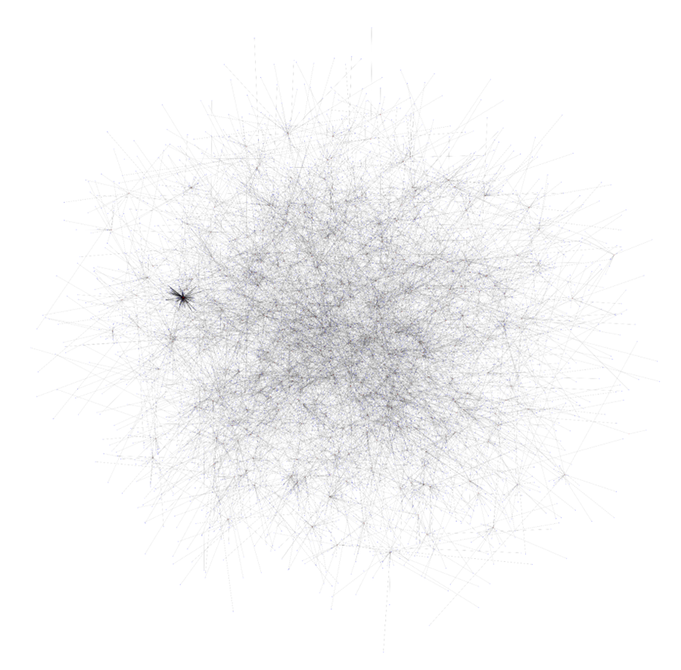
Biggest Network Graph

Slide 6

Computed Network Centrality
To measure influence, we calculated centrality scores using network science.
We used three key metrics:
Degree Centrality – Number of direct board connections (visibility).
Eigenvector Centrality – How well-connected their connections are (prestige).
Closeness Centrality – How quickly they can reach others (strategic position).
Combining these gives a well-rounded picture of a director’s influence.

Slide 7
Merged Fortune 1000 Company Data
We added a new layer: whether a director has served on a Fortune 1000 company board.
These are America’s biggest companies by revenue.
A director with this background likely has experience and connections in powerful, acquisition-ready firms.
We added a flag (worked_in_top_company) to highlight them.

Slide 8
Created Influence Scores
We created a new feature: influence score.
This is the sum of the standardized centrality values (degree, eigenvector, closeness).
It lets us rank all directors based on both their network position and top-company experience.
The higher the score, the more powerful and connected the director.

Slide 9
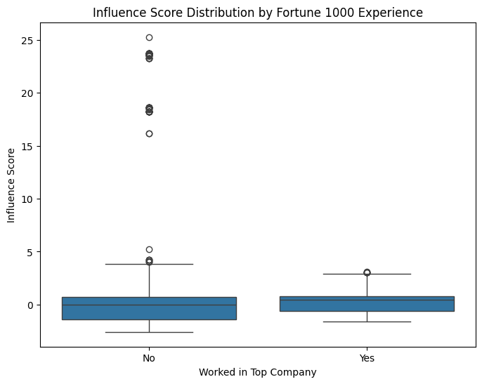
Influence Score vs
Fortune 1000 Experience

Slide 10
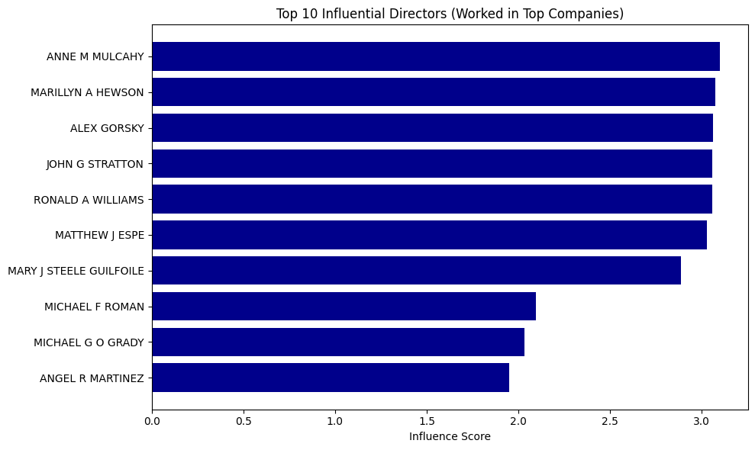
Result: Top 10 Influential Directors

Slide 11
Conclusion
- A few directors are highly connected and influential
- Many top-ranked directors are linked to Fortune 1000 firms
- These individuals are ideal for facilitating acquisitions

