Slide 1
Quantum Computing Companies Stock Price Prediction
Xiaoyan Hua
Mingqian Chen

Slide 2
Why We Want to Learn Quantum Computing Companies Stock Prices?
1. Current state of quantum computing market
2. Predict the quantum computing market trend
3. Which company to invest
4. The future of market and impact on academia
Notes:
https://www.globaltechoutlook.com/top-five-trends-in-quantum-computing-in-2021/
https://www.forbes.com/sites/forbestechcouncil/2021/07/30/four-ways-quantum-computing-could-change-the-world/?sh=453e41704602
https://www.investmentmonitor.ai/tech/what-is-quantum-computing-and-how-will-it-impact-the-future#:~:text=According%20to%20Markets%20and%20Markets,about%20its%20potential%20for%20disruption.
Drug And Materials Development, Finance, Climate Change, Cyber And Information Security, Preparing For The Quantum Era
https://news.rice.edu/news/2021/way-i-see-it-state-quantum-computing
https://www.globenewswire.com/news-release/2022/03/04/2396846/0/en/Quantum-Computing-Market-to-Grow-Exponentially-Increasing-Product-Applications-to-Generate-Remunerative-Market-Opportunities-Fortune-Business-Insights.html
https://www.globaltechoutlook.com/top-five-trends-in-quantum-computing-in-2021/

Slide 3
Outline
Theoretical Background:
Linear regression
Recurrent neural network (RNN)
Long short-term memory (LSTM)
Data Analysis:
Data preparation
Comparison of the model performance
linear regression with time series, improved linear regression with SMA
LSTM, improved LSTM
Conclusion

Slide 4
Companies to Predict
Companies to predict:
ACN IBM MSFT QNC.V INTC BIDU NOK MIELY
Dataset:
Kaggle Project (quantumstock1.csv)
Quantum Computing Company Report

Slide 5

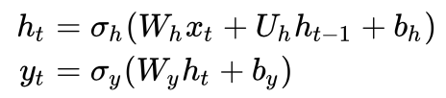
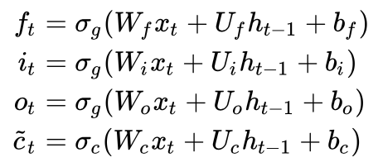

Methods to Solve Stock Predictions
Linear Regression
Recurrent Neural Network(RNN)
Long Short-Term Memory (LSTM)
Notes:
解决此问题的常用方法
深度学习中解决此问题的方法（背景时间）
预测问题
linear regresion
rnn
lstm

Slide 6
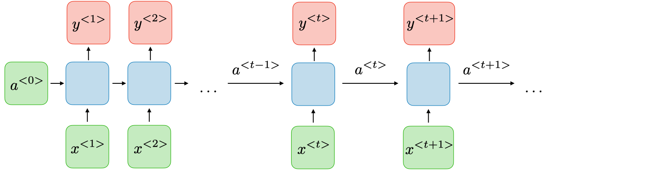
Naive Recurrent Neural Network (RNN)
1. Allow previous outputs to be used as inputs while having hidden states
2. Gradient vanishing/exploding
Notes:
https://stanford.edu/~shervine/teaching/cs-230/cheatsheet-recurrent-neural-networks
Credit: Afshine Amidi and Shervine Amidi

Slide 7
Gradient Vanishing
The optimizer of RNN gets the first-order derivative of the loss function to search for the optimal values. Because RNN is recursive, the first-order derivation process will make a number smaller and smaller, then eventually vanish.
This certain mathematic process makes RNN not a good choice to retain the past memories.
We need a recursive structure that the information does not vanish quickly.
Notes:
https://programmathically.com/understanding-the-exploding-and-vanishing-gradients-problem/
https://www.analyticsvidhya.com/blog/2021/06/the-challenge-of-vanishing-exploding-gradients-in-deep-neural-networks/
In our stock price example, the price of this Friday may be influenced by the prices of previous Fridays, or even the price of same day last year. RNNs may not be able to retain the price information of same day last year, while LSTM in theory is designed to retain it.

Slide 8

LSTM
Forget Gate
Output Gate
Input Gate
Notes:
https://adventuresinmachinelearning.com/recurrent-neural-networks-lstm-tutorial-tensorflow/
https://github.com/christianversloot/machine-learning-articles/blob/main/build-an-lstm-model-with-tensorflow-and-keras.md
http://colah.github.io/posts/2015-08-Understanding-LSTMs/
Explain: yellow square: neural network layer, pink circle; pointwise operation; arrow: vector transfer. Concatenate(合并), copy(分开)
https://www.javatpoint.com/long-short-term-memory-rnn-in-tensorflow

Slide 9
Long Short-Term Memory (LSTM)
Uses the short-term memory processes to create longer memory
Cell:
Remembers values over arbitrary time intervals
Input gate, output and forget gates:
Regulate the flow of information into and out of the cell.
Sigmoid functions with output in [0,1] to pass limited information or all information. A value of zero means filter out the information completely, while a value of one means passing the information completely.
Notes:
https://adventuresinmachinelearning.com/keras-lstm-tutorial/
-- The Keras LSTM architecture
https://medium.com/swlh/a-technical-guide-on-rnn-lstm-gru-for-stock-price-prediction-bce2f7f30346
https://en.wikipedia.org/wiki/Long_short-term_memory

Slide 10
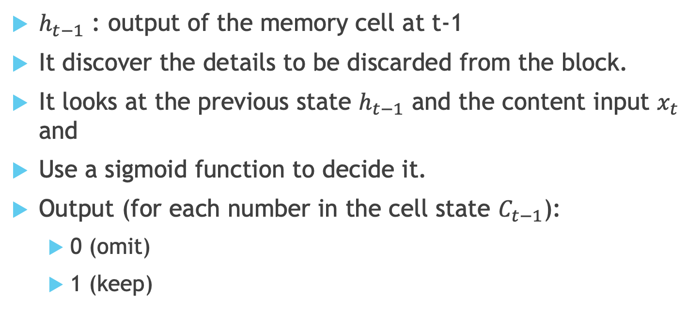
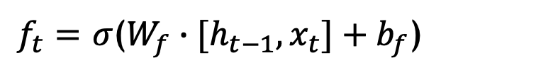
Forget Gate
$f_{t}=$ $σ$($W_{f}∙[h_{t−1},x_{t}]+b_{f}$)
$h_{t−1}$ : output of the memory cell at t-1
It discover the details to be discarded from the block.
It looks at the previous state $h_{t−1}$ and the content input $x_{t}$ and
Use a sigmoid function to decide it.
Output (for each number in the cell state $C_{t−1}$):
0 (omit)
1 (keep)
Notes:
Forget Gate
The forget decides which information from long term memory be kept or discarded and this is done by multiplying the incoming long term memory by a forget vector generated by the current input and incoming short memory.
https://analyticsindiamag.com/lstm-vs-gru-in-recurrent-neural-network-a-comparative-study/

Slide 11
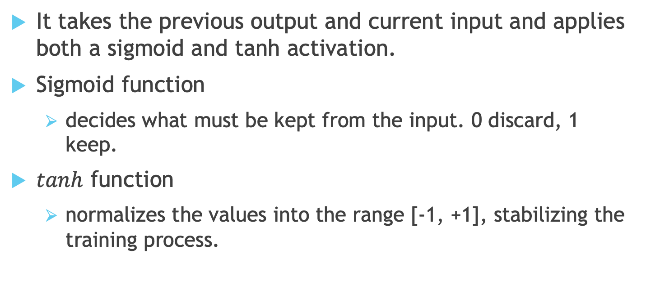
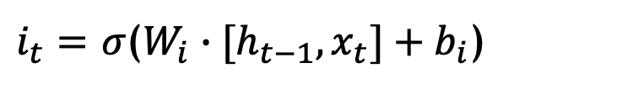

Input Gate
$i_{t}=$ $σ$($W_{i}∙[h_{t−1},x_{t}]+b_{i}$)
$${\tilde{C}}_{t}=tanh⁡(W_{C}∙[h_{t−1},x_{t}]+b_{C})$$
It takes the previous output and current input and applies both a sigmoid and tanh activation.
Sigmoid function
decides what must be kept from the input. 0 discard, 1 keep.
$tanh$ function
normalizes the values into the range [-1, +1], stabilizing the training process.
Notes:
Input Gate
The input gate decides what information will be stored in long term memory. It only works with the information from the current input and short term memory from the previous step. At this gate, it filters out the information from variables that are not useful.

Slide 12

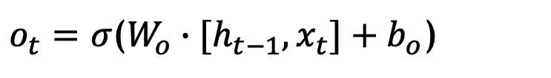
Output Gate
$o_{t}=$ $σ$($W_{o}∙[h_{t−1},x_{t}]+b_{o}$)
$$h_{t}=o_{t}∗tanh⁡(C_{t})$$
It takes a normalized value for memory through tanh and a sigmoid activated value for the previous output and current input
Decides what must be predicted for the current input value
Output value, pass value and memory to the next cell.
Notes:
Output Gate
The output gate will take the current input, the previous short term memory and newly computed long term memory to produce new short term memory which will be passed on to the cell in the next time step. The output of the current time step can also be drawn from this hidden state.

Slide 13
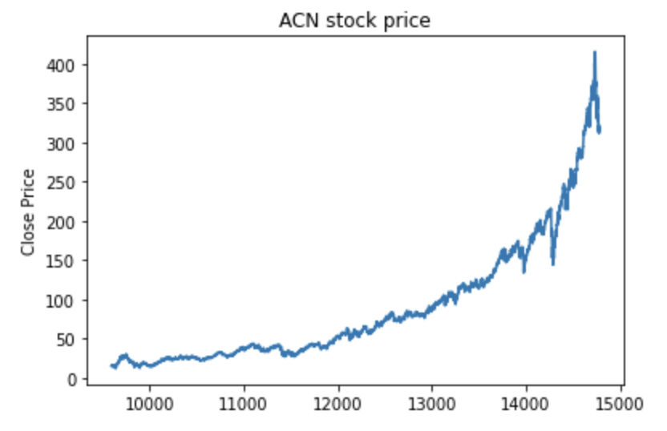
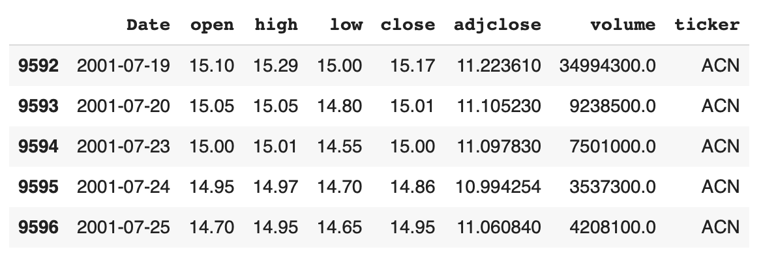
Prepare Dataset
Take ACN as an example
data shape: (5190, 8)
date period: 2001-07-19 to 2021-03-03
features: Open, High, Low, Close, Adjclose, Volume
Notes:
Output set:
Close: predicting close price aims to determine the future movement of the stock value of a financial exchange.
input set:
Open: If we have higher closing prices than the opening prices that we have some profit otherwise we saw losses.
Volume: increasing price and decreasing volume show lack of interest, and this is a warning of a potential reversal.
Different models require different input parameters and forms
Train and test:
Considering the amount of data, we divide dataset into a training set(90%) and a test set(10%)
要改

Slide 14
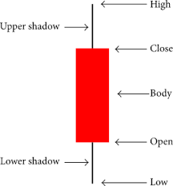
Stock Features
Open:
The start price of a stock on a trading day
Low / High:
The lowest/highest price on a trading day
Close:
The end price of a stock on a trading day
Adjust Close:
Amends a stock's closing price to reflect that stock’s real value
Volume:
Number of shares of a security traded between daily open and close
Notes:
Adjust Close:
amends a stock's closing price to reflect that stock's value after accounting for any corporate actions
Volume:
the number of shares of a security traded between daily open and close

Slide 15
Prepare Dataset
Input and Output:
Output: predicting Close aims to determine the future movement of the stock value of a financial exchange
Input: Different models require different input features and forms
Train and Test:
Considering the amount of data, we divide dataset into a training set (90%) and a test set(10%)
Notes:
Output set:
Close: predicting close price aims to determine the future movement of the stock value of a financial exchange.
input set:
Open: If we have higher closing prices than the opening prices that we have some profit otherwise we saw losses.
Volume: increasing price and decreasing volume show lack of interest, and this is a warning of a potential reversal.
Different models require different input parameters and forms
Train and test:
Considering the amount of data, we divide dataset into a training set(90%) and a test set(10%)
要改

Slide 16

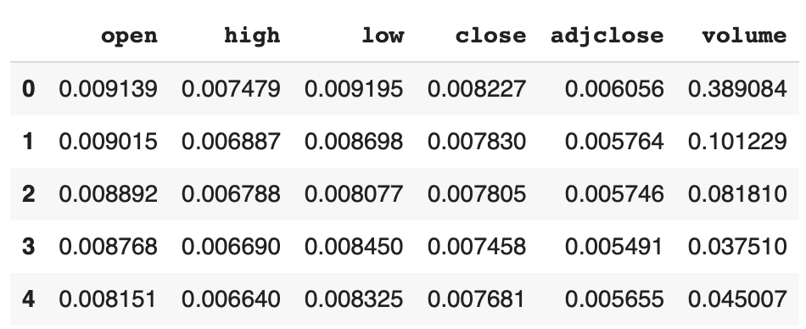
Prepare Dataset: Normalization

Slide 17
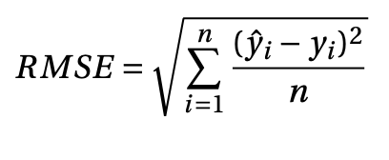
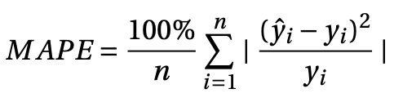
Accuracy
Root Mean Square Error (RMSE)：
Mean Absolute Percentage Error (MAPE)：

Slide 18
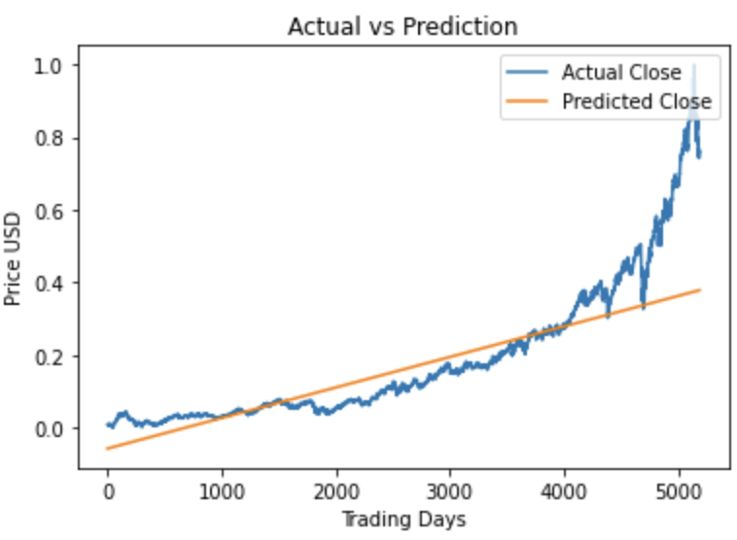
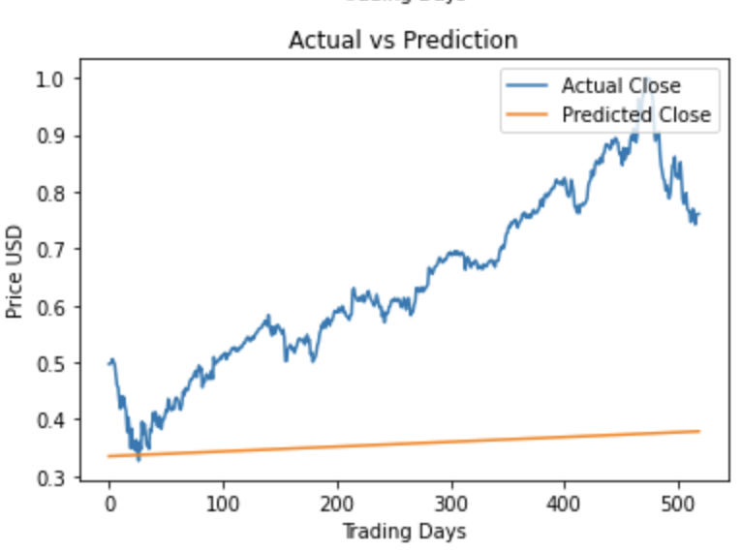
Linear Regression 1: Time Series
Input Set:
Trading date
Output Set:
Close price
Pros and cons:
Easy to implement
Fail to capture nonlinear changes in price
Unable to reflect other features
Accuracy:
RMSE:0.3180
MAPE:0.4124
train set and test set
only test set

Slide 19
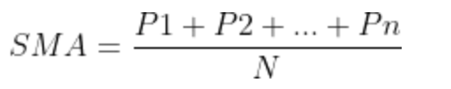
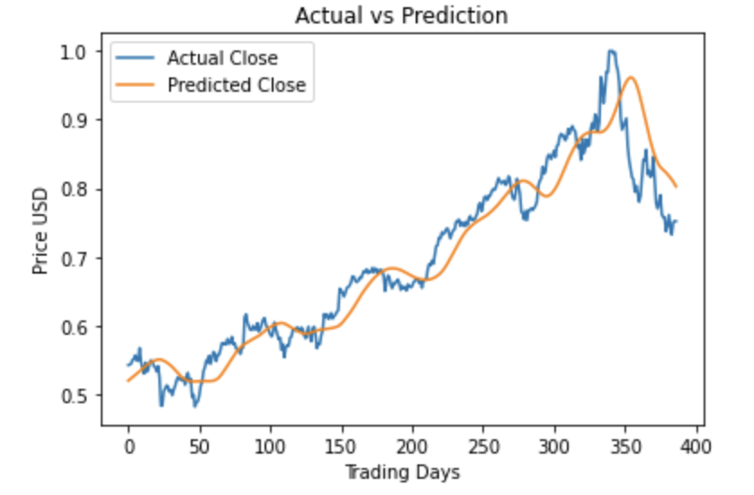
Linear Regression 2: SMA
Input Set:
Simple moving average(SMA) of Open from 30 days before the predicted day
Output Set:
Close price
Pros and cons:
Better fitness than before
Unable to reflect the impact of volume
Unable to fit mutations in time
Accuracy:
RMSE: 0.0401
MASE: 0.0494
Notes:
To begin with, we can use moving averages (or MA) to understand how the amount of history (or the number of past data points) considered affects the model's performance. A simple moving average computes the mean of the past N data points and takes this value as the predicted N+1 value.

Slide 20
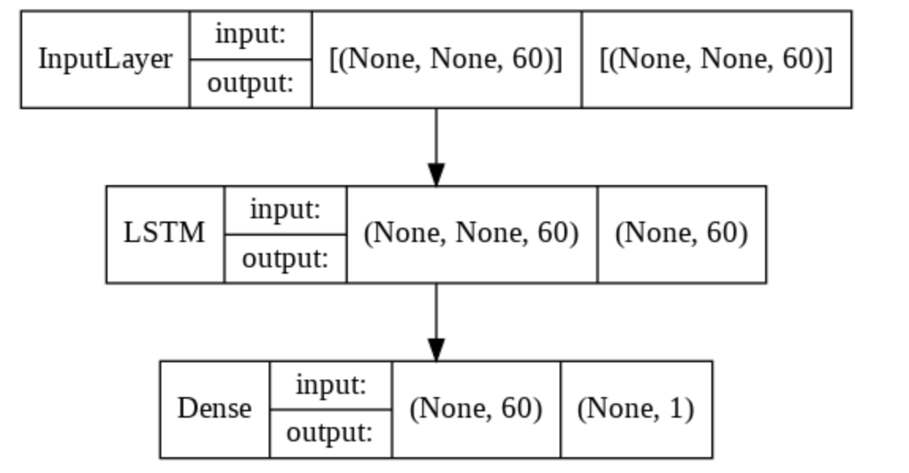
Basic LSTM Model
Input:
Open: If we have higher Close than the Open that we have some profit otherwise we saw losses
Volume: indicates market strength, as rising markets on increasing volume viewed strong and vice versa
Data of first 60 days as an input unit
Output:
Close of the predicted day

Slide 21
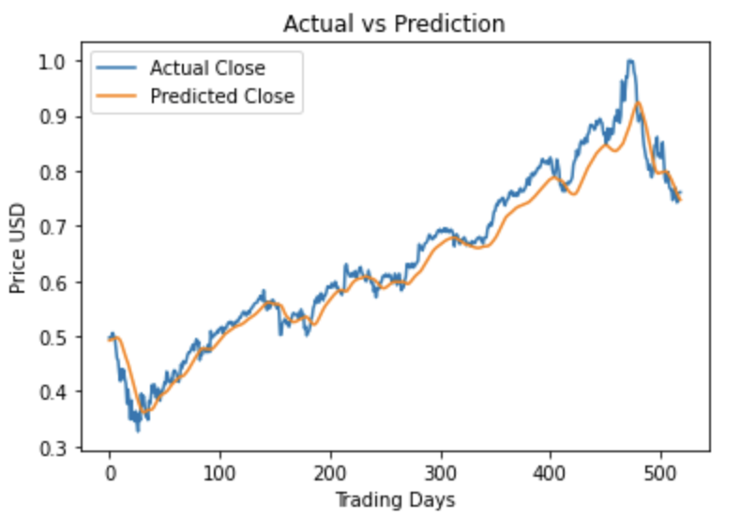
Basic LSTM Model
Pros and Cons:
Model chronological sequences and their long-range dependencies precisely
Solve problem of vanishing gradients of RNN
Require more resources and time to get trained
Affected by random weight initialization
Prone to overfitting
Accuracy:
RMSE:0.0336
MAPE:0.0406
Notes:
优缺点：
https://www.geeksforgeeks.org/understanding-of-lstm-networks/
https://iopscience.iop.org/article/10.1088/1742-6596/2161/1/012065/pdf

Slide 22
Some ways to improve LSTM Model
Add hidden layer:
Adding stacked multi-layers is for extracting more abstract information.
In this case, we changed layers from 1 into 3
Add Dropout:
A regular method to reduce overfitting and improving model performance
In this case, we added dropout of 0.2 at each layer of LSTM
Increase epochs:
The times that the learning algorithm will work through the entire training dataset
In this case, we Increased epochs from 10 to 100
Notes:
reference: add hidden layer:
And the stacked multi-layer LSTM model is for extracting more abstract information.
(in this case, we changed layers from 1 into 3)
add Dropout:
a regularization method where input and recurrent connections to LSTM units are probabilistically excluded from activation and weight updates while training a network. This has the effect of reducing overfitting and improving model performance
(in this case, we added dropout of 0.2 at each layer of LSTM )
Increased epochs:
a hyperparameter that defines the number times that the learning algorithm will work through the entire training dataset.
(in this case, we Increased epochs from 10 to 100 )

Slide 23
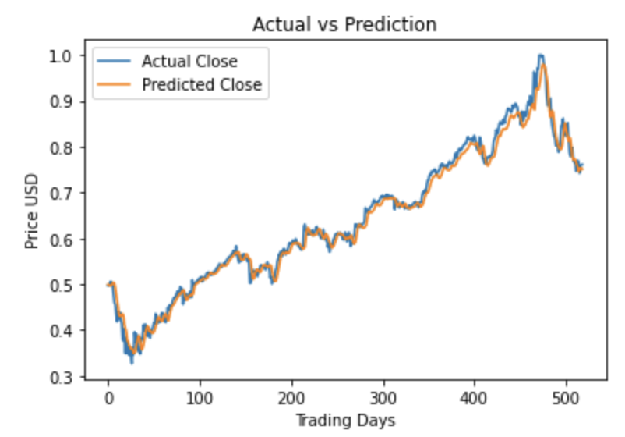
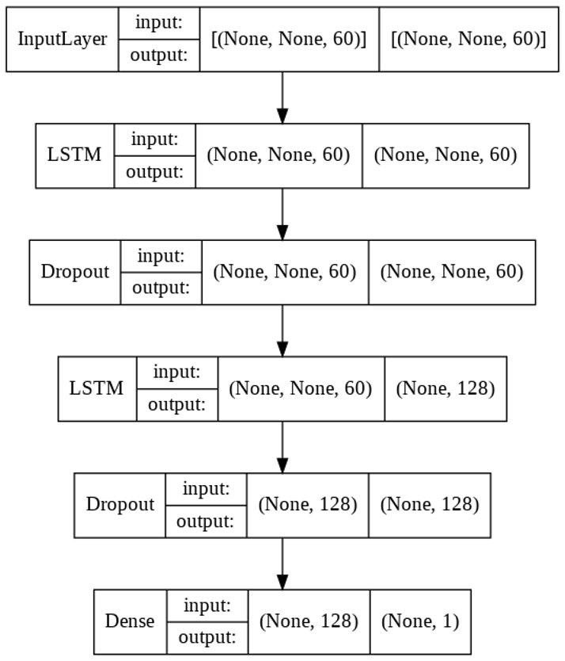
Improved LSTM model
Input and output:
The same as basic model
Accuracy:
RMSE:0.0185
MAPE:0.0224

Slide 24
Evaluating Prediction Performance for Stock Price Prediction
 | Linear regression |  | LSTM
Corporation | RMSE | MAPE | RMSE | MAPE
ACN | 0.0401 | 0.0494 | 0.0185 | 0.0224
IBM | 0.0351 | 0.0419 | 0.0152 | 0.0174
MSFT | 0.0285 | 0.0356 | 0.0343 | 0.0416
QNC.V | 0.0474 | 0.1724 | 0.0260 | 0.0933
INTC | 0.0470 | 0.0501 | 0.0214 | 0.0214
BIDU | 0.0648 | 0.0762 | 0.0297 | 0.0381
NOK | 0.0069 | 0.1070 | 0.0034 | 0.0438
MIELY | 0.0377 | 0.0420 | 0.0181 | 0.0207
Linear regression model here refers to linear regression with SMA
LSTM model refers to improved LSTM

Slide 25
Conclusion
In this project, we implement two models to predict stock price: linear regression and LSTM
According to our comparison, LSTM is more precise than linear regression in most cases
Due to its complicated cell, LSTM requires far more resources and time to get trained
We may try another commonly used method next: Gated Recurrent Unit(GRU) which has fewer training parameter and executes faster
Notes:
https://www.hindawi.com/journals/sp/2021/4055281/

Slide 26
Thank you!

