Slide 1

Fantastic Four
Smart Attendance System

Slide 2
Group Members
Redah Gamieldien-222641681- Testing/Frontend lead
Lyle Solomons-22222222- Software lead
Ethan Williams-221454780- Documentation/Presenter lead
Qaasim Isaacs-222544422- Hardware/Assembler lead

Slide 3
Introduction
Good day lecturer and fellow students.
We are Group Fantastic Four, and today we will be presenting our IoT project titled Smart Attendance System.
The purpose of this project is to improve the way student attendance is recorded in classrooms by using RFID and cloud-based IoT technology.

Slide 4
Project Idea & Problem Statement Problem Statement
Currently, student identification cards are mainly used only to access campus facilities. However, classroom attendance is still recorded manually using attendance sheets.
This creates several problems:
Attendance sheets can be lost or damaged
Students may sign attendance for absent friends
Manual attendance recording is time consuming
Attendance tracking becomes unreliable and prone to human error
Because of these issues, there is a need for a smarter and more efficient attendance system.

Slide 5
Project Idea & Problem Statement Proposed Solution
We developed a Smart Attendance System using RFID and ESP32 with real-time monitoring.
System Flow:
RFID card is scanned
LED + buzzer provide feedback
Attendance is recorded automatically
ESP32 reads the UID (Students information)
Data is sent via Wi-Fi
GitHub stores project documentation

Slide 6
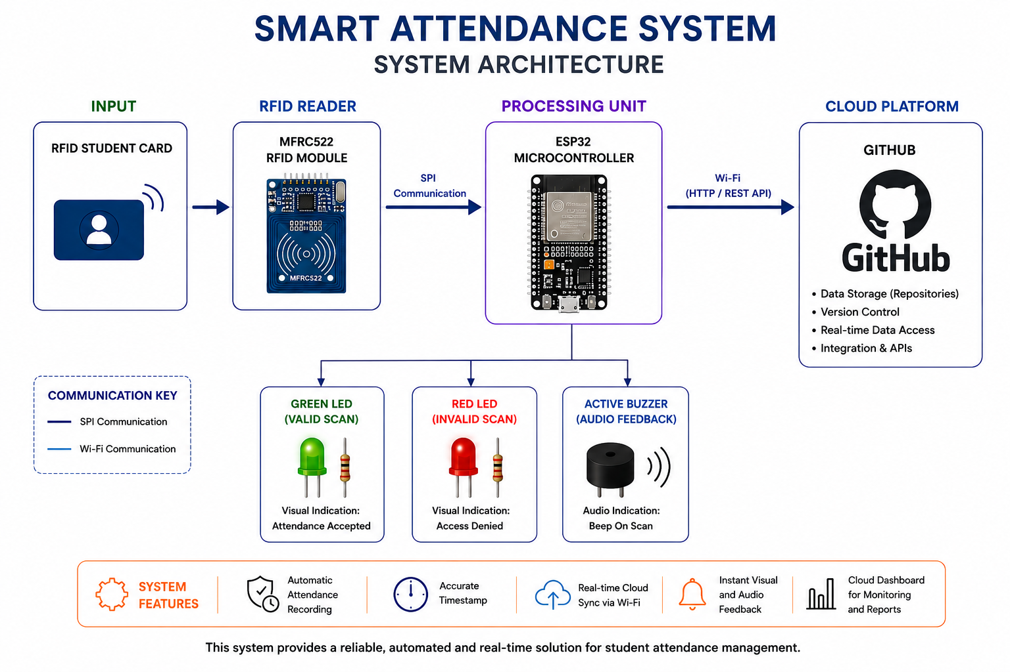
SYSTEM FLOW

Slide 7
Objectives
The objectives of our project are:
To track student attendance automatically and accurately
To help lecturers manage attendance records more efficiently
To reduce human error and fraudulent attendance marking
To demonstrate the use of IoT technology in a real-world educational environment

Slide 8
SYSTEM ARCHITECTURE & DESIGN Circuit design
The MFRC522 RFID module communicates with the ESP32 using the SPI communication protocol.
Additional components:
Green LED connected to GPIO 25
Red LED connected to GPIO 26
Buzzer connected to GPIO 27
The breadboard was used for prototyping the system connections.
RC522 Pin | ESP32 Connection
SDA | GPIO 5
SCK | GPIO 18
MOSI | GPIO 23
MISO | GPIO 19
IRQ | Not Connected
GND | GND
RST | GPIO 22
3.3V | 3.3V

Slide 9
Design Decisions
ESP32 as main controller was chosen because it supports both RFID processing and built-in Wi-Fi for sending data to the cloud.
RFID (MFRC522) was used for fast, contactless identification using unique card UIDs.
Firebase Realtime Database was selected to store attendance data because it updates instantly and removes the need for a local server.
HTTP POST requests were used to send data from ESP32 to Firebase in JSON format.
Wi-Fi communication was implemented to connect the hardware system to the cloud database.
Room-based tracking (e.g. A101) was included to identify where attendance is recorded.
LEDs and buzzer were added to give immediate visual and audio feedback for success or failure.
UID-based authentication was used to verify users quickly and simply without passwords.
Real-time processing was prioritised so attendance is recorded instantly when a card is scanned.
System was designed to be scalable, allowing more rooms and devices to be added later.

Slide 10
Hardware Components
Our system consists of several hardware components that work together.
The main component is the ESP32 Development Board, which acts as the central controller of the entire system.
We also used:
The MFRC522 RFID module to scan student RFID cards
RFID tags/cards for student identification
Green and red LEDs for scan feedback
An active buzzer for audio notifications
Jumper wires and a breadboard for circuit connections
A power supply unit to provide stable power to the system
And an enclosure casing to protect the hardware setup
These components work together to create a functional smart attendance system.

Slide 11
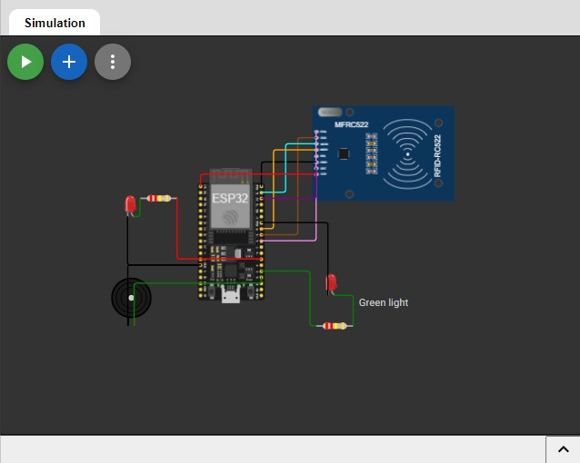
Circuit Diagram / Wiring
Component | ESP32 / Microcontroller Pin | Notes
MFRC522 SDA (SS) | GPIO 5 | SPI Slave Select pin
MFRC522 SCK | GPIO 18 | SPI Clock
MFRC522 MOSI | GPIO 23 | SPI Master Out Slave In
MFRC522 MISO | GPIO 19 | SPI Master In Slave Out
MFRC522 RST | GPIO 22 | RFID Reset pin
MFRC522 VCC | 3.3V | RFID module powered from ESP32
MFRC522 GND | GND | Common ground
Green LED (+) | GPIO 13 | Use 220Ω resistor in series
Green LED (-) | GND | Ground connection
Red LED (+) | GPIO 12 | Use 220Ω resistor in series
Red LED (-) | GND | Ground connection
Buzzer (+) | GPIO 14 | Active buzzer for scan feedback
Buzzer (-) | GND | Common ground
ESP32 USB Port | USB Power | Used for programming and power supply

Slide 12
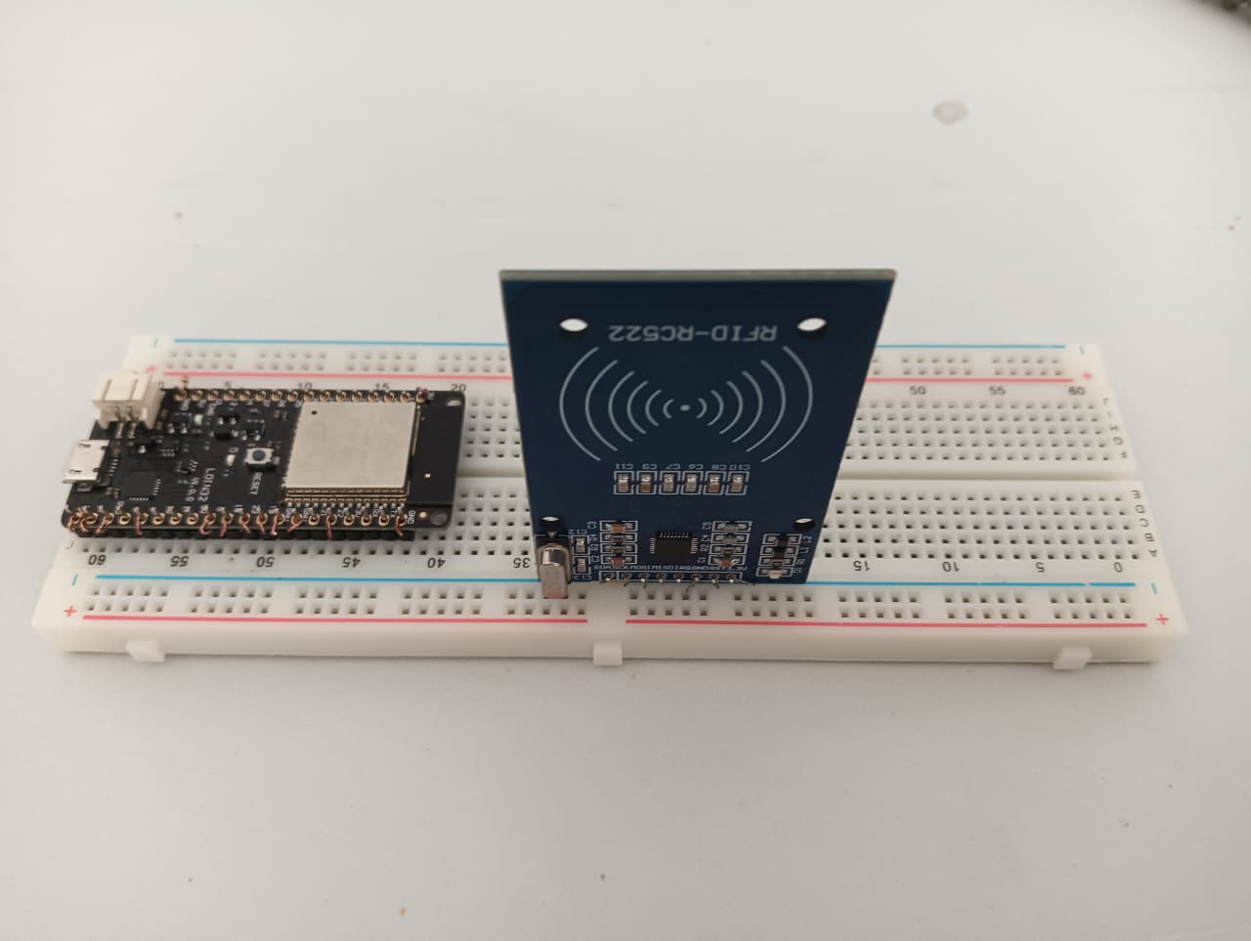
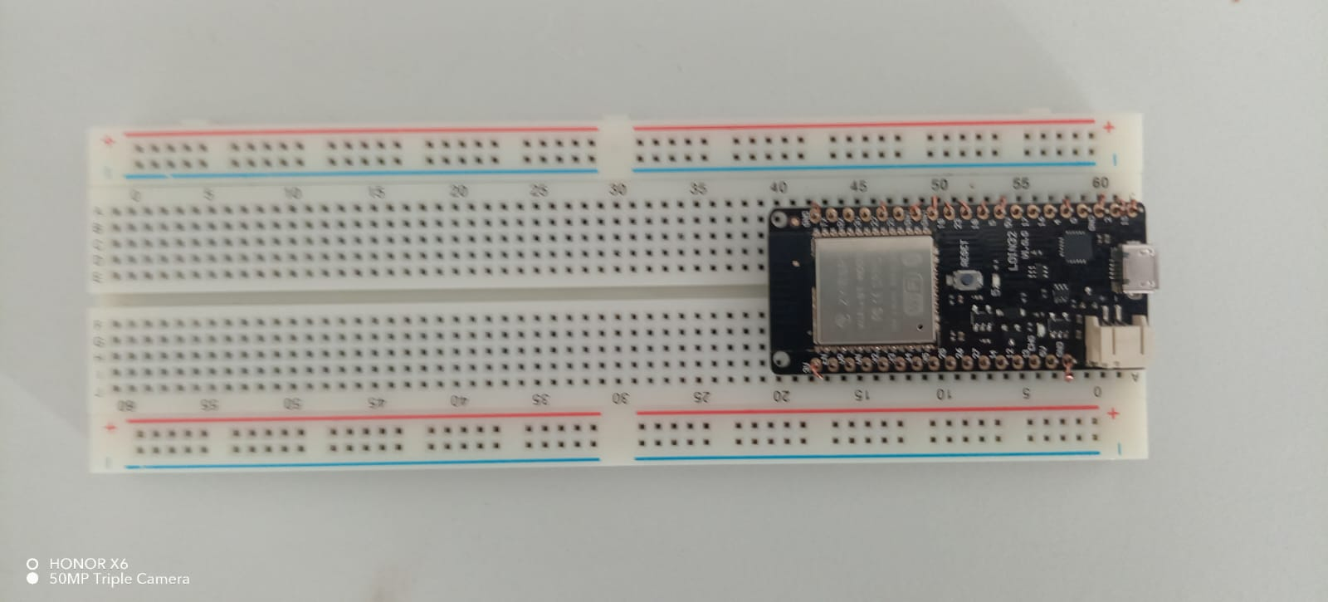
Build Process
Step 2: Install MFRC522 RFID Scanner to the breadboard
Step 1: Install Esp32 to breadboard

Slide 13
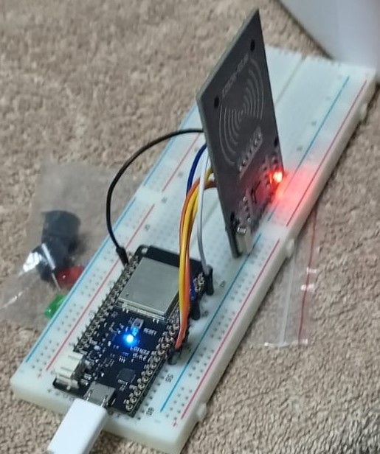
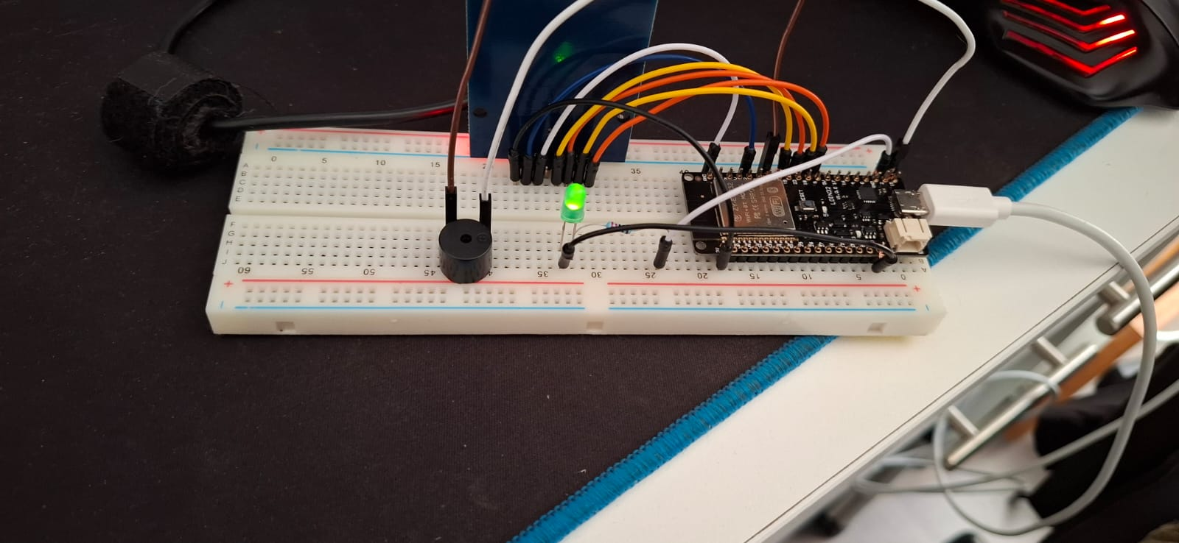
Build Process cont.
Step 3: Connect Esp32 to MFRC522 RFID scanner
Step 4: Install the Green LED with the appropriate Ohms resistor to the breadboard

Slide 14
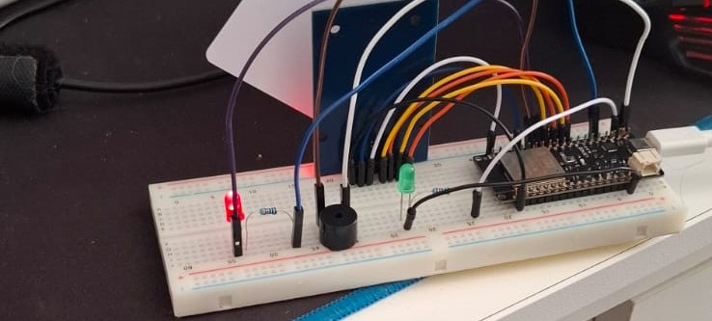
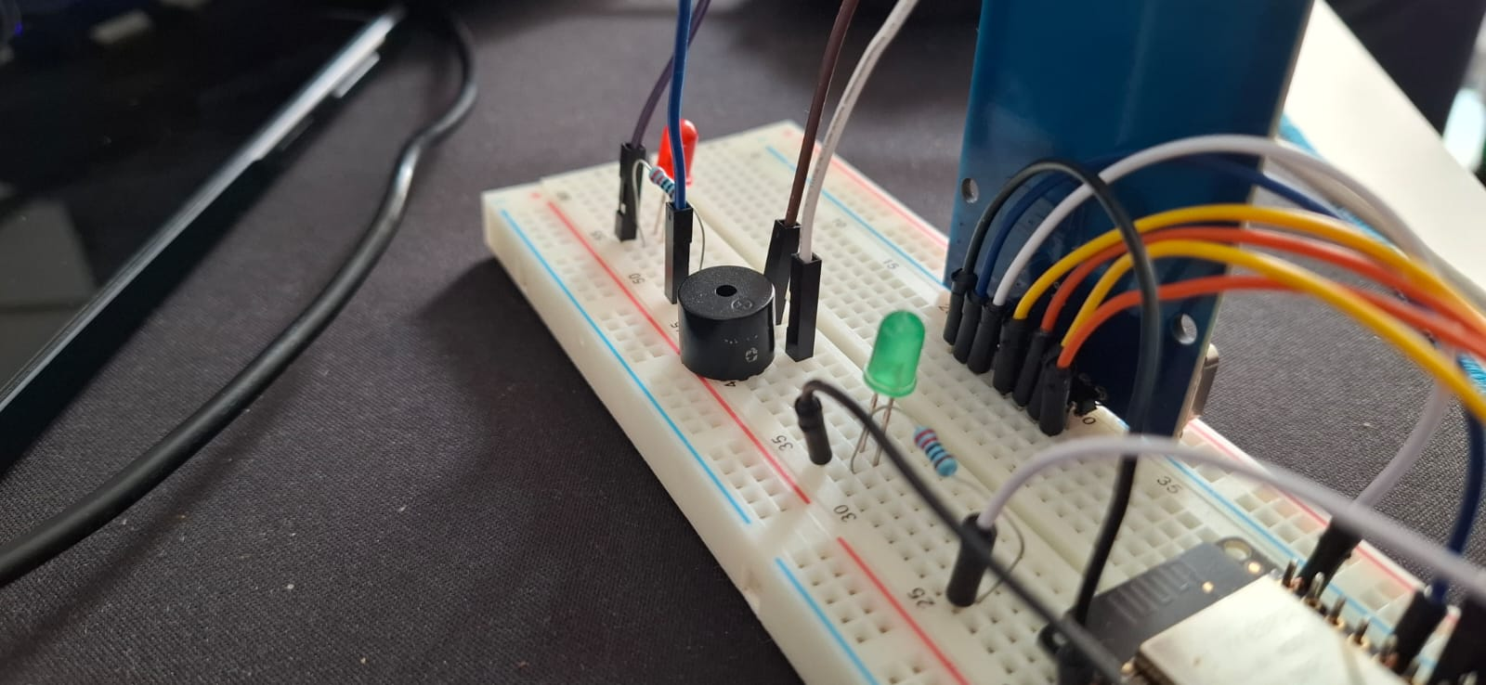
Build Process cont.
Step 5: Install the Red LED with the appropriate Ohms resistor to the breadboard
Step 6: Mount the Buzzer into the breadboard

Slide 15
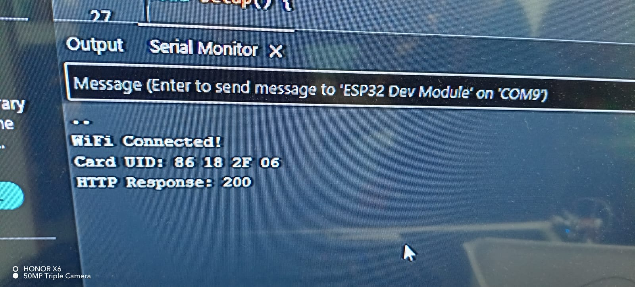
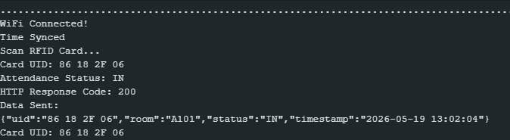
Build Process cont.
Step 7: Set up database
Step 8: Ensure Database is capable of logging data

Slide 16
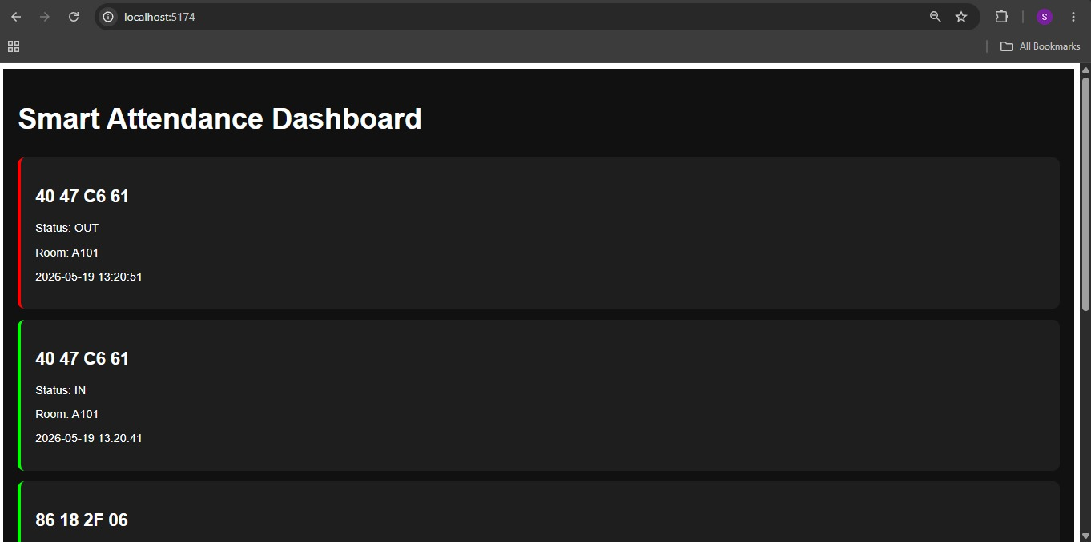
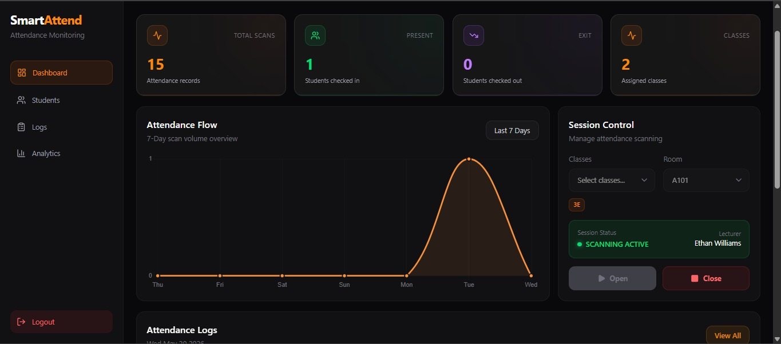
Build Process cont.
Step 9: Dashboard
Step 10: Final UI for data capturing

Slide 17
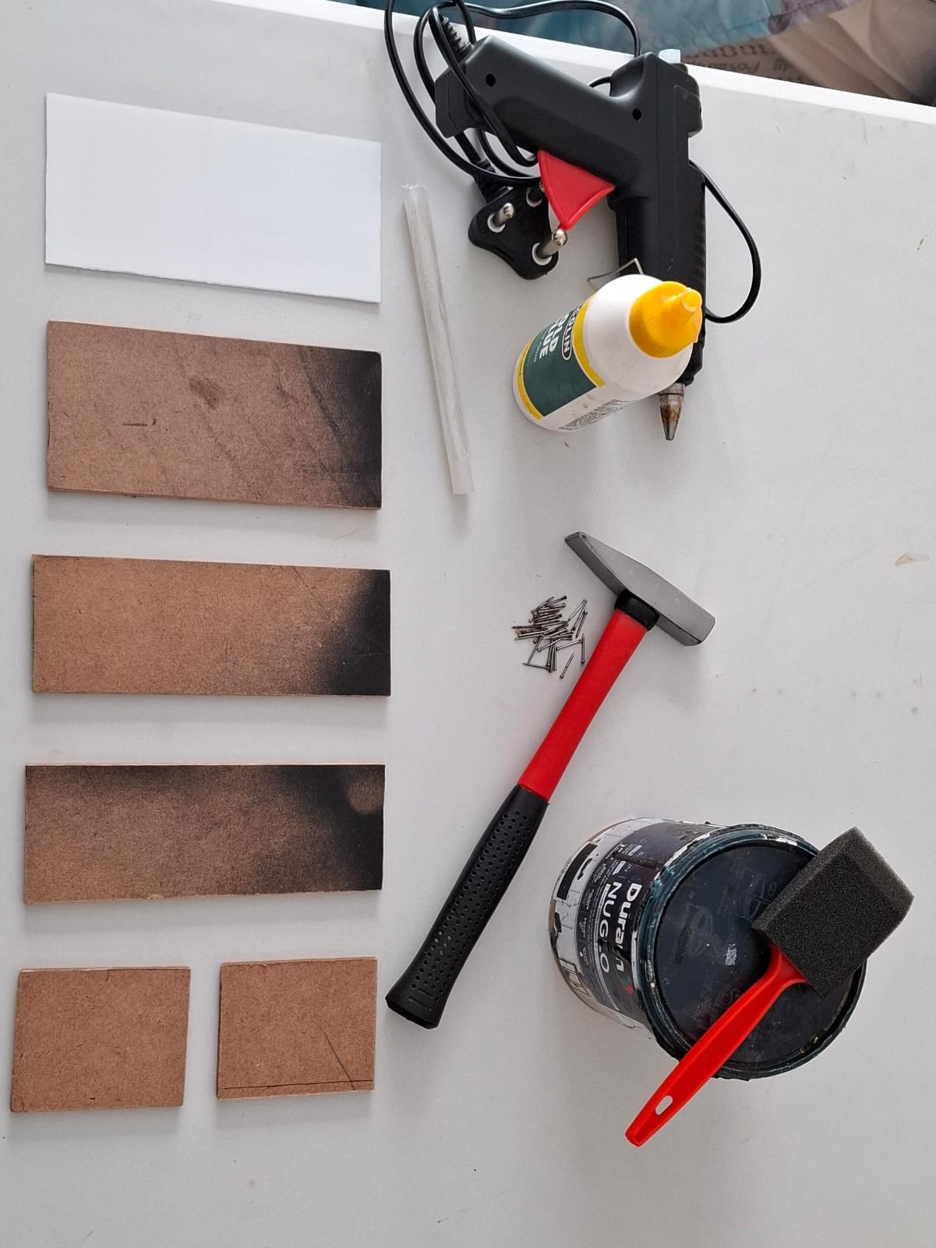
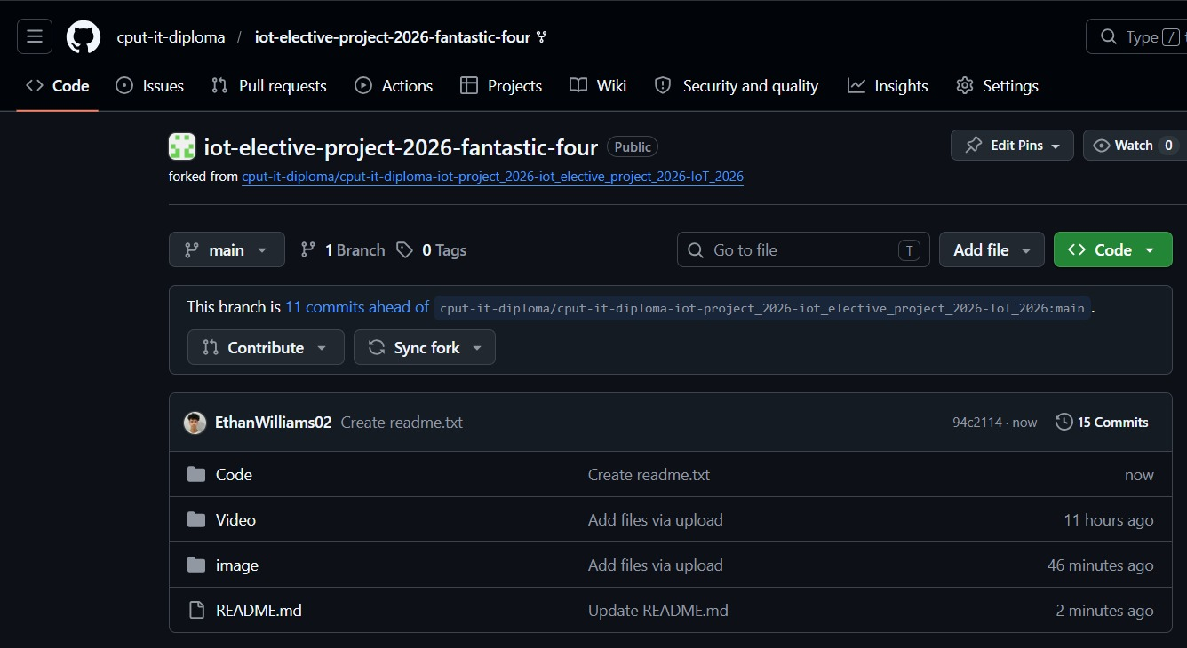
Build Process cont.
Step 11: GitHub upload
Step 12: Components for the hardware housing case

Slide 18
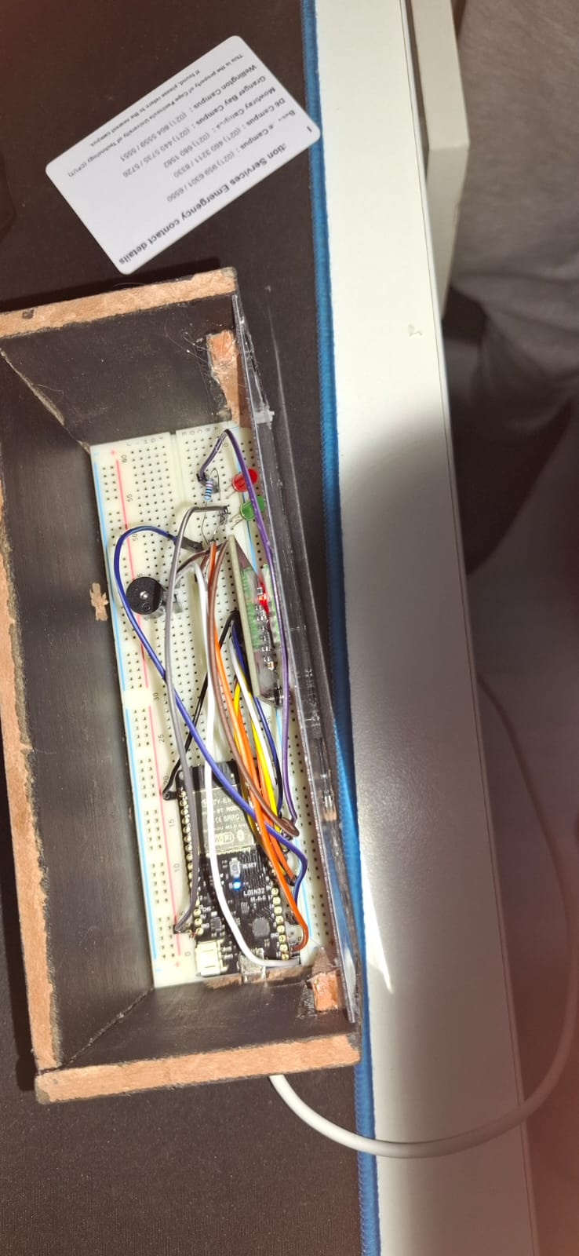
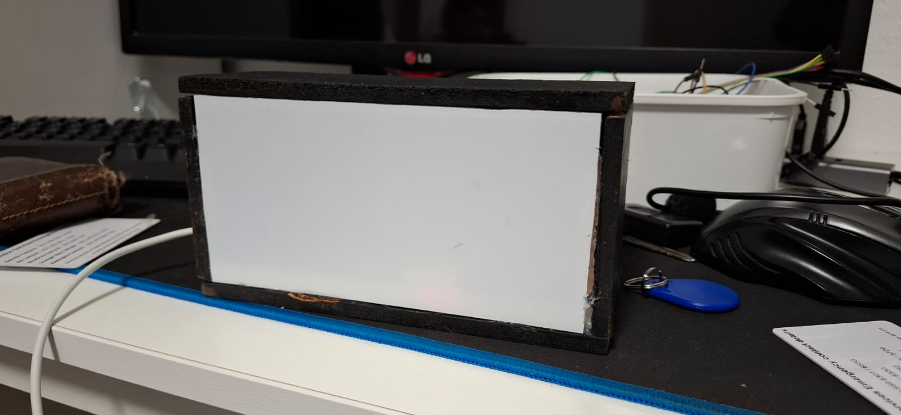
Build Process cont. Step 13: Completed housing case

Slide 19
Software & Technologies
Tool | Purpose
Arduino IDE | Programming ESP32
GitHub | Version control
Wokwi | Simulation
C++ | Firmware language
ESP32 Wi-Fi Library | Connectivity
MFRC522 Library | RFID communication

Slide 20
Code Documentation
Code Documentation Main Firmware (main.ino)
Key Functions
void setup() {
// Initializes RFID reader, WiFi connection,
// Firebase communication, LEDs, buzzer,
// and NTP time synchronization.
}
void loop() {
// Continuously scans RFID cards,
// validates student data,
// checks active class session,
// and logs attendance to Firebase.
}
Function Name | Description
setup() | Initializes hardware, WiFi, RFID, and Firebase
loop() | Handles RFID scanning and attendance logging
getTimeStamp() | Retrieves current date and time
instantBeep() | Plays short buzzer sound
accessGranted() | Indicates successful scan
accessDenied() | Indicates failed scan
http.GET() | Retrieves data from Firebase
http.POST() | Sends attendance data to Firebase
deserializeJson() | Parses Firebase JSON data
rfid.PICC_HaltA() | Stops RFID communication after scan

Slide 21
Testing & Results
Test # | Description | Expected Result | Actual Result | Pass/Fail
1 | ESP32 powers on and connects to system | ESP32 initializes successfully | ESP32 booted successfully after first restart attempt | ✅ Pass
2 | MFRC522 RFID scanner detects RFID card | RFID card detected within 2 seconds | Initial scan delay of 3 seconds, then successful detection | ✅ Pass
3 | RFID data transmission to ESP32 | UID transmitted accurately | First read returned incomplete UID, second read successful | ✅ Pass
4 | Green LED indication for valid card | Green LED lights up on authorized scan | LED flickered briefly before remaining stable | ✅ Pass
5 | Red LED indication for invalid card | Red LED lights up on unauthorized scan | Worked correctly after resistor connection adjustment | ✅ Pass
6 | Active buzzer audio feedback | Buzzer sounds during scan | Sound volume was initially low, corrected after rewiring | ✅ Pass
7 | 220Ω resistor protection for Green LED | LED brightness controlled safely | No overheating detected during testing | ✅ Pass
8 | 220Ω resistor protection for Red LED | Stable LED operation | Minor flicker observed initially, later stabilized | ✅ Pass
9 | SPI communication between ESP32 and MFRC522 | Continuous communication without interruption | Temporary communication timeout occurred once, auto-recovered | ✅ Pass
10 | Full attendance system operation | All components operate together correctly | System completed scans and feedback successfully after minor troubleshooting | ✅ Pass

Slide 22
Challenges & Solutions
Challenge Encountered | Solution Applied
ESP32 crashing during startup due to code error | Debugged and corrected the faulty code logic in the Arduino IDE
MFRC522 RFID scanner not detecting cards | Rechecked SPI wiring connections and corrected misplaced pins
RFID reader giving inconsistent scans | Added delays and improved scan handling in the code
Red LED not turning on properly | Fixed loose jumper wire connection and verified GPIO pin assignment
Green LED flickering during scans | Added proper 220Ω resistor and stabilized power connection
Active buzzer producing weak sound | Corrected buzzer polarity and updated output signal timing
ESP32 failing to upload code | Selected the correct COM port and ESP32 board configuration

Slide 23
References
ESP32 Docs – https://docs.espressif.com/projects/esp-idf/en/latest/esp32/
MFRC522 Library – https://github.com/miguelbalboa/rfid
Arduino IDE – https://www.arduino.cc/en/software
Wokwi – https://wokwi.com/

