Slide 1
Design Principle
DP
Alert@NP
Here is where my design begins
Name: Mok Qing Ling
Brought to you by Year 1 Information Technology

Slide 2
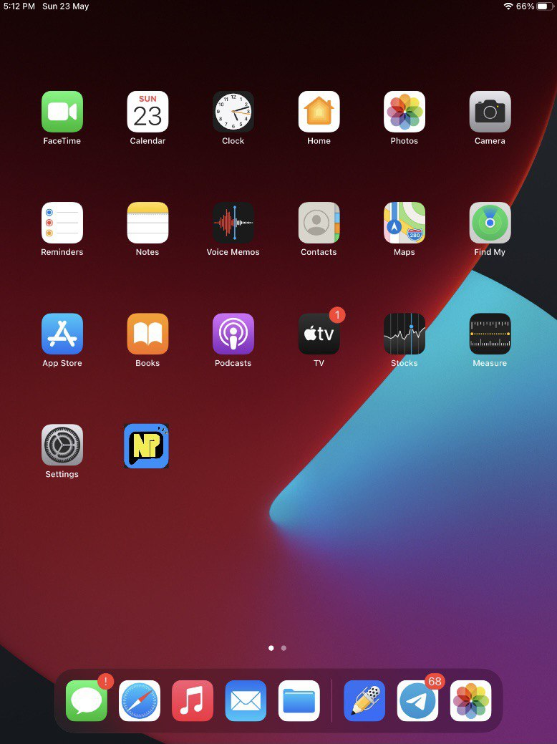

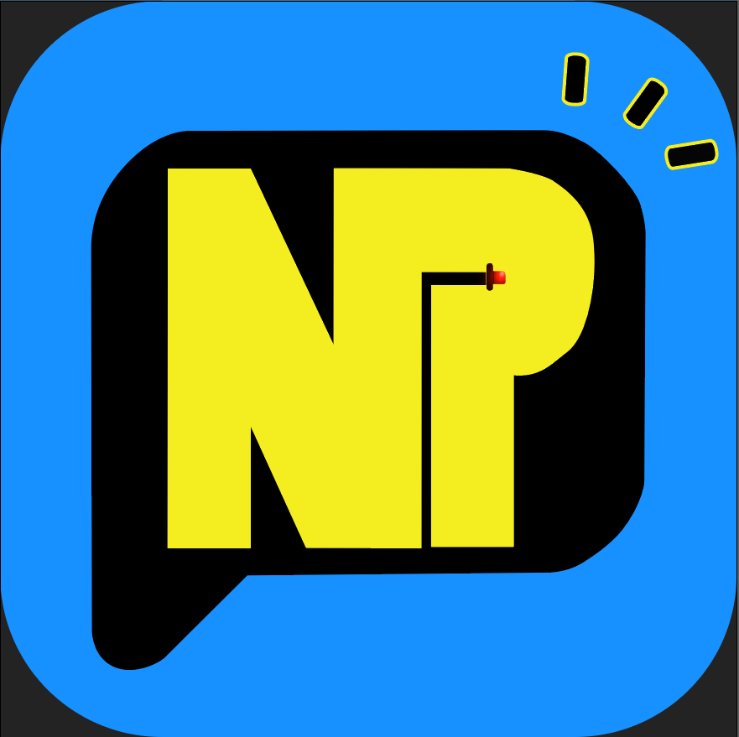
Logo
01.
Design Rationale:
Improve the design of the application icon
Prevent people from instinctively avoiding warning sign
Draw more user to use this application
Original App Logo
Revamped App Logo

Slide 3



Splash Screen
02.
Design Rationale:
Easier to remember as compared to the original splash screen, an image of “NP Block 51”
Simple and catching the attention user
Design 1
Design 2
Design 3

Slide 4
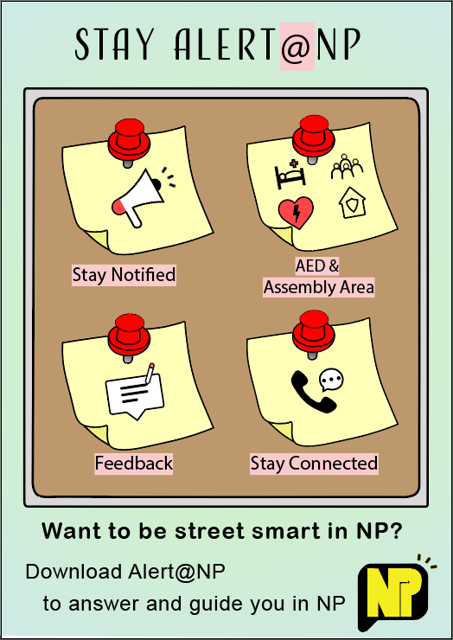
Infographic
03.
Design Rationale:
Simple and easy to understand
Rhetorical question
Features instead of functionality and statistic

Slide 5
The End
CREDITS: The template background was created by Slidesgo

