Slide 1


Slide 2


Slide 3







Slide 4
Maximum wifi Coverage Problem
GOAL: Find the optimal placement of routers to maximise the number of happy campers
TOOL: DOcplex translator of Qiskit Aqua

Slide 5
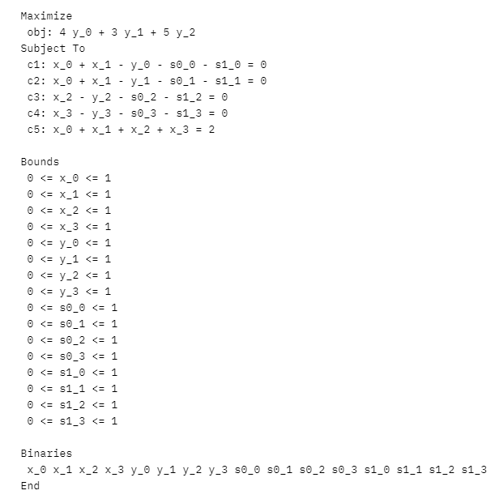
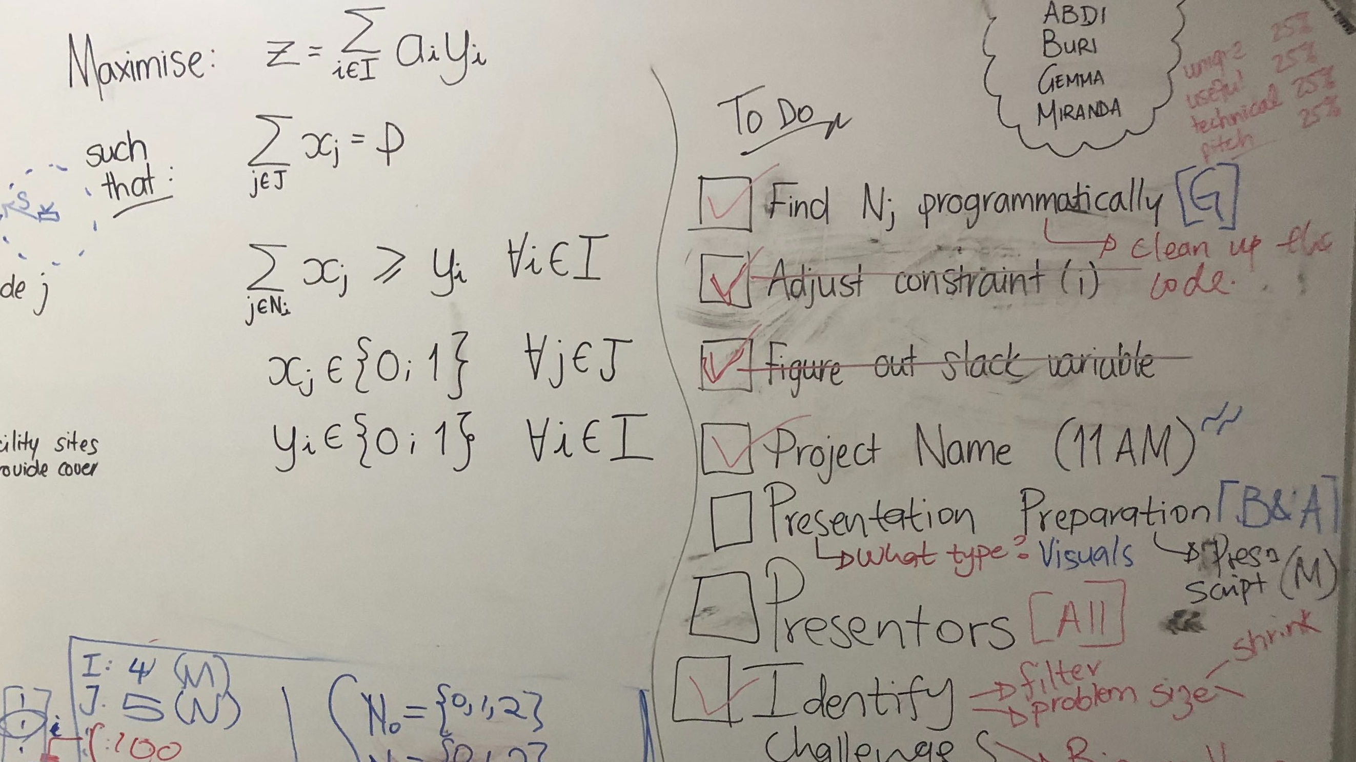

Slide 7
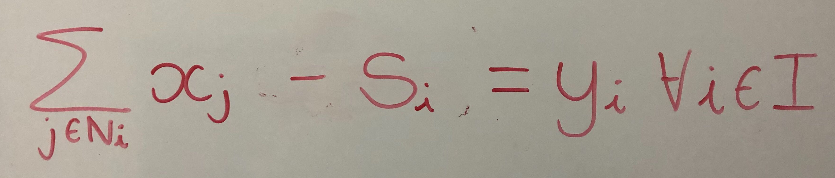

Slide 8
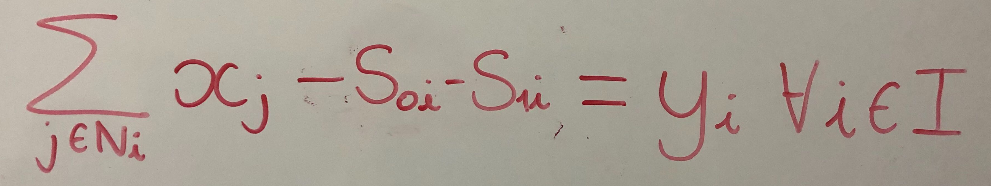

Slide 10

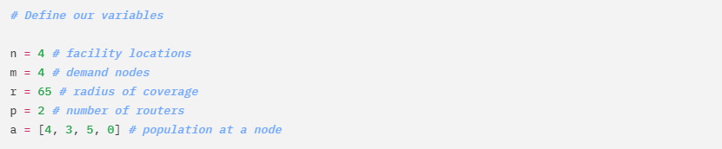

Slide 11
