Slide 1
Aether Eye
SEMANTIC SLAM AND LIDAR MAPPING WITH
MLLM GUIDED NAVIGATION
Guided By: Prof Aryalakshmi Ratheesh
Dept Of Computer Science & Engineering
Mar Baselios Christian College Of Engineering
& Technology
Presented By:
Adhil Biju
Ajas Mathew
Alan Taittus
Deva Nandh P R
Jewel Leelu Sunil

Slide 2
INTRODUCTION
Traditional aids like white canes provide limited environmental information and can't detect distant obstacles.
They lack contextual understanding, real-time guidance, and critical safety features like fall detection, which increases risk for users.
So we found a gap in indoor and outdoor navigation and decided to use separate systems for both .
So we are use a hardware components to provide exact estimate of the distance and provide a independent system.
Software based solution that provide scene description of the context and use gps for outdoor Navigation and slam for indoor navigation

Slide 3
EXISTING SOLUTION
SMART CAP – VISUAL GUIDANCE SYSTEM:
Detects objects using a camera and provides spoken feedback.
Solution: Offers basic visual awareness through audio cues.
VOICE-BASED SMART NAVIGATION SYSTEM:
Shoe-mounted system using ultrasonic sensors and GPS for guidance.
Solution: Assists outdoor navigation but with limited obstacle detail.
SMART ASSISTIVE NAVIGATION SYSTEM:
Smart stick with multi-sensor input and voice/vibration alerts.
Solution: Improves safety but lacks advanced semantic understanding.

Slide 4
PROPOSED SYSTEM
Wearable Architecture: A lightweight smart cap integrating Raspberry Pi 4, Pi Camera, LiDAR, and IMU sensors for hands-free operation.
Advanced Sensor Fusion: Combines Time-of-Flight LiDAR for centimeter-level distance accuracy with RGB vision for object recognition.
MLLM-Based Intelligence: Uses Multi-Modal Large Language Models to convert raw sensor data into meaningful, natural language descriptions.
Seamless Navigation: Supports GPS-based outdoor navigation and Semantic SLAM for indoor localization and mapping.
Safety Monitoring: Includes pothole and downward-step detection, along with IMU-based fall detection and emergency alerts.
Multimodal Feedback: Delivers guidance via speech output for intuitive user interaction.

Slide 5
ADVANTAGES OF THE PROPOSED SYSTEM
Unlike traditional aids that only detect obstacles, the system identifies what the obstacle is (person, staircase, furniture), enabling informed and safer navigation decisions.
LiDAR-based depth measurement provides centimeter-level accuracy with a long detection range (up to 10 meters), significantly outperforming ultrasonic and infrared sensor.
Utilizes IMU-based motion analysis to detect falls and abnormal movement patterns in real time, automatically triggering emergency alerts and adding a critical safety layer beyond obstacle detection.
Enables accurate GPS-free indoor navigation by constructing real-time semantic maps, identifying landmarks such as doors, corridors, and stairs, and providing context-aware path guidance in complex indoor environments.

Slide 6
SYSTEM ARCHITECTURE
The architecture uses a minimal sensor set (Camera/RGB, LiDAR, IMU, GPS) to achieve reliable environment perception and user localization.
The camera is used to recognize the live feed and this feed is transferred to the server to handle processing .
A Lang Chain-based server preprocesses inputs (text, images, signals) and stores relevant facts in memory (vector/structured) so past interactions can be retrieved.
This gives the assistant contextual awareness, letting it respond based on history, user preferences, and learned entities instead of treating each request in isolation.

Slide 7
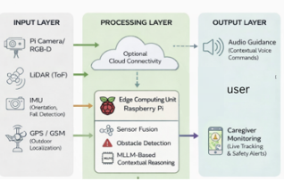
SYSTEM ARCHITECTURE

Slide 8
SYSTEM ARCHITECTURE
The GPS provide accurate distance measurements for navigating outdoor environment.
IMU provides step measurements and fall detection alerts.
Lidar provides data necessary for building a map using slam thus provides indoor guidance.
Real-time navigation assistance is delivered through audio guidance for immediate and proactive user support.
A dedicated caregiver monitoring output enables live tracking and safety alerts through cloud connectivity.

Slide 9
ALGORITHMS
Text-to-Speech Conversion (Fourier Transform): Converts written text into audible speech by transforming frequency-domain signals into time-domain waveforms using Fourier analysis.
Euclidean Geometry – Bounding Box Definition: Uses coordinate geometry to represent and localize detected objects as rectangular regions defined by corner points in an image plane.
Image Representation & Color Space Conversion: Represents images as multi-dimensional pixel matrices and converts between color models (e.g., BGR to RGB) by rearranging or transforming channel values

Slide 10
PROPOSED METHODOLOGY
Time-critical sensor data is processed by microcontrollers, while complex AI tasks are handled by the Raspberry Pi or cloud.
The navigation system automatically switches between GPS for outdoor use and SLAM for indoor environments. Separation between indoor and outdoor navigation enables more accurate tracking and a smoother user experience
Data from all sensors is combined to generate clear and actionable voice guidance using a Text-to-Speech engine whose output is based on a llm which has memory to store past data and retrieve those info.

Slide 11
SYSTEM MODULES
Input Module: Captures real-time environmental and positional data from LiDAR, camera, GPS provides the distance to a outdoor location , and IMU provides user orientation and step tracking . This combined continuously senses obstacles, terrain variations, and user movement to ensure accurate perception.
Processing Module: Performs SLAM where the lidar’s input data is mapped into a 2d map which along with object detection, and semantic scene interpretation is used to generate a output. AI models analyze the surroundings to identify obstacles, landmarks, and navigable paths in real time.
Output Module: audio alerts are triggered instantly for critical obstacles to enhance user safety.The ouput is trsnsmitted through Bluetooth peering.
Communication Module: Supports cloud–server data synchronization and connectivity. It enables offloading of computationally intensive tasks such as vision processing and MLLM inference.

Slide 12
TOOLS AND ALGORITHMS USED
Object Detection: YOLO (v3/v5/v8) for real-time object recognition.
Multi-Modal Large Language Model (MLLMs) like RynnEC and Vision-Language Models (VLLMs) implemented using langchain and vector databases.
Semantic SLAM for real-time indoor localization and 3D environment modeling.
Text-to-Speech Libraries - They provide clear, real-time voice instructions to guide the user safely through the environment.
ROS for system orchestration - ROS manages inter-module communication, synchronization, and data flow across the system.
OpenCV - It handles tasks such as frame capture, resizing, filtering, and feature extraction. Preprocessed visual data improves the performance and reliability of downstream AI models.

Slide 13
RESULT
Successfully implemented Neo-7M GPS–based live location tracking with real-time data transmission to a cloud server.
Laid the foundation for contextual navigation by Frame by Frame image capturing and integrating GPS data with ongoing fine-tuning of the RynnEC MLLM.
Established the setup for raspberry Pi and Cam.

Slide 14
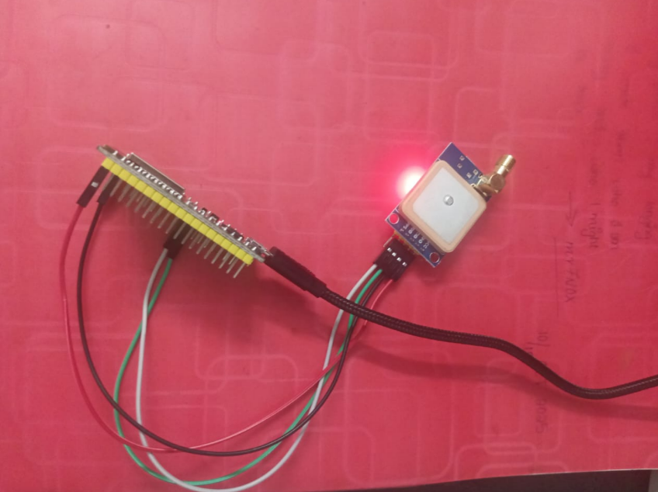
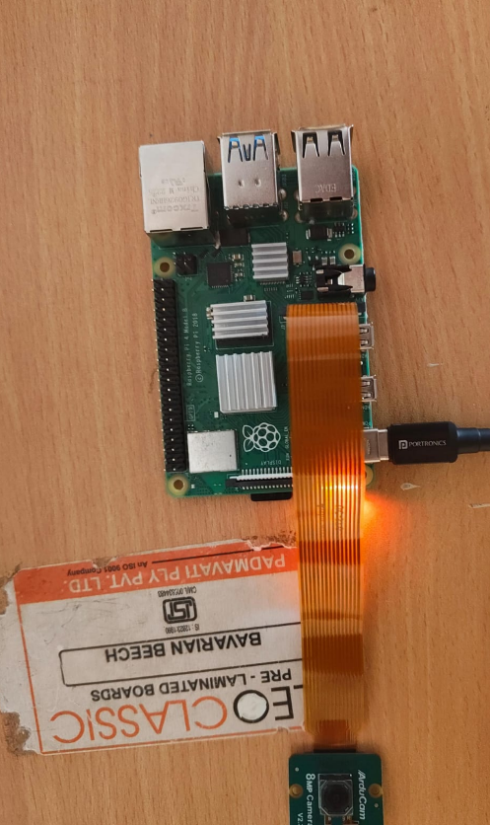
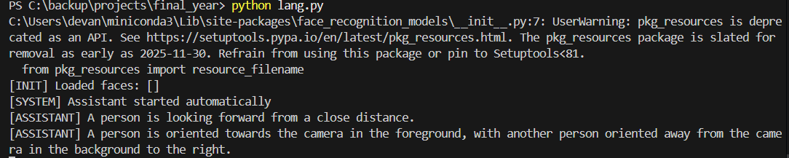
RESULT
2
1
3

Slide 15
FUTURE WORKS
Integrate LiDAR-based Semantic SLAM to enable accurate indoor navigation, real-time mapping, and obstacle classification in unmapped environments.
Enhance safety and user interaction features through real-time hazard prediction, adaptive voice feedback, and expanded caregiver alert mechanisms . Improve memory of agent to store known footprints , indoor environment and identify Persons.

Slide 16
CONCLUSION
System Realization: Successfully demonstrates an AI-enhanced wearable navigation system using LiDAR and sensor fusion.
Semantic Advancement: Validates the effectiveness of MLLMs in delivering meaningful real-time guidance.
User Empowerment: Enhances autonomy, safety, and confidence for visually impaired users.
Scalability : Establishes a modular foundation for future assistive technology innovations and reduce the overhead of the system.

