Slide 1
TIME COMPLEXITY
EXERCISES

Slide 2
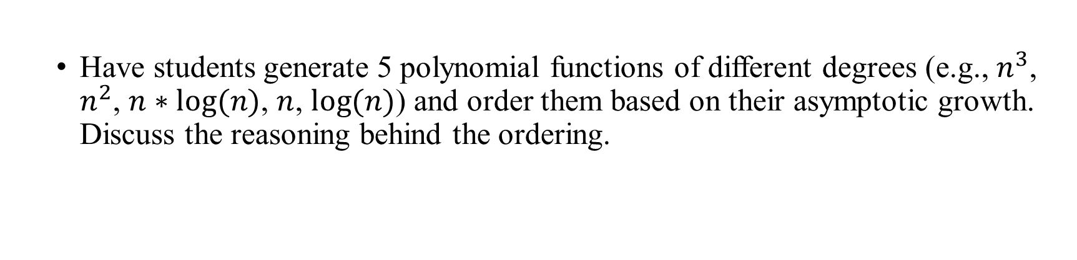
EXERCISE 1
Have students generate 5 polynomial functions of different degrees (e.g., $n^{3}$, $n^{2}$, $n∗log⁡(n)$, $n$, $log⁡(n)$) and order them based on their asymptotic growth. Discuss the reasoning behind the ordering.

Slide 3
EXERCISE 2
s generate 10 functions and order them based on asymptotic growth

Slide 4
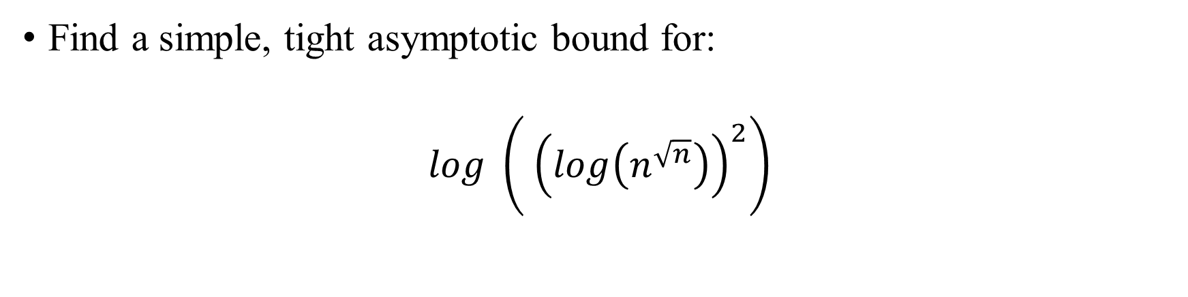
EXERCISE 3
Find a simple, tight asymptotic bound for:
$$log \left.\left( {\left(log\left(n^{\sqrt{n}}\right)\right)}^{2}\right.\right)$$

Slide 5
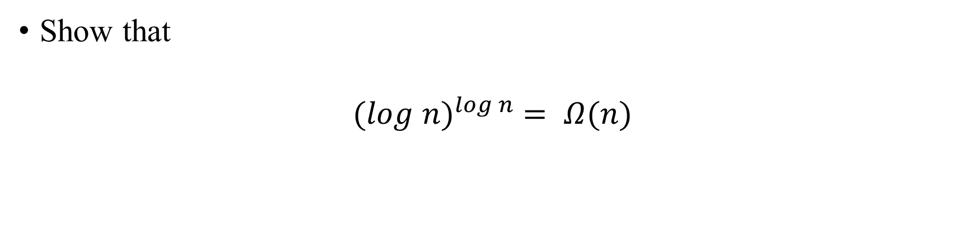
EXERCISE 4
Show that
$${(log n)}^{log n} = Ω(n)$$

Slide 6
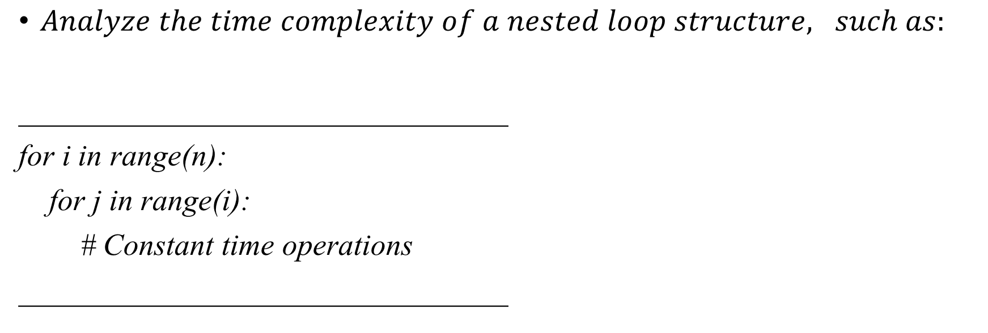
EXERCISE 5
$Analyze the time complexity of a nested loop structure, such as:$
________________________________
for i in range(n):
for j in range(i):
# Constant time operations
________________________________

Slide 7
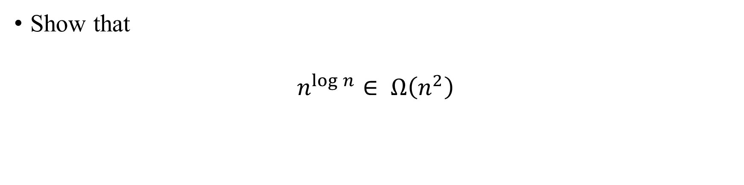
EXERCISE 6
Show that
$$n^{\log{n}}∈ Ω\left(n^{2}\right)$$

Slide 8
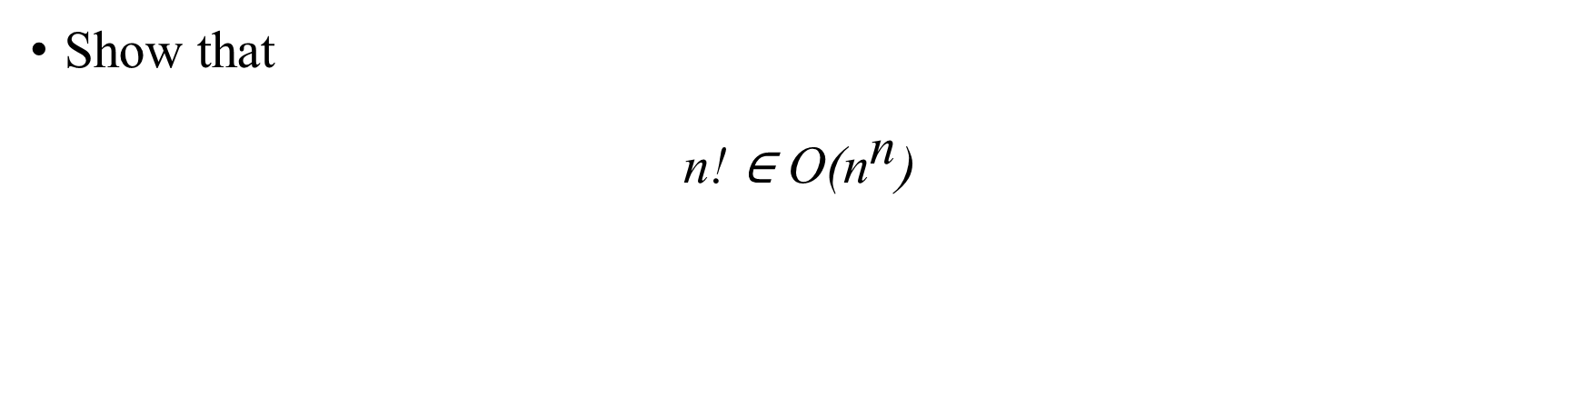
EXERCISE 7
Show that
$$\text{n}\text{! ∈ }\text{O}\text{(}{\text{n}}^{\text{n}}\text{)}$$

Slide 9
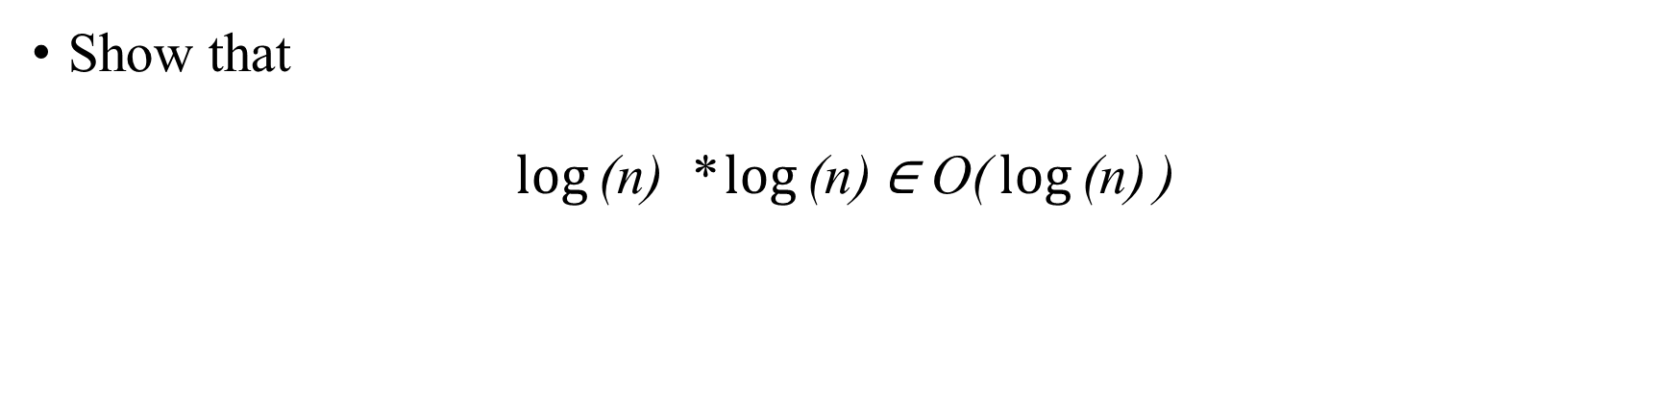
EXERCISE 8
Show that
$$\log{\text{(}\text{n}\text{)}} \text{*}\log{\text{(}\text{n}\text{)}}\text{∈ }\text{O}\text{(}\log{\text{(}\text{n}\text{)}}\text{)}$$

Slide 10
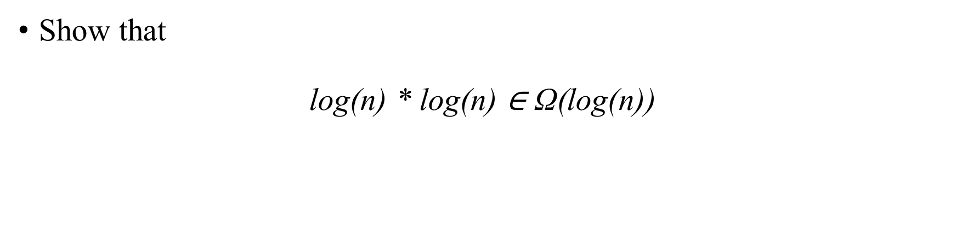
EXERCISE 9
Show that
$$\text{log}\text{(}\text{n}\text{) * }\text{log}\text{(}\text{n}\text{) ∈ }\text{Ω}\text{(}\text{log}\text{(}\text{n}\text{))}$$

Slide 11
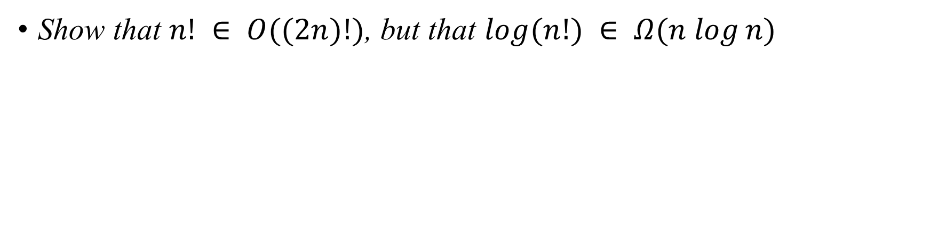
EXERCISE 10
Show that $n! ∈ O((2n)!)$, but that $log⁡(n!) ∈ Ω(n log⁡n)$

