Slide 1
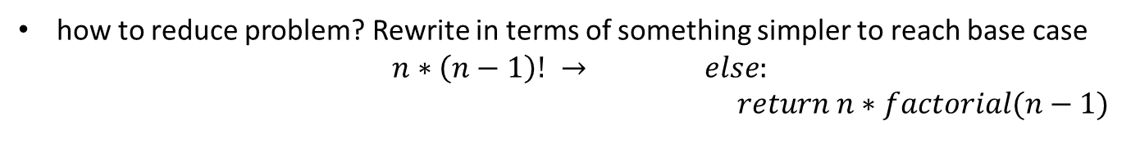
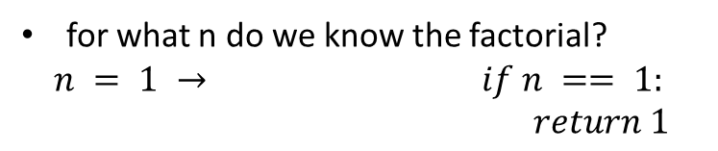
FACTORIAL
n! = n*(n-1)*(n-2)*(n-3)* … * 1
for what n do we know the factorial?
$$n = 1 → if n == 1:$$
$return 1$
Base case
how to reduce problem? Rewrite in terms of something simpler to reach base case
$$n∗\left(n−1\right)! → else:$$
$return n∗factorial(n−1)$
Recursive step

Slide 2
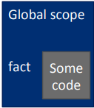
RECURSIVE
FUNCTION
SCOPE
EXAMPLE
int fact(n):
if n == 1{
return 1
} else{
return n*fact(n-1)
}
print(fact(4))

Slide 3
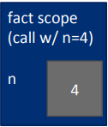
RECURSIVE
FUNCTION
SCOPE
EXAMPLE
int fact(n):
if n == 1{
return 1
} else{
return n*fact(n-1)
}
print(fact(4))

Slide 4
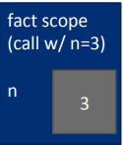
RECURSIVE
FUNCTION
SCOPE
EXAMPLE
int fact(n):
if n == 1{
return 1
} else{
return n*fact(n-1)
}
print(fact(4))

Slide 5
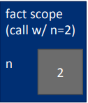
RECURSIVE
FUNCTION
SCOPE
EXAMPLE
int fact(n):
if n == 1{
return 1
} else{
return n*fact(n-1)
}
print(fact(4))

Slide 6
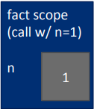
RECURSIVE
FUNCTION
SCOPE
EXAMPLE
int fact(n):
if n == 1{
return 1
} else{
return n*fact(n-1)
}
print(fact(4))

Slide 7
RECURSIVE
FUNCTION
SCOPE
EXAMPLE
int fact(n):
if n == 1{
return 1
} else{
return n*fact(n-1)
}
print(fact(4))
Return 1
Base case

Slide 8
RECURSIVE
FUNCTION
SCOPE
EXAMPLE
int fact(n):
if n == 1{
return 1
} else{
return n*fact(n-1)
}
print(fact(4))
Return 2 * fact(1)
Return 1
Return 2*1
Base case

Slide 9
RECURSIVE
FUNCTION
SCOPE
EXAMPLE
int fact(n):
if n == 1{
return 1
} else{
return n*fact(n-1)
}
print(fact(4))
Return 3 * fact(2)
Return 2 * fact(1)
Return 1
Return 3*2
Return 2*1
Base case

Slide 10
RECURSIVE
FUNCTION
SCOPE
EXAMPLE
int fact(n):
if n == 1{
return 1
} else{
return n*fact(n-1)
}
print(fact(4))
Return 4 * fact(3)
Return 3 * fact(2)
Return 2 * fact(1)
Return 1
Return 4*6
Return 3*2
Return 2*1
Base case

Slide 11
RECURSIVE
FUNCTION
SCOPE
EXAMPLE
int fact(n):
if n == 1{
return 1
} else{
return n*fact(n-1)
}
print(fact(4))
Cout << fact(4)
Return 4 * fact(3)
Return 3 * fact(2)
Return 2 * fact(1)
Return 1
Return 4*6
Return 3*2
Return 2*1
Base case

Slide 12


Slide 13


Slide 14
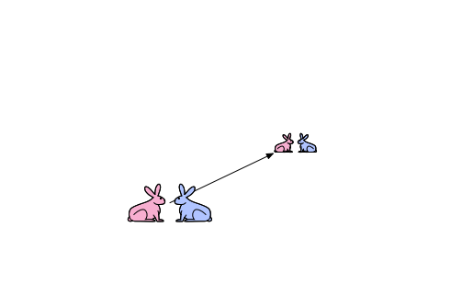

Slide 15
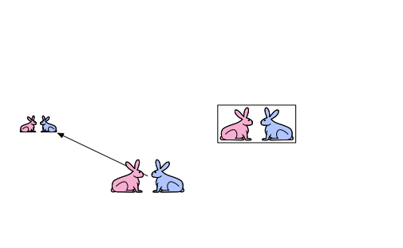

Slide 16
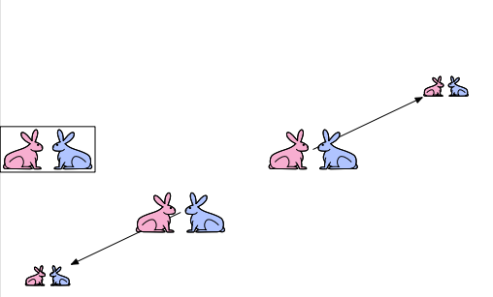

Slide 17
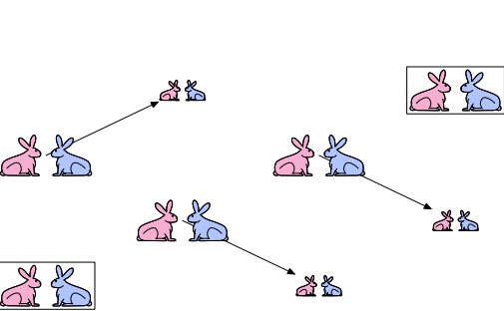

Slide 18
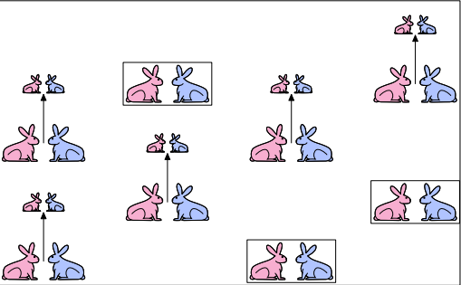

Slide 19
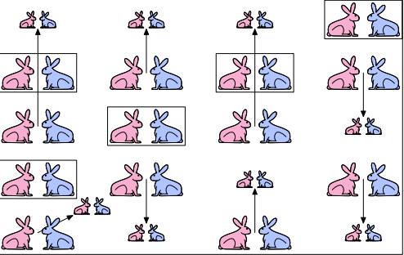

Slide 20
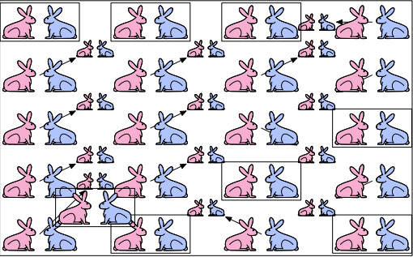

Slide 21
Hanoi Town 1

Slide 22
Hanoi Town 2

